Slide 1
Recruitment solution for Capgemini (hackathon)
By- Naveen Rishishwar
Mo. No.- +91-9412616493
E-mail-rishishwarnaveen@gmail.com

Slide 2
Content
Introduction
Data Cleaning
Data Pre-Processing
Algorithm Selection
Recruitment Procedure
Final Report for Hiring procedure
Future Scope
Conclusion

Slide 3
Introduction
We need to overcome the problem of the shortage and abundance of the employees, because both are the loss cases for the company.
One is the direct loss and another one is in term of potential loss.
We need to develop the algorithm that will predict the requirement of the employee considering the factor like Location, skills, Experience Grade and month.
We need to search for the required Employees in our database for best suitable Employees to fulfill the need thus minimizing the number of new hiring.
Thus we are going to ensure that company will always have employee in advance to fulfill the need of project and by this profit is going to be increase.

Slide 4
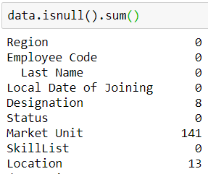
Data cleaning
There are some instance (observation) with null value.
Null value in Designation column need to replaced something so I am replacing this with 9999
Null value in Location is replaced with 0 that represent the Bangalore city.

Slide 5
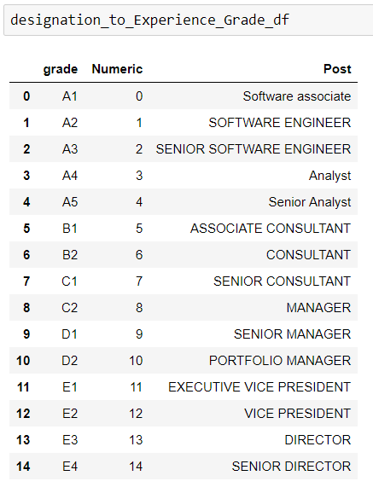
Data Pre-processing
For making reference between both data sheets,
I am making this reference between experience grade numeric number and post.
Source for this sequence and grading is Quora.

Slide 6
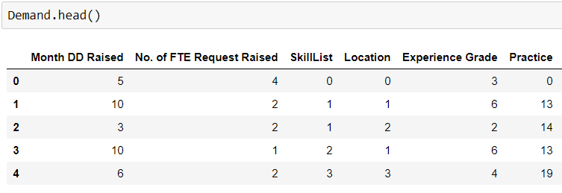
Data pre-processing (cont.)
Similarly I am Pre-processing the data into numeric format so algorithm can understand clearly and differentiate between different values.
If status is equal to zero than he is Billable.
If Status is equal to zero that mean employee is on bench, there are 396 employees are on bench.
And these value are mapped by using the dictionary
that will also help in mapping again.
This processes is done almost for all columns in both
table except for that are already a number.

Slide 7
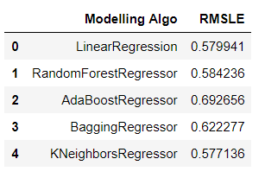
Algorithm Selection
I have used random search cv for selection of the algorithm for making prediction.
And find out that Linear regression, random Forest Regressor and K Nearest Neighbor Regressor are having lowest root mean square log error(RMSLE).
Another one reason is, it uses various decision tree for making a prediction due to that produces better result.

Slide 8
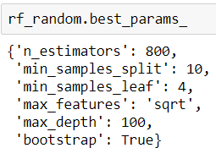
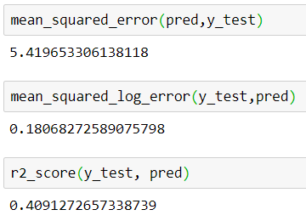
Algorithm Selection (Cont.)
I have used Randomized Search CV for finding out the best parameters for Random forest.
With best parameters I got the 0.18 Root Mean Square Log Error(rmsle).

Slide 9
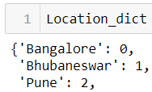
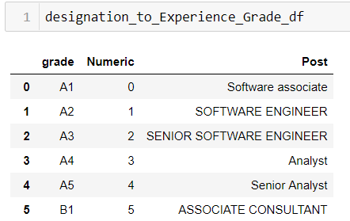
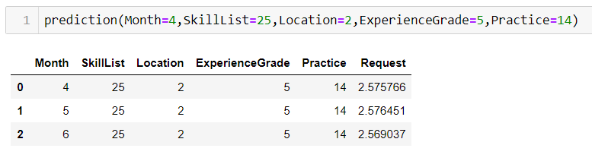
Recruitment Procedure
For making Prediction about the next two months in advance to ensure proper availability of employee, we just need to call prediction method that will automatically return the value for next two months.
We can automate the process for making the prediction for next two month along with the current month employee demand prediction, so HR team can assure proper availability of the employee.

Slide 10
Recruitment Procedure
Prediction
(Algo.)
From Bench
need
From Bench but lower designation
Yes
No
Final Report with hiring procedure
No
need
No
No
Yes
New Hiring
need
Promotion from different Place
need
Promotion from same place
Yes
Yes

Slide 11
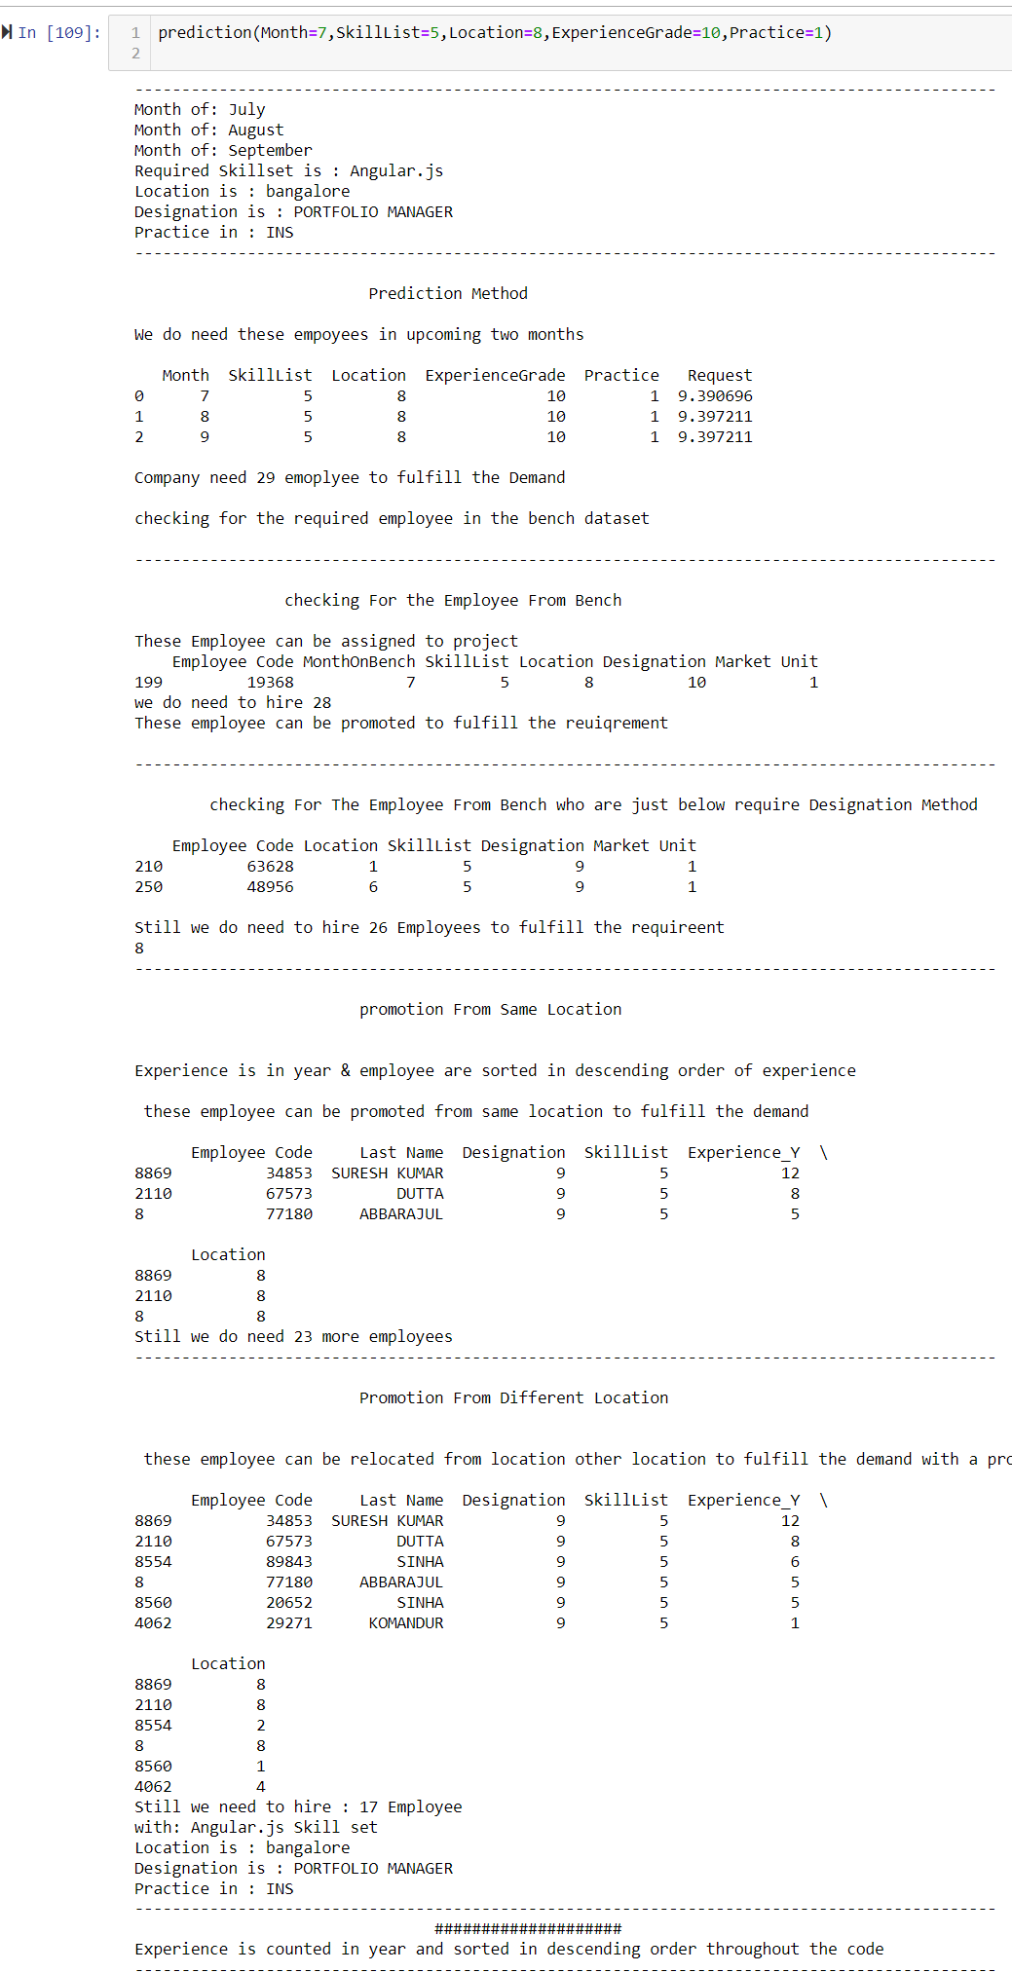
Final Report for Hiring procedure
This is the cropped image of output of the algorithm
We will get the final report, that will tell the how many employee can be assigned from Bench, how many employee can be promoted from same location to fulfill the need and how many employee can be transferred from other location with a promotion to fulfill the need.
If we still need more employee then how many employee we need to hire for fulfilling the need?
Original Image

Slide 12
Conclusion
By the help of this algorithm we will get to know the exact demands of the employee including for next two months. It will automatically give you the suggestion of employee those can be assigned to project to fulfill the requirement.
In the last model will give you the final report that also include the employee that can transferred promoted and employee on bench and requirement of new employee to fulfill the need.
So through this model company will ensure maximum utilization of resources and maximum profit.

Slide 13
Future Scope
This model can be optimized for making prediction more accurately, considering other factor thus organization can ensure the maximum profit.
This algorithm can be deploy to any desired sources like website, mobile application, etc.
Another version of algorithm can also be created that will be more location oriented.
For that we have to cluster the data based on the location and make model for each location that will more accurate demand of at particular location.

Slide 14
!!!!Thank you !!!!

