Slide 1
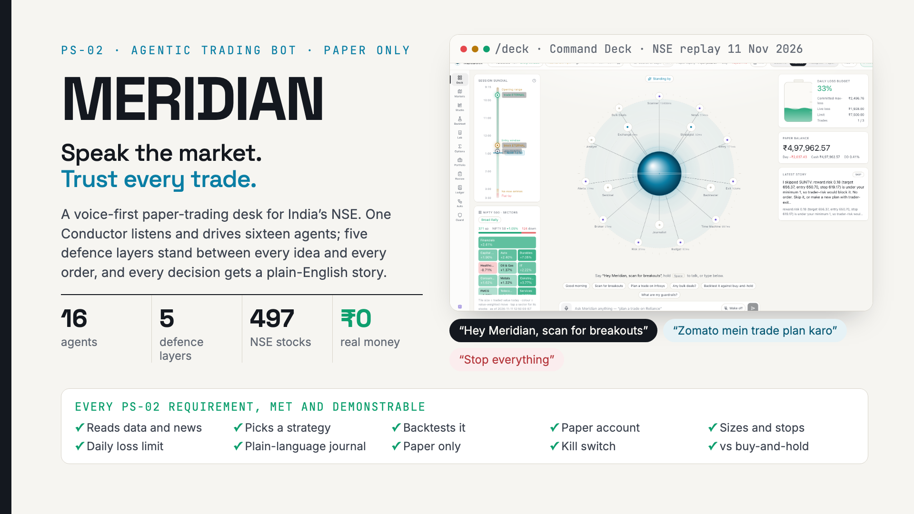
Notes:
Meridian answers PS-02 end to end; screenshot is the real prototype on the recorded NSE session of 11 Nov 2026.

Slide 2
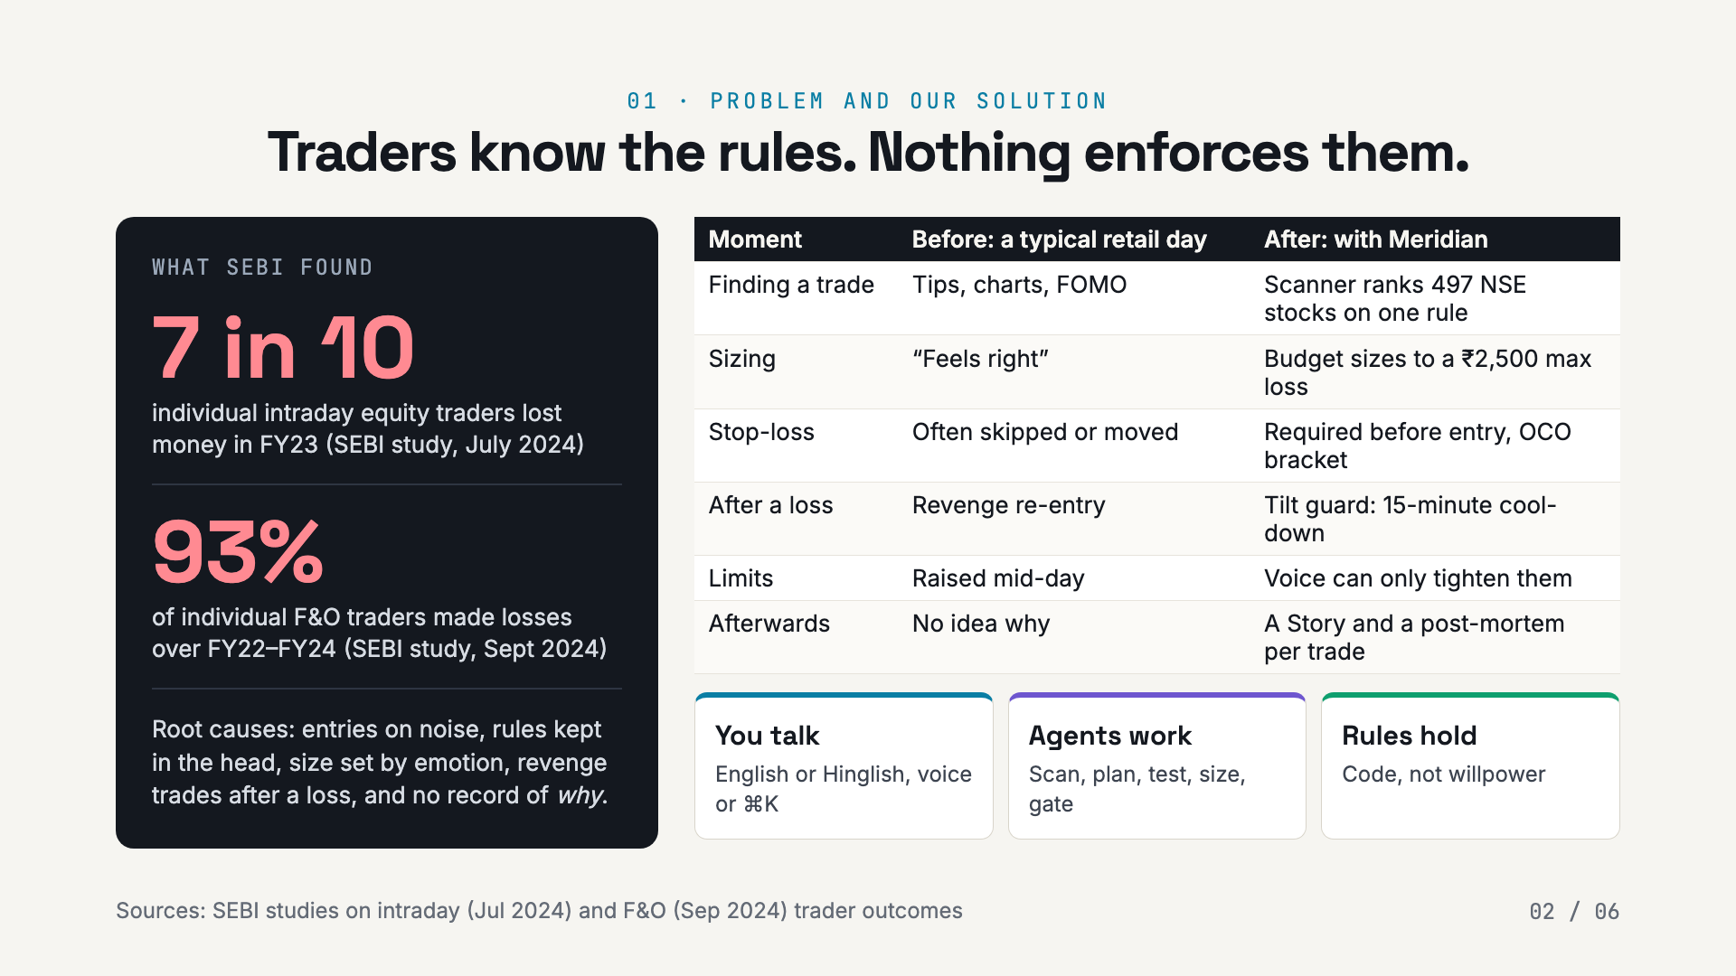
Notes:
SEBI studies: 7 in 10 intraday traders lost money (FY23); 93% of F&O traders lost money (FY22-24). Meridian moves the rules into code.

Slide 3
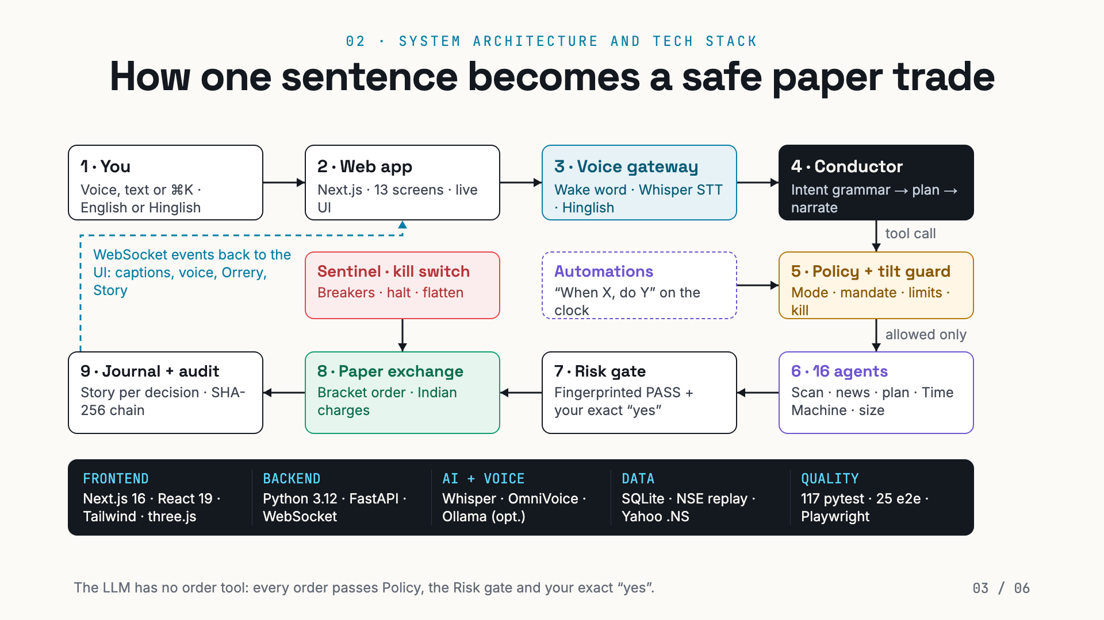
Notes:
Read the flow 1 to 9: you speak, the web app streams to the voice gateway, the Conductor plans, Policy and the tilt guard allow or refuse each tool call, the 16 agents work, the Risk gate and your exact yes approve, the paper exchange fills, the journal and audit chain record, and events stream back to the UI.

Slide 4
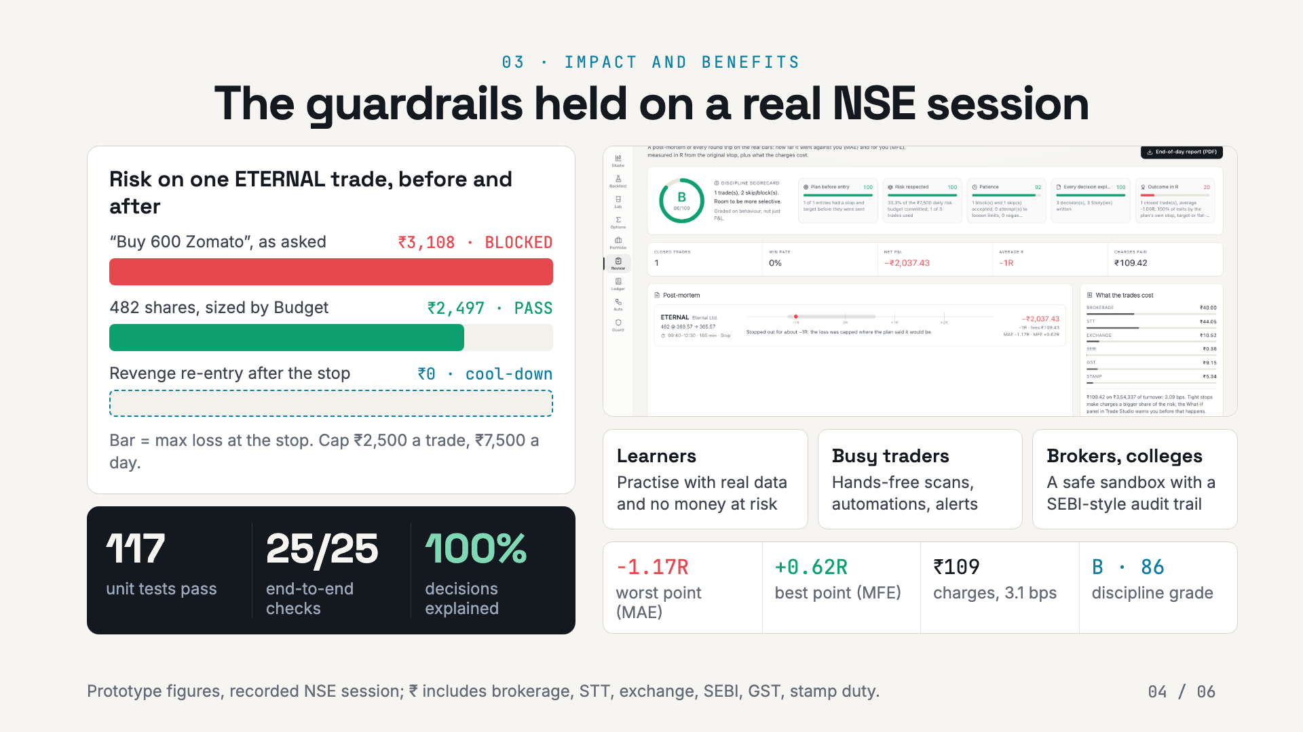
Notes:
600 shares would risk Rs 3,108 and was blocked; Budget sized 482 shares at Rs 2,497; the revenge re-entry was blocked by the tilt guard.

Slide 5
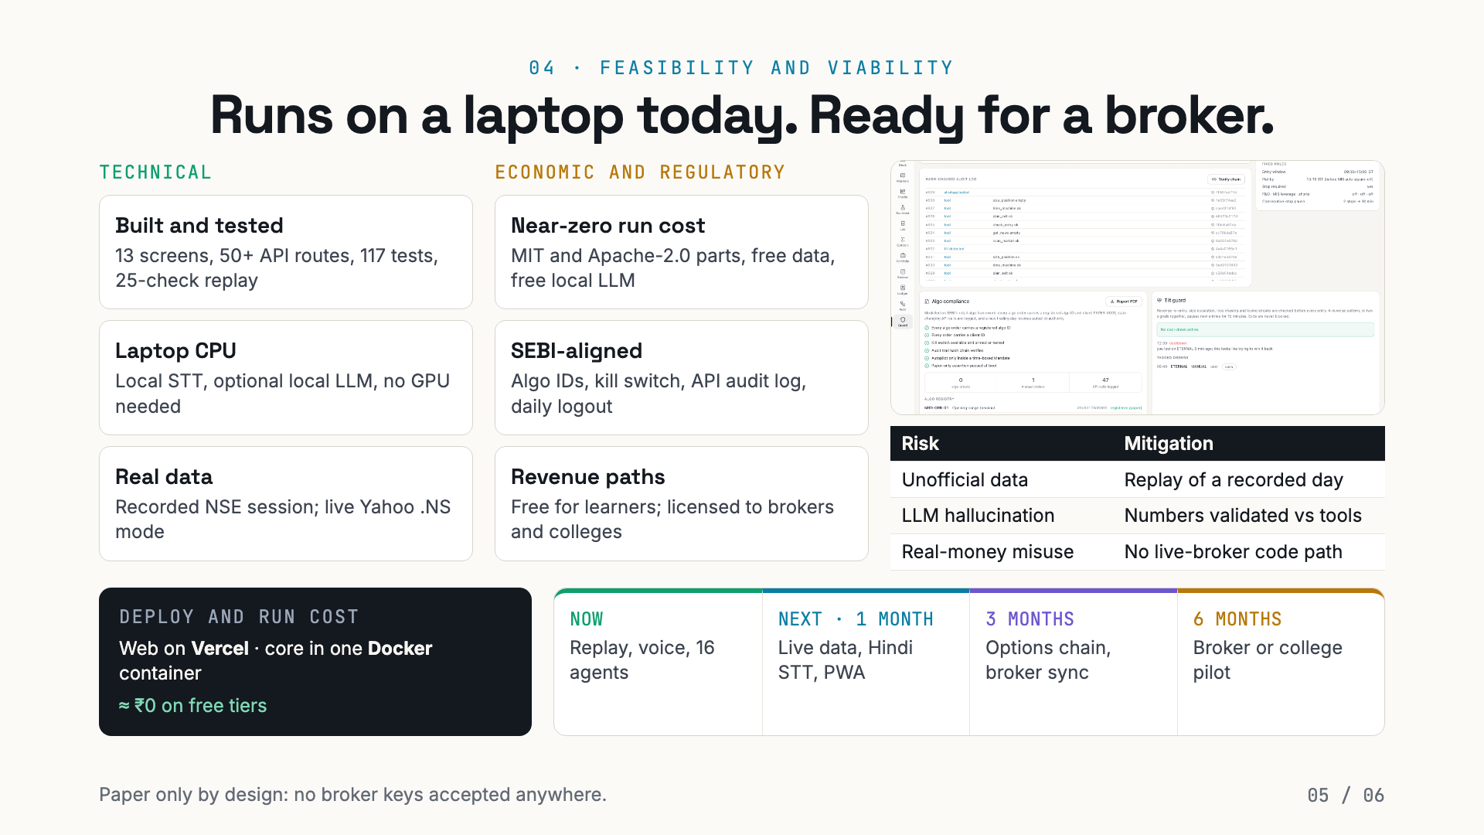
Notes:
Runs on a laptop CPU with open components; deploys as Vercel plus one Docker container; SEBI-style algo IDs and audit log.

Slide 6
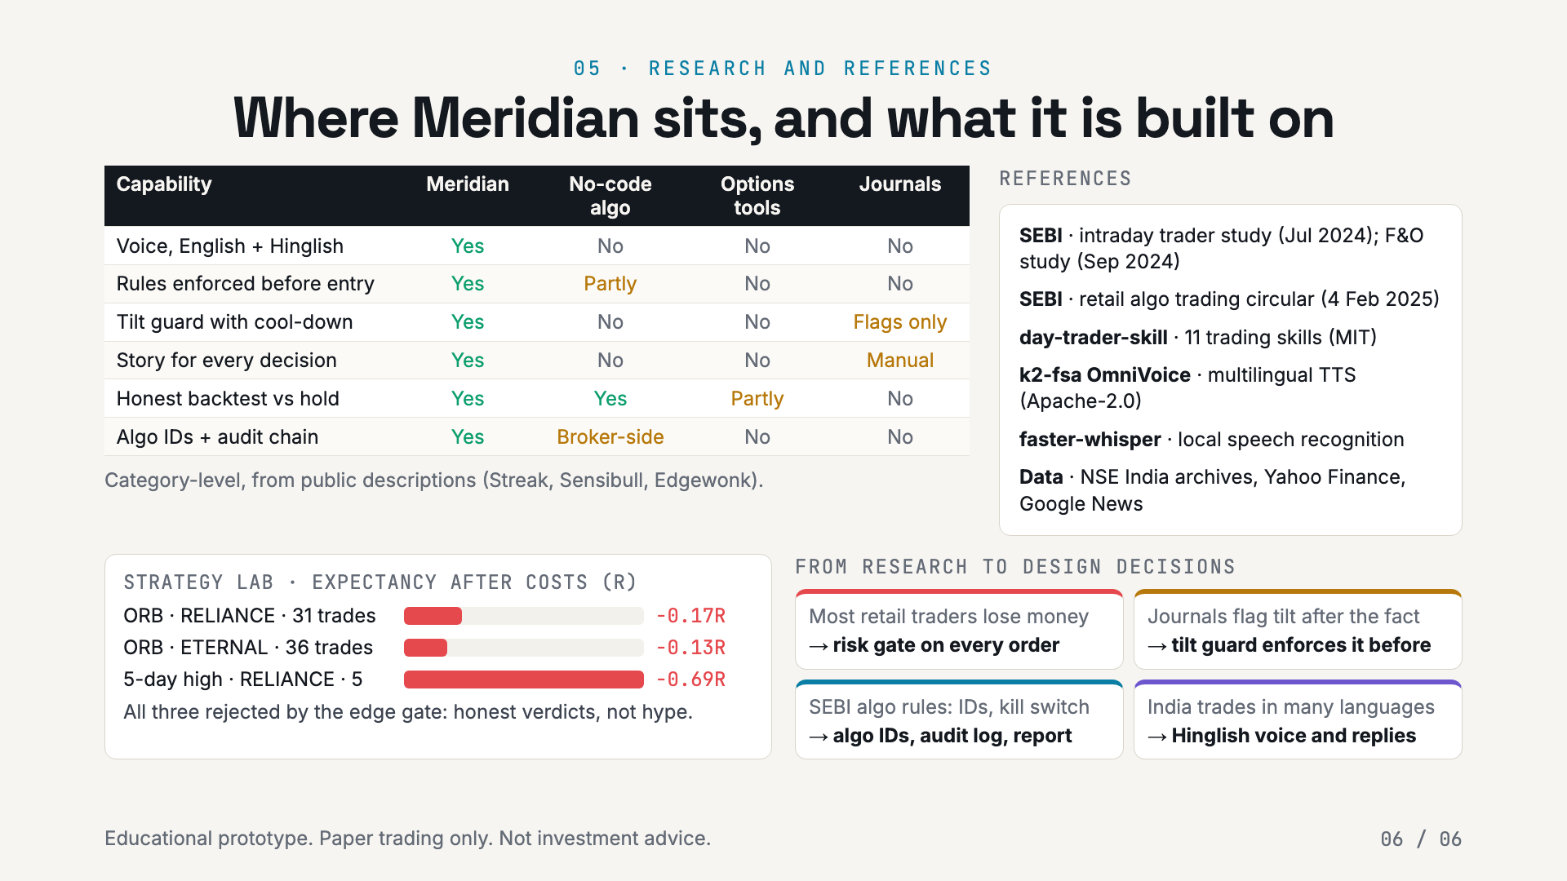
Notes:
Category comparison from public descriptions; Strategy Lab backtests on real bars were all rejected by the edge gate.

