Slide 1

Development of a GLOF Warning System through Strong Endurance Drone-based Long-Range (LoRa) Communication for the Upper Catchment of the Tista River
(Proposal under NIDM Research Project on Disaster Management: Innovation & Action Research)
Presented by
Dr. Manoj Kumar Rana (PI),
Dr. Snehasish Ghosh (Co-PI)
Department of Computing Technologies
SRM Institute of Science and Technology, Kattankulathur, Tamil Nadu, 603203, India

Slide 2
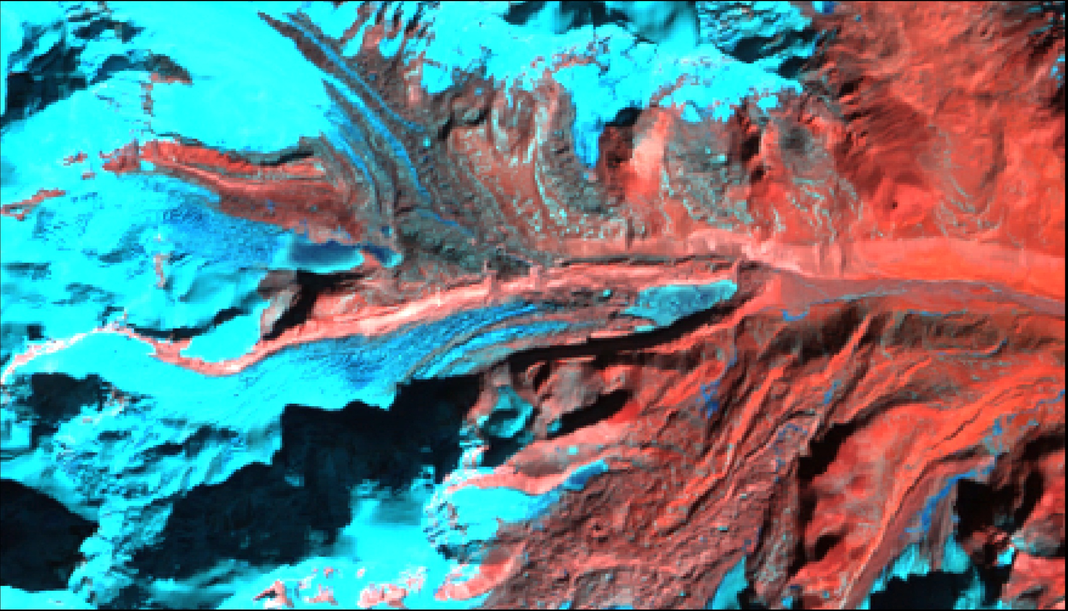
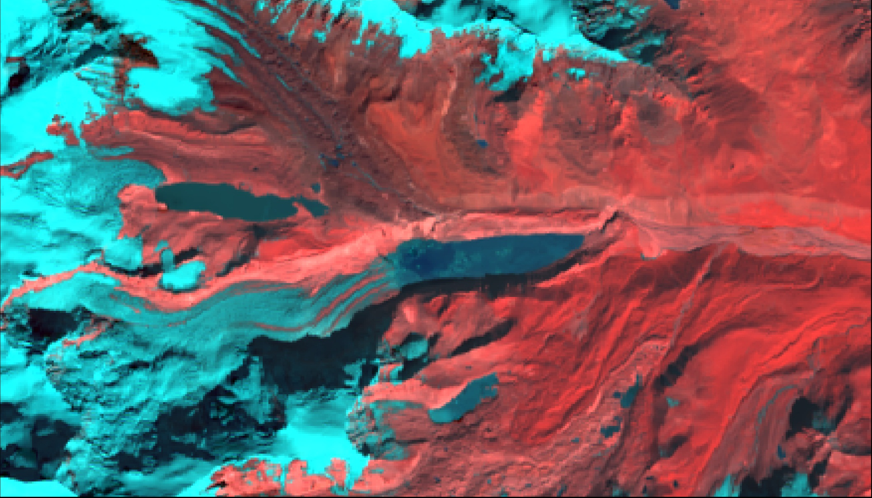
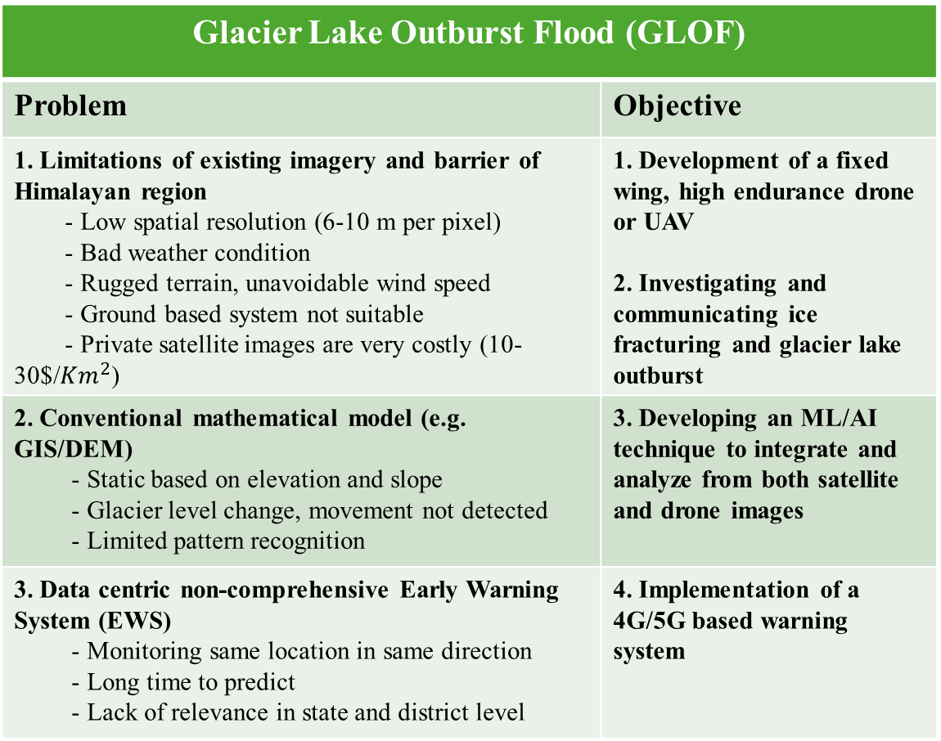
Problem and Objective
Upper Tista Basin, Sikkim [Dec 1990]
Glacier Lake Outburst Flood (GLOF)
Problem | Objective
1. Limitations of existing imagery and barrier of Himalayan region - Low spatial resolution (6-10 m per pixel) - Bad weather condition - Rugged terrain, unavoidable wind speed - Ground based system not suitable - Private satellite images are very costly (10-30$/${Km}^{2}$) | 1. Development of a fixed wing, high endurance drone or UAV 2. Investigating and communicating ice fracturing and glacier lake outburst
2. Conventional mathematical model (e.g. GIS/DEM) - Static based on elevation and slope - Glacier level change, movement not detected - Limited pattern recognition | 3. Developing an ML/AI technique to integrate and analyze from both satellite and drone images
3. Data centric non-comprehensive Early Warning System (EWS) - Monitoring same location in same direction - Long time to predict - Lack of relevance in state and district level | 4. Implementation of a 4G/5G based warning system
Upper Tista Basin, Sikkim [Dec 2023]

Slide 3
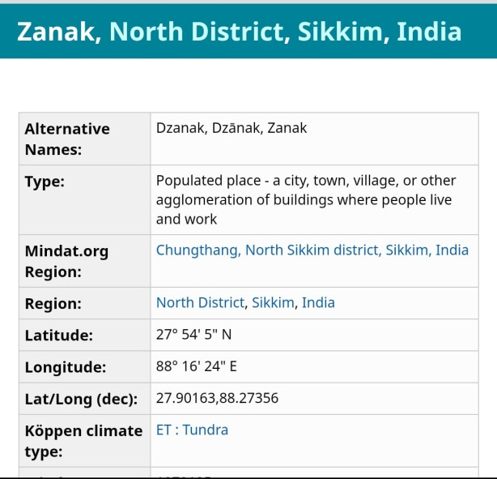
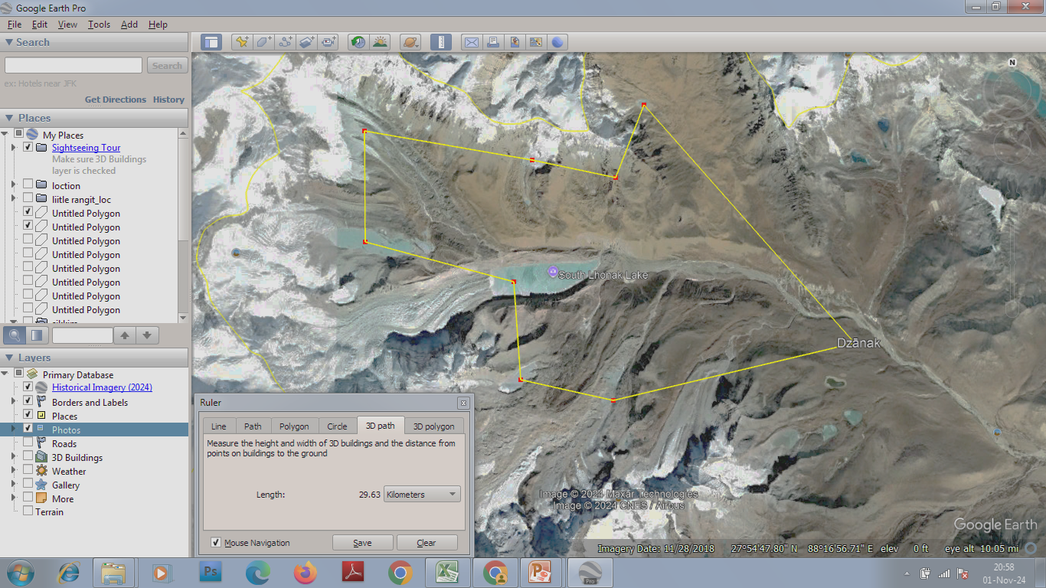
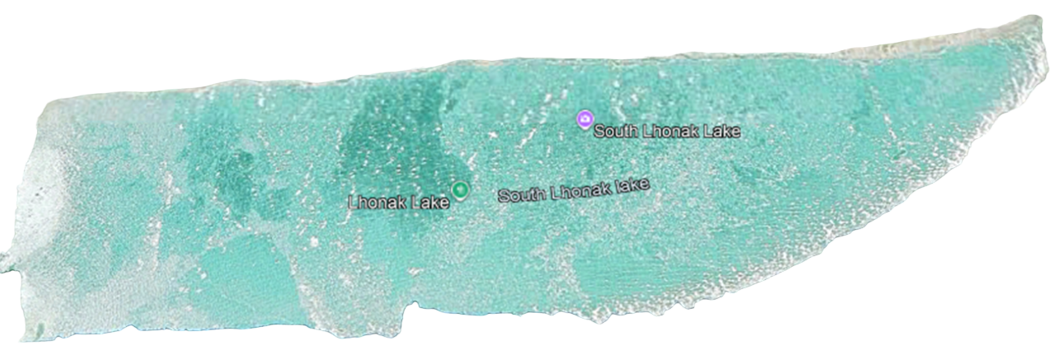

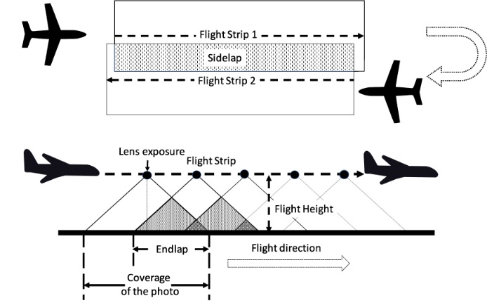
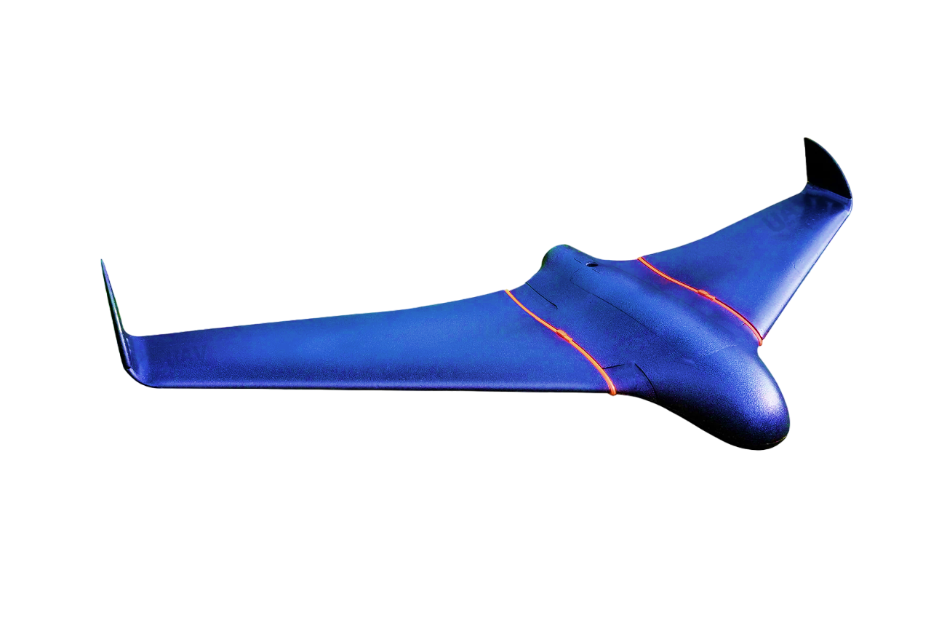
Glacial Lake Monitoring and Communication
Lake 4
Lake 3
Drone trajectory over a lake
Lake 2
Lake 1
4G/5G connection to send instant images at regular intervals
LoRa Connection to control the drone (telemetry)
Camp
Image stored in SSD card

Slide 4
Overall Procedure
Start
Fly Back to the Landing Site
Mission Planning commands:
(www.ardupilot.org/planner)
- Python programming
- Ground clearance: 450-800 m
- Automatic take-off
- LoRa Setup
- Load waypoints of different glacial lakes
Drone and Ground Station Set Up
AI/ML Data Processing and Prediction
Quantization and Labelling Vulnerability
Flying to the Next Waypoint of the Lake Sequence
Image store and transmission:
- Co-ordinate of each image from GNSS receiver stored and sent (www.rtklib.com/rtklib.htm)
- Camera triggering in each 60 m distance
Vulnerability Beyond Threshold?
Capture and Store Images in Camera SSD Card and Sent to Ground Station
No
No
More Lakes to Survey?
Yes
Create maps and Send Email/SMS automatically
Yes
End

Slide 5
Drone Configuration and Communication
LoRa communication
Motor and Controller module
Run the drone
PID controller for smooth flight
Remote control module
Range: 1-2 km
Manual operation
Airspeed Sensor
Ground station
Internet
Pixhawk autopilot
Integrate all components
Python programming enabled
Control the airplane as per instruction
(https://pixhawk.org/)
Telemetry module
Control drone remotely (Drone’s altitude, battery)
Range: 10-12 Km
Use LoRa
4G/5G modem
- SIM card enabled and provide internet to drone
15 V
Power module
2 16Ah Li-Ion batteries
2-3 hour and 200 km
5 V
USB
Jetson Nano
Small computer
Process images to send to ground server
Drone
GPS module
7.2 V
Camera module
24 MP, 4K, 1/4000 s shutter speed
1 pixel= 15-20 cm
Auto triggered
LIDAR module
Maintain safe distance
Effective during landing
USB
Communication

Slide 6
Early Warning System
Broadcast SMS to Local People
Warning Issuance
Auto Email to State and District Level Personnel Body
Zone wise Vulnerability Detection in the Local Settlements Areas in One/More Districts
Decision Support System Creation
Labelling Glacial Event According to Vulnerability
Glacial Morphometric Parameters:
Hypsometric Integral
Ice Compactness Index
Snout Index, etc.
Glacial Lake Morphometric Parameters:
Volume
Mean Depth
Shoreline Index, etc.
Data Processing and Analysis `
Processing through ML/AI models (CNN, Random Forest, Support Vector Machine (SVM))
Sentinel-2 and ResourceSat-2 (LISS-IV) data and image
Drone captured data and images
Database Creation
Existing
Instant/Live

Slide 7
Relevance for State and District
Zero casualties through DRR as per disaster management act
Determination of level of vulnerability and issue a warning at local and district level
  Communication through Email, SMS and Website update to proper Personnel/Body
Forecasting of GLOF for next few days and even weeks
Proposed to conduct GLOF awareness workshop at state level with the help of SRM-SIKKIM campus

Slide 8
Work
Plan
ACTIVITIES | I YEAR |  |  |  | II YEAR
 | 3 | 6 | 9 | 12 | 3 | 6 | 9 | 12
1. Student selection (UG level), Equipment purchase, Satellite data acquisition
2. Field visit and data collection: Drone image collection, Database creation, Ground based evidence
3. Image processing through software: Object detection and image classification
4. Glacial and glacial lake Morphometric analysis and quantification
4. ML based model and decision Support System
5. Early Warning System for GLOF: Monitoring of Dynamic changes of glacial lake, Checking warning at various level, Message broadcasting using 4G/5G network
6. Report Submission
7. Research publications and patent work

Slide 9
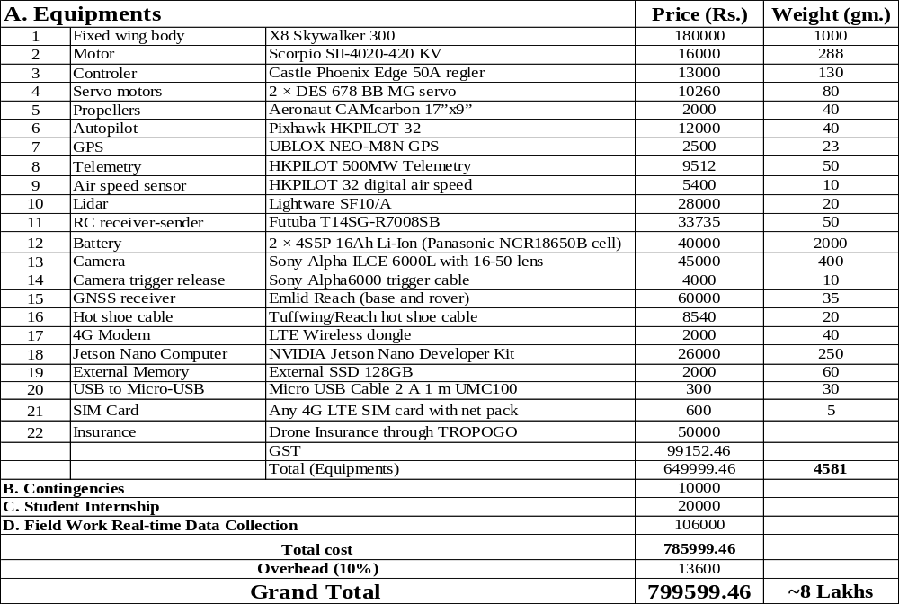
Proposed Budget

Slide 10
Deliverables and Outcome
An efficient Machine Learning model, determining GLOF
  Much better result than conventional mathematical model
  No dependency on satellite and ground system images
A low-cost high endurance drone
  Takeoff and landing in steep terrain
  Sustain against strong katabatic winds
  No unreliable compass used
  Tolerate battery deterioration in low temperature, limited technical support
  Easy drone launch and landing process
Instant and automatic EWS system
UG student internship supported and GLOF awareness program, organised through SRM Sikkim campus
Project can be extended for land slide and other disaster scenarios

Slide 11
References
Compendium of Task Force Report on NDMA Guidelines Management of Glacial Lake Outburst Floods (GLOFs) A Publication of the National Disaster Management Authority, Government of India.October 2020, New Delhi.
J. C. Ryan, et al., UAV photogrammetry and structure frommotion to assess calving dynamics at store glacier, a large outlet draining the greenland ice sheet. Cryosphere, vol. 9, 1–11, 2015. doi: 10.5194/tc-9-1-2015.
G. Jouvet, et al., Initiation of a major calving event on the bowdoin glacier captured by UAV photogrammetry. Cryosphere, vol. 11, 911–921, 2017. doi: 10.5194/tc-11-911-2017.
T. R. Chudley, et al., High-accuracy uav photogrammetry of ice sheet dynamics with no ground control. Cryosphere, vol. 13, 955–968, 2019. doi: 10.5194/tc-13-955-2019.
G. Jouvet, et al., In-situ measurements of the ice flow motion at Eqip Sermia glacier using a remotely controlled UAV. Geosci. Instr. Methods Data Syst. Discuss., 1–15, 2019. doi: 10.5194/gi-2019-6.
A. Walter, et al., Calving event size measurements and statistics of Eqip Sermia, Greenland, from terrestrial radar interferometry, Cryosphere Discuss., 1–23, 2019. doi: 10.5194/tc-2019-102.
C. Rohner, et al., Multisensor validation of tidewater glacier flow fields derived from sar intensity tracking, Cryosphere Discuss., 1–27, 2019. doi: 10.5194/tc-2018-278
C. Taylor, et al., Glacial lake outburst floods threaten millions globally, Nat Commun 14, 487, 2023. https://doi.org/10.1038/s41467-023-36033-x
S. Kaushik, et al., Increasing risk of glacial lake outburst flood in Sikkim, Eastern Himalaya, Remote Sensing Applications: Society and Environment, vol. 36, November 2024.
P. Hazra, et al., Assessment of Proglacial Lakes in Sikkim Himalaya, India for Glacial Lake Outburst Flood (GLOF) Risk Analysis using HEC-RAS and Geospatial Techniques, J Geol Soc India, vol. 98, 344–352, 2022. https://doi.org/10.1007/s12594-022-1986-1.
S. Schmidt, et al., Cryosphere hazards in Ladakh: the 2014 Gya glacial lake outburst flood and its implications for risk assessment, Nat Hazards, vol. 104, 2071–2095, 2020. https://doi.org/10.1007/s11069-020-04262-8.

Slide 12
Thank You!!

