Slide 1
NeuroVibe
Anusha[RA2311003010584], Koushani[RA2311003010585],
Rishit [RA2311003010587]

Slide 2

Recap of Review-1
Problem Statement:
Objective:
Physically challenged individuals or users with limited mobility need intuitive ways to control electrical appliances.
To build a low-cost brain–computer interface that allows users to control room devices (light, fan) by detecting EEG patterns corresponding to mental “ON/OFF” commands.
Proposed System Idea:
Capture EEG signals using Brain BioAmp Band + BioAmp EXG PillProcess & classify signals with a machine-learning modelSend results to ESP32 for IoT-based device control (LED / DC motor)

Slide 3
Mathematical Modelling of the Algorithm
Input Variables: EEG signal windows X ∈ ℝⁿ (n samples per window) Output Variable: Y ∈ {0 = LED_OFF, 1 = LED_ON}
Feature Extraction Equations:
Mean μ = (1/n) Σ xᵢ
Std σ = √(1/n Σ (xᵢ − μ)²)
Band-power features via FFT: Pₖ = |FFTₖ(X)|²
Model Equation (Random Forest): f(X) = argmax Σ wⱼ · Iⱼ(X) (over decision trees j)
r
Optimization: Information Gain / Gini Impurity minimization in trees

Slide 4
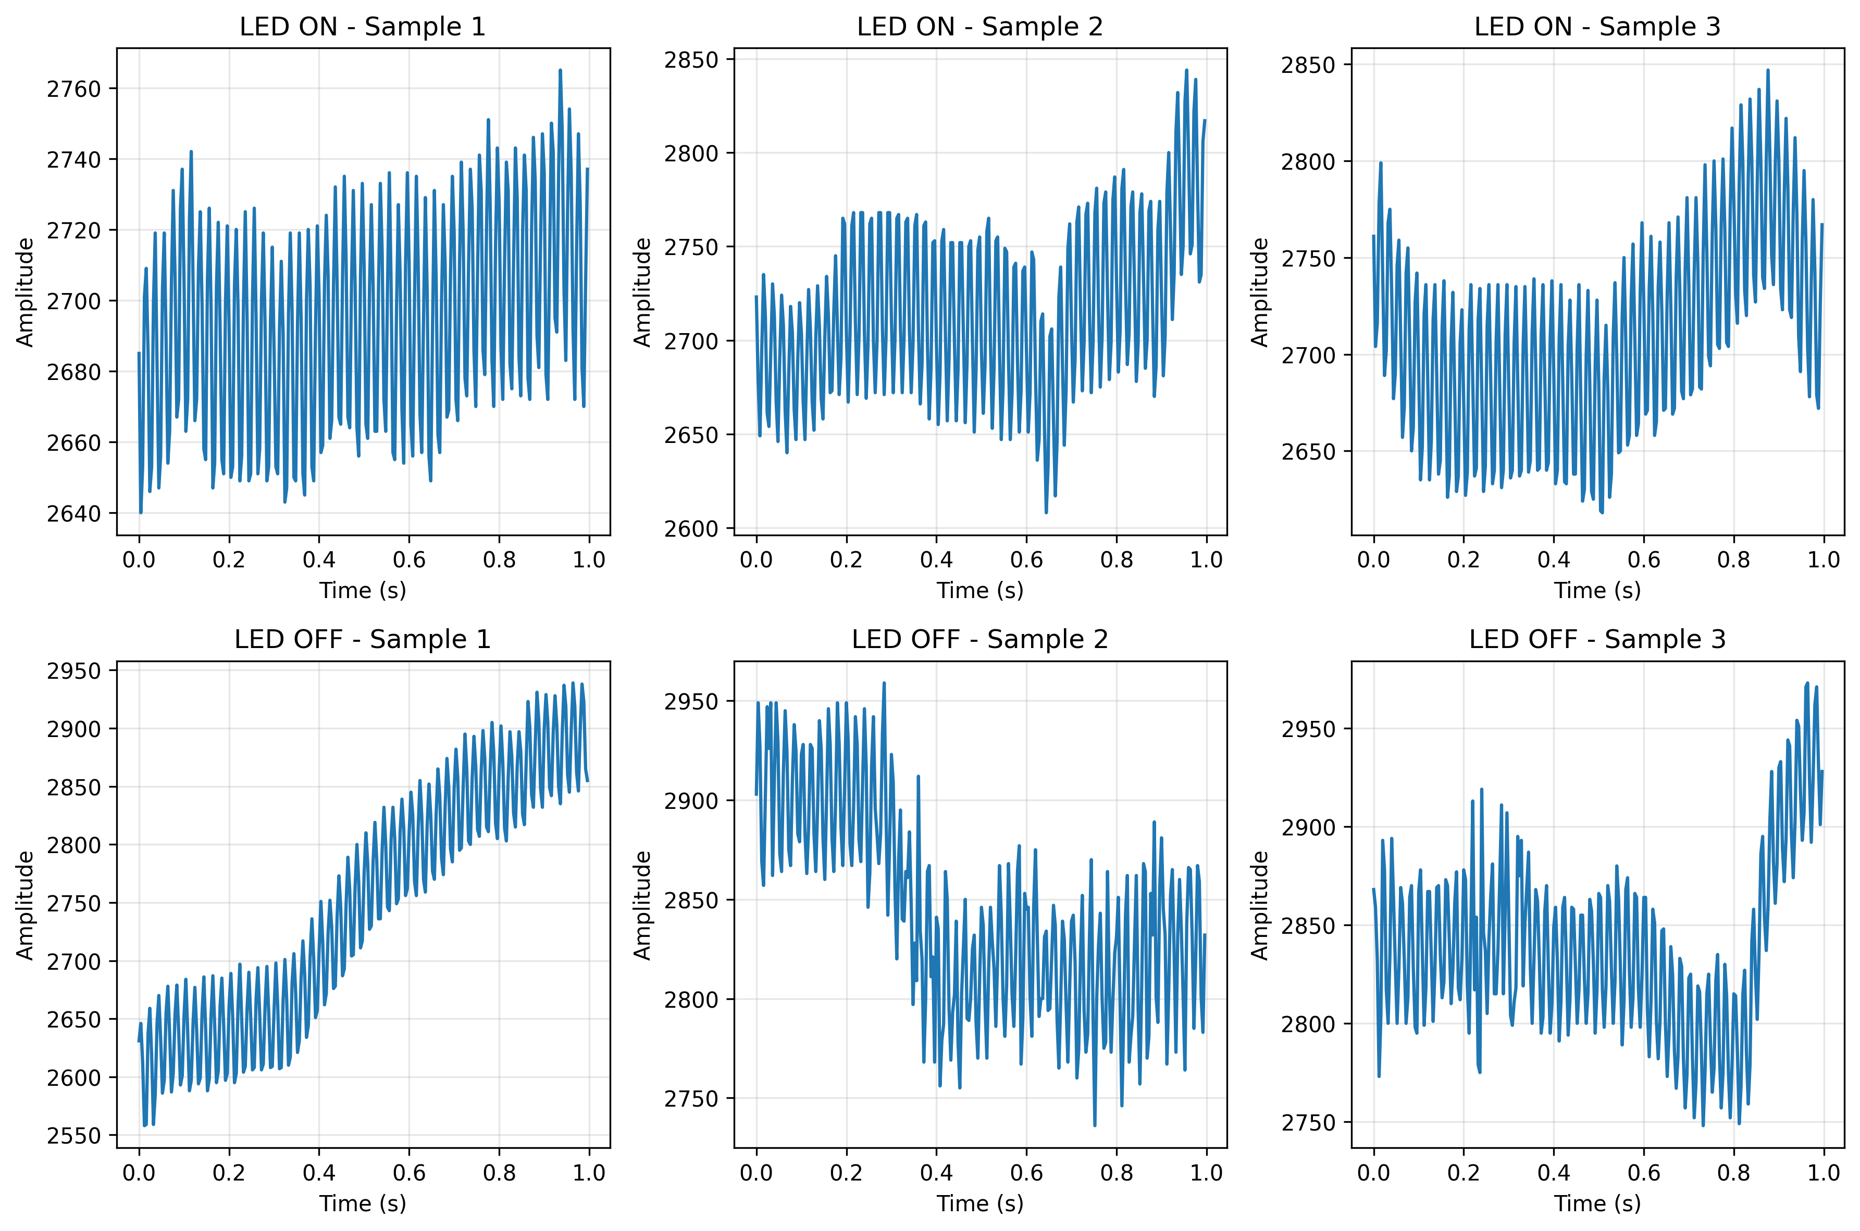
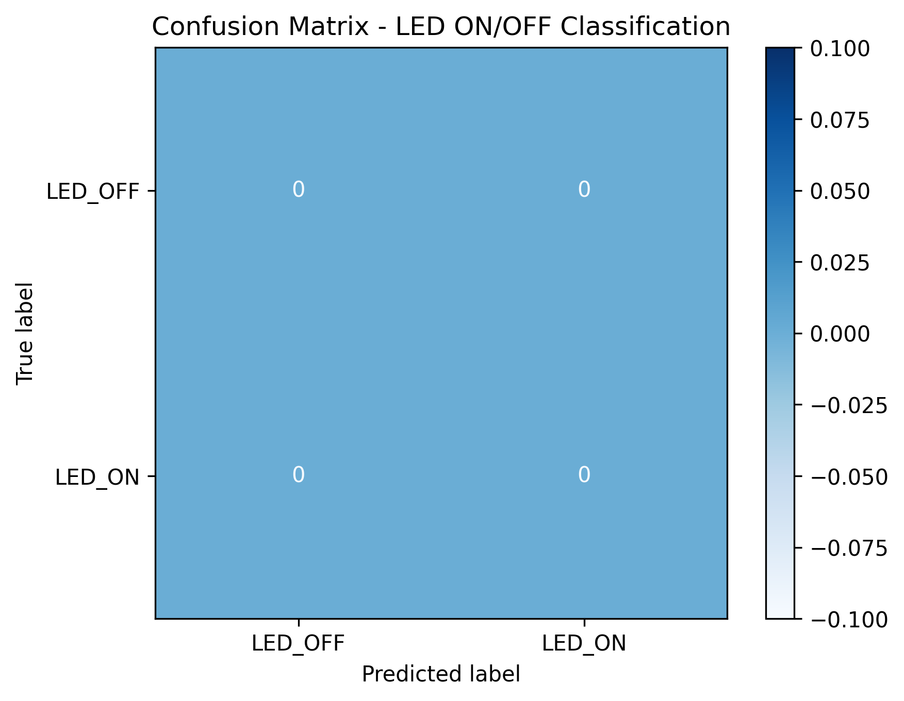
Initial / Partial Results
Metric | Value
Accuracy | 72 %
Precision | 0.70
Recall | 0.73
F1-Score | 0.71
Observations:
Graphs / Tables:
Clear separation between “LED ON” and “LED OFF” brain states in filtered signals. Accuracy improves with longer, cleaner recordings. Real-time test successfully toggled LED on ESP32 when classified > 0.7 confidence.

Slide 5
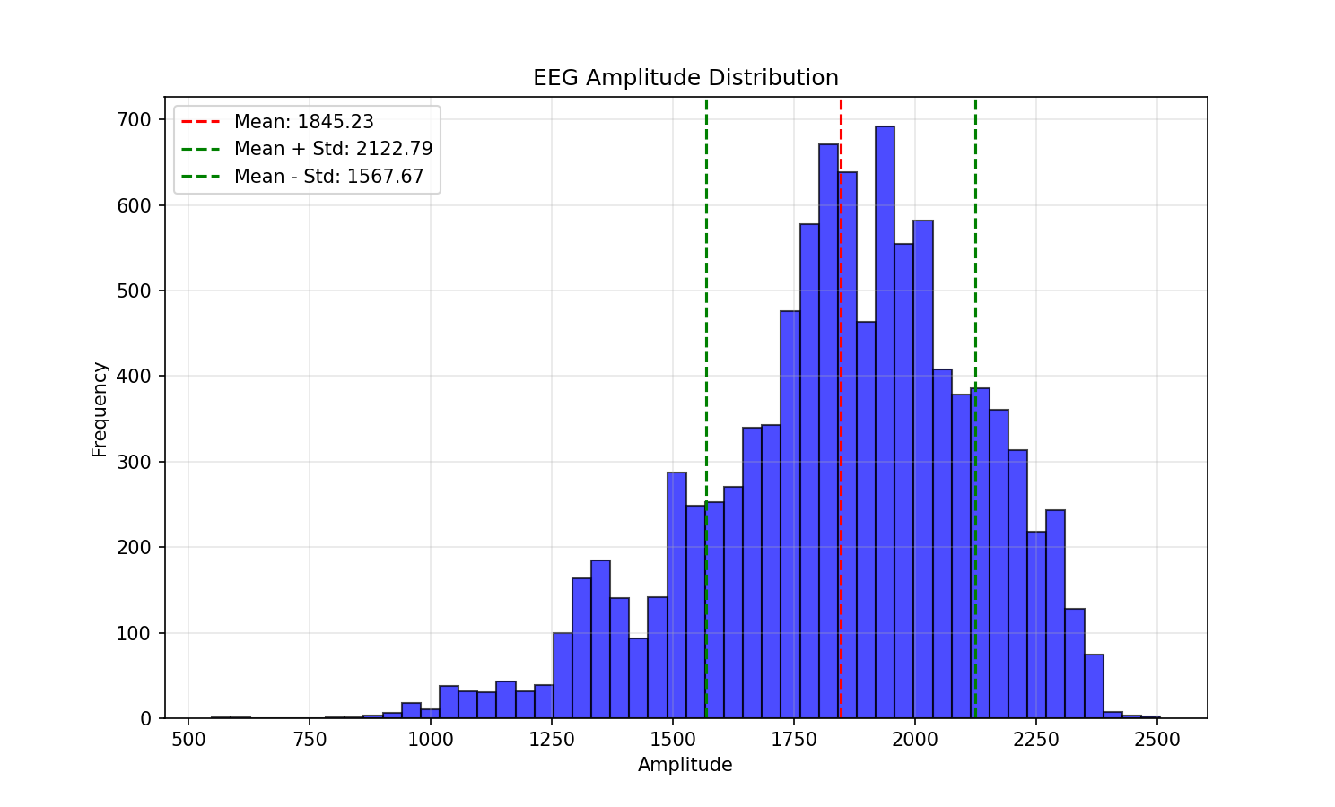
Python Implementation of the Model
Key Scripts: record_eeg.py, train_model.py, run_realtime.py
Implementation Flow: 1️⃣ Collect raw EEG → NumPy arrays 2️⃣ Pre-process (filter 1-50 Hz, normalize) 3️⃣ Extract statistical + FFT features 4️⃣ Train Random Forest classifier 5️⃣ Send real-time predictions to ESP32 via serial
Sample Snippet: Sample Visualization:
from sklearn.ensemble import RandomForestClassifier
import joblib, numpy as np
data = np.load('led_dataset.npz')
X, y = data['X'], data['y']
model = RandomForestClassifier(n_estimators=100)
model.fit(X.reshape(len(X), -1), y)
joblib.dump(model, 'eeg_model.joblib')

