Slide 1

MLSA PROJECTS

Slide 2
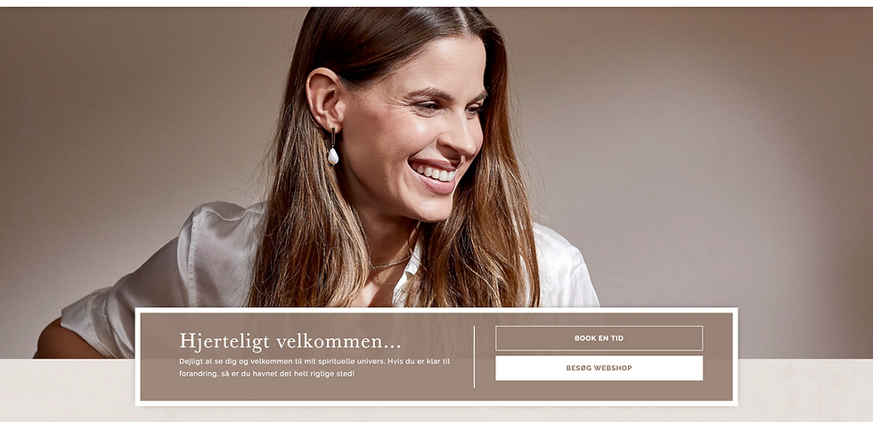
PROJECT 1.PERSONAL WEB PAGE

Slide 3
Objective:
This project is about how to make a simple personal web page which contains my basic information.

Slide 4

Contents:
1.Title of the web page
2.Basic information including name , social media skills , education and experience.

Slide 5

Overview and Audience:
This project is a part of MLSA SUMMER INTERNSHIP PROGRAM .I have simply included my basic information in this project.
So , in simple , it targets those audience who simply wants to have a quick information about me.

Slide 6
Description:
Firstly , there is an index.html file which includes HTML elements which contains various elements.
It contains separate CSS file-main.css which add a little bit of styling to my web page.

Slide 7
Conclusion:
This project is about how to create a simple personal web page without using extra Html elements or CSS styling elements.

Slide 8


