Slide 1


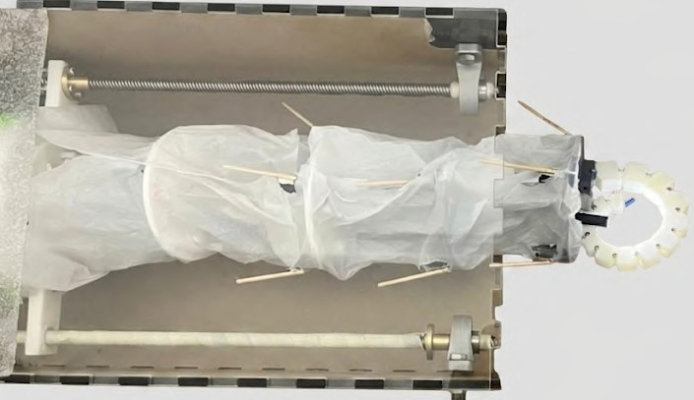



TUE-16
Secure Adaptive Continuum Explorer
VEERESH S K (23B1309) RISHITH GUPTA (23B1234) ARSHIT SINGH (23B1275) PRITHVI SANGAM (23B1292) ARIJIT PAUL (23B1219)

Slide 2



SUMMARY
01
02
03
WHAT?
modular continuum tentacle-based end-effector using tendon-driven actuation and visual feedback
industrial maintenance, medical/surgical researchers and rescue professionals requiring flexible robotic systems
overcomes limited accessibility and dexterity, adaptive grasping and safe interaction
WHO?
PROBLEM?

Slide 3
SPECIFICATIONS
04
05
₀₁ LINK BENDING : 30°
MINIMUM GRABBING : 1.25 cm RADIUS
02
EXTENSION OF : 40 cm LEADSCREW
MAXIMUM GRABBING : 3.5 cm RADIUS
₀₃ CAMERA FOV : 60°

Slide 4
STATUS OF PROJECT
Key Requirements proposed at the beginning of the semester
Status at end of semester
Remarks/Justification
bending of individual continuum links
complete
end-effector object gripping
complete
hybrid continuum-tentacle mechanical design
complete

Slide 5
STATUS OF PROJECT
Key Requirements proposed at the beginning of the semester
Status at end of semester
Remarks/Justification
user control through GUI commands on keyboard with live camera feedback
complete
limit switch-based obstacle avoidance
complete

Slide 6
STATUS OF PROJECT
Key Requirements proposed at the beginning of the semester
Status at end of semester
Remarks/Justification
integrated multiple RPis and ICs
complete
autonomous navigation, control and object retireval
incomplete
manual control algorithm complex, and more costly sensors required

Slide 7
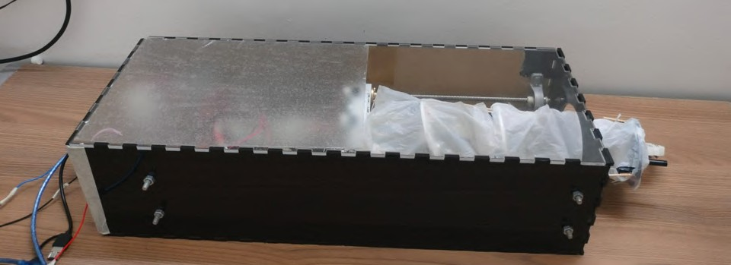
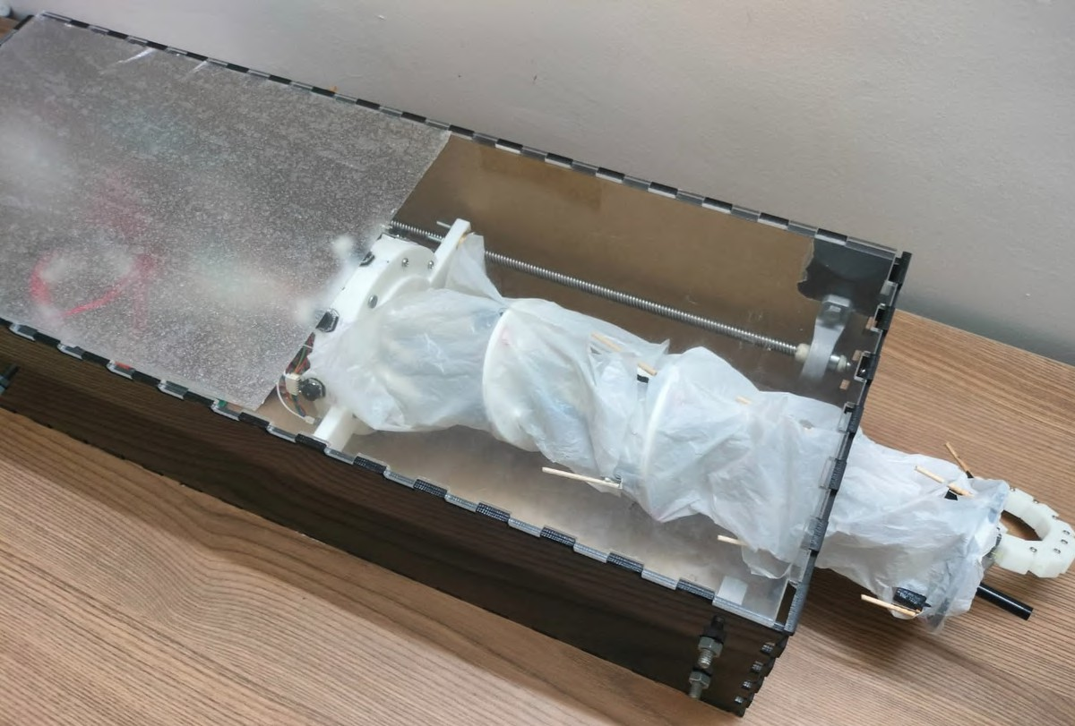
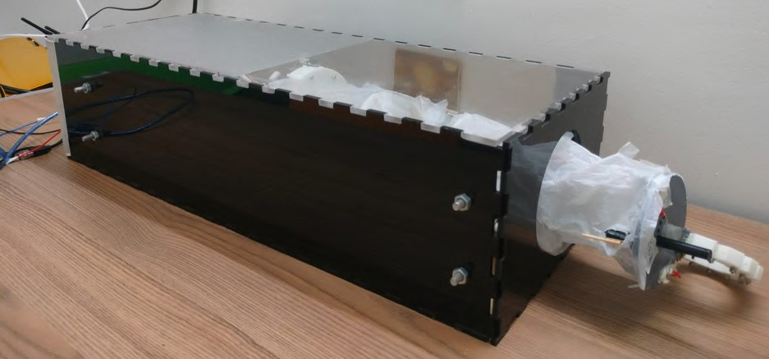
PHOTOGRAPHS OF FINAL PROTOTYPE

Slide 8
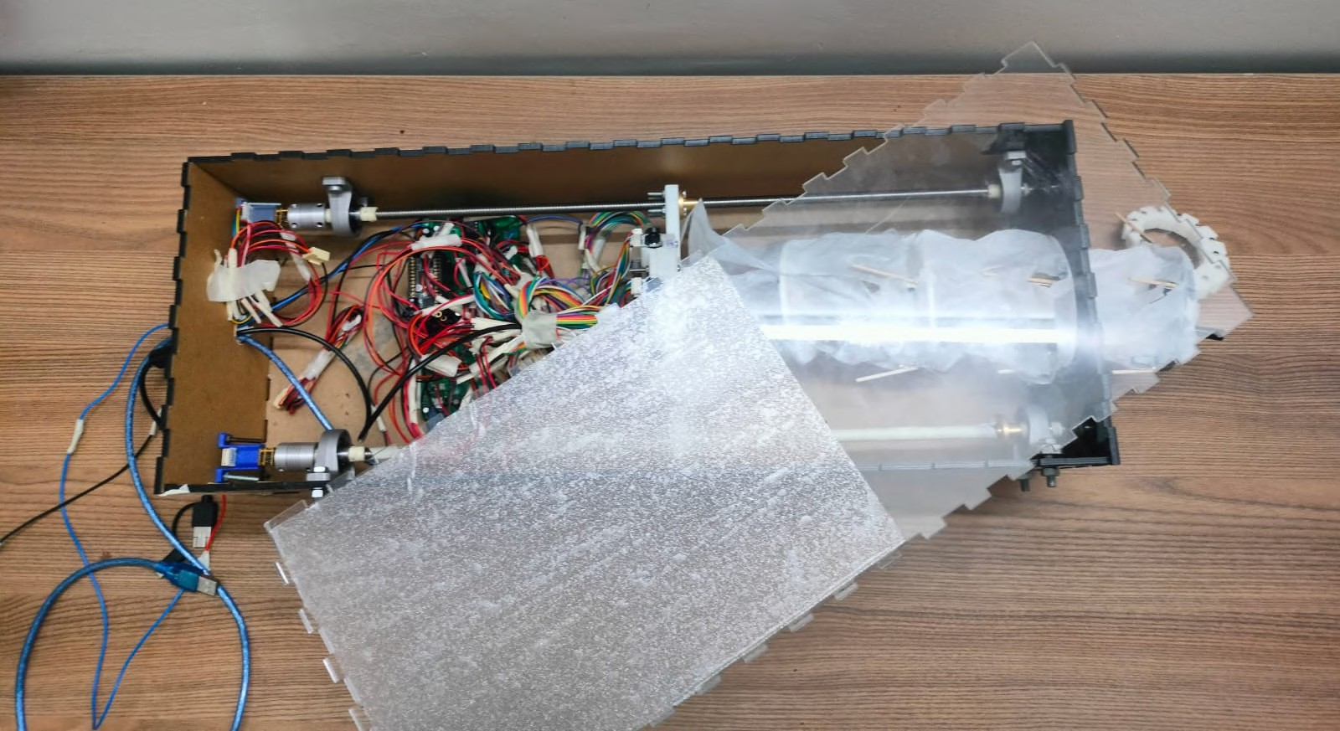
PILLOW
BEARING
LEADSCREW
CONTINUUM LINKS
EN^{T}DE-^{N}EF^{TA}EF ^{C}C^{L}T^{E}OR
COUPLERS
PCB

Slide 9
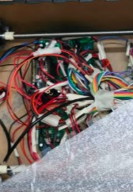
MOTOR DRIVER
ENDOSCOPE
CAMERA
BASE PLATE WITH MOTORS
MASTER RPI
LIMIT SWITCHES
LEADSCREW
MOTOR

Slide 10
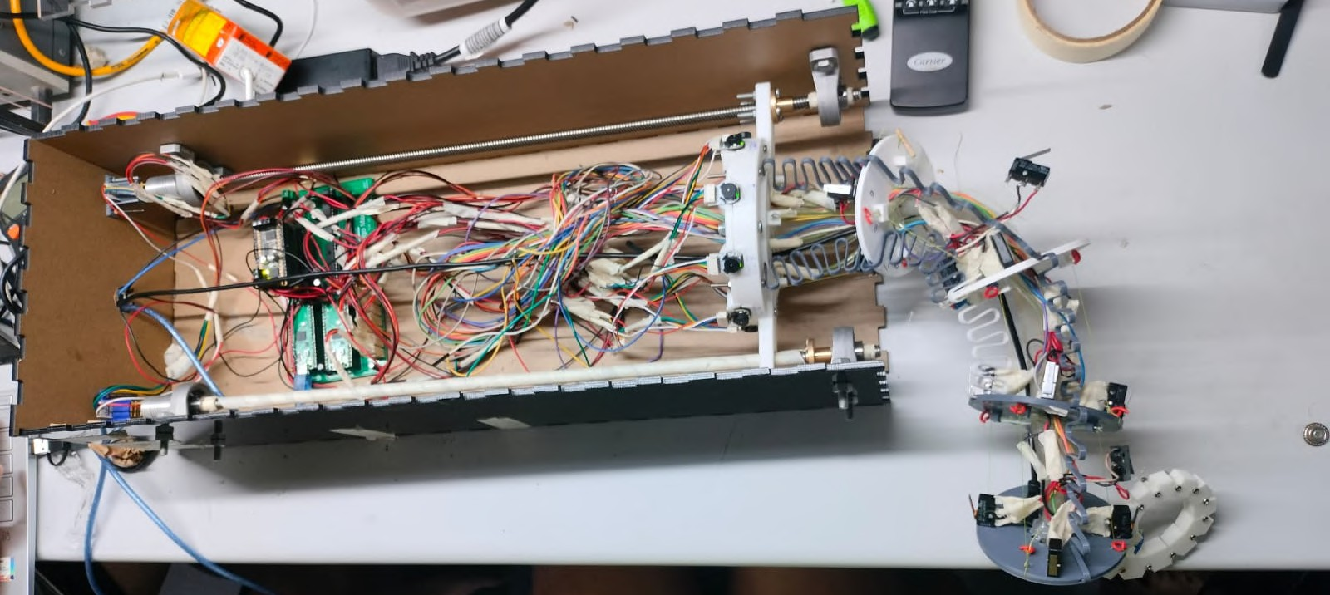
CONTINUUM BENDING TO THE LIMIT !!!

Slide 11



Challenges
Solutions
Remarks
spool design
multiple iterations, 2 winding spool with opposite directions
working but better solutions possible
CHALLENGES
FACED AND
tentacle material choice and design
final design hinge-based, printed in PLA, tried resin printing
effective bending and movement
HOW WE
SOLVED
THEM
insufficient ports on RPi Pico
used port expanders and master-slave architecture
increased ports (26 to 26+32) and better task distribution
realised torque was less
changed routing of cables and brought motors to base plate
getting enough torque

Slide 12
Challenges
Solutions
Remarks
mistakes in PCB design
fixed using micro-surgery and removal of Vsys of main RPi
PCB is working without any issues
CHALLENGES
FACED AND
HOW WE
defect in motors
micro-surgery to connect terminals and connector
motor defect fixed and working
SOLVED
THEM
double lead screw alignment
keeping one lead screw stationary, moving other
better movement than earlier
tight mechanical tolerances
changed designs and 3D printers for better prototype
more flexible and accurate design

Slide 13
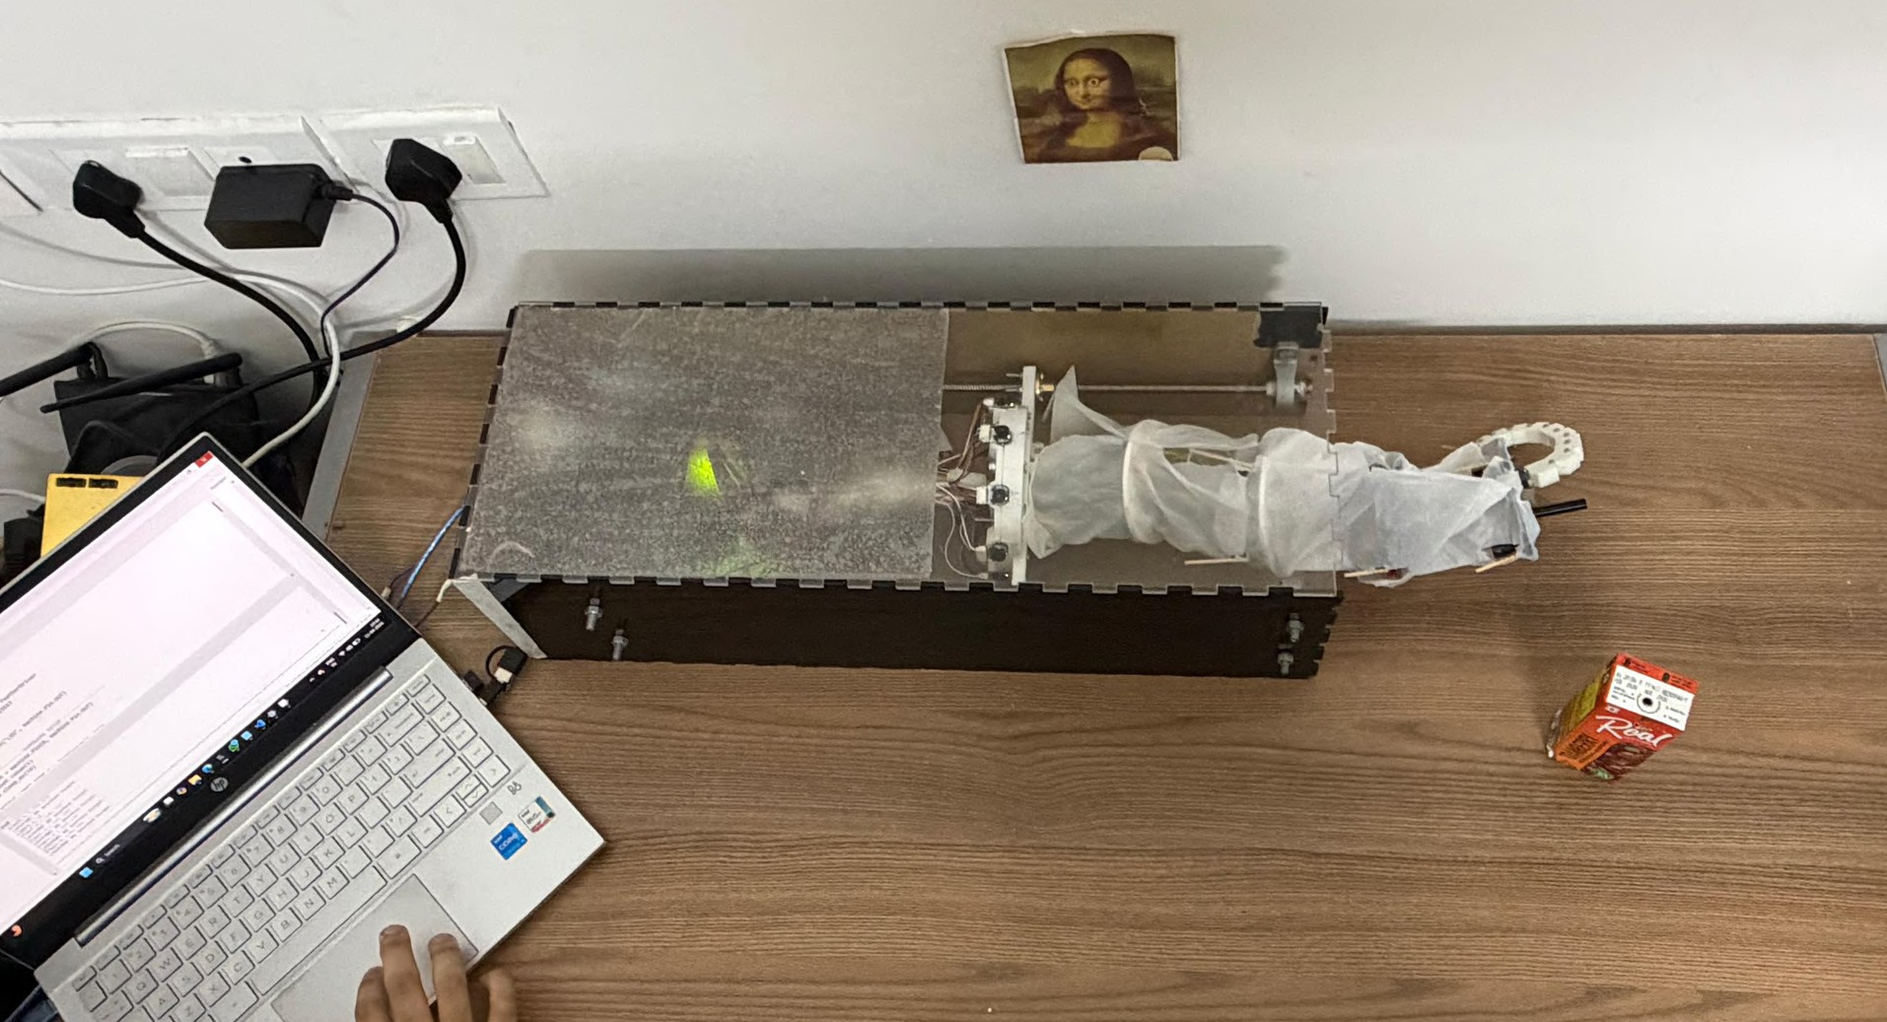
DEMO VIDEO

Slide 14
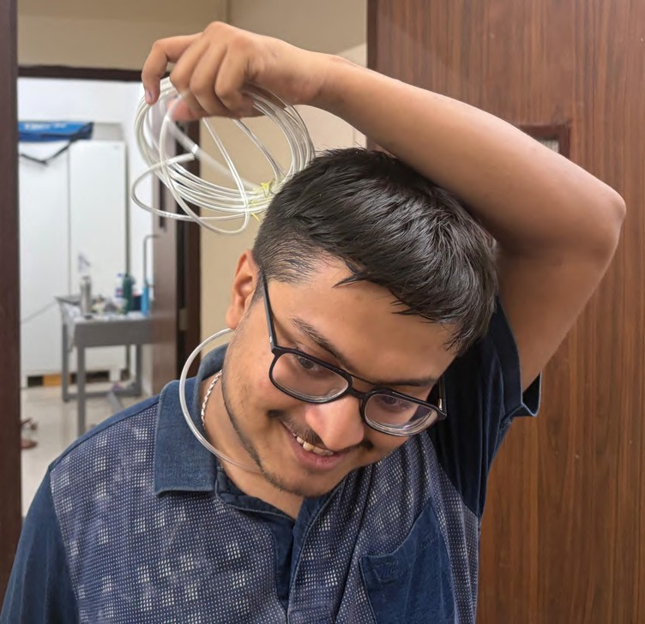
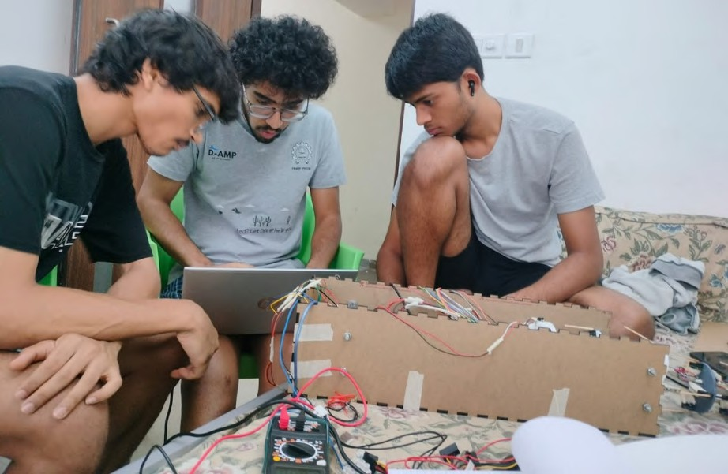
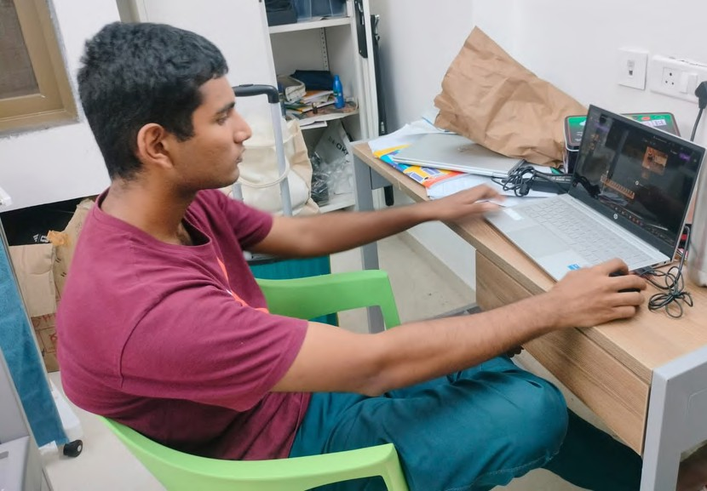
MINDS BEHIND
THIS

