Slide 1

Software Project- Road Repair and Tracking Software
BY-
S.SUMITH CHANDRA – 22CS10067
M.NIKHIL KUMAR – 22CS10042
K.RISHITH KUMAR - 22CS10037
TEAM : AKATSUKI

Slide 2



PROBLEM DESCRIPTION
ROAD REPAIR AND TRACKING SOFTWARE DEVELOPED TO AUTOMATE BOOK KEEPING TASKS AND ASSIGNING WORKS FOR ROAD REPAIR OPERATIONS OF A CITY'S PUBLIC WORKS DEPARTMENT.
Clerks
Supervisors
Administrator
Registers Complaints Raised by Residents
Updates Customers on the Work Progress
After visiting the repair site, records the resource data and assigns work priority
Edits resources as needed during the ongoing work and marks completed upon finishing
Updates work schedule
Updates Resources
Generate Statistics Upon request from mayor

Slide 3
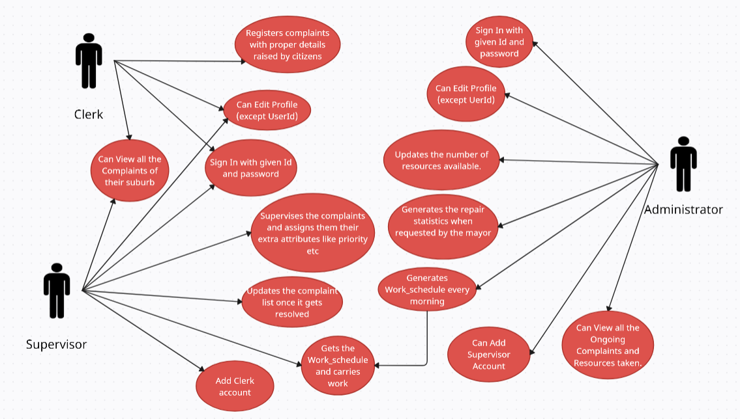
Use Case Diagram:

Slide 4
TECHNICAL DETAILS –
FRONTEND : ReactJS , HTML , CSS.
BACKEND : MongoDB , ExpressJS, Mongoose,NodeJS.
Models : We created classes for each entity of system.
Templates: Different pages with unique url's.
Event Handling: Views respond to user interactions like clicks and input changes, driving the application's functionality.
Routing and Navigation: Utilizing React Router, views enable seamless navigation between different pages or views within the application.
Integration with Backend APIs: Views communicate with backend APIs to fetch and update data, ensuring real-time data interaction for users.
Error Handling: Views gracefully handle errors by displaying informative messages and guiding users on how to proceed, enhancing user trust and satisfaction

Slide 5
Challenges Faced
Due to our limited experience in web development, we encountered challenges during the initial stages while familiarizing ourselves with the front-end and back-end technologies.
Despite utilizing GitHub for collaborative development and attempting to merge individual code contributions, conflicts arose during the merge process.
Integrating frontend components with backend APIs was challenging, especially with data consistency and format mismatches.

Slide 6
Possible improvements
A search bar could be introduced, allowing clerks to access complaints swiftly by entering either the complaint ID or the address and providing timely updates on their reported issues.
A User Account where the user can give the feedback about the repair done and also can view the status of the work going on.
•Integration of OTP (One-Time Password) authentication during login enhances account security by introducing dynamically generated passwords, thereby fortifying the protection of user accounts with an additional layer of defense.

Slide 7
THANK YOU

