Slide 1
Data Analysis in Tableau
-Ashu Mehta
Database Systems

Slide 2
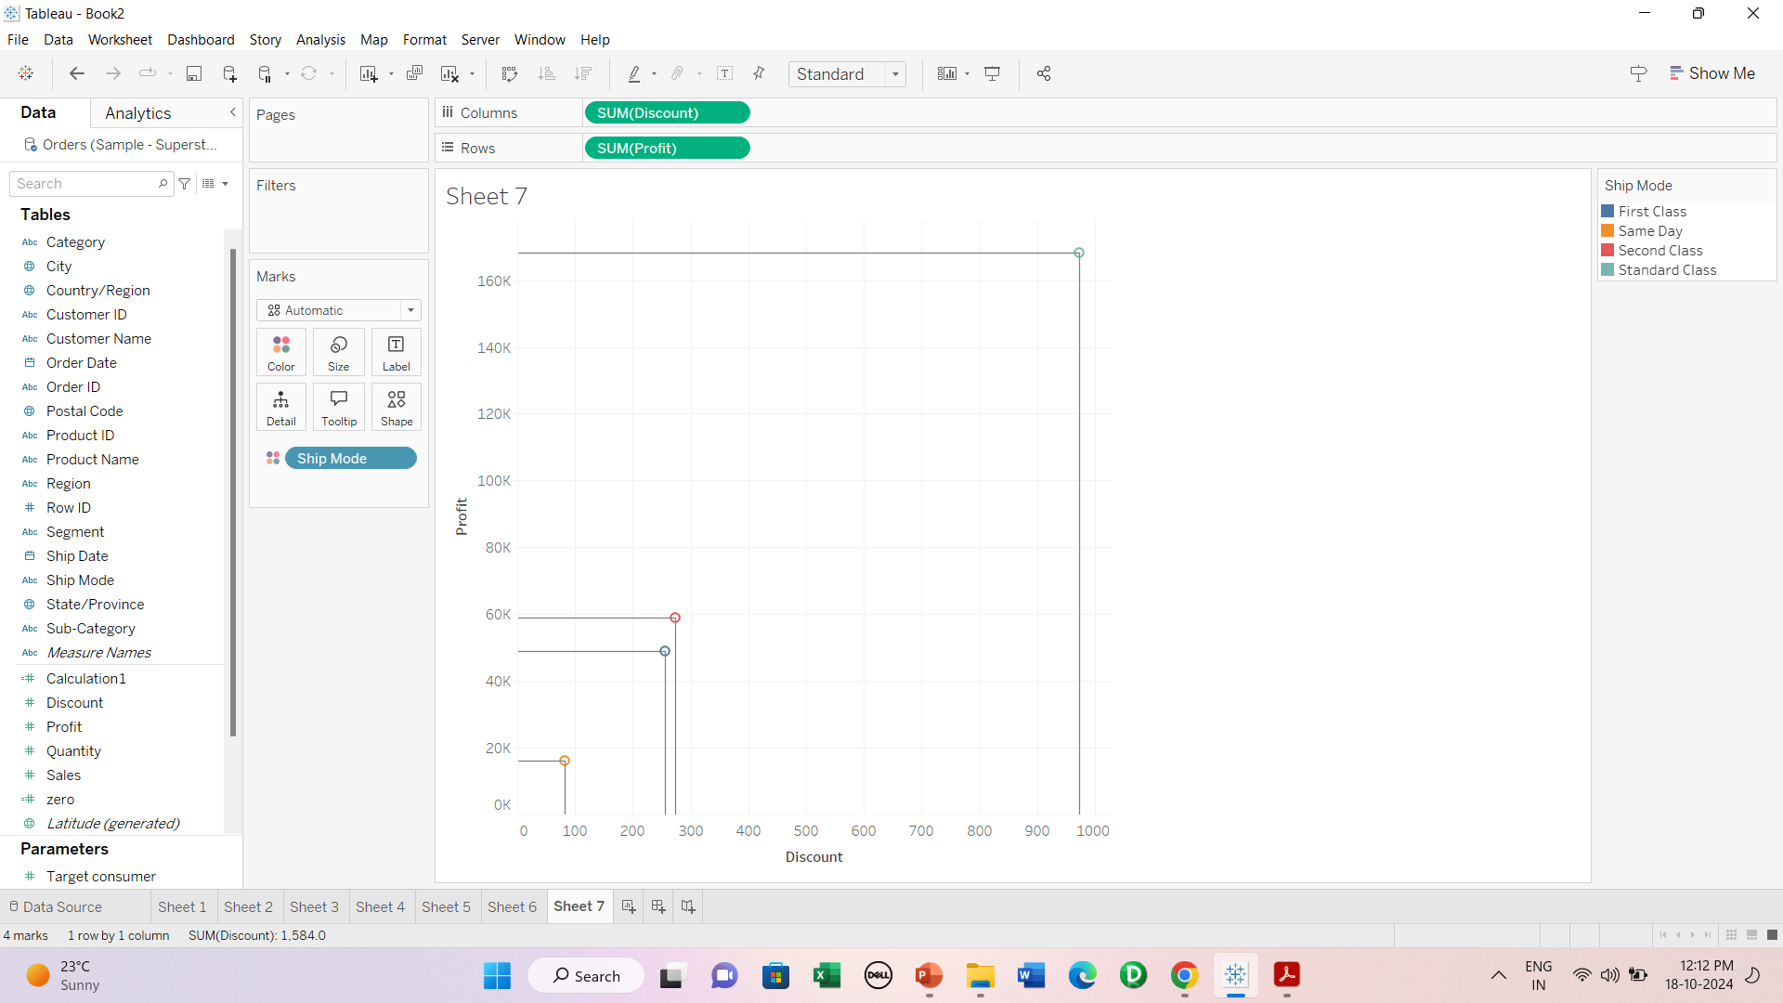
Drop Lines

Slide 3
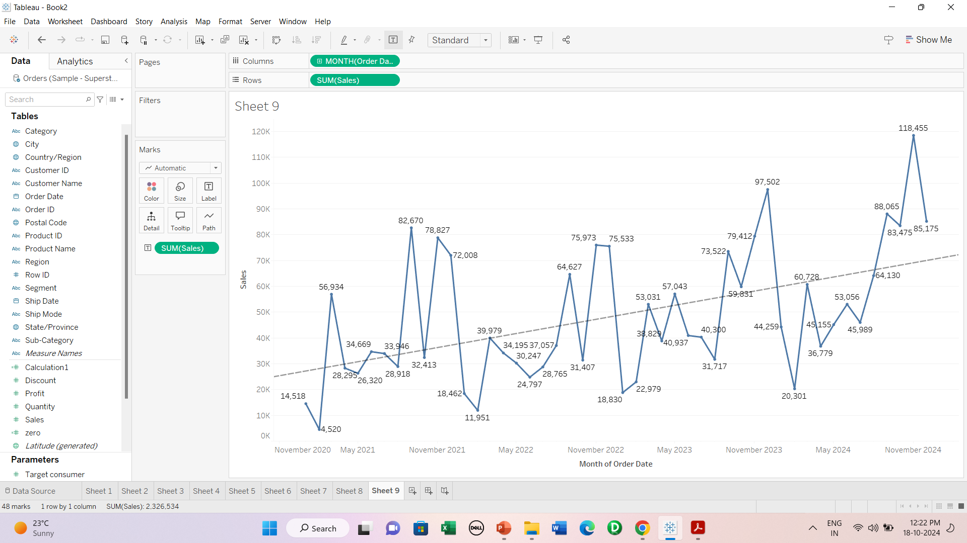
Trend lines

Slide 4
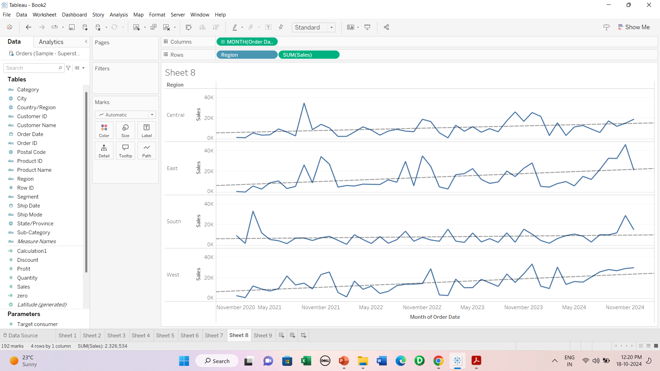
Region wise trend

Slide 5
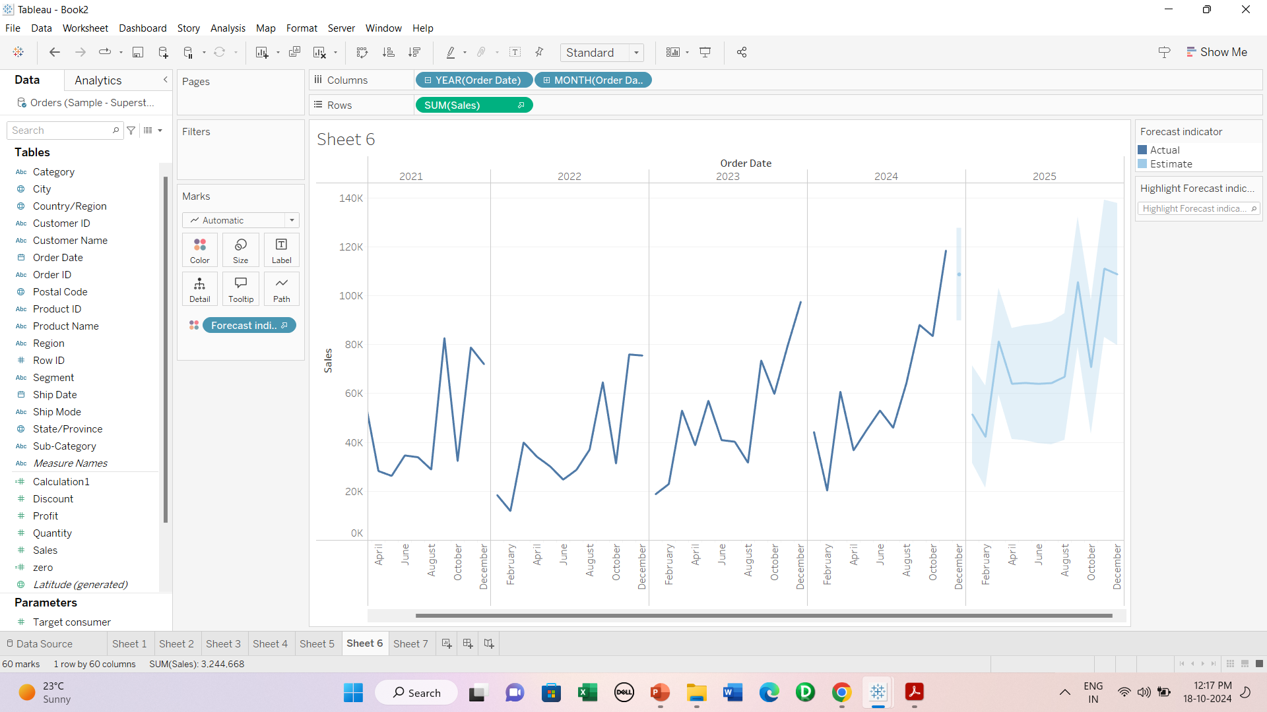
Forecast lines

Slide 6
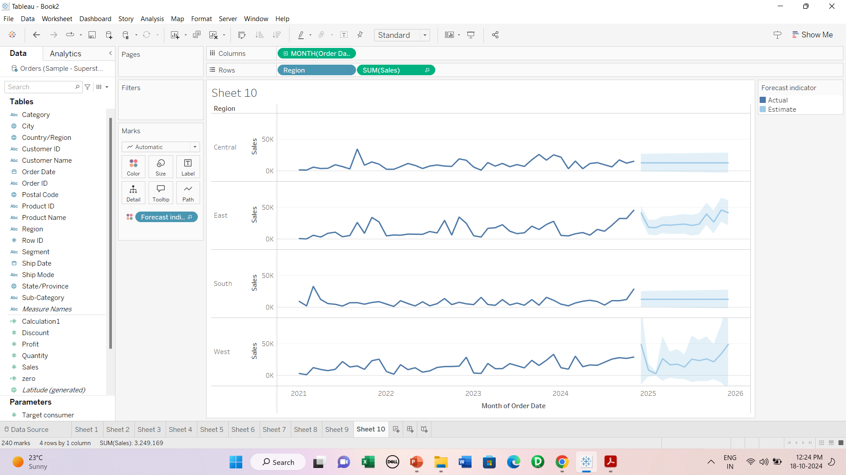
Region wise forecast

Slide 7
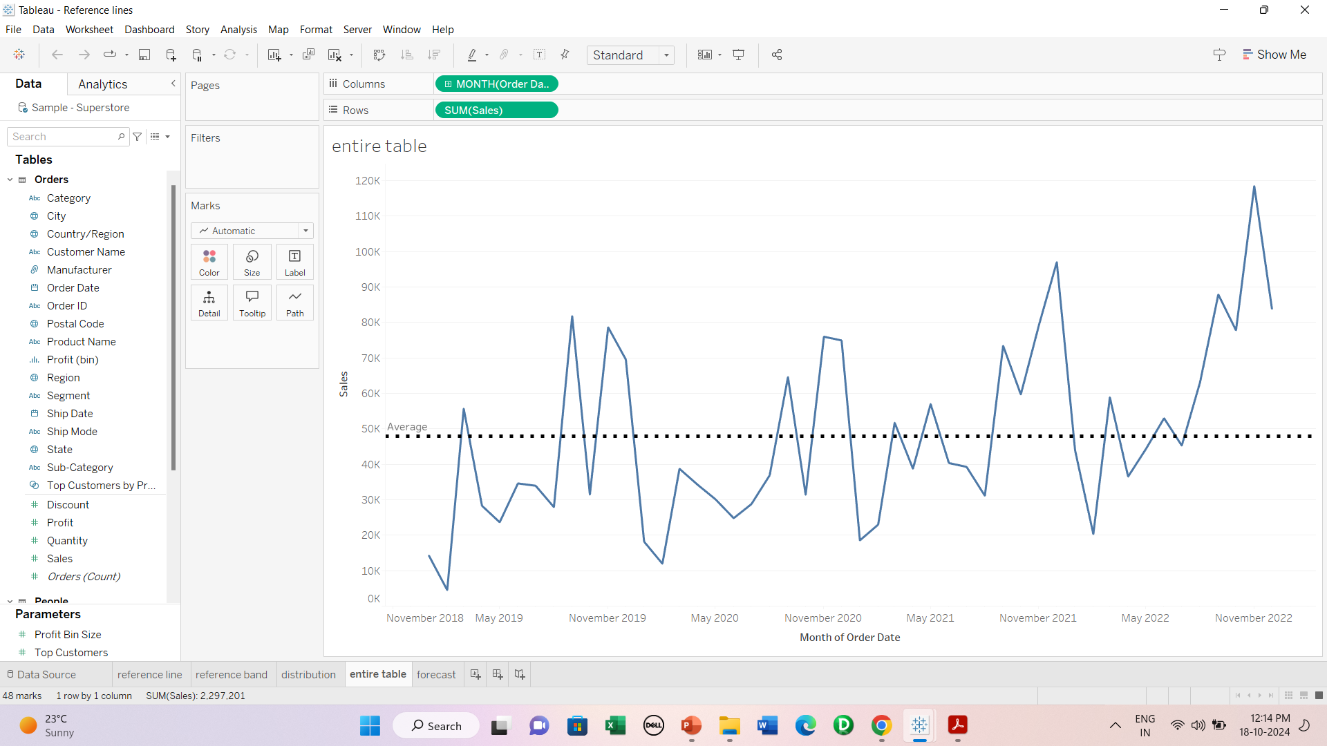
Reference Lines-1

Slide 8
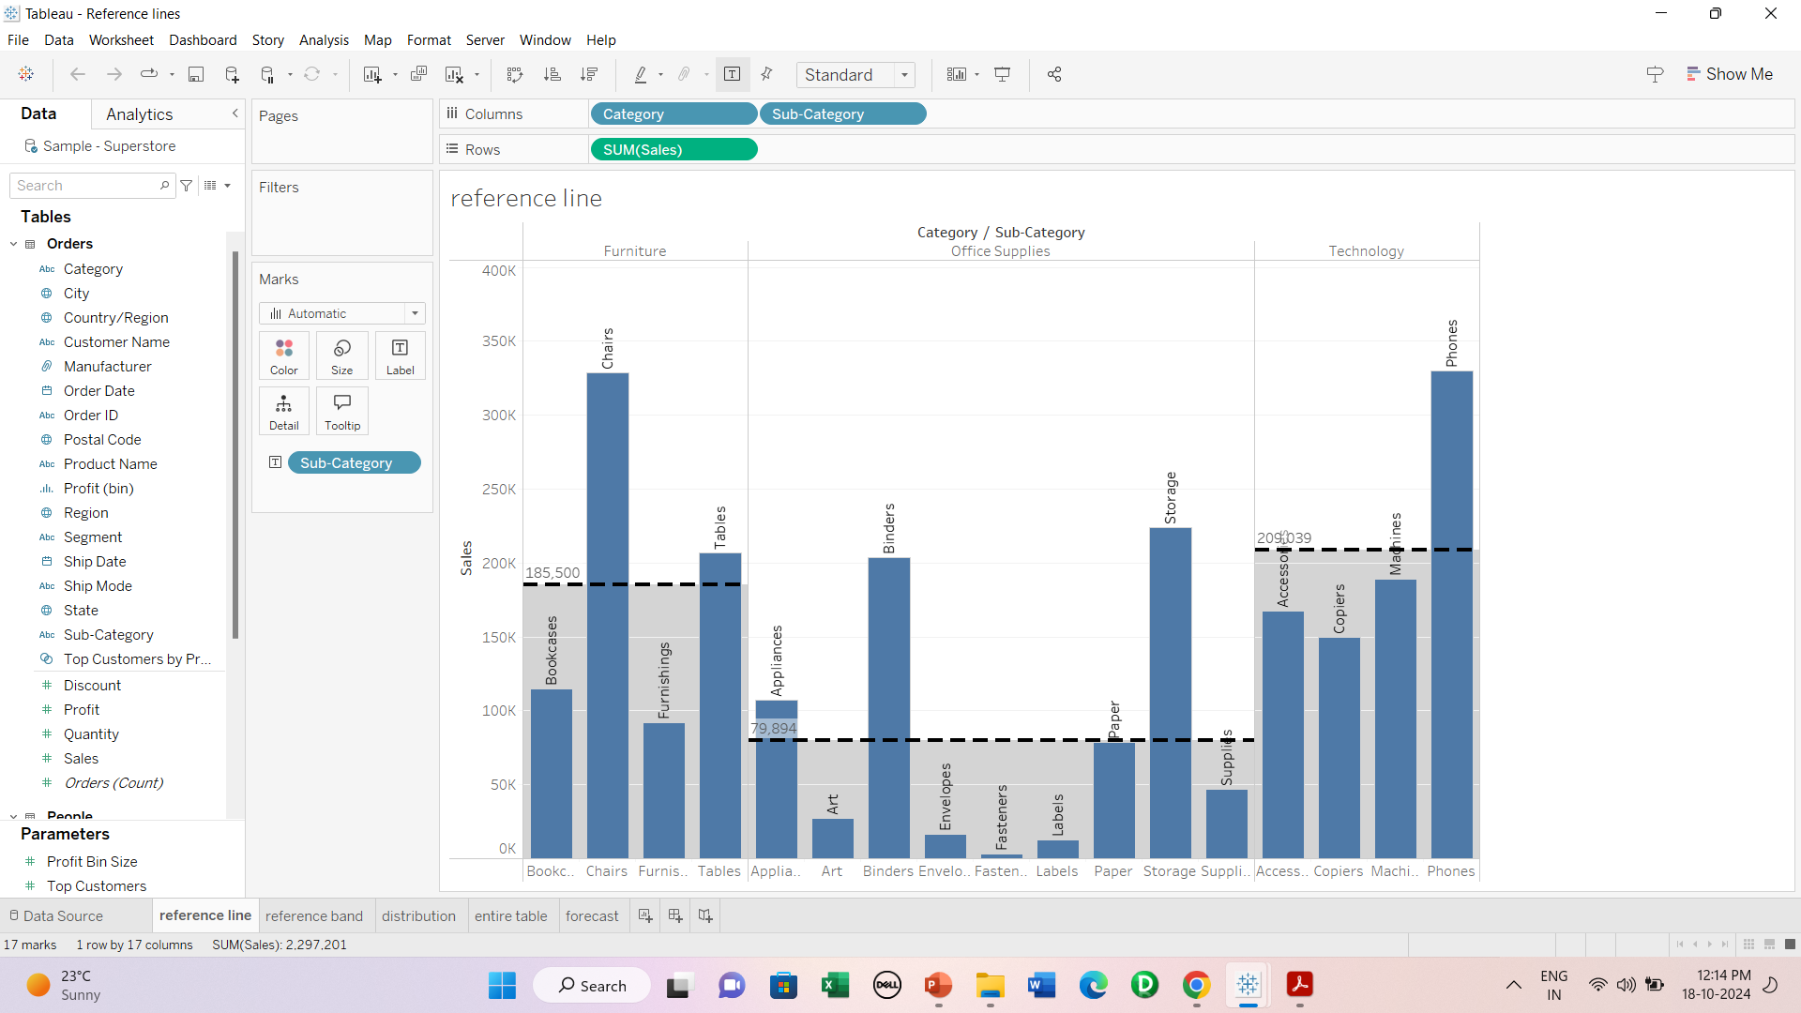
Reference Lines-2

Slide 9
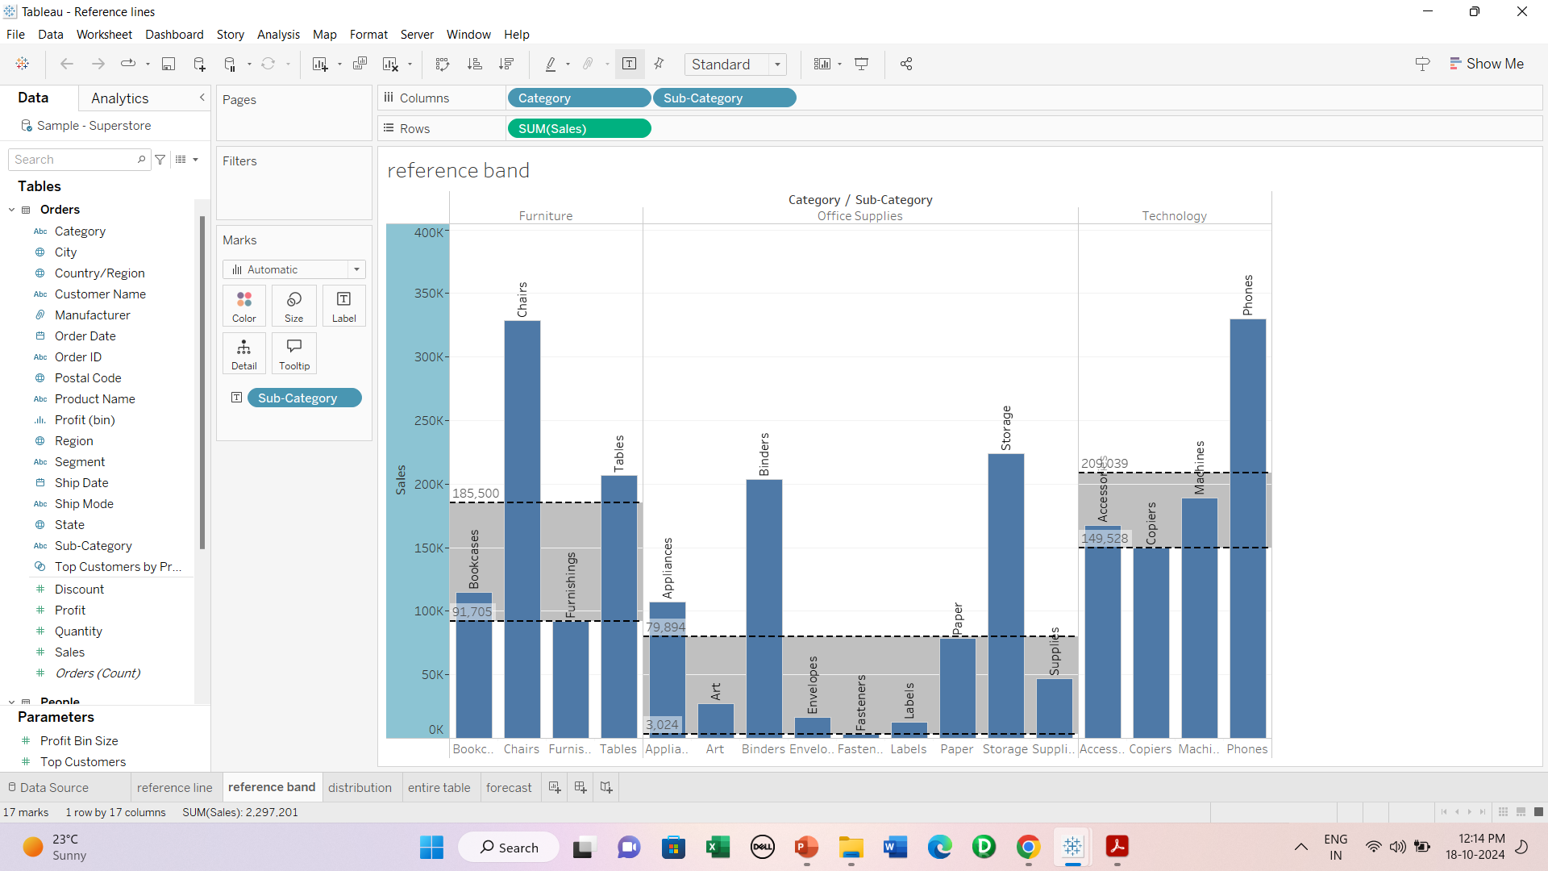
Reference Band

Slide 10
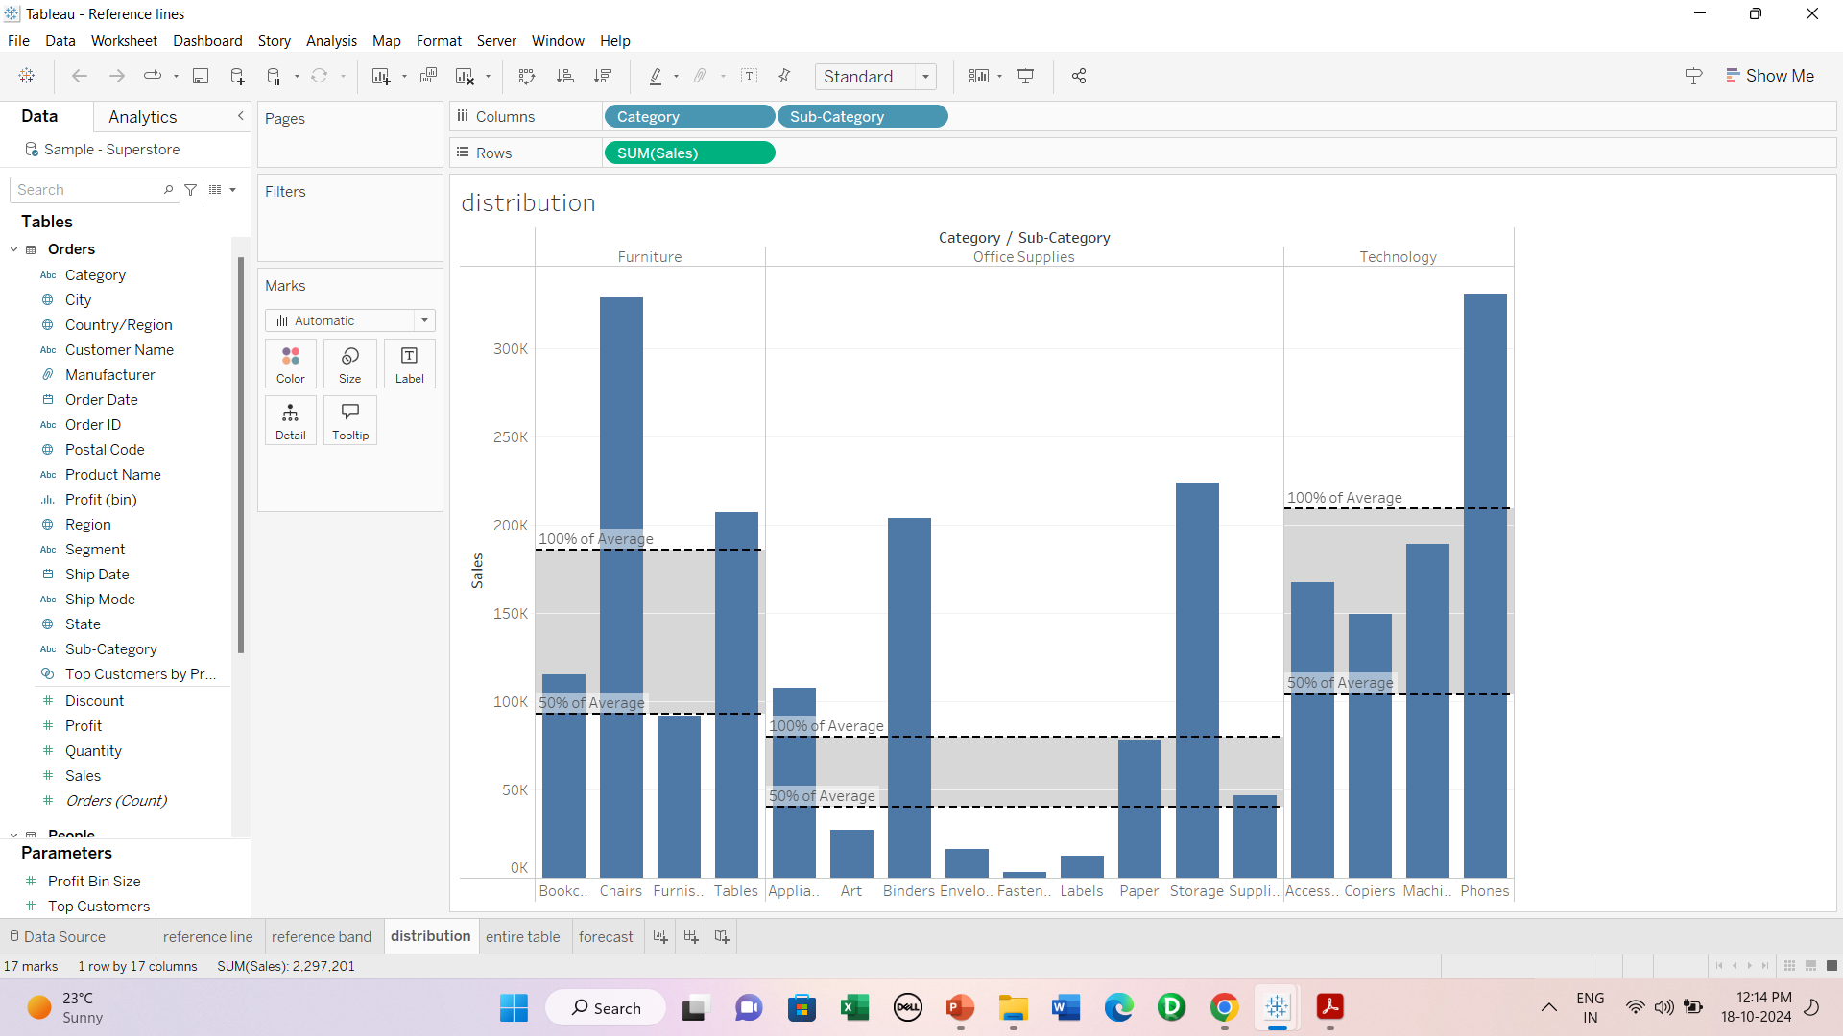
Reference Distribution

