Slide 1
Actions in Tableau
-Ashu Mehta
Database Systems

Slide 2
Actions
Used to add interactivity to worksheets and dashboards.
Available in Worksheet tab
Types of interaction
Hover
Select
Menu
Types of actions
Filter
Highlight
Go to URL
Go to sheet

Slide 3
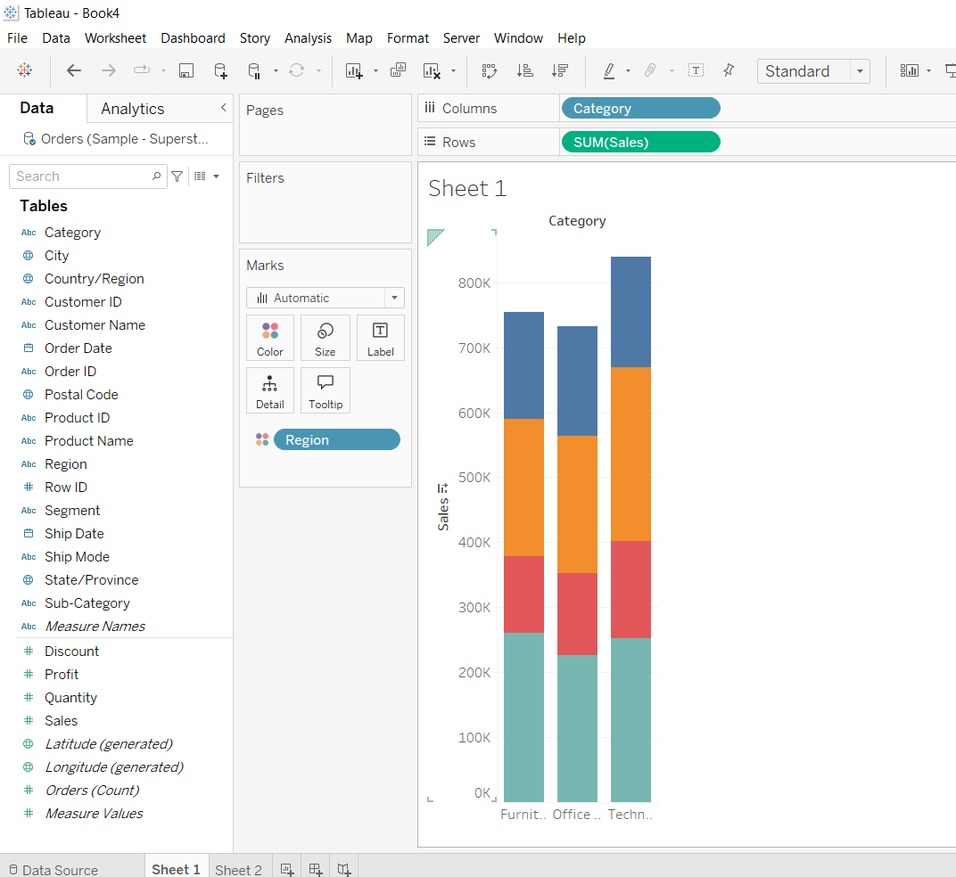
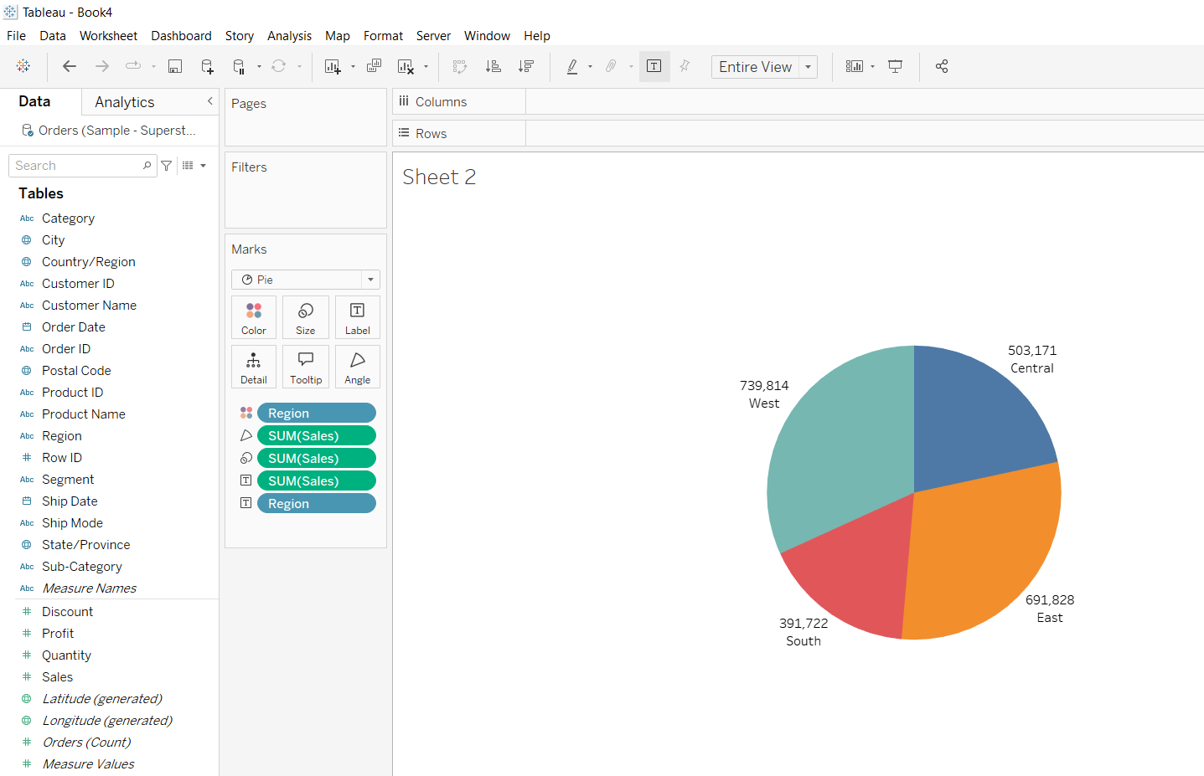
Go to sheet

Slide 4
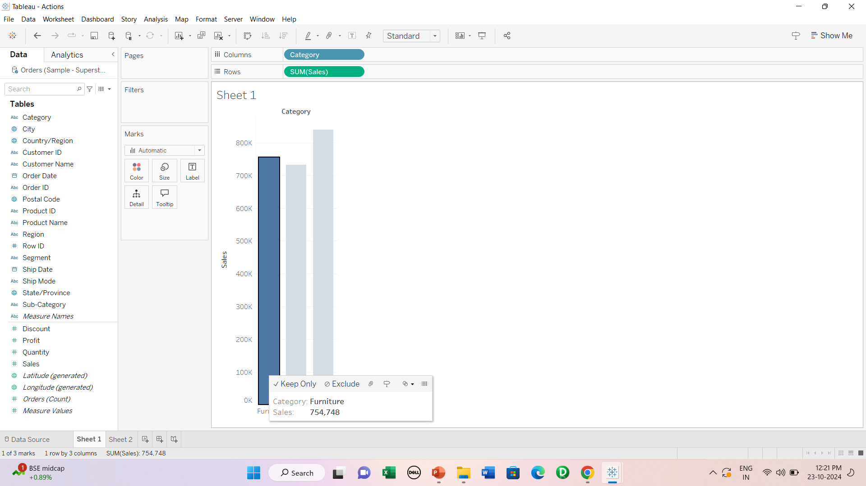
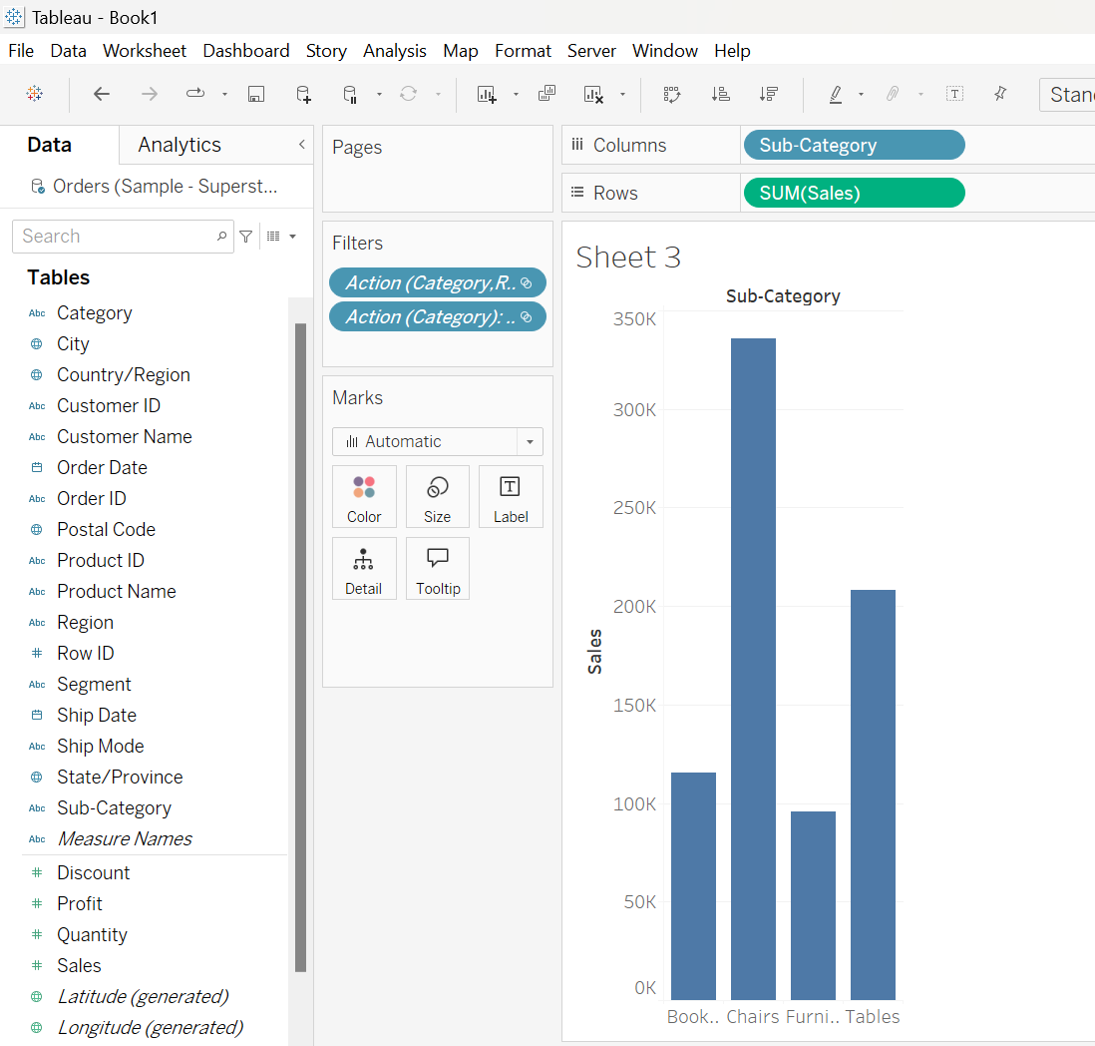
Filter

Slide 5
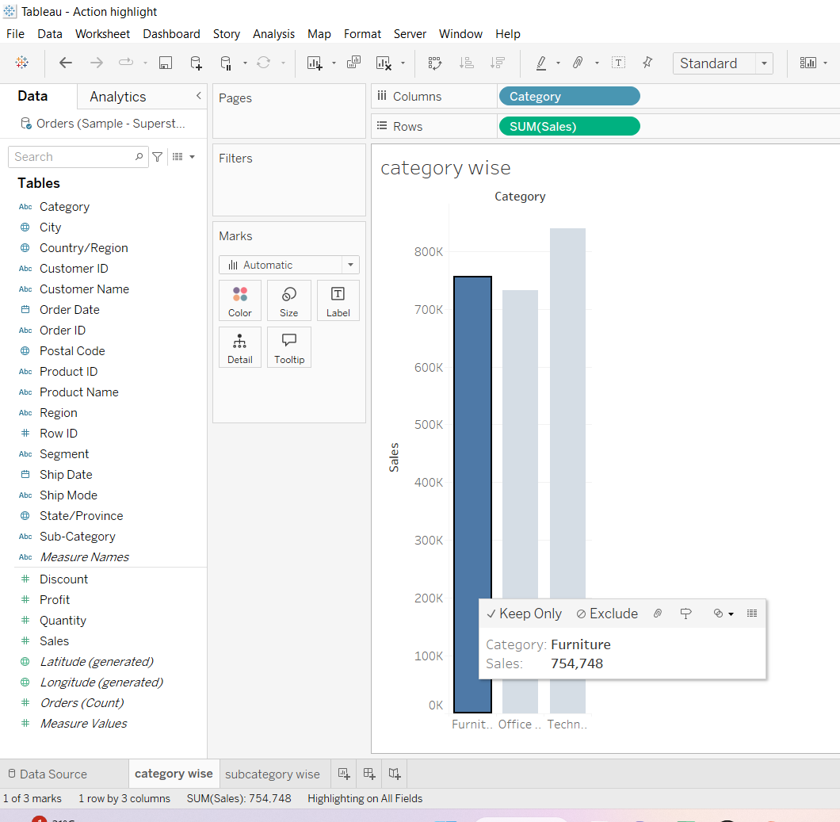
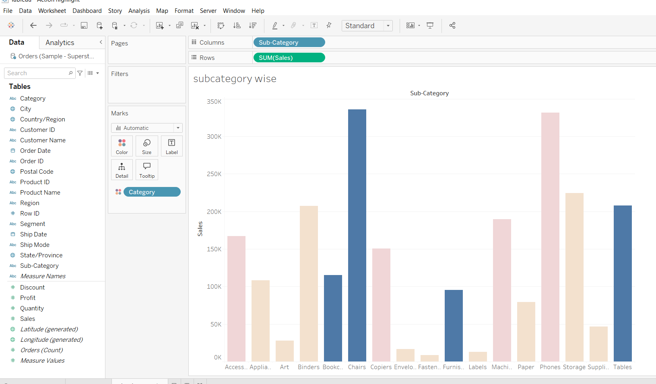
Highlight

Slide 6
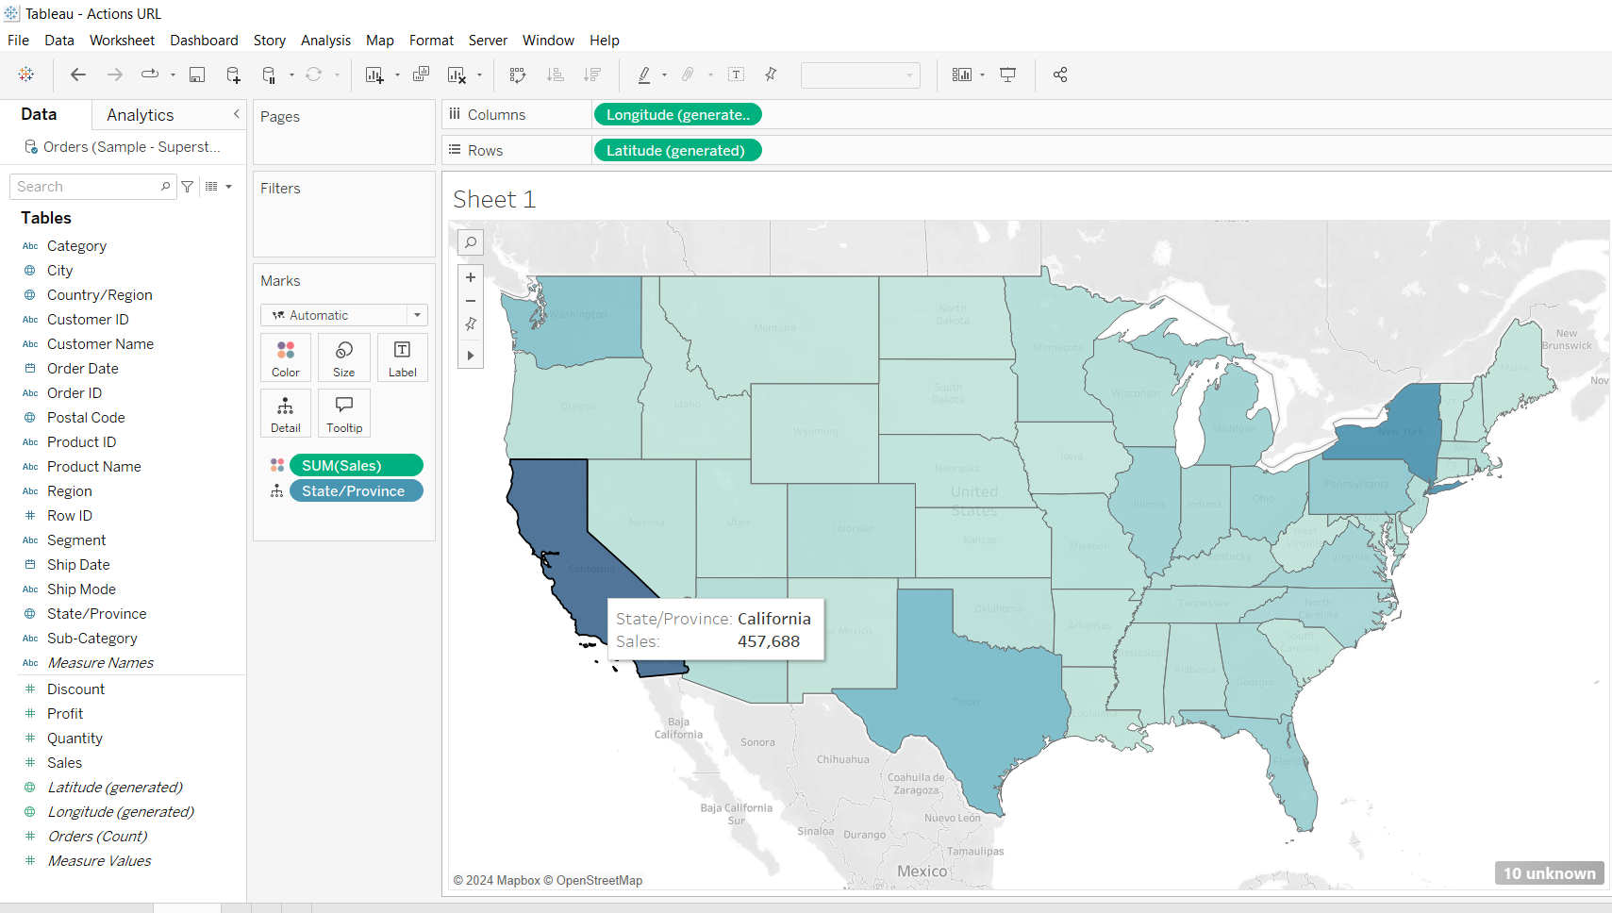
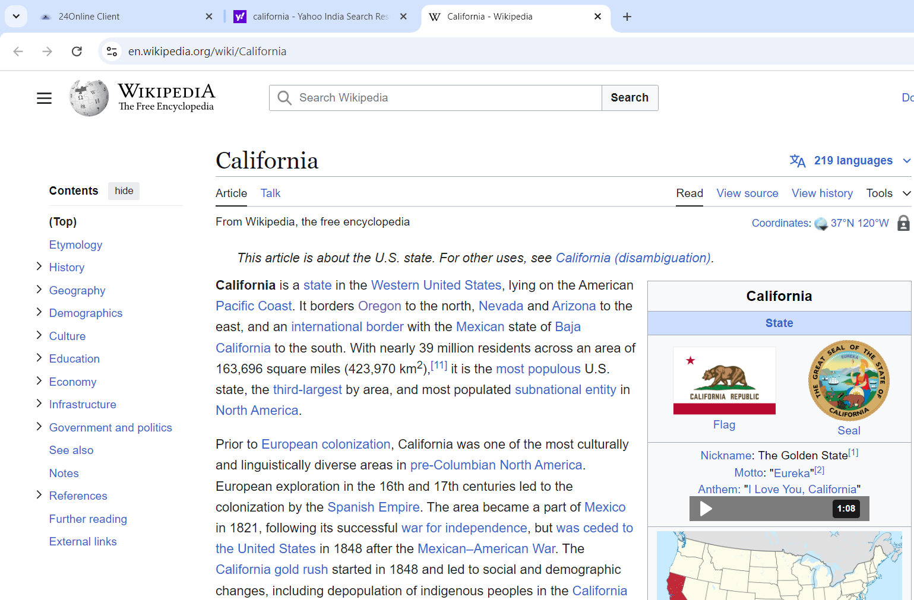
Go to URL

Slide 7
Dashboard
Creating dashboard
Applying filters and connecting filters to multiple sheets
Applying actions

Slide 8
Apply following actions
1. Click on a chart to go to a specific sheet.
2. Click on a mark in one chart to highlight it in another chart.
(eg- total vs urban population & region wise internet usage)
3. Click on a mark in one chart to apply a filter in another chart.
(eg- total vs urban population & mobile phone usage ranks according to region)
4. Click on a mark to open a URL in the browser/dashboard.

