Slide 1



Waste Classification Using CNN Model

Slide 2

Learning Objectives :
Comprehend the role of AI in sustainable waste management.
Explore CNN architectures for high-precision image classification.
Gain hands-on experience in data preprocessing, augmentation, and deep learning model training.
Enhance skills in TensorFlow/PyTorch for AI-driven waste sorting.
Develop deployment strategies for real-time waste classification applications.
GOAL
Source :
www.freepik.com/

Slide 3
Tools and Technology used :
Programming & Frameworks
Python – Primary programming language for model development.
TensorFlow & Keras / PyTorch – Deep learning frameworks for training CNN models.
OpenCV – Used for image processing and augmentation.
Data & Computational Tools
Dataset – Public datasets like TrashNet, TACO dataset, or custom datasets.
Jupyter Notebook / Google Colab – Development environments for model training.
NumPy, Pandas & Matplotlib – For data manipulation and visualization.
Cloud Platforms (Optional) – AWS, Google Cloud, or Firebase for model deployment.

Slide 4
Methodology :
Dataset:
Describe the dataset used for training and testing. Mention the source, size, and classes of waste. Show examples of images from the dataset. (Important: Address any data augmentation techniques used).
CNN Architecture:
Detail the architecture of your CNN model. If using transfer learning, specify the pre-trained model and any modifications. If a custom CNN, describe the layers (convolutional, pooling, fully connected), activation functions, and any regularization techniques (dropout, L2 regularization). A simple architecture diagram is helpful here.
Training Process:
Explain the training process. Mention the optimizer (Adam, SGD), loss function (categorical cross-entropy), batch size, number of epochs, and any early stopping criteria.
Evaluation Metrics:
Describe the metrics used to evaluate the model's performance (accuracy, precision, recall, F1-score, confusion matrix).

Slide 5
Problem Statement:
Waste mismanagement is a critical global challenge leading to severe environmental pollution, inefficient recycling, and increased landfill accumulation. Traditional waste classification heavily relies on manual sorting, which is time-consuming, expensive, and prone to human errors.
The increasing volume of urban waste demands an automated and intelligent waste classification system to efficiently categorize waste into recyclable and non-recyclable materials. An AI-driven solution can significantly enhance waste segregation, optimize recycling processes, and promote sustainable waste management.
Thus, an AI-based waste classification system using CNN (Convolutional Neural Networks) is essential to provide fast, accurate, and automated waste identification, enabling efficient recycling and eco-friendly waste disposal.

Slide 6
Solution:
How the Solution Works
Step 1: Data Collection & Processing
Collect images from public datasets (TrashNet, TACO) and real-world waste sources.
Preprocess images (resizing, normalization, augmentation) for better feature extraction.
Step 2: CNN Model Development
Implement a deep CNN architecture with convolutional layers to extract features from waste images.
Use pre-trained models like VGG16, ResNet, or MobileNet to improve accuracy.
Apply techniques like batch normalization and dropout to optimize performance.
Step 3: Model Training & Optimization
Train the model using categorical cross-entropy loss function and Adam optimizer.
Perform hyperparameter tuning (learning rate, batch size, number of layers) for better accuracy.

Slide 7
Step 4: Model Testing & Evaluation
Validate on a test dataset to measure accuracy, precision, recall, and F1-score.
Analyze misclassification cases using a confusion matrix.
Step 5: Deployment & Integration
Deploy the trained model using Flask API, FastAPI, or TensorFlow Lite.
Integrate into smart waste bins, recycling plants, or municipal waste management systems.
Enable real-time waste classification via mobile or web applications.
Impact of the Solution
🔹 Enhances waste segregation accuracy and efficiency. 🔹 Reduces human intervention, minimizing labor costs and errors. 🔹 Promotes recycling, ensuring proper disposal of waste materials. 🔹 Scalable for large-scale waste management systems. 🔹 Real-time classification makes smart waste disposal practical and sustainable

Slide 8
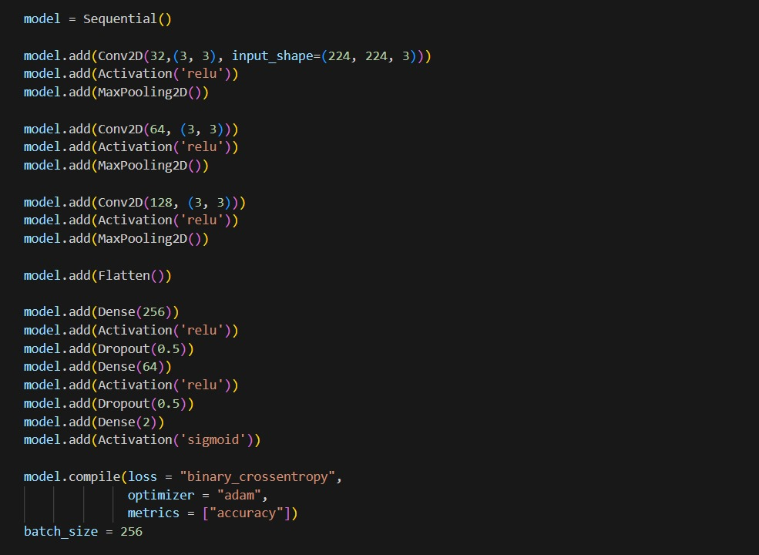
Screenshot of Output:

Slide 9
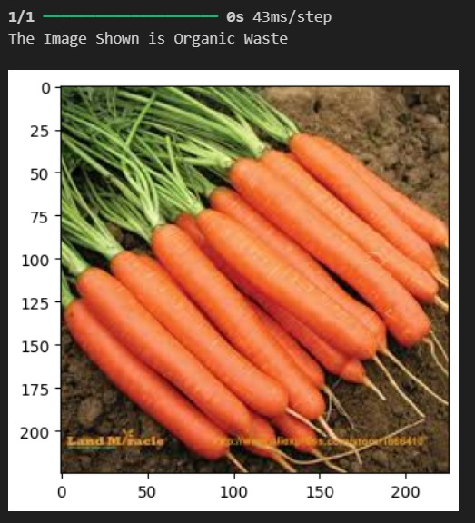

Screenshot of Output:

Slide 10
Conclusion:
The Waste Classification Using CNN Model presents an innovative, AI-driven approach to addressing waste management challenges. By automating waste classification, this system enhances recycling efficiency, reduces human labor, and promotes environmental sustainability.
The project highlights the transformative power of deep learning in solving real-world problems, paving the way for future advancements in AI-driven waste management systems.
Further improvements can include real-time IoT integration, enhanced dataset diversity, and the use of edge AI for faster on-device classification, making this solution even more robust and scalable.

Slide 11
THANK YOU

