Slide 1

Sensitivity of Streamflow parameters
RISHITHA BIKKUMALLA
PhD Student, Civil Engineering

Slide 2
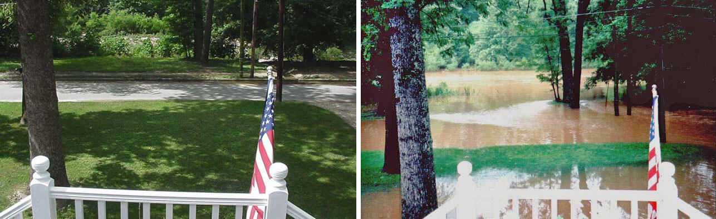
INTRODUCTION
Streamflow or discharge: Amount of water in a stream or river.
Streamflow data is used in water storage facilities, forecasting and predicting floods, managing reservoirs, etc.
The main influence on streamflow is rainfall runoff.
Streamflow can be affected by many parameters.
        Watershed characteristics
        Climate Conditions
        Etc
Here, we predict the streamflow by changing various parameters through hydrologic modelling (HEC-HMS) and compare them with the observed streamflow.
Low flow/high flow at Peachtree Creek at Atlanta, Ga. (USGS 02336300)

Slide 3
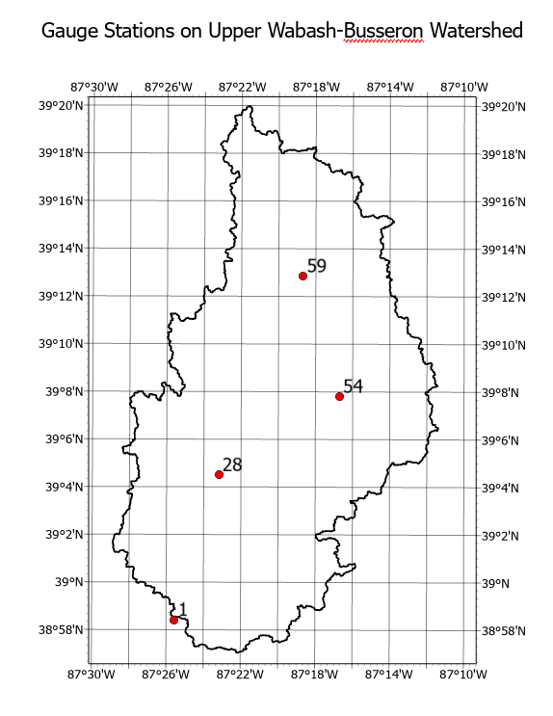
Data Source
1) Observed Daily Streamflow data:
Link: https://waterdata.usgs.gov/nwis/sw
Streamflow Nodes | Site Number | Guage Station Name | Longitude | Latitude
1 | 03342500 | BUSSERON CREEK NEAR CARLISLE, IN | -87.4258 | 38.9742
28 | 03342300 | BUSSERON CR NR SULLIVAN IN | -87.3864 | 39.0758
54 | 03342219 | BIG BRANCH TRIB 4.4 MILES NE OF DUGGER, IN | -87.2783 | 39.1308
59 | 03342100 | BUSSERON CREEK NEAR HYMERA, IN | -87.3114 | 39.215
Daily streamflow data is sourced from USGS for 1964-2003. But, only the interested timeframe, 1980-1982 is studied.
Format: Space delimited in .txt
Upper Wabash-Busseron watershed, HUC 0512011115, with 4 different streamflow nodes.

Slide 4
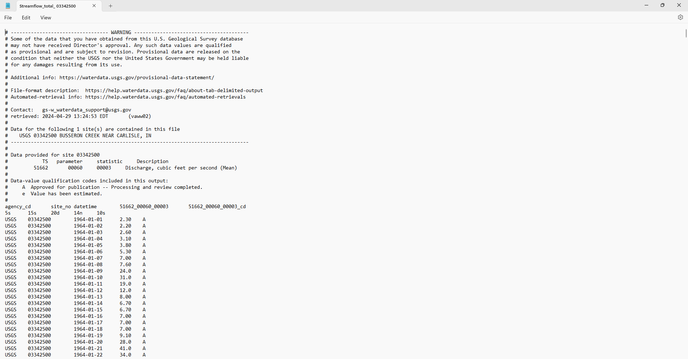
Fig: Screenshot of the text file containing all the streamflow data

Slide 5
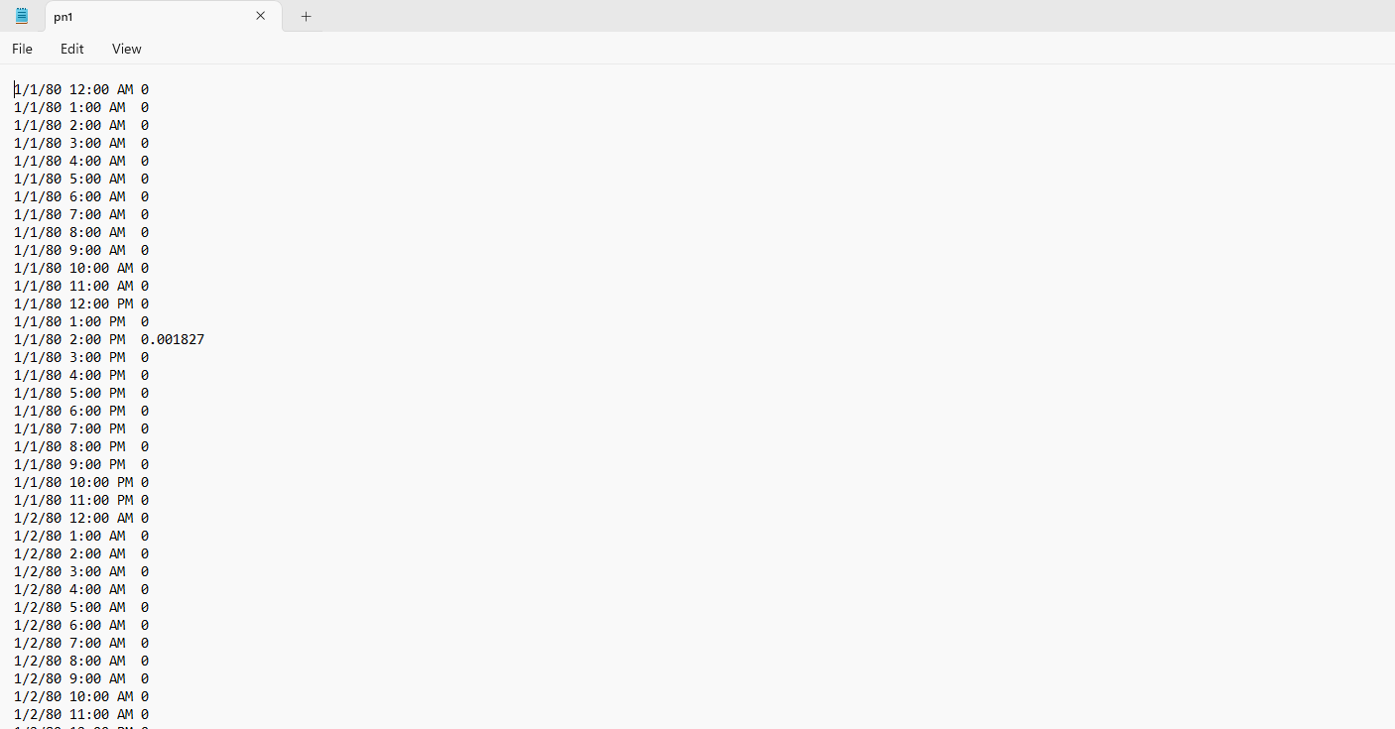
2) Hourly Precipitation Data:
- This was readily available to me in a text format from 1/1/80 12:00 AM to 12/31/82 12:00 AM.
- This was originally extracted from the NASA Land Data Assimilation System.
Link: https://ldas.gsfc.nasa.gov/nldas/v2/forcing
Screenshot of the text file containing all the precipitation data

Slide 6

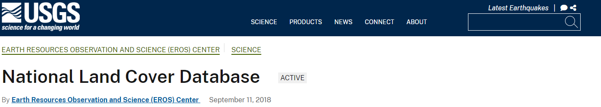
3) Predicted Daily Streamflow Data
4) Other Datasets:
i) DEM (Digital Elevation Model) - NAD 1983 UTM Zone 16N DEM over the Wabash River in .tif format.
ii) Soil Data from SSURGO - Geodatabase(.gdb) file, which contains soil type and other details.
iii) LULC (Landuse Land Cover Data) - .tif file
Link: https://earthexplorer.usgs.gov/
All these datasets were used
as inputs into
HEC-HMS.
Link: https://www.nrcs.usda.gov/resources/data-and-reports/soil-survey-geographic-database-ssurgo
Link: https://www.usgs.gov/centers/eros/science/national-land-cover-database

Slide 7
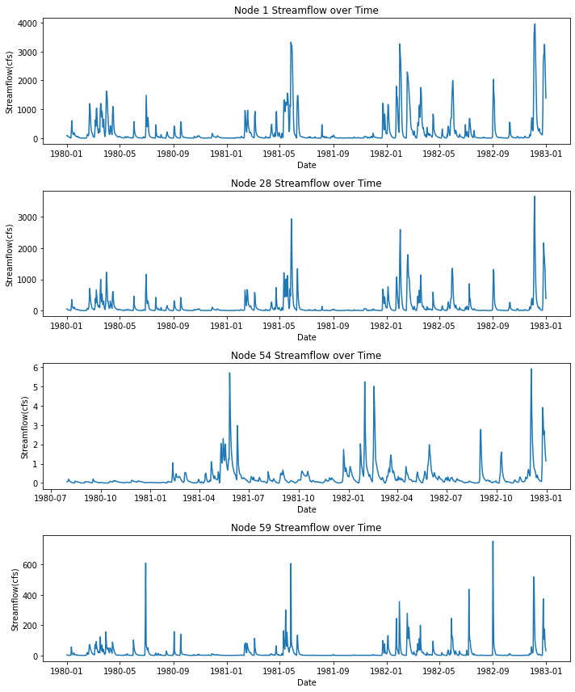
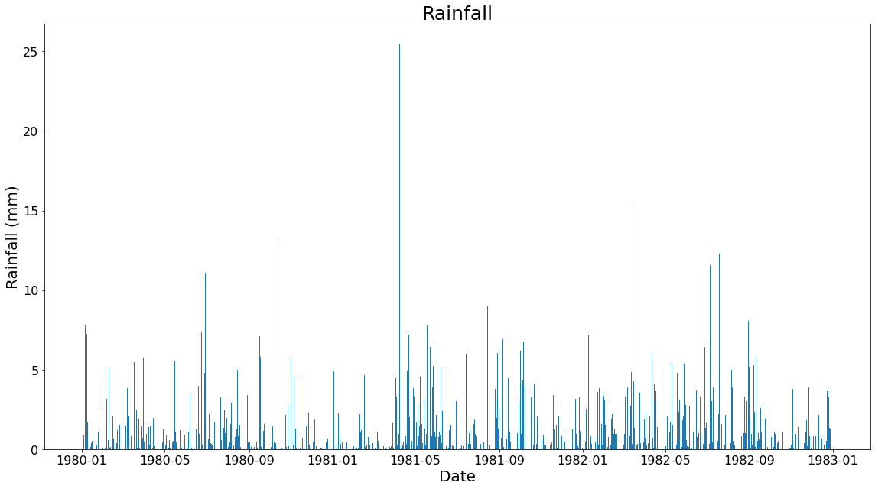
Graphical Data Analysis
Streamflow of 4 gauge stations of Upper Wabash watershed for 3 years.
Rainfall for 3 years is shown in the plot.

Slide 8
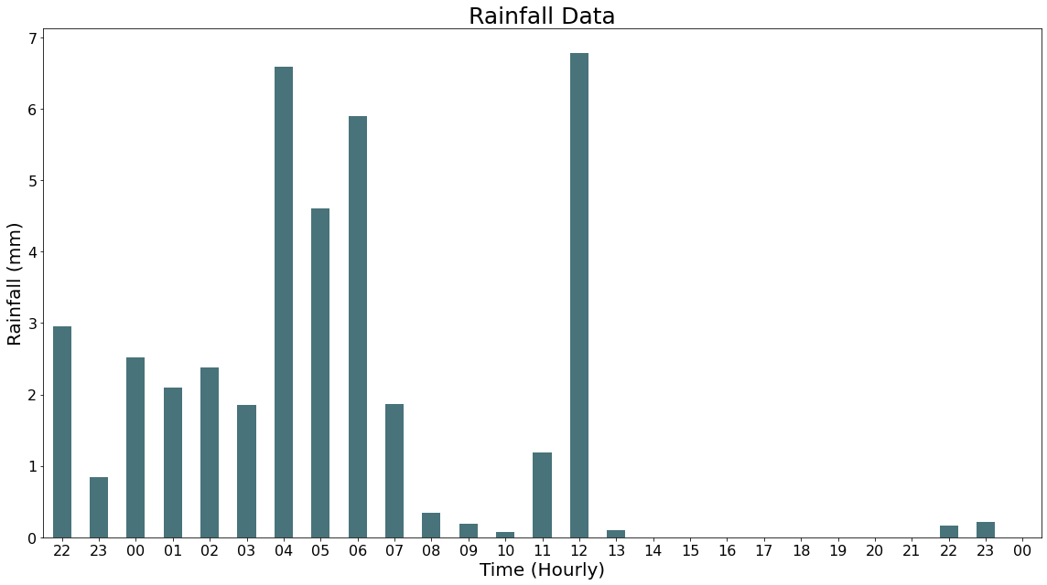
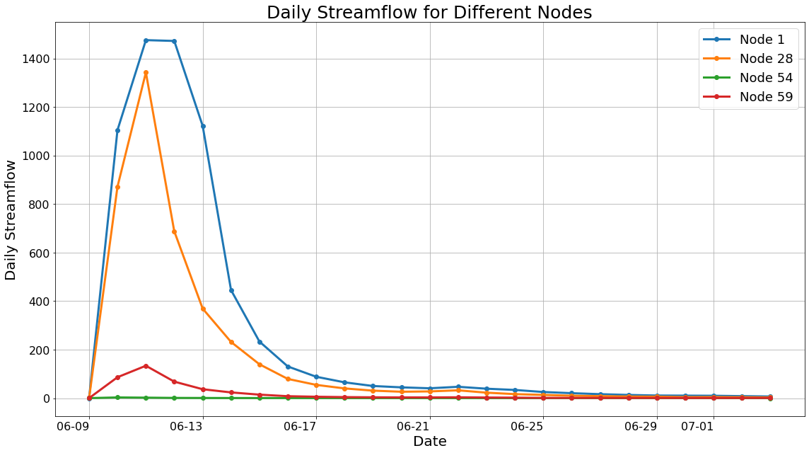
Rainfall Event: 06/09/1981_22:00 to 06/11/1981_00:00,
Corresponding Streamflow: 6/1/1966 to 9/30/2003
27-hour, hourly rainfall of the watershed
It can be observed that only first 16 hours had significant rainfall
21-day Streamflow of The Upper Wabash - Busseron Watershed for all nodes corresponding to the rainfall event.
Very small streamflow of Node 54

Slide 9
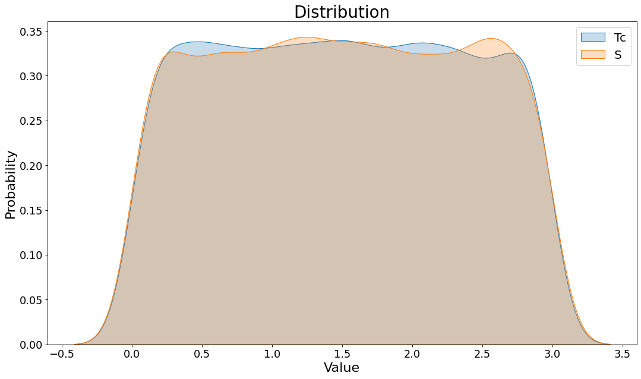
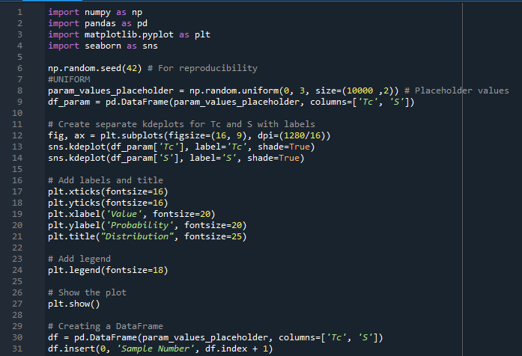
Prediction of Daily Streamflow Data
Two parameters, Time of Concentration (Tc) and Storage Coefficient(S), were considered to predict the streamflow in HEC- HMS.
1000 Samples of Tc and S were used.
KDE plot of 1000 samples of Tc and S.
These values were generated from a uniform distribution, which is visible from the KDE plot.
The uniform distribution is not perfect due to the small sample size.

Slide 10
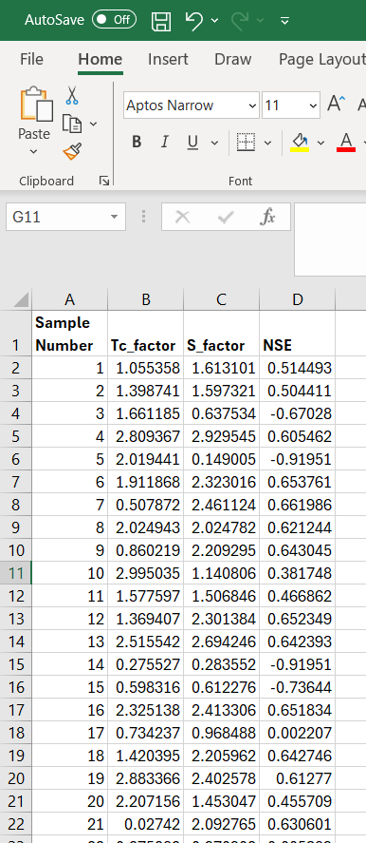
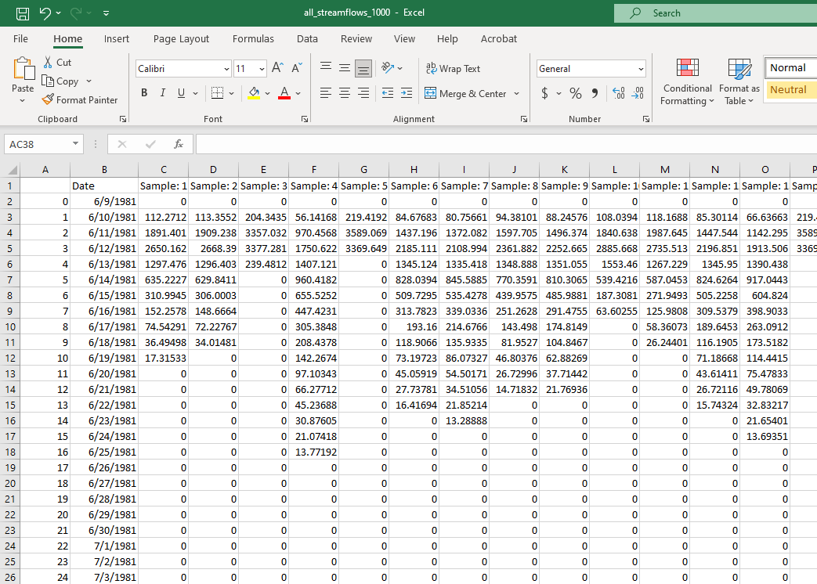
Prediction of Daily Streamflow Data
i) NSE corresponding to each prediction
ii) Streamflows from all simulations
Screenshot of the CSV file containing all the simulated data
Screenshot of the CSV file containing the
parameters and NSE corresponding to the simulation.
NSE: Nash–Sutcliffe efficiency is a performance metric

Slide 11
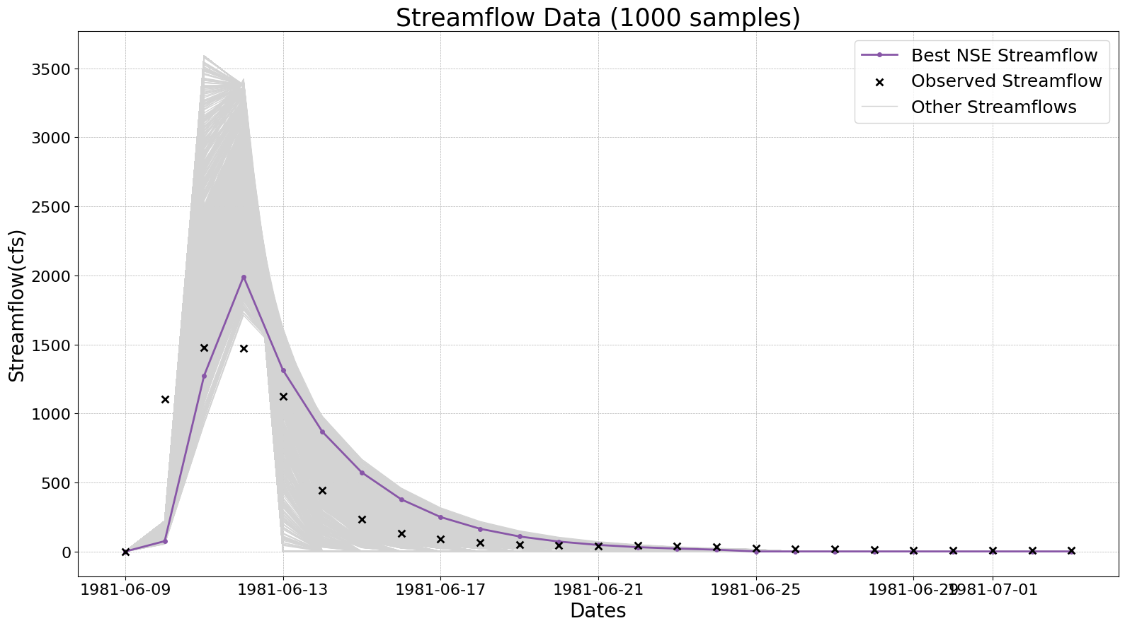
Understanding predicted vs observed Streamflow at Node1:
The purple colored line corresponds to the streamflow of the highest NSE of 0.667
The grey lines are the other 999 streamflow simulations
The black x’s correspond to the observed streamflow values.
It can be observed that the 2nd predicted value is never predicted well.

Slide 12
Data Quality Checking
Streamflow Data:
  Null Values Check
  Gross Error Check (Streamflow should lie between 0 to 5000cfs)
  Maximum streamflow of each node should be greater than 100cfs
2) Rainfall Data:
1) Null Values Check
2) Gross Error Check (Precipitation should lie between 0 to 100 mm)
3) Predicted Data:
1) Null Values Check
2) Tc and S should lie between 0 and 3
3) Predicted Streamflow should be positive

Slide 13
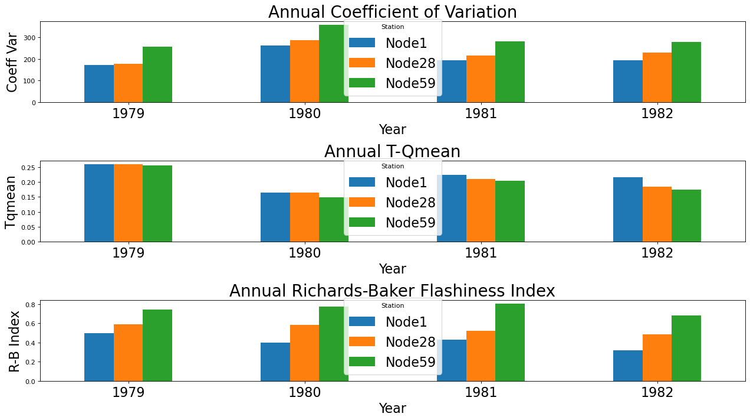
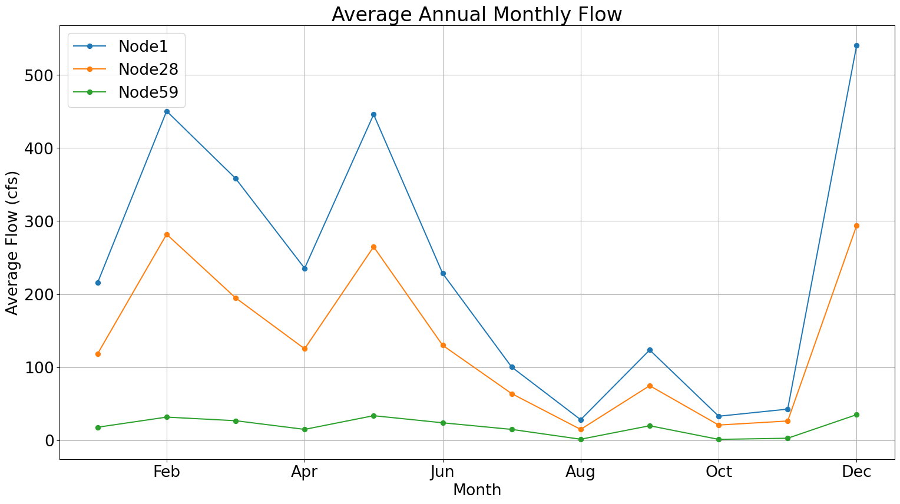
Statistics and Metrics
Annual Coefficient of Variation: A statistical measure of the dispersion of data points in a data series around the mean. The coefficient of variation appears to fluctuate from year to year for each location, with no clear trend of increase or decrease over the four years.
Annual T-Q Mean: The fraction of time (days) that streamflow exceeds the mean annual streamflow (Qmean). Higher for 1979 because water year consists of data from 1980 and no data from 1979
Annual Richards-Baker Flashiness Index: Measures the rapid changes in streamflow. Node 59 has a higher index, which indicates more rapid changes, which can be indicative of flash floods or other rapid runoff events.

Slide 14
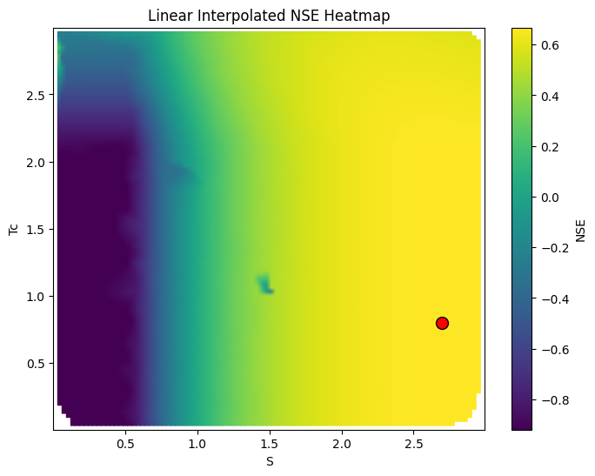
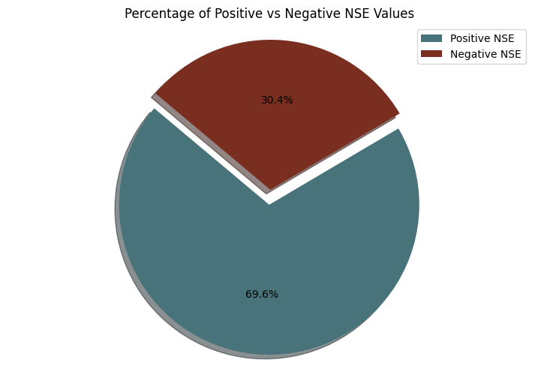
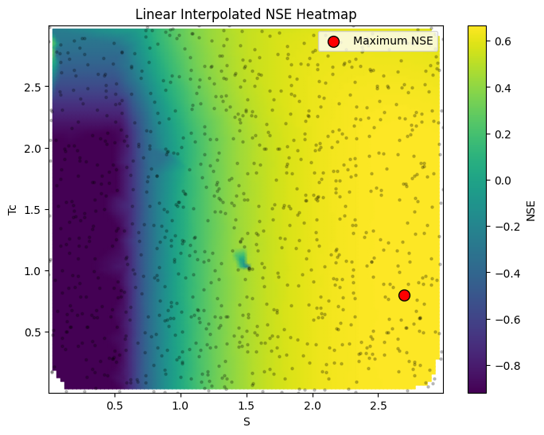
Statistics and Metrics
Maximum NSE: 0.667 at Tc = 0.79, S = 2.69.
At the blue gradient regions (Regions where S<0.75), the NSE is negative.
As the gradient slowly changes towards blue, the NSE values increase.
The black dots are the sample points.
The gradient variation is almost the same for a fixed Tc value, hence it is less sensitive.
From the 1000 samples, 696 sets of Tc and S resulted in a positive NSE value, whereas 304 of them resulted in a negative NSE.
It means that most of the sample pairs correspond to positive NSE

Slide 15
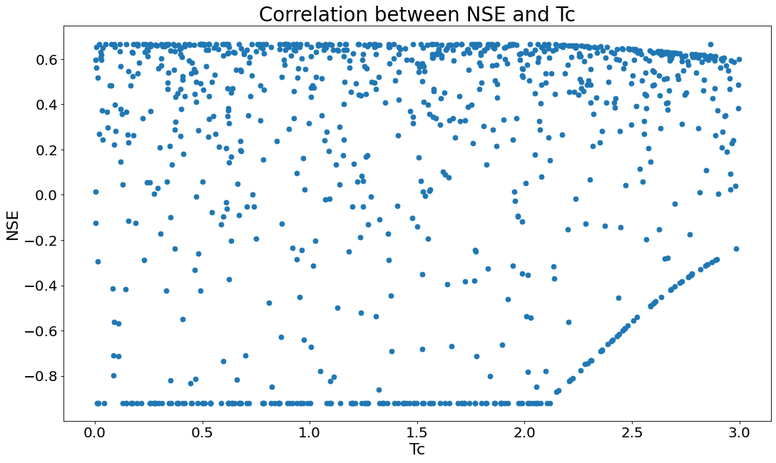
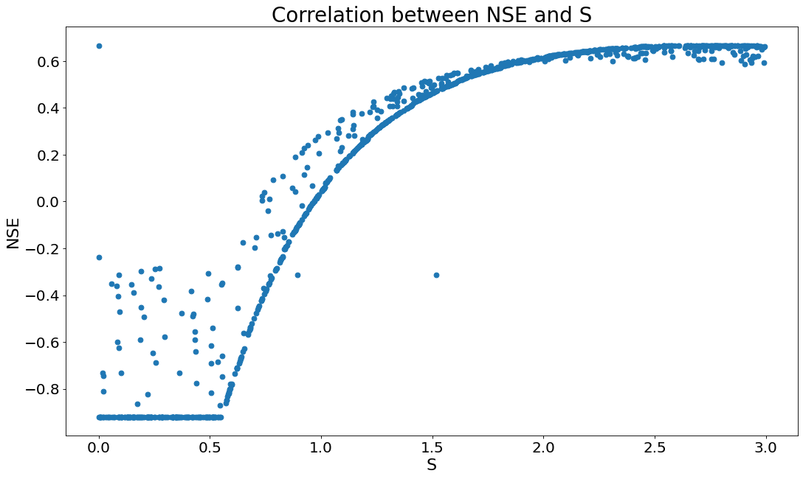
Statistics and Metrics
Correlation between NSE and Tc.
Tc is not very sensitive. It has a wide range of NSE values when varied.
Correlation between NSE and S.
S is very sensitive. As S increases, NSE also increases almost exponentially.

Slide 16
CONCLUSION
- The research aimed to predict streamflow using the (HEC-HMS) and to compare the predictions with observed streamflow data.
- Through graphical data analysis, it was determined that among the Upper Wabash-Busseron watershed nodes, nodes 1, 28, and 59 had significant streamflow, while node 54, a small tributary, had less streamflow.
- In the data quality checking process, checks for null values, gross errors, and range validations were performed on the streamflow, rainfall, and predicted data to ensure the integrity of the analysis.
- The maximum Nash-Sutcliffe efficiency (NSE) value achieved was 0.667, indicating the model's predictive performance.
- Sensitivity analysis revealed that the Storage Coefficient (S) was very sensitive. In contrast, the Time of Concentration (Tc) was less sensitive.
- Understanding streamflow parameters is important as it helps us predict floods, plan water resources, and much more.
- This course helped me understand my data better and improved my Python skills to a great extent.

Slide 17
THANK YOU!

