Slide 1


Slide 2
TEAM MEMBERS
Aniket Kumar Singh
Saravanan Rishitha
Panidapu Hima Chandana
Lehimsha Shaik
Navuru Sai Saaketh

Slide 3

CONTENTS
Problem Statement
Project Architecture
Brief Introduction
Exploratory Data Analysis
Model Building
Model Deployment
Challenges
Dataset Details
Information Regarding Suggested Methods

Slide 4
1.PROBLEM STATEMENT
The goal of this project is to develop a Book Recommendation System that helps users discover new books based on their past preferences and similar users' preferences.
The system will use collaborative filtering methods to predict a user’s rating for books they haven’t interacted with and provide personalized book recommendations.

Slide 5
2. PROJECT ARCHITECTURE
​​DATASETS
Import libraries
Load datasets
DATA CLEANING
Handling missing values
Checking duplicates
EXPLORATORY DATA ANALYTICS
Histogram, Bar Graph, Boxplot
Outliers detection through Boxplot
MODEL SELECTION
DEPLOYEMENT

Slide 6
3. BRIEF INTRODUCTION
Recommendation systems are used to predict the preferences or ratings that users would give to an item.
They are essential in industries like e-commerce, online streaming, and social media to improve user engagement.
There are two primary types of recommendation systems.
Collaborative Filtering: Recommends items by identifying patterns based on user interactions.
Content-Based Filtering: Recommends items based on item metadata (e.g., genre, category).
Book recommendation systems are designed to solve this issue by filtering through the vast amount of available content and suggesting books that are relevant to individual users.

Slide 7
Focus on
This project will focus on Collaborative Filtering, using methods like User-User and Item-Item similarity, and Matrix Factorization.
Amount
With the overwhelming amount of literature available, it becomes challenging for readers to find books that suit their interests.

Slide 8
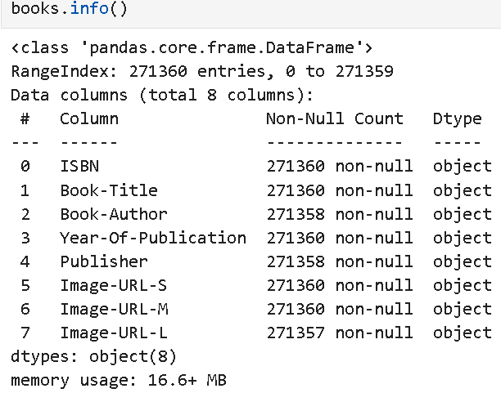
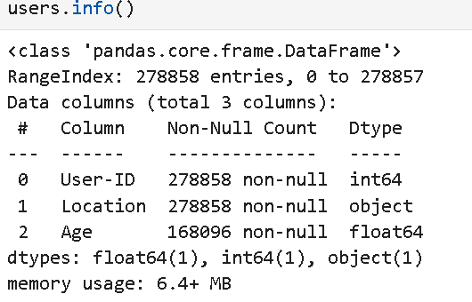
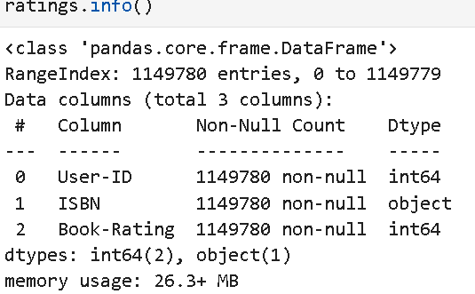
4. DATASETS DETAILS

Slide 9
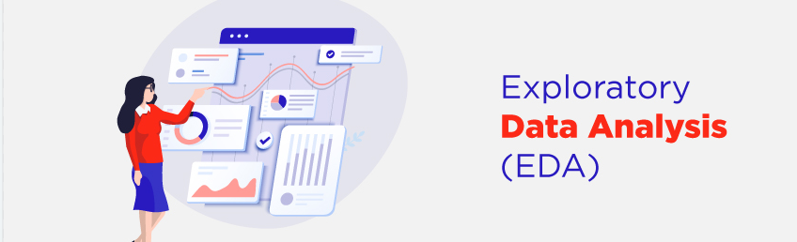
Exploratory Data Analysis (EDA) is a fundamental step in understanding the data before moving on to modeling. It ensures that the data is clean, relevant, and ready for model training.
Through descriptive statistics and visualization, EDA provides a solid foundation for identifying trends, patterns, and relationships that are essential for building a robust and accurate machine learning model.

Slide 10

Histograms: Show the distribution of a numerical variable.
Box Plots: Detect outliers and observe the spread of the data.
A bar chart is a graphical representation of data where the length or height of bars represents the values of categorical data. Bar charts are useful when you want to compare different categories.
A density plot is a graphical representation that shows the distribution of a dataset by estimating its probability density function.

Slide 11
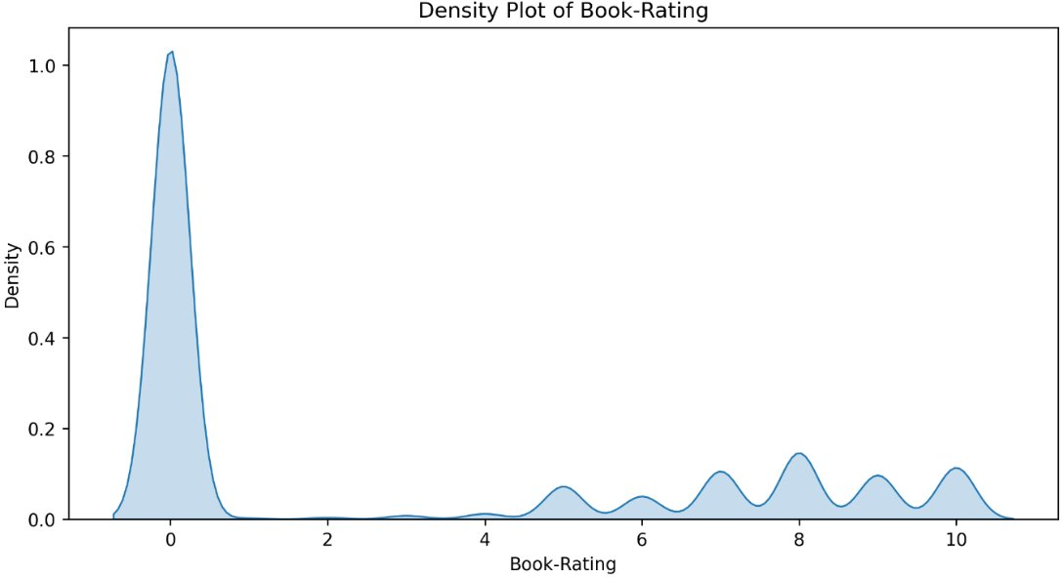

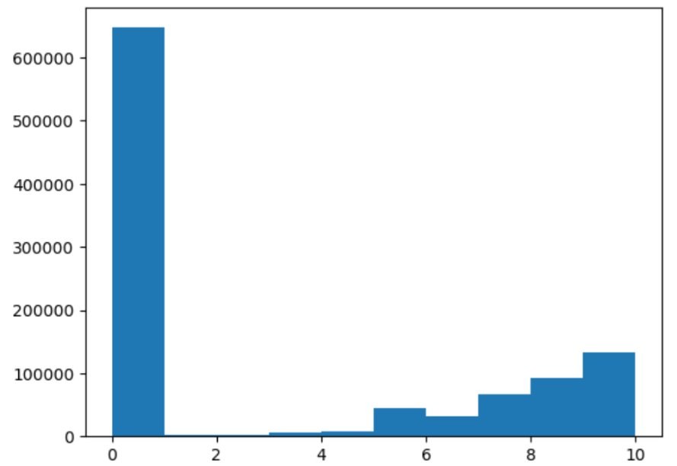
Histogram for Book-Rating

Slide 12

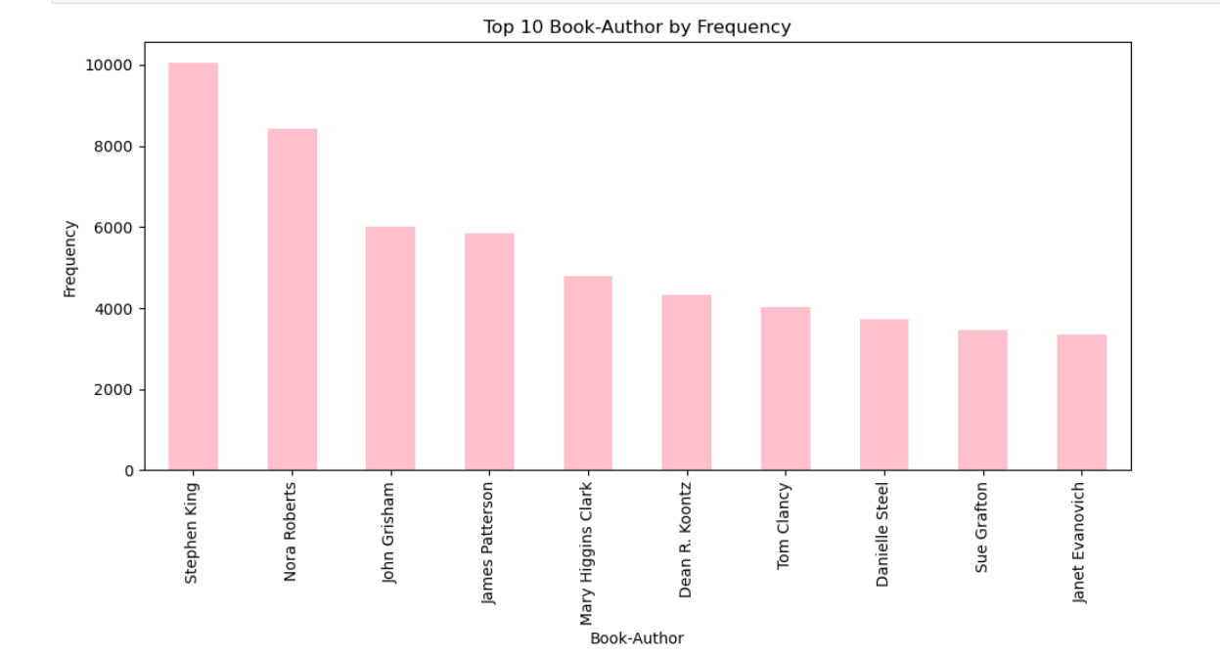
BAR GRAPH FOR TOP 10 CATEGORIES

Slide 13

6. MODEL BUILDING
Collaborative filtering is a recommendation technique that predicts a user's preferences by analyzing past interactions between users and items.
It assumes that users who have agreed on items in the past will agree on future items.

Slide 14

ADVANTAGES
No need for item metadata: Works solely on user interactions, making it suitable even without item-specific information.​
Effective for large datasets: Can uncover hidden patterns in large datasets by analyzing user behavior.​
Personalized recommendations: Provides tailored suggestions based on user preferences and interactions.

Slide 15
DRAWBACKS
Cold start issue: Has trouble making recommendations for new products to those who haven't interacted with them much or at all.
Data sparsity: Since many users only interact with a small portion of the items, sparse matrices may make it challenging to identify similarities.
Scalability: Computing similarities between users and products becomes increasingly computationally demanding as the dataset grows.

Slide 16
7. INFORMATION REGARDING SUGGESTED MODELS
The code is designed to recommend up to 5 books to a user based on the ratings given by similar users.
It first gathers the books rated by similar users, predicts how the target user might rate those books, and then selects the top 5 books to recommend.
The predictions are stored for evaluation against the actual ratings given by the similar users.
pt: A pivot table (likely user-item matrix) where rows are users, columns are books, and values are ratings.

Slide 17

Similarity scores:
An array of similarity scores (probably calculated using cosine similarity or Pearson correlation) between the target user and all other users.
RMSE (Root Mean Squared Error): Measures the square root of the average squared difference between predicted and actual ratings. Lower values indicate better predictions.
MAE (Mean Absolute Error): Measures the average absolute difference between predicted and actual ratings. Again, lower values are better.
Hyperparameter Tuning: You could test different numbers of similar users (e.g., 3, 5, 10) to see how it affects prediction accuracy.

Slide 18
8.MODEL DEPLOYMENT
Deployment is the process by which ML model is moved from an offline environment and integrated into an existing production environment, such as a live application.
Using Streamlit our project is deployed.
Streamlit is a powerful open-source framework which is used to create interactive web apps for data science and machine learning projects.

Slide 19
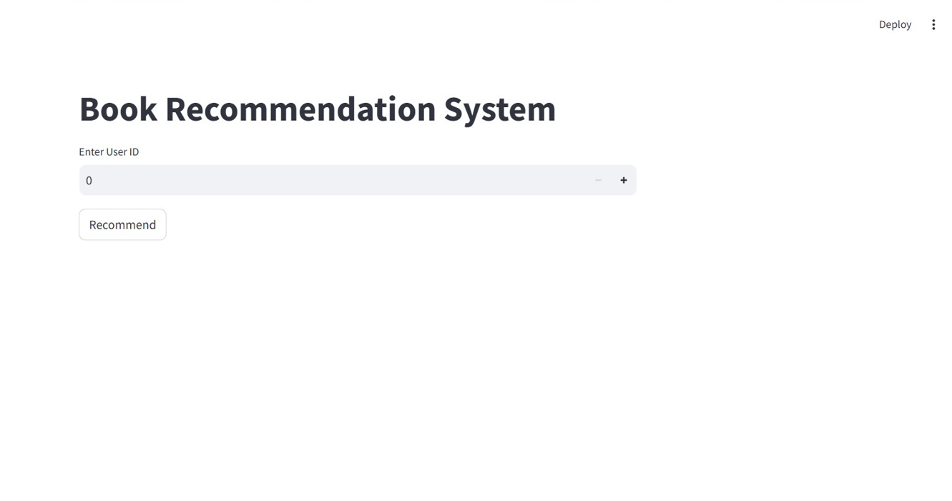

Slide 20



Slide 21

9. CHALLENGES
We first encountered issues with the data set, which consists of three sets with many interconnected columns.
Determines the link between variables in that pre-processed data.
EDA is an interesting part, but the selection of variables and make more effective visualization is a quite tough task.
We attempted putting the KNN algorithm into practice, but it is giving memory errors.

Slide 22

THANK YOU!

