Slide 1


Slide 2
BANKRUPTCY PREDICTION GROUP1

Slide 3
TEAM MEMBERS
Aniket Kumar Singh
Saravanan Rishitha
Panidapu Hima Chandana
Lehimsha Shaik
Navuru Sai Saaketh
Deepa B

Slide 4

CONTENTS
Problem Statement
Project Architecture
Brief Introduction
Exploratory Data Analysis
Model Building
Model Deployment
Challenges
Dataset Details

Slide 5
1.PROBLEM STATEMENT
Bankruptcy prediction is a critical task for businesses, financial institutions, and investors to assess the financial health and stability of companies.
Early identification of companies at risk of bankruptcy allows stakeholders to take preventive measures and mitigate financial losses.
The goal is to build a robust prediction system that helps classify companies as either "bankruptcy" or "non-bankruptcy" based on these variables.

Slide 6
2. PROJECT ARCHITECTURE
​​DATASETS
Import libraries
Load datasets
DATA CLEANING
Handling missing values
Checking duplicates
EXPLORATORY DATA ANALYTICS
Histogram, Bar Graph, Boxplot
Outliers detection through Boxplot
MODEL SELECTION
DEPLOYEMENT

Slide 7
3.BRIEF INTRODUCTION
The ability to predict corporate bankruptcy is crucial in today's volatile economic environment.
The target variable for this model is whether a company is at risk of bankruptcy.
Recommendation systems are used to predict the preferences or ratings that users would give to an item.

Slide 8
Introduction to the Dataset:
This dataset contains a comprehensive set of financial ratios and performance indicators for various companies. Each row represents a company, and the columns describe its financial health through metrics such as:
Return on Assets (ROA)
Gross Margins
Operating Profit Rate
Cash Flow Rate
Tax rates
Leverage ratios (Debt to Equity, Liability to Equity)

Slide 9
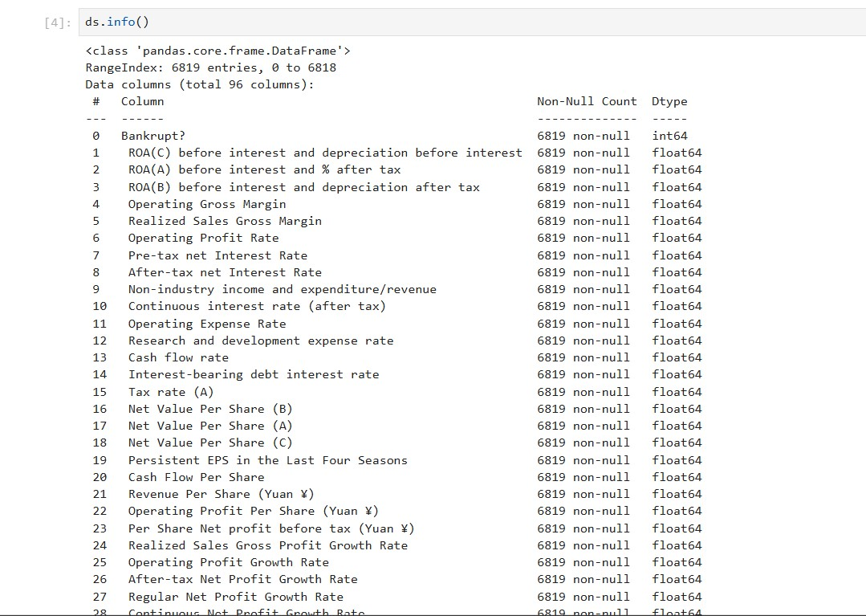
4. DATASETS DETAILS

Slide 10

Exploratory Data Analysis (EDA) is a fundamental step in understanding the data before moving on to modeling. It ensures that the data is clean, relevant, and ready for model training.
Through descriptive statistics and visualization, EDA provides a solid foundation for identifying trends, patterns, and relationships that are essential for building a robust and accurate machine learning model.

Slide 11

Histograms: Show the distribution of a numerical variable.
Box Plots: Detect outliers and observe the spread of the data.
A bar chart is a graphical representation of data where the length or height of bars represents the values of categorical data. Bar charts are useful when you want to compare different categories.
A density plot is a graphical representation that shows the distribution of a dataset by estimating its probability density function.

Slide 12
DATA PRE-PROCESSING
Steps to Perform:
Handle missing values (if any)
Normalize/Scale numeric values
Encode categorical variables (if needed)
Check for class imbalance

Slide 13
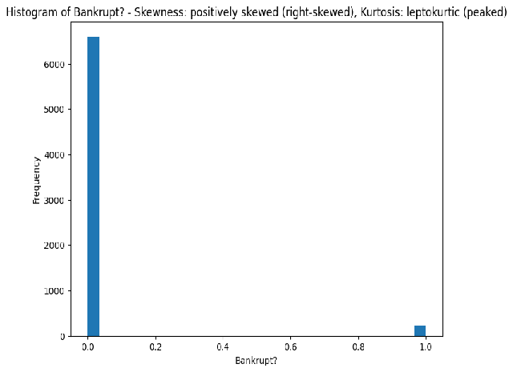
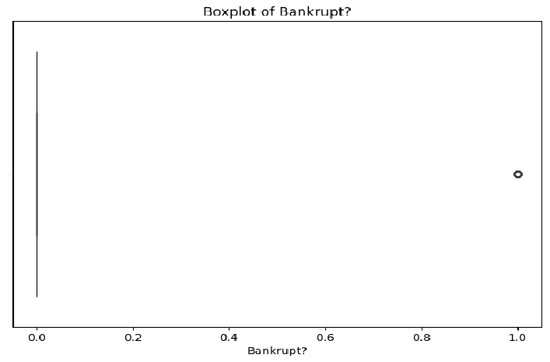

Slide 14
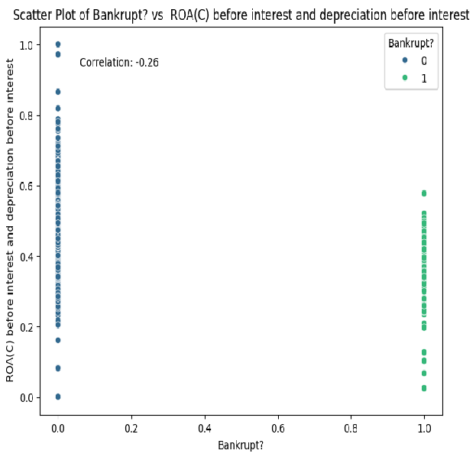
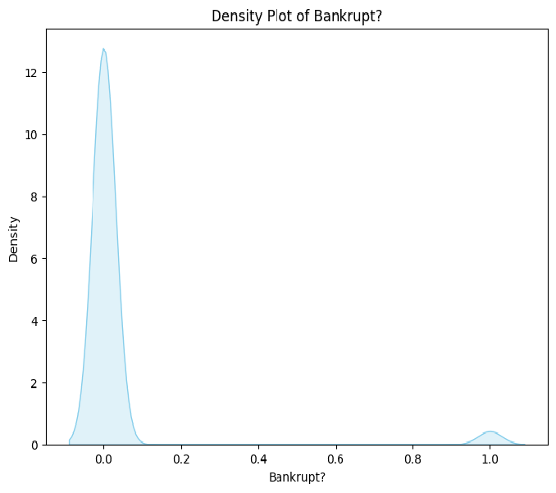

Slide 15
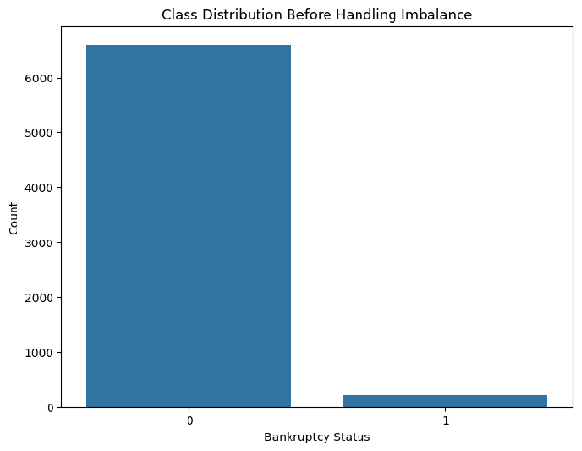
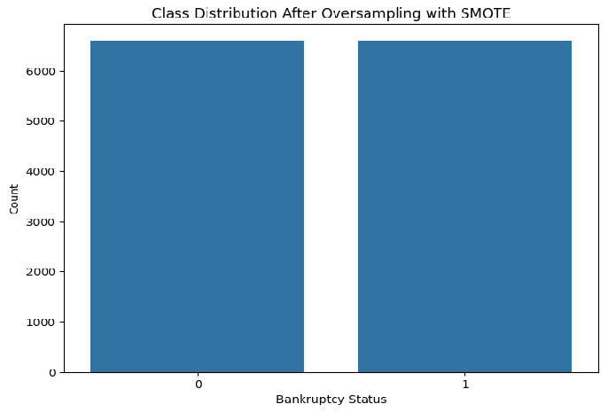
BEFORE PERFORMING AND AFTER PERFORMING SMOTE TECHNIQUE

Slide 16
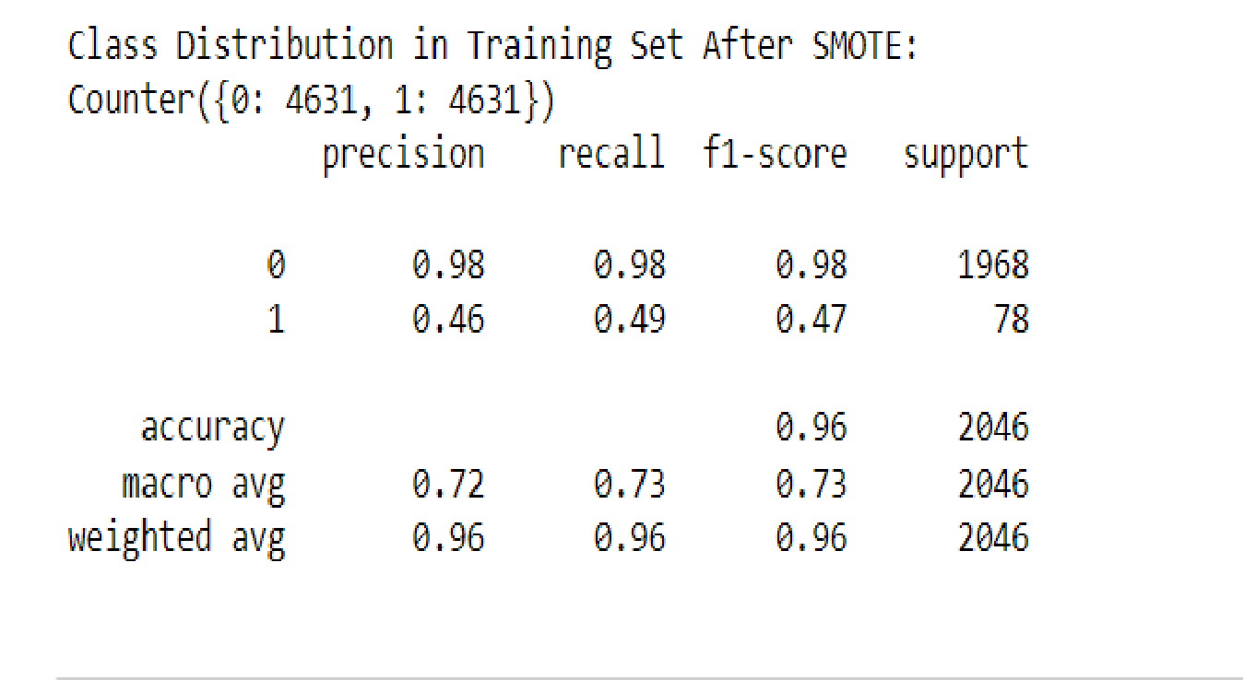

Slide 17

6. MODEL BUILDING
Models to Consider:
Random Forest
KNeighborsClassifier
SVM
XGBM (XTREME GRADIENT BOOSTING MODEL)
GradientBoostingClassifier
Logistic Regression
Among all the methods, the XGBoost Classifier and Random Forest achieved the highest training and test accuracies

Slide 18
MODEL BUILDING PROCESS
Data Preprocessing
File Import: The dataset is imported from a CSV file, which contains financial information related to the bankruptcy prediction problem.
Input Features: 15 financial ratios are used as the input features (independent variables) for model building, including profitability measures like ROA(C) before interest and depreciation, Operating Profit Rate, and Cash flow rate.

Slide 19
Target Variable: The target variable is Bankrupt?, which is a binary classification label (1 for bankruptcy and 0 for non-bankruptcy).
Train-Test Split: The data is split into training and testing sets using an 80-20 ratio to evaluate the model’s performance.
Scaling: StandardScaler is applied to scale the input features to ensure that all features contribute equally to the model and improve the performance of the XGBoost classifier.

Slide 20
Dimensionality Reduction
Principal Component Analysis (PCA) is applied to reduce the data's dimensionality.
In this case, 15 principal components are selected, helping reduce noise and collinearity in the features, leading to improved model performance.

Slide 21

Xtreme Gradient Boosting Model
XGBoost is a powerful, fast, and scalable machine learning algorithm that is used for classification tasks.
It handles missing data and is robust against overfitting.
The model is trained on the training dataset and saved to a file (xgb_model.json) for later use in the Streamlit app.

Slide 22
8.MODEL DEPLOYMENT
Deployment is the process by which ML model is moved from an offline environment and integrated into an existing production environment, such as a live application.
Using Streamlit our project is deployed.
Streamlit is a powerful open-source framework which is used to create interactive web apps for data science and machine learning projects.

Slide 23
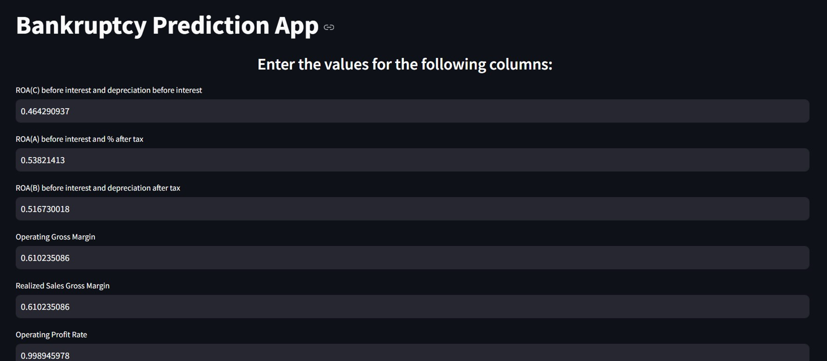

Slide 24
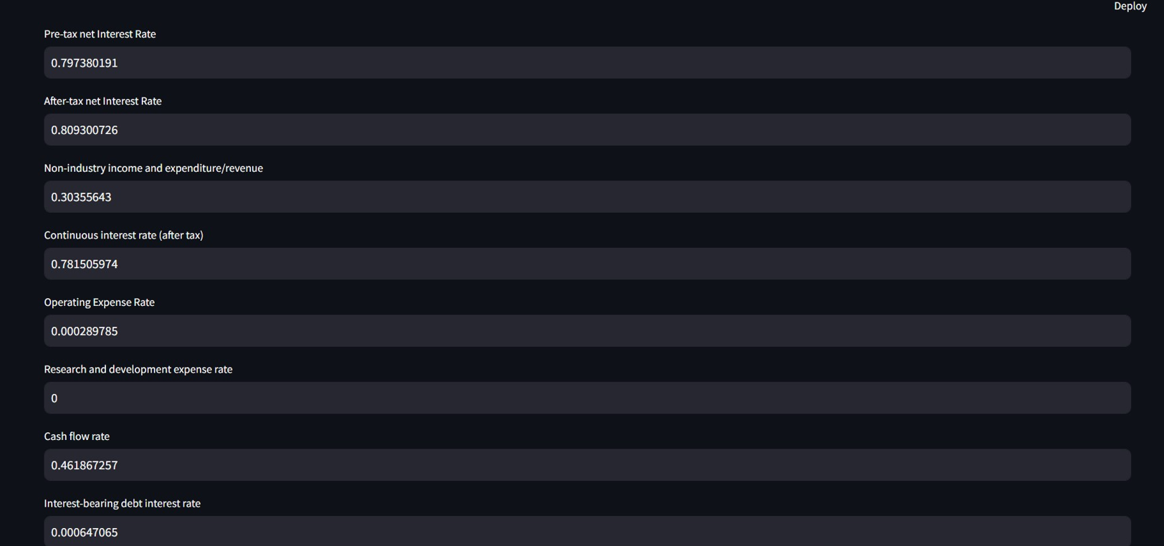

Slide 25
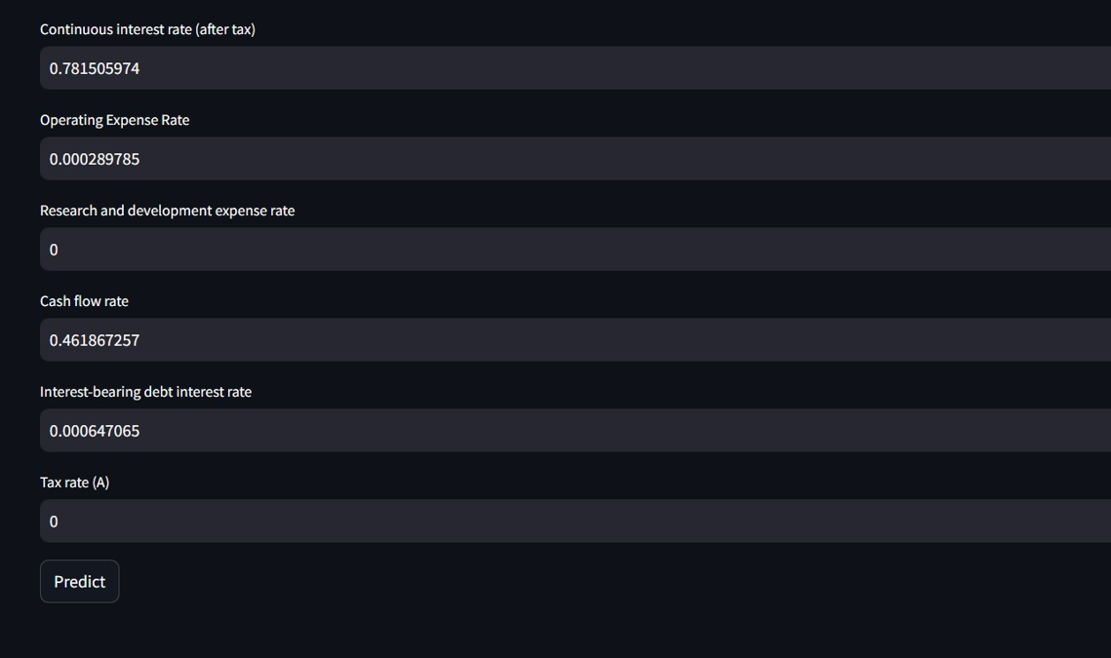
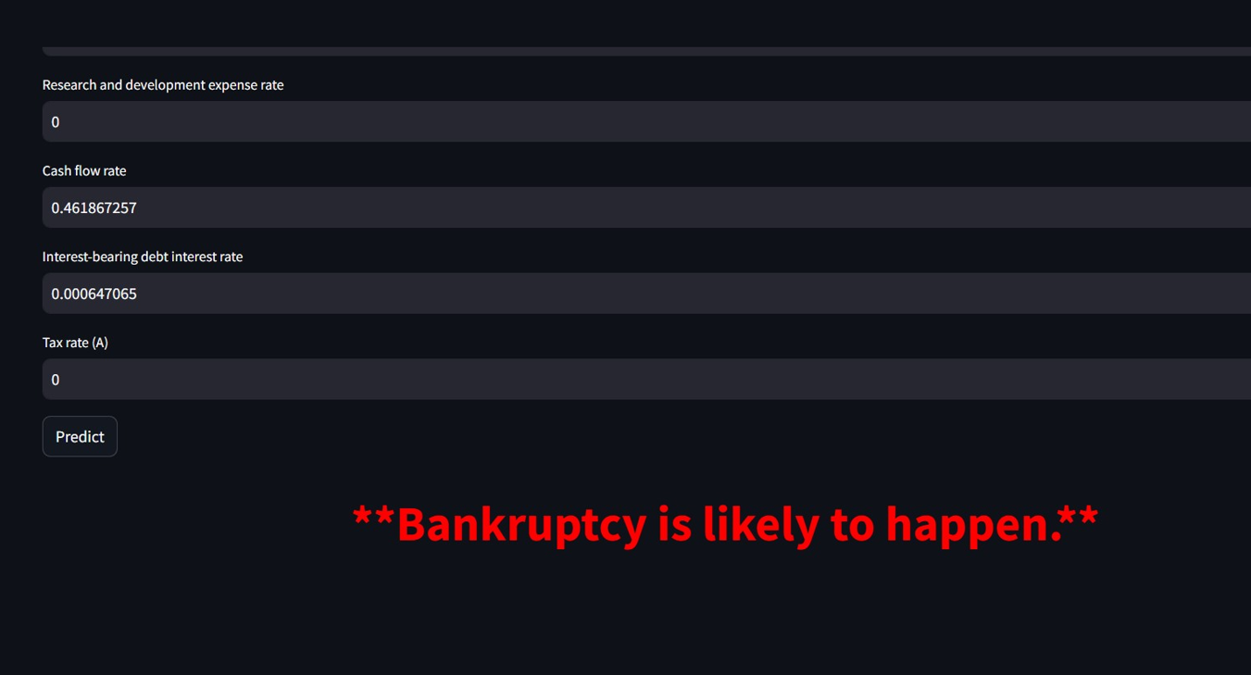

Slide 26

9. CHALLENGES
The data set, which is made up of three sets with numerous interconnected columns, was where we first ran into problems.
Determines the link between variables in that pre-processed data.
EDA is an interesting part, but the selection of variables and make more effective visualization is a quite tough task.
We attempted putting the KNN algorithm into practice, resulted in a lower accuracy.
It was difficult to strike a balance between precision and recall deciding on the best technique and selecting features.

Slide 27

THANK YOU!

