Slide 1

Book database Management system
PIC mini project

Slide 2
This Book Database Management System (BDMS) is a software application designed to efficiently manage and organize books within a library or bookstore. It serves as a digital repository, allowing users to store, retrieve, and view book titles.
Purpose:
This program is designed to allow users to:
Add new books to a database.
Search for books by their names.
View a list of all stored books.
Exit the application after completing tasks.

Slide 3
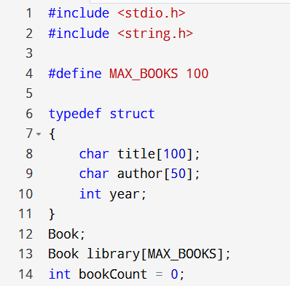

Slide 4
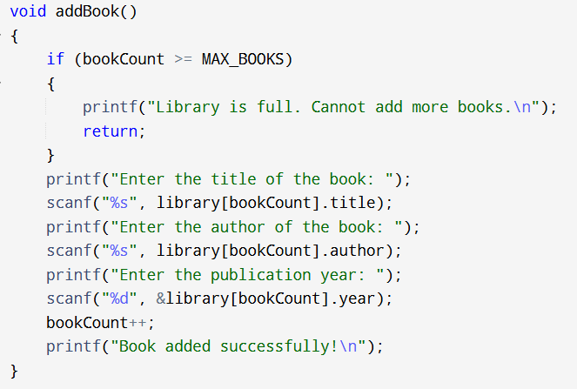

Slide 5
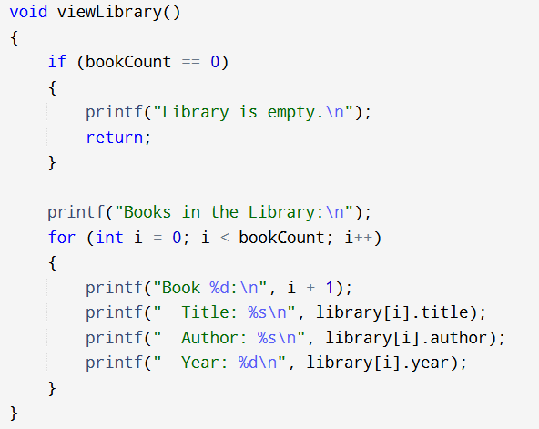

Slide 6
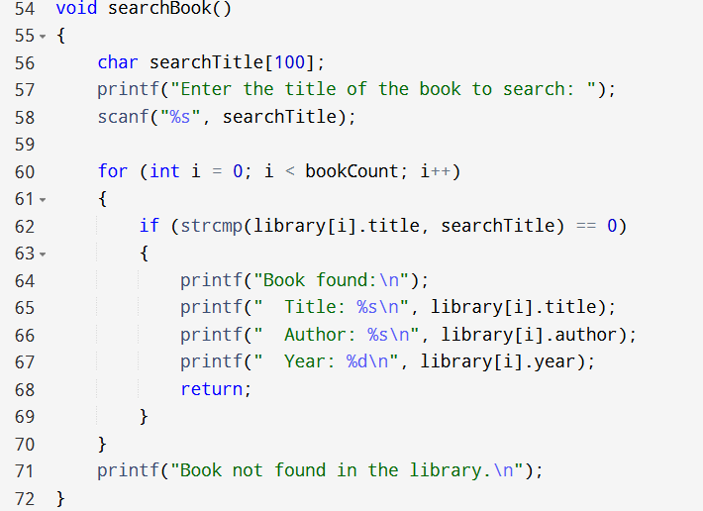

Slide 7
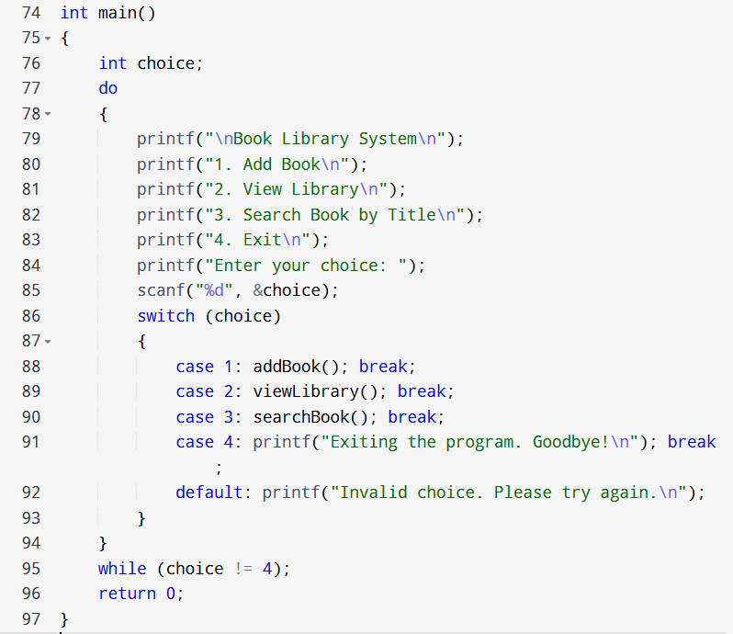

Slide 8
CONCLUSION
The Book Management System is a practical demonstration of basic programming concepts in C. It showcases the use of arrays, loops, string manipulation, and decision-making structures to manage and interact with data efficiently. This program is simple yet effective, providing a strong foundation for building more advanced applications in the future.

Slide 9
T E A M 6
Rishitha. MS
Saida Sunaina
Shadgunya Rao inna
Shulagno Banerjee
Shaik Mohammed Rehan

