Slide 1
Cyber Bullying Detection Using Machine Learning

Slide 2
Group Member Information
Rasi Bhavana Rasi (700735512)
Rishitha Gangula (700730771)
Pagadala Sahil Naidu (700748694)
Prathima Vangala (700734540)

Slide 3
Role/Responsibilities and Contribution in project
Description/Task | Responsibility - Person
Data Read and Preprocessing | Rishitha Gangula & Sahil Naidu Pagadala
PCA Feature Extraction | Sahil Naidu Pagadala & Prathima Vangala
Implementation(Navie Bayes,SVM, XGBoost,Random Forest) | Rasi Bhavana Elluri , Sahil Naidu Pagadala, Rishitha Gangula & Prathima Vangala
Result Analysis | Rasi Bhavana Elluri & Rishitha Gangula

Slide 4
Motivation
Cyber bullying is a growing concern in today's society and can have serious psychological impacts on its victims.
Therefore, it is important to develop effective methods for detecting cyber bullying in online communities and social media platforms to prevent its spread and support victims.

Slide 5
Objectives
The objectives of this research project are to develop a machine learning model using Naive Bayes with hyper parameters to detect cyber bullying in social media platforms, and to evaluate its effectiveness compared to existing methods.
Specifically we used for tweet data.

Slide 6
Related work
Previous research has used various machine learning algorithms, such as SVM and Decision Trees, for cyber bullying detection.
However, these methods often suffer from low accuracy and high false positive rates.
Therefore, this research aims to improve upon these methods by using Naive Bayes with hyperparameters.

Slide 7
Problem Statement
The problem addressed in this research project is the lack of accurate and efficient methods for detecting cyber bullying in social media platforms, which can lead to serious negative impacts on its victims.

Slide 8
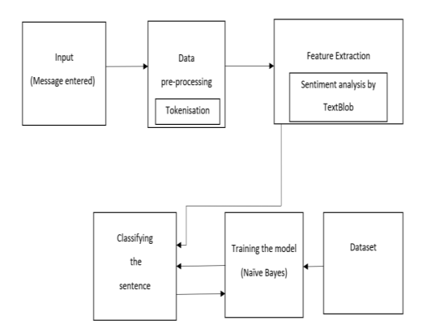
Proposed Solution
The proposed solution for this research project is to use Naive Bayes with hyperparameters to develop a machine learning model for cyber bullying detection in social media platforms.
The model will be trained on a dataset of labeled cyber bullying comments, and its accuracy and performance will be evaluated using various metrics.
Additionally, feature selection and hyper parameter tuning techniques will be used to improve the model's accuracy and reduce false positives.

Slide 9
Result Analysis
An accuracy of 83% for a Naive Bayes model means that the model correctly classified 83% of the comments as either cyber bullying or non-cyber bullying. This is a good starting point, but further analysis is needed to understand the model's performance and potential areas for improvement.
One way to evaluate the model's performance is to use a confusion matrix. A confusion matrix is a table that shows the number of true positives, true negatives, false positives, and false negatives.
From this, you can calculate metrics such as precision, recall, and F1 score, which provide more detailed insights into the model's performance.
For example, if the model classified 100 comments as cyber bullying, and 85 of them were truly cyber bullying while the remaining 15 were not, then it would have 85 true positives and 15 false positives.
If the model classified 100 comments as non-cyber bullying, and 70 of them were truly non-cyber bullying while the remaining 30 were actually cyber bullying, then it would have 70 true negatives and 30 false negatives. With this information, you can calculate metrics such as precision, recall, and F1 score for both classes.

Slide 10
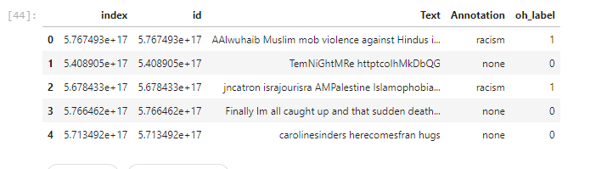
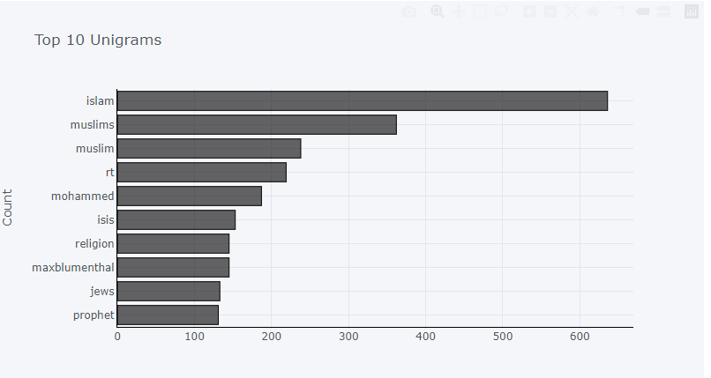
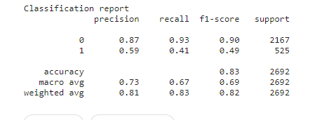
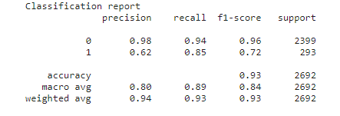
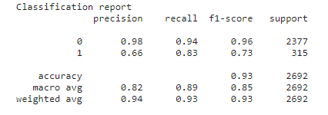
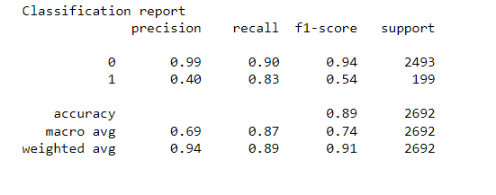
Result
Data Visualization
Naive Bayes Report
Data Sample
SVM Classification Report
XG Boost
Random Forest

Slide 11
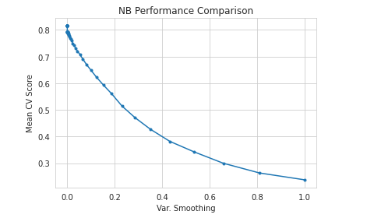
Hyper parameter Tuning

Slide 12
References
"Cyberbullying Lexicon for Social Media" by O. C. Hang and H. M. Dahlan: This paper proposes a lexicon-based approach for cyberbullying detection in social media, using a predefined set of words and phrases related to cyberbullying to identify potentially harmful content.
Hang, O. C., & Dahlan, H. M. (2019). "Cyberbullying Lexicon for Social Media." In 2019 6th International Conference on Research and Innovation in Information Systems (ICRIIS), pages 1-6. doi: 10.1109/ICRIIS48246.2019.9073679.
"Detecting Cyberbullying in Online Social Networks using Machine Learning, Signal Processing, and Text Mining Techniques" by G. De Francisci Morales, F. Figueiredo, and M. Sandler: This paper proposes a multi-modal approach for cyberbullying detection in online social networks, combining machine learning, signal processing, and text mining techniques to analyze textual, visual, and acoustic features of social media posts.
"A Deep Learning Framework for Cyberbullying Detection on Social Media Data" by R. Sharma, D. Soni, and D. Sharma: This paper proposes a deep learning framework for cyberbullying detection on social media data, using a combination of convolutional neural networks (CNNs) and long short-term memory (LSTM) networks to capture both textual and visual features of cyberbullying content.

