Slide 1

SENTIMENT ANALYSIS ON CUSTOMER REVIEWS
2/12/2025

Slide 2
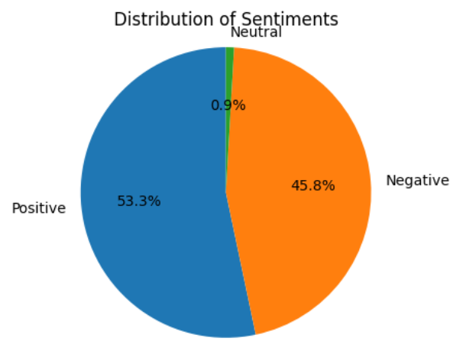
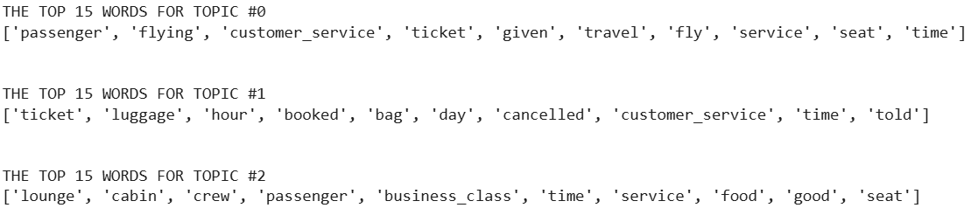
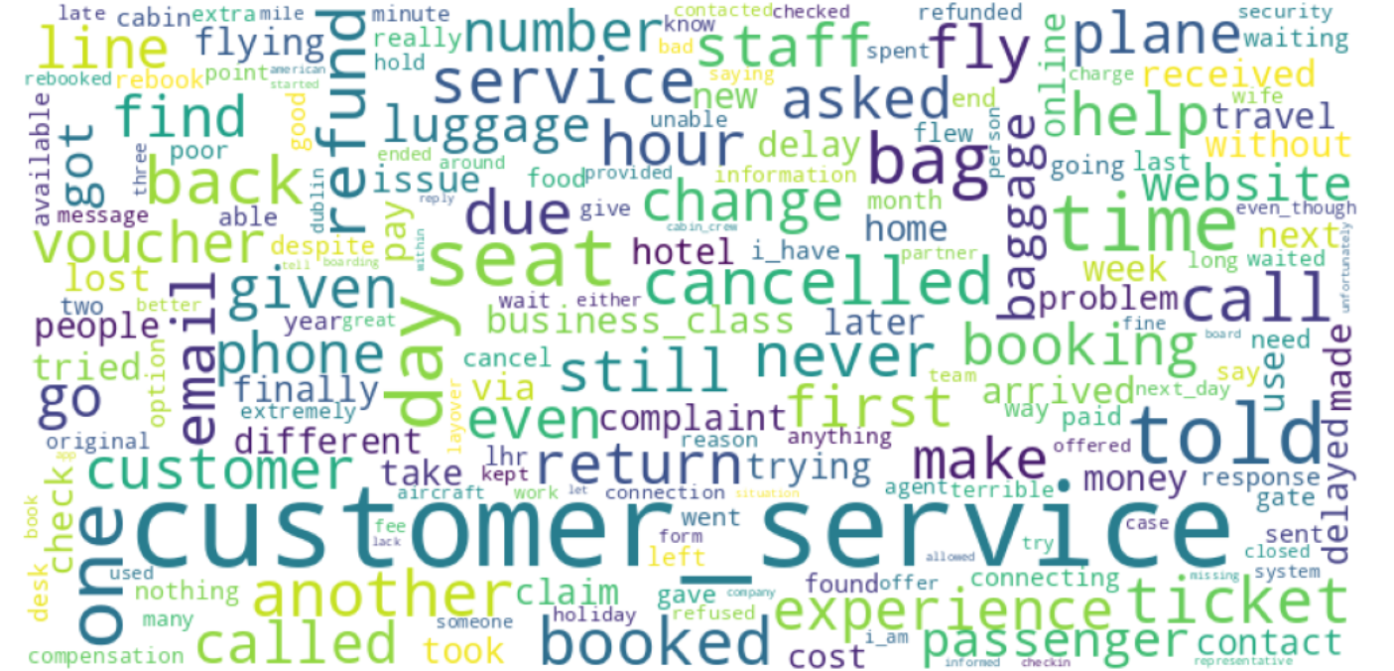
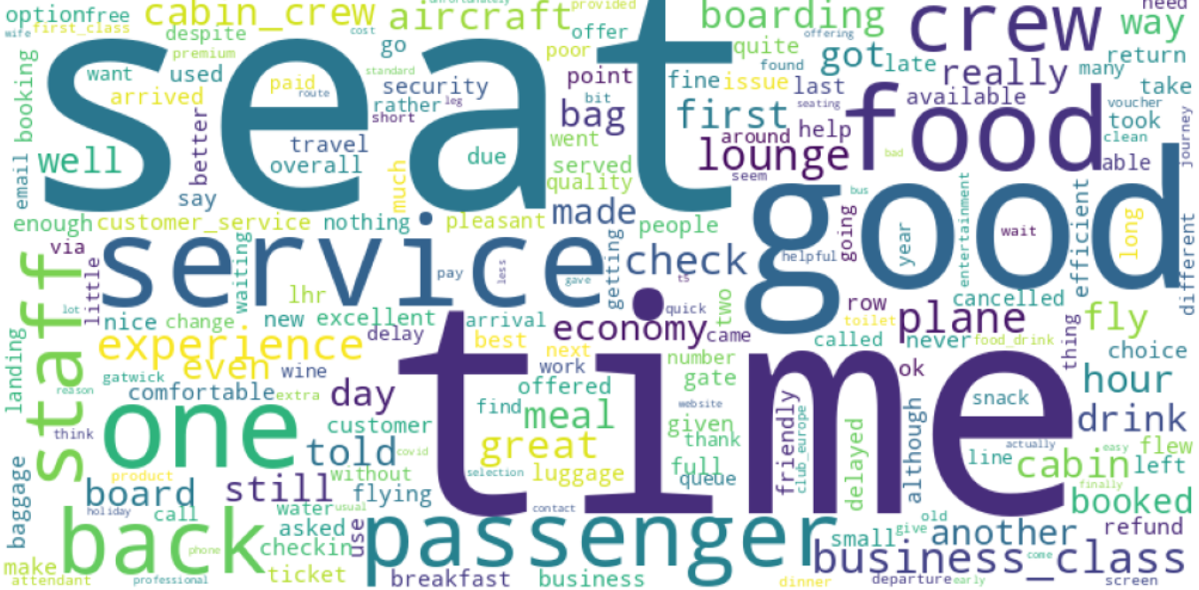
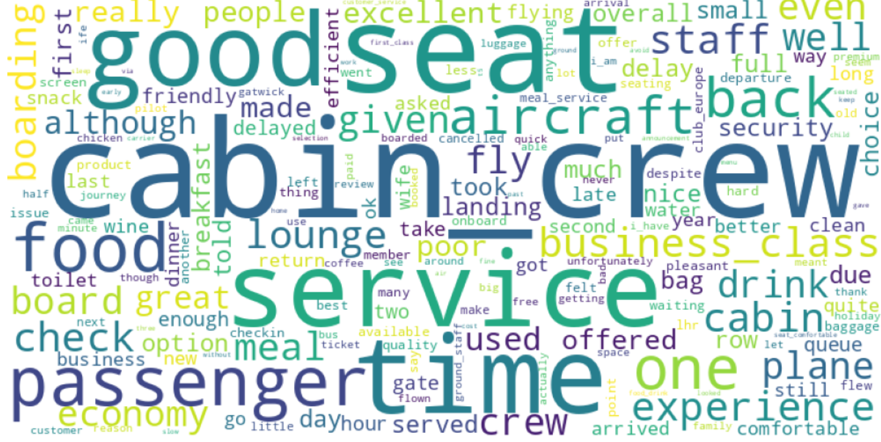
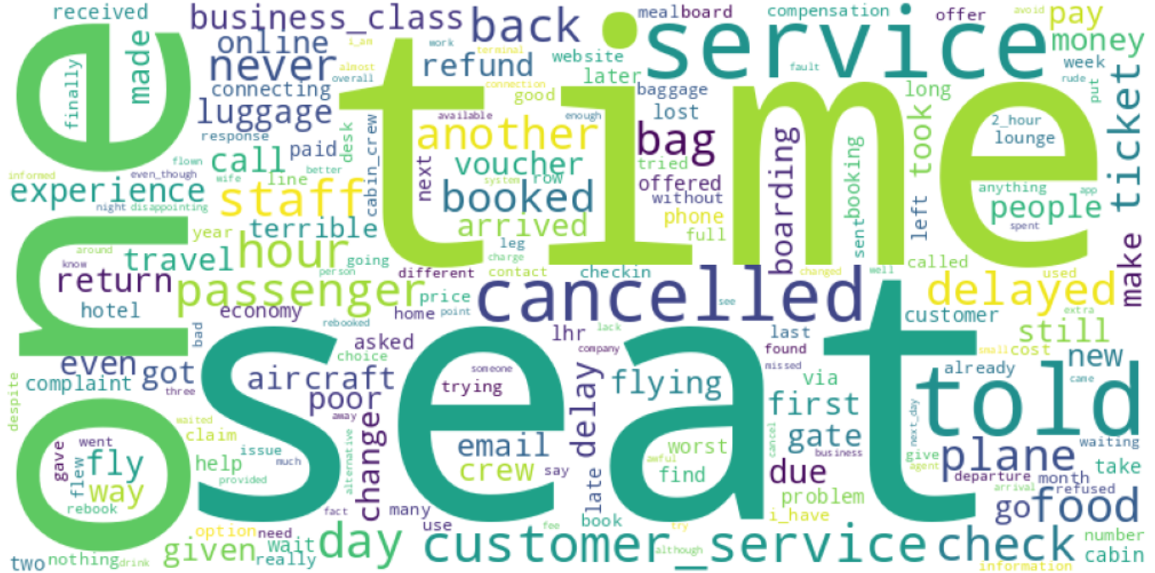
SENTIMENT ANALYSIS INSIGHTS
According to the customer reviews, British Airways has good food, lounge and business class with supportive cabin crew.
But they might need to improve their customer service response time in issues like flight delays and cancellations, refunds and baggage claims.
Top 3 topics in the reviews: customer service, cancellations and refunds, cabin crew
Out of 1000 reviews taken more than 500 reviews were positive, which is more than 50%
when looking at reviews about
customer service, customers were
talking about: * delay in responses.
* refunds, vouchers.
* Rebooking and cancellations.
Positive reviews talk about good:
* seating.
* service in plane, staff, crew.
* Food, Lounge.
* Business class
when looking at reviews about
cabin crew, customers were talking
about: * service being quick and friendly.
* having good food, comfortable
seating.
* nice lounge and boarding
experience.
Negative reviews talk about not better:
* customer service response time.
* Baggage service.
* Refunds and rebooking.
* Delays and cancellations

