Slide 1

Airflow
Rishitha Thoka

Slide 2
What is Airflow?
Apache Airflow is an open-source platform for orchestrating and automating workflows.
It allows users to define, schedule, and monitor complex workflows as Directed Acyclic Graphs (DAGs).
Airflow is designed to be scalable, extensible, and flexible, making it suitable for a wide range of use cases in data engineering, data science, and DevOps.
It was originally developed by Maxime Beauchemin while working at Airbnb in 2014 and later open-sourced in 2015.
Being open-source means that Airflow is freely available for anyone to use, modify, and contribute to, fostering a vibrant community of users and contributors.

Slide 3
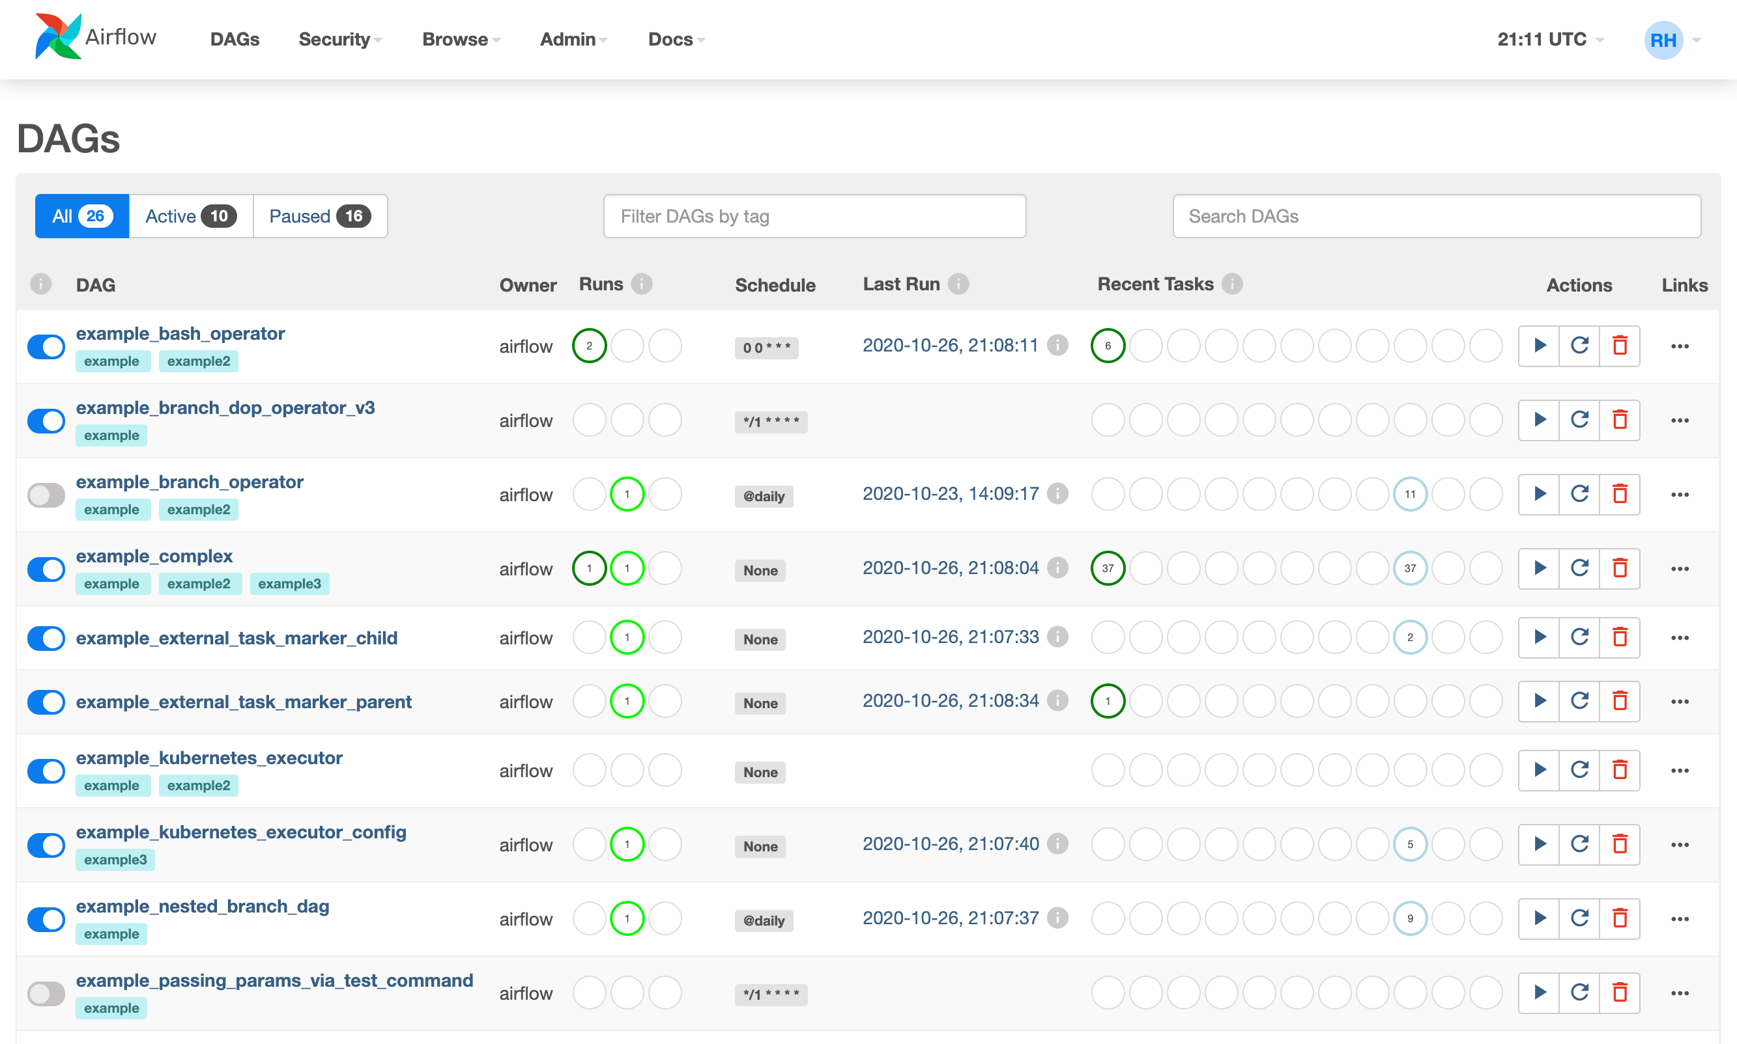

Slide 4
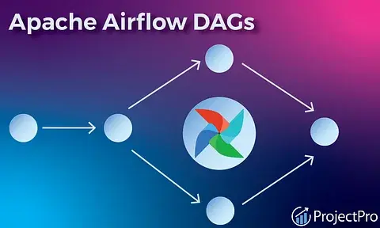
Features of Apache Airflow
Directed Acyclic Graphs (DAGs)
DAGs are a fundamental concept in Apache Airflow used to represent workflows.
DAGs consist of nodes (tasks) connected by edges (dependencies) in a directed acyclic graph structure.
They are acyclic, meaning there are no cycles or loops in the graph. This ensures that tasks are executed in a logical order without creating infinite loops.

Slide 5
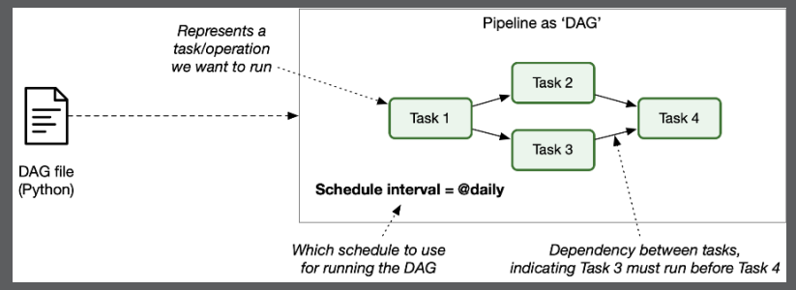
Features of Apache Airflow
Tasks and Dependencies
Tasks represent units of work within a workflow. These tasks can be anything from data processing, data transformations, data loading, or even external interactions like sending emails or making API calls.
Dependencies define the relationships between tasks, specifying which tasks need to be completed before others can start.
Airflow provides various types of dependencies, including:
Upstream Dependencies: Tasks that need to be completed before a given task can start.
Downstream Dependencies: Tasks that can only start after a given task has completed.
Cross-Dependencies: Dependencies between tasks that are not strictly upstream or downstream but have a relationship (e.g., tasks in parallel branches that should start together).

Slide 6
Features of Apache Airflow
Executors:
Schedulers:
Executors in Airflow determine how tasks are executed.
There are different types of executors available in Airflow, such as:
LocalExecutor: Executes tasks sequentially on a single machine.
CeleryExecutor: Distributes task execution across a Celery cluster, allowing for parallel processing.
DaskExecutor: Uses Dask for distributed task execution, suitable for computationally intensive tasks.
SequentialExecutor: Executes tasks sequentially in a single-threaded manner, one after another, without parallelism.
The scheduler in Airflow is responsible for determining when tasks should run based on their dependencies and schedule definitions.
Airflow supports various scheduling options:
Cron-based Scheduling: Allows tasks to be scheduled based on cron expressions, enabling precise scheduling at specific times, intervals, or recurring patterns.
Interval-based Scheduling: Tasks can be scheduled at fixed intervals, such as every hour, day, week, etc.
Date/Time-based Scheduling: Tasks can be scheduled to run at specific dates and times.
External Triggering: Tasks can also be triggered externally by events or other systems, providing flexibility in workflow automation.

Slide 7
Features of Apache Airflow
Operators
Operators are building blocks used to define individual units of work within a workflow (Directed Acyclic Graph or DAG). Each operator performs a specific task or action.
Airflow provides a variety of built-in operators and allows users to create custom operators to suit their workflow requirements. Here are some commonly used operators in Airflow:
BashOperator: Executes a bash command or script.
PythonOperator: Executes a Python function or method.
EmailOperator: Sends an email notification.
DummyOperator: Does nothing (useful for testing or as a placeholder).
SQLAlchemyOperator: Executes a SQL command using SQLAlchemy.
PostgresOperator: Executes a SQL command on a PostgreSQL database.
MySQLOperator: Executes a SQL command on a MySQL database.
S3FileTransferOperator: Transfers files to/from Amazon S3.
SFTPOperator: Transfers files via SFTP.
HttpOperator: Sends an HTTP request and retrieves the response.
Sensor: Waits for a certain condition to be met before proceeding (e.g., file existence, API response).
SubDagOperator: Executes a sub-DAG within the main DAG.
TriggerDagRunOperator: Triggers the execution of another DAG.
BranchPythonOperator: Executes different tasks based on a condition.
DockerOperator: Executes a Docker container.
KubernetesPodOperator: Executes a Kubernetes pod.
HiveOperator: Executes HQL (Hive Query Language) commands on Hive.

Slide 8
Monitoring and Logging
Airflow Web UI
The Airflow Web UI provides a user-friendly interface for managing workflows, monitoring task execution, and accessing system metrics.
Users can view and manage DAGs, tasks, dependencies, and schedules through the web interface.
Task Status Monitoring
The Web UI allows users to monitor the status of individual tasks within workflows, including their current state (e.g., running, success, failure), start and end times, and task dependencies.
Log Tracking
Airflow logs detailed information about task execution, including stdout, stderr, and any custom logging statements within tasks.
Users can track and review task logs directly from the Airflow Web UI, helping to diagnose issues and troubleshoot workflow problems.
Real-time Workflow Progress
The Web UI provides real-time updates on workflow progress, showing the overall status of DAG runs, task completion rates, and any errors or warnings encountered during execution.
Users can monitor workflows as they execute, enabling proactive management and intervention when needed.

Slide 9
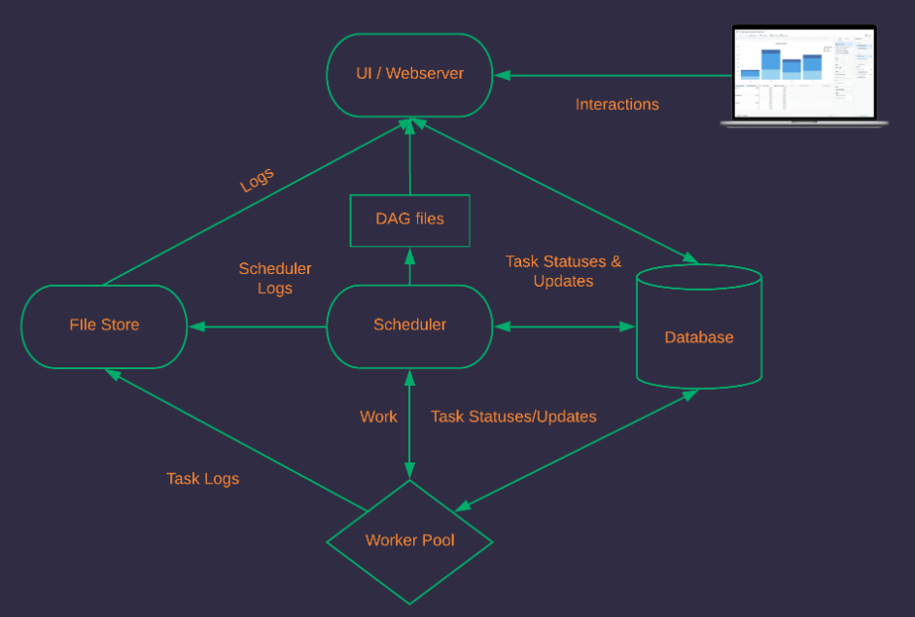
Architecture of airflow

Slide 10
Extensibility
Custom Operators
Apache Airflow allows users to create custom operators by extending base Operator classes, enabling the execution of specialized tasks or interactions with specific systems and services.
Custom operators can encapsulate complex logic, data processing, or external integrations, enhancing the flexibility and functionality of workflows.
Sensors
Sensors in Airflow are specialized operators that wait for a certain condition to be met before proceeding with task execution.
They are useful for scenarios where tasks need to wait for external events, file availability, database changes, or API responses before continuing.
Sensors enhance workflow reliability by ensuring that tasks only execute when the required conditions are satisfied.
Integration with External Systems (databases, cloud services, APIs)
Airflow seamlessly integrates with a wide range of external systems and services, including databases (SQL, NoSQL), cloud platforms (AWS, Google Cloud, Azure), and APIs (RESTful, SOAP).
Integration capabilities allow tasks to interact with external data sources, trigger external actions, retrieve data, perform computations, and more, making Airflow a powerful automation platform for diverse use cases.
Flexibility for Diverse Workflow Requirements
Airflow's architecture and design provide flexibility to accommodate diverse workflow requirements, from simple ETL processes to complex data pipelines, machine learning workflows, and DevOps automation.
Users can define workflows using Python code, leverage built-in operators and sensors, customize workflows with custom operators, and scale workflows using distributed execution options.
This flexibility enables Airflow to adapt to evolving business needs, technology stacks, and data processing challenges effectively.

Slide 11
Scalability
Horizontal Scaling
Apache Airflow supports horizontal scaling, allowing users to scale their workflows by adding more worker nodes or resources as needed.
Horizontal scaling enhances system performance, throughput, and reliability by distributing workload across multiple nodes or instances.
Distributed Task Execution
Airflow facilitates distributed task execution, enabling tasks within workflows to be executed in parallel across multiple workers or nodes.
Distributed task execution improves workflow efficiency, reduces execution times, and increases overall system throughput.
Handling Large-scale Data Workflows
Airflow is designed to handle large-scale data workflows, including ETL processes, data pipelines, machine learning workflows, and more.
Its scalability features, distributed execution options, and support for different executors make it suitable for managing complex data processing tasks and handling large volumes of data efficiently.

Slide 12
Use Cases
ETL Processes: Apache Airflow is widely used for Extract, Transform, Load (ETL) processes, facilitating data ingestion, transformation, and loading into data warehouses or analytics platforms.
Data Pipelines: Airflow enables the creation and management of complex data pipelines, orchestrating data movement, processing, and synchronization across systems.
Machine Learning Workflows: Airflow supports machine learning workflows by automating model training, evaluation, deployment, and monitoring processes.
DevOps Automation: Airflow streamlines DevOps automation tasks such as infrastructure provisioning, deployment pipelines, and workflow scheduling for continuous integration and deployment (CI/CD).

Slide 13
Conclusion
Apache Airflow's Role in Streamlining Data Workflows
Apache Airflow plays a crucial role in streamlining data workflows by providing a unified platform for orchestrating, scheduling, and monitoring tasks within workflows.
Its flexibility, extensibility, and scalability make it suitable for a wide range of use cases across industries, including data engineering, data science, analytics, and DevOps.
Airflow's ability to handle complex dependencies, support for distributed task execution, integration with external systems, and real-time monitoring capabilities contribute to efficient and reliable workflow automation.
By leveraging Apache Airflow, organizations can optimize data processing, improve productivity, reduce time-to-insight, and achieve better operational efficiency in managing data-centric workflows.

Slide 14
Thank You

