Slide 1

WAVES
Done BY:RISHITHA THOKA
UNIQUE ID:E0322026
Stream: b.tech artificial intelligence and data analytics
Year:1st year
Term:2

Slide 2
WHAT IS A WAVE?
It is a particle wave disturbance that moves away from a source and carries energy with it
WAVES MOTION:
The propagation of a pattern caused by a vibration.

Slide 3
TYPES OF WAVES
Transverse waves:
Occur when the individual particles or segments of a medium vibrate from side to side perpendicular to the direction in which the waves travel.
Longitudinal waves:
Occur when the individual particles of a medium vibrate back and forth in the direction in which the waves travel
Mechanical waves:
A wave which needs a medium in order to propagate itself. Sound waves, waves in a slinky, and water waves are all examples of this.
Electromagnetic waves:
These waves are disturbance that does not need any object medium for propagation and can easily travel through the vacuum. They are produced due to various magnetic and electric fields. The periodic changes that take place in magnetic and electric fields and therefore known as electromagnetic waves.

Slide 4
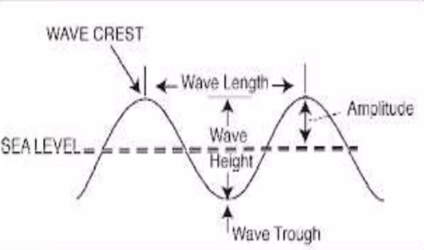
Characteristics of a wave

Slide 5
CHARACTERISTICS OF A WAVE
Crest and trough- Highest point and lowest point of wave
Amplitude- It is the maximum displacement of a vibrating particle of the medium on either side of its normal position when the wave passes
Wavelength- It is the distance between adjacent crest or trough
Frequency- the number of waves that pass particular point every second
Period-The time required for one cycle, a complete notion that returns to its starting points
SPEED OF WAVE:
The distance the wave travels per unit time. It is related to the frequency of the wave and wavelength of the wave.
WAVE SPEED= FREQUENCY X WAVELENGTH

Slide 6
Properties of a wave
REFLECTION:
It is the bouncing of a wave that hits the surface
REFRACTION:
Change in the direction of waves as they pass from one medium to another medium
Bending of waves as they pass from one medium to anoyher medium of different density
DIFFRACTION:
The bending of waves around small openings and around edge of barriers
INTERFERENCE:
The interaction between two wave
Overlapping of waves
Can be destructive or constructive

Slide 7
THANK YOU

