Slide 1


INNOVASIA 2K25
TITLE PAGE
Problem Statement Title-
Theme-
Team Name-<NoName/>
SmartCollab-The Smart Collaboration Ecosystem
FINTECH

Slide 2

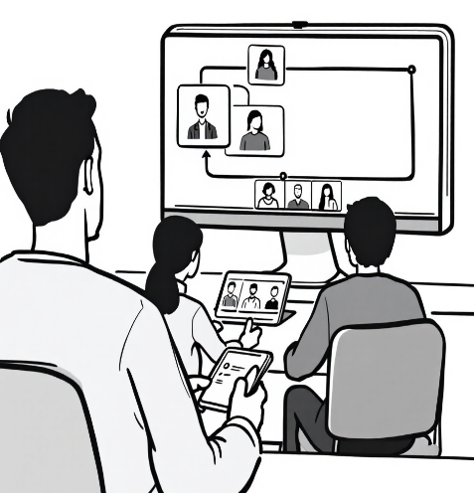
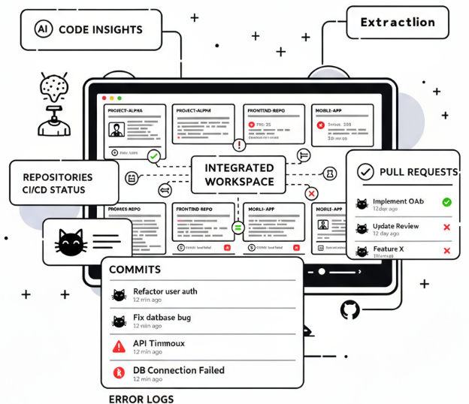


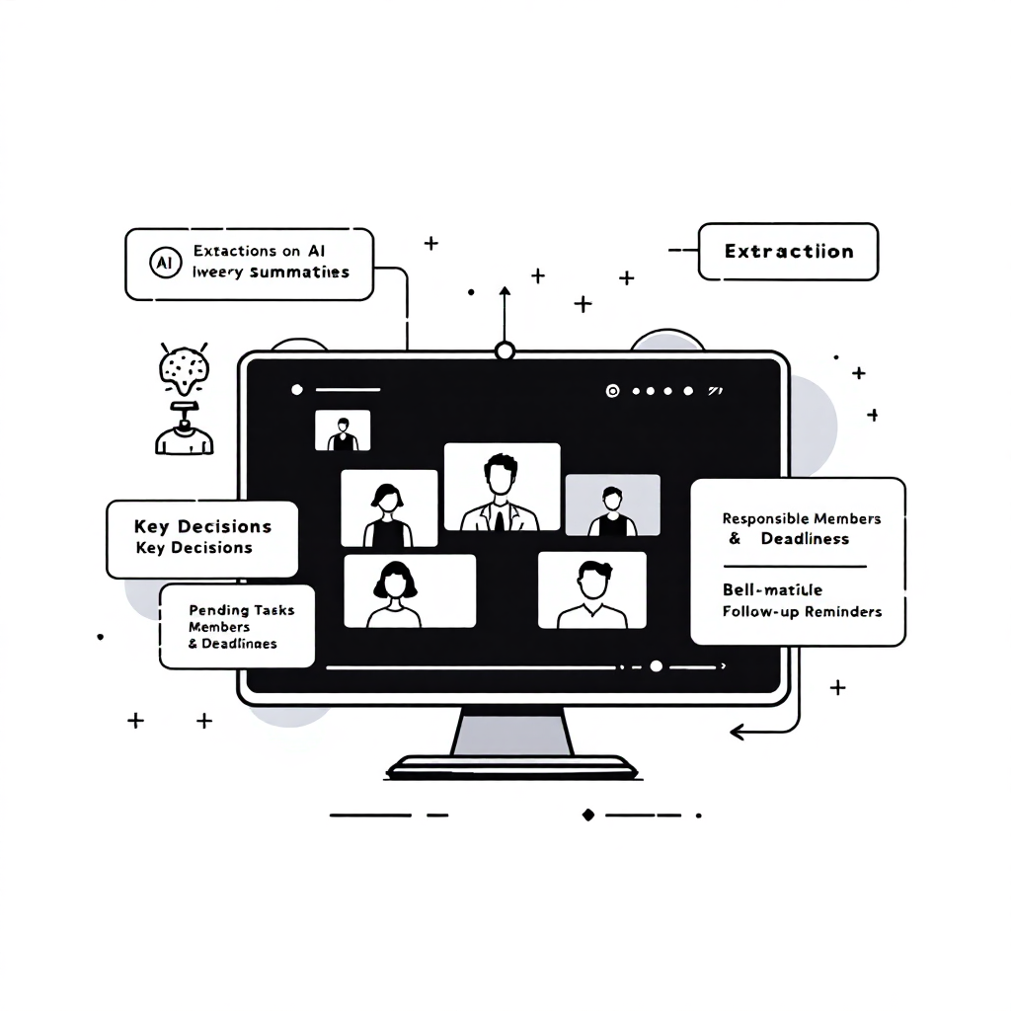

IDEA TITLE
Workspace Hub:
Creates multiple collaborative workspaces where users can work together efficiently.
Integrates Google Meets: Integrated with AI-generated summaries and transcripts for absent members, automatically stored for future reference and context retrieval.
ContextIQ is a web platform where multiple users can create and manage multiple workspaces, linked directly to GitHub repositories via the GitHub API.
Links each workspace to GitHub repositories, providing access to previous code, commits, pull requests, and error logs and extracts data from that
Semantic search for precise answers: Lets users quickly query GitHub repos, notes, and meeting transcripts to find answers without reading all code — ideal for new contributors.
Smart Onboarding:
AI guides new contributors through personalized learning paths, helping them quickly understand past discussions, team roles, and project preferences
AI Summarization & Action Extraction.
Automatically extract
key decisions such as
Pending tasks
Responsible members and deadlines
Follow-up reminders
Integrates Notion for personalized and shared notes, keeping all workspace knowledge organized and can be used later.

Slide 3
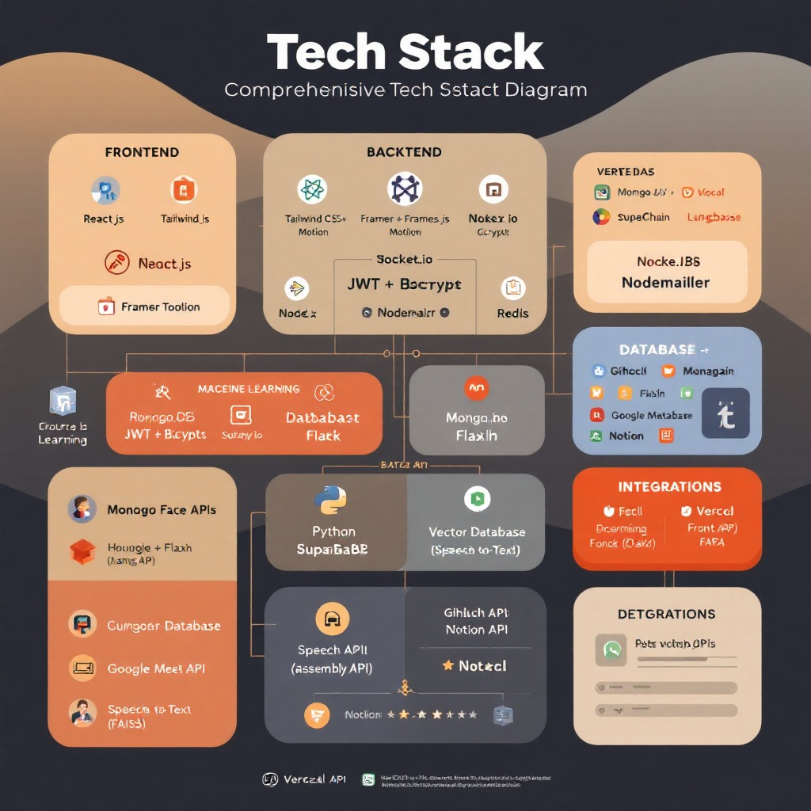
TECHNICAL APPROACH

Slide 4
Challenges & Future Scope
1
2
FEASIBILITY
Providing personalized onboarding for users with diverse experience levels
Strategy: Leverage AI-driven assessments to gauge experience and deliver customized tutorials, guided workflows, and contextual recommendations for faster and more effective onboarding.
Providing personalized onboarding for users with diverse experience levels
Strategy: Leverage AI-driven assessments to gauge experience and deliver customized tutorials, guided workflows, and contextual recommendations for faster and more effective onboarding.
Technical Feasibility
->AI-driven task assignment
->code review suggestions
->Cross-repository analytics dashboard
Operational Feasibility
3
4
->Personalized learning recommendations
->Mobile and tablet support for on-the-go collaboration
Challenge: Managing large-scale repositories and multiple contributors efficiently
Strategy: Adopt modular system design, enforce version control best practices, and use automated CI/CD pipelines to streamline integration and minimize conflicts.
Challenge: Ensuring data privacy and security
Strategy: Implement end-to-end encryption, role-based access control, secure authentication (OAuth2), and regular audits to comply with standards like GDPR.
Economic Feasibility
->Marketplace Integrations with other tools (e.g. Figma) to expand ecosystem reach
->Advanced knowledge graph linking code, docs

Slide 5
IMPACT AND BENEFITS
Potential impact on the target audience
Benefits of the solution (social, economic, environmental, etc.)

Slide 6

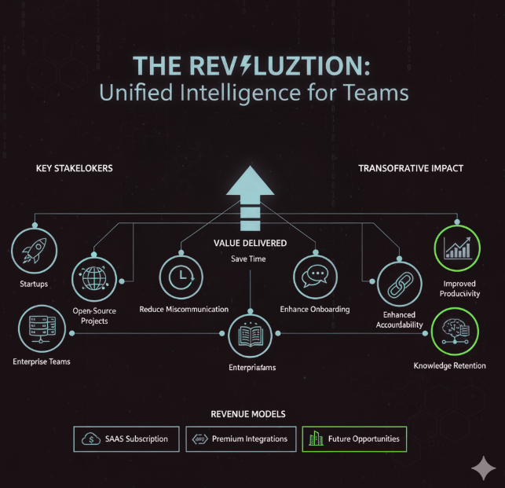


IMPACT & BENIFITS
🧩 Target Market: Collaboration-based ecosystems that rely heavily on communication, version control, and knowledge retention,open-source projects, and enterprise teams
💼 Revenue Model: Freemium plan, paid integrations (GitHub+, Notion Pro), and enterprise licenses
🔗 Market Strategy:
Partner with GitHub & Notion ecosystems
Offer onboarding support for open-source communities
🌍 Scalability:
Cloud-based infrastructure for multi-team workspaces
API-driven integrations for future tools
Reduced Onboarding Time: 40–50% faster with AI-assisted learning paths
🤝 Improved Collaboration: Unified chat, meetings, and docs in one context
🧠 Smarter Decisions: AI-driven insights from project data
🔒 Increased Transparency: Project timelines and summaries for all stakeholders
🌱 Long-Term Impact: Promotes inclusive, knowledge-driven work culture

Slide 7
RESEARCH AND REFERENCES
Details / Links of the reference and research work

