Slide 1
FINAL PROJECT PRESENTATION | 2026–27
LSTM Autoencoder-Based
Persistent and Transient Anomaly Classification in Open RAN KPIs
Machine Learning • Open Radio Access Networks
Yaswanth Srikar | 2520040026
Omprakash Jena | 2520040057
Rishi Vardhan | 2520040078
Guide: Dr. Vinnakota Venu Balaji • Department of ECE

Slide 2
01 • INTRODUCTION
The problem: not every anomaly is a fault
Open RAN produces time-dependent KPIs that need context, not just fixed thresholds.
NORMAL
TRANSIENT
PERSISTENT
KPIs follow expected patterns.
A short deviation, then recovery.
Abnormal behaviour continues.
Illustrative throughput sequence
92
95
91
93
96
94
30
t1
t2
t3
t4
t5
t6
t7
One sudden drop that recovers may be transient; a sustained drop may be persistent.
LSTM AUTOENCODER • OPEN RAN KPI ANOMALY CLASSIFICATION
2

Slide 3
02 • OBJECTIVES
What this project aims to do
Separate detection of abnormal behaviour from its duration-based interpretation.
01
Prepare KPI time series
02
Learn normal behaviour
Handle timestamps, missing values, scaling and windows.
Train an LSTM Autoencoder mainly on baseline recordings.
03
Detect deviations
04
Interpret duration
Use reconstruction error and a validation-derived threshold.
Use temporal continuity to flag short-lived vs sustained anomalies.
LSTM AUTOENCODER • OPEN RAN KPI ANOMALY CLASSIFICATION
3

Slide 4
03 • DATASET
SpotLight Open RAN dataset
Experiments use baseline and anomaly recordings from the SpotLight project.
BASELINE RECORDINGS
ANOMALY CATEGORIES
• 1UE
• 5UE
• 7UE-Ping
• MAC • MIXED • NETWORK
• PDCP • RADIO
Used primarily to learn normal KPI patterns.
Used for testing and analysis.
Saved experiment split: 57 baseline recordings (40 train, 8 validation, 9 normal test) + 16 anomaly recordings.
12 selected KPI features • Source: SpotLight Open RAN dataset
LSTM AUTOENCODER • OPEN RAN KPI ANOMALY CLASSIFICATION
4

Slide 5
04 • METHODOLOGY
End-to-end system pipeline
The system first detects unusual windows, then examines continuity over time.
KPI DATA
PREPROCESS
WINDOWS
LSTM AE
ERROR
DECISION
timestamped
multivariate series
clean • scale
select features
20 time steps
× 12 features
learn normal
patterns
reconstruction
MSE
threshold +
duration rules
NORMAL
TRANSIENT
PERSISTENT
Conceptual workflow; duration rules require validation against event-level ground truth.
LSTM AUTOENCODER • OPEN RAN KPI ANOMALY CLASSIFICATION
5

Slide 6
05 • MODEL
How the LSTM Autoencoder works
An encoder compresses the sequence; a decoder reconstructs it.
INPUT
ENCODER
LATENT
DECODER
OUTPUT
20 × 12
KPI window
LSTM 64 → 32
compact
sequence
LSTM 32 → 64
reconstructed
20 × 12
LOW RECONSTRUCTION ERROR
HIGH RECONSTRUCTION ERROR
Sequence resembles learned normal behaviour.
Sequence may be anomalous; compare with threshold.
Training objective: minimize mean squared reconstruction error (MSE).
LSTM AUTOENCODER • OPEN RAN KPI ANOMALY CLASSIFICATION
6

Slide 7
06 • DETECTION LOGIC
From reconstruction error to anomaly flag
Thresholding provides the first-stage decision.
RECONSTRUCTION ERROR
THRESHOLD RULE
MSE = average of (actual KPI − reconstructed KPI)²
Error > threshold → Anomaly
Error ≤ threshold → Normal
Saved run threshold: 0.028941 (reported as validation 95th percentile).
Important reproducibility note: the saved configuration also mentions a 99th percentile. This mismatch should be checked before claiming a final calibrated threshold.
LSTM AUTOENCODER • OPEN RAN KPI ANOMALY CLASSIFICATION
7

Slide 8
07 • EXPERIMENT
Model and training configuration
Values below are from the saved experiment artifacts.
Input window
20 time steps × 12 features
Architecture
LSTM 64 → 32 → 32 → 64; Dense output
Loss / optimizer
Mean squared error / Adam
Learning rate
0.001
Batch size / epochs
64 / up to 100
Training data
Baseline KPI windows
Training loss decreased from approximately 0.30791 to 0.02193; minimum validation loss was approximately 0.00990.
LSTM AUTOENCODER • OPEN RAN KPI ANOMALY CLASSIFICATION
8

Slide 9
08 • RESULTS
Detection performance on the saved test run
Metrics show useful anomaly signal, but substantial false positives remain.
Accuracy
Precision
Recall
68.32%
28.55%
58.10%
F1-score
ROC–AUC
PR–AUC
38.29%
0.688
0.356
Interpretation: recall is higher than precision, meaning many labelled anomalies are found, but many normal windows are also flagged.
These are saved-run results, not a claim of production-ready performance.
LSTM AUTOENCODER • OPEN RAN KPI ANOMALY CLASSIFICATION
9

Slide 10
09 • ERROR ANALYSIS
Confusion matrix: false alarms are a major issue
Window-level counts from the saved evaluation.
TRUE NEGATIVES
FALSE POSITIVES
101,371
42,613
FALSE NEGATIVES
TRUE POSITIVES
12,283
17,031
Practical implication: threshold calibration, feature scaling, class imbalance and event-aware scoring need further investigation.
LSTM AUTOENCODER • OPEN RAN KPI ANOMALY CLASSIFICATION
10

Slide 11
10 • TRANSIENT VS PERSISTENT
Duration-based classification: current status
The project includes a duration rule, but this stage is not yet validated as a classifier.
TRANSIENT
PERSISTENT
Anomaly appears briefly and returns toward normal.
Anomaly remains elevated across time and does not recover.
Saved duration-rule output: 335 transient and 1,384 persistent detections (rule setting: 3 consecutive anomalous windows). These are rule-based outputs, not ground-truth-validated class counts.
Caution: windows are 20 time steps long with stride 1, so adjacent windows overlap heavily. Counting windows as elapsed duration can exaggerate persistence. Event-level ground-truth validation is still needed.
LSTM AUTOENCODER • OPEN RAN KPI ANOMALY CLASSIFICATION
11

Slide 12
11 • EVENT-LEVEL EVALUATION
Event matching reveals a key limitation
A detector can flag many windows yet produce too many separate predicted events.
Reference events
Predicted events
Matched events
69
1,719
67
Event precision
Event recall
Event F1
3.90%
97.10%
7.49%
Priority improvement: merge nearby positive windows into coherent events, tune thresholds, and evaluate detection delay.
LSTM AUTOENCODER • OPEN RAN KPI ANOMALY CLASSIFICATION
12

Slide 13
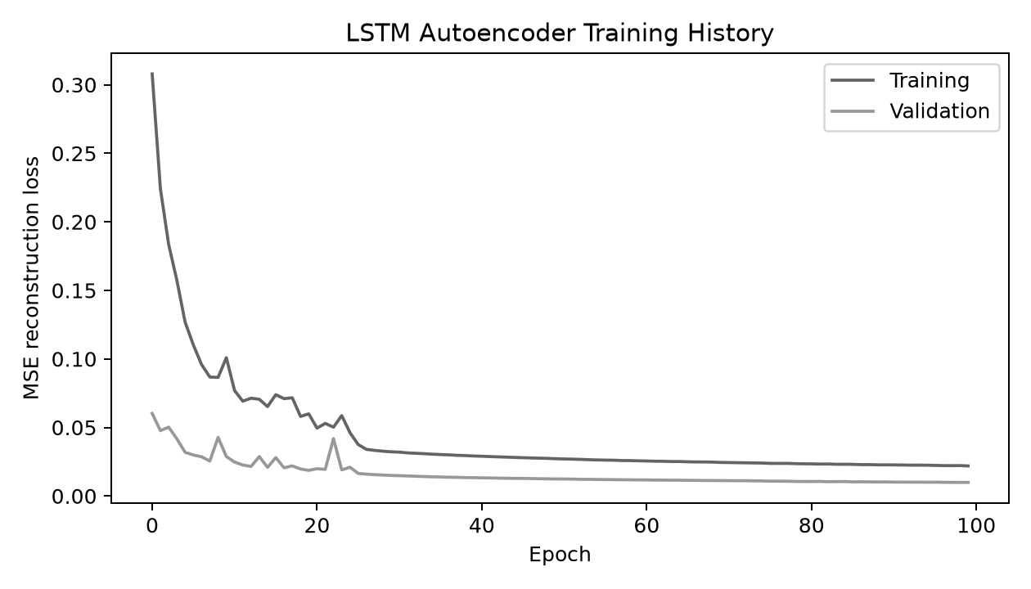
12 • TRAINING RESULTS
Training and validation loss
Actual training-history figure saved by the project pipeline.
WHAT THE GRAPH SHOWS
• Training loss fell from ≈0.30791 to ≈0.02193.
• Minimum validation loss was ≈0.00990 near epoch 99.
• This indicates the model learned to reconstruct the training sequences; it does not by itself prove strong anomaly classification.
LSTM AUTOENCODER • OPEN RAN KPI ANOMALY CLASSIFICATION
13

Slide 14
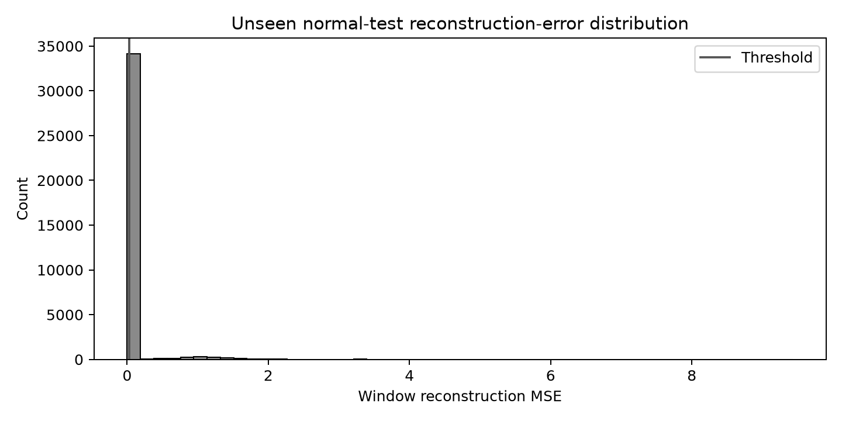
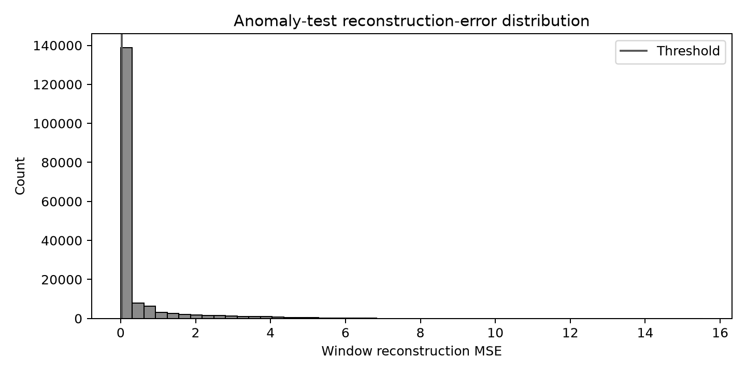
13 • DETECTION EVIDENCE
Reconstruction-error distributions
Saved plots help explain how the threshold separates normal and anomalous windows.
Normal test error distribution
Anomaly test error distribution
LSTM AUTOENCODER • OPEN RAN KPI ANOMALY CLASSIFICATION
14

Slide 15
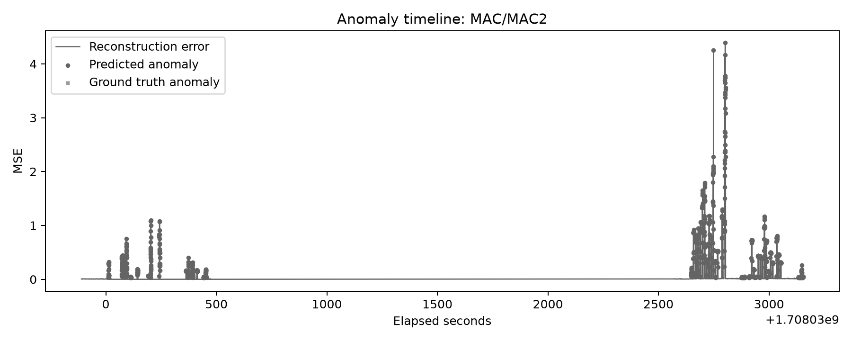
14 • TIME-SERIES BEHAVIOUR
Anomaly timeline
A time view is needed because the project focuses on transient versus persistent events.
Note: adjacent windows overlap (20 samples, stride 1); duration must be calculated from timestamps/event merging, not raw window counts alone.
LSTM AUTOENCODER • OPEN RAN KPI ANOMALY CLASSIFICATION
15

Slide 16
15 • WIRELESS-NETWORK EVALUATION
Which communication metrics fit this dataset?
Evaluate the ML model in terms of network behaviour—but only report metrics supported by measurements.
AVAILABLE KPI FEATURES
METRICS: DIRECT VS DERIVED
• PUSCH count / average PUSCH count
• Uplink PRB size, maximum and minimum
• Uplink MCS, minimum and maximum
• Uplink transport block size (TBS), min/max
• UL transmission count
These can support analysis of radio-resource use, modulation/coding behavior and uplink transmission activity.
Potentially derivable after checking units and sampling interval:
• Data-rate / throughput estimate from transmitted bits or TBS over time
• PRB/resource-use trends; MCS/TBS behavior
Not directly measured in the selected 12 features:
• Latency, goodput, BER, PER, EVM
• Spectral efficiency and ergodic capacity (need suitable rate/bandwidth/channel measurements)
LSTM AUTOENCODER • OPEN RAN KPI ANOMALY CLASSIFICATION
16

Slide 17
16 • WIRELESS IMPACT
How to evaluate network impact responsibly
The current experiment evaluates anomaly detection; it does not yet measure end-to-end wireless QoS.
REPORT NOW (SUPPORTED)
TO CLAIM NETWORK QOS GAINS
• Detection: precision, recall, F1, ROC–AUC, PR–AUC
• False-positive rate and false alarms
• Reconstruction error and threshold
• KPI patterns around detected events
• Radio-side proxies: PRB, MCS, TBS, UL transmission activity
Collect or derive, with units and sampling interval:
• Throughput / goodput (bit/s)
• Spectral efficiency (bit/s/Hz)
• Latency (ms), PER and BER
• EVM (%) and channel-quality measures
• Ergodic capacity only with channel/SNR assumptions or measurements
Then compare normal vs anomaly periods and, ideally, baseline detector vs proposed model.
Do not present unmeasured BER, PER, EVM, latency or capacity as achieved results. They are recommended future evaluation metrics if the required data becomes available.
LSTM AUTOENCODER • OPEN RAN KPI ANOMALY CLASSIFICATION
17

Slide 18
17 • FINAL INTERPRETATION
What we can conclude from the current experiment
The model detects abnormal KPI windows, but reducing false alarms and validating event duration remain key.
ROC–AUC
WINDOW F1
EVENT RECALL
0.688
38.29%
97.10%
Wireless-communication interpretation: the selected KPIs describe uplink scheduling/resource use and transmission behavior. The model can help surface unusual radio-side operating patterns. However, the present dataset and saved outputs do not establish improvements in throughput, spectral efficiency, latency, BER/PER, EVM or capacity. Those require additional measurements and a controlled comparison.
Recommended next step: align each anomaly with timestamped radio KPIs, compute only metrics with valid units, and compare event-level performance against a baseline detector.
LSTM AUTOENCODER • OPEN RAN KPI ANOMALY CLASSIFICATION
18

Slide 19
18 • DISCUSSION
What the current prototype demonstrates—and what remains
A clear, honest summary strengthens the final presentation.
WHAT WORKS
NEXT STEPS
• Resolve 95th vs 99th percentile threshold mismatch
• Reduce false positives and improve event merging
• Correct duration logic for overlapping windows
• Validate transient/persistent labels with ground truth
• Compare with simple baselines; measure detection delay
• End-to-end KPI preprocessing and windowing
• LSTM Autoencoder trained on baseline data
• Reconstruction-error anomaly scoring
• Initial window-level and event-level evaluation
Category coverage is incomplete in saved labelled subsets for MAC and NETWORK; zero positive windows are not definitive evidence of failure.
LSTM AUTOENCODER • OPEN RAN KPI ANOMALY CLASSIFICATION
19

Slide 20
19 • CONCLUSION
Key takeaways
The project is a working prototype and a foundation for more reliable Open RAN monitoring.
An LSTM Autoencoder can learn temporal patterns in baseline Open RAN KPIs.
Reconstruction error provides an initial anomaly signal.
The saved test run achieved ROC–AUC 0.688, but precision and event-level F1 remain low.
Transient vs persistent classification needs duration-aware, ground-truth validation.
Final message: detect unusual behaviour, then establish whether it persists before prioritizing action.
LSTM AUTOENCODER • OPEN RAN KPI ANOMALY CLASSIFICATION
20

Slide 21
20 • REFERENCES
Research and project resources
Key sources supporting the dataset and model approach.
• Sun et al., “SpotLight: Accurate, Explainable and Efficient Anomaly Detection for Open RAN,” ACM MobiCom 2024. DOI: 10.1145/3636534.3649380
• Malhotra et al., “LSTM-based Encoder-Decoder for Multi-sensor Anomaly Detection,” 2016. arXiv:1607.00148
• Su et al., “Robust Anomaly Detection for Multivariate Time Series through Stochastic Recurrent Neural Network (OmniAnomaly),” KDD 2019.
• Xu et al., “Unsupervised Anomaly Detection via Variational Auto-Encoder for Seasonal KPIs in Web Applications (Donut),” 2018.
• SpotLight code repository: github.com/netsys-edinburgh/SpotLight
LSTM AUTOENCODER • OPEN RAN KPI ANOMALY CLASSIFICATION
21

Slide 22
FINAL PROJECT PRESENTATION
Thank you.
Questions & Discussion
LSTM Autoencoder-Based Persistent and Transient Anomaly Classification in Open RAN KPIs
Department of Electronics & Communication Engineering
LSTM AUTOENCODER • OPEN RAN KPI ANOMALY CLASSIFICATION
22

