Slide 1
PROJECT
PROFESSIONAL
PRO CALC
SCIENTIFIC CALCULATOR
123 + 456
AC
(
)
÷
A complete desktop calculator built with Python and Tkinter
7
8
9
×
4
5
6
−
BASIC MATH
SCIENTIFIC
GST
LOAN & EMI
AGE – BMI - CONVERT
1
2
3
+
PRESENTED BY
ORGANIZATION
0
.
π
=
Rishi Yadav
Nexthikes IT Solution
PYTHON | TKINTER | EXE

Slide 2
Project Overview
Developed a desktop scientific calculator using Python and Tkinter.
Provides basic arithmetic operations and expression handling.
Includes sin, cos, tan, log, square root and π functions.
Calculates GST amount and final payable amount.
Estimates monthly Loan EMI, total interest and repayment.
Calculates age in years, months and days.
Calculates BMI score and health category.
Converts length, weight, time, speed, volume and temperature.
Maintains calculation history during the current session.
SCIENTIFIC CALCULATOR • 02

Slide 3
Technology & Libraries Used
Python
Tkinter & tk
Core programming language used to build the calculator and its calculation logic.
Creates the main window, display, equal-sized buttons, custom popups and unit-converter controls.
Math & AST modules
Date & Utility Logic
Math provides sin, cos, tan, log, square root and π. AST supports safer arithmetic-expression evaluation.
Date handles age calculation; conversion formulas support length, weight, time, speed, volume and temperature.
SCIENTIFIC CALCULATOR • 03

Slide 4
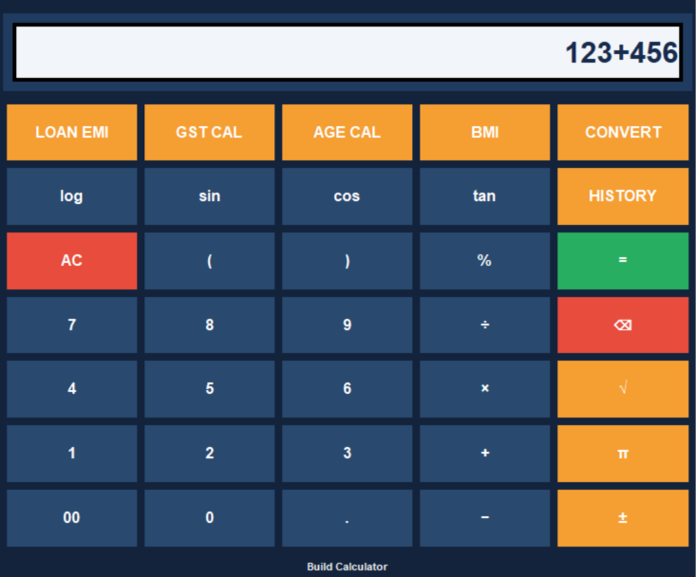
User Interface & Button Layout
A clean, five-column interface with quick access to everyday and scientific tools.
CALCULATOR INTERFACE
KEY FEATURES
01
Basic & Scientific Math
Arithmetic, brackets, %, sin, cos, tan, log, √ and π.
02
Finance Tools
GST breakdown and Loan EMI with interest and total repayment.
03
Personal Calculators
Age in years/months/days and BMI score with category.
04
Unit Converter
Length, weight, time, speed, volume, temperature and currency.
05
History & Usability
Session history, clear input fields and guided popups.
SCIENTIFIC CALCULATOR • 04

Slide 5
Core Calculator Features
Basic arithmetic: addition (+), subtraction (−), multiplication (×) and division (÷).
Expression controls: brackets, percentage, sign toggle, AC and backspace.
Scientific functions: square root (√), sin, cos, tan, log₁₀ and π.
GST Calculator: calculates GST amount and final amount from the entered rate.
Loan EMI: calculates monthly EMI, total interest and total repayment.
Age & BMI: calculates age in years/months/days and BMI category from user inputs.
Unit Converter: converts length, weight, time, speed, volume, temperature and manually-rated currency.
History: records calculations for review during the current session.
SCIENTIFIC CALCULATOR • 05

Slide 6
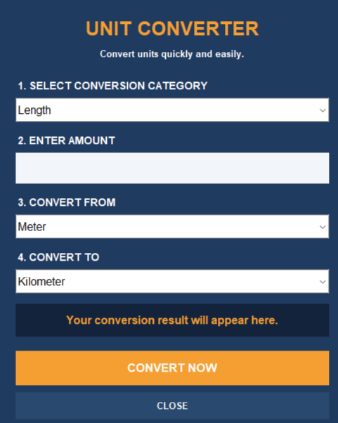
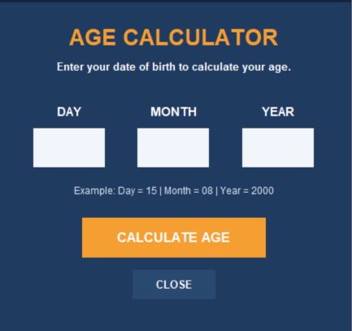
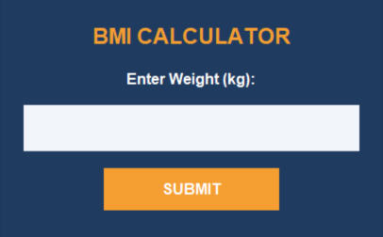
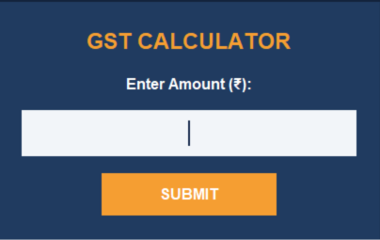
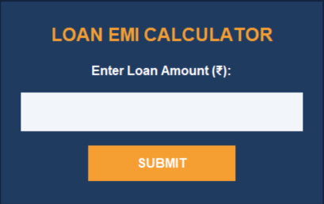
Finance & Everyday Utility Modules
Actual popup screens from the calculator application
AGE CALCULATOR
BMI CALCULATOR
UNIT CONVERTER
GST CALCULATOR
LOAN EMI
Enter date of birth to view age in years, months and days.
Enter weight and height to calculate BMI.
Select category, amount and units to convert.
Enter amount and GST rate to calculate tax.
Enter loan amount to calculate monthly EMI.
SCIENTIFIC CALCULATOR • 06

Slide 7
Project Summary
WHAT THIS PROJECT DELIVERS
Combines basic arithmetic and scientific calculations in one desktop interface.
Adds GST, Loan EMI, Age, BMI and Unit Converter tools.
Uses consistent button styling and clear custom popups.
Keeps calculation history available during the current session.
THANK YOU

