Slide 1

Title: Prediction Of Bandgap, Formation Energy and Bulk modulus of IIIA-VA group materials using ML model(XGBoost)
Sunitha Pavani 22CSB0B11
Rishmitha.R 22CSB0C15
Machine Learning for materials informatics (MLMI)

Slide 2
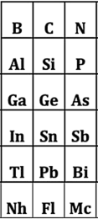
IIIA-VA Semiconductor Materials
III–V semiconductors are compounds formed by combining elements from
Examples : GaAs, InP, AlN, GaN, InSb, AlP
IIIA VA
They are covalent crystals with partial ionic character.
Similar crystal structures – most crystallize in zinc-blende or wurtzite lattices, enabling consistent property comparison.
All are III–V semiconductors – exhibit direct or indirect band gaps

Slide 3







Applications Of IIIA-VA Materials
Light-Emitting Diodes (LEDs)
Laser Diodes
High-Speed & RF Electronics
Solar Cells
Infrared Detectors & Sensors
‹#›
Notes:
Why you studying this materials

Slide 4
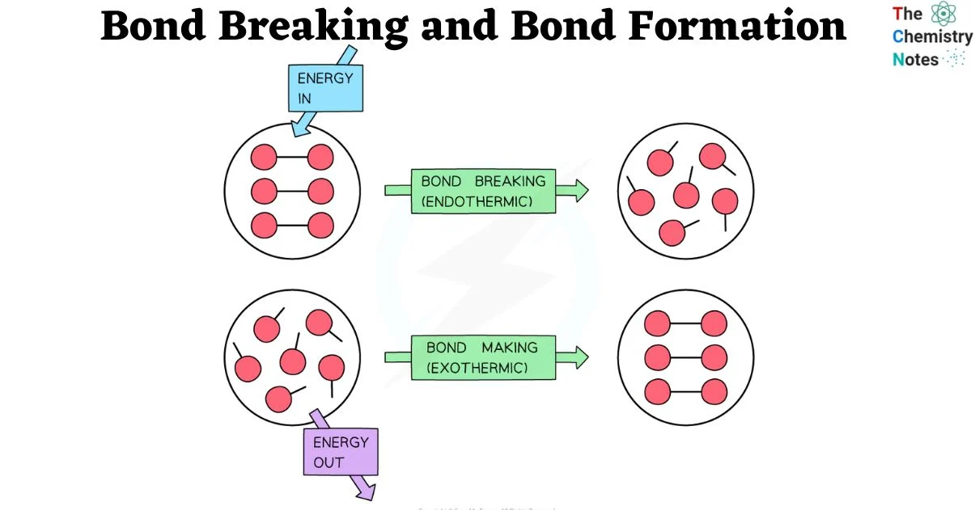
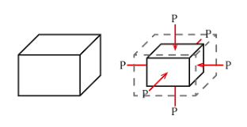
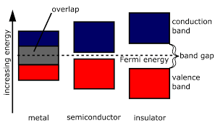
Properties to Predict
Bandgap:
Energy difference between the valence band and conduction band.
Controls optical absorption and electronic conductivity.
Bulk Modulus:
The bulk modulus is a measure of a material’s resistance to uniform compression
Related to mechanical stiffness and bonding strength.
Formation Energy:
Energy released or absorbed when a compound is formed from its constituent elements.
Indicates thermodynamic stability of the material.

Slide 5
Model Overview – XGBoost
XGBoost is a machine learning algorithm based on Gradient Boosted Decision Trees (GBDT).
Working Principle:
Starts with an initial prediction (e.g., mean of data).
Builds a new decision tree to predict those residuals.
Adds the new tree’s prediction (scaled by learning rate) to improve results.
Repeats this process until the error is minimized.
‹#›

Slide 6
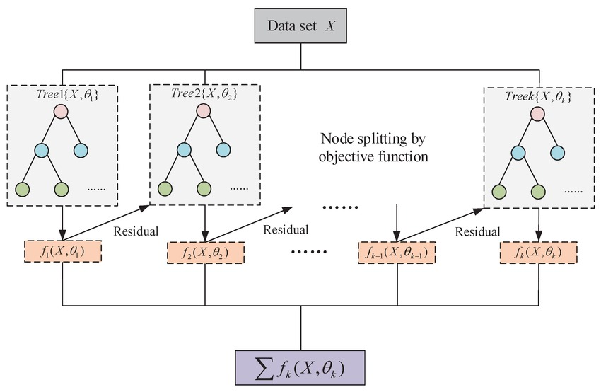
Model Overview – XGBoost
‹#›

Slide 7
XGBoost Regression Model
XGBoost (Extreme Gradient Boosting): A high-performance ensemble learning method based on gradient-boosted decision trees.
Gradient Boosting Update Rule:
ŷᵢ^(t) = ŷᵢ^(t−1) + η * fₜ(xᵢ)
Objective Function:
ℒ^(t) = Σ l(yᵢ, ŷᵢ^(t−1) + fₜ(xᵢ)) + Ω(fₜ)
Regularization Term (for trees):
Ω(f) = γ * T + (1/2) * λ * Σ(wⱼ²)
ŷᵢ^(t) → prediction for sample i at iteration t
fₜ(xᵢ) → new tree (weak learner) output at iteration t
η → learning rate
l → loss function (e.g., MSE for regression)
Ω(fₜ) → regularization term for tree complexity
T → number of leaves in the tree
wⱼ → weight of leaf j
γ, λ → regularization hyperparameters
Why XGBoost?
Learns complex nonlinear relationships between structure & properties
Handles small scientific datasets effectively
Built-in regularization to reduce overfitting
Supports feature importance for model interpretability
Highly optimized for speed, parallelism, and scalability
Notes:
1️⃣ Gradient Boosting Update Rule
Shows how XGBoost adds trees iteratively to improve predictions.
2️⃣ Objective Function
Explains prediction + regularization in one formula.
3️⃣ Regularization Term (for trees)
Prevents overfitting, a key strength of XGBoost.

Slide 8
Features and Labels
Label | Physical Domain | Features
Bandgap (optb88vdw_bandgap) | Electronic | is_orthogonal, mp_ratio, avg_valence, structural_density, atoms_per_cell, mass_diff, mp_diff, lattice_a, lattice_b, en_diff, r_sum_over_mass_sum, alpha, avg_lattice_constant, lattice_c, unit_cell_volume
Bulk Modulus (bulk_modulus_kv) | Mechanical / Elastic | Structural: a, b, c, alpha, beta, gamma, min_dist, max_dist, avg_dist Compositional: Z_mean, mass_mean, en_diff
Formation Energy (formation_energy_peratom) | Thermodynamic / Stability | mass_sum, structural_density, avg_valence, avg_molar_volume, lattice_b, Z_diff, avg_melting_point, polarizability_est, spg_number, Z_sum

Slide 9
Formulas for the calculation of predicting properties
Property | Formula | Parameters
Bandgap | Bandgap (E₉): E₉ = E_C − E_V | EC = energy at conduction band minimum EV = energy at valence band maximum
Bulk Modulus | Bulk Modulus (B): B = −V * (dP/dV) Alternative (from energy–volume curve): B = V * (d²E/dV²) | V = volume P = pressure E = total energy of the material
Formation Energy | Formation Energy (E_f): E_f = [E_total(AₓBᵧ) − x*μ_A − y*μ_B] / (x + y) | E_total(AxBy) = total DFT energy of compound AxBy μA = chemical potential of element A μB = chemical potential of element B x = number of atoms of A y = number of atoms of B

Slide 10
Loss Function
Training Loss Function: Mean Squared Error (MSE)
Mean Squared Error (MSE): MSE = (1/n) × Σ (yᵢ – ŷᵢ)²
Parameters:
n = total number of data points
yᵢ = actual (true) value
ŷᵢ = predicted value
Why MSE?
Penalizes larger errors more heavily due to squaring.
Encourages predictions to be close to true values on average.
Smooth gradient for optimization → better convergence in tree-based models.
Evaluation Metrics
R² (Coefficient of Determination): R² = 1 – [ Σ (yᵢ – ŷᵢ)² / Σ (yᵢ – ȳ)² ]
Mean Absolute Error (MAE): MAE = (1/n) × Σ |yᵢ – ŷᵢ|
Root Mean Squared Error (RMSE): RMSE = √[ (1/n) × Σ (yᵢ – ŷᵢ)² ]

Slide 11
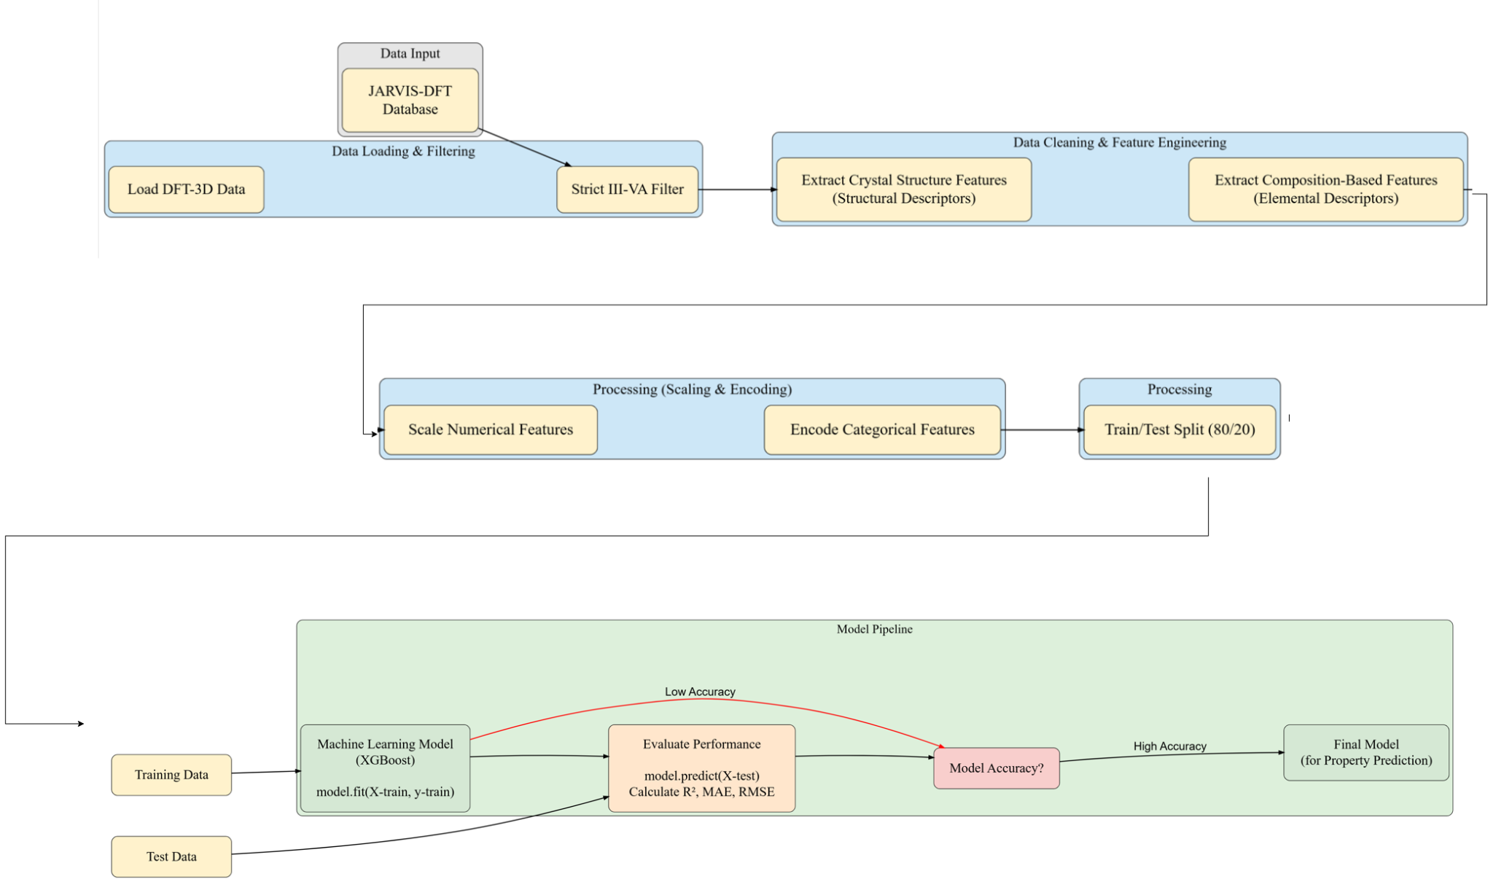
Pipeline for Predicting Target Properties
‹#›

Slide 12
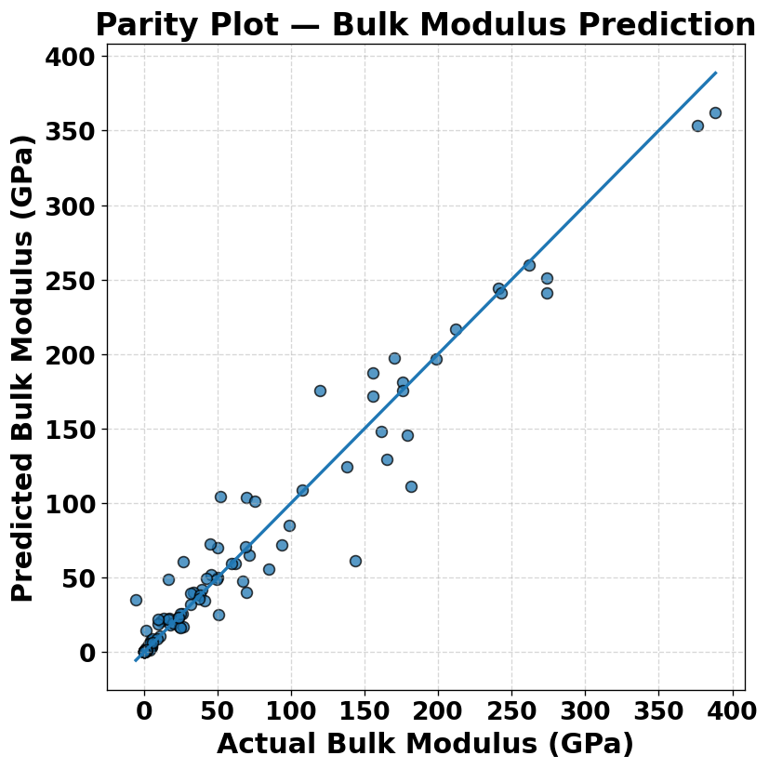
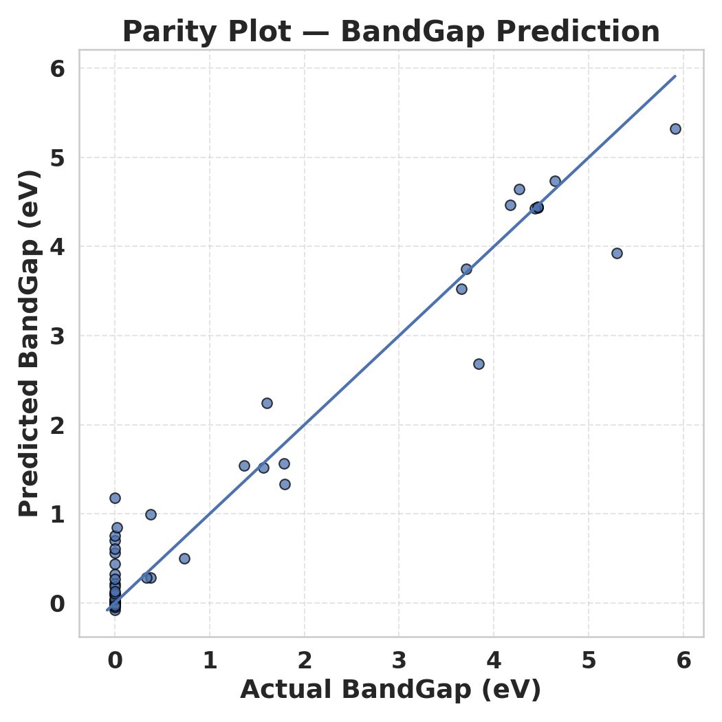
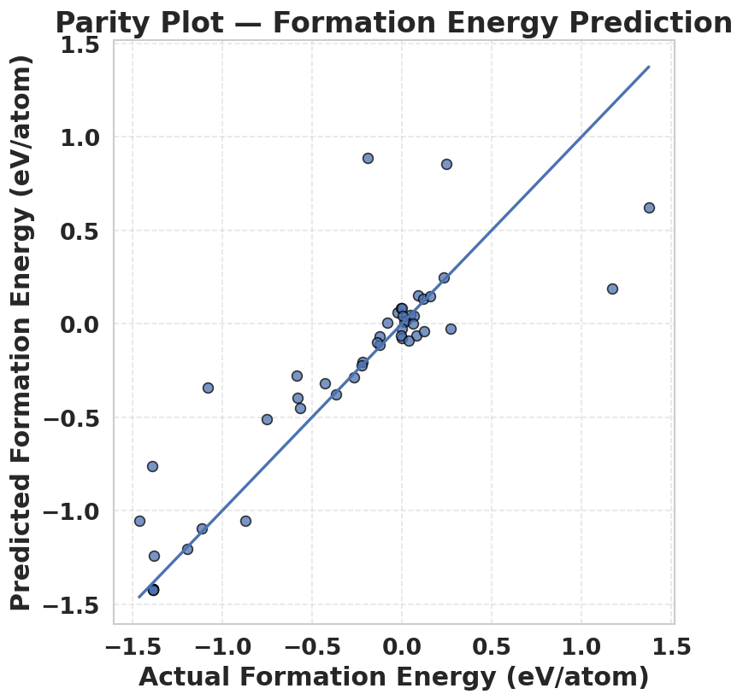
Parity Plots & Accuracy
 | Train R2 | Test R2 | MAE | RMSE
Bandgap (eV) | 0.994 | 0.949 | 0.2689 | 0.4362
Bulk Modulus (GPa) | 0.999 | 0.946 | 16.971 | 26.446
Formation Energy (eV/atom) | 0.996 | 0.736 | 0.153 | 0.334
‹#›
Notes:
Therefore, we find that AENET is the easiest to train at 300 epochs, compared to the other MLIPs considered in this work
that one of the key hyperparameters that influences (training) errors, and computational time in AENET is the number of epochs used during training.

Slide 13
Conclusions
To overcome the high computational cost and time required by DFT for screening new IIIA–VA materials, a machine-learning-based predictive framework using XGBoost has been developed.
We constructed ML models to estimate Band Gap, Formation Energy, and Bulk Modulus using reliable JARVIS-DFT data and carefully engineered structural and compositional features.
The predicted results show strong agreement with DFT-reported values, demonstrating that the proposed ML approach can efficiently capture key material property trends while drastically reducing computation time.
This framework provides a promising pathway for rapid materials discovery and optimization in semiconductor applications, enabling large-scale screening of unexplored III–V compounds.
‹#›

