Slide 1



Loan Recovery Performance
Dashboard
- K. Rishmitha Rao

Slide 2
Learning Objectives
To design and implement a Loan Recovery Performance Dashboard in Power BI :
Goal: To translate raw financial data into actionable insights for collection managers
Skills Demonstrated:
Using visualizations to segment risk (e.g., age, loan type) and measure operational success.
Prioritizing high-risk loans (high value, high delinquency) for optimized collection efforts.
Source :
www.freepik.com/

Slide 3
Tools and Technology used
Power BI
Microsoft Excel / CSV
Python / Pandas
Key Techniques: Scatter plots for risk prioritization, Donut charts for status distribution, and custom bar charts for loss segmentation.

Slide 4
Methodology
Data Acquisition
Data Cleaning
Measure Creation (DAX)
Visualization
Insight Generation

Slide 5
Problem Statement:
The Challenge: Management lacked a real-time, consolidated view of loan health, leading to inefficient collection efforts.
Key Information Gaps:
Financial Risk: No quick way to see the total Outstanding Loan Amount at risk or the precise breakdown of Written Off losses.
Prioritization: Difficulty in identifying which loans were both high-value and highly delinquent (high Days Past Due).
Segmentation: Failure to segment losses by key borrower demographics like Employment Type to improve future lending policies.

Slide 6
Solution:
A multi-page Loan Recovery Dashboard created in Power BI that addresses all key business questions.
Dashboard Features:
KPI Cards: Track overall Recovery Rate and total Written Off Amount.
Risk Heatmap: The scatter plot allows for immediate triage of collection cases.
Strategic Segmentation: Visuals isolate the Written Off segment to understand which Loan Types and Employment Types drive the highest losses.

Slide 7
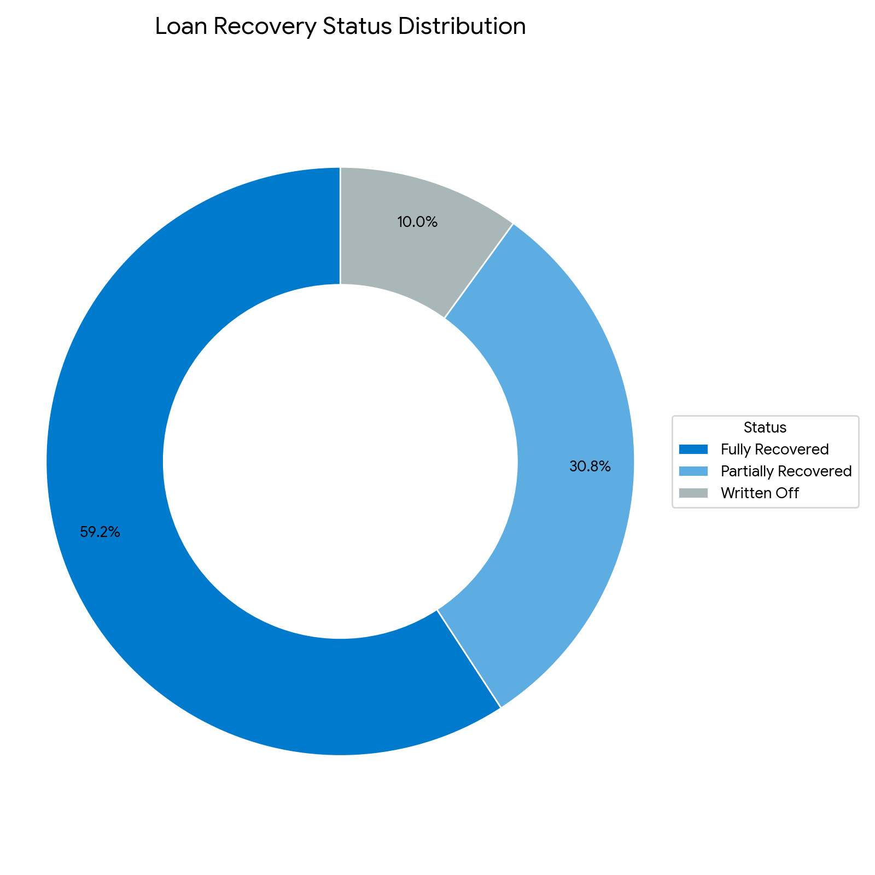
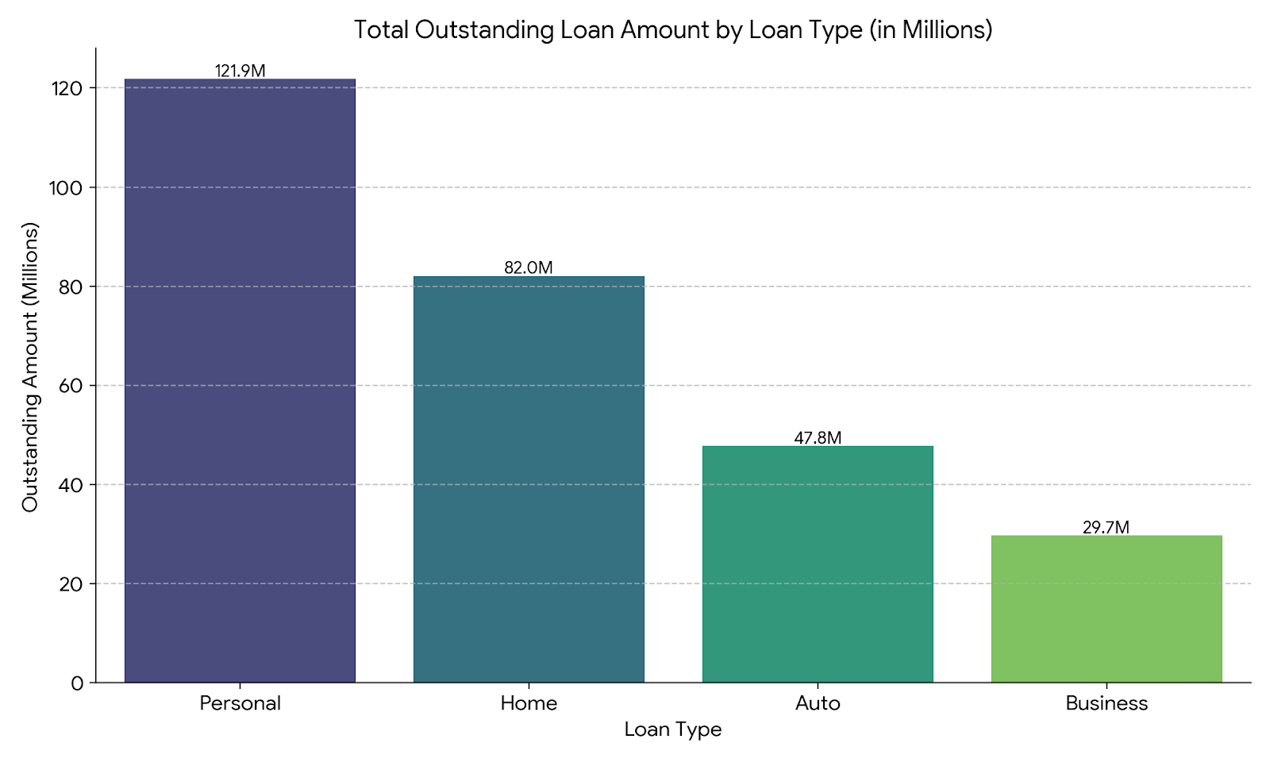
Screenshot of Output:

Slide 8
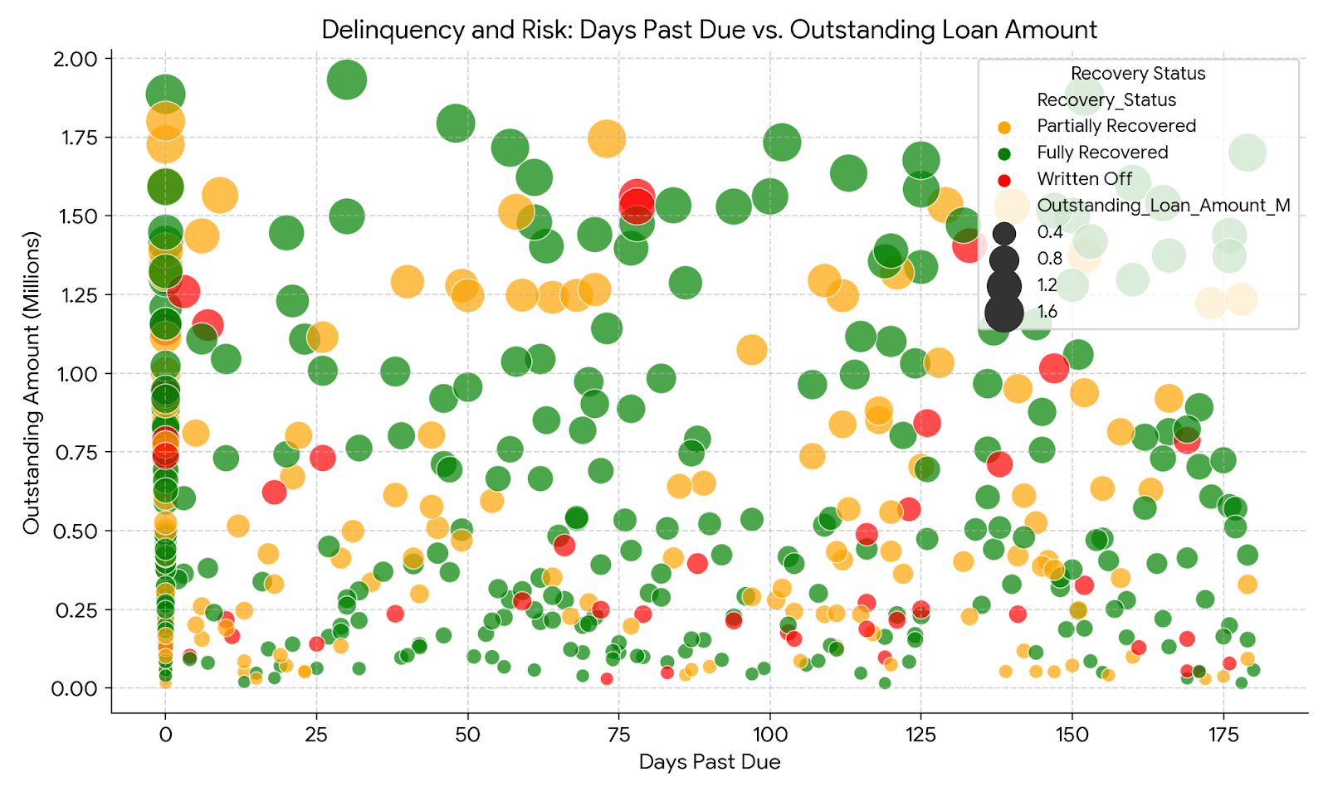
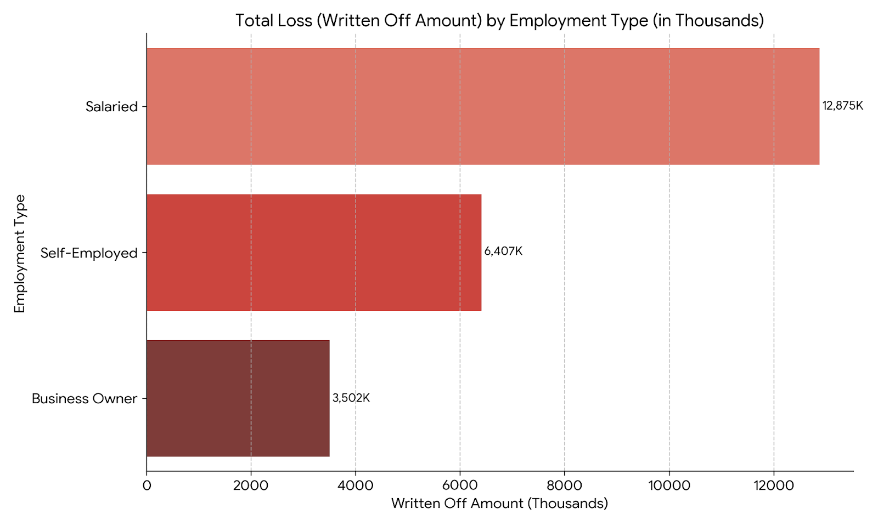
Screenshot of Output:

Slide 9
Conclusion:
Value Delivered: Provided collection managers with the ability to prioritize collection efforts based on the highest-risk loans (high delinquency and high value).
Key Finding: Identified that despite a high overall recovery rate, the largest financial losses were concentrated within specific segments, notably the Salaried employment type.
Impact: The dashboard enables data-driven decisions to reduce financial losses and improve the efficiency of the collection team.

