Slide 1
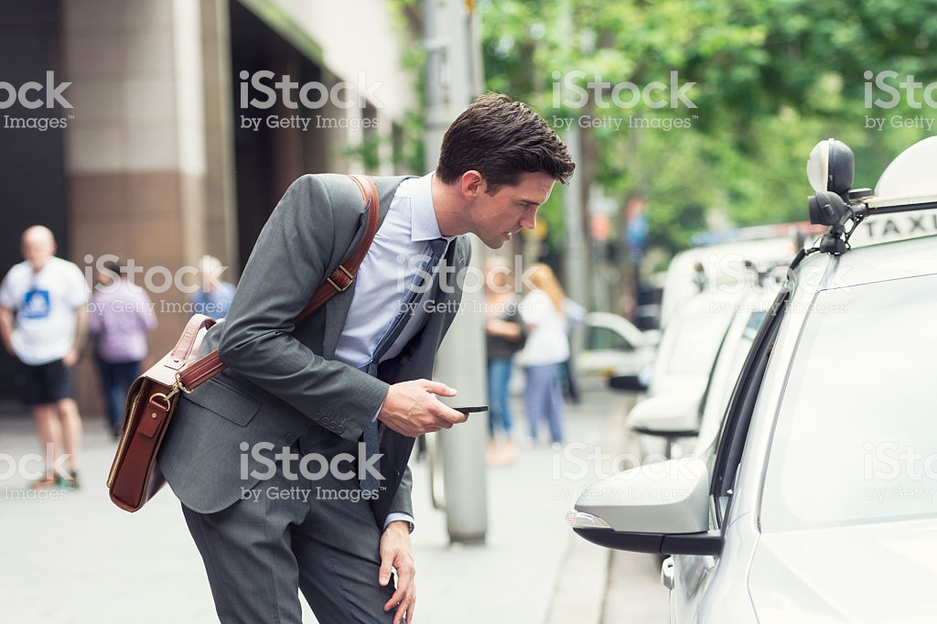
Problems:
Difficult to find a doctor in your locality

Slide 2
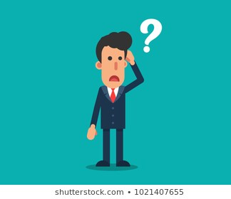
Not to do:
You don’t need to stop at any shop or find a person to ask the address of a specialized doctor.
You don’t need to search the google and besides that sometimes you don’t get information about the doctor on the google itself.

Slide 3
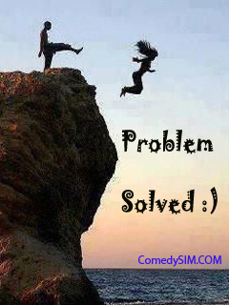
What to do?
You don’t need to worry at all.
It’s right in your pocket.
Just open your app and you get every relevant information about the doctors that you are seeking.

Slide 4
Here is your app:
An app to store the relevant information about the doctors.
Like their qualification, rating, awards, experience, fees, address, contact details.
You can check their reviews at first if you are uncomfortable.

Slide 5
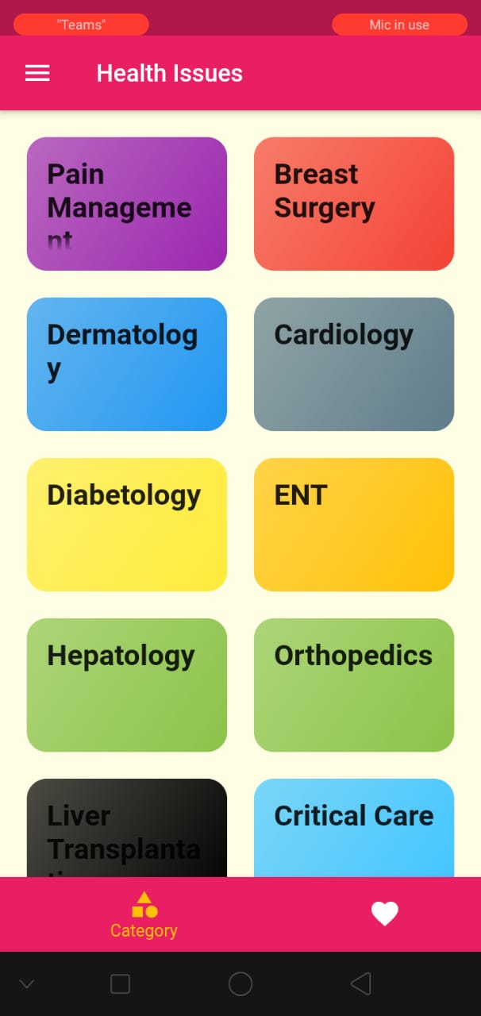
How to use the app?
It’s quite simple.
After opening the app, you will see this screen at first.
This shows all the health issues that a person can face.
It basically categories the health related problems.

Slide 6
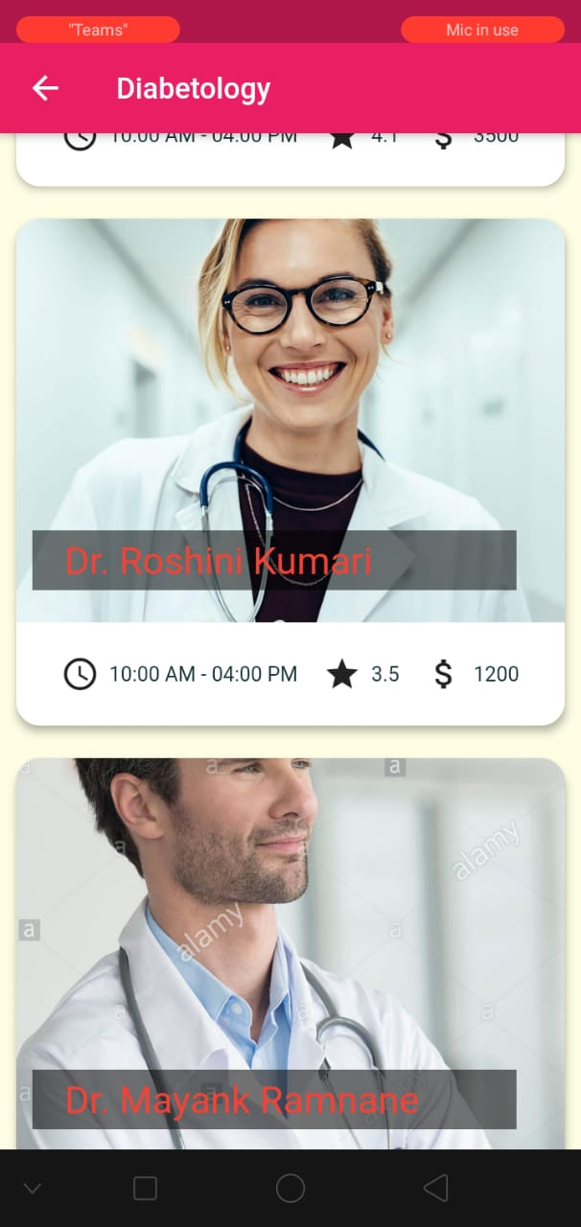
How to use the app?
After you click on any health issues, you will be shown various doctors in those speciality.
You will get to know how much they cost.
What’s their rating, so that you can get proper treatment.

Slide 7
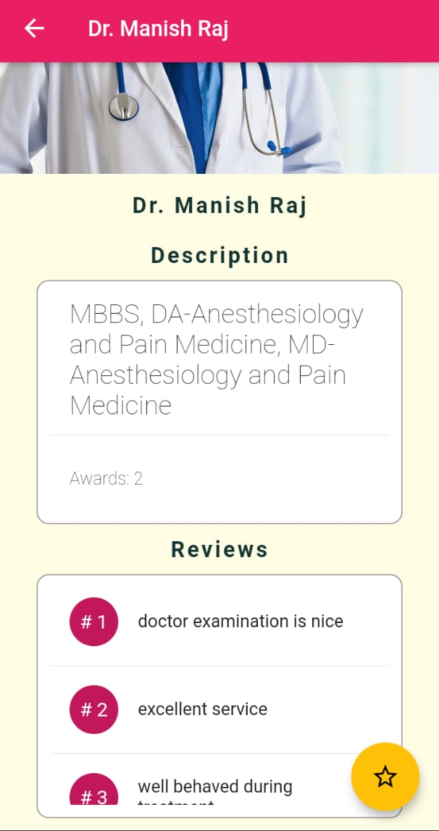
How to use the app?
After that, if you click on any profile, you can see every information that you are seeking.
You can also see their reviews.
Here is another feature for you.
You can add any doctor as your favourite.
So that in future, if you are in hurry and you can directly open your doctor.

Slide 8
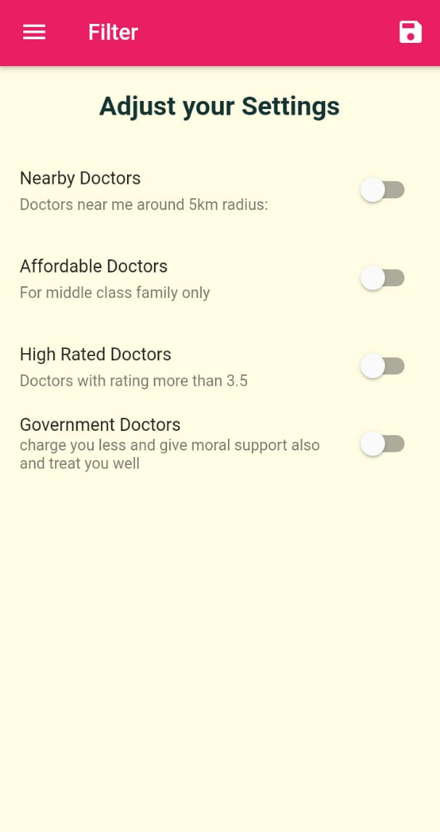
How to use the app?
Suppose in your locality, there are many doctors.
So, in that case, you can filters the doctors related to location,
their ratings.

Slide 9
