Slide 1
Building new boxes

Slide 2

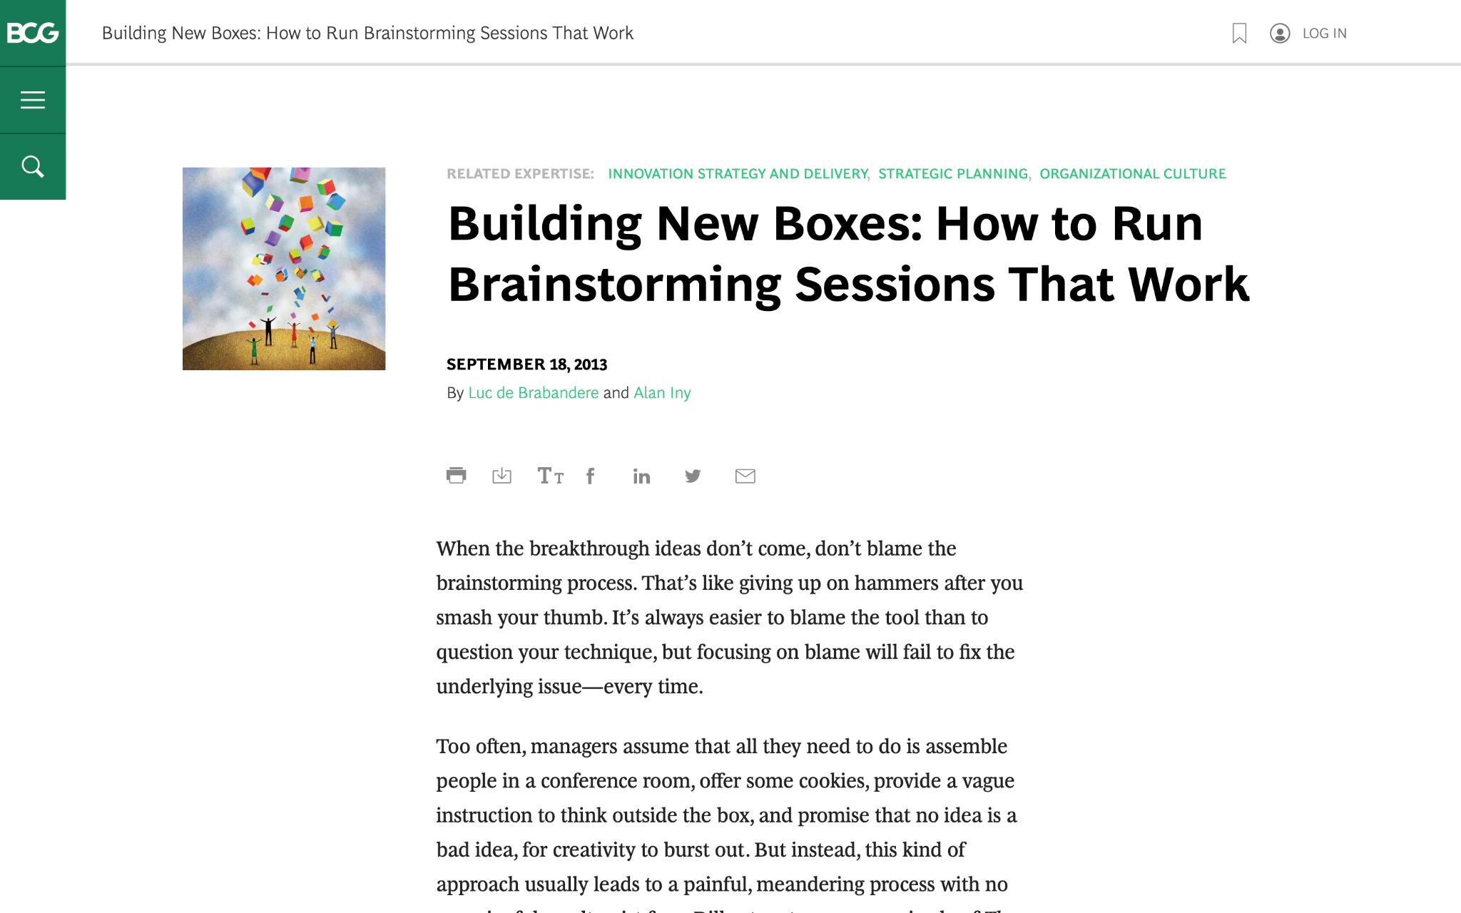
We are going to discuss effective brainstorming. Start by reviewing this article on the BCG website:
Building New Boxes: How to Run Brainstorming Sessions That Work

Slide 3

The article offers five suggestions to achieve real, valuable insights from brainstorming
We will focus on three of these in today’s task (as well as the brainstorming itself), highlighted in green
1.
Frame the question effectively
2.
Create creativity conditions
3.
Reveal and doubt your boxes
4.
Bring new boxes
5.
Follow up
Brainstorm

Slide 4

Your task
BCG has been brought in to help ClothingCo, a luxury clothing brand, grow their top line (i.e., increase revenue) after a period of declining sales.
The client is gearing up for the winter season. Imagine that you are a strategy consultant working on the project.
You will enter your responses in the green boxes throughout the remaining slides.

Slide 5
Frame the question effectively
Question to be reframed
How could we sell more outerwear this winter season?
–
Revised, effective questions:
[How could we be the statement of luxury itself to the premium customers this winter season? ]
[What if we advertise ourselves as not only luxurious but also a future investment for the next generation?]
[How could we optimize outwear assortment, visibility and promotion strategy to align with evolving customer preferences this winter?]
–
Remember: A good question for brainstorming will be narrow and concrete, so that people feel they know how to begin answering it.
“If I were given one hour to save the planet, I would spend fifty-nine minutes defining the problem and one minute resolving it.”
– Albert Einstein

Slide 6
Reveal and doubt your boxes
In this fictional scenario, make assumptions that seem reasonable
–
What boxes currently exist that are still relevant?
[luxury brand]
[exclusive to affluent customers]
–
What boxes currently exist that need to be doubted?
[only a clothing brand]
[outerwear is only about providing warmth in winter]
[physical retails stores]
[brand name is enough to sustain the brand value]
[discounting damages the equity of brand]
The first step in the creative process entails identifying and doubting one’s current boxes and determining which ones require re-evaluation or replacement.
Make a short list of the shared beliefs and assumptions that likely prevail in ClothingCo. Determine which are still relevant and which need to be redefined.

Slide 7
Bring new boxes
New box #1
[diversity in fashion to match evolving customers’ preferences]
[Issue - compromise in the purpose of winter wear-warmth.
Opportunity - coming up with new styles, outfit set and layering that match with the evolving customer preferences, campaigned by influencers]
New box #2
[discounts]
[Issue – damages brand equity
Opportunity – discount window with limited time frame, loyalty based perks discount increases the demand]
Prepare for brainstorming by creating new boxes to bring to the session; new boxes will nurture ideation and can dramatically increase the odds of a useful result.
Remember: Defining new boxes requires a mixture of analysis and art. Boxes need to be grounded in fact. Different sectors will call for different inputs.

Slide 8
Brainstorm
Choose one of the effective questions you created on slide 5, and a new box from slide 7, and brainstorm potential ideas to address the question
Question | [How could we optimize outwear assortment, visibility and promotion strategy to align with evolving customer preferences this winter?]]
New box | [diversity in fashion to match evolving customers’ preferences]
[diversity in style, design and idea]
[layered clothing to combat winter]
[storytelling]
[influencer validation]
[endorsement by a celebrity]
[introducing new items such as boots, gloves, hats, etc.]
[items ranging from elegant to flamboyant concept]
[digital fluency]

