Slide 1
Report on advisory service given to improve the Customer & Operations and Transformation services
Healthy Co.

Slide 2
Executive summary
This deck focuses on summarizing the points gathered such as :
from data analysis - slide 3
from research – slide 4
ways to improve patient experience – slide 5
Slide 3 : It shows the co-relation of doctors, nurses, patients, patients’ wait time depending upon nurses and doctors and also its effect on cost of revenue.
Slide 4: It shares the best practices that are found in the research and how the client can apply such approaches to its benefit.
Slide 5: It states the ways to improve the patients experience including (but not limited to) patient wait times.

Slide 3
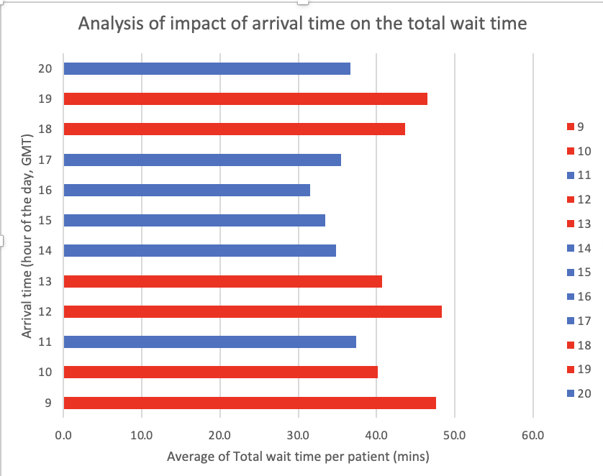
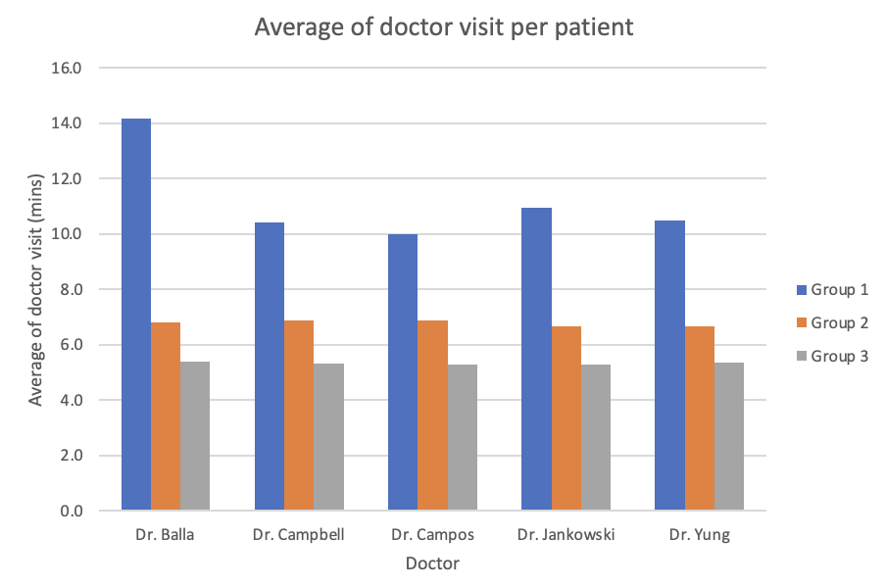
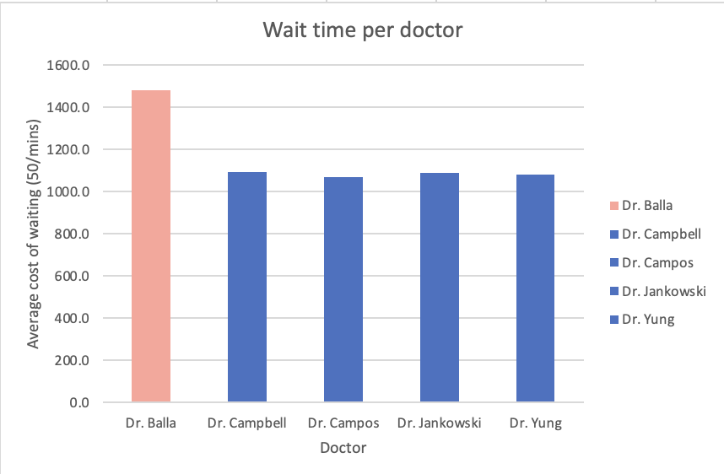
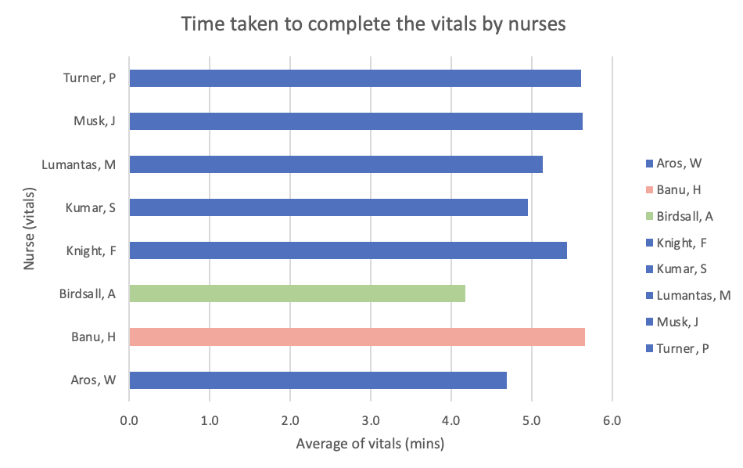
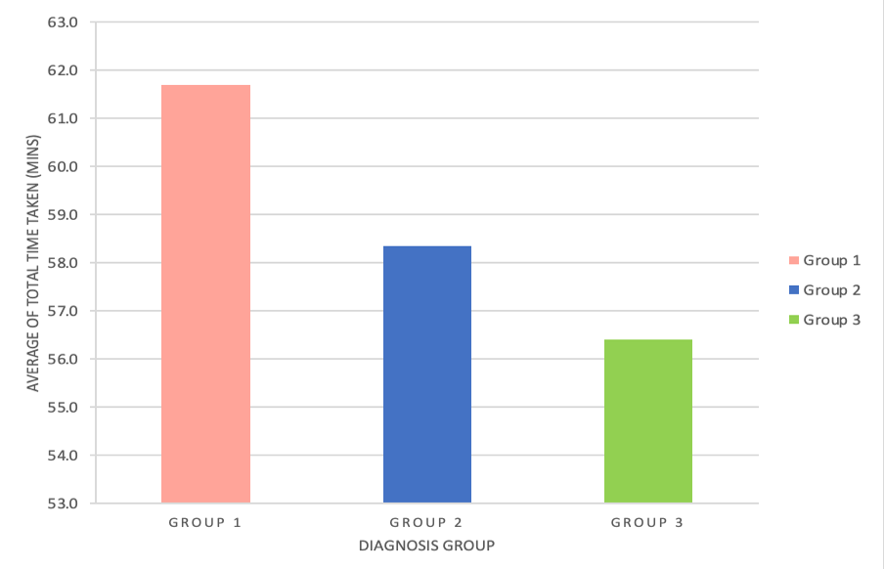
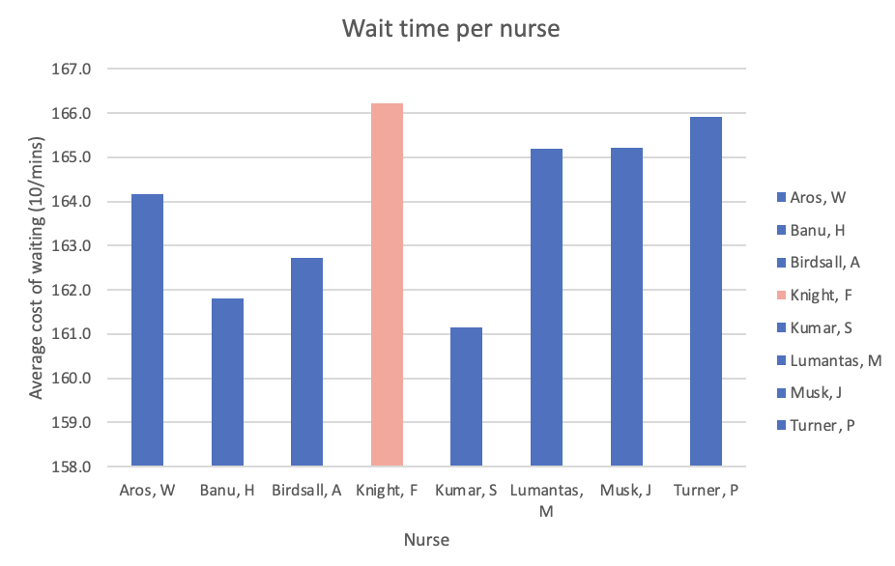
Insights of Data Analysis
Graph 1:The patients arriving during morning time (9 AM and 10 AM), the afternoon time (12PM, 1PM) and the evening time (6 PM and 7 PM) have to wait the most. While 9 AM has the worst impact with an average of 47.6 mins wait time, 4PM has the least impact with an average of 31.5 mins wait time.
Graph 2: While Banu H. took the longest time with an average of 5.7 , Birdsall A. took the shortest time with an average of 4.2
Graph 1: Each doctor mostly spend similar time with group 2 and 3 but Dr. Balla takes the most time with diagnosis group 1 with an average of 14.2 mins.
Graph 2: The total time taken by diagnosis group 1 is the longest with an average of 61.7 mins , whereas the diagnosis group 3 took the least amount of time with an average of 56.4 mins
Graph 1: Nurse Knight is losing the most revenue for the company with an average cost of waiting of 166.2 mins.
Graph 2: Dr. Balla is losing the most revenue for the company with an average wait time of 29.6 mins.

Slide 4
Best practices found in the research
AI-driven Patient Intake
  Impact: Automates registration and prioritizes cases, reducing check-in times and improving patient flow.
Predictive Staff Scheduling
  Impact: Optimizes staff schedules based on patient demand, improving efficiency and reducing wait times.
Block Appointment Scheduling
  Impact: Groups patients into specific time slots, balancing patient flow and reducing congestion.
Staff Retraining
  Impact: Improves triage efficiency, reducing time spent on initial assessments and speeding up patient processing.
Some of the applications of these practices for the client:
Use predictive scheduling to align staffing with patient demand, ensuring that Nurse Knight and Dr. Balla are available during peak times, reducing wait times for more urgent patients (Group 1).
Implement block scheduling based on patient severity (Group 1, 2, 3) to reduce congestion, ensuring that Group 1 patients are seen first and reducing wait times for all groups.

Slide 5
To improve patient experience, including (but not limited to) patient wait times.
Following steps can be taken:
Self Check-In Kiosks : Digital kiosks allow patients to check in without filling out paperwork.
Mobile Pre-Registration : Patient complete forms online before their visit.
Free Guest Wi-Fi : Let patients access internet while they wait.
Estimated Wait Time Transparency : Let patients know expected wait times at check-in.
Express Triage for Low-Risk Patients : Fast-track simple cases to reduce congestion.
Auto-Fill Forms from Patient History : Use stored info to reduce paperwork repetition.
Comfort Kits for Longer Waits : Offer water, snacks, or small activities during long waits.

Slide 6
Self-reflection form
Once you are happy with your presentation, read through the presentation checklist, and then record yourself presenting (you won’t submit this recording). Watch the recording, and complete this self-reflection slide. Submit as part of your deck.
What did you do well? What are your areas of strength?
Clarity Explanation Confidence Focus Fluency
What could have gone better? What are your areas of focus for next time?
Hand gesture

