Slide 1


[Data Analysyis Report of Social Buzz]

Slide 2


Today's agenda
Project recap
Problem
The Analytics team
Process
Insights
Summary

Slide 3

N
A social meadia platform, Social Buzz has reached a massive scale within recent years and does not have the resources internally to handle it. To start our engagement with Social Buzz, we are running a 3 month initial project in order to prove to them that we are the best firm to work with. They are expecting the following: -
An audit of their big data practice
Recommendations for a successful IPO
An analysis of their content categories that highlights the top 5 categories with the largest aggregate popularity.
In this project, I, as an analyst will work on analysis of sample data sets with visualizations to understand the popularity of different content categories and sort out top five among them.
Project Recap

Slide 4

Problem
To find the top five content categories with the largest popularity

Slide 5



Data Analyst (Me)
Rishu Mandal
The Analytics team
Chief Technology Architect
Andrew Fleming
Senior Principal
Marcus Rompton

Slide 6
Process
1
Identification of data sets required to handle client’s business question
2
Cleaning the datasets
3
Extracting and merging data
4
Corelating between different datasets and data model
5
Sort to find the top 5 categories

Slide 7

Insights
The data given by Social Buzz had 11 categories of content namely:
Animals
Science
Healhty eating
Technology
Food
Culture
Travel
Cooking
Soccer
Education
Fitness
Studying
Dogs
Tennis
Veganism
Public speaking

Slide 8
There were many types of reactions suhc as:
Adore
Cherish
Disgust
Dislike
Hate
Heart
Indifferent
Interseted
Intrigued
Like
Love
Peeking
Scared
Super love
Want
Worried

Slide 9
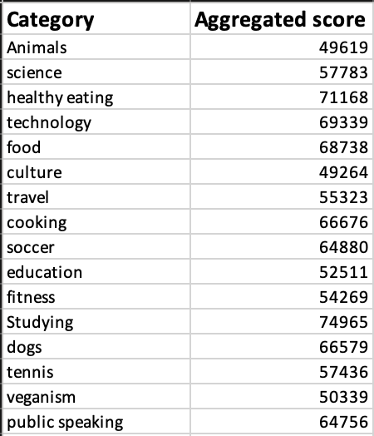
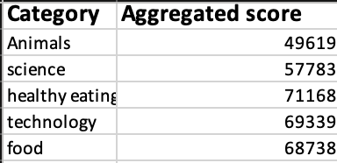
All categories with the aggregated score
Top 5 categories with their aggregated scores
As we can conclude from the above data, the top five categories are animals, science, healthy eating, technology and food.
The highest category is healthy eating with the highest reaction score of 71168.

Slide 10

As we can conclude from the above data, the top five categories are animals, science, healthy eating, technology and food.
The highest category is healthy eating with the highest reaction score of 71168.
Summary

Slide 11

Thank you!
ANY QUESTIONS?

