Slide 1
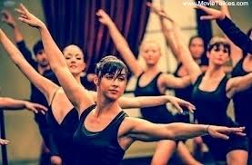
DANCE ACADEMY

