Slide 1
Alternative Dollar Auction Game: Modeling and Simulation Based on "Thirty-Six Stratagems" and Game Theory.
CS/ECON 206
Duke Kunshan University
Yiwei Liang

Slide 2
Contents
Introduction
Research Question
Coding Works
Game Flow
Results
Intellectual Merits
Practical Impacts
Conclusion

Slide 3
Introduction
Dollar Auction game is a non-zero-sum sequential game played by two or more bidders, with the objective of winning a dollar bill. In this project, develop a new tool to simulate the dollar auction game and change the original game into an alternative form. Consider the real-world application of Dollar Auction game, it usually explains the effects and consequences of sunk costs and costly competition. Applying this project, we have a more flexible Dollar Auction game environment to simulate more complex situations. At the same time, this project provides new solutions to decrease the probability and amount of lost money.

Slide 4
Research Question:
What are the effects of incorporating strategies from the "Thirty-Six Stratagems" and game theory in an alternative dollar auction game and how to consider a more complex situation compared to the original dollar auction game.
Implement Method:
Object oriented programming base on python and its libraries.

Slide 5
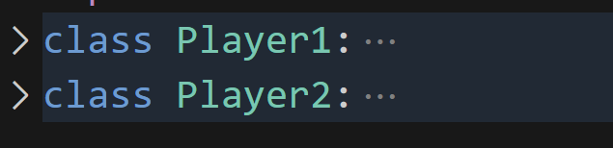
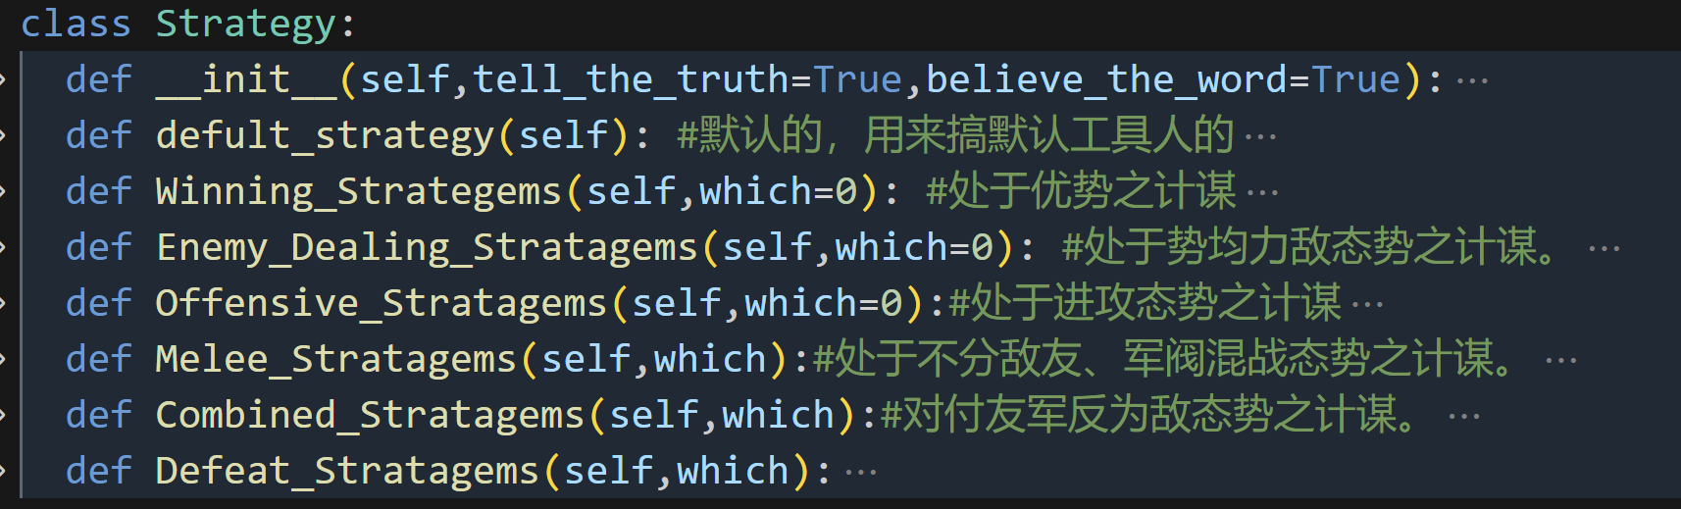
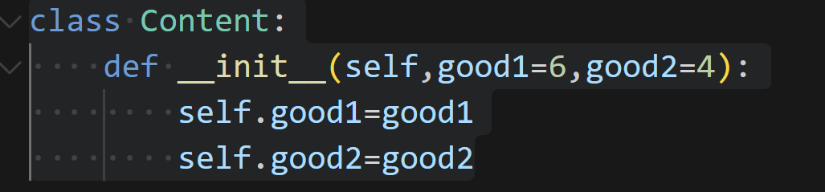
Coding Works:
The code implements a game that involves two players (Player1 and Player2) competing against each other. The game progresses through multiple rounds, and the players make decisions regarding their moves, strategies, and payments.

Slide 6
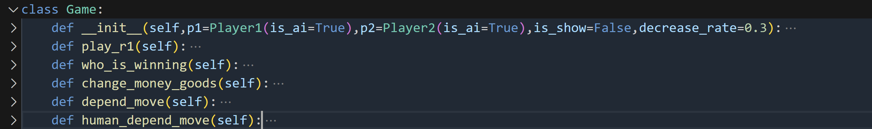
Coding Works:
Class Definitions:
Content: Represents the content of the game, including the goods available.
Player1: Represents Player 1 and contains attributes and methods related to Player 1's moves, strategies, and decisions.
Player2: Represents Player 2 and contains attributes and methods related to Player 2's moves, strategies, and decisions.
Game: Represents the game itself and coordinates the interactions between Player 1 and Player 2.

Slide 7
Game Flow
1. The game starts with the creation of Player 1 and Player 2 instances, along with the initialization of game-related variables.
2. Each round of the game consists of the following steps:
Player 1 and Player 2 make their moves by calling the player_move method.
If the players are AI-controlled, a random strategy is chosen. Otherwise, the human player is prompted for their actions.
Players decide whether to use stratagems or not. If they choose to use stratagems, they select a specific stratagem and execute it using the which_stra method.
Players determine their actual pay values for goods and the tell values they want to convey to the opponent.
The game handles dependent moves, adjusting pay values based on opponent's tell values and a random factor.
Money and goods are updated based on the pay values and a decrease rate.
The game determines the winner based on the players' money. The winning player is recorded, along with the winning strategies used.
3. The game continues for multiple rounds until completion.
4. The game keeps track of the real winning results by comparing each player's money to their initial money.
5. The game ends, and the final results are available, including the winner, winning strategies, and real winning statistics.

Slide 8



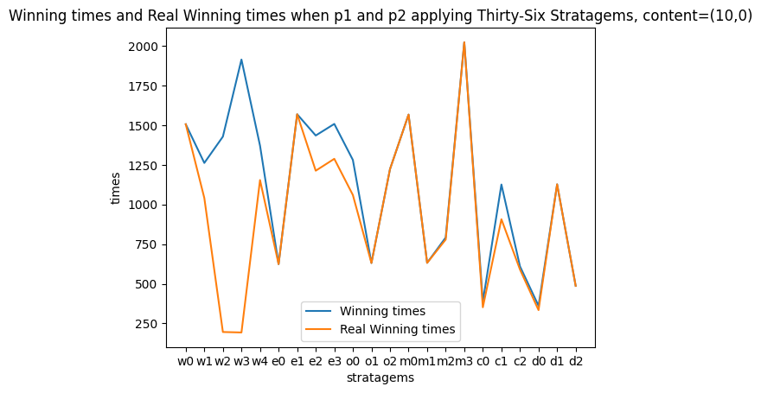


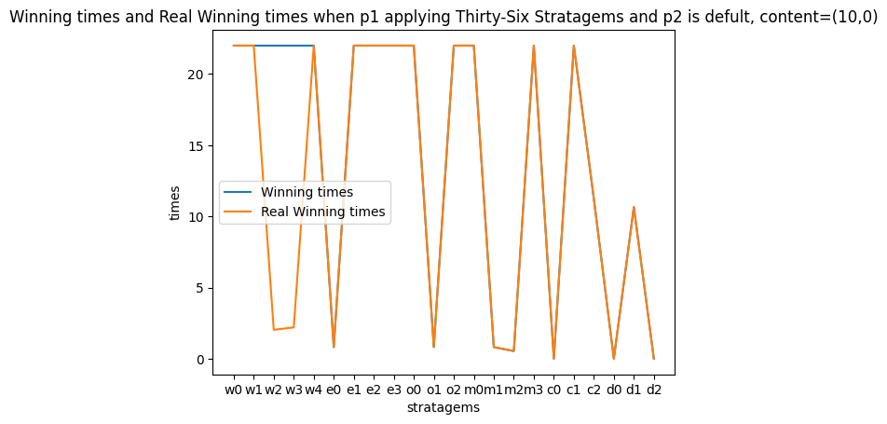
Results

Slide 9
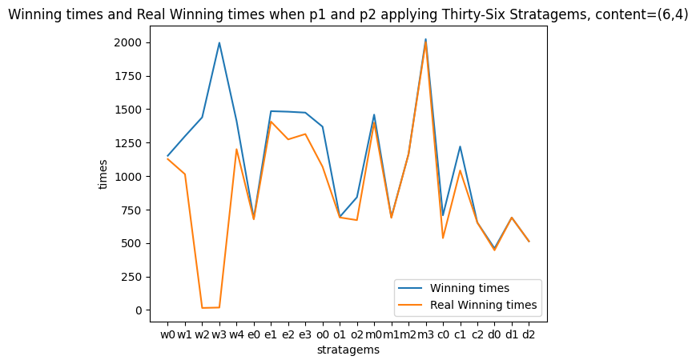
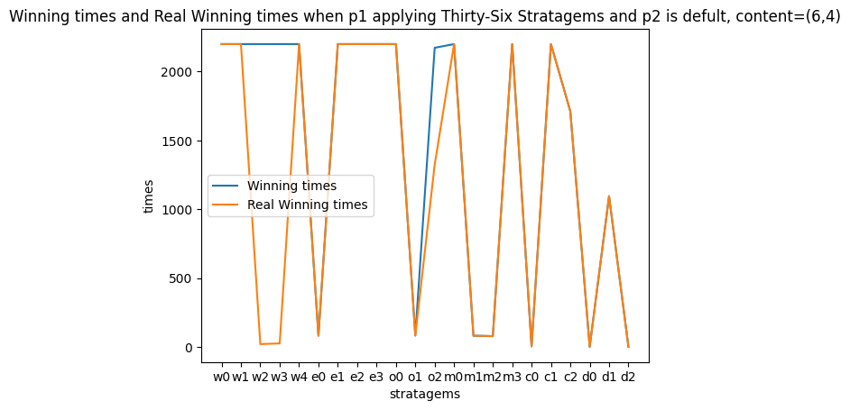
Results

Slide 10
Results
Paying a higher value increases the probability of winning the game: The code suggests that players who pay a higher value for goods have a higher chance of winning.
Splitting action goods can lead to a more complex situation and reduce damage from irrational opponent options.

Slide 11
Intellectual Merits
Algorithmic Analysis: The project involves analyzing game strategies and decision-making processes using algorithmic techniques. By examining various factors such as payment values, goods distribution, and strategic choices, it contributes to the understanding of optimal game-playing strategies.
Game Theory: The code implementation demonstrates practical applications of game theory principles. It explores the dynamics between two players, their strategies, and the resulting outcomes. This contributes to the field of game theory by providing empirical data on the effectiveness of different strategies.

Slide 12
Practical Impacts:
Strategic Planning: The project can be utilized in various practical scenarios that involve strategic planning and decision-making. Industries such as finance, marketing, and military planning could benefit from analyzing game strategies and understanding the implications of different choices.
Risk Management: The project sheds light on the risks associated with different actions in a game. It highlights the importance of assessing potential losses and developing risk management strategies. This knowledge can be applied to real-world situations, such as investment decisions or competitive market analysis.

Slide 13
Conclusion:
In conclusion, the project is useful and meaningful as a tool and new solution and still can be improved.

Slide 14
Thank You!

Slide 15
References:
G. Cungen and Z. Yongxin, “The psychology of the thirty-six stratagems and its management position,” Psychological Science, vol. 26, no. 3, pp. 411–414, 2003.
V. Neumann and O. Morgenstern, Theory of Games and Economic Behavior. (Second edition.). Princeton University Press, 1947.
R. L. Tung, “Strategic management thought in east asia,” Organizational Dynamics, vol. 22, no. 4, pp. 55–65, 1994.
Shubik, Martin. "The dollar auction game: A paradox in noncooperative behavior and escalation." Journal of conflict Resolution 15, no. 1 (1971): 109-111.
S. H. Verstappen, “The thirty-six strategies,” 2017.

