Slide 1
Tree vs. Crop
Yiyuan Qin
ECON 206 Final Presentation
2023 Spring

Slide 2
Table of contents
01
02
03
04
Introduction
Methodology
What is the game?
How to design the game?
Application
Q&A
Where can this game
be applied?
Okey dokey!
Ask if you want!

Slide 3
What’s the game?
01
03
04
Q&A
02
Methodology
Application
Introduction
Old game
Environment vs. economy
Research gap
Macroscopic
Outdated vision of people
My game
Multi-factor
Multi-players
Cooperatioin
Lee, Chih-Sheng. 2012. “Multi-Objective Game-Theory Models for Conflict Analysis in Reservoir Watershed Management.” Chemosphere 87 (6): 608–13. doi:10.1016/j.chemosphere.2012.01.014.

Slide 4
Game Environment
01
03
04
Q&A
02
Methodology
Application
Introduction
Player
10 players (you can change whatever you want)
Strategies
Choose to plant crop(economy) or tree(environment)
Payoff
Two kinds: environmental--all tree/10 and economic payoff--own crop

Slide 5
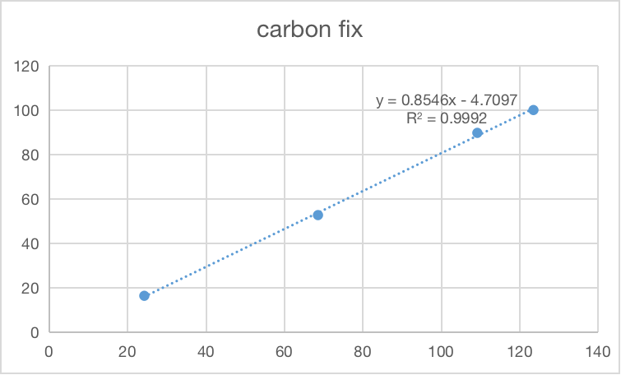
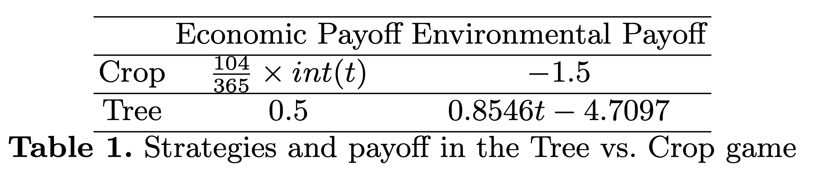
Game Payoff Matrix
01
03
04
Q&A
02
Methodology
Application
Introduction
Crop economic payoff > Tree economic payoff
Crop environmental payoff< Tree environmental payoff

Slide 6
Adding factors
01
03
04
Q&A
02
Methodology
Application
Introduction
Psychological Factors
Social Factors:
1
5
1
Risk Aversion
Education and Awareness
5
2
6
2
Environmental Concerns
3
7
6
Social Norms
4
8
3
Time Preference
Competitive Pressure
7
4
Collaboration and Cooperation
8
Altruism
Alpha

Slide 7
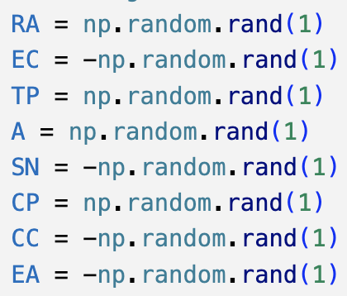
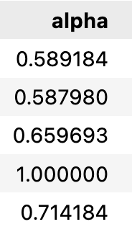
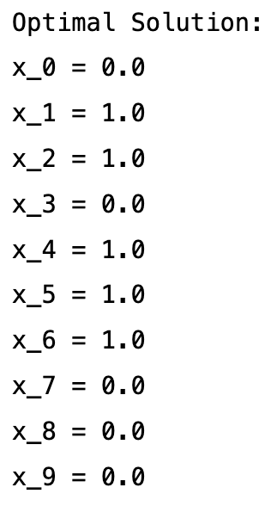
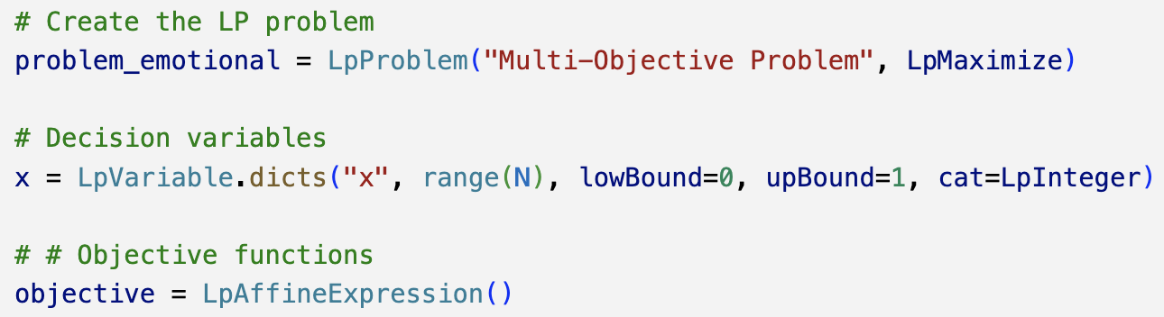
Multi-objective optimization (pulp)
01
03
04
Q&A
02
Methodology
Application
Introduction
objective for each player = maximum (alpha*own_economic_profit + (1-alpha)*all_environment_profit/10)

Slide 8
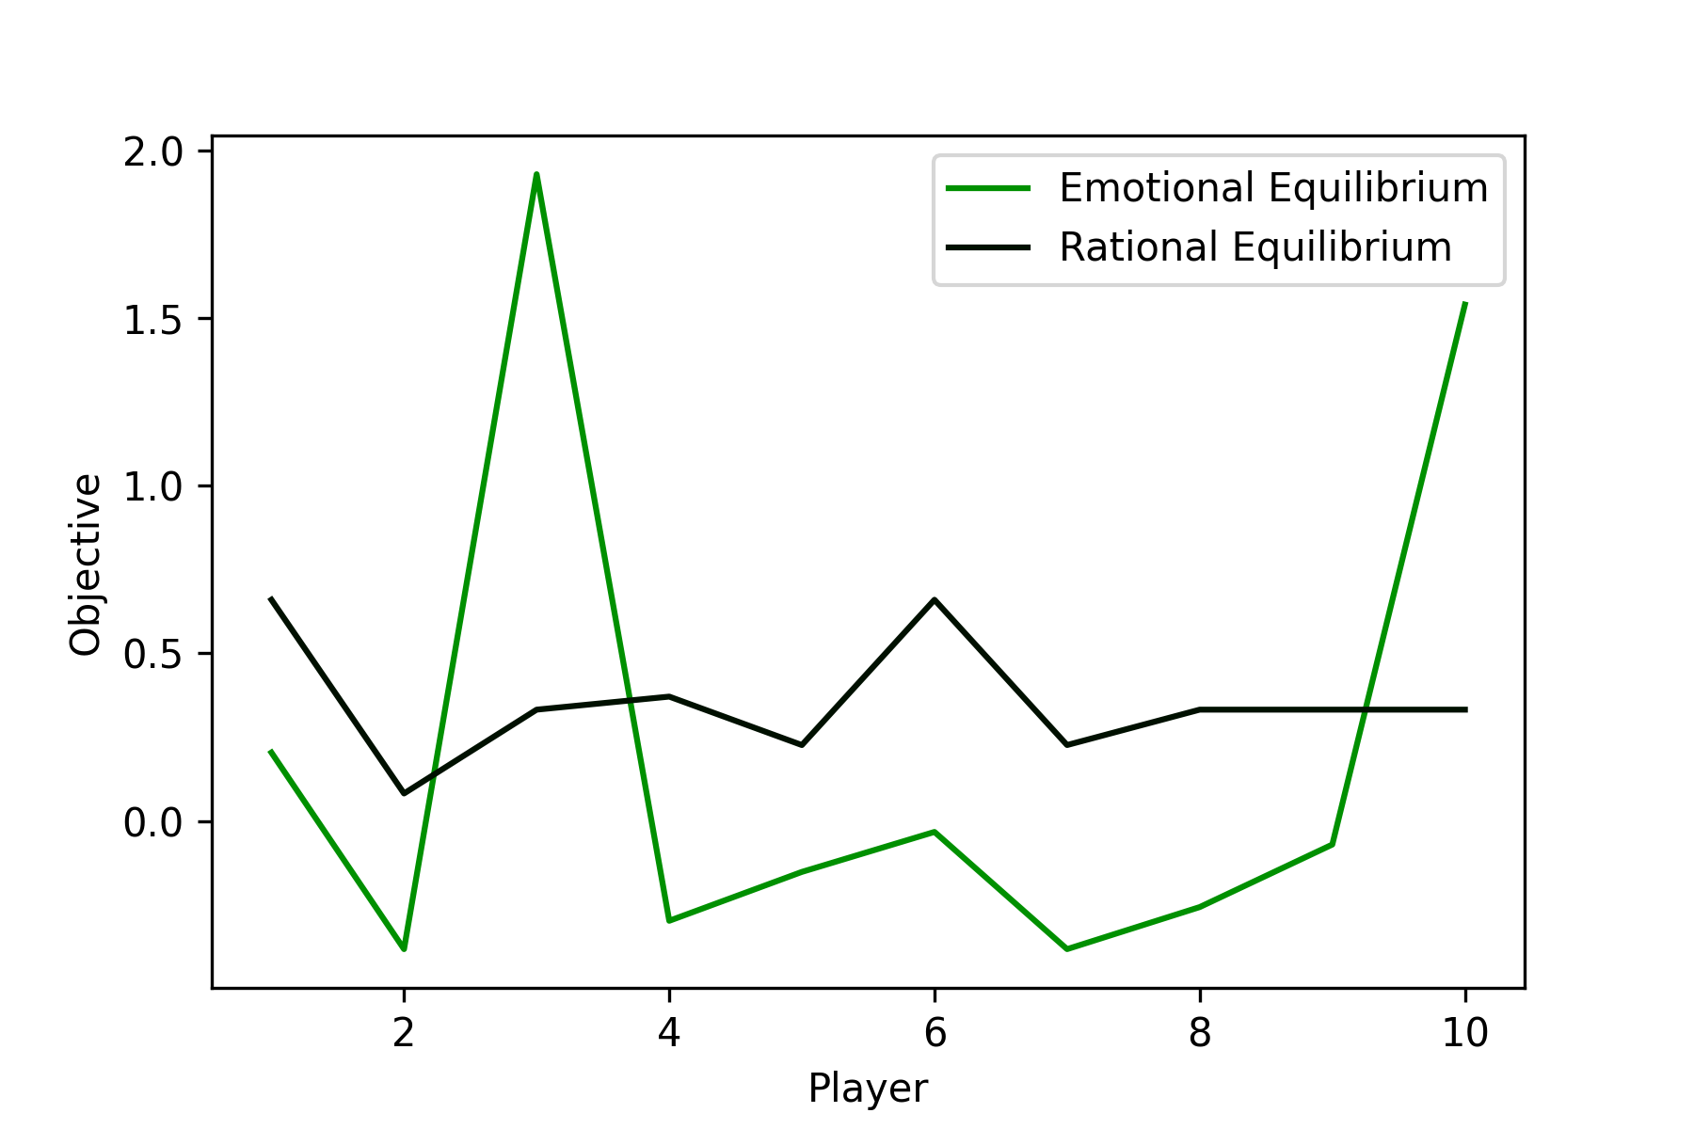
Results and Limitations
01
03
04
Q&A
02
Methodology
Application
Introduction

Slide 9
What’s the potential application?
01
03
04
Q&A
02
Methodology
Application
Introduction
Sustainable Resource Management
Rural Development
Help rural areas find a balance between economic development and environmental protection
A
B
Help inform resource management strategies that optimize both economic and environmental objectives.
Policy Development and Decision-Making
Environmental Education and Awareness
D
C
Policymakers can gain insights into the trade-offs and synergies between economic and environmental outcomes
Fostering greater environmental awareness and responsible decision-making.

Slide 10
Q&A
01
03
04
Q&A
02
Methodology
Application
Introduction
If you have any question, feel free to ask me!

Slide 11
Thanks!
yq74@duke.edu
Duke Kunshan University

