Slide 1

ISIMIP (Inter-sectoral Impact Model Intercomparison Project) and downloading data
Riccardo Soldan
March 2023

Slide 2

Content
Brief overview of ISIMIP
How to download data from ISIMIP

Slide 3
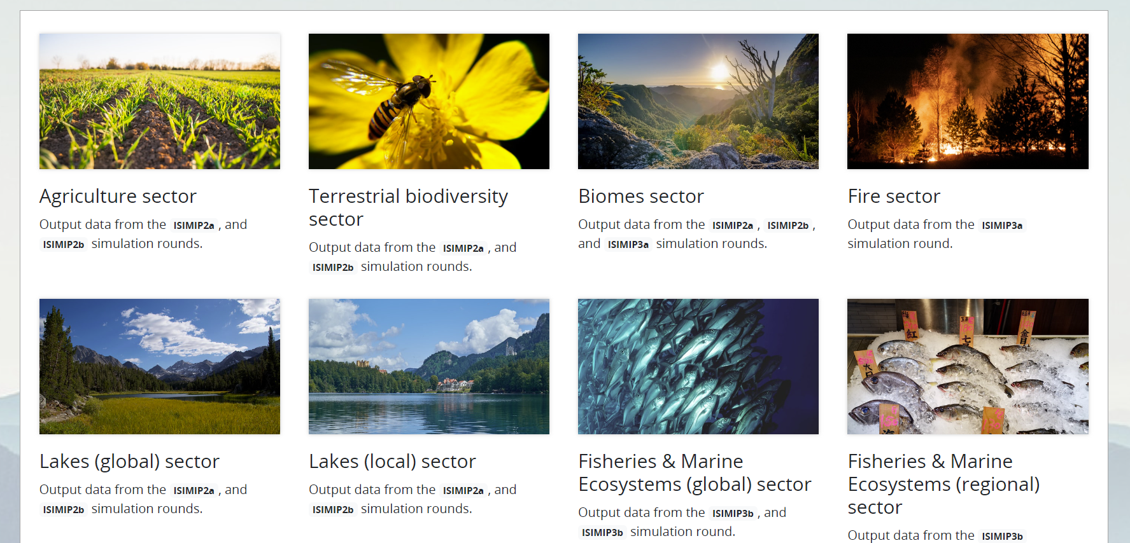
Overview of ISIMIP (Inter-sectoral Impact Model Intercomparison Project)
ISIMIP is the equivalent of CMIP for Impact models. It tries to provide a framework to answer the following question. What will be the impact of climate change on natural and human systems?

Slide 4
How to Download the data
Access the data
Select the ecosystem of interest
Filter and download (the rest of the tutorial will be live)
You can now use climate4R to read netCDF files and other R libraries to visualize the results

Slide 5
Thank you! Contact details: riccardo.soldan@fao.org

