Slide 1

Developing a decision support system for FAO’s Framework for Environmental and Social Management – FESM

Slide 2
ESS 9.1-9.4
Could the project through activities or policy advice negatively impact places, objects, values or knowledge and practices of cultural importance to communities?
Could the project lead to excavations, flooding, demolitions, movement of earth, landscape transformation, or alteration to social/ cultural uses or heritage?
Could the project lead to the use of tangible and/or intangible forms (e.g. collections, areas, practices, traditional knowledge) of cultural heritage for commercial or other purposes?
Does the project have the consent of the stewards or owners of the heritage that may be impacted?

Slide 3
ESS 9.1-9.4 data
At each ESS questions, show exposure, hazard and vulnerability plus the the combined layer
UNESCO sites (exposure)
GIAHS (exposure)
Ramsar sites (exposure)

Slide 4
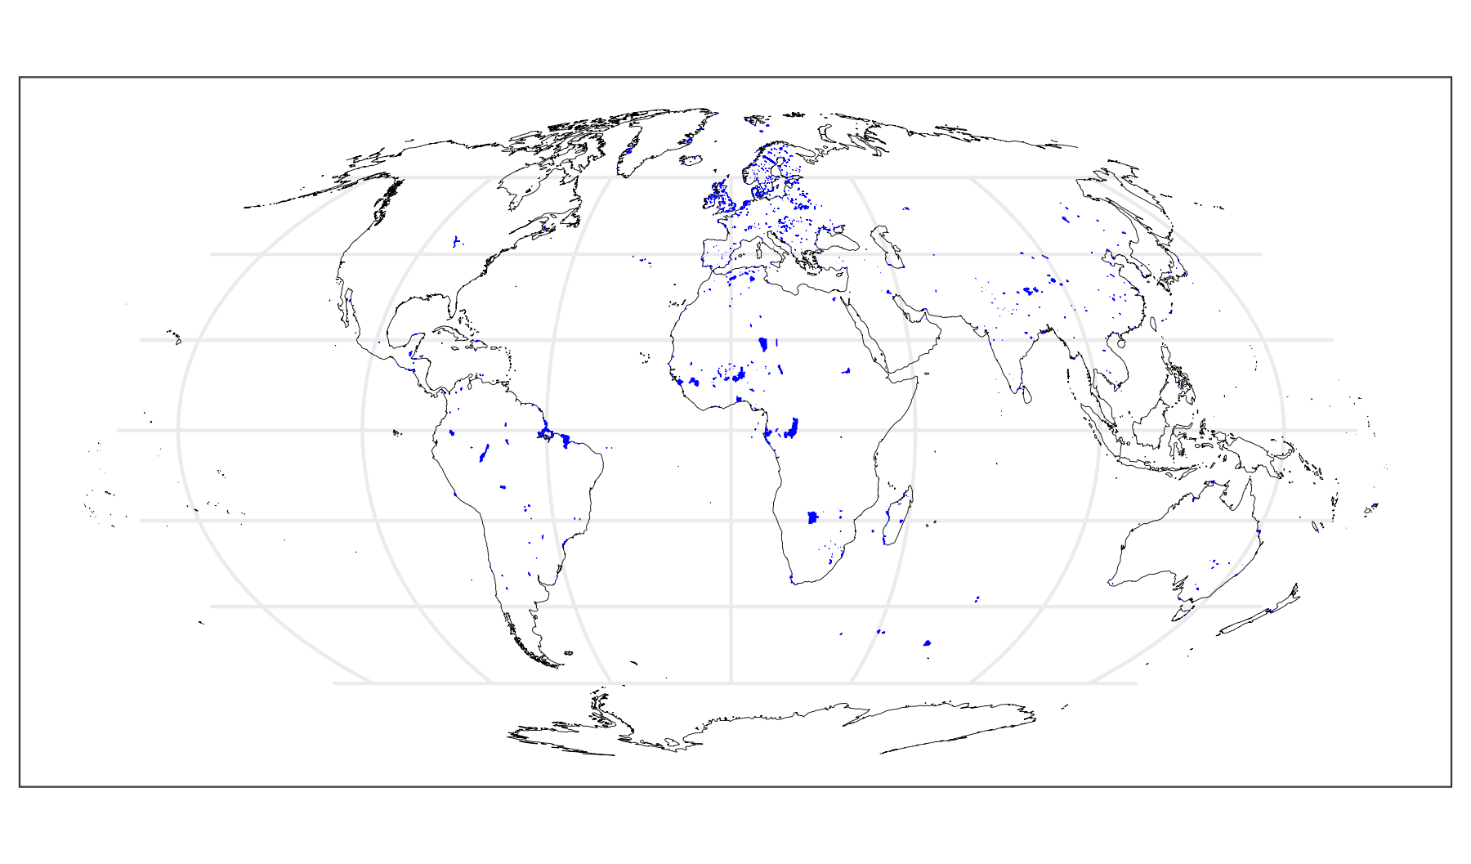
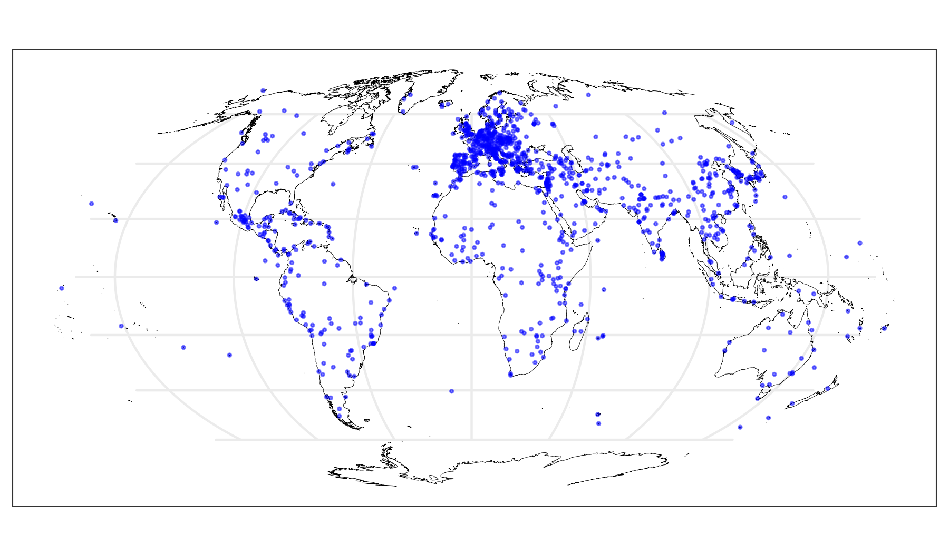
Final layers
RAMSAR sites
UNESCO sites
GIAHS

