Slide 1
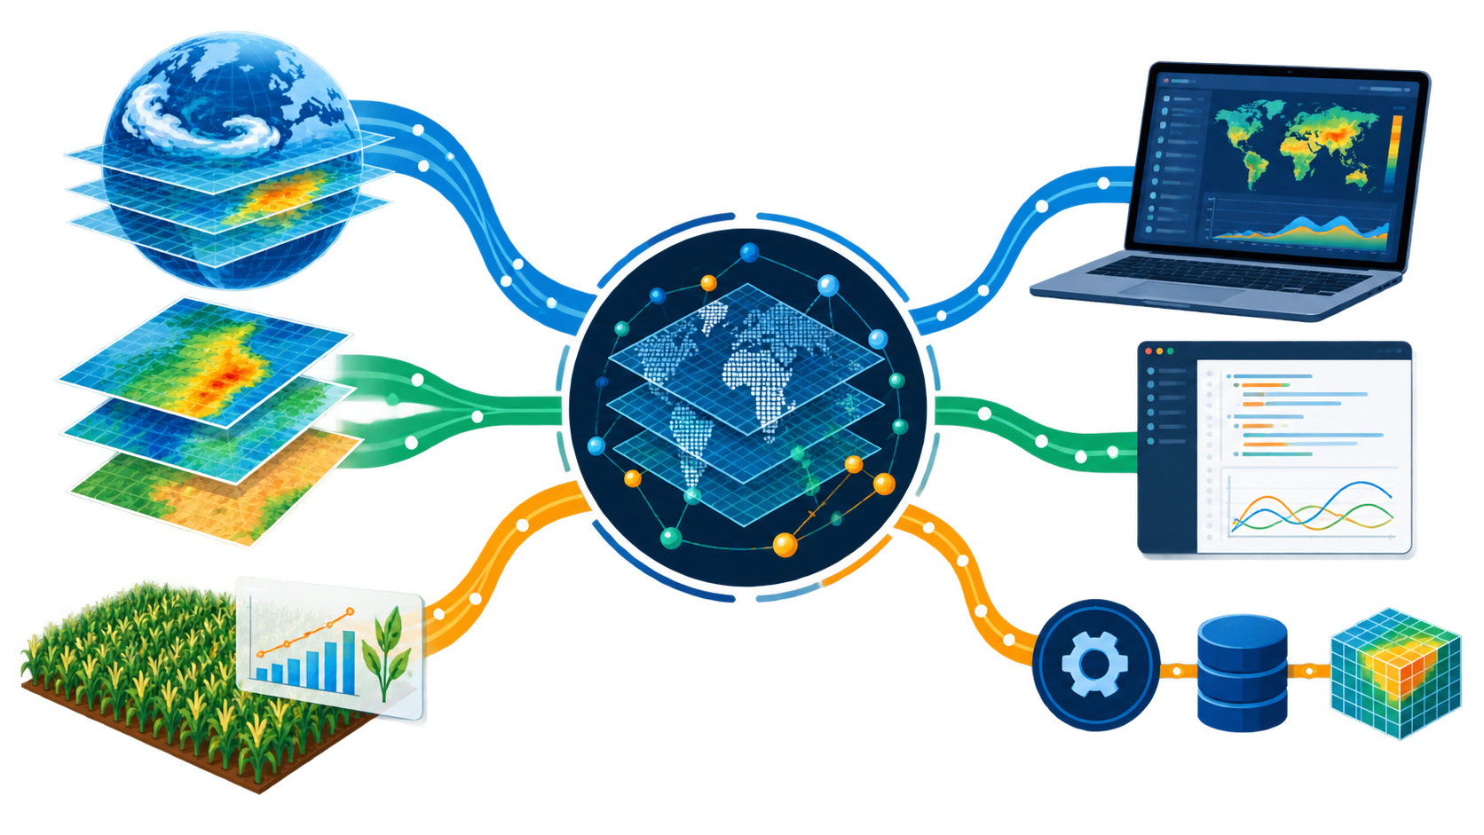
One CAVA framework, three ways to work
Climate and impact data enter one shared analytical backbone. Users choose the interface that fits their work.
CLIMATE AND IMPACT DATA
CAVA FRAMEWORK
PLATFORM, R AND PYTHON
The data and processing stay consistent. The entry point changes with the user.
CAVA MODULE 1
20
Notes:
Use the illustration to explain one simple idea. Climate and agricultural impact information flows through a shared CAVA analytical framework. Users can then work through the CAVA Platform, the R SDK, or the Python SDK and backend services. The entry point changes, while the underlying data handling and traceability remain consistent. ISIMIP3b impact models use independent climate forcing, so CAVA harmonizes interpretation rather than claiming identical model inputs. Source: https://cavaplatform.fao.org/about. Illustration generated with OpenAI image generation for this presentation.

Slide 2
CAVA can support country-level climate information products
Countries can reuse the analytical core while adding national data, priorities and institutional workflows
REUSABLE CAVA CORE
COUNTRY TAILORING
COUNTRY OR REGIONAL PRODUCT
A tested foundation
National data
An operational climate system
Global climate and impact datasets
Give visibility to nationally generated climate information
Locally relevant maps and indicators
01
02
Automated reports and analytical pipelines
Shared processing methods and metadata
Local priorities
Adapt indicators, reporting and decision workflows
03
Programmatic access for national applications
Platform, R SDK and Python SDK
04
A system adapted to institutional needs
Flexible deployment
CURRENT EXAMPLES
Southeast Asia
Sri Lanka
ADDED VALUE
Countries reuse the technical foundation while keeping national information and priorities visible.
MSS regional climate system
National CAVA system
CAVA MODULE 1
21
Notes:
CAVA can be deployed as a country or regional climate information system. Countries and institutions can integrate national datasets, give visibility to locally generated information, adapt indicators and workflows, and choose a deployment ranging from a visualization interface to analytical pipelines, automated reports and programmatic access. The CAVA About page lists a Southeast Asia system using Meteorological Service Singapore datasets and a Sri Lanka national implementation. Source: https://cavaplatform.fao.org/about

