Slide 1

CAVA
CAVA TRAINING SERIES
CLIMATE AND AGRICULTURE RISK
VISUALIZATION AND ASSESSMENT
Understanding climate information and the CAVA ecosystem
MODULE 1
28 September 2026
10:00–11:30 · Online
From climate information to climate impact analysis

Slide 2
Training series agenda
Four modules move from concepts to practical access, technical workflows and impact modelling
01
28 SEP
Introduction to the CAVA ecosystem
TODAY
Riccardo Soldan, Hideki Kanamaru, Ezequiel Cimadevilla
90 min · online
02
29 SEP
Using the CAVA Platform
Riccardo Soldan, Andrea Setti
90 min · online
03
30 SEP
Climate data workflows with CAVA backend
Riccardo Soldan, Samuel Greenrod
2 hours + optional hour · hybrid
04
01 OCT
Climate data for crop modelling (joint training with NSL)
Riccardo Soldan, Federica Chiozza, Dario Spiller
2 hours + optional hour · hybrid
CAVA MODULE 1
02

Slide 3
Today’s learning journey
Climate science explains the data. The workflow determines how people can access and use it.
00–05
40–55
70–90
Introduction
Accessing climate data today
Discussion
Riccardo
Riccardo
All
1
2
3
4
5
05–40
55–70
The climate science behind the data
What CAVA changes and how it works
Hideki
Ezequiel
Learning outcome
Climate models, climate data and the role of CAVA
CAVA MODULE 1
03

Slide 4
Wait a second. Did we need another tool?
CAVA development justification
1
Internal first
2
Opened to everyone
We realised the same barrier affects many others: accessing and using climate information.
Because the tool was genuinely useful, we decided to make it available more broadly.
The aim is to help more practitioners bring climate information into project design.
CAVA was originally developed for the Climate Risk Team.
Its first purpose was to support climate risk assessments for GEF and GCF projects.
It continues to be used internally in project design
CAVA MODULE 1
04

Slide 5
The role of CAVA
Democratising access, usability and interpretation of climate information
1
CAVA
2
Climate risk lens
3
Project design
Access, use and interpret climate information
A hazard is not the same as a risk
Use the risk picture to adjust activities
To judge whether planned activities are climate-resilient, combine hazard information with three project-specific questions:
1
Location
Move or protect exposed assets
Extreme heat
H
E
V
A
2
Design
Choose resilient materials / standards
Heavy rain
Met Drought
Hazard
Exposure
Vulnerability
Adaptive capacity
Timing
Avoid high-risk seasons
3
What may happen?
What is in harm’s way?
How sensitive is it?
Can it cope or adapt?
CAVA helps you understand where hazards may occur, how intense they may be, and how they may change
4
Management
Build buffers, contingency and monitoring
Climate risk emerges from the interaction of these factors.
Outcome: climate resilient activities
Two quick checks
A
Same hazard ≠ same impact
B
No exposure → little or no risk
Extreme heat can severely reduce crop yields, while a building may be much less sensitive.
A flood hazard may exist in the area, but a project asset outside the flood-prone zone is not exposed.
CAVA MODULE 1
04

Slide 6
CAVA in the broader FAO digital ecosystem
Climate service conceptually connected to the broader FAO’s digital ecosystem
AIDA
CAVA
FAO Agro-informatics
Platform
Agro-Informatics
Digital Assistant
Climate and Agriculture Risk
Visualization and Assessment
CAVA MODULE 1
06

Slide 7

From a decision question to climate information
Understanding what climate information is and where it comes from
First, understand the climate evidence
Different climate datasets and why they differ, why model bias, ensembles and indicators matter.
CAVA MODULE 1
05

Slide 8
The climate science behind the data
Climate information, climate projections and uncertainty
HIDEKI · 35 MINUTES
06

Slide 9
Three sources of climate information
Historical reference information and future projections answer different questions
01
02
03
OBSERVATIONS
REANALYSIS
CLIMATE SIMULATIONS
Measurements from stations, satellites and other instruments
Observations combined with a numerical model
Model experiments under defined scenarios
Recorded conditions at observed locations and times
A complete gridded reconstruction of past conditions, such as ERA5
Long-term change under plausible future conditions
Together, they provide complementary views of the climate system
CAVA MODULE 1
07

Slide 10
Climate projection and weather forecast
The two products differ in their starting point, time horizon and interpretation
WEATHER FORECAST
CLIMATE PROJECTION
DAYS TO WEEKS
DECADES
Begins with the observed state of the atmosphere
Begins with assumptions about future forcing
Describes the sequence of weather. Skill declines as the forecast horizon increases.
Describes climate statistics. It does not predict the weather on a specific future day.
A projection asks what climate could emerge under defined conditions
CAVA MODULE 1
08

Slide 11
Why many models and scenarios?
Models represent the climate system differently, while scenarios represent alternative future conditions
MODELS
SCENARIOS
Different scientific teams make different choices about how to represent physical processes.
Alternative emissions and land-use pathways produce different levels of climate forcing.
A multi-model ensemble samples part of this model uncertainty.
CMIP coordinates experiments so results can be compared across models and scenarios.
Interpret the range
The spread is information about plausible outcomes, not a reason to select the most convenient model.
CAVA MODULE 1
09

Slide 12
From global to regional climate information
Regional models add spatial detail within a global model’s large-scale climate
CORDEX-CORE
›
›
Coordinated regional simulations at about 25 km for major inhabited regions
GLOBAL MODEL
REGIONAL MODEL
REGIONAL INFORMATION
Represents the whole climate system on a global grid
Uses global-model boundary conditions over a defined region
Resolves more regional features at finer grid spacing
More detail does not remove uncertainty. It changes what regional processes and patterns the model can represent.
CAVA MODULE 1
10

Slide 13
Model and downscaling uncertainty
Regional projections inherit choices from the global model and add choices in the downscaling chain
GLOBAL MODELS
REGIONAL MODELS
GCM A
RCM 1
REGIONAL
PROJECTION ENSEMBLE
GCM B
GCM C
RCM 2
Multi-model and multi-RCM ensembles sample structural choices. Their spread remains an incomplete measure of uncertainty.
CAVA MODULE 1
11

Slide 14
Multiple models and uncertainty
The ensemble shows a range of plausible responses across models and scenarios
01
MODEL RESPONSE
02
FUTURE SCENARIO
03
INTERNAL VARIABILITY
Different representations of the climate system
Different future emissions and land-use pathways
Natural fluctuations within the climate system
ENSEMBLE
A range of plausible climate responses
CENTRE
SPREAD
AGREEMENT
Mean or median change
Range across models
Direction and consistency of change
CAVA MODULE 1
12

Slide 15
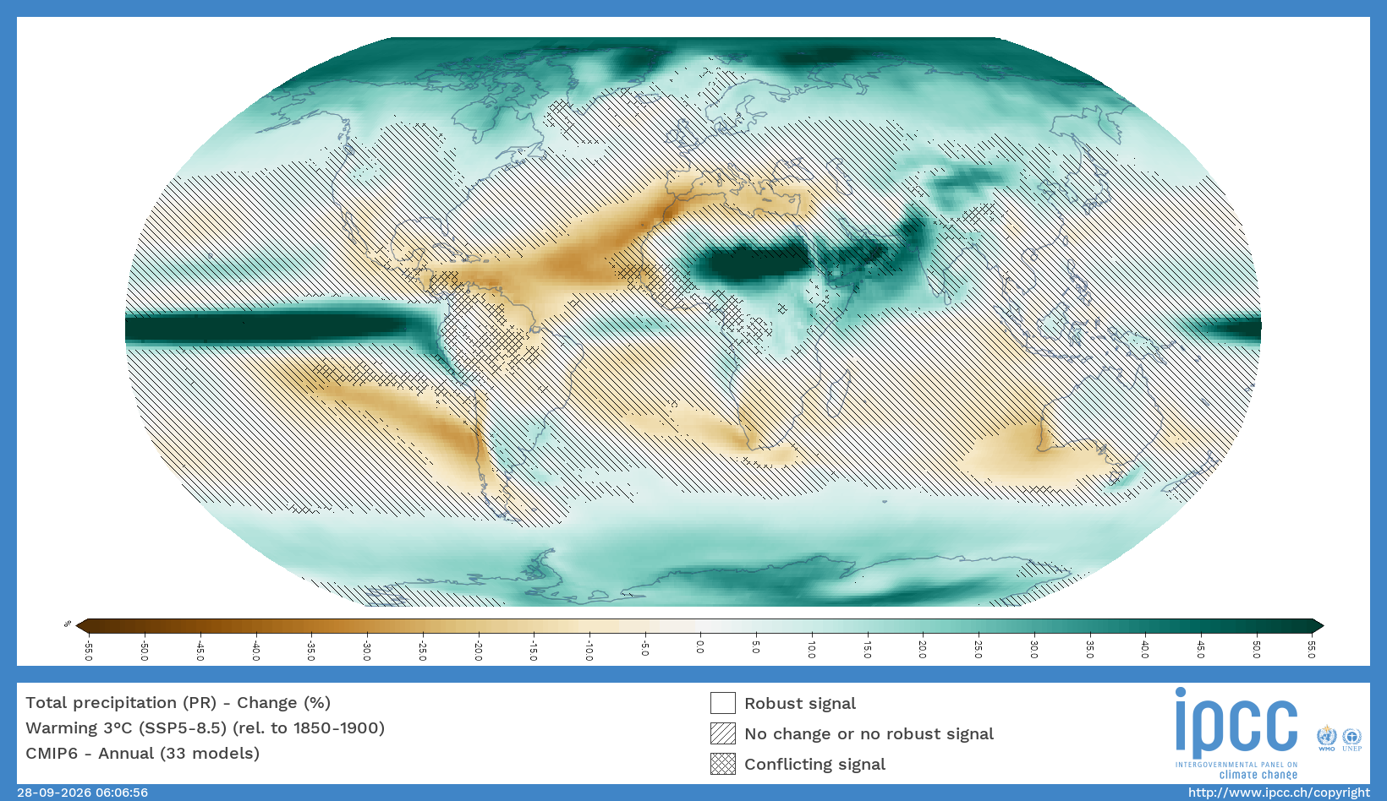
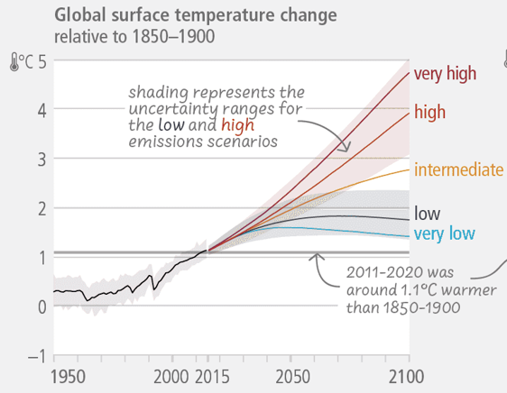
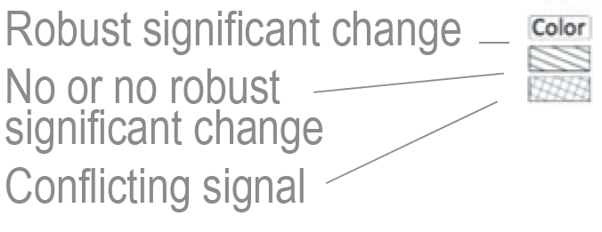
Global mean temperature projections
Annual precipitation projection under 3 degrees warming, SSP5-8.5
CAVA MODULE 1
12

Slide 16
Model bias
A climate model may reproduce the broad climate while showing systematic differences from a reference dataset
Illustrative historical distribution
A bias is systematic
It may affect the mean, variability, seasonality or extremes. Performance can also differ by variable and region.
Model output should not automatically be treated as observations or truth.
Reference
Model
Conceptual illustration · no observed data shown
CAVA MODULE 1
13

Slide 17
Bias correction
Adjustment can improve agreement with a historical reference, but it does not make the future certain
1
2
3
4
COMPARE
ESTIMATE
APPLY
CHECK
Historical model simulation with a reference dataset
A statistical adjustment for the selected variable and location
The adjustment consistently to historical and projected data
Whether the corrected data suit the intended application
Limits of correction
It does not remove model uncertainty or repair every simulation weakness
CAVA MODULE 1
14

Slide 18
How each source should be handled
The response depends on whether the source is intrinsic, conditional, structural or systematic
SOURCE
TYPE
RESPONSE
PRACTICAL ACTION
INTERNAL VARIABILITY
Intrinsic
Represent
Use multiple initial-condition members
SCENARIO
Conditional
Explore
Compare plausible pathways
MODEL RESPONSE
Structural
Represent
Use multi-model ensemble
GCM–RCM CHAIN
Structural
Compare
Sample driving and regional models
SYSTEMATIC BIAS
Partly adjustable
Adjust carefully
Validate the method and retain caveats
REFERENCE DATA
Observed uncertainty
Test sensitivity
Compare suitable observation or reanalysis products
Keep the variability that represents plausible outcomes. Correct only diagnosed, method-specific bias.
CAVA MODULE 1
15

Slide 19
Interpreting a climate signal
A map or chart needs context before it can support a project decision
READ THE SIGNAL
TEST THE INTERPRETATION
01
MAGNITUDE
04
SPREAD
How large is the change relative to the baseline?
How wide is the range across models and scenarios?
02
PATTERN
05
RELEVANCE
Where and when does the change occur?
Does the indicator reflect the decision and exposed system?
03
AGREEMENT
06
LIMITATIONS
Do most models show the same direction of change?
Which assumptions could change the interpretation?
Climate information informs judgement alongside sector expertise, local knowledge and risk preferences
CAVA MODULE 1
16

Slide 20
Accessing climate data today
Climate data are available, but users still have to locate, select, retrieve and prepare them before analysis.
RICCARDO · 15 MINUTES
17

Slide 21
Where climate information is found today
Climate data are distributed across catalogues, archives and technical services
01
WEB PORTALS
02
DISTRIBUTED ARCHIVES
Copernicus Climate Data Store
ESGF data nodes
Institutional repositories
Files organised by experiment
The data exist
Access patterns, accounts and request methods vary by source.
CAVA MODULE 1
18

Slide 22
A climate-data request becomes a workflow
Most of the work happens before the indicator is calculated
DISCOVER
REQUEST
HARMONIZE
Find the relevant catalogue or service
Configure access, register and API calls
Align units, calendars and spatial grids
01
02
03
04
05
SUBSET
SPECIFY
Choose dataset, model, scenario, variable and period
Limit the data to the project area and dates
RESULT
A defensible workflow, but one that users must assemble and repeat
CAVA MODULE 1
18

Slide 23
What problem does CAVA solve?
Climate archives contain valuable information, but users repeatedly perform specialist preparation before analysis can begin
THE BOTTLENECK
CAVA
WHAT CHANGES
Accessing and interpreting climate information is challenging:
Choice of climate information
Access
Processing
Interpretation
Climate data become easier to use without hiding the scientific choices
A shared access and processing layer
ACCESS
Retrieve only the place, period and variables needed
READY
Analysis-ready historical and future data
HARMONIZE
Apply consistent handling of formats and conventions
CONSISTENT
Comparable indicators, maps and outputs
REUSE
Expose the same workflow through web tools, code and APIs
CAVA democratises access and interpretation of climate information while retaining scientific approach
CAVA MODULE 1
20

Slide 24
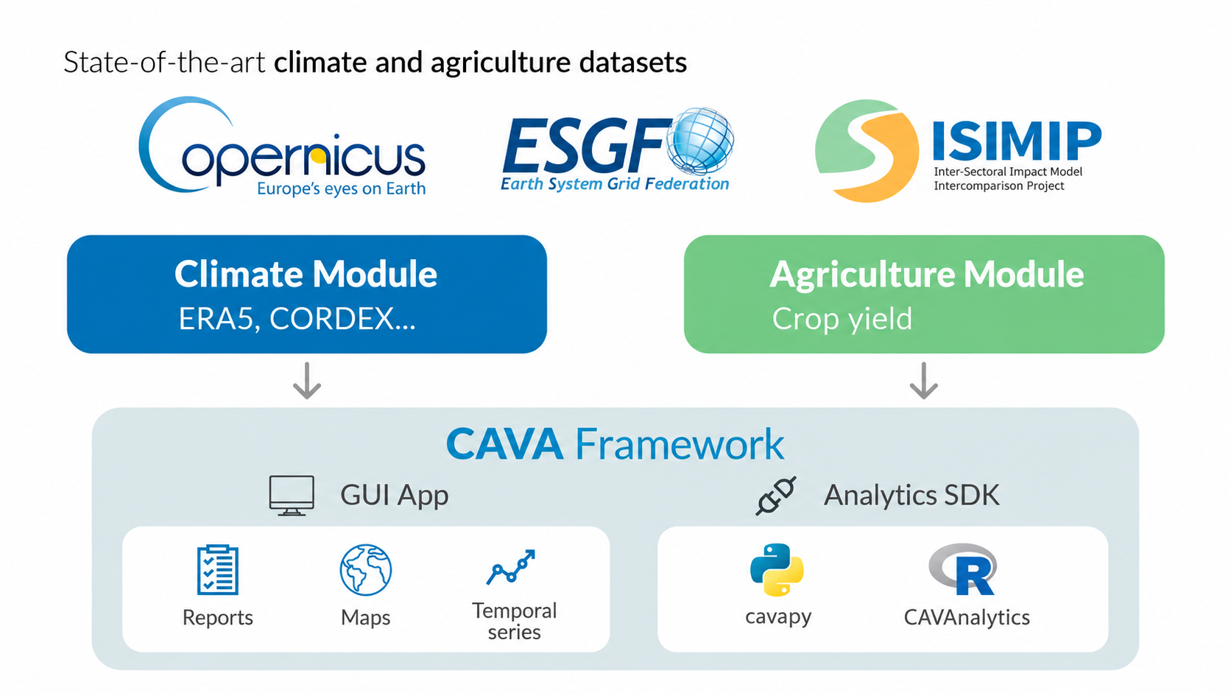
One CAVA framework, several entry points
A common backend supports guided exploration, reproducible analysis and integration into other workflows
CAVA MODULE 1
21

Slide 25
CAVA can support country-level climate information products
Countries can reuse the analytical core while adding national data, priorities and institutional workflows
REUSABLE CAVA CORE
COUNTRY TAILORING
COUNTRY OR REGIONAL PRODUCT
A tested foundation
National data
An operational climate system
Global climate and impact datasets
Give visibility to nationally generated climate information
Locally relevant maps and indicators
01
02
Automated reports and analytical pipelines
Shared processing methods and metadata
Local priorities
Adapt indicators, reporting and decision workflows
03
Programmatic access for national applications
Platform, R SDK and Python SDK
04
A system adapted to institutional needs
Flexible deployment
CURRENT EXAMPLES
Southeast Asia
Sri Lanka
ADDED VALUE
Countries reuse the technical foundation while keeping national information and priorities visible.
MSS regional climate system
National CAVA system
CAVA MODULE 1
22

Slide 26
Why CAVA framework was applied to CORDEX datasets
Shared infrastructure creates the greatest benefit where scientific value and technical reuse costs are both high
COMMUNITY INVESTMENT
REUSE BARRIERS
Regional climate simulations require sustained scientific and computational effort
The same scientific richness creates substantial preparation work for users
01
Coordinated experiments across regional modelling groups
FILES
Large NetCDF collections distributed across archives
GRIDS
Rotated or curvilinear coordinates require specialist handling
TIME
Non-Gregorian calendars and long daily time series
ENSEMBLES
GCM, RCM, scenario and member combinations must remain traceable
CAVA turns a hard-to-reuse archive into consistent access while preserving the scientific choices.
CAVA MODULE 1
23

Slide 27
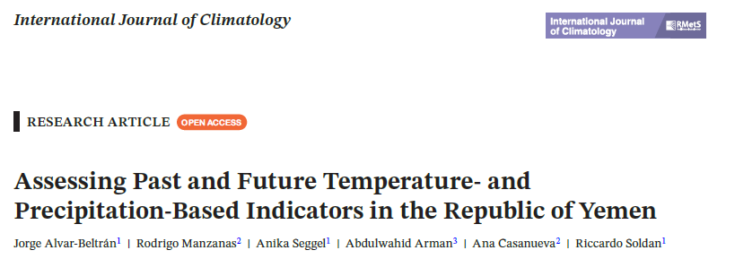
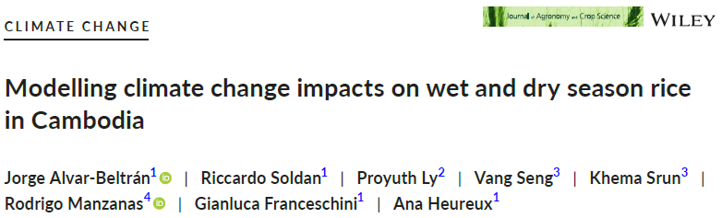
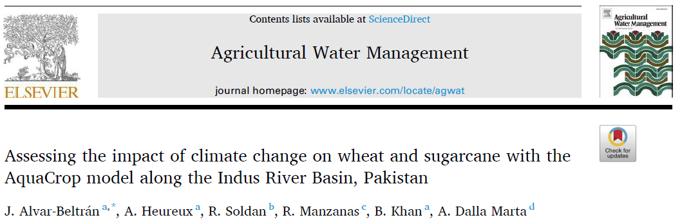
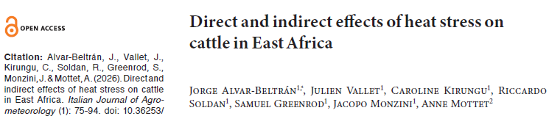
Case studies and peer-reviewed evidence
INVESTMENT CASE STUDIES
PEER-REVIEWED PUBLICATIONS
DaIMA – Dairy Interventions for Mitigation and Adaptation (IFAD-GCF)
Assessment of climate change impacts on livestock
Transforming the Indus Basin with Climate Resilient Agriculture and Water Management (FAO-GCF)
Assessment of climate change impacts on sugarcane and wheat
Climate Trends and Extremes in the Indus River Basin, Pakistan
Strengthening of NDA and enabling strategic frameworks for engagement with GCF in Yemen
Assessing past and future temperature/precipitation-based indicators in Yemen
CAVA × CORDEX
09

Slide 28
How CAVA operationalizes the workflow
A common data backbone supports different interfaces for different users and analytical needs.
EZEQUIEL · 15 MINUTES
24

Slide 29
CAVA data backbone
A shared infrastructure connects source datasets, harmonized access and user-facing outputs
01
SOURCE DATA
ERA5 and CORDEX-CORE climate datasets (NetCDF, ~20 TB)
02
REMOTE SERVICES AND COMPUTE
THREDDS and OPeNDAP deliver only the requested subset
03
HARMONIZATION
Spatial selection, calendars, units and analysis-ready structures
04
ANALYTICAL OUTPUTS
Indicators, maps, time series and data for downstream workflows
CAVA MODULE 1
25

Slide 30
CAVA data backbone
The same underlying data services can support no-code, R and Python workflows
CLIMATE ARCHIVES
DATA SERVICES + PROCESSING
USER ENTRY POINTS
CAVA Platform and Datalab
ERA5
CORDEX-CORE
CORDEX-CORE-BC
(>200,000 NetCDF files)
Remote subset
Harmonize
Aggregate and calculate
CAVAanalytics (R)
cavapy (Python)
Design principle
Users choose an interface that matches their task and technical skills without rebuilding the data pipeline.
Remote data access enabled
No need to download thousands of NetCDF files, URLs provide transparent access to analysis ready data (ARD) and data cubes.
CAVA MODULE 1
26

Slide 31
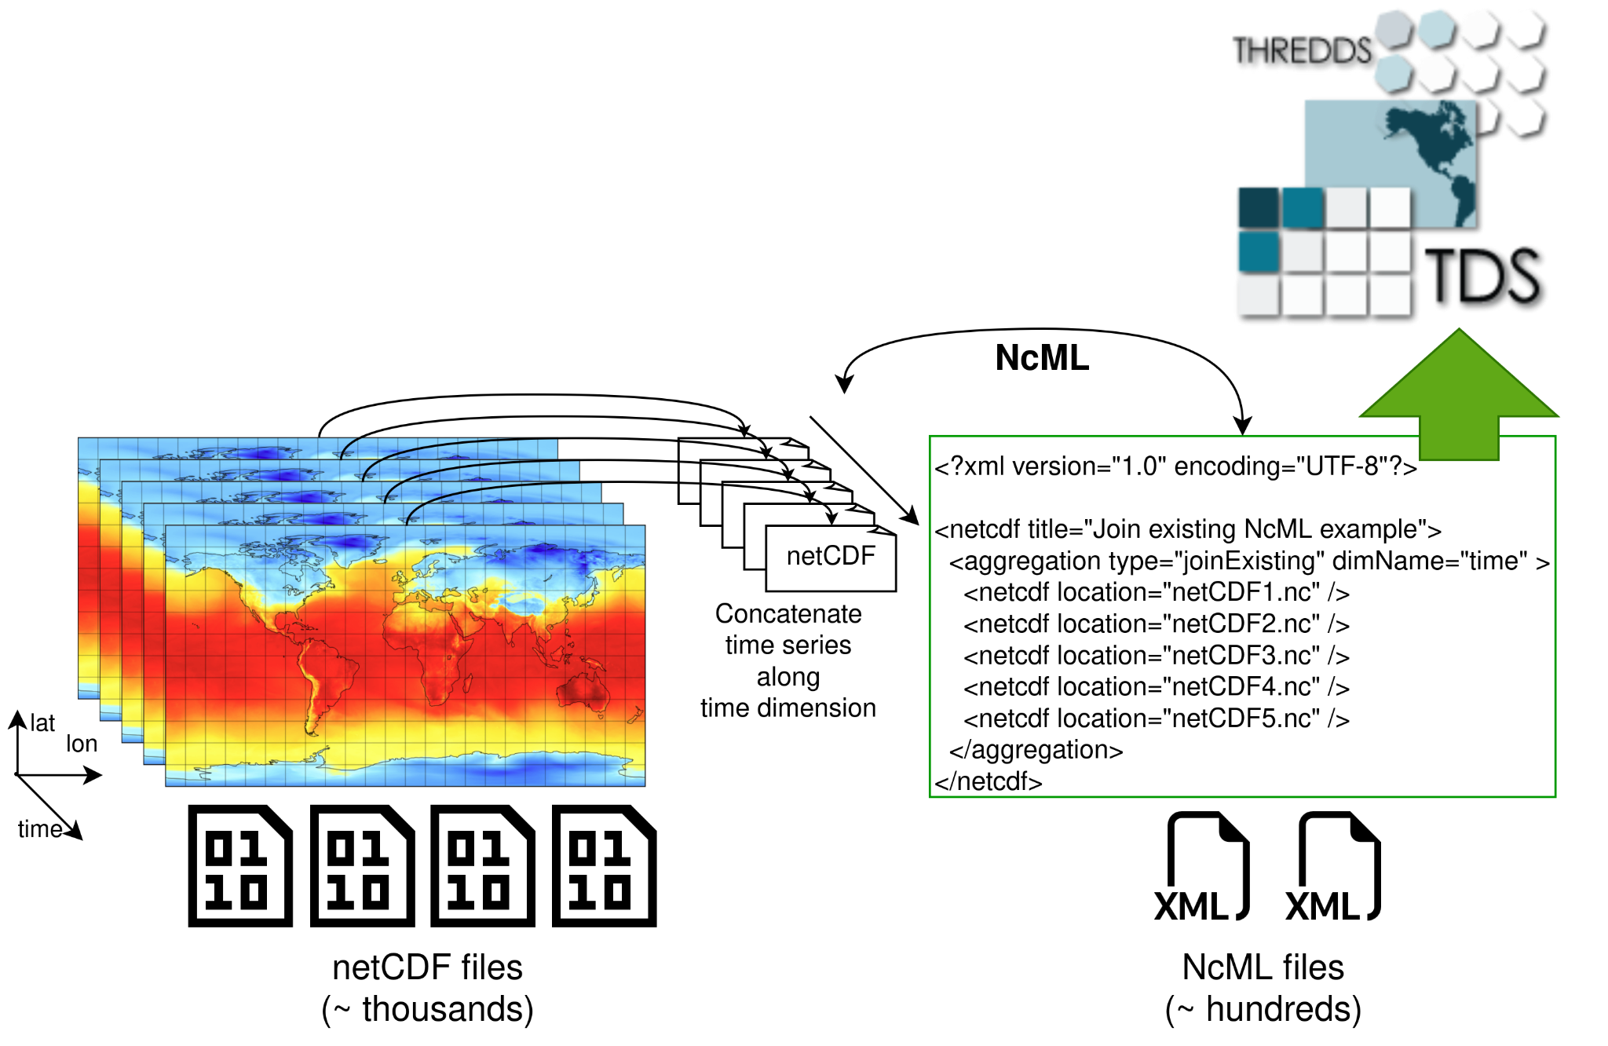
CAVA data backbone
The same underlying data services can support no-code, R and Python workflows
Virtual Analysis Ready Data
The huge amount of NetCDF files makes it hard to navigate datasets.
⚠ Most of the time in data analysis is spent doing the boilerplate code required to deal with file systems and large amounts of NetCDF files.
By adopting Analysis Ready Data boilerplate code is reduced significantly, heavily simplifying client applications and user experience.
CAVA MODULE 1
27

Slide 32
CAVA data backbone
The same underlying data services can support no-code, R and Python workflows
R
Python
CAVAanalytics
cavapy
EXPLORE
ANALYSE
INTEGRATE
CAVA Platform
R workflows
Python workflows
Web access for maps and climate-impact information (https://cavaplatform.fao.org)
Processing, indicators and visualization (https://github.com/un-fao/CAVAanalytics)
Programmatic retrieval, subsetting and processing (https://github.com/un-fao/cavapy)
CAVA MODULE 1
28

Slide 33
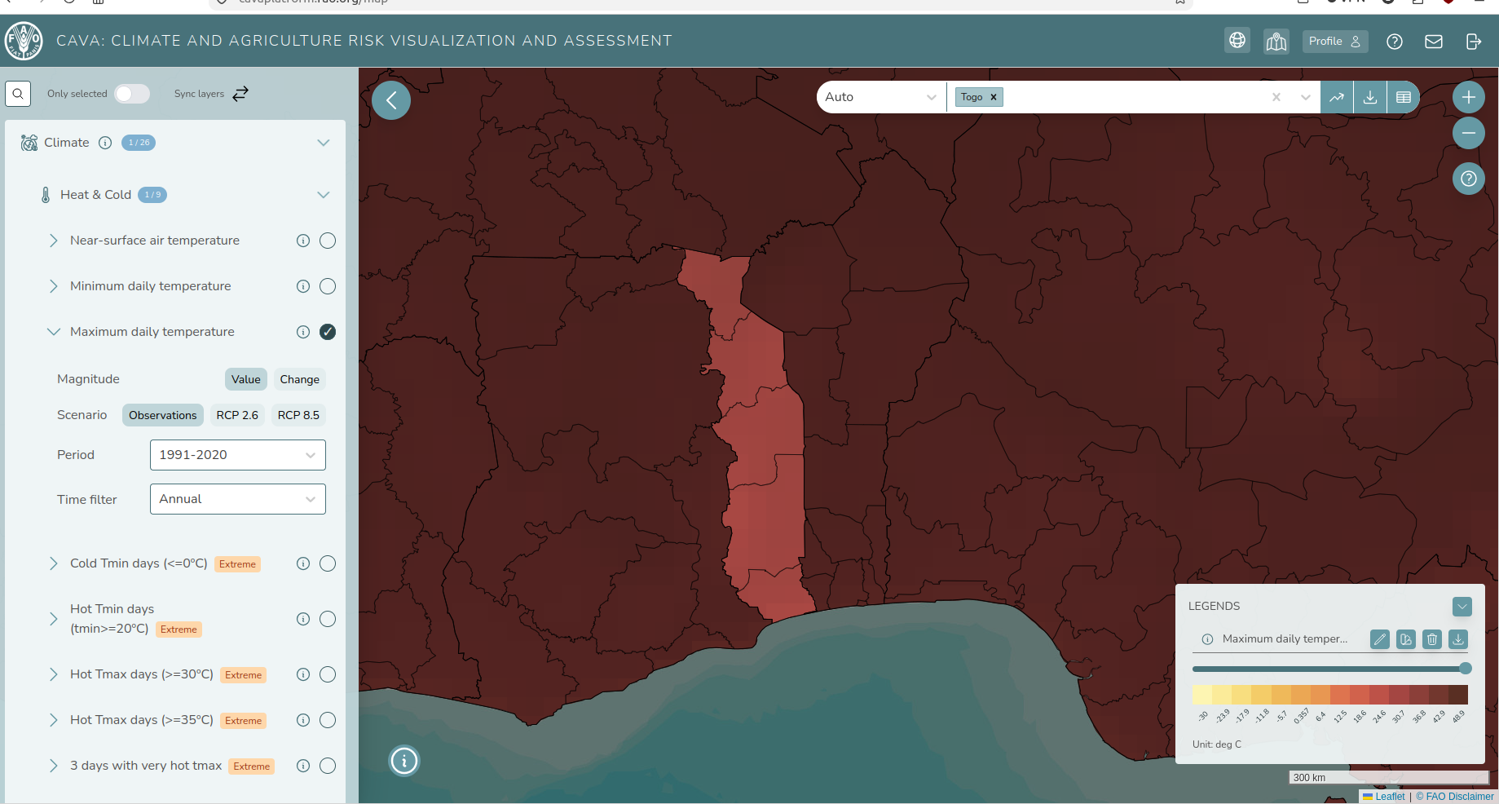
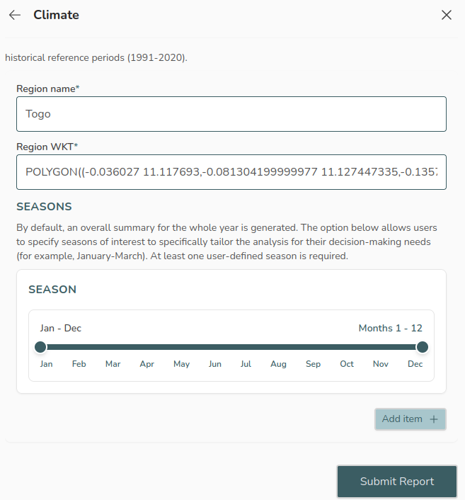
CAVA data backbone
The same underlying data services can support no-code, R and Python workflows
The CAVA platform
Web interface, no coding required - Available at https://cavaplatform.fao.org.
Based on CAVA packages, user jobs are submitted to a cloud infrastructure managed by IFCA (Cantabria).
Users are notified by email when their reports are ready to download as PDF files. Data downloads supported in CSV and PNG formats too.
CAVA MODULE 1
29

Slide 34
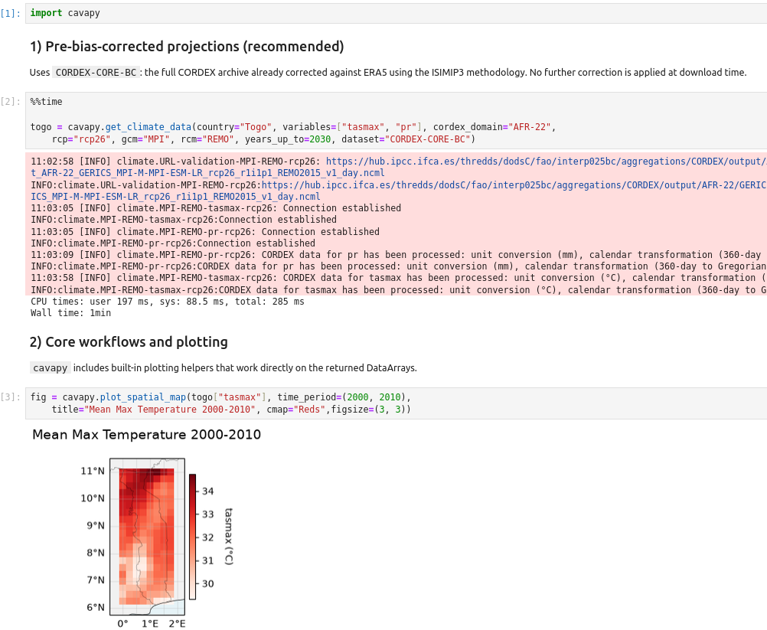
CAVA data backbone
The same underlying data services can support no-code, R and Python workflows
Coming soon - The CAVA datalab
Single-click analysis-ready programming cloud environments in the browser for everyone.
The datalab provides freely available computing infrastructures in the cloud required to connect users to the storage infrastructure managed by IFCA (remote data access).
Still work in progress - Available at Github.
⚠ Coding skills required!
CAVA MODULE 1
21

Slide 35
Questions and discussion
What remains unclear before we progress in the CAVA training tomorrow?
01
Data sources and models
02
Bias correction and ensembles
03
CAVA tools and entry points
Next: Module 2 · Using the CAVA Platform

