Slide 1
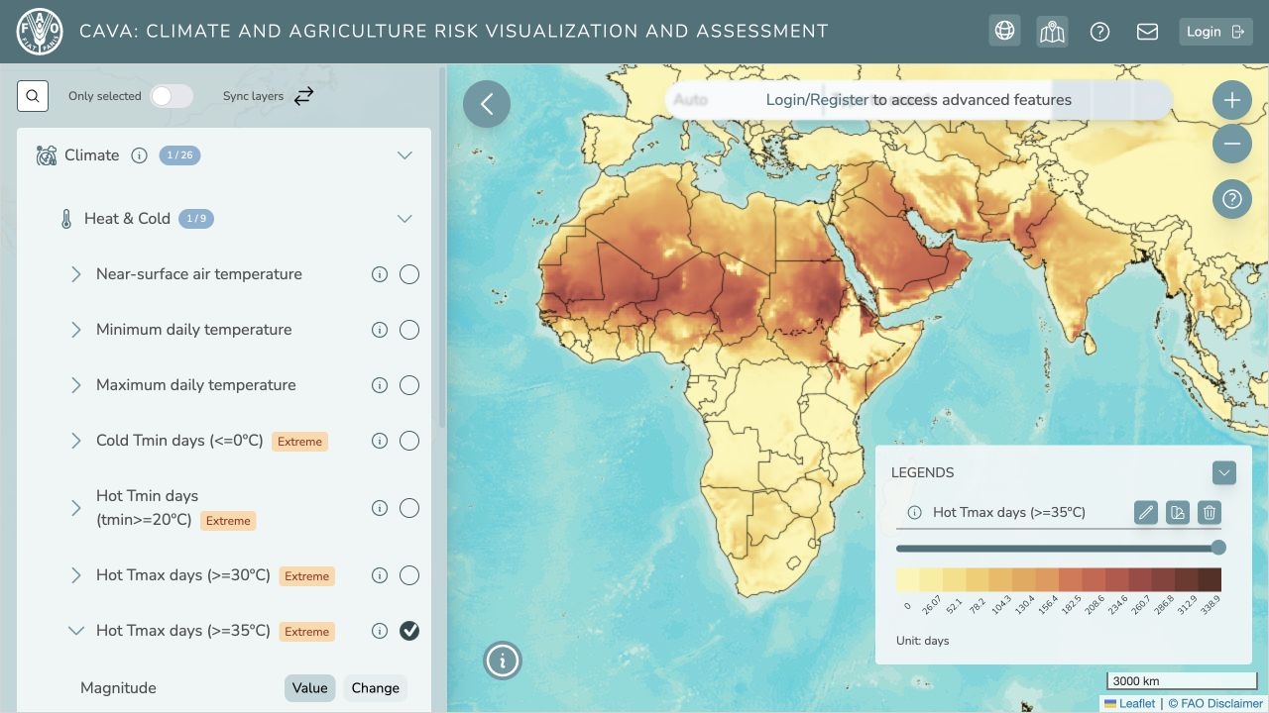
CAVA TRAINING SERIES
Using the
CAVA Platform
MODULE 2
29 September 2026
10:00–11:30 · Online
From a project question to a usable climate signal

Slide 2
Today’s route
A guided demonstration, with time to interpret and try the controls
05
min
Start with a project question
Choose the information we need
05
min
Explore the Platform
Select an indicator, then compare periods and scenarios
05
min
Read the climate signal
Look at magnitude, pattern and uncertainty
30
min
Live demo
Repeat the workflow in real-time
20
min
Advanced outputs with Andrea
Climate report and processed data
20
min
Questions
Link to Module 3
CAVA MODULE 2
02

Slide 3
A project question becomes four choices
The choices come before the first map click
How will extreme heat change in our project area over the next 30 years?
01
02
03
04
Area
Indicator
Horizon
Scenario
Which geography or project boundary?
What represents extreme heat?
What period?
Which future pathway?
CAVA MODULE 2
03

Slide 4
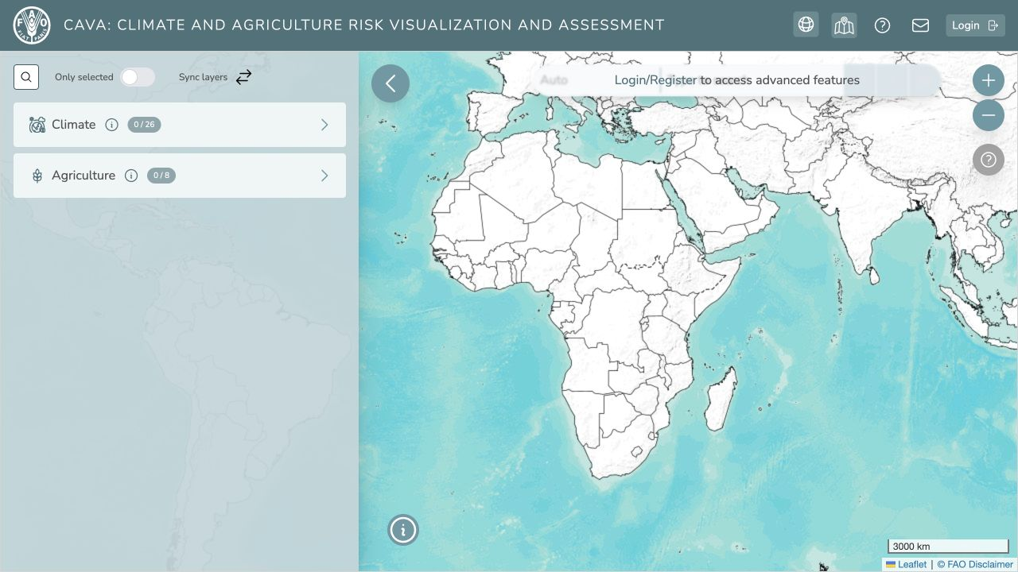
The Platform at a glance
Three places to look before interpreting a map
LEFT
Browse climate and agriculture layers
CENTRE
See the spatial pattern
RIGHT
Check the legend and units
Public map view captured 22 September 2026
CAVA MODULE 2
04

Slide 5
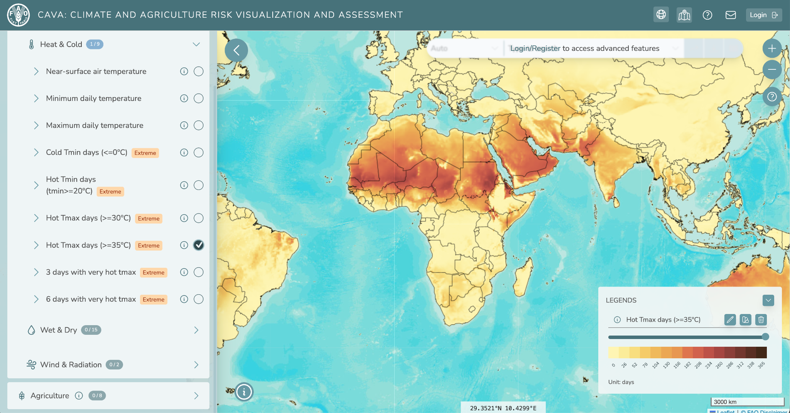
The indicator and historical reference
Live demonstration: select the heat layer and read its settings
LAYER
Climate › Heat & Cold
INDICATOR
Hot Tmax days ≥35°C
REFERENCE
Observations, 1991–2020
Public map: Hot Tmax days (≥35°C), observations, annual view
CAVA MODULE 2
05

Slide 6
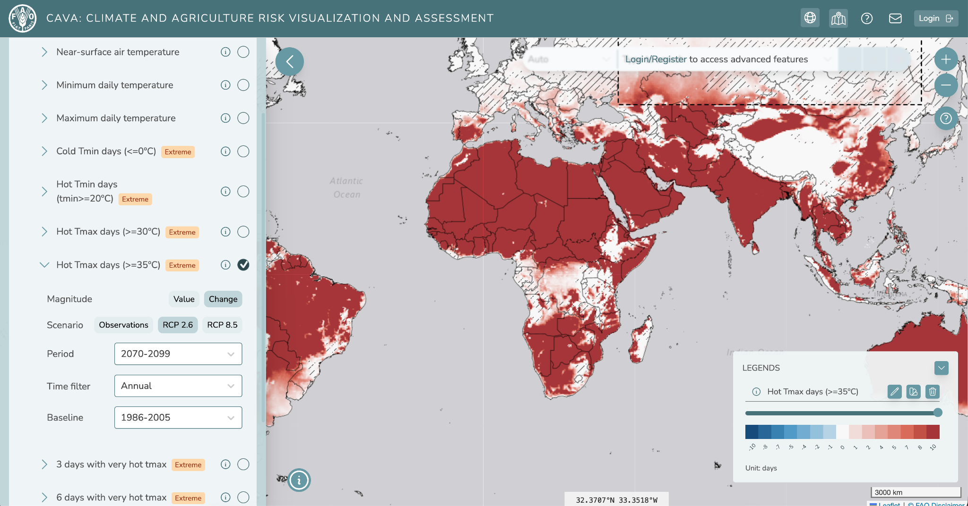
A future climate view
Keep the indicator fixed while changing scenario and time horizon
SCENARIO
Choose a future pathway
PERIOD
Select the project-relevant horizon
READING
The value map shows future conditions
Public map: RCP 8.5, 2070–2099, annual value view
CAVA MODULE 2
06

Slide 7
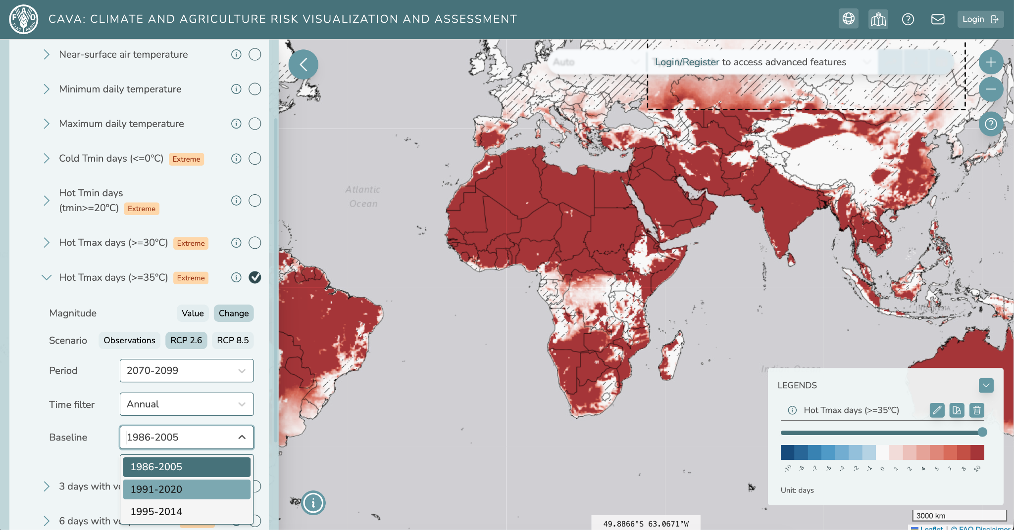
Change needs a reference period
The map changes meaning when “Value” becomes “Change”
COMPARE
Switch from Value to Change
BASELINE
Read the reference period
UNITS
Check whether the legend shows days or degrees
Public map: RCP 8.5, 2070–2099 change from 1986–2005
CAVA MODULE 2
07

Slide 8
Reading a climate signal
A map is the beginning of interpretation
01
Magnitude
How large is the difference, in the legend’s units?
02
Pattern
Is the signal widespread or localized?
03
Comparison
Which baseline, scenario and future period are selected?
04
Confidence
Combination of all previous points
CAVA MODULE 2
08

Slide 9
YOUR TURN
Let’s do a live demo
01
Choose a geography and relevant indicator
02
Select a future scenario and period
03
Compare Value and Change, then read the units
Be ready to describe one pattern and one uncertainty.

Slide 10
Advanced outputs
Andrea’s live demonstration: outputs that travel beyond the map
PDF
XLSX
Climate report
Processed climate data
Key climatologies and analyses for discussion and project documentation
Structured inputs for further analysis and downstream impact modelling
The live demonstration will show the available request and download steps.
CAVA MODULE 2
10

Slide 11
BEFORE YOU LEAVE
Can you explain the map
without the map?
01
The indicator and its units
02
The scenario, periods and baseline
03
The signal, and what remains uncertain
Next: Module 3 · Climate data workflows with cavapy and CAVAanalytics

