Slide 1


Climate change and climate change impacts on São Tomé and Príncipe with a focus on fishery and tourism sectors in a Blue Economy context Sao Tome and Principe, November/December 2025
Adaptation recommendations
By: Samuel Greenrod, Marco Fusi, Riccardo Soldan, Lionel Kinadjian

Slide 2
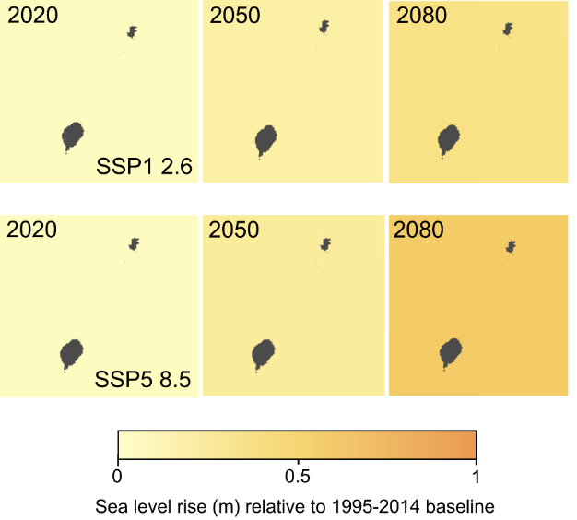
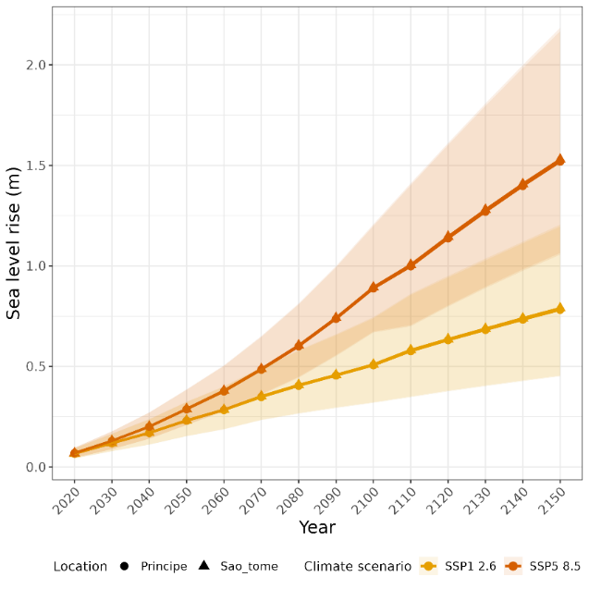
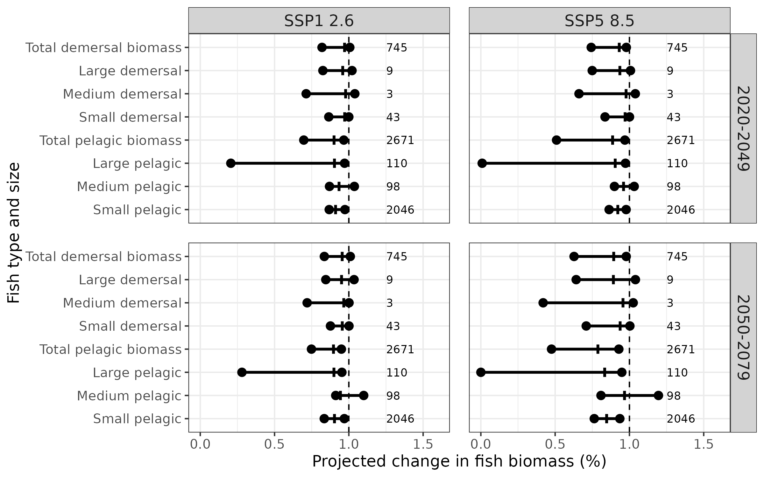
Summary of report findings
Future climate change is expected to negatively affect blue economy in STP
Fisheries
Decrease in fish biomass
Decrease in probability of fish species occurrence
Tourism
Sea level rise
Increased tourist discomfort
Risk of coral bleaching
Decrease in occurrence probability of sports fishing species

Slide 3
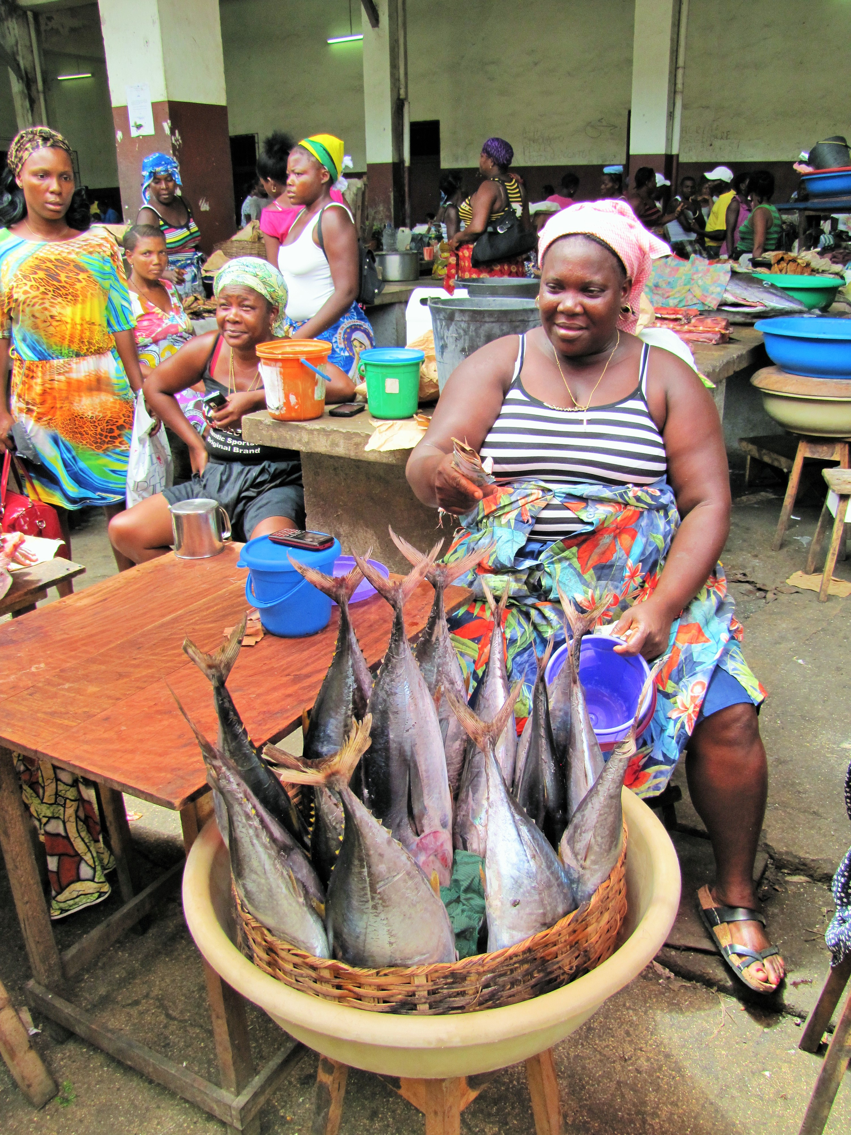

Fisheries adaptation recommendations – infrastructure
Development of fisheries infrastructure
Construction of additional fishing ports
Building of district retail markets with adequate refrigeration equipment
Construction of a workshop for the construction of improved fishing boats
Build a manufacturing unit for essential fishing materials
Development of official food storage and preparation hygiene rules.
Development of road networks between fishing ports and markets and investment in refrigerated vehicles for safe fish transport

Slide 4
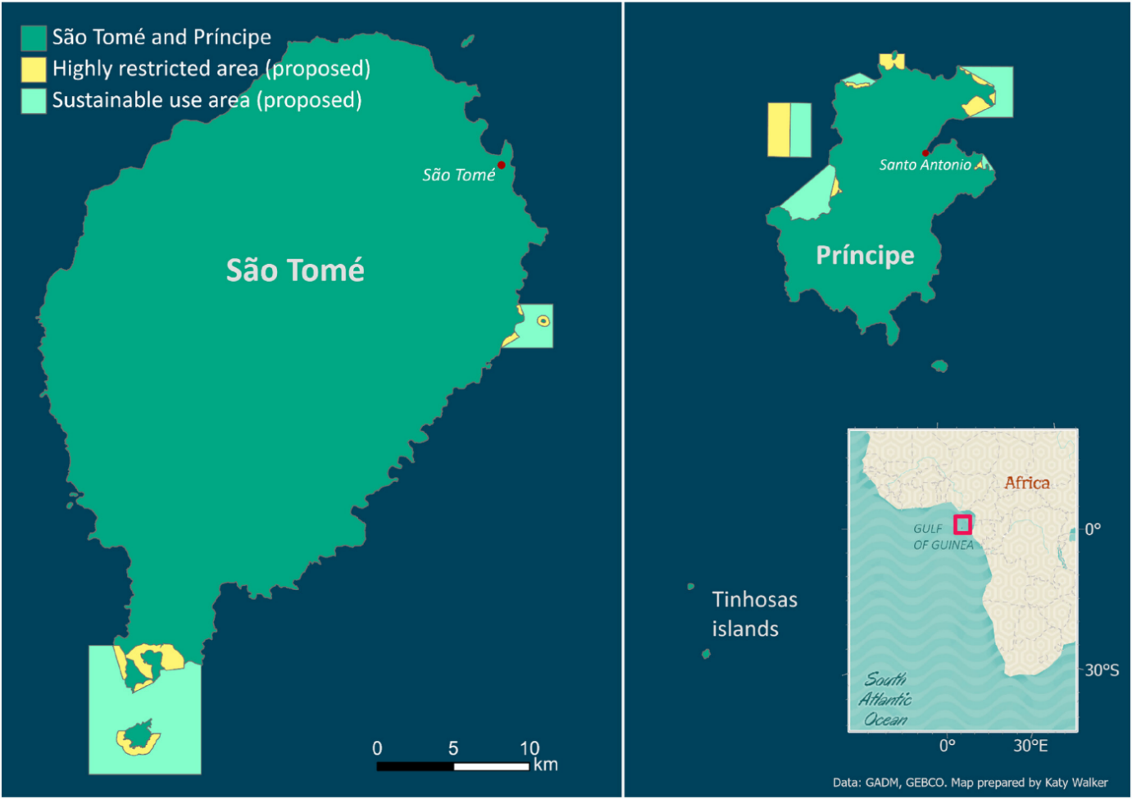
Fisheries adaptation recommendations – protection of fish species
Protection of fish species
Further development and enforcement of marine protected areas (MPAs)
Responsible use of moored fish aggregating devices (FADs)
Regulatory framework to avoid overfishing
Returning juveniles
Use of unweighted purse seine fishing methods
Catch limits based on fish stocks
Limits on number of fishing vessels
The need for fish protection in STP has recently been acknowledged:
Eight Marine Protected Areas were agreed in stakeholder co-management Assemblies in 2024
Nuno et al., 2024; https://doi.org/10.1111/csp2.13196

Slide 5
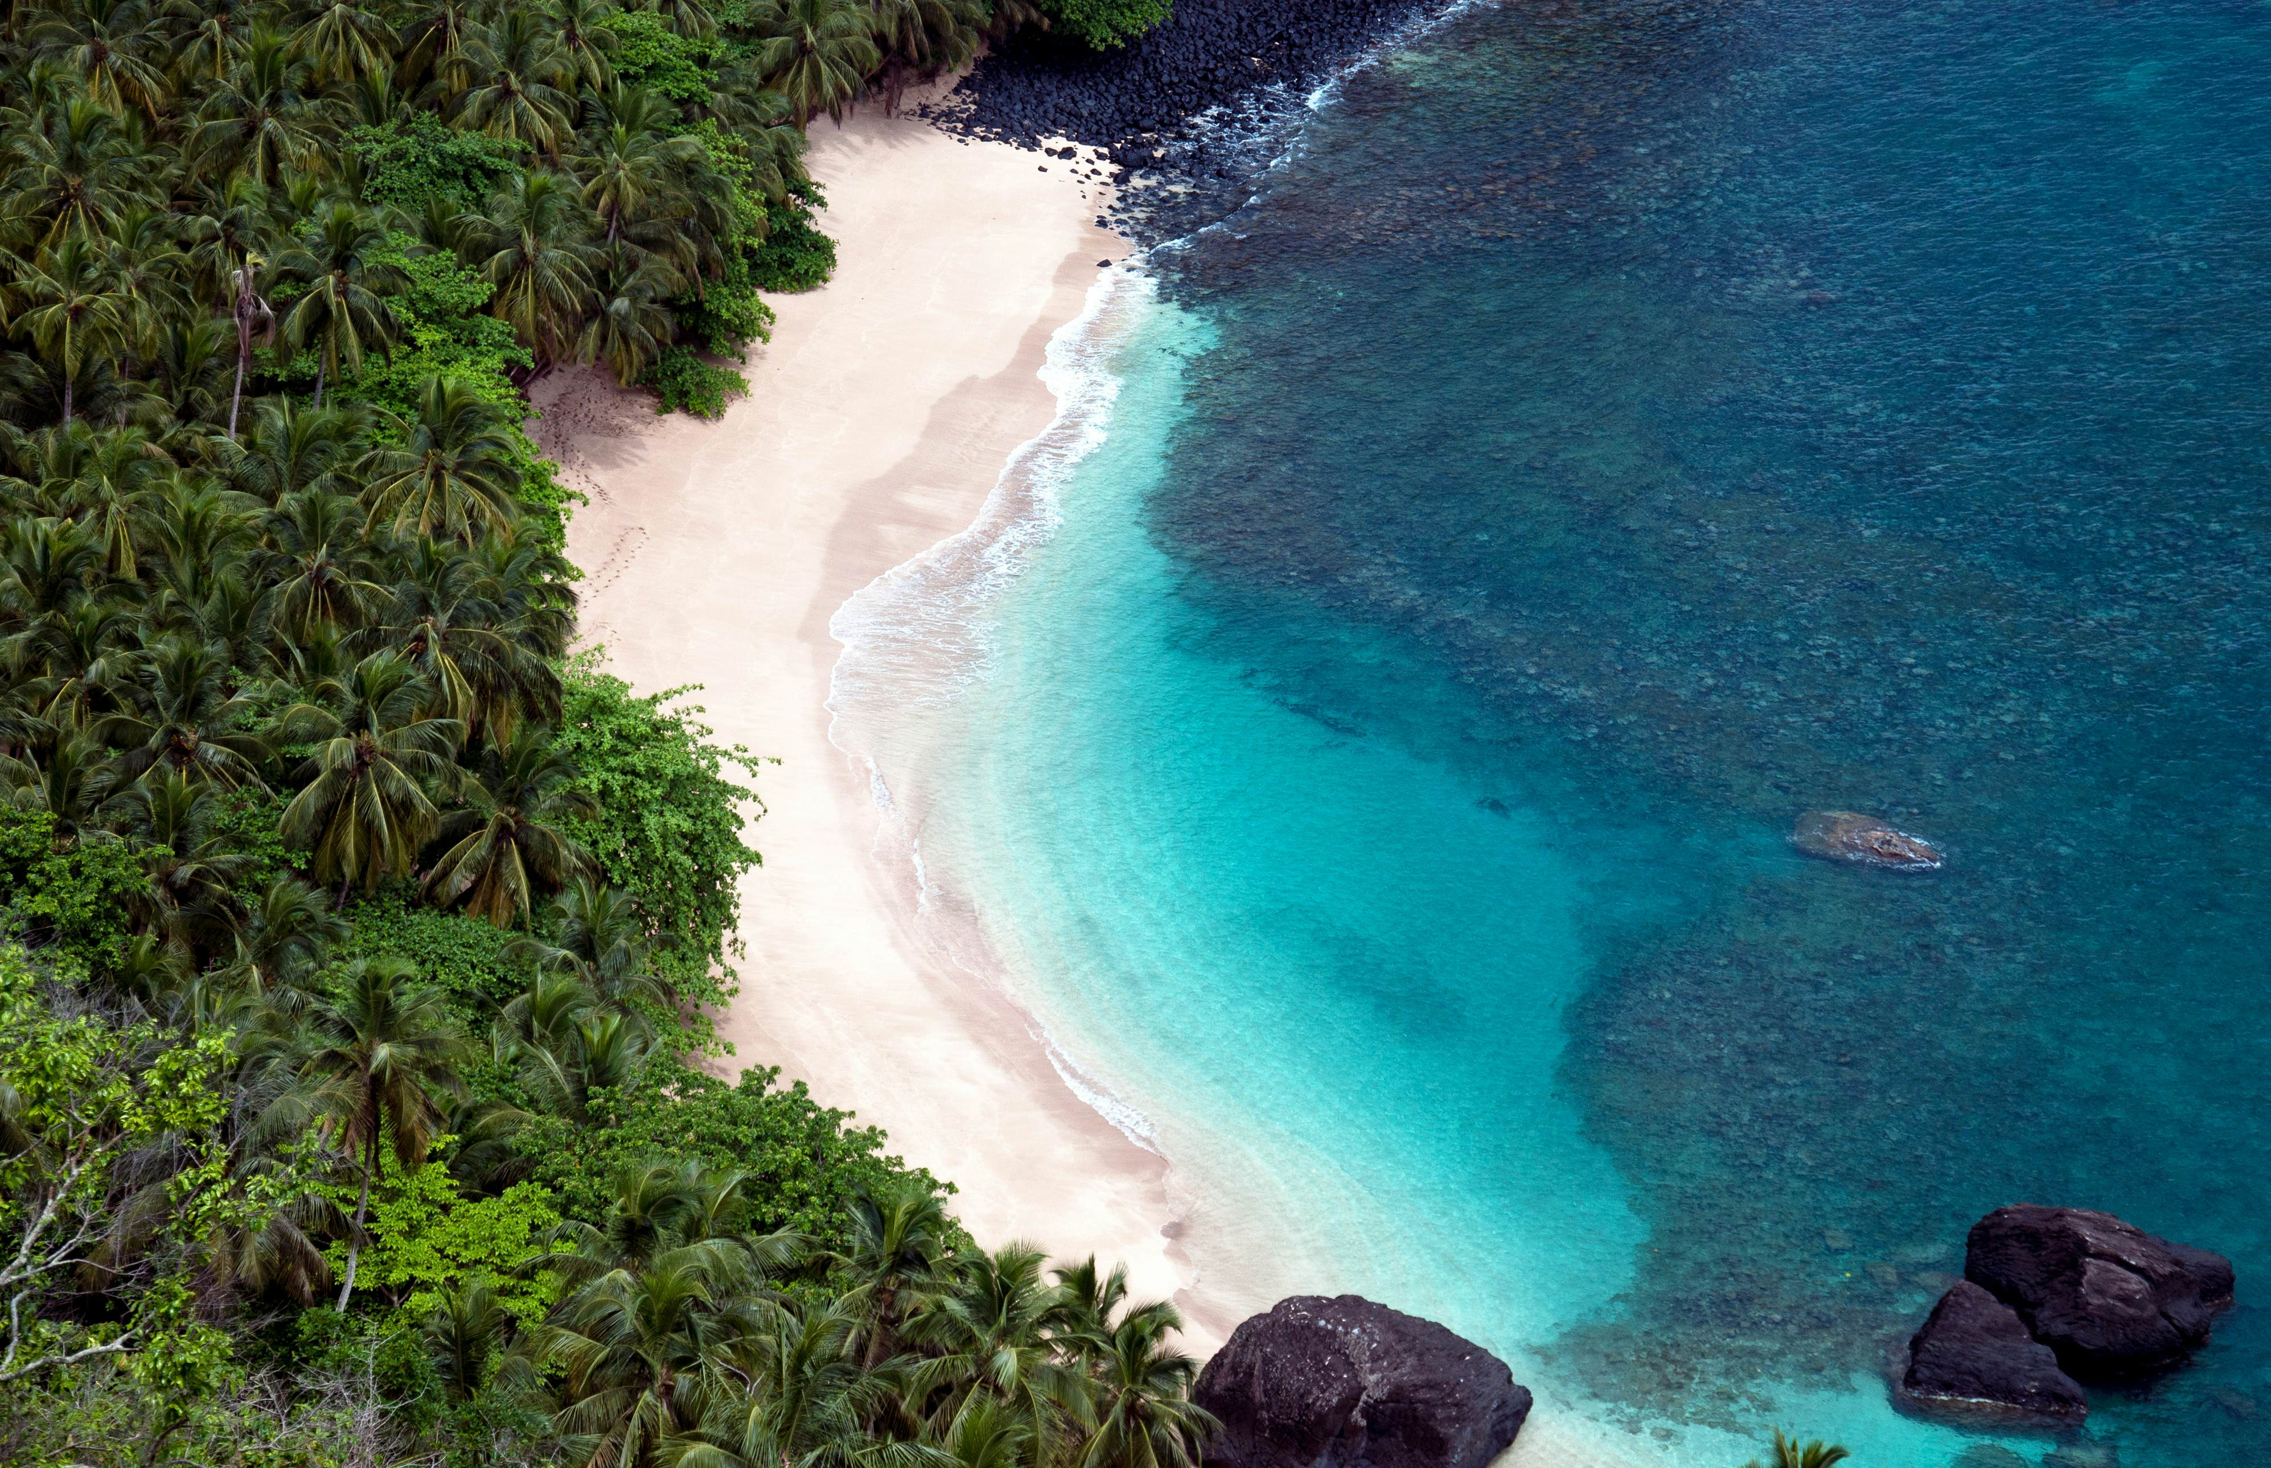
Tourism adaptation recommendations – coastal erosion
WACA+ recommended measures
Construction of dikes, breakwaters (e.g gabions), and protective walls
Creating safe expansion zones for coastal communities.
Establishment of a climate alert system
Rehabilitation of tide stations
Sand dredging to repair eroded beaches
Diversification of coastal activities
Construction of drainage ditches and water tanks
Similar measures in the GCF-funded:
“Building Climate Resilient Safer Islands in the Maldives” project approved in 2021
“Tonga Coastal Resilience” project approved in 2024

Slide 6

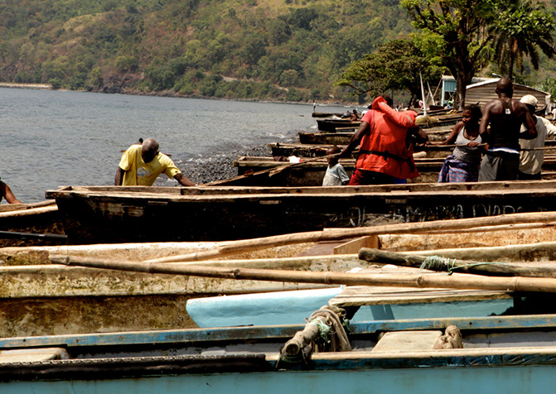
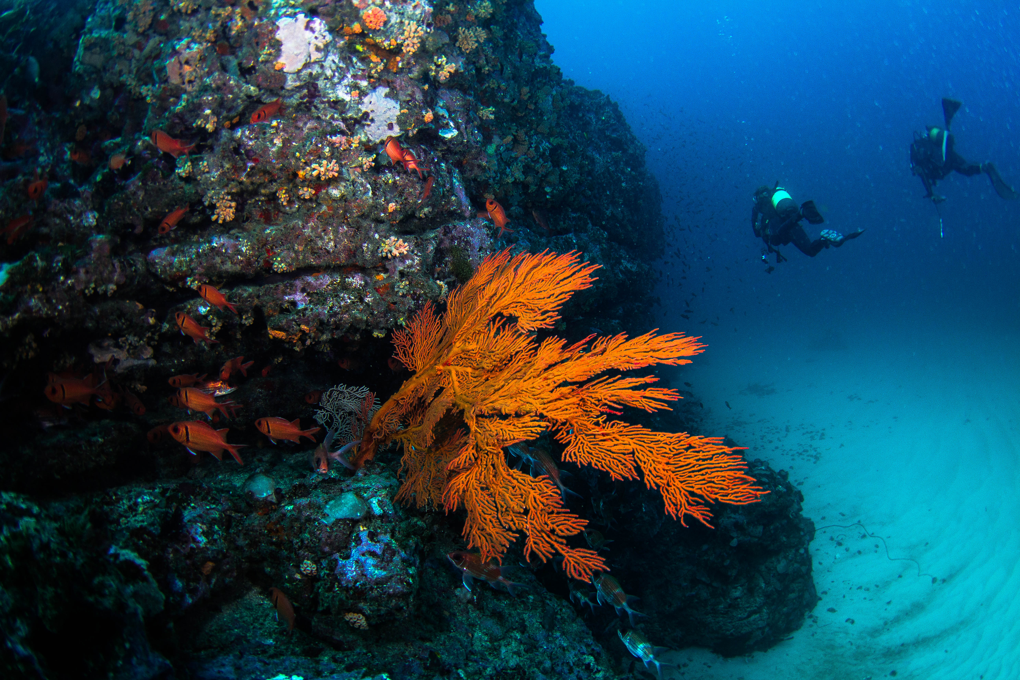
Blue economy adaptation recommendations
Fisheries and tourism are linked as part of blue economy:
Over-fishing may reduce diving opportunities
Coral damage may impact fish nurseries and reduce fish biomass
Decreases in fish biomass may constrain sports fishing potential

Slide 7
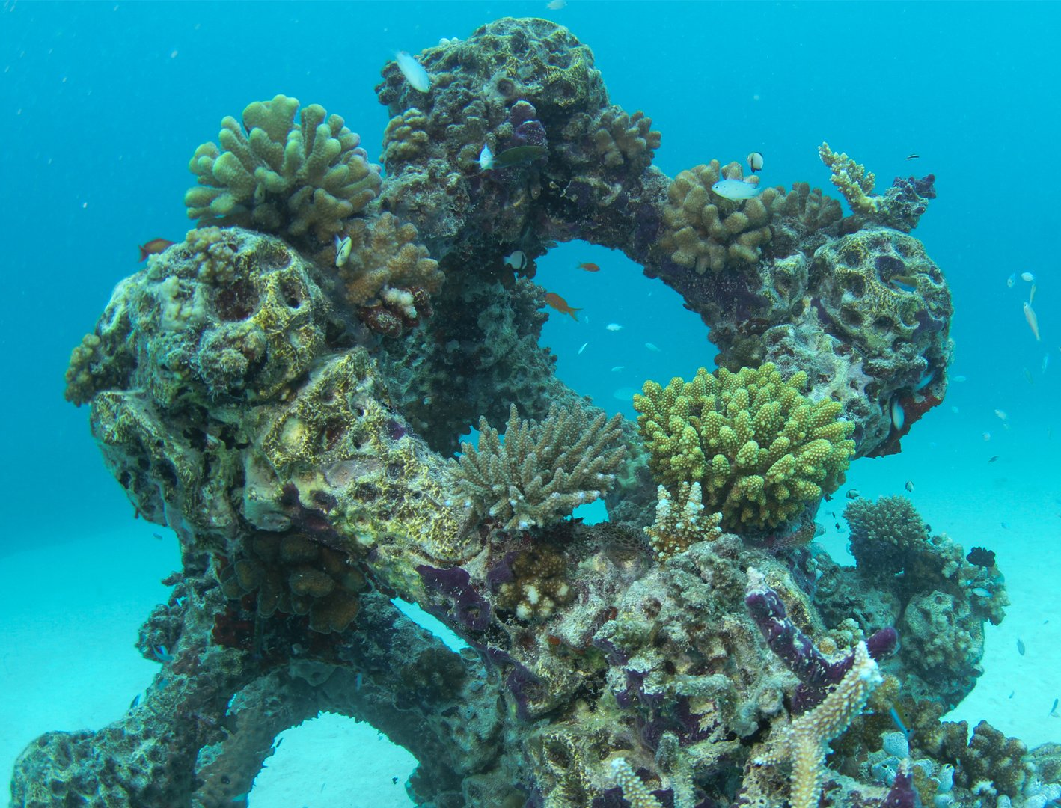
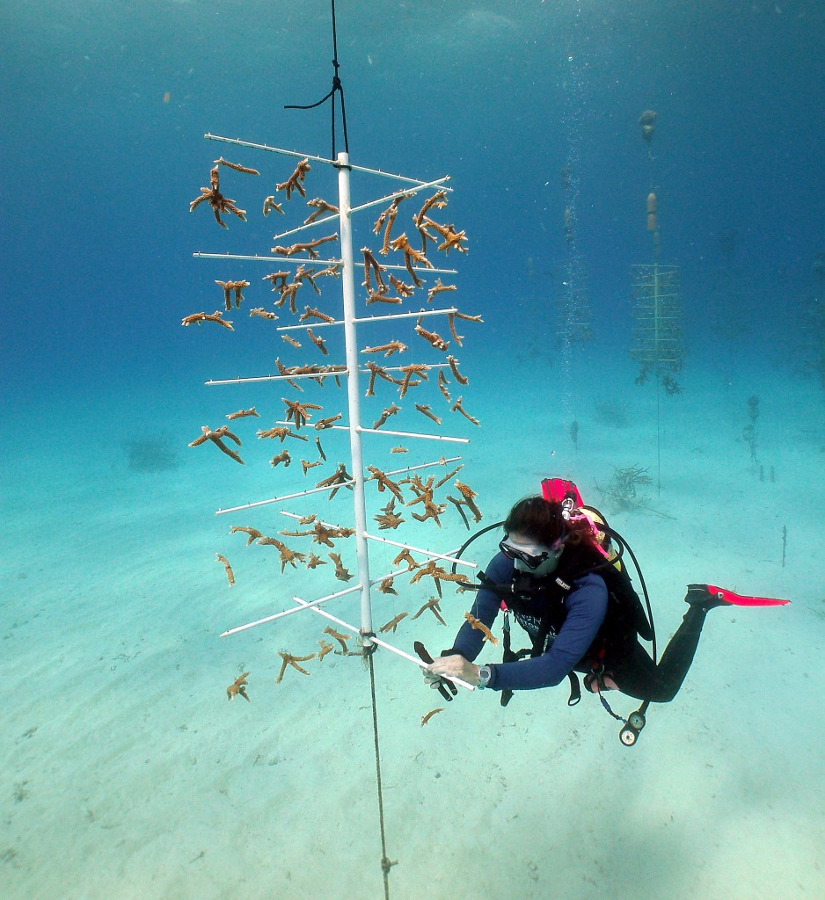
Blue economy adaptation recommendations– eco-tourism
Coral protection is a primary focus of GCF-funded “Global Fund for Coral Reefs Investment Window” approved in 2021
First artificial reefs were installed in São Tomé at the beginning of 2022 by MARAPA and the Tatô Programme
Coral vulnerability assessments
Regular assessment of coral health
Identifying storm sheltered areas
Regular ocean variable assessment for coral vulnerability
Development of coral nurseries for transplanting into damaged areas
Development of artificial reefs

Slide 8

Tourism adaptation recommendations – eco-tourism
Code of conduct for sustainable diving
Limitations on number of divers
No-touch policy for corals
Mandatory use of reef-safe sunscreen
Sustainable anchoring practices
Education for tourists and guides on environmental impact
Regulatory framework
Licensing or authorisation for dive operators
Minimum sustainability and safety criteria
Designation of no-fishing or restricted recreational zones in the most sensitive reefs
Monitoring, enforcement, and sanctions for proven environmental damage
These suggestions are in line with guidance by Green Fins – international recognised project implemented by The Reef-World Foundation and the UN Environment Programme

Slide 9
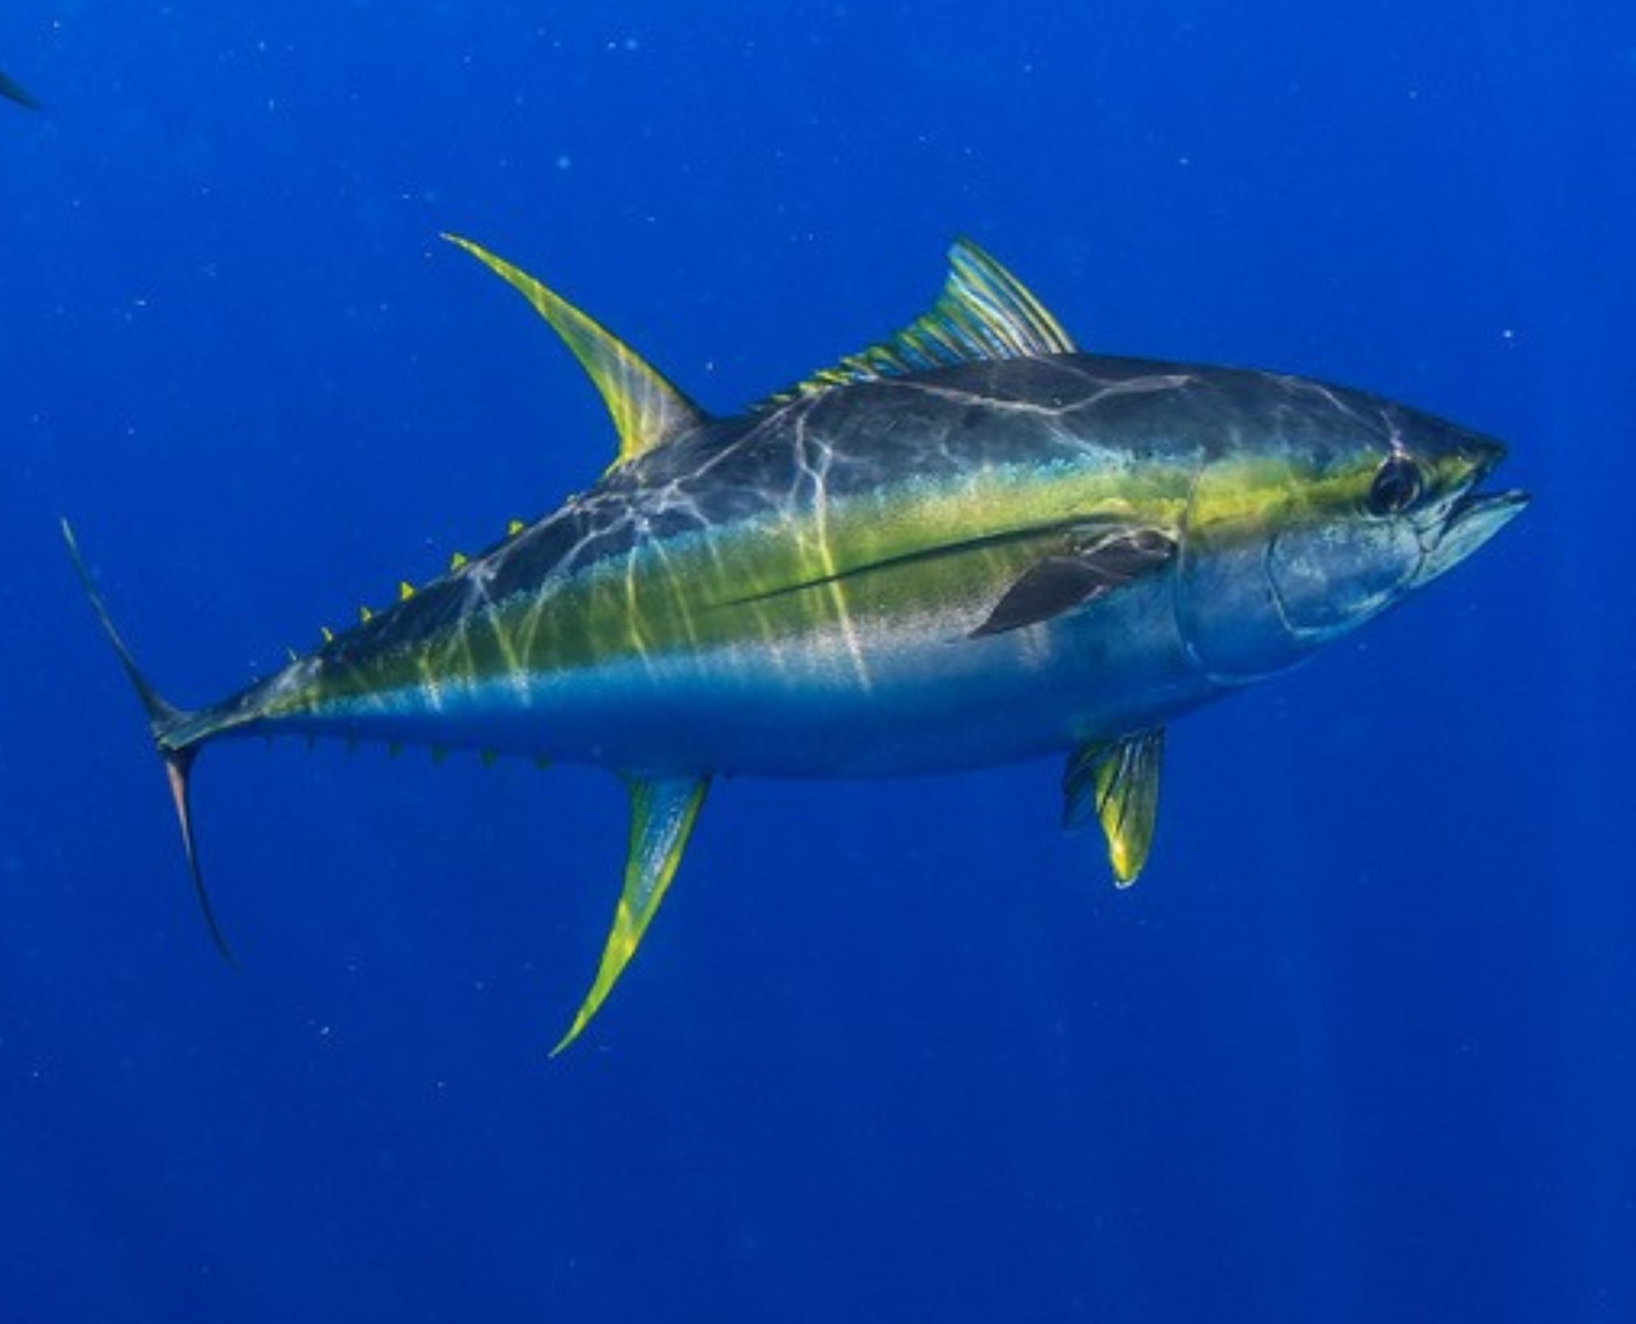
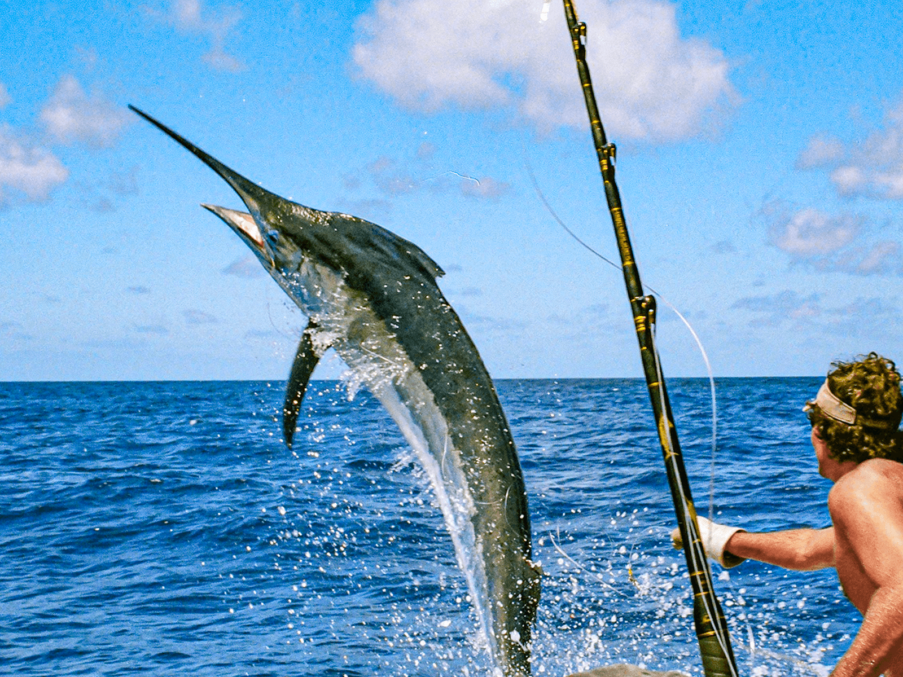
Tourism and fisheries adaptation recommendations – sports fishing
Regulatory framework for sports fishing
Creation of sport fishing zones based on existing ecological studies
Compulsory licenses for amateur and sport fishing
Respect for the closed season (breeding seasons)
Catch limits and minimum sizes
Prohibition of fishing endangered species
Recording of catches and shipments
Require certified guides and safe, seaworthy vessels
Environmental and maritime inspection
Country/Destination | Regulation and Services
Costa Rica | Compulsory permits, protected areas
Brazil (Pantanal) | Amateur fisherman registration, closed season, catch limits
Mauritius | Regulated tournaments, eco-friendly accommodation
Portugal (Azores) | Fishing-tourism licensing, environmental inspection

Slide 10
Link tourism and fisheries for blue economy
Regulatory framework for sports fishing
Creation of sport fishing zones based on existing ecological studies
Compulsory licenses for amateur and sport fishing
Respect for the closed season (breeding seasons)
Catch limits and minimum sizes
Prohibition of fishing endangered species
Recording of catches and shipments
Require certified guides and safe, seaworthy vessels
Environmental and maritime inspection
Country/Destination | Regulation and Services
Costa Rica | Compulsory permits, protected areas
Brazil (Pantanal) | Amateur fisherman registration, closed season, catch limits
Mauritius | Regulated tournaments, eco-friendly accommodation
Portugal (Azores) | Fishing-tourism licensing, environmental inspection
Notes:
E.G catch and release – sports fishing without harming fisheries
Find overlap between sectors

Slide 11
Thank you

