Slide 1


Climate change and climate change impacts on São Tomé and Príncipe with a focus on fishery and tourism sectors in a Blue Economy context Sao Tome and Principe, November/December 2025
Report findings
By: Samuel Greenrod, Marco Fusi, Riccardo Soldan, Lionel Kinadjian

Slide 2
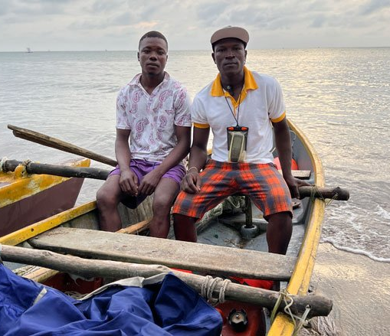
Blue economy
Blue economy is the sustainable use of ocean resources for economic growth, including:
Fisheries
Renewable energy Tourism
The blue economy is particularly important for small island developing states, which are largely dependent on their natural resources. However, due to its dependence on natural resources, the blue economy is highly vulnerable to climate change.
As oceanic changes force fishers to go further from the coast, they are exposed to more danger. Célcio Dias – known as Mano, on the right, relies on a GPS to return safely home. Photo: Flore de Preneuf/ World Bank

Slide 3
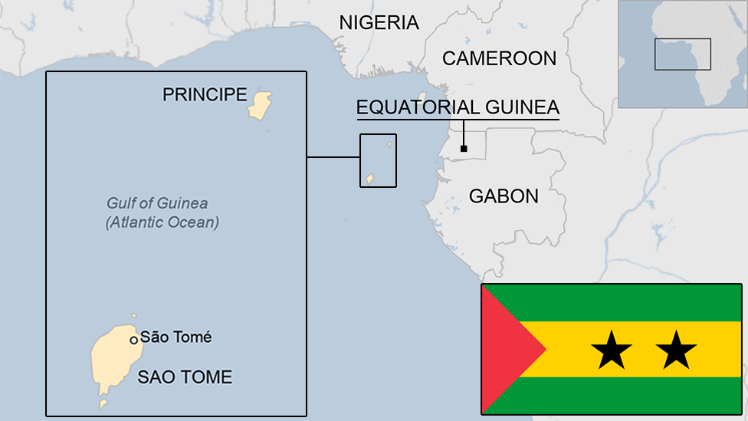
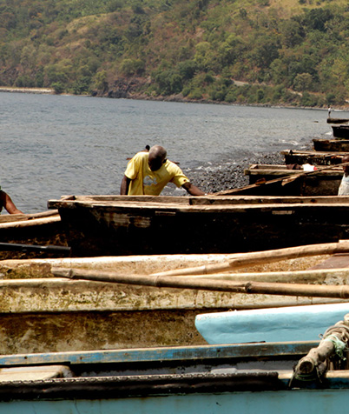
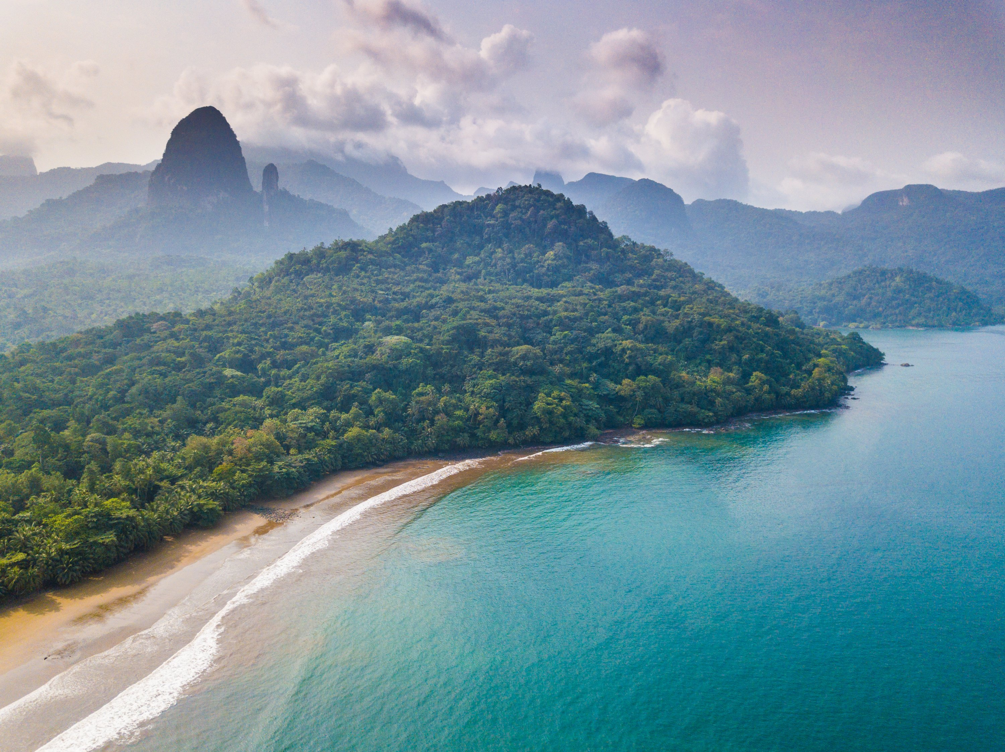
Focus of report
Assess impact of climate change on STP fisheries and tourism:
Assess climate change hazards
Determine climate change impacts
Identify climate adaptation options

Slide 4
Presentation overview
Sector baseline (fisheries)
Historical ocean trends
Future ocean trends
Impact analysis (fisheries)
Sector baseline (tourism)
Historical climate trends
Future climate trends
Impact analysis (tourism)

Slide 5

Fisheries in STP
Fisheries are crucial for the economy and employment
5-10% GDP
Employ 10-15% population
Fish comprises ~53% of animal protein intake
Fish conservation is also important for future tourism:
Sports fishing
Diving
Threats
Ocean warming
Ocean acidification
5

Slide 6
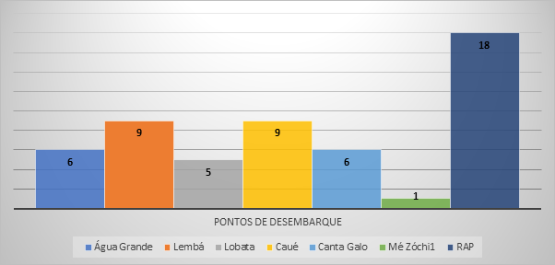
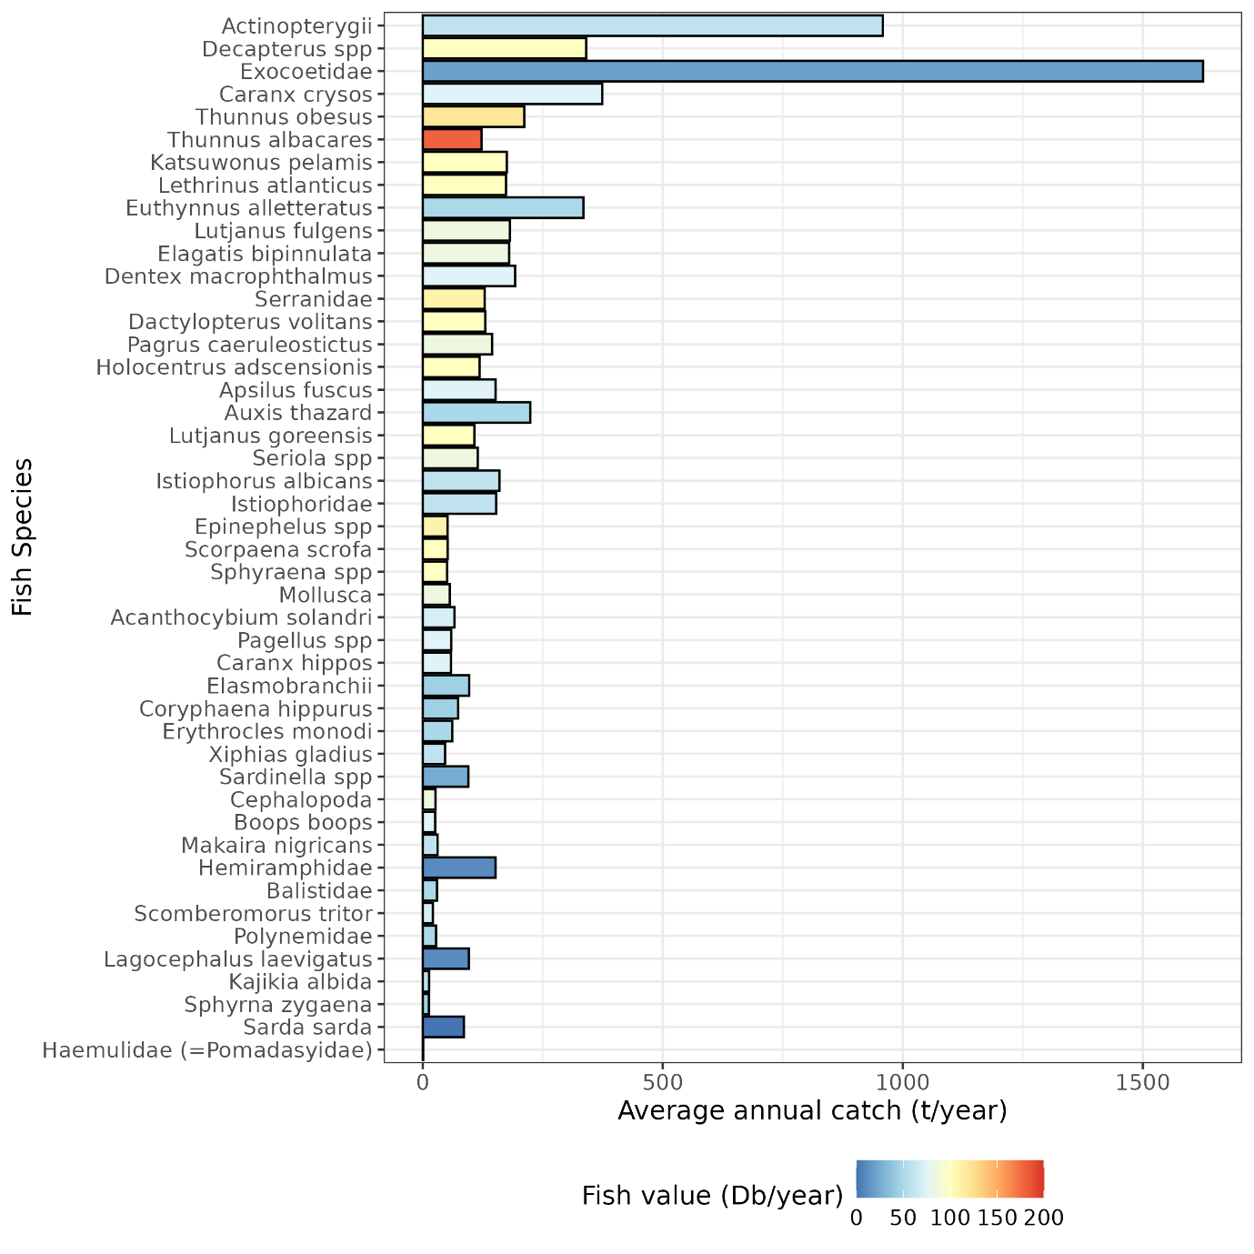
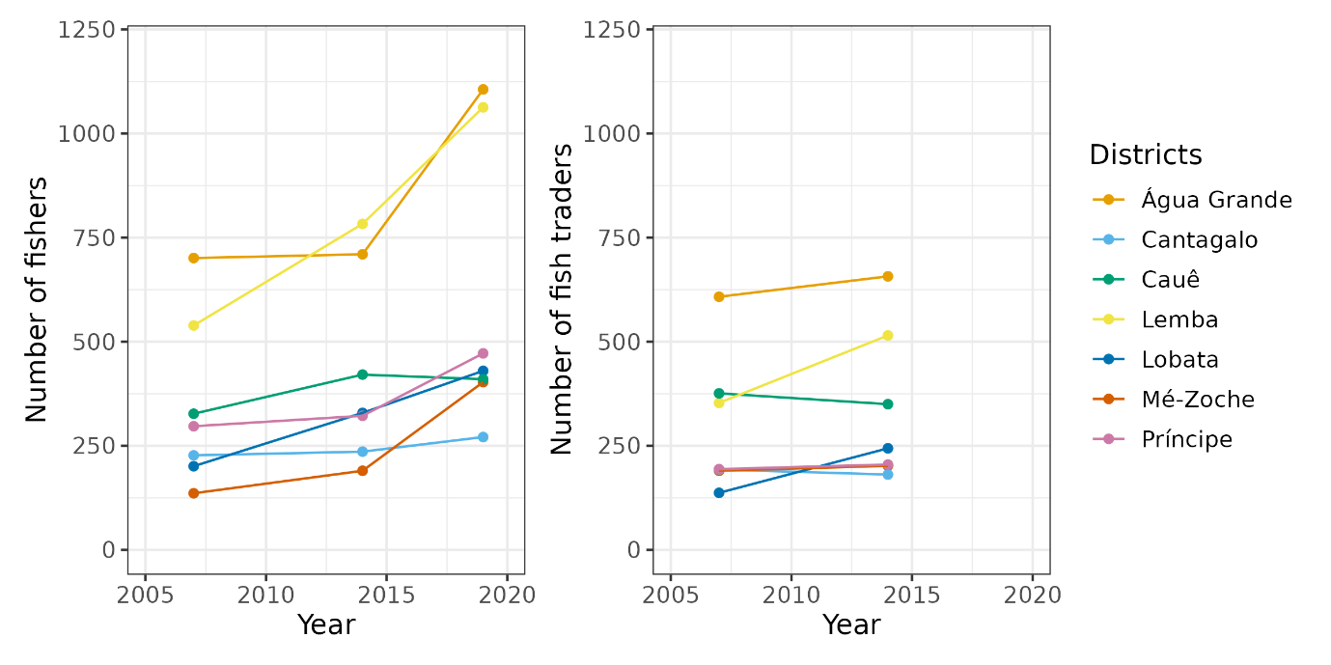
Fisheries in STP
Flying fish
Ray-finned fish
Blue runner
Scads
Little tunny

Slide 7
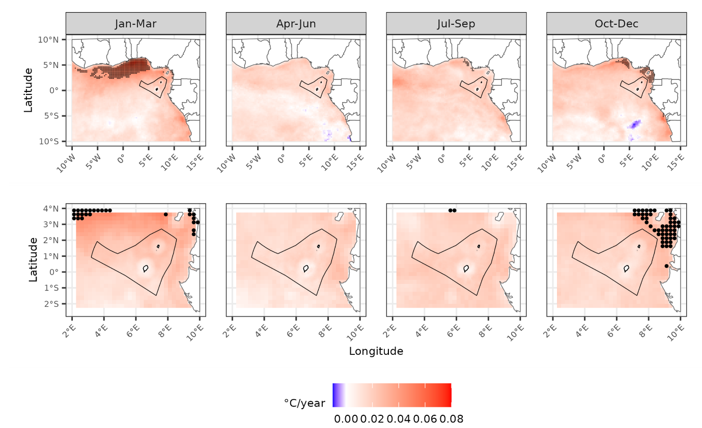
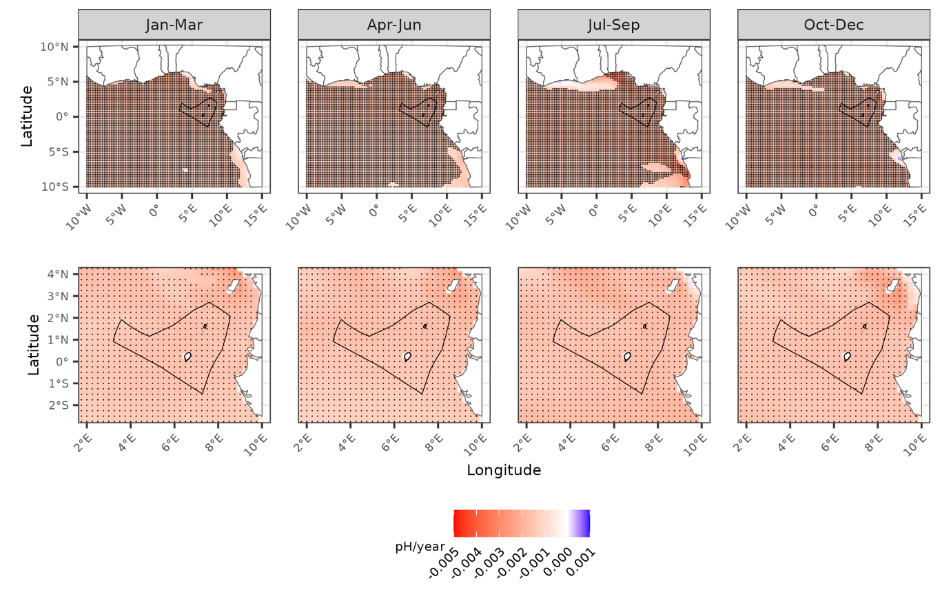
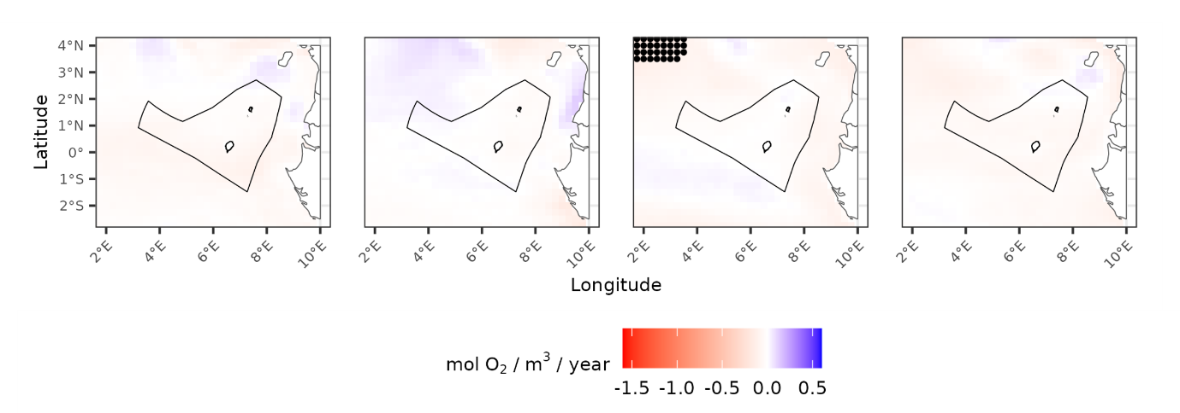
Fisheries – climate exposure (historical)
Data source: Copernicus Marine Data Store reanalysis datasets (1993-2023)
Historical ocean trends:
Sea surface temperatures rising
Sea surface pH decreasing (acidification)
Sea surface oxygen remains stable

Slide 8
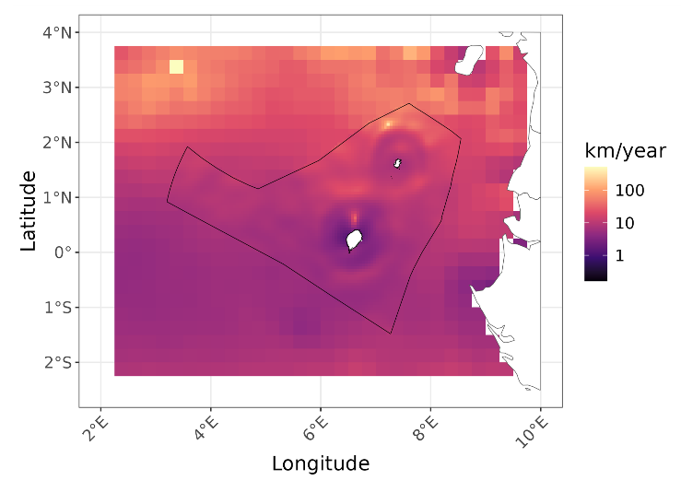
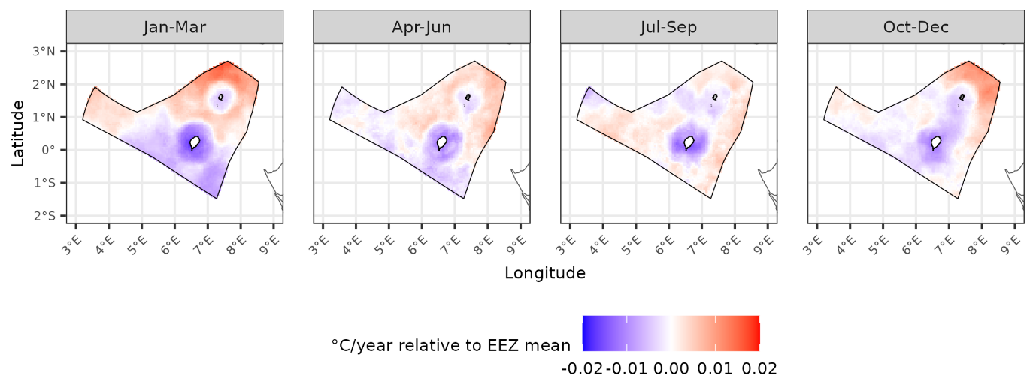
Fisheries – climate exposure (historical)
Notable observation:
Thermal buffering close to the coastline
Slower climate velocity close to coastline

Slide 9
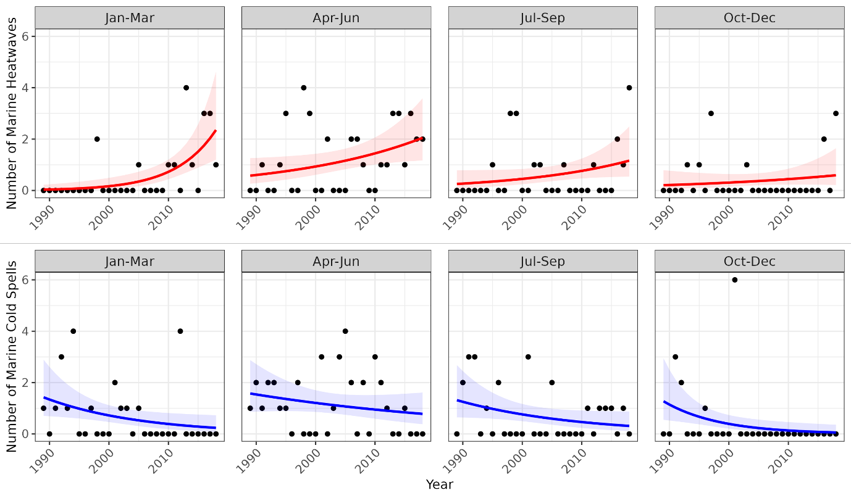
Fisheries – climate exposure (historical)
Historical ocean anomalies:
Increase in frequency of marine heatwaves
Decrease in frequency of marine cold spells

Slide 10
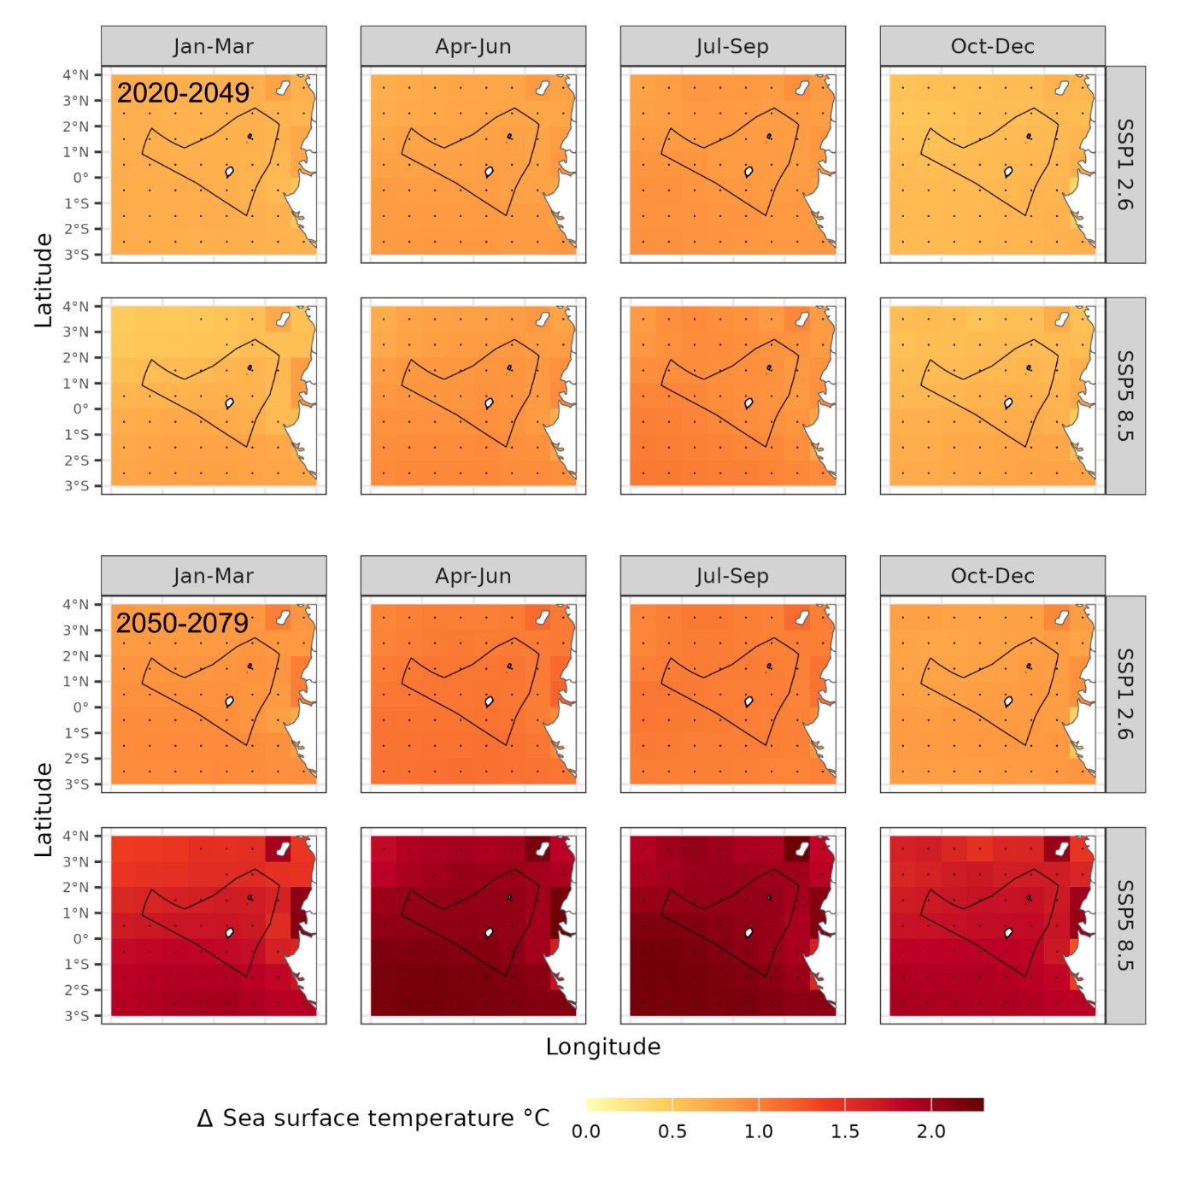
Fisheries – climate exposure (future)
Data source: three Earth System Models and one climate model ensemble
Climate scenarios:
Two shared socioeconomic pathways
SSP1 2.6 (low carbon, optimistic)
SSP5 8.5 (high carbon, pessimistic)
Historical baseline (1989-2019)
Two future time periods
2020-2049
2050-2079
10

Slide 11
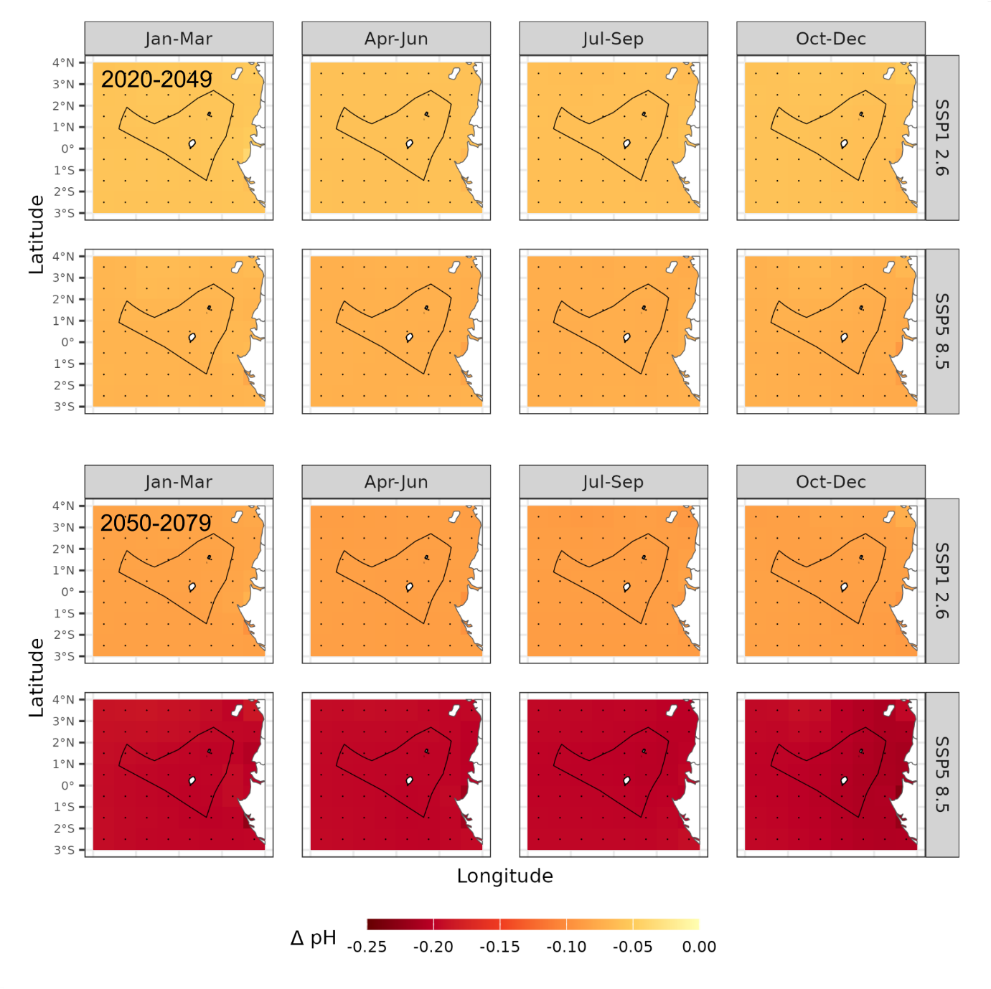
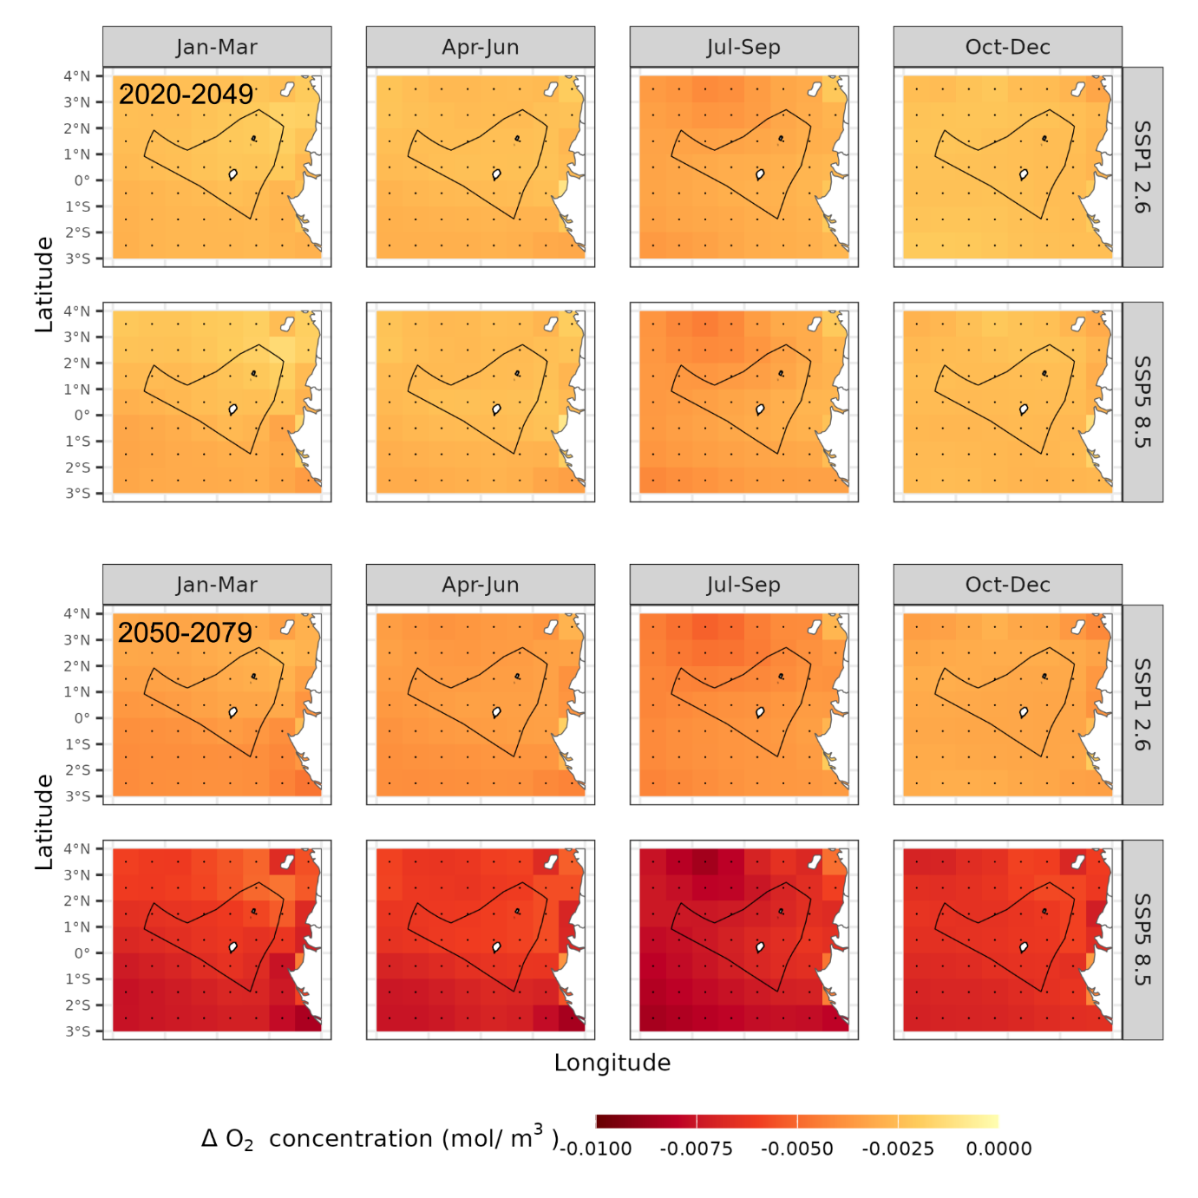
Fisheries – climate exposure (future)

Slide 12
Fisheries – climate exposure (future)
 | RCP 2.6 (low carbon scenario) |  |  |  |  |  |  |  | RCP 8.5 (high carbon scenario)
 | 2020-2049 |  |  |  | 2050-2079 |  |  |  | 2020-2049 |  |  |  | 2050-2079
 | JFM | AMJ | JAS | OND | JFM | AMJ | JAS | OND | JFM | AMJ | JAS | OND | JFM | AMJ | JAS | OND
Marine heatwave | 6.4 | 7.1 | 9.3 | 4.2 | 6.5 | 8.3 | 10.4 | 5.3 | 5.2 | 6.8 | 10.0 | 3.8 | 5.7 | 6.9 | 12.5 | 6.2
Marine cold spell | 0.26 | 0.30 | 0.27 | 0.20 | 0.22 | 0.30 | 0.27 | 0.20 | 0.42 | 0.30 | 0.27 | 0.20 | 0.22 | 0.30 | 0.27 | 0.20
High oxygen streak | 0.38 | 0.35 | 0.34 | 0.60 | 0.38 | 0.35 | 0.34 | 0.60 | 0.46 | 0.35 | 0.34 | 0.50 | 0.38 | 0.35 | 0.34 | 0.60
Low oxygen streak | 6.5 | 15.6 | 8.9 | 16.4 | 7.9 | 18.5 | 10.6 | 22.9 | 5.9 | 13.8 | 9.7 | 15.4 | 10.1 | 23.1 | 18.4 | 23.6
High pH streak | 0.25 | 0.22 | 0.20 | 0.83 | 0.25 | 0.22 | 0.20 | 0.83 | 0.25 | 0.22 | 0.20 | 0.83 | 0.25 | 0.22 | 0.20 | 0.83
Low pH streak | 8.6 | 7.6 | 6.5 | 27.7 | 7.6 | 7.7 | 5.9 | 24.4 | 8.6 | 7.6 | 6.4 | 25.8 | 7.6 | 7.6 | 5.9 | 24.4
High salinity streak | 0.88 | 1.0 | 1.1 | 2.0 | 0.88 | 1.0 | 1.1 | 2.3 | 0.88 | 1.0 | 0.75 | 2.0 | 0.88 | 1.0 | 0.83 | 2.4
Low salinity streak | 2.8 | 2.6 | 2.5 | 0.83 | 2.3 | 3.2 | 1.5 | 0.92 | 4.5 | 6.8 | 5.2 | 1.8 | 13.6 | 20.9 | 17.5 | 2.3

Slide 13
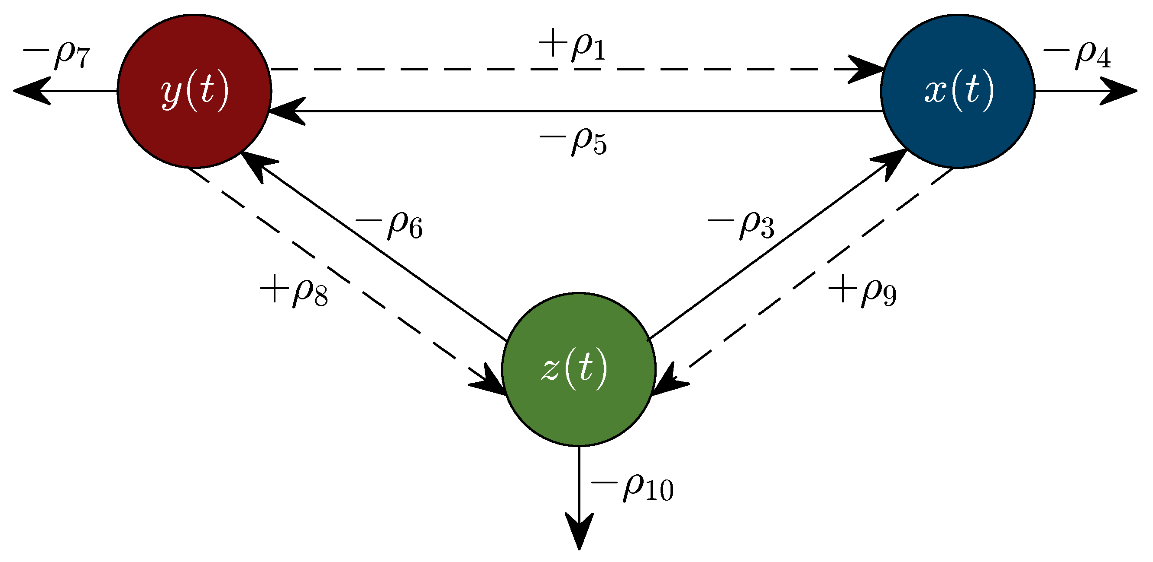

Fish impact analysis
Climate impact on fisheries was assessed using two types of model: mechanistic and empirical
Mechanistic models – use equations that model how fish systems function and interact with climate
Empirical models – find statistical associations between species presence and environmental parameters

Slide 14
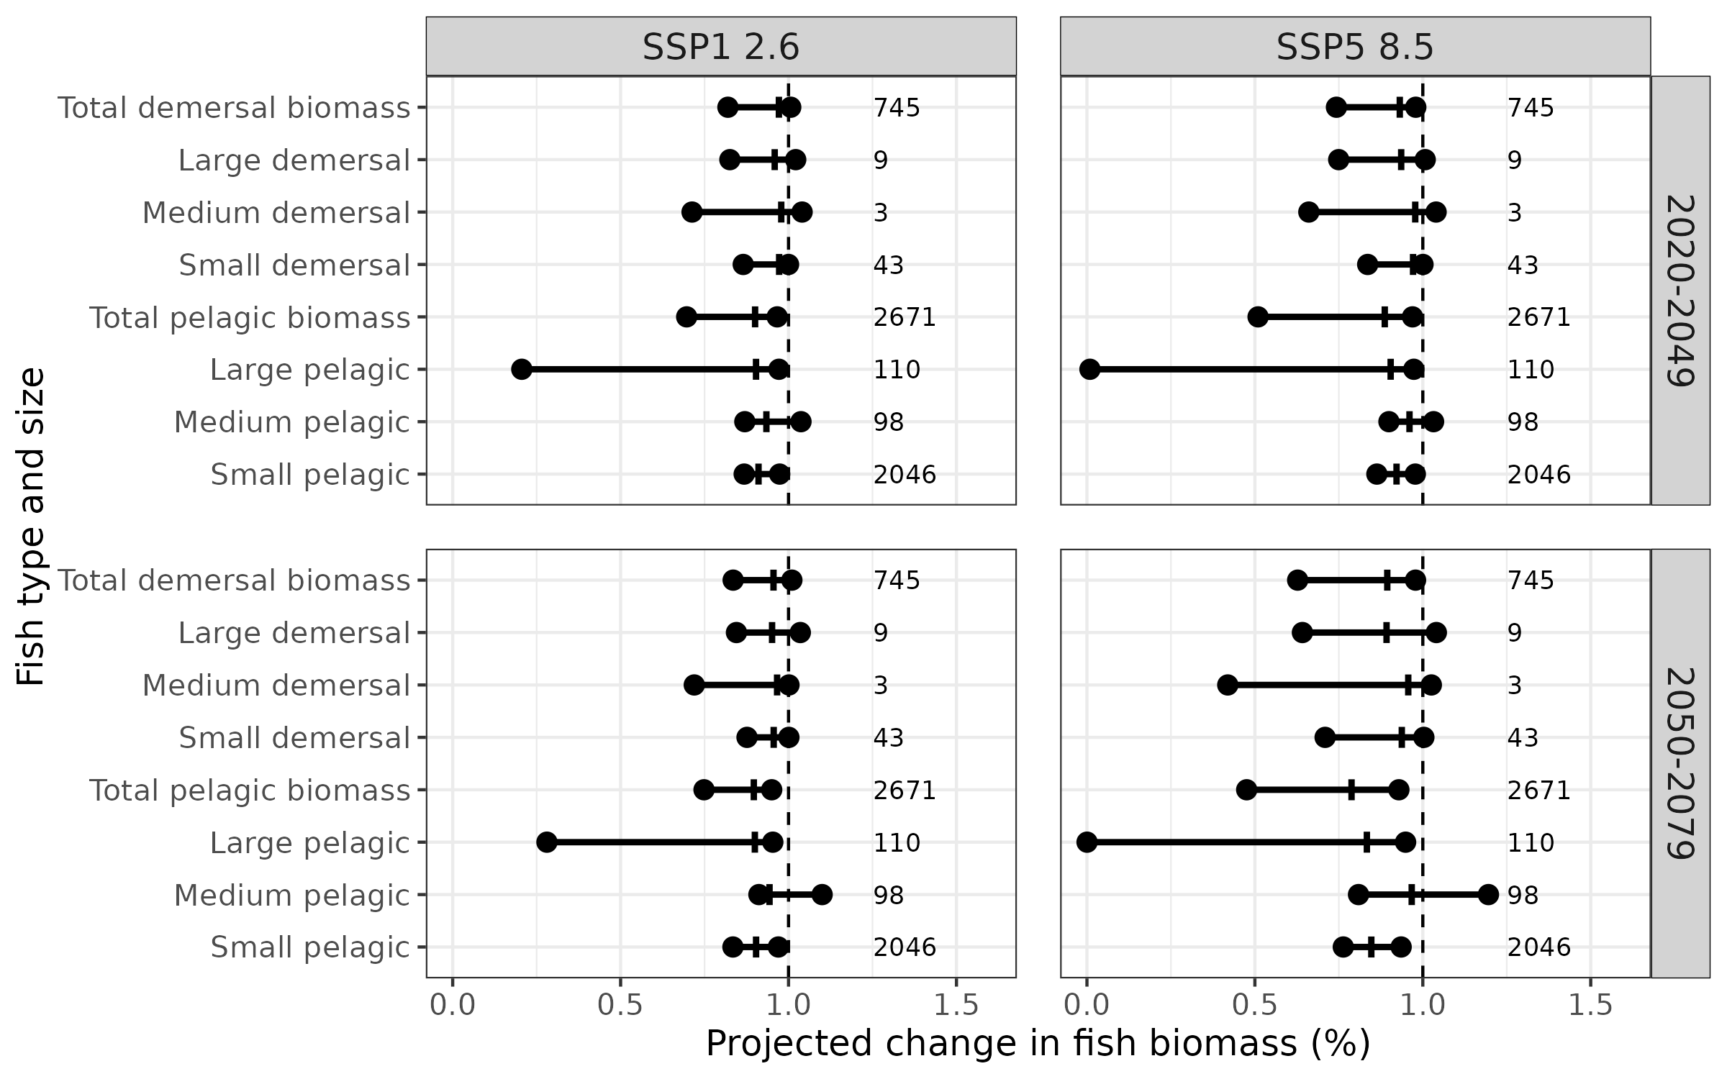
Fisheries – climate impact (mechanistic modelling)
ISIMIP
Fish biomass impact models:
APECOSM
BOATS
EcoOcean
DBPM
FEISTY
ZooMSS
Climate models
IPSL-CMIP6-LR
GFDL-ESM4

Slide 15
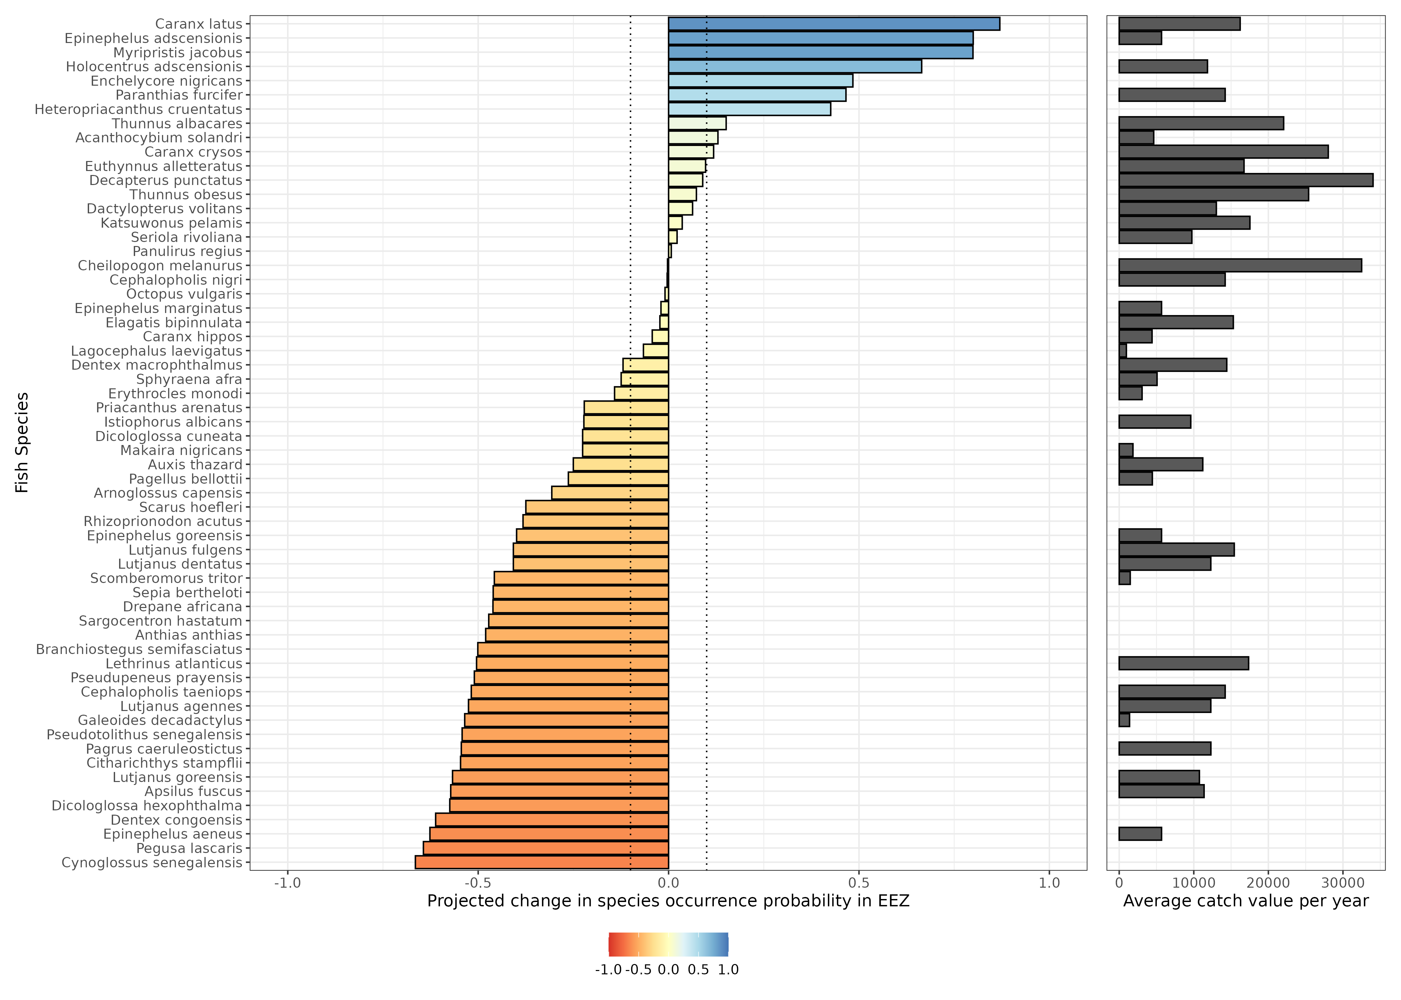
Fisheries – climate impact (empirical modelling)
Fish occurrence probability is projected to vary considerably with climate change
With a 0.1 change cut-off, occurrence probability projected to:
Increase for 10 species
No change for 14 species
Decrease for 36 species

Slide 16
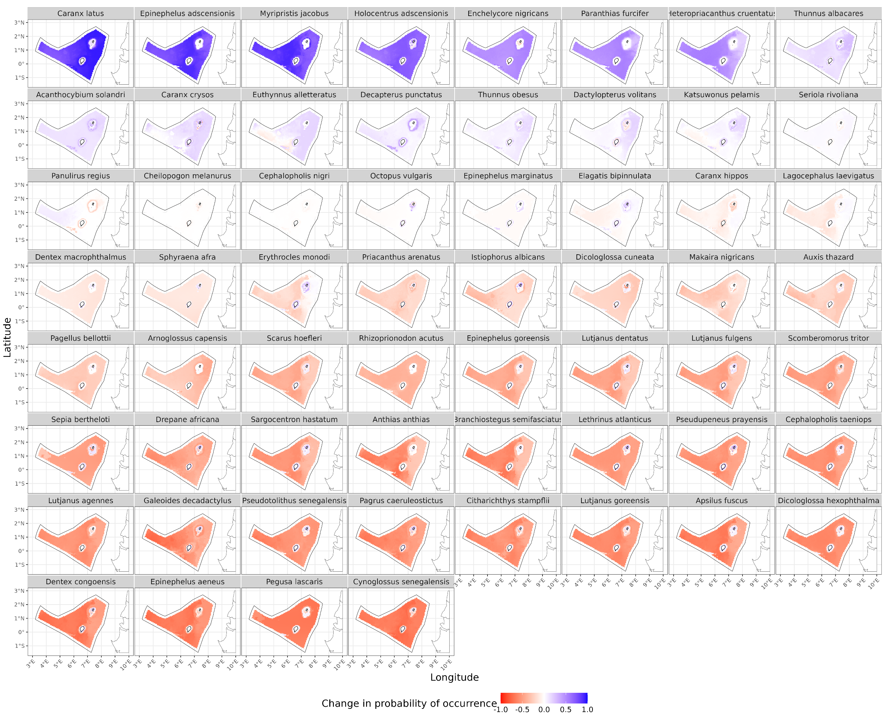
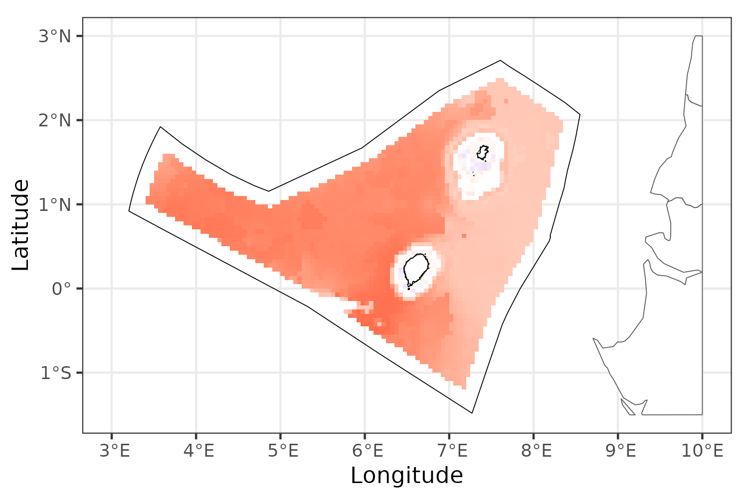
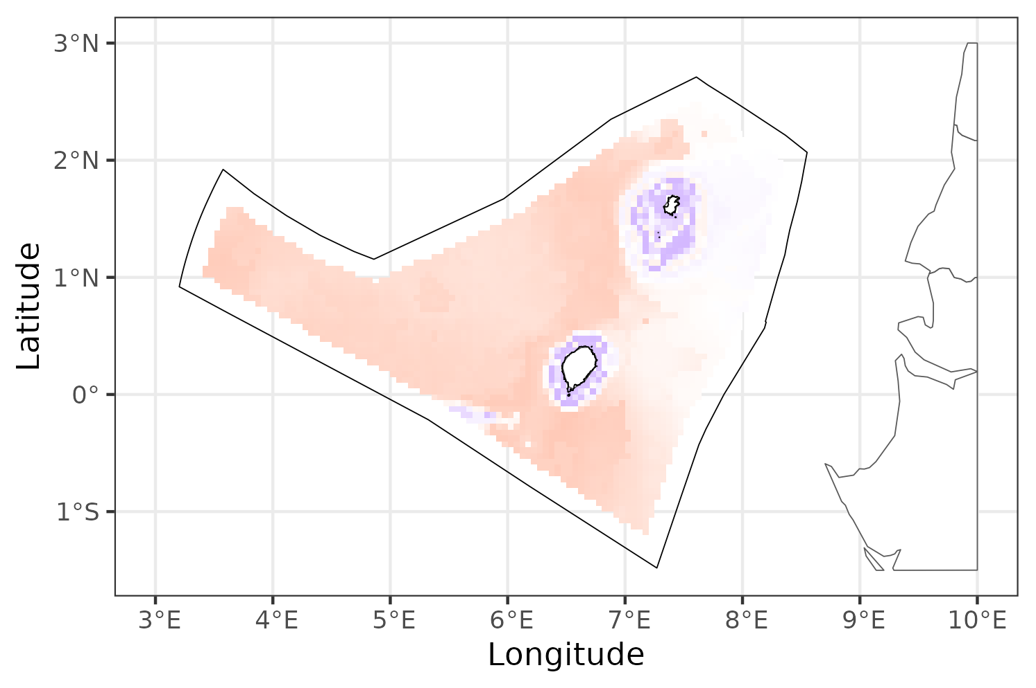
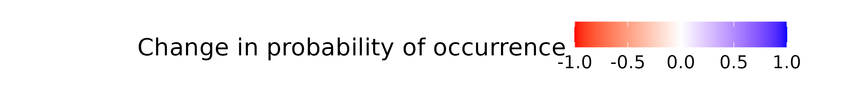
Fisheries – climate impact (empirical modelling)
Climate impact is greater in the west than east, consistent with mechanistic models
Coastal waters are buffered from climate impact
Anthias anthias
Erythrocles monodi

Slide 17
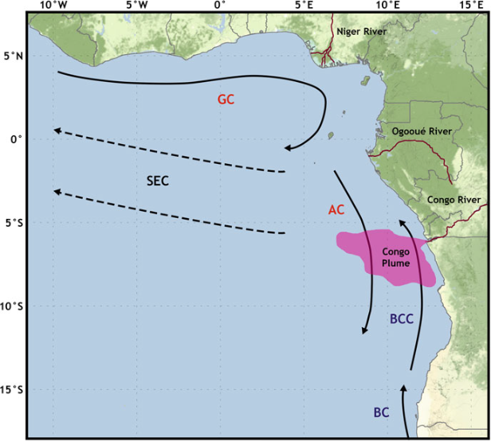
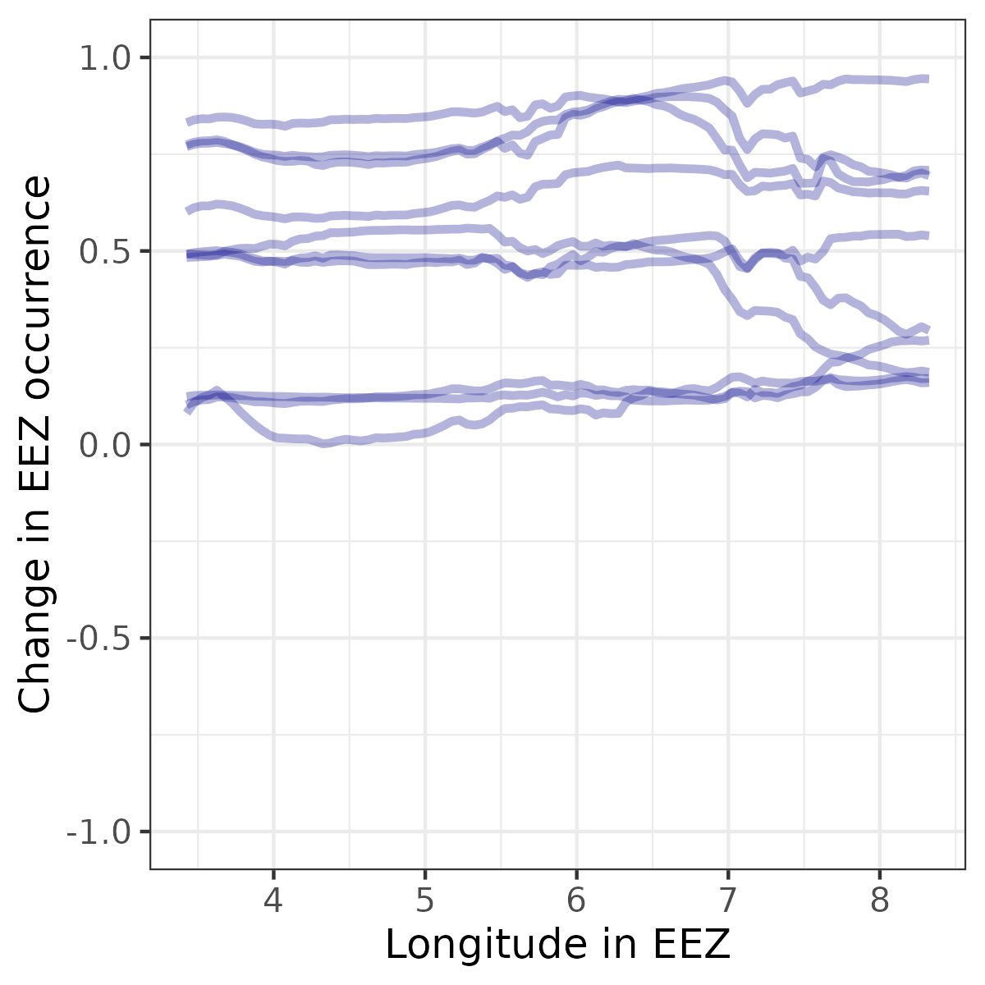
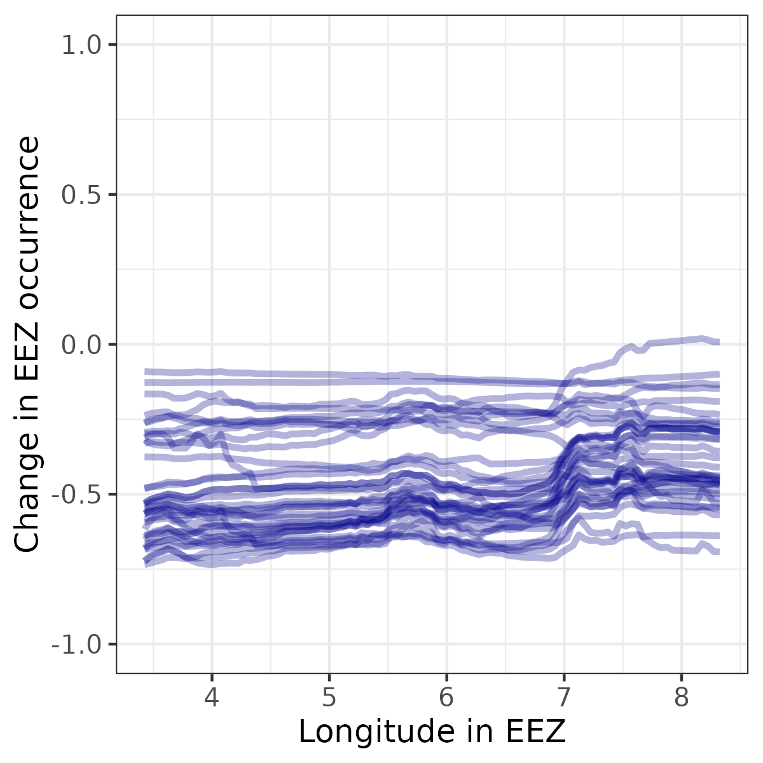
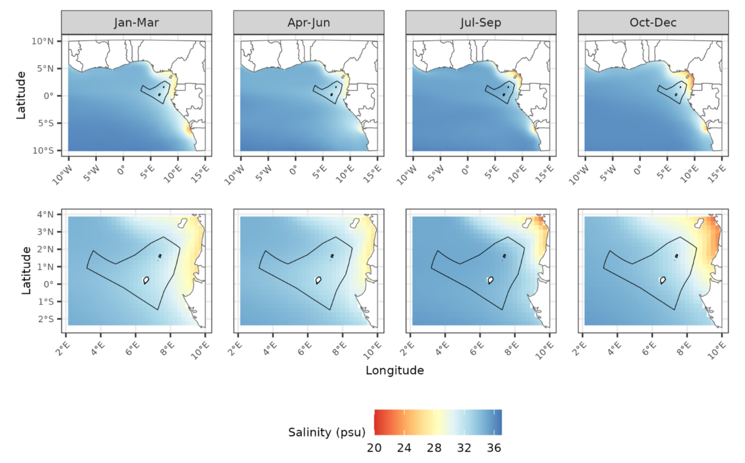
Fisheries – climate impact (empirical modelling)
Positively affected by climate change
Negatively affected by climate change

Slide 18
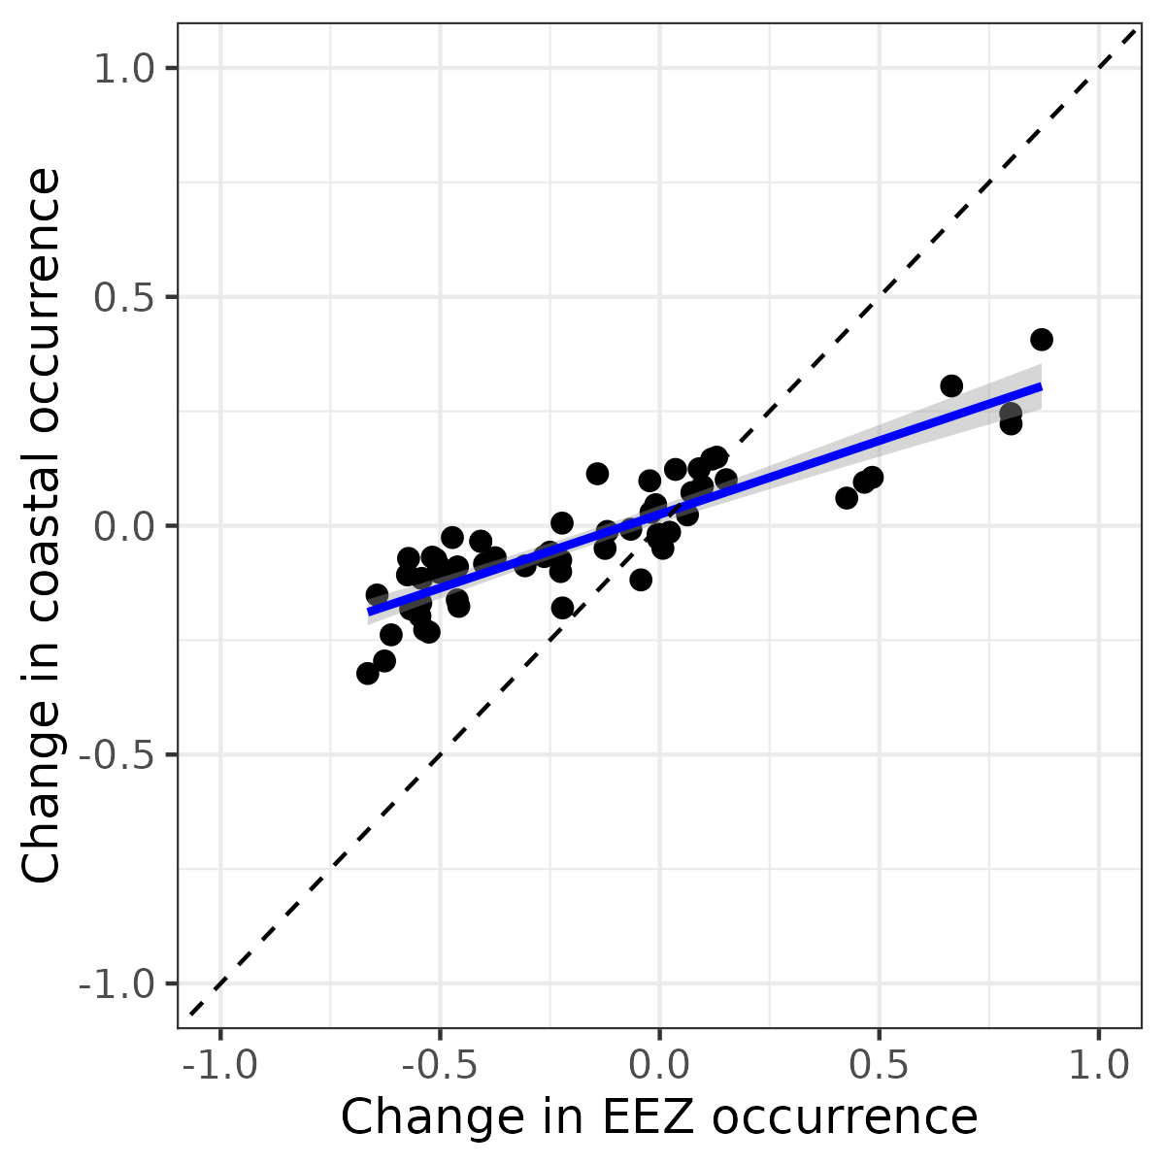
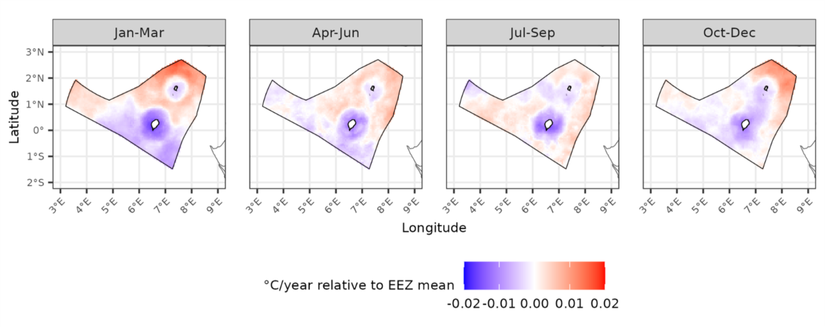
Fisheries – climate impact (empirical modelling)
Coastal buffering occurs across all species
Result may be due to greater climatic stability near coast
m = 0.32
R² = 0.78

Slide 19
Conclusions for fisheries
Historical and projected trends:
Increase in sea surface temperatures
Decrease in sea surface pH and oxygen
Variable impacts on overall rainfall
Increase in frequency of heatwaves and extreme rainfall
Rising sea levels
Impacts
Dangerous weather conditions for tourists
Erosion of beaches/coastal areas
19

Slide 20
Tourism in STP
GDP: 6-8% (14% indirect)
Employment: ~10%
Highlights:
Sun and beach
Diving
Ecotourism
Sports fishing
Threats
High temperatures and humidity
Extreme weather
Coastal erosion

Slide 21
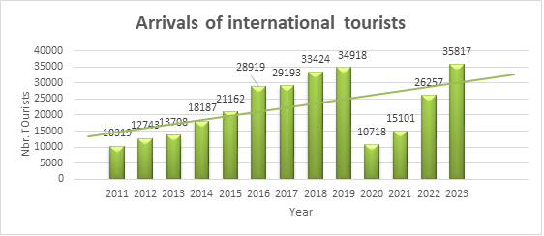
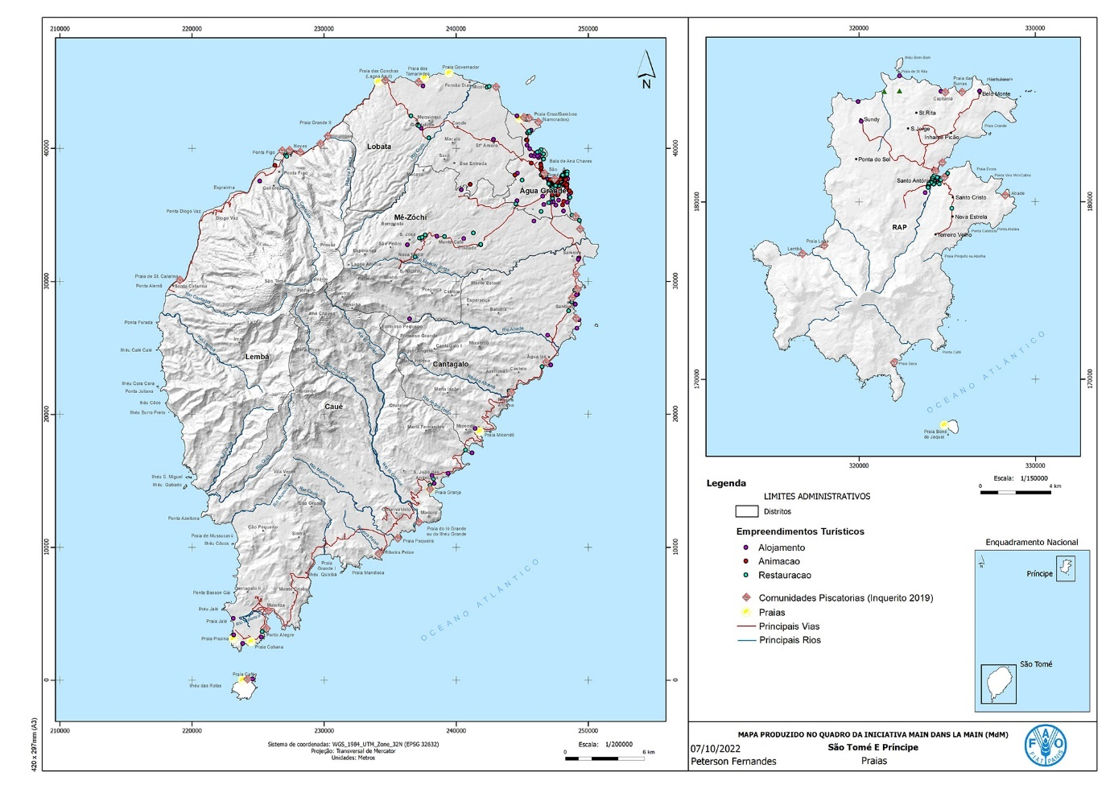
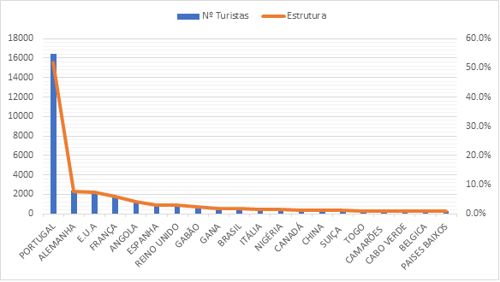
Tourism in STP
Locations of tourist provisions

Slide 22
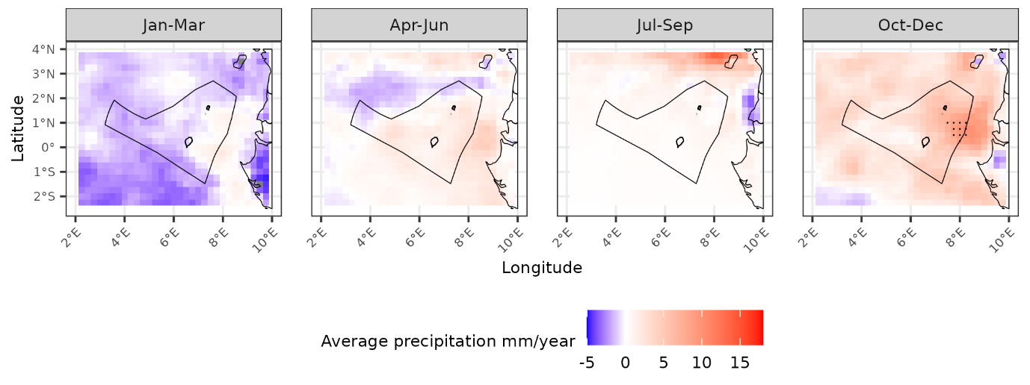
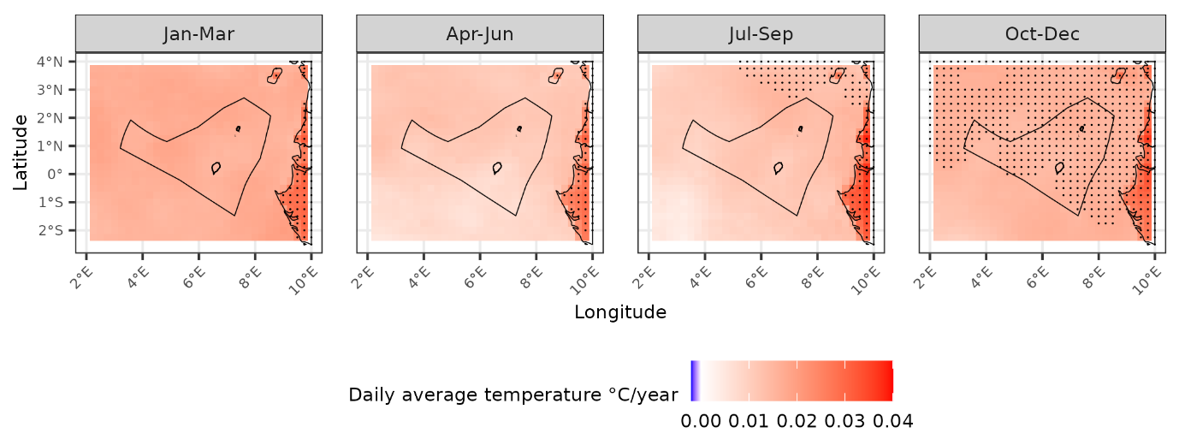
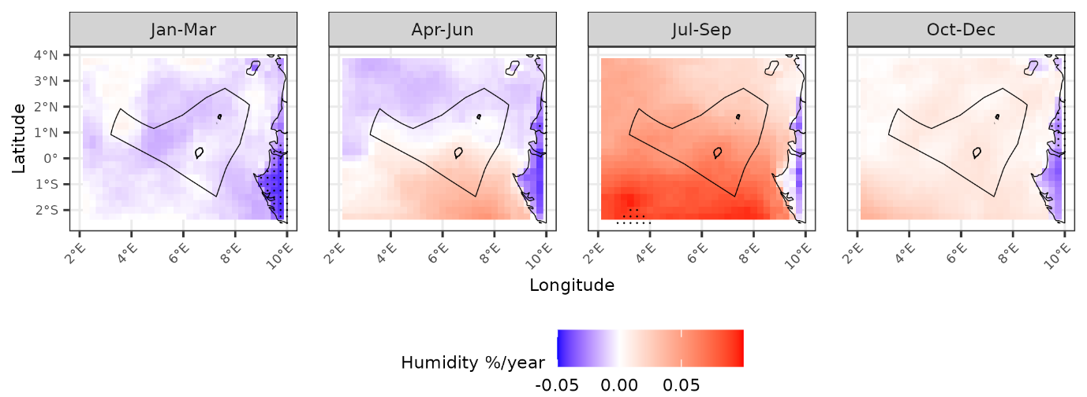
Tourism – climate exposure (historical)
Data source: ERA5 reanalysis dataset
Past climate trends:
Rising surface temperatures
More precipitation in October-December
More humid in July-December

Slide 23
Tourism – climate exposure (historical)
Times difference in frequency of climate anomalies between 1980-1990 and 2010-2020
 | São Tomé |  |  |  | Príncipe
 | Jan-Mar | Apr-Jun | Jul-Sep | Oct-Dec | Jan-Mar | Apr-Jun | Jul-Sep | Oct-Dec
Heatwaves | 1.77 | 1.31 | 1.00 | 1.00 | 3.20 | 2.71 | 1.00 | 1.00
Heavy rainfall days | 2.11 | 6.99 | 2.18 | 2.00 | 1.40 | 1.94 | 1.53 | 3.23
Extreme rainfall days | 75.8 | 29.0 | 0.85 | 3.72 | 1.68 | 8.07 | 1.09 | 4.65
Dry days | 1.84 | 1.12 | 1.01 | 0.93 | 1.27 | 1.28 | 0.98 | 1.05

Slide 24
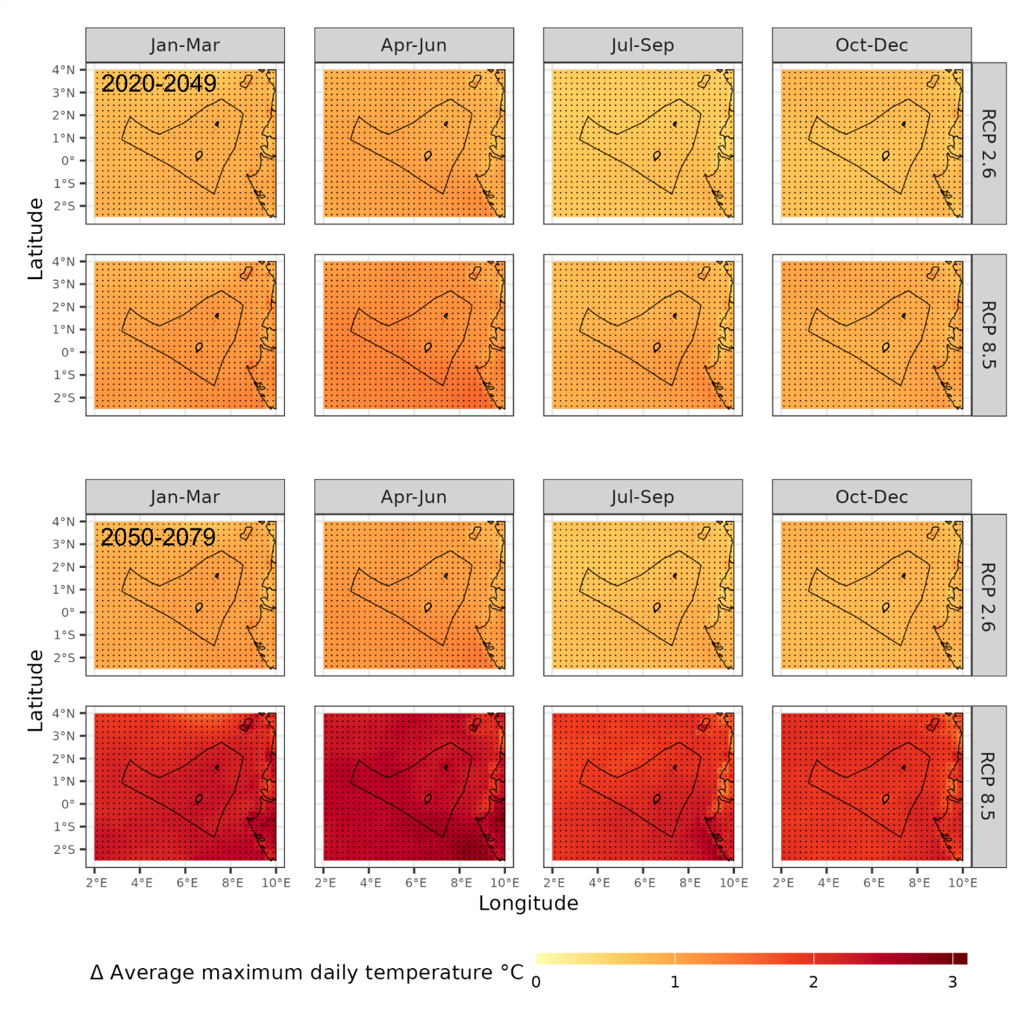
Tourism – climate exposure (future)
Data source: CORDEX-CORE bias-corrected, downscaled CMIP5 ensemble
Climate scenarios:
Two representative concentration pathways
RCP 2.6 (low carbon, optimistic)
RCP 8.5 (high carbon, pessimistic)
Historical baseline (1980-2005)
Two future time periods
2020-2049
2050-2079

Slide 25
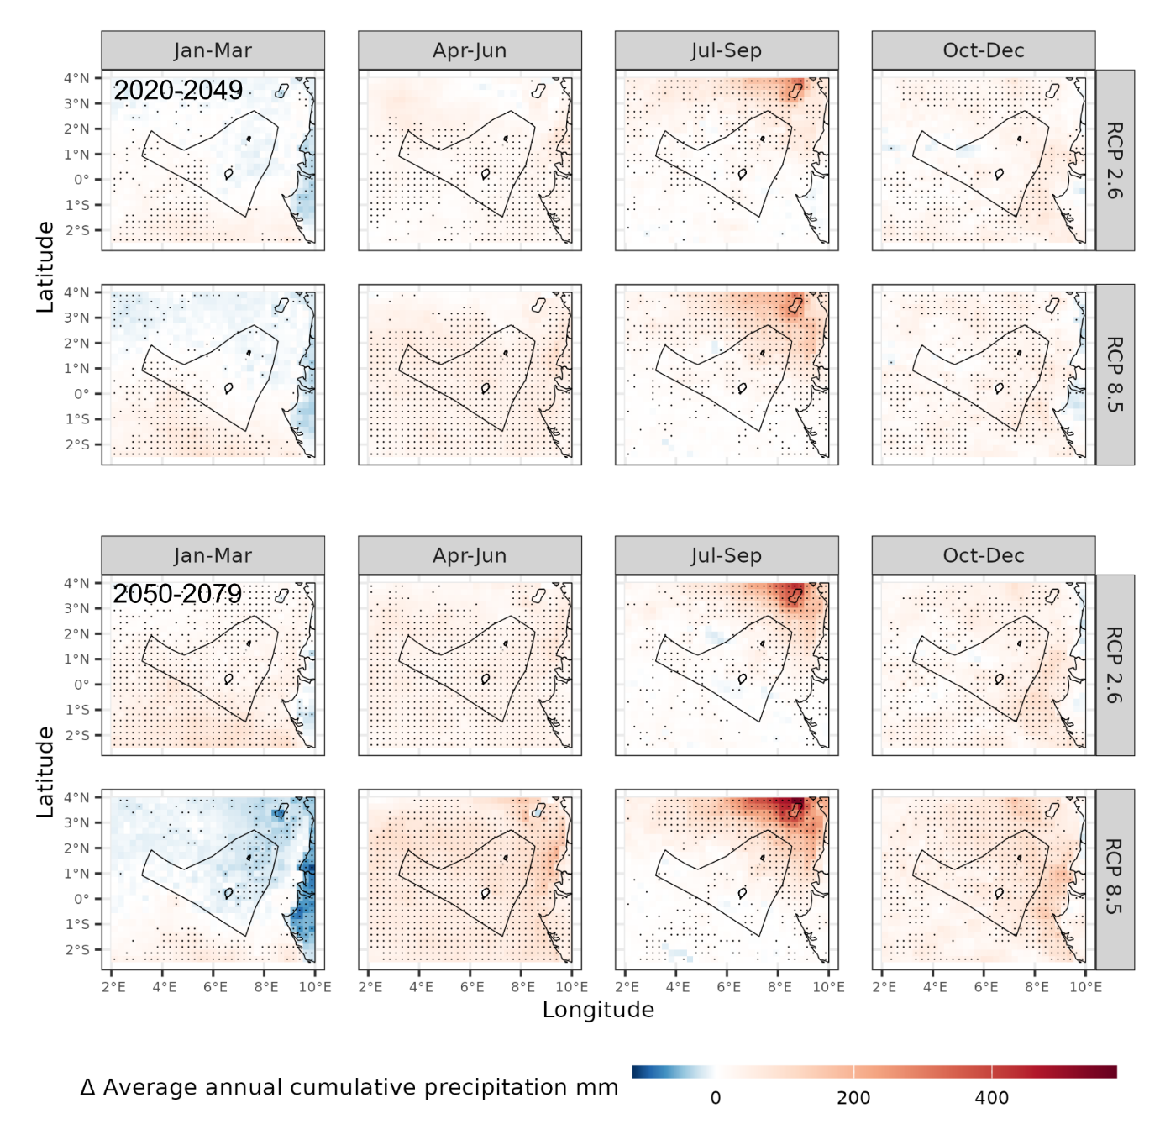
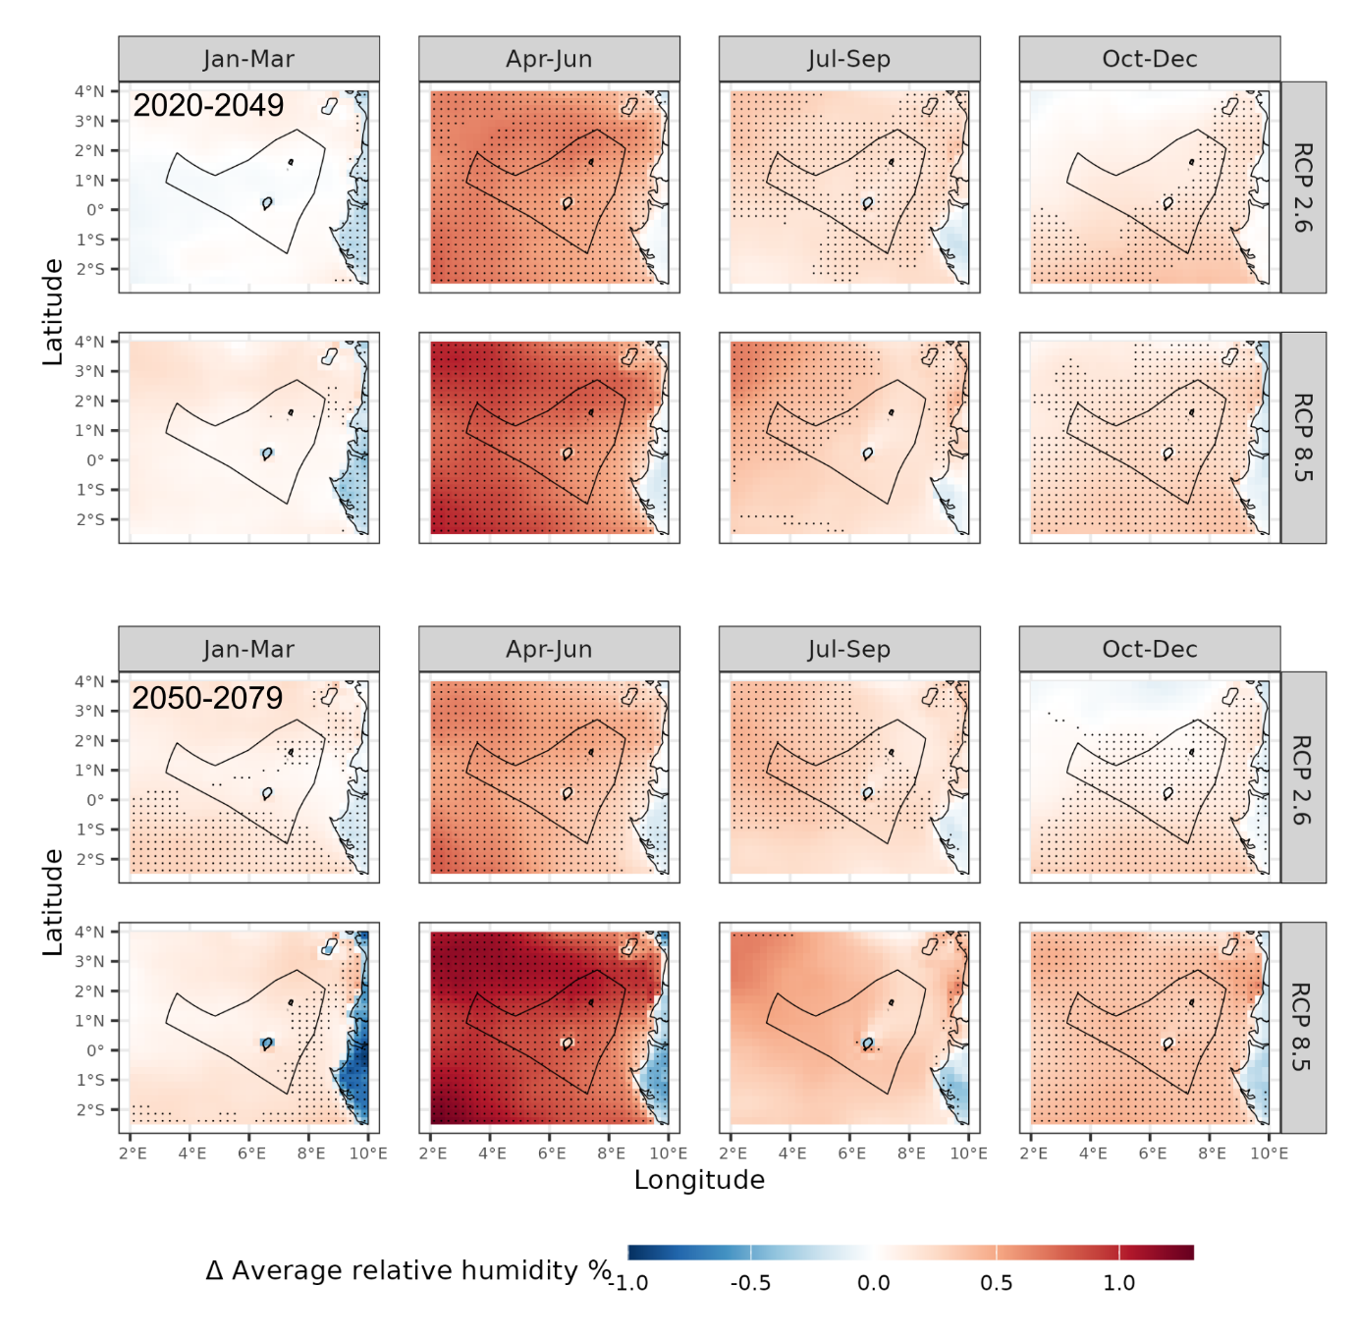
Tourism – climate exposure (future)
Future climate trends:
Hotter – increasing surface temperatures
Possibly more rainfall in April-December
More humid
Potential risk of

Slide 26
Tourism – climate exposure (future)
Climate anomaly | Frequency of extreme events in future projections relative to baseline (1980-2005)
 | RCP 2.6 (low carbon scenario) |  |  |  |  |  |  |  | RCP 8.5 (high carbon scenario)
 | 2020-2049 |  |  |  | 2050-2079 |  |  |  | 2020-2049 |  |  |  | 2050-2079
 | JFM | AMJ | JAS | OND | JFM | AMJ | JAS | OND | JFM | AMJ | JAS | OND | JFM | AMJ | JAS | OND
São Tomé
Heatwaves | 2.3 | 1.6 | 0 | 0.1 | 2.3 | 1.7 | 0 | 0.2 | 2.2 | 1.6 | 0 | 0.3 | 1.1 | 1.5 | 0.2 | 2.0
Heavy rainfall days | -0.02 | 0.05 | 0.04 | 0.25 | 0.1 | 0.3 | 0.02 | 0.5 | 0.08 | 0.2 | 0.05 | 0.2 | -0.05 | 0.3 | -0.02 | 0.3
Extreme rainfall days | 0.03 | 0.06 | 0.06 | 0.08 | 0.01 | 0.08 | 0.03 | 0.2 | 0.05 | 0.05 | 0.06 | 0.1 | 0.01 | 0.09 | 0.03 | 0.2
Dry days | 0.9 | -1.1 | 1.4 | 2.2 | -1.3 | -1.9 | 1.9 | 1.2 | 1.5 | -2.4 | 0.3 | 2.5 | 2.5 | -1.3 | 3.3 | 0.8
Príncipe
Heatwaves | 0.5 | 0.5 | 0 | 0.9 | 0.4 | 0.4 | 0 | 1.1 | 0.3 | 0.4 | 0.01 | 1.3 | -0.6 | 0.02 | 1.1 | 2.5
Heavy rainfall days | 0.05 | 0.08 | 0.5 | 0.5 | 0.2 | 0.5 | 0.4 | 0.5 | 0.1 | 0.2 | 0.9 | 0.5 | -0.05 | 1.0 | 1.0 | 0.8
Extreme rainfall days | 0.004 | 0.05 | 0.2 | 0.2 | 0.04 | 0.01 | 0.3 | 0.1 | 0.05 | 0.02 | 0.4 | 0.2 | 0.01 | 0.1 | 0.4 | 0.5
Dry days | 0.8 | -1.0 | 2.6 | 0.4 | -0.4 | -1.2 | 1.4 | 0.8 | 1.6 | -1.7 | -0.6 | 1.1 | 5.7 | -1.4 | 0.9 | 0.01

Slide 27
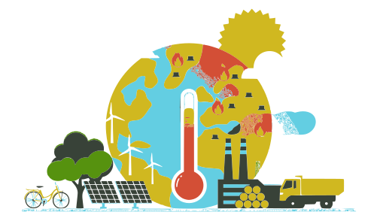
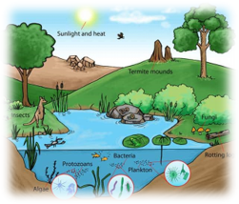

Tourism – climate impact analysis
Direct impacts
Indirect impacts

Slide 28
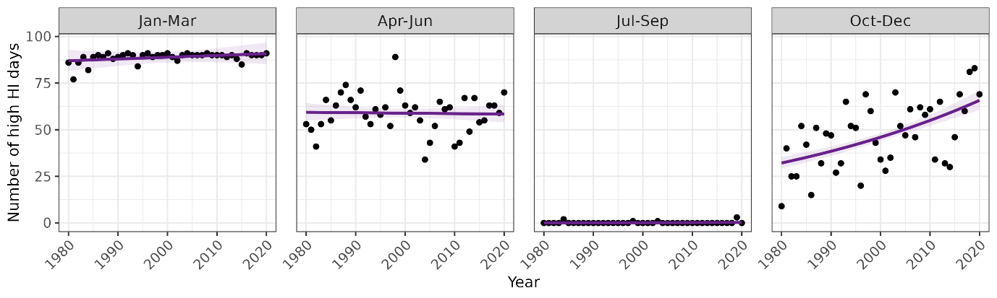
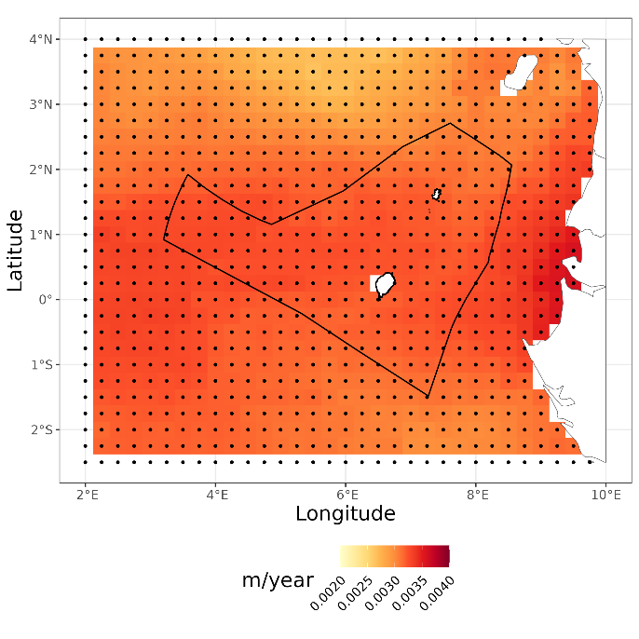
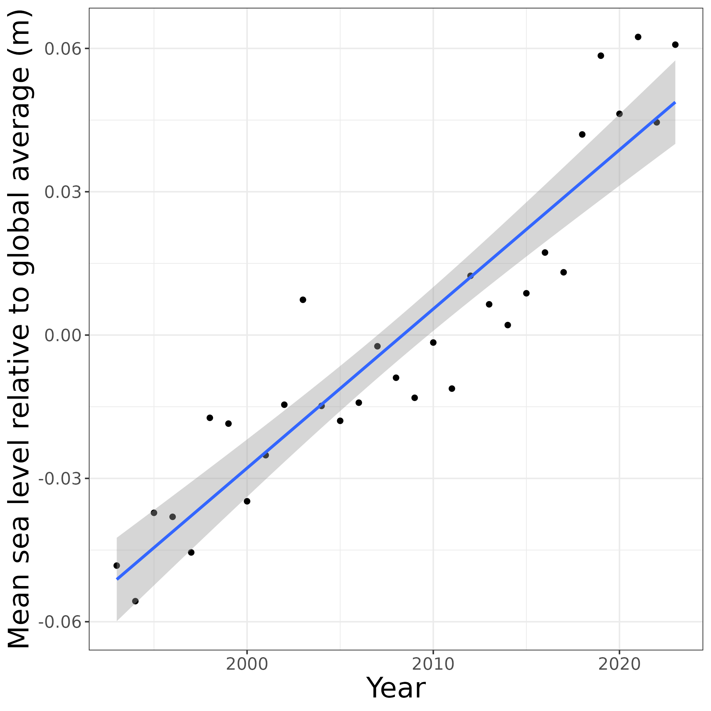
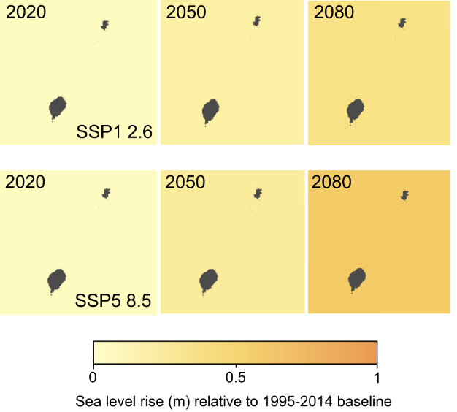
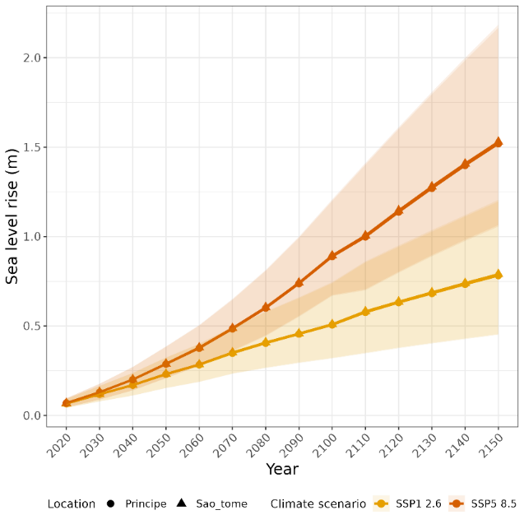
Tourism – direct impacts
Historical increase in high heat index days in Oct-Dec
Historical and projected sea level rise
High heat index days in Sao Tome – same results for Principe
Historical sea level rise (1993 – 2023)
Projected sea level rise

Slide 29
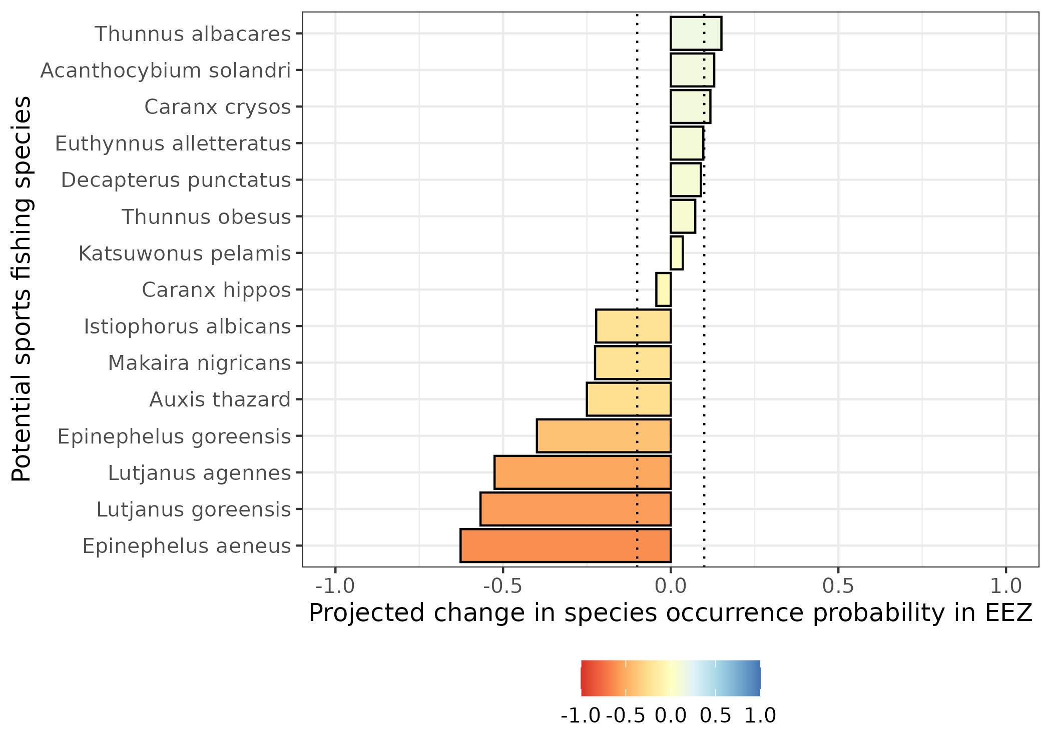
Tourism – indirect impacts
15 fish species identified as candidates for sports fishing
With a 0.1 change cut-off, presence probability projected to:
Increase for 3 species
No change for 5 species
Decrease for 7 species
Tuna
Grouper
Snapper

Slide 30
Conclusions for tourism
Historical and projected trends:
Increase in average temperatures and humidity
Variable impacts on overall rainfall
Increase in frequency of heatwaves and extreme rainfall
Impacts
Dangerous weather conditions for tourists
Erosion of beaches/coastal areas

Slide 31
Overall takeaways
Sao Tome and Principe fisheries and tourism are highly vulnerable to climate change
Adaptation measures are likely needed to reduce climate change impacts
This work is still ongoing, and your feedback is essential for improvements.

Slide 32
Thank you

