Slide 1


Technical workshop for GCF project: Climate change and climate change impacts on São Tomé and Príncipe with a focus on fishery and tourism sectors in a Blue Economy context Sao Tome and Principe, November/December 2025
Impact modelling for fish biomass projections
By: Samuel Greenrod, Marco Fusi, Riccardo Soldan, Lionel Kinadjian

Slide 2
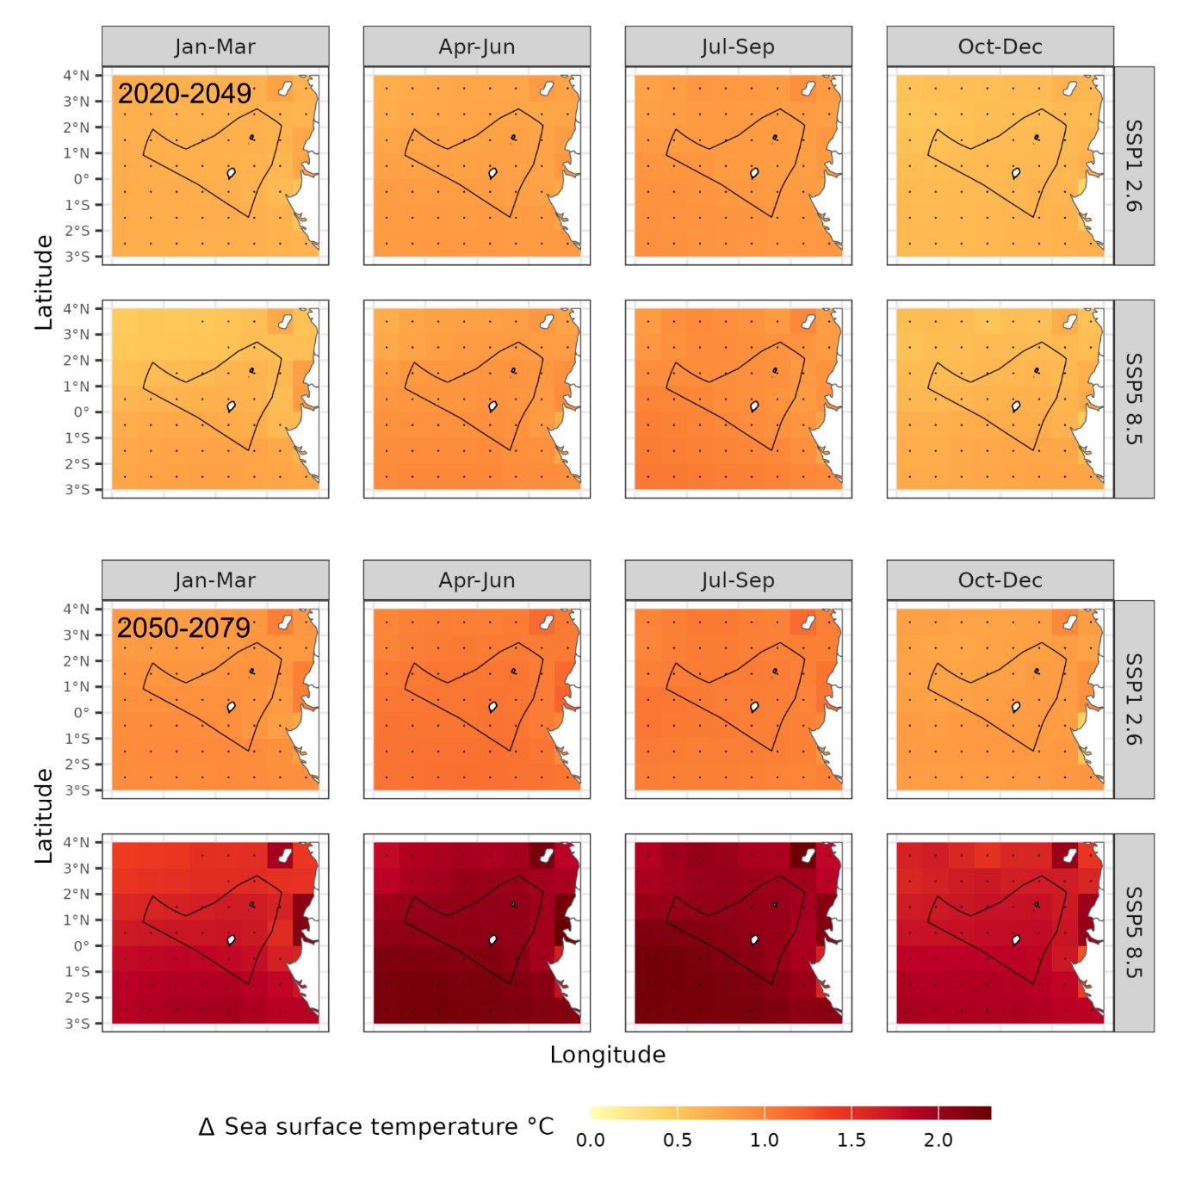
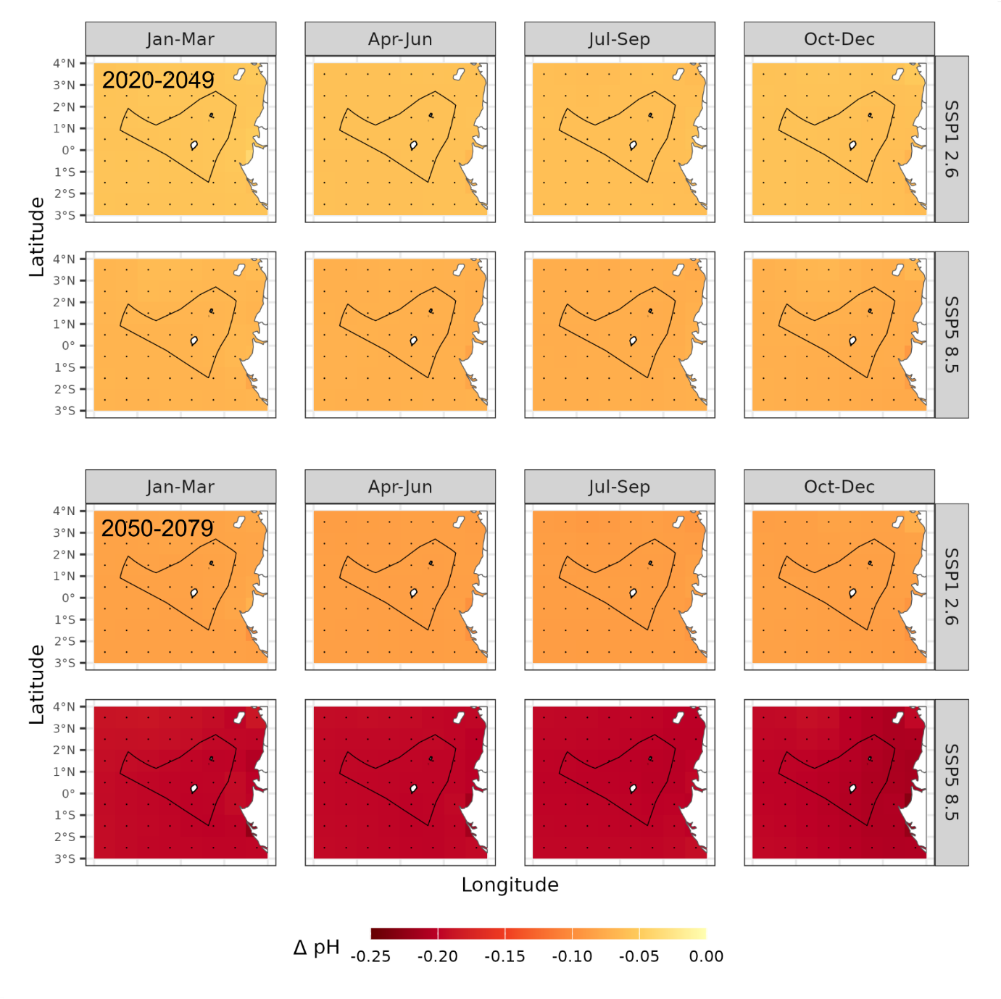
Fisheries in Sao Tome and Principe: the challenge
Climate models project significant future oceanographic change
Climate change is expected to affect fisheries by altering:
Fish reproduction
Fish densities
Fish migration patterns
Values are relative to historical run

Slide 3
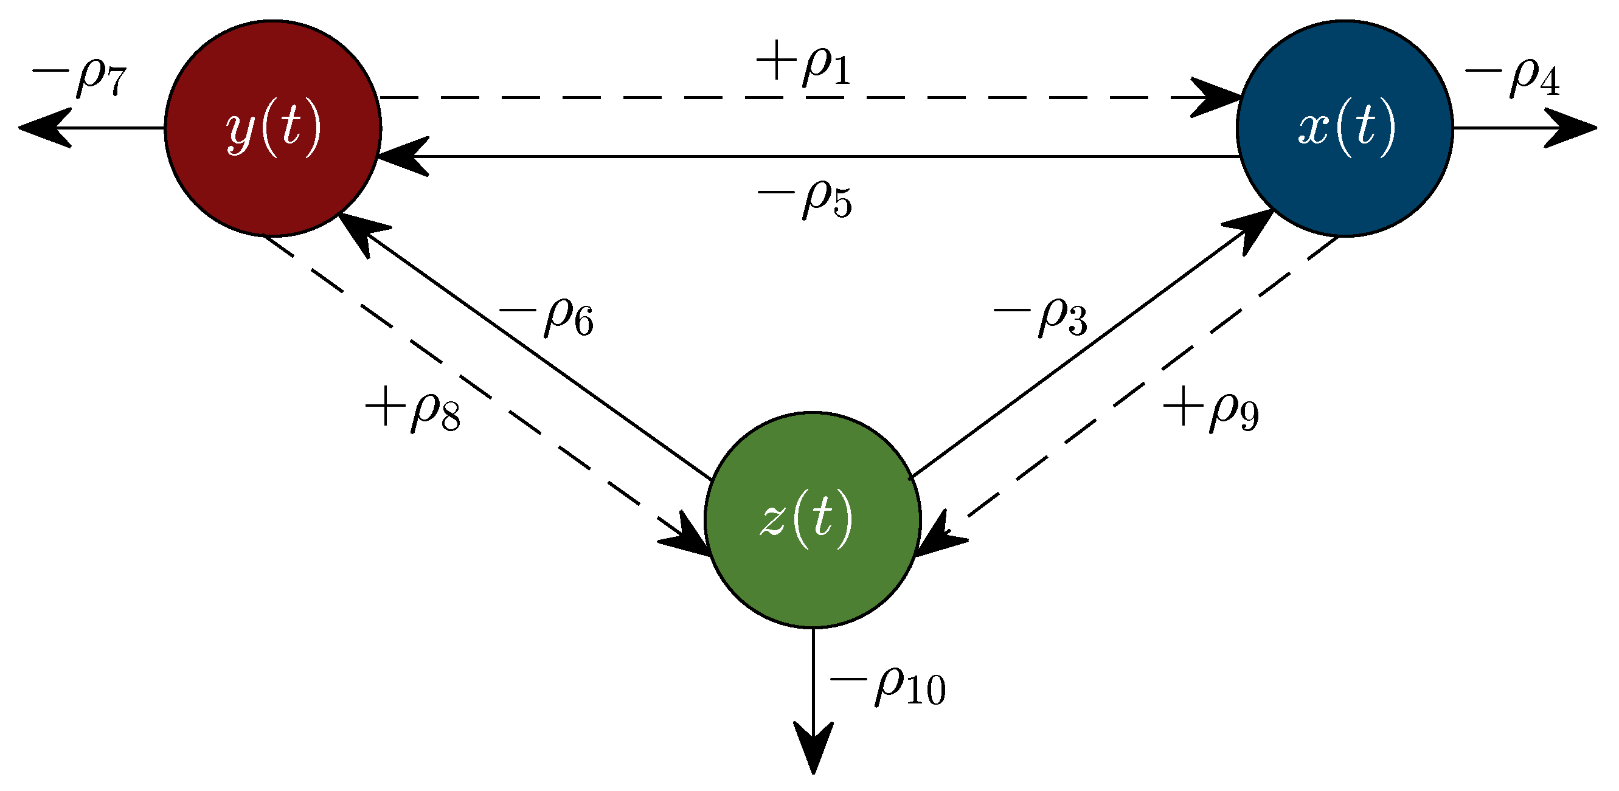
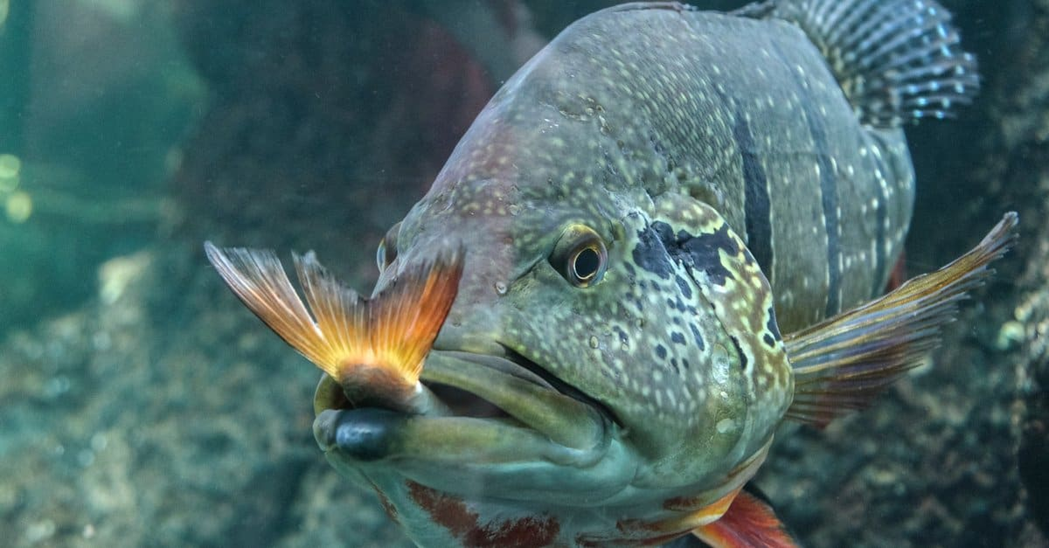
Impact-based modelling
Impact models are referred to as “mechanistic” as they use complex equations to model how fish systems function and interact with their environment
For example, impact models often consider:
Predator-prey interactions
Resource availability
Energy transfer
Migration
Impact models give projections of fish biomass based on future projected climate inputs

Slide 4

The Inter-Sectoral Impact Model Intercomparison Project
ISIMIP is a project aimed at providing a consistent framework for climate impact modelling
Specific focus topics:
Agriculture
Water
Forests
Fisheries
Energy
Input:
Specific climate model ensemble (CMIP) and Earth System Model projections
Specific climate forcings (SSPs)
Consistent impact models
Output:
Global impact model simulations
Climate/ocean forcing inputs can also be extracted

Slide 5
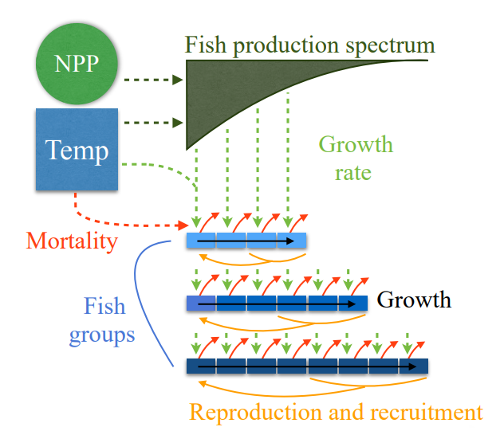
Fish biomass impact models
BiOeconomic mArine Trophic Size-spectrum (BOATS)
Available fish biomass impact models:
APECOSM
BOATS (fishing intensity)
EcoOcean (fishing intensity)
DBPM
FEISTY
ZooMSS
Climate models
IPSL-CMIP6-LR
GFDL-ESM4

Slide 6
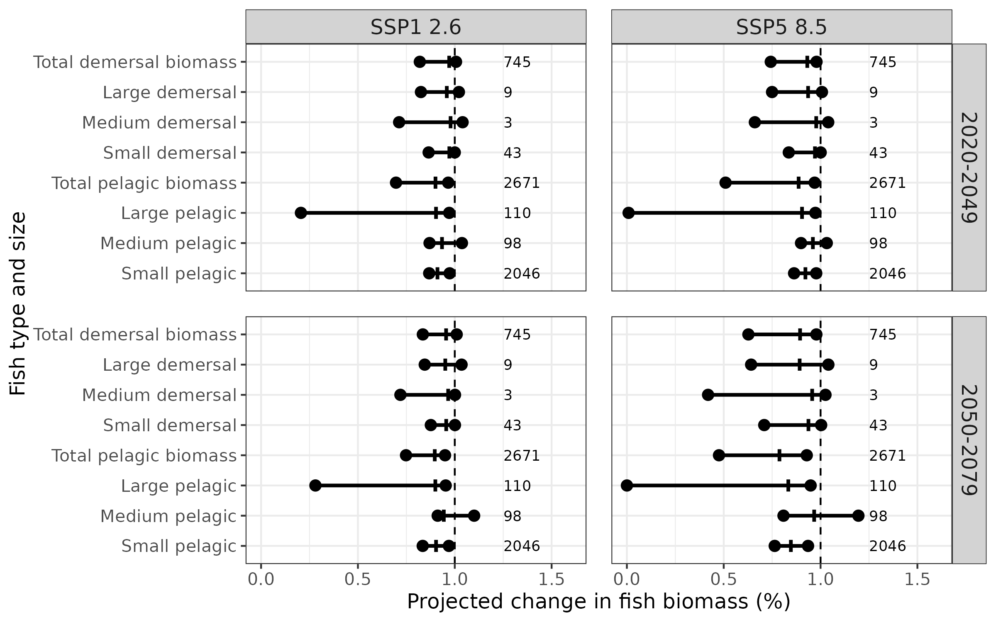
Simulating climate impact on fish biomass
Available fish biomass impact models:
APECOSM
BOATS (fishing intensity)
EcoOcean (fishing intensity)
DBPM
FEISTY
ZooMSS
Climate models
IPSL-CMIP6-LR
GFDL-ESM4

Slide 7
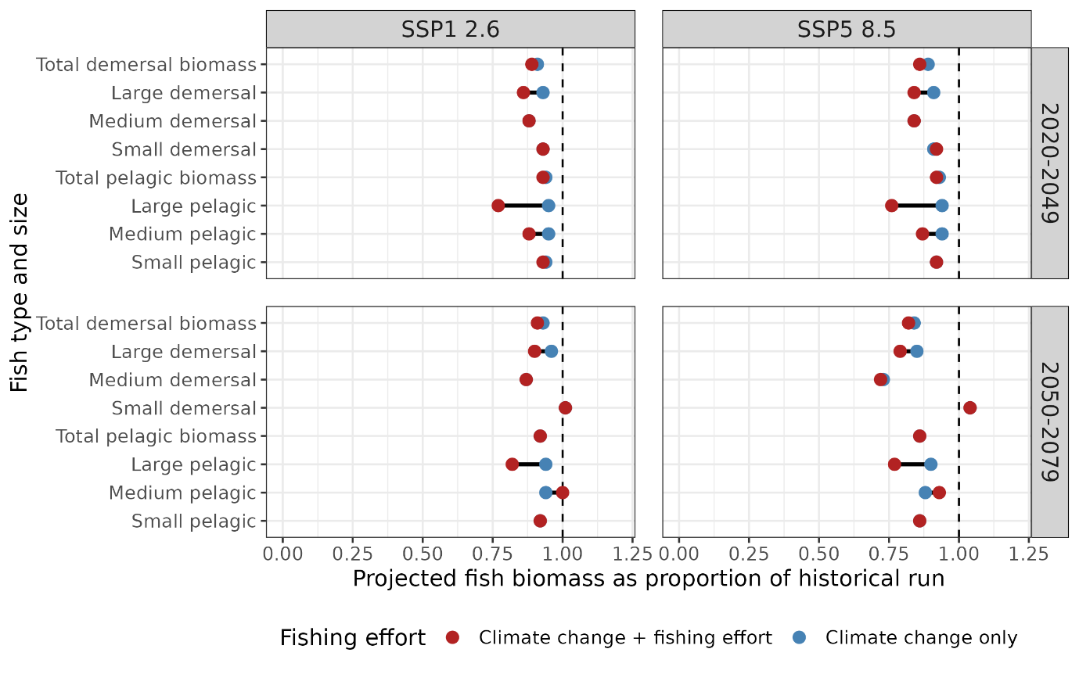
Incorporation of fishing intensity into models
Available fish biomass impact models:
APECOSM
BOATS (fishing intensity – total only)
EcoOcean (fishing intensity)
DBPM
FEISTY
ZooMSS
Climate models
IPSL-CMIP6-LR
GFDL-ESM4

Slide 8
Conclusions
Mechanistic models can allow the estimation of the climate impact on total fish biomass The ISIMIP database allows for consistent, multi-model comparisons of climate impact. These factors allow for a robust assessment based on prior knowledge and research

