Slide 1


Training workshop for the GCF project: Climate change and the impacts of climate change in Sao Tome and Principe, focusing on the fishing and tourism sectors in the context of the Blue Economy Sao Tome and Principe, November/December 2025
Species Distribution Modeling Using Maxent
By: Samuel Greenrod, Marco Fusi, Riccardo Soldan, Lionel Kinadjian

Slide 2
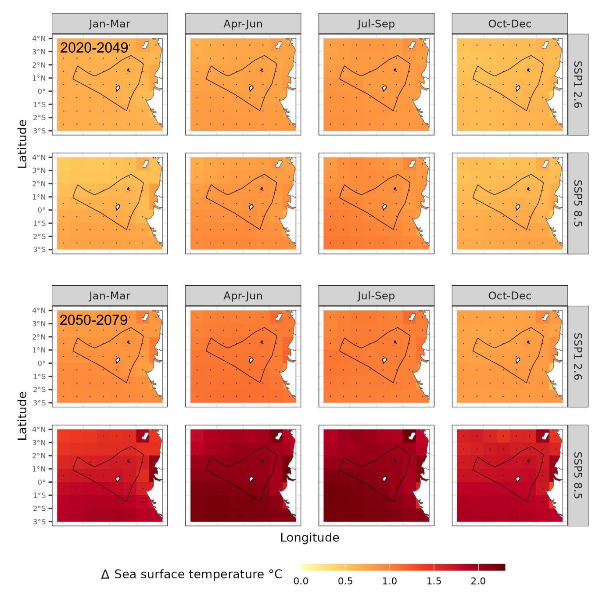
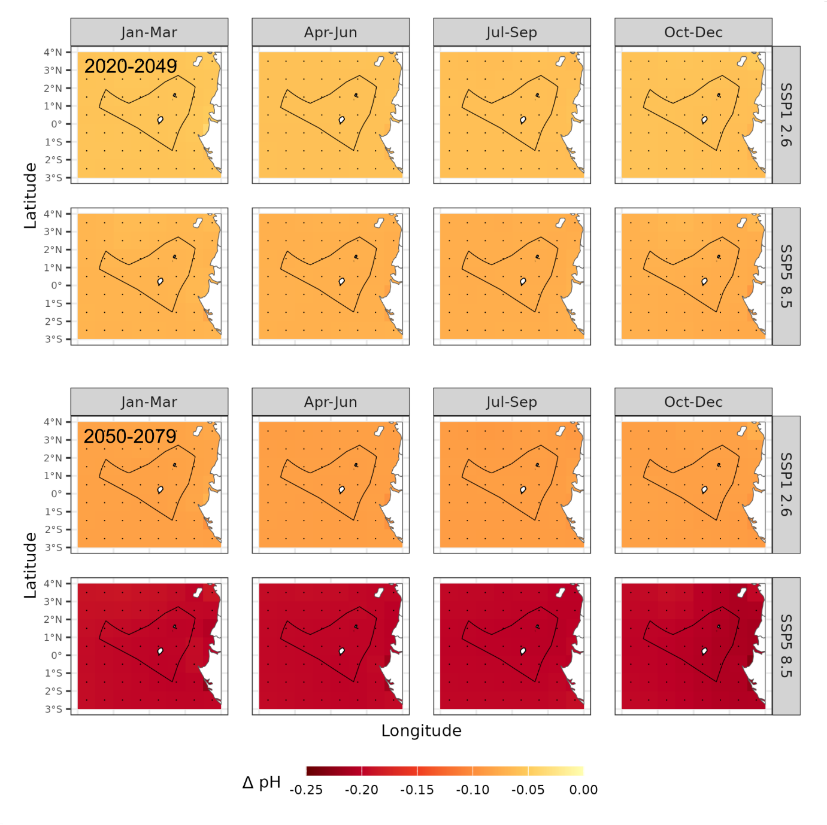
Fisheries in Sao Tome and Principe: the challenge
Climate models project significant oceanographic changes in the future Climate change is expected to affect fisheries by altering:
Fish reproduction Fish densities Fish migration patterns
The values are related to the historic race

Slide 3

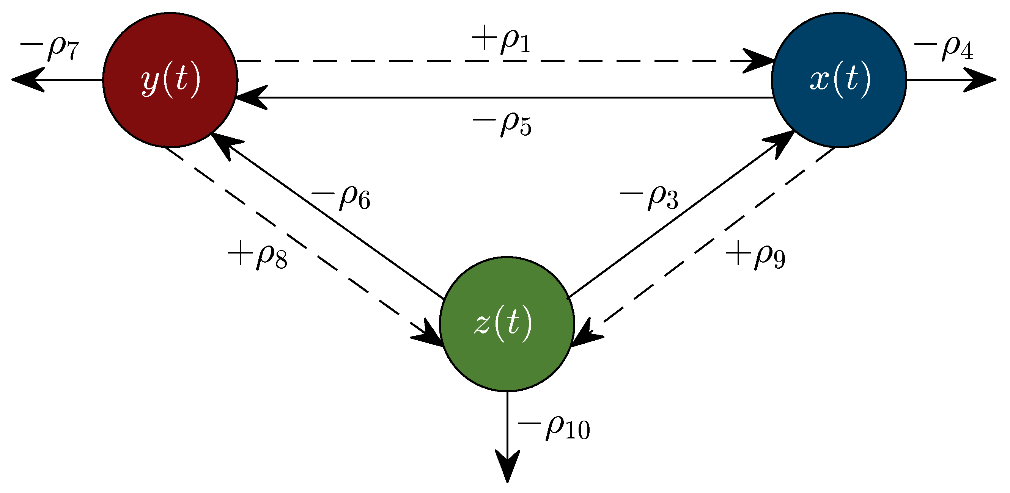
Species distribution modeling approaches
Species distribution modeling can be used to assess the climate impact on fish distribution Most models are "empirical" – find statistical associations between species occurrence and environmental parameters
MaxEnt R-INLA SdmTMB
A small number are "mechanistic" – they use equations that model how fish systems work and interact with the climate

Slide 4
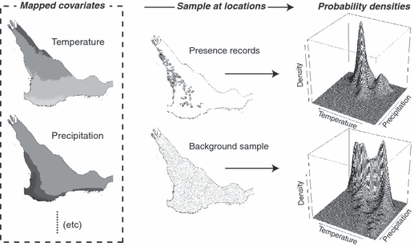
Empirical Modeling – MaxEnt for Species Distributions
For the STP report, we used an empirical modeling approach called "MaxEnt" or Maximum Entropy:
Records of species presence Climate values in a region Compares the probability distribution of the associated climate values with background data.
Once the model is trained, you can apply new climate projection data.
Probability of occurrence calculated for: Time periods: Historic season, 2020-2049, 2050-2079 Climate scenarios: SSP1 2.6 & SSP5 8.5 Climate model: CMIP6 set

Slide 5
Important considerations
Advantages of MaxEnt:
Handles presence-only data: MaxEnt is suitable for situations where only presence data is available, which is common in ecological research.
Handles complex relationships: It can model complex interactions between environmental variables and species distributions.
Open-source software: MaxEnt is free and open source.
Widely used: It is one of the most widely used SDM methods in ecology.
Possible limitations:
Bias in background data:
The choice of background data can influence the results of the model.
Assumptions about environmental relationships:
MaxEnt assumes that environmental variables are the main drivers of species distribution, which may not always be true.
Overfitting:
Overfitting can occur if the model is too complex for the available data, leading to poor predictive performance in new areas.

Slide 6
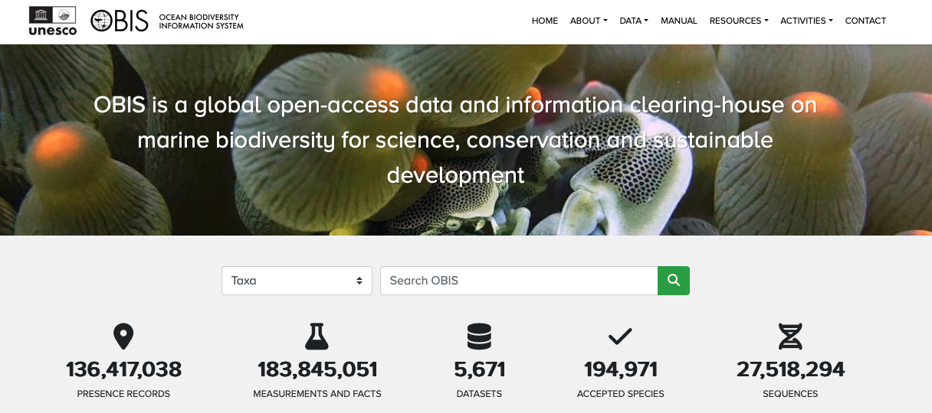
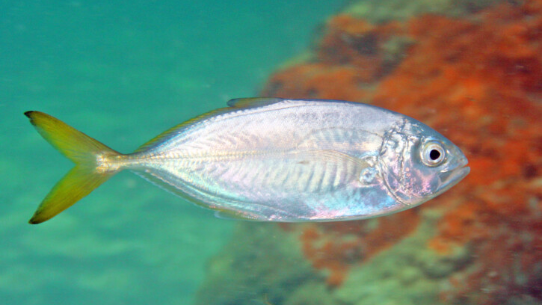
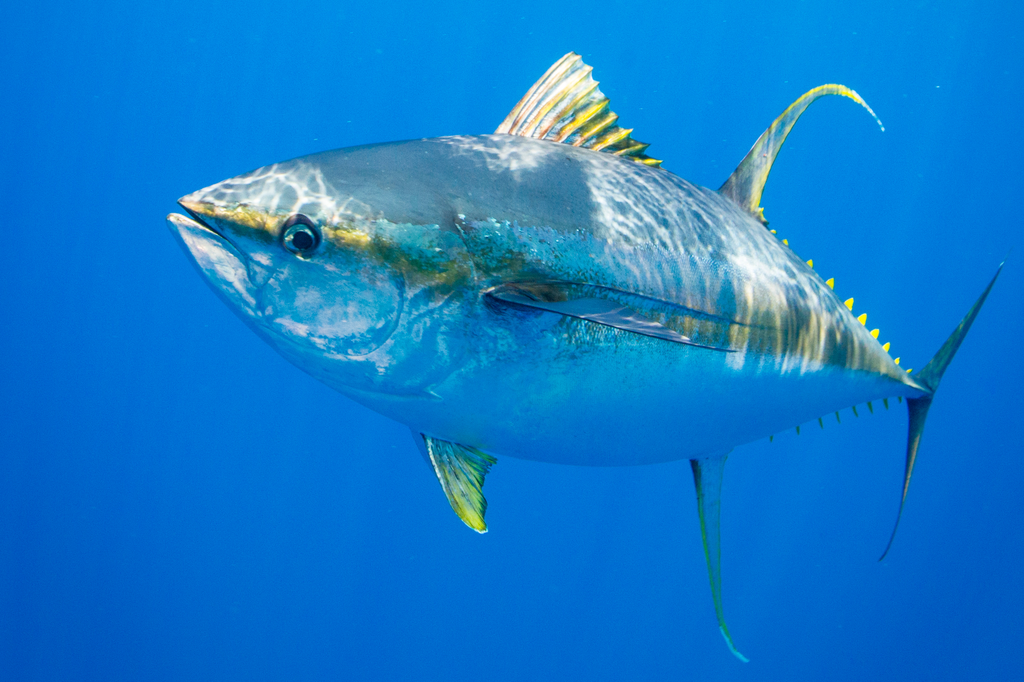
Data collection – Species presence data
MaxEnt only requires presence data, not presence/absence data The data was acquired from the Ocean Biodiversity Information System (OBIS) Mandatory information:
Species Name Historical positions of Lon/Lat

Slide 7
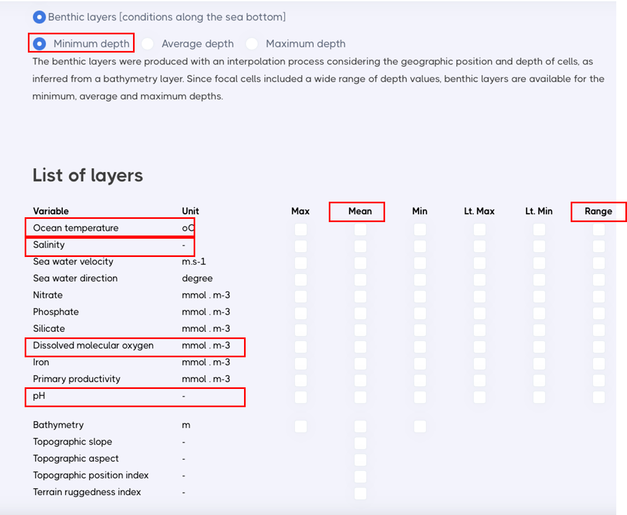
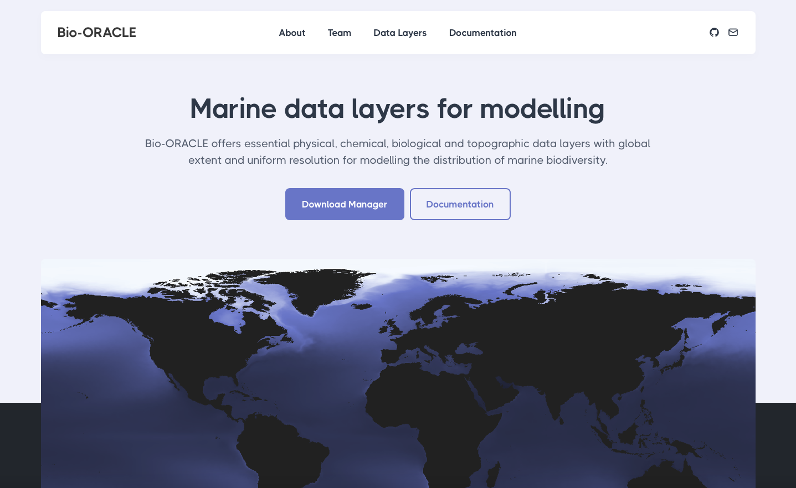
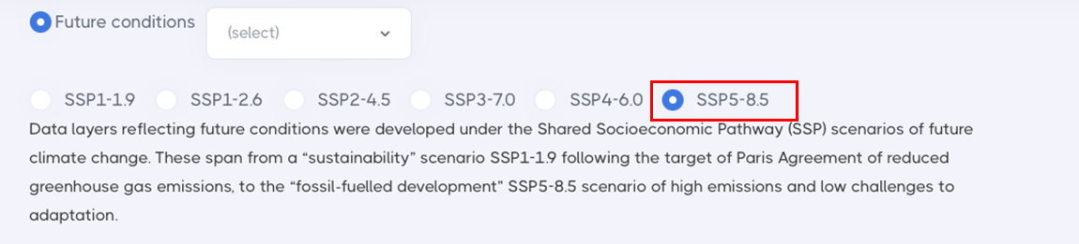
Data collection – marine climate data
Future historical and climate data was obtained from Bio-Oracle:
Ocean temperature Salinity Dissolved molecular oxygen pH
Selected average and range values*

Slide 8
Example: Caranx crysos

Slide 9
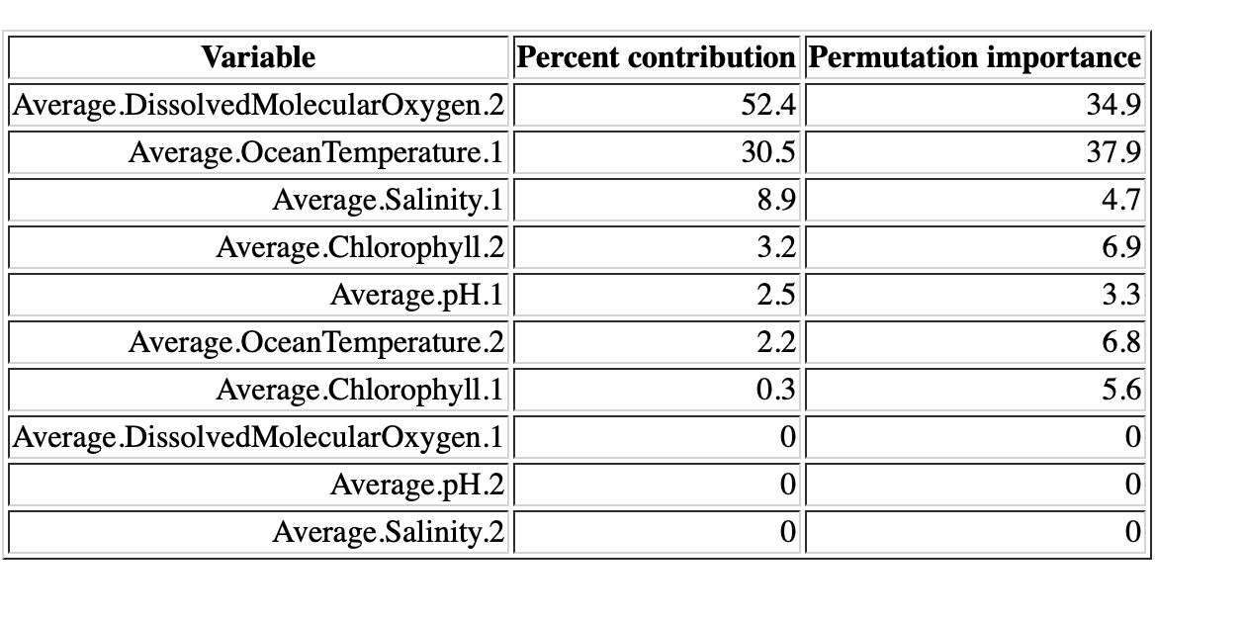
Empirical Modeling – MaxEnt for Species Distributions
.2 = Range.
1 = Mean
For Caranx crysos:
Most important indicators:
Dissolved Molecular Oxygen Range Average ocean temperature

Slide 10
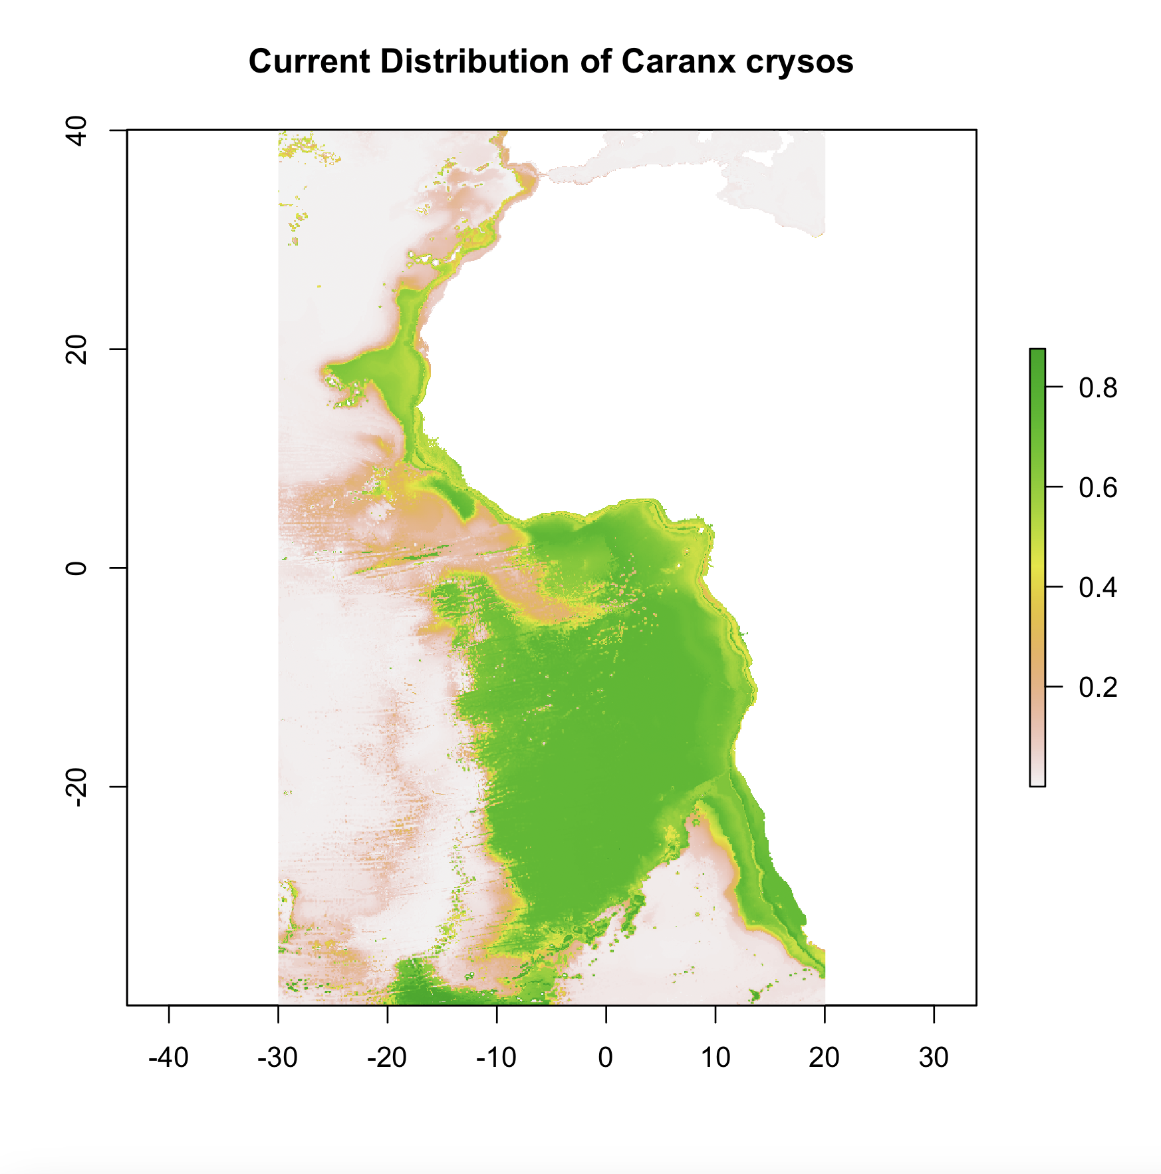
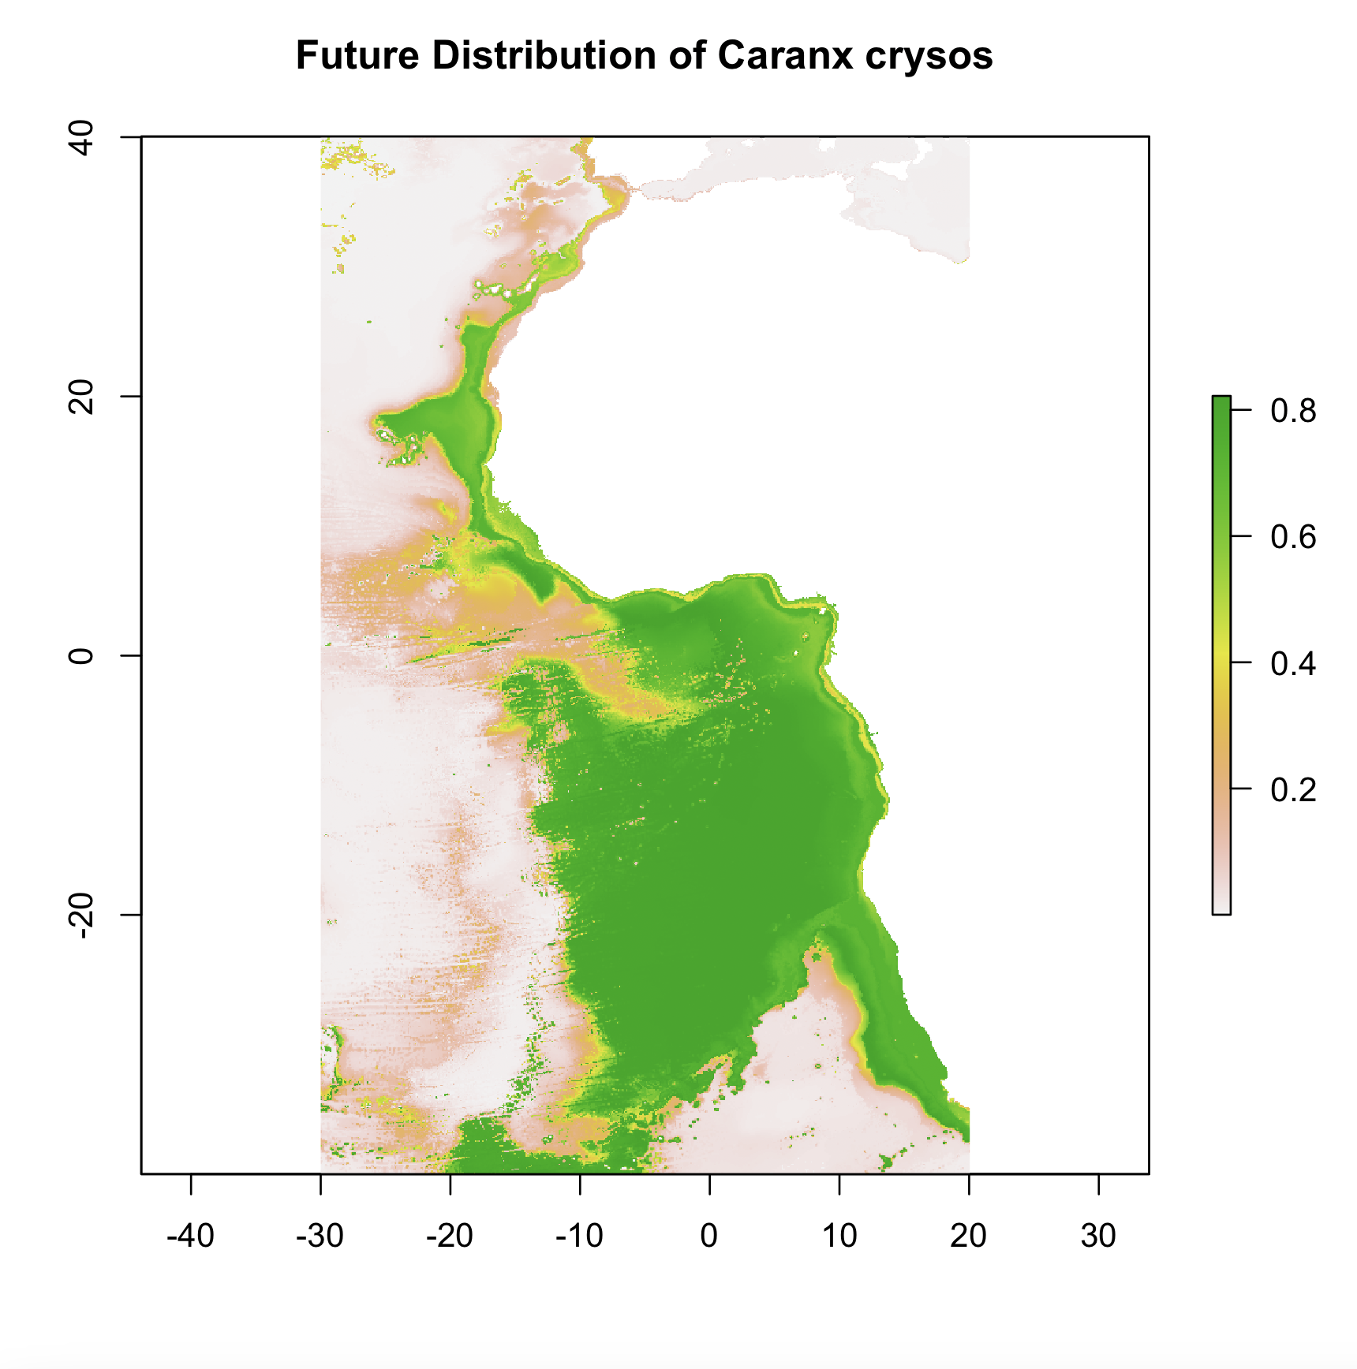
Empirical Modeling – MaxEnt for Species Distributions
Probability of occurrence of species

Slide 11
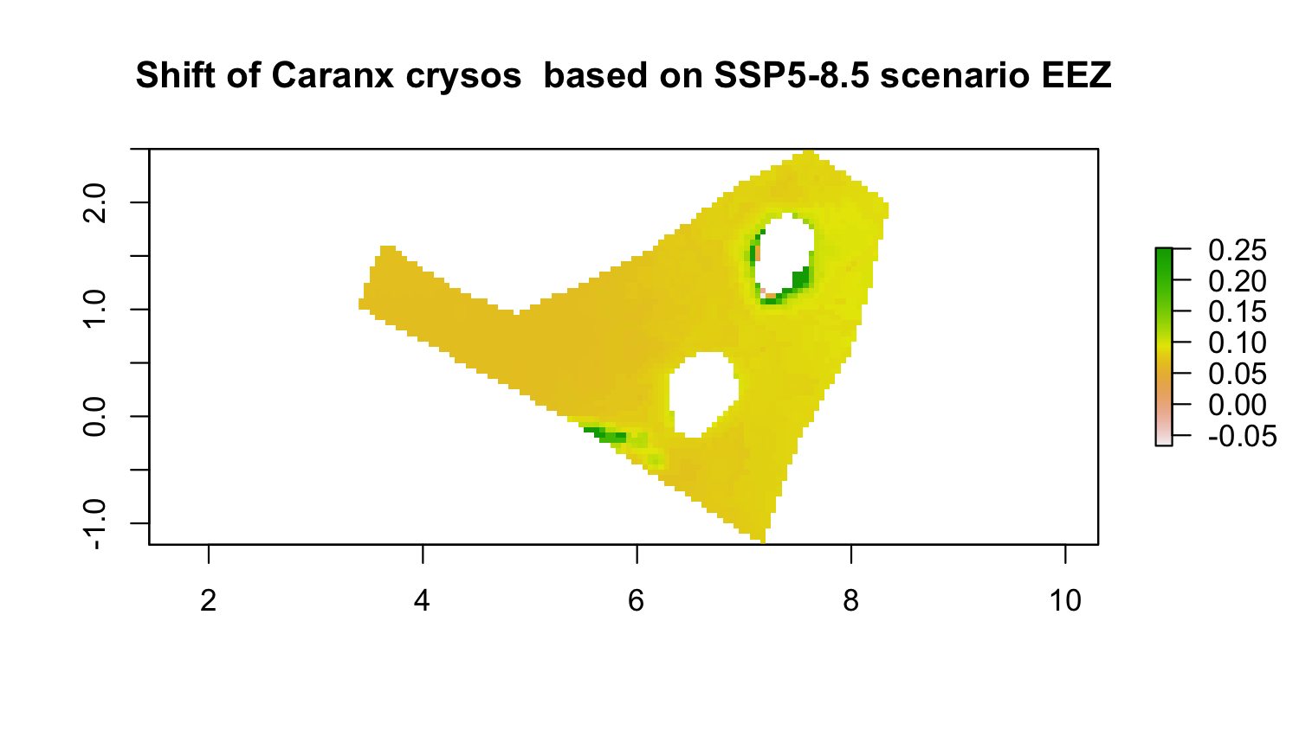
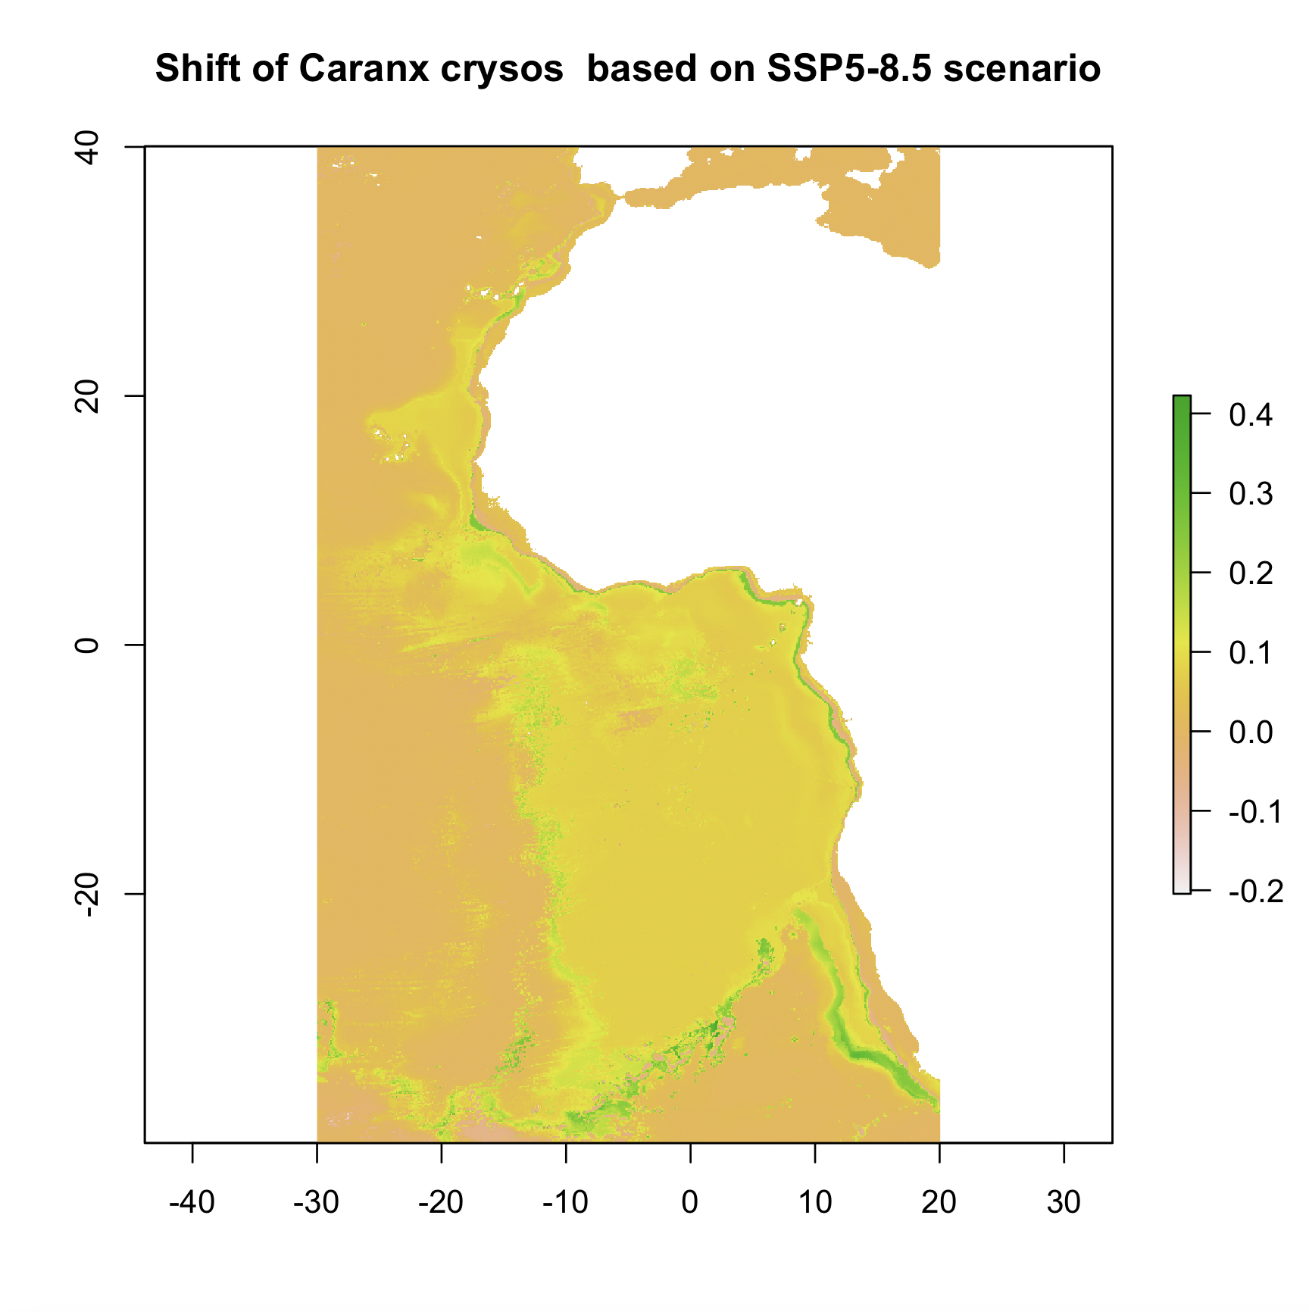
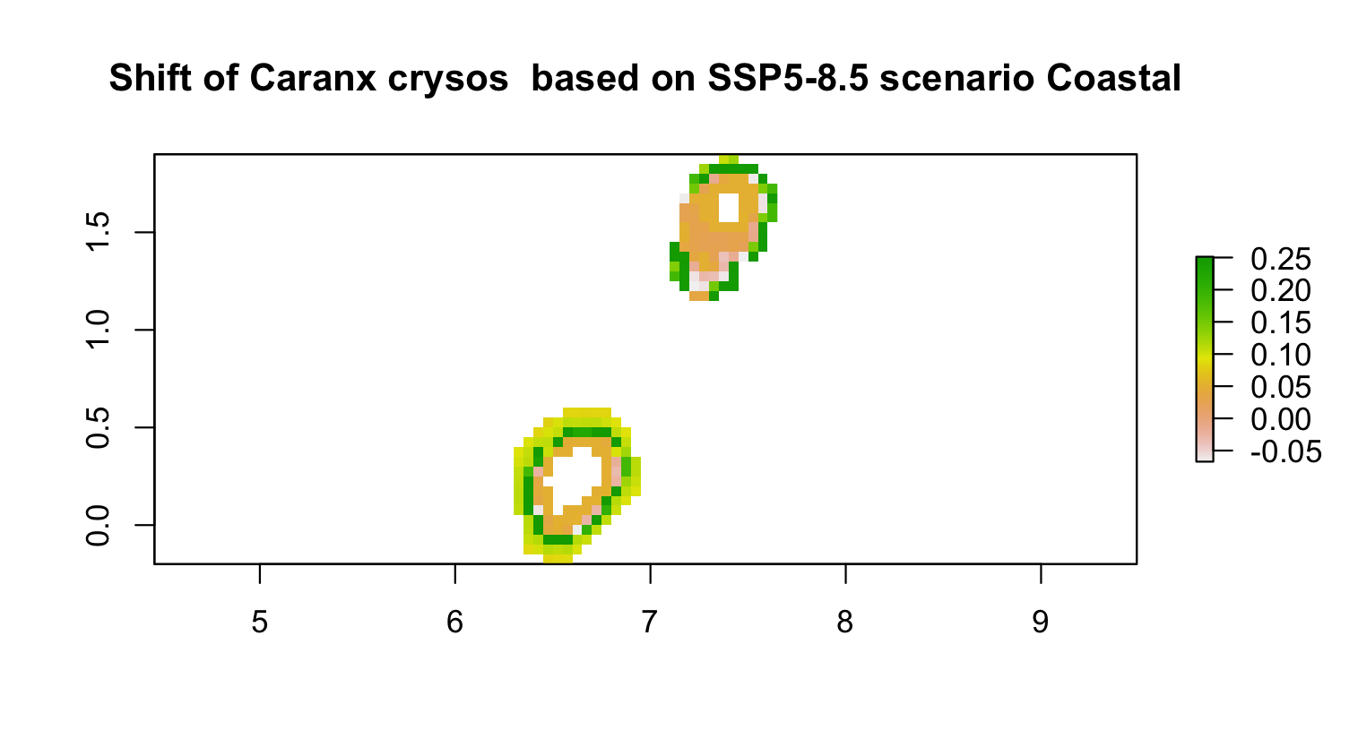
Empirical modelling – MaxEnt for species distributions
Change in the probability of species occurrence
Shift in probability of species occurrence

Slide 12
Conclusion
Climate change is expected to alter the distribution of fish species Projected changes in distributions can be evaluated by empirical modeling MaxEnt is a simple way to do this using minimal data

