Slide 1
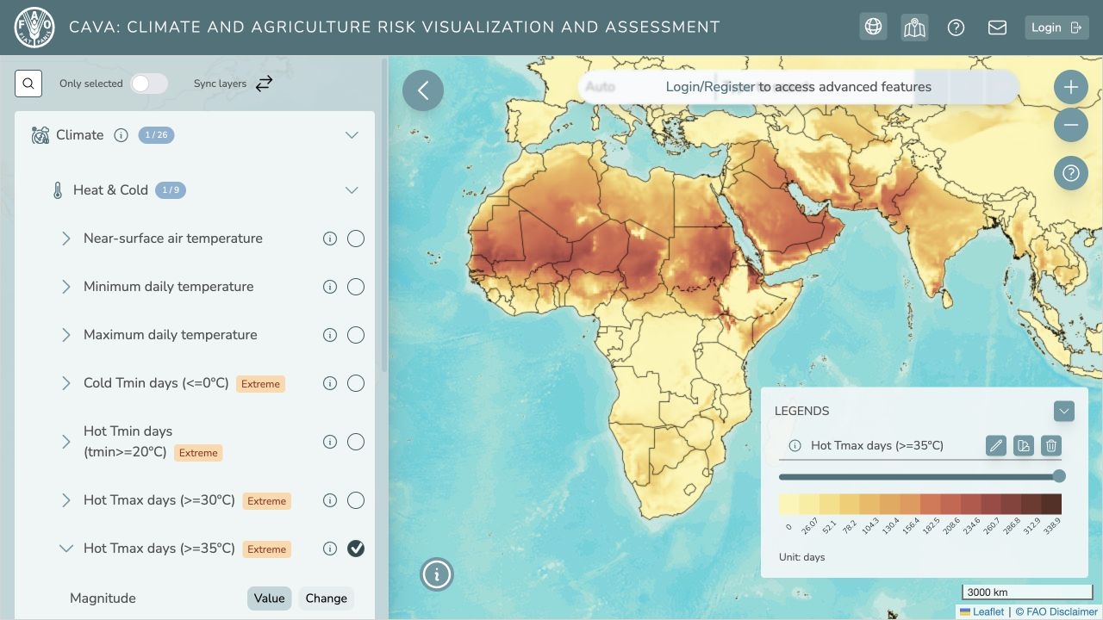
CAVA TRAINING SERIES
Climate data workflows
with CAVAanalytics
and cavapy
MODULE 3
30 September 2026
09:00–12:00 · Hybrid
Installation and reproducible climate analysis
Notes:
Timing: 2 minutes. Introduce Module 3. The first 30 minutes cover installation and troubleshooting. Riccardo then leads the CAVAanalytics notebook and Sam leads cavapy.

Slide 2
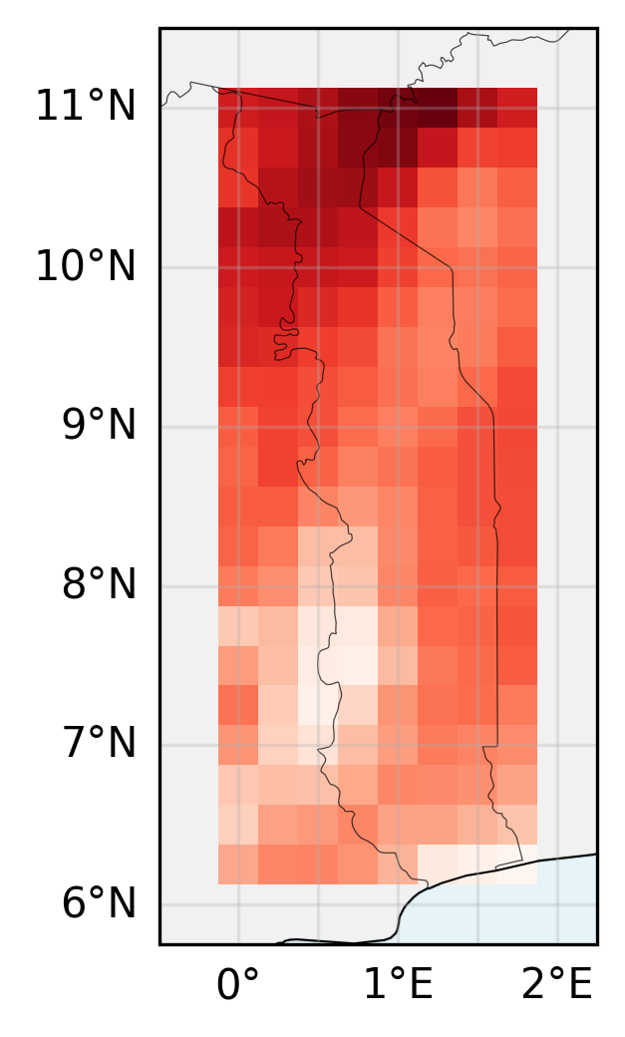
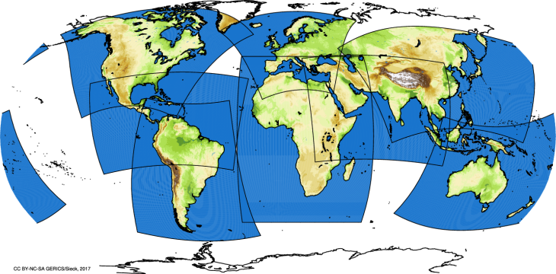
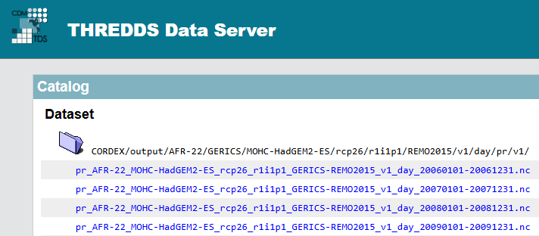
Cavapy workflow
Steps used in cavapy get_climate_data() function
Inventory lookup
Identifies URLs from live THREDDS inventory
Spatial subsetting
Download grid cells inside designated country or bounding box
Domain validation
Corrected domain suggested if invalid domain provided
CAM-22
AFR-22
Country = “Togo”
CAVA MODULE 3
01
Notes:
Miniforge includes Mamba. Participants who already use Miniforge, Miniconda or Anaconda and have access to Mamba can skip the first installation. VS Code is recommended, while Cursor is also compatible. Install the Python and Jupyter extensions.

Slide 3
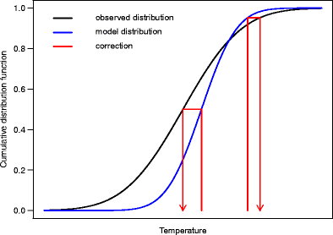
Cavapy workflow
Steps used in cavapy get_climate_data() function
Parallelisation
Variables are fetched in parallel
Fault tolerance
Data fetching retries up to three times
Bias correction
EQM ERA5 bias correction or pre-bias corrected data available
Data processing
Unit conversion
Regridding
Calendar harmonisation
Pr
Pr
Tasmax
Tasmin
Rsds
SfcWind
Hurs
Tasmax
Kelvin (K)
Celsius (°C)
Tasmin
Rotated polar coords
Lat & Lon
Rsds
365-day calendar + NaN
360-day calendar
SfcWind
Hurs
CAVA MODULE 3
02
Notes:
Miniforge includes Mamba. Participants who already use Miniforge, Miniconda or Anaconda and have access to Mamba can skip the first installation. VS Code is recommended, while Cursor is also compatible. Install the Python and Jupyter extensions.

Slide 4
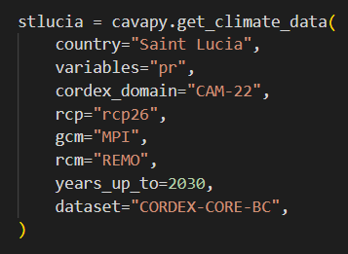
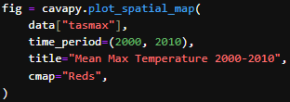
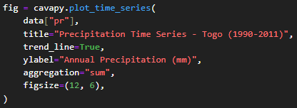
Cavapy commands
Example code used in climate data loading
Get_climate_data()
Plotting functions
Area covered
Domain
GCM-RCM combination
Pre-bias corrected with ERA5
Returns an “xarray” dataset with daily precipitation projections
CAVA MODULE 3
03
Notes:
Miniforge includes Mamba. Participants who already use Miniforge, Miniconda or Anaconda and have access to Mamba can skip the first installation. VS Code is recommended, while Cursor is also compatible. Install the Python and Jupyter extensions.

Slide 5
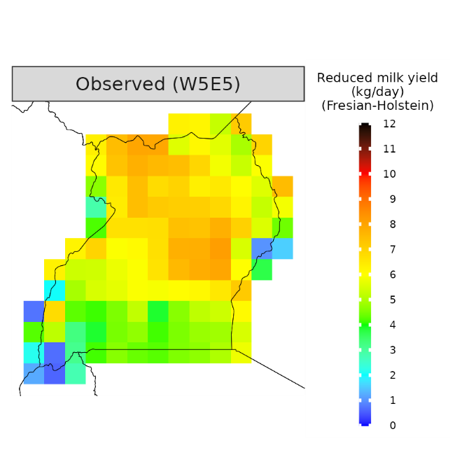
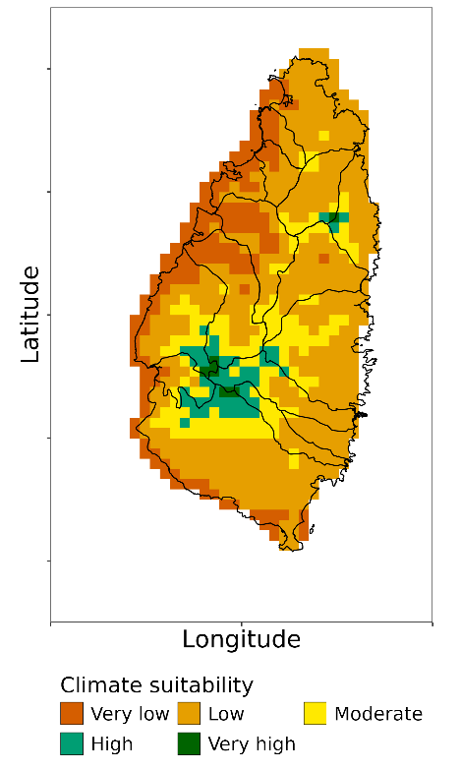
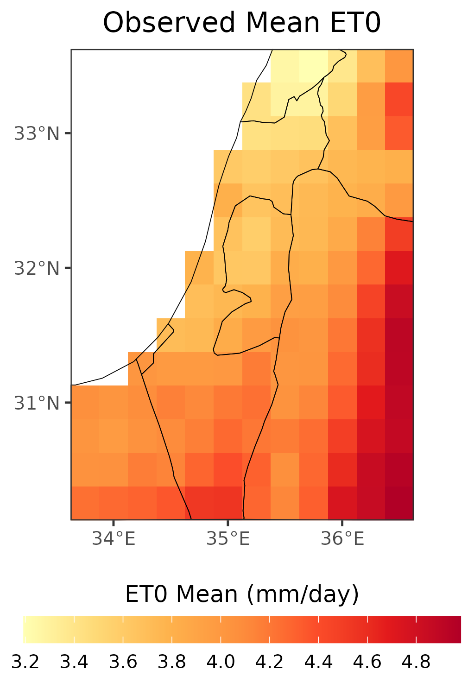
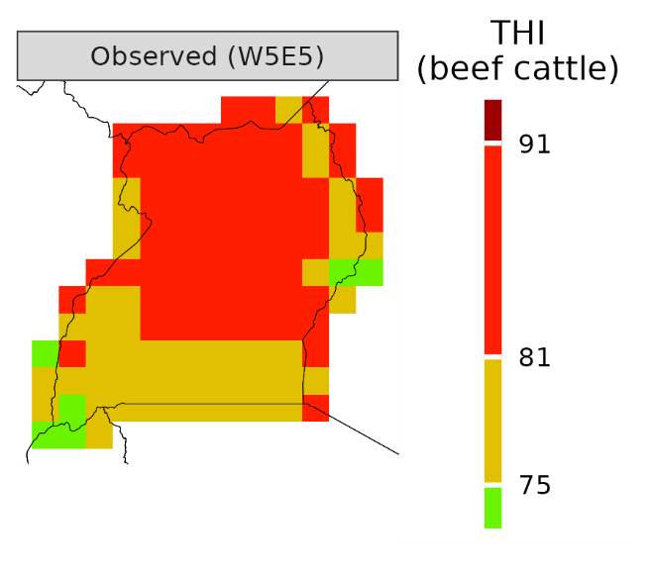
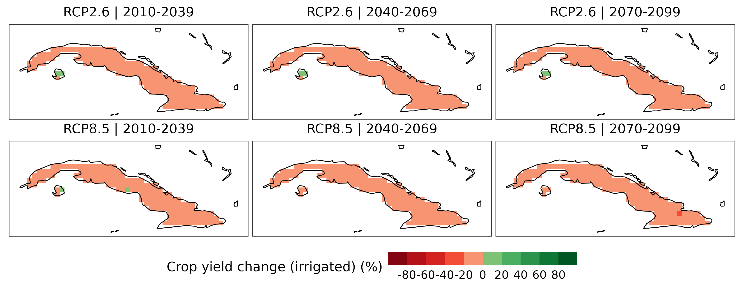
Application examples
Example cases where cavapy outputs can be used for downstream analyses
Creation of climate data composites
Impact modelling
Reference evapotranspiration
Temperature-humidity index
Milk yield loss
Climate suitability
Crop modelling
CAVA MODULE 3
04
Notes:
Miniforge includes Mamba. Participants who already use Miniforge, Miniconda or Anaconda and have access to Mamba can skip the first installation. VS Code is recommended, while Cursor is also compatible. Install the Python and Jupyter extensions.

Slide 6
NEXT
Open the cavapy notebook
01
Load and inspect a country-scale multi-model dataset
Select Python (CAVA) as the notebook kernel.
Notes:
Open the supplied CAVAanalytics notebook and select R (CAVA). The remote data-loading cell is the slowest step and requires internet access.

