Slide 1


Climate change and climate change impacts on São Tomé and Príncipe with a focus on fishery and tourism sectors in a Blue Economy context Sao Tome and Principe, November/December 2025
Adaptation recommendations
By: Samuel Greenrod, Marco Fusi, Riccardo Soldan, Lionel Kinadjian

Slide 2
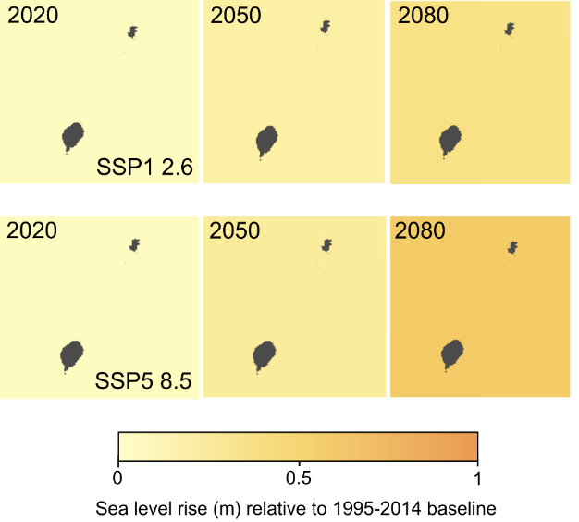
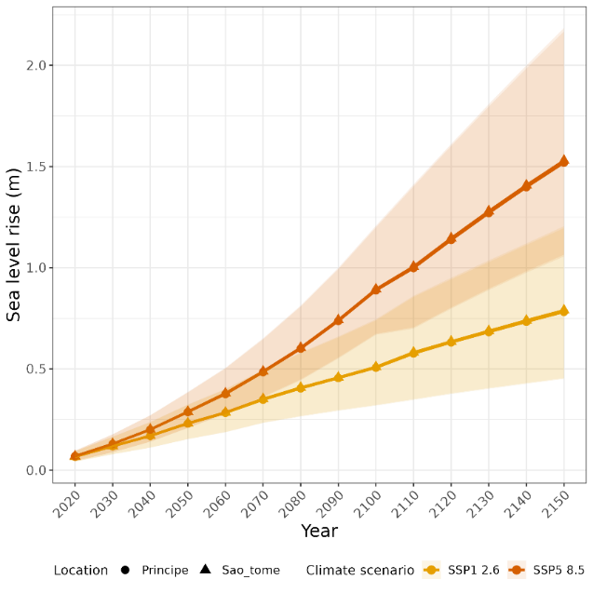
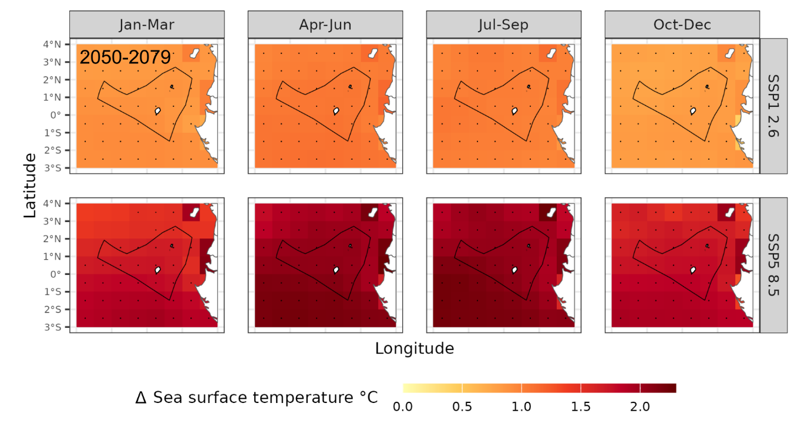

Summary of report findings
Future climate change is expected to affect both tourism and blue economy:
Sea level rise
Increased tourist discomfort
Reduction in EEZ fish biomass
Alterations to probability of pelagic and demersal occurrence in EEZ and species
An adaptation strategy to mitigate the impacts of climate change is needed

Slide 3
Tourism adaptation recommendations – coastal erosion
WACA+ recommendations to mitigate coastal erosion impact:
Construction of dikes, breakwaters (e.g gabions), and protective walls in most vulnerable areas.
Creating safe expansion zones for coastal communities.
Establishment of a climate alert system on the state of the sea
Rehabilitation of tide stations
Sand dredging to repair eroded beaches
Diversification of activities and support measures for populations whose livelihoods depend on coastal activities
Construction of drainage ditches and water tanks

Slide 4
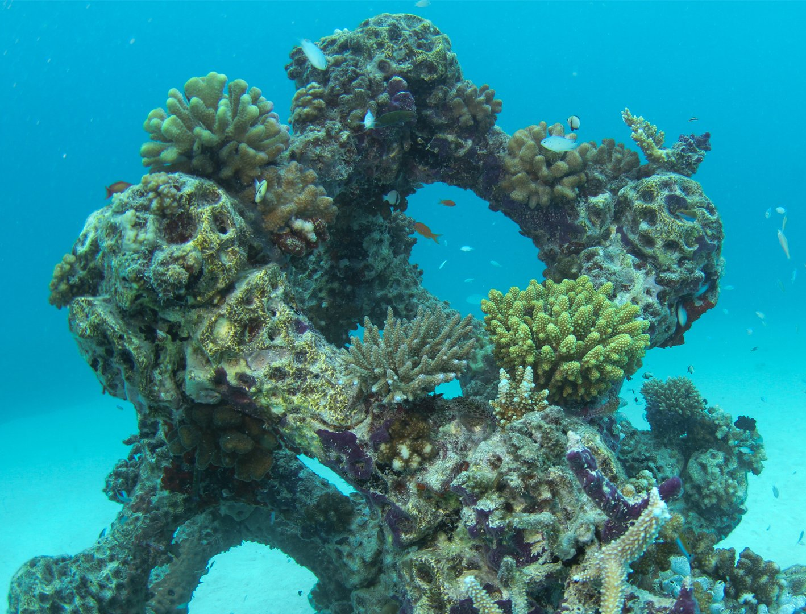
Tourism adaptation recommendations – eco-tourism
Coral reef restoration:
Cultivating healthy coral fragments in nurseries until they reach an appropriate size and then transplanting into the damaged reef.
Small pieces of coral broken up by storms or human activity can be fixed to degraded reefs.
Installation of artificial reefs

Slide 5
Tourism adaptation recommendations – eco-tourism
Code of Conduct for Sustainable Diving:
Limitations on the number of divers per site or per day;
Prohibition of coral contact or the use of overly aggressive fins;
Mandatory use of reef-safe sunscreen;
Sustainable anchoring practices (use of buoys instead of anchors to avoid seabed damage);
Education for tourists and guides on the environmental impact of their actions.
Regulatory framework:
Licensing or authorisation for dive operators;
Minimum sustainability and safety criteria;
Designation of no-fishing or restricted recreational zones in the most sensitive reefs;
Monitoring, enforcement, and sanctions for proven environmental damage.

Slide 6
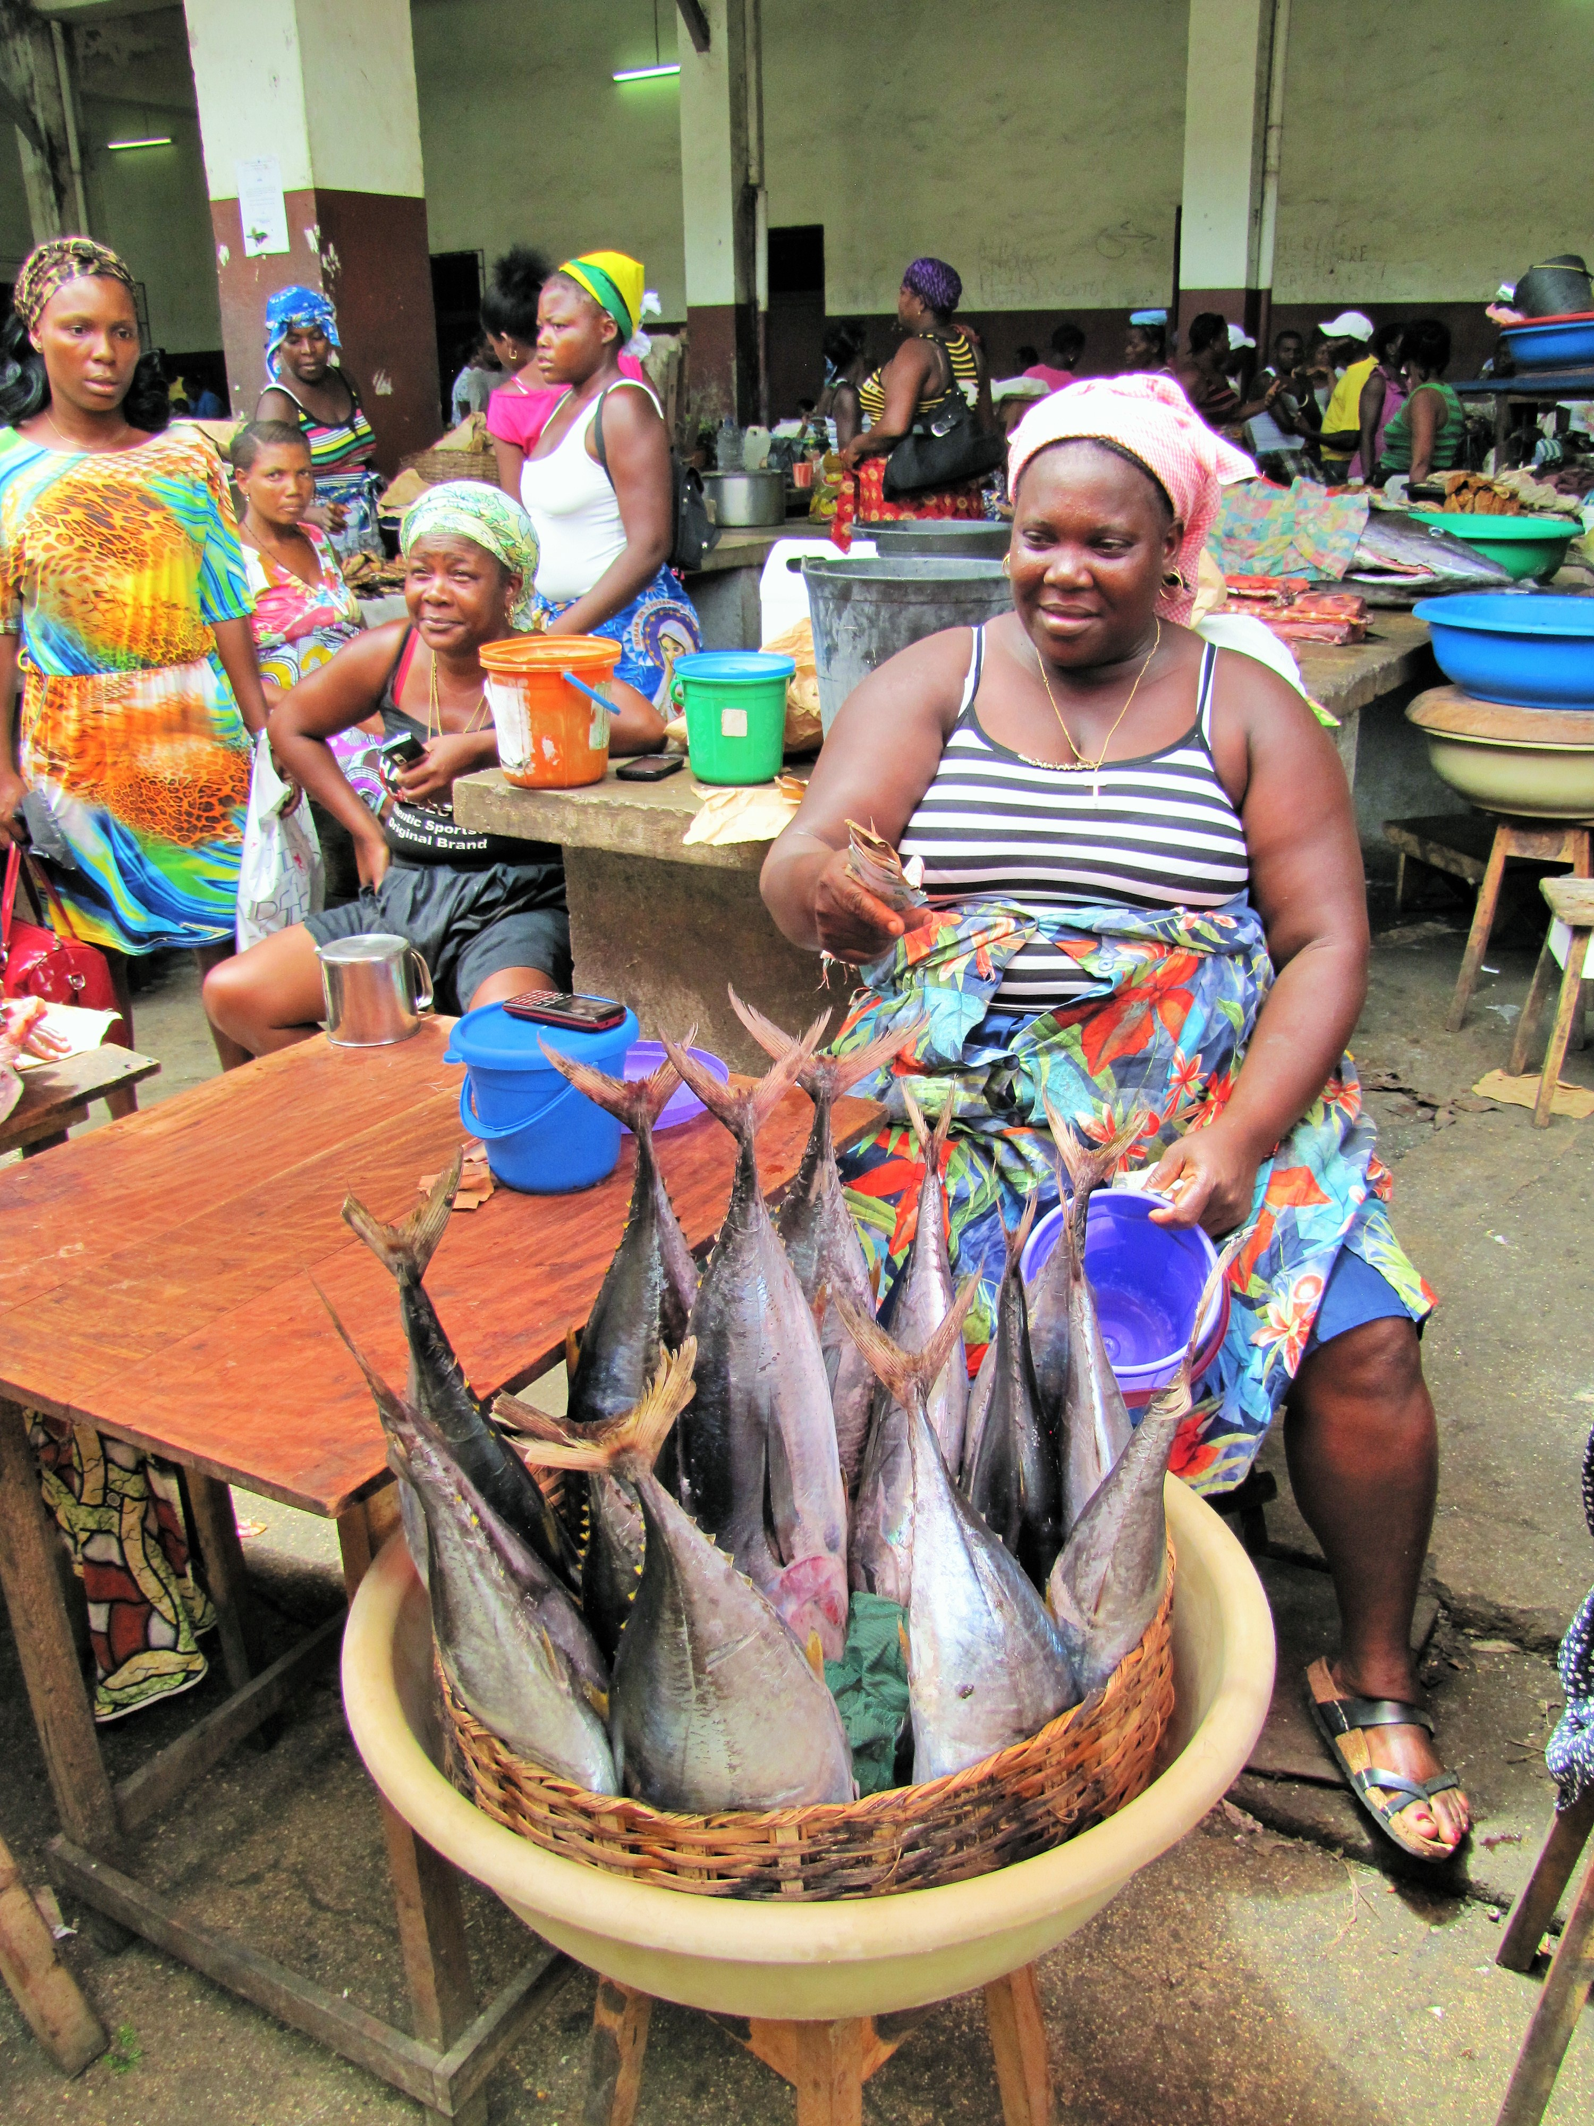
Fisheries adaptation recommendations – infrastructure
Construction of additional fishing ports
Building of district retail markets with adequate refrigeration equipment (ice and cold storage, freezers)
Construction of a workshop for the construction of improved fishing boats
Build a manufacturing unit for essential fishing materials (nets, mooring lines, cables, hooks, etc.)
Development of official food storage and preparation hygiene rules Development of road networks between fishing ports and markets and investment in refrigerated vehicles for safe fish transport.

Slide 7
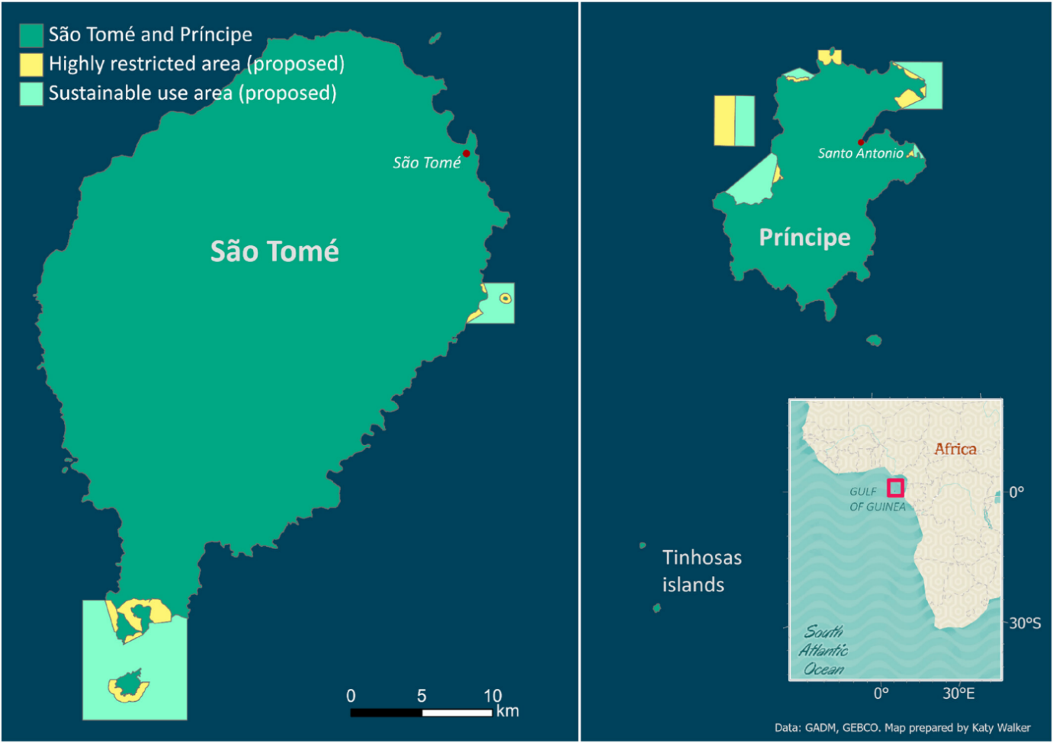
Fisheries adaptation recommendations – protection of fish species
Further development and enforcement of marine protected areas (MPAs).
Responsible use of moored fish aggregating devices (FADs).
Regulatory framework to avoid over-fishing:
Returning juveniles
Use of unweighted purse seine fishing methods
Catch limits
Limits on number of fishing vessels

Slide 8
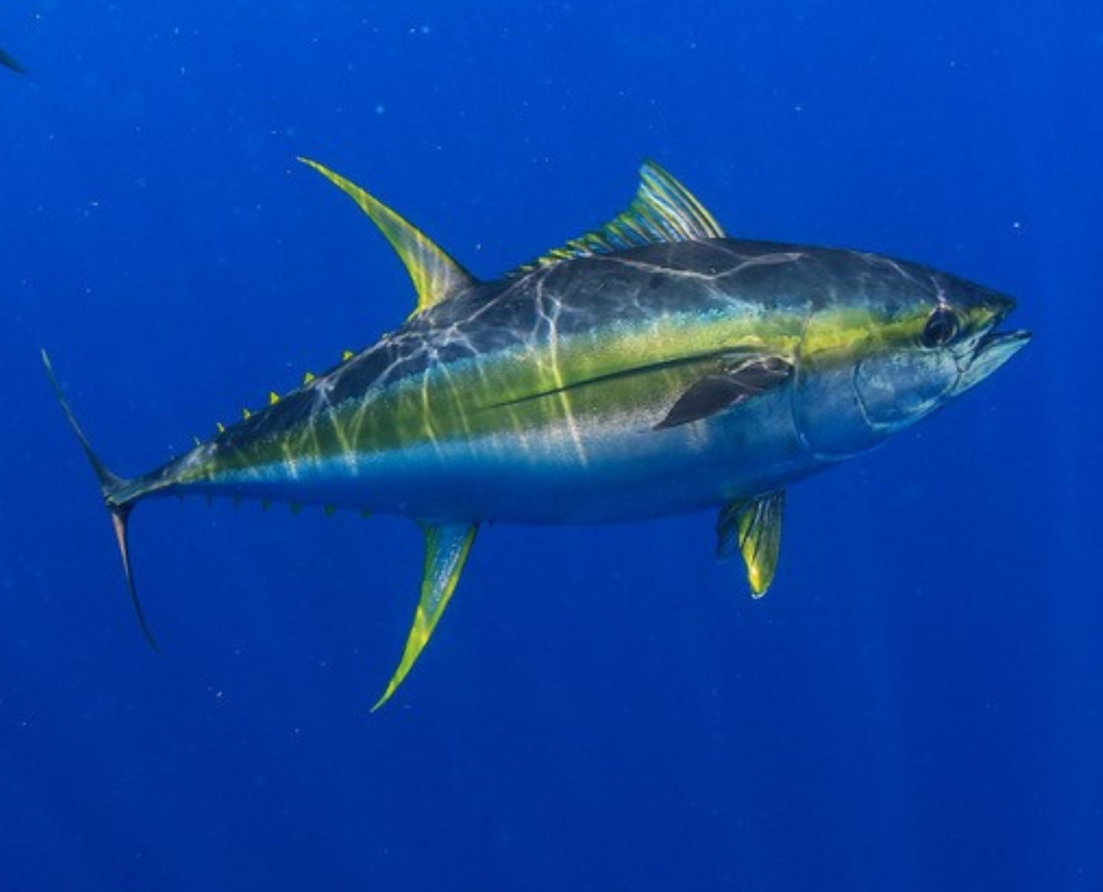
Tourism and fisheries adaptation recommendations – sports fishing
Creation of sport fishing zones based on existing ecological studies
Compulsory licenses for amateur and sport fishing
Respect for the closed season (breeding seasons)
Catch limits and minimum sizes
Prohibition of fishing endangered species
Recording of catches and shipments
Require certified guides and safe, seaworthy vessels.
Environmental and maritime inspection.

Slide 9
Merci Thank you

