Slide 1


Climate change and climate change impacts on São Tomé and Príncipe with a focus on fishery and tourism sectors in a Blue Economy context Sao Tome and Principe, November/December 2025
GCF project cycle and report findings
By: Samuel Greenrod, Marco Fusi, Riccardo Soldan, Lionel Kinadjian

Slide 2
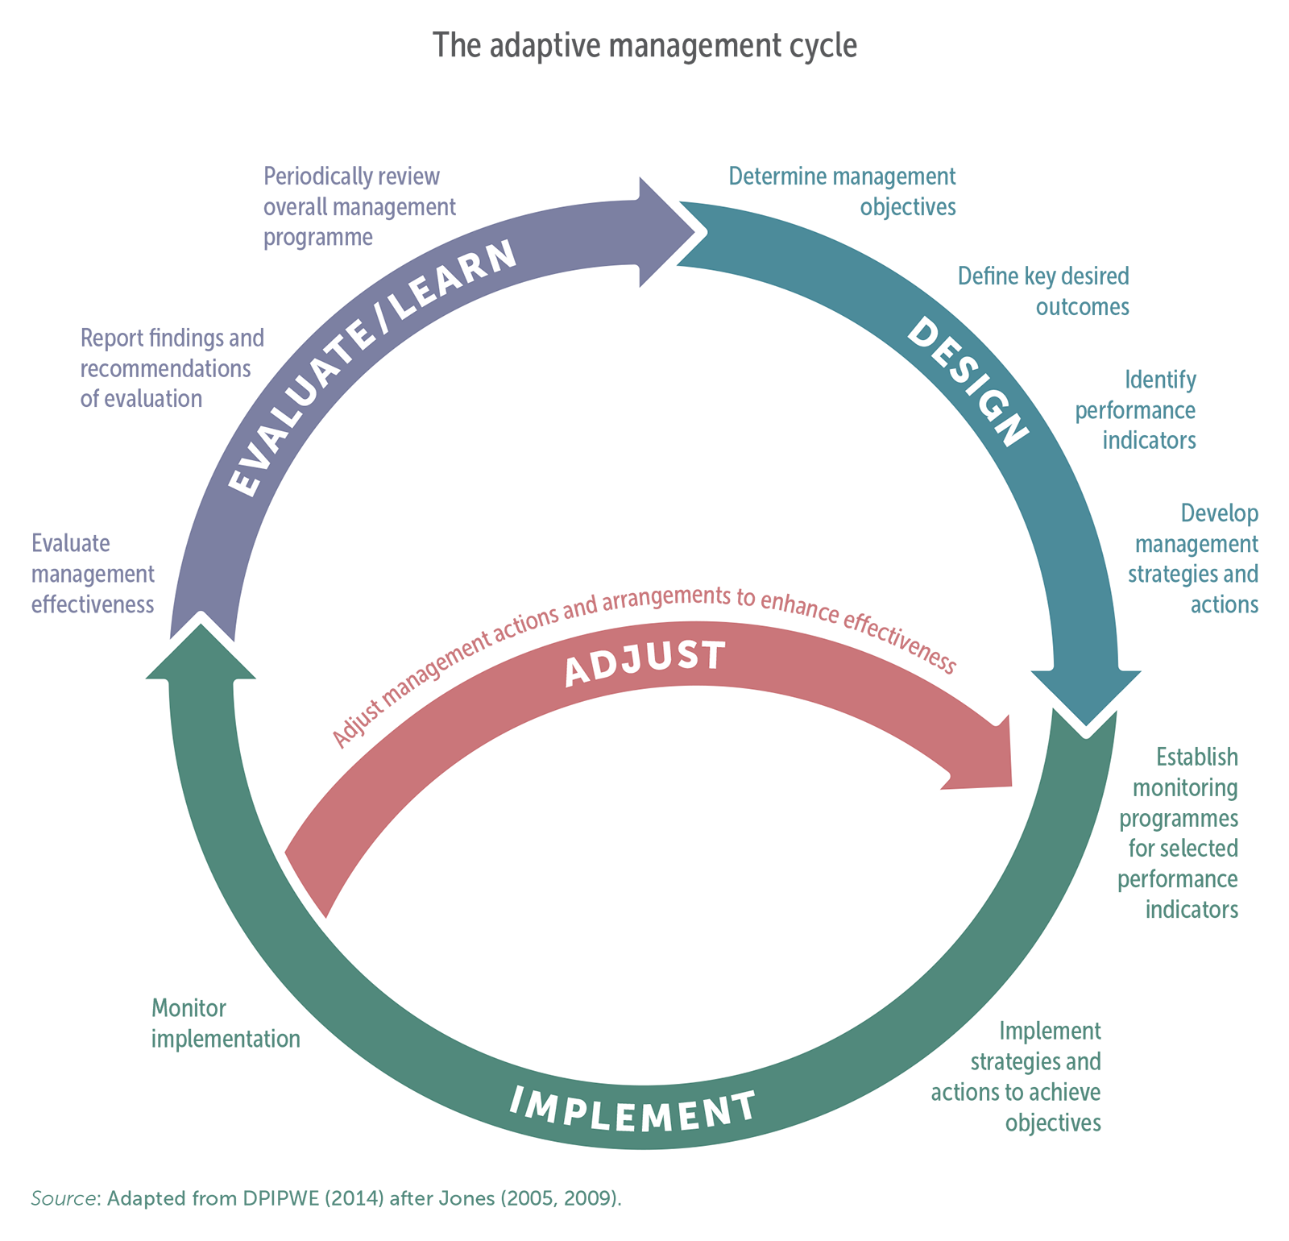

The GCF process

Slide 3
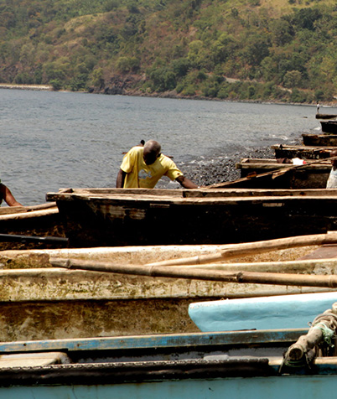
Report overview
Assess climate impact on STP fisheries and tourism:
Climate exposure
Climate vulnerability
Climate adaptation

Slide 4
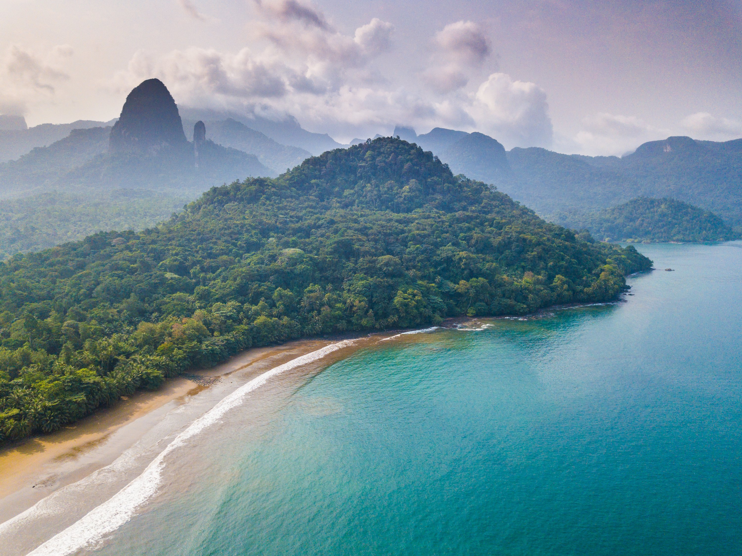
Tourism in STP
GDP: 6-8% (14% indirect)
Employment: 10%
Highlights:
Sun and beach
Diving
Ecotourism
Sports fishing
Threats
Sea level rise
Tourist discomfort

Slide 5
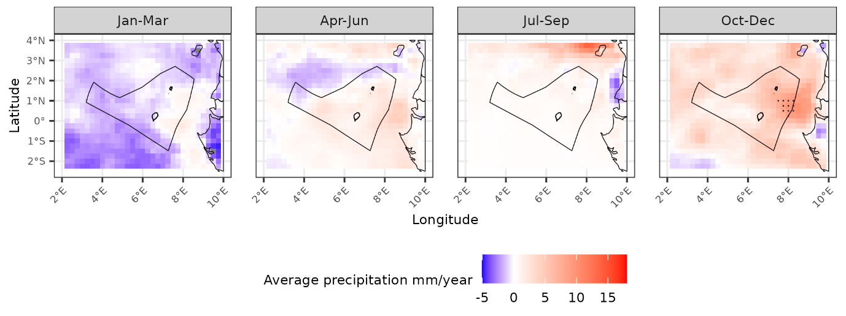
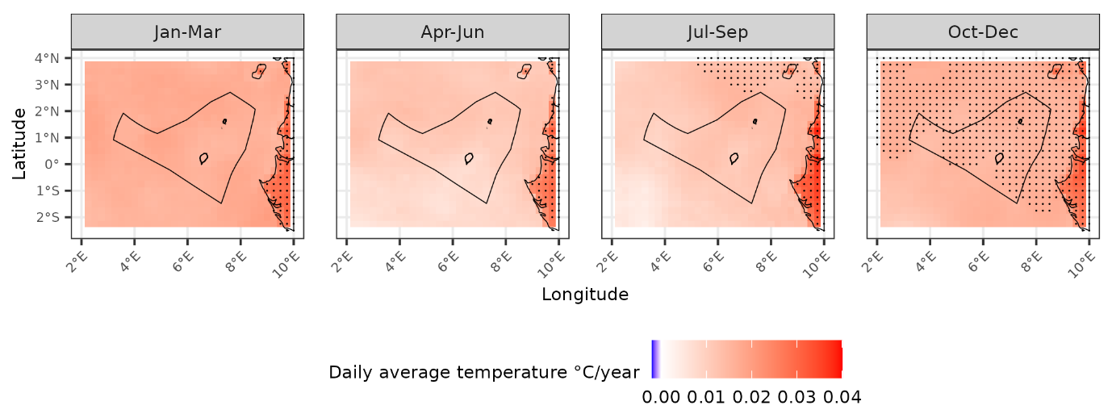
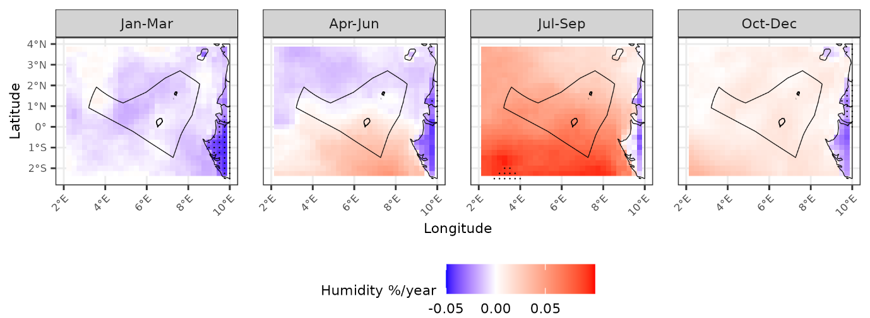
Tourism – climate exposure
Past climate trends:
Hotter – increasing temperatures and heatwave frequency
Wetter – increasing precipitation in Oct-Dec and more high precipitation events
More humid in Jul-Dec

Slide 6
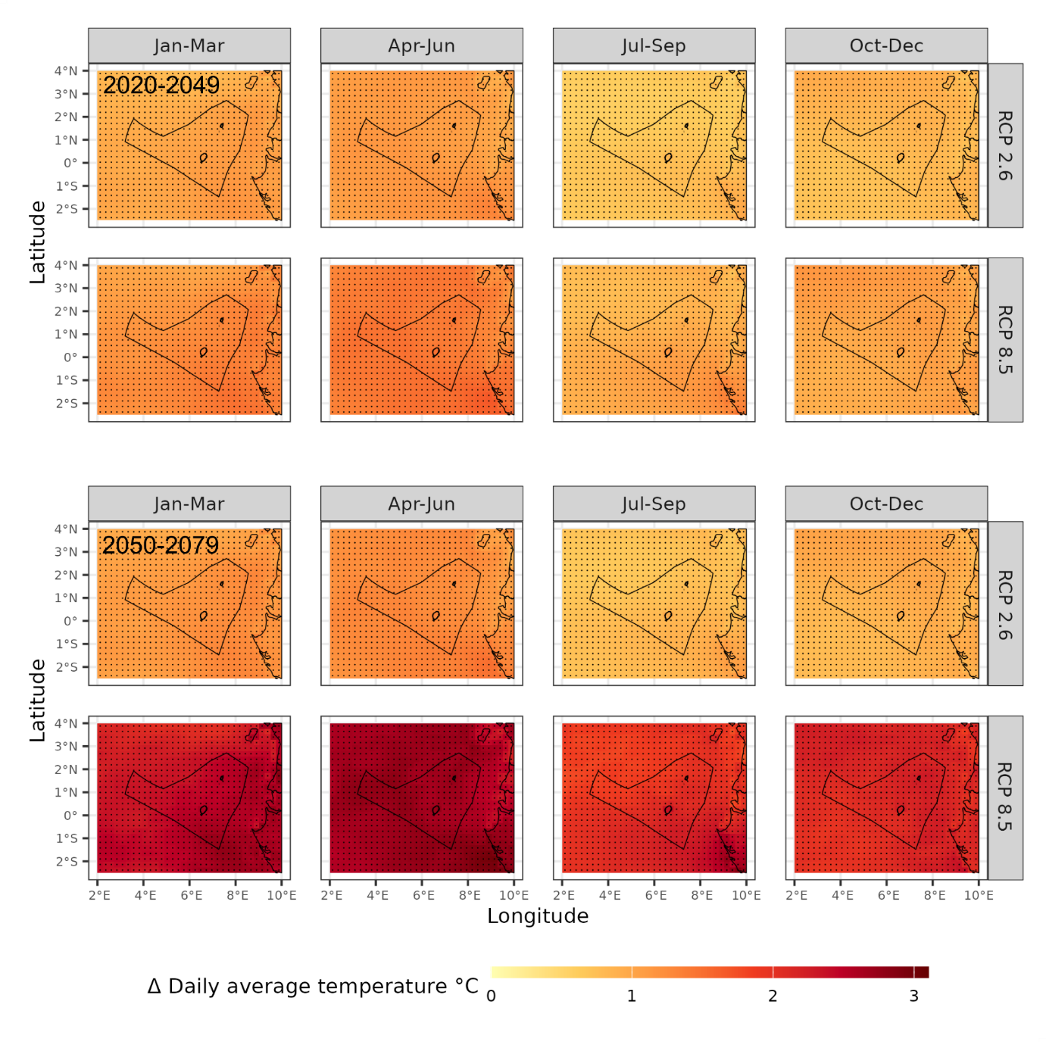
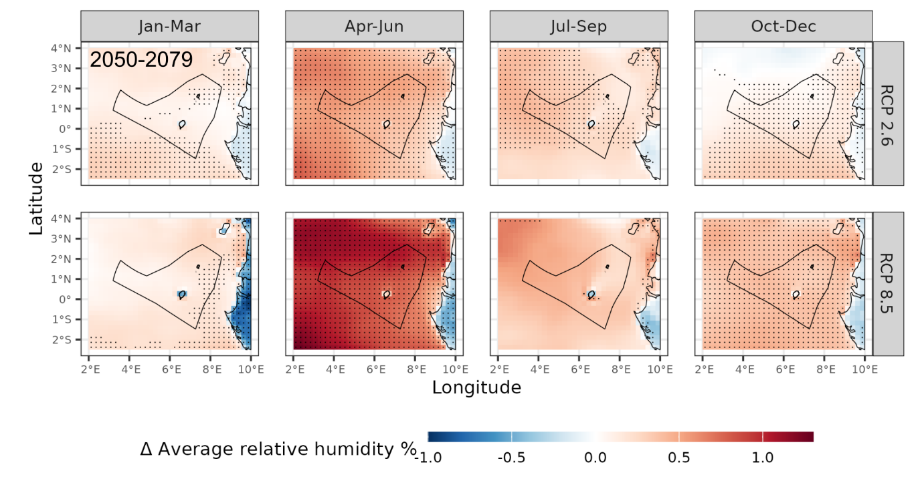
Tourism – climate exposure
Future climate trends:
Hotter – especially in Jan-June
Higher warming by 2050-2079
Higher warming under RCP 8.5
More precipitation in Apr-Dec
More humid in Apr-Jun

Slide 7
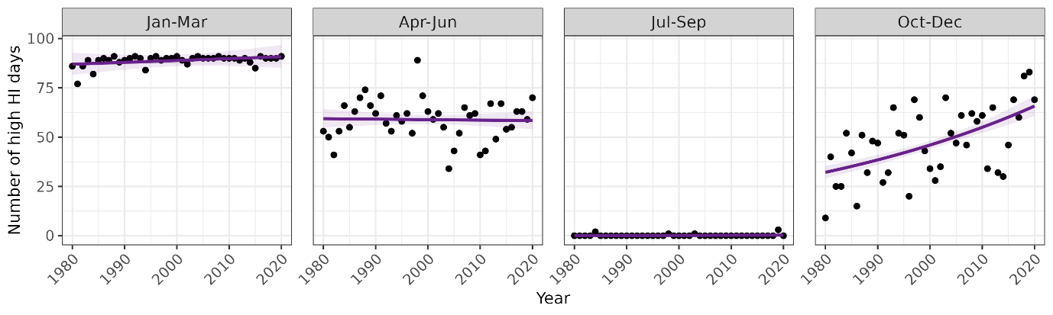
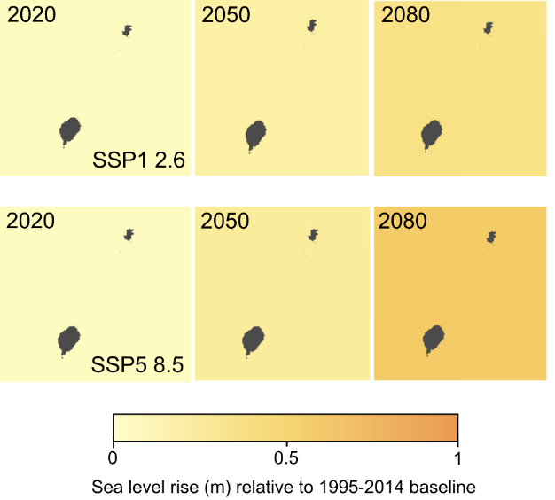
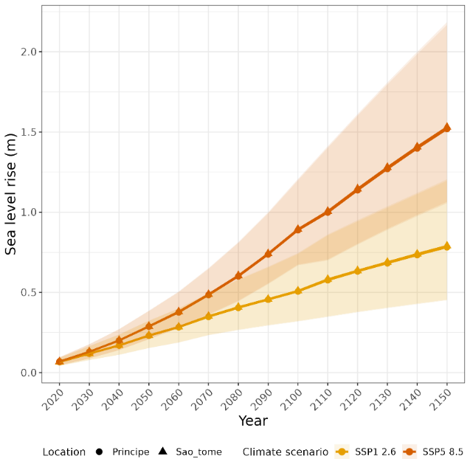
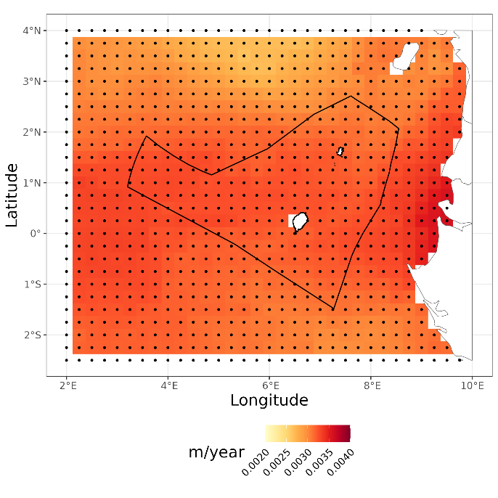
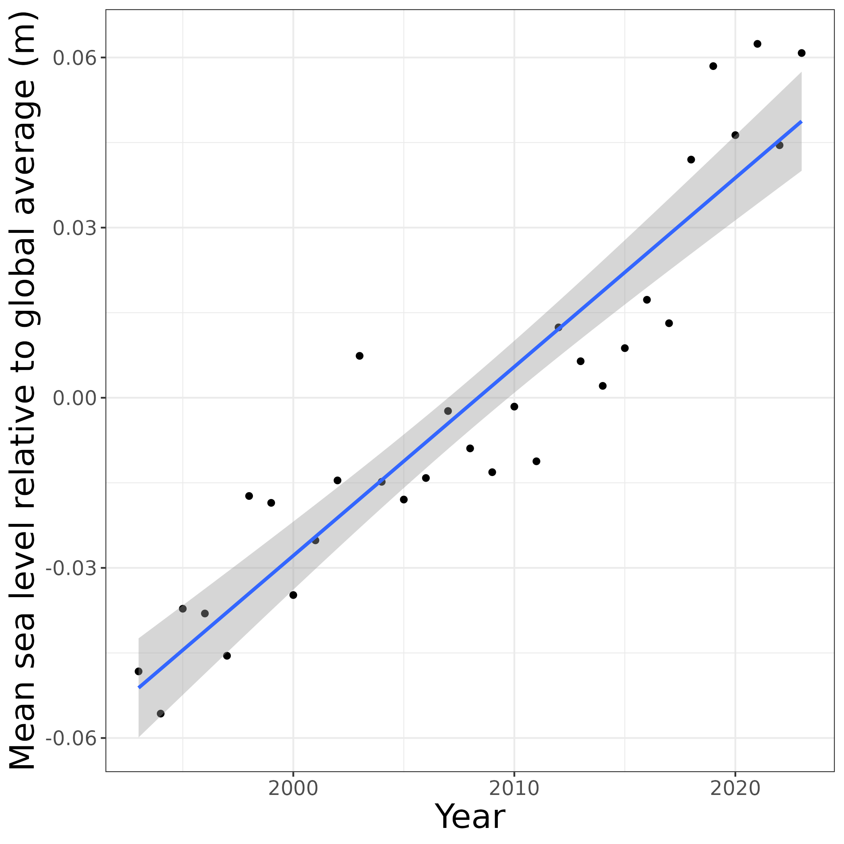
Tourism – climate impact
Historical increase in high heat index days in Oct-Dec
Historical and projected sea level rise
Projected
Historical

Slide 8
Fisheries in STP
Fisheries are crucial for the economy and employment
5-10% GDP
Employ 10-15% population
Fish comprises ~53% of animal protein intake
Fish conservation is also important for future tourism:
Sports fishing
Diving
Threats
Ocean warming
Ocean acidification

Slide 9
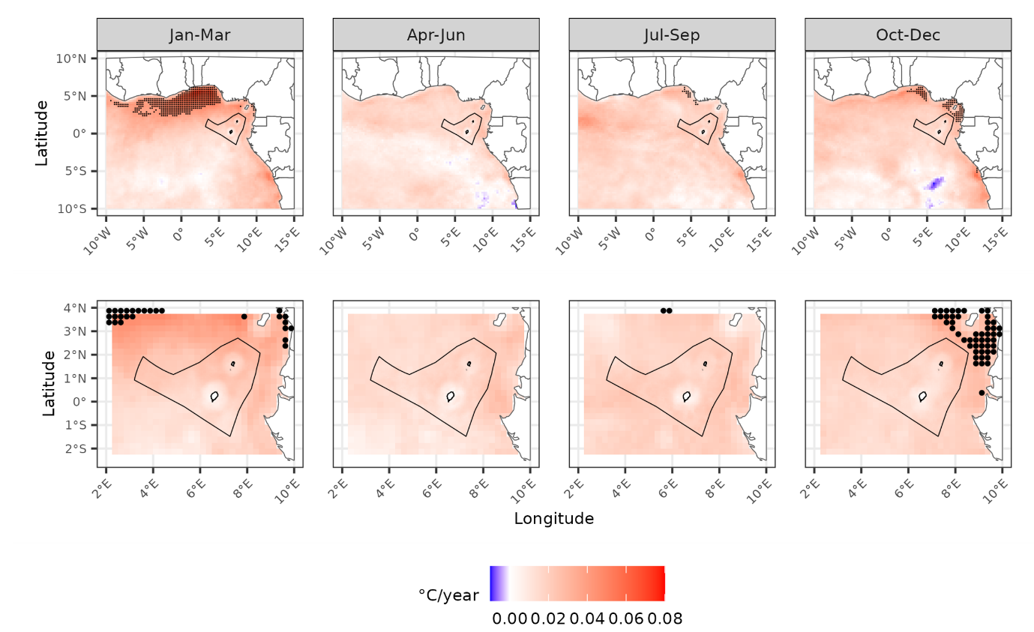
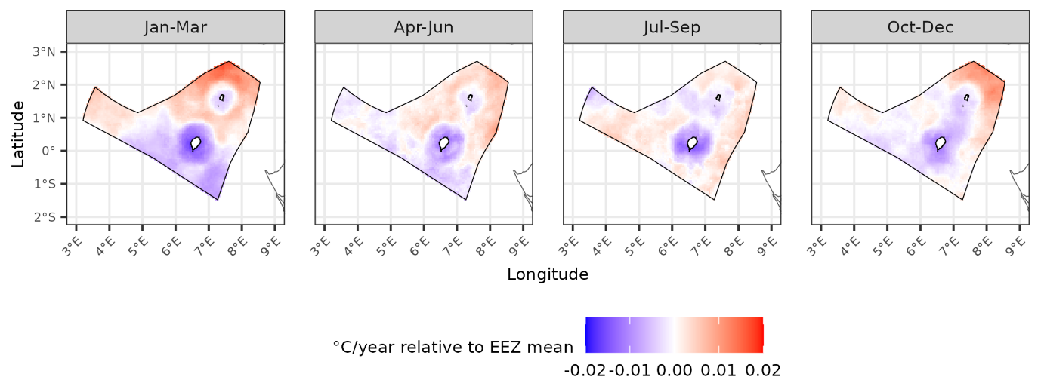
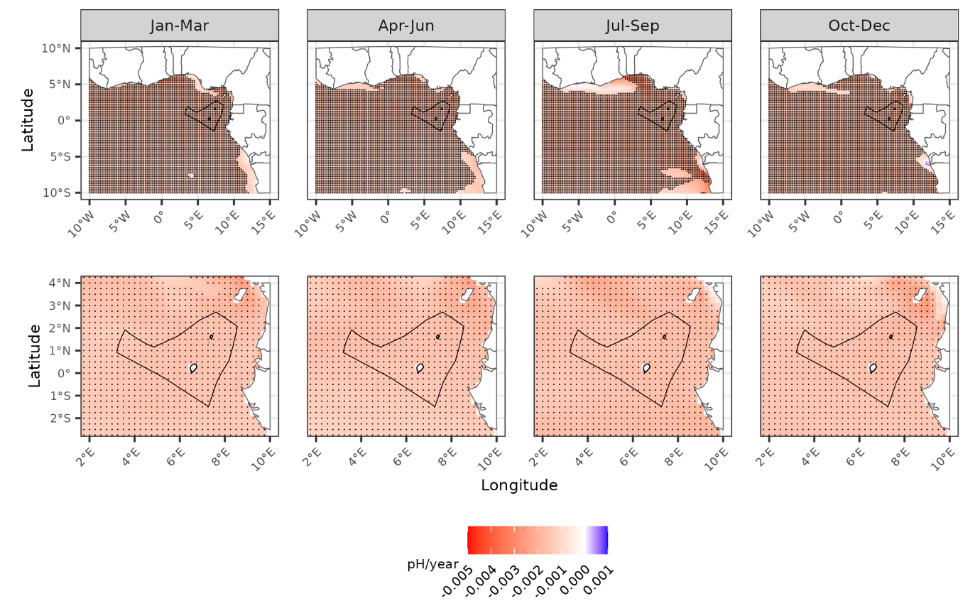
Fisheries – climate exposure
Past climate trends:
Hotter – increasing temperatures and marine heatwave frequency
Acidification
Deoxygenation

Slide 10
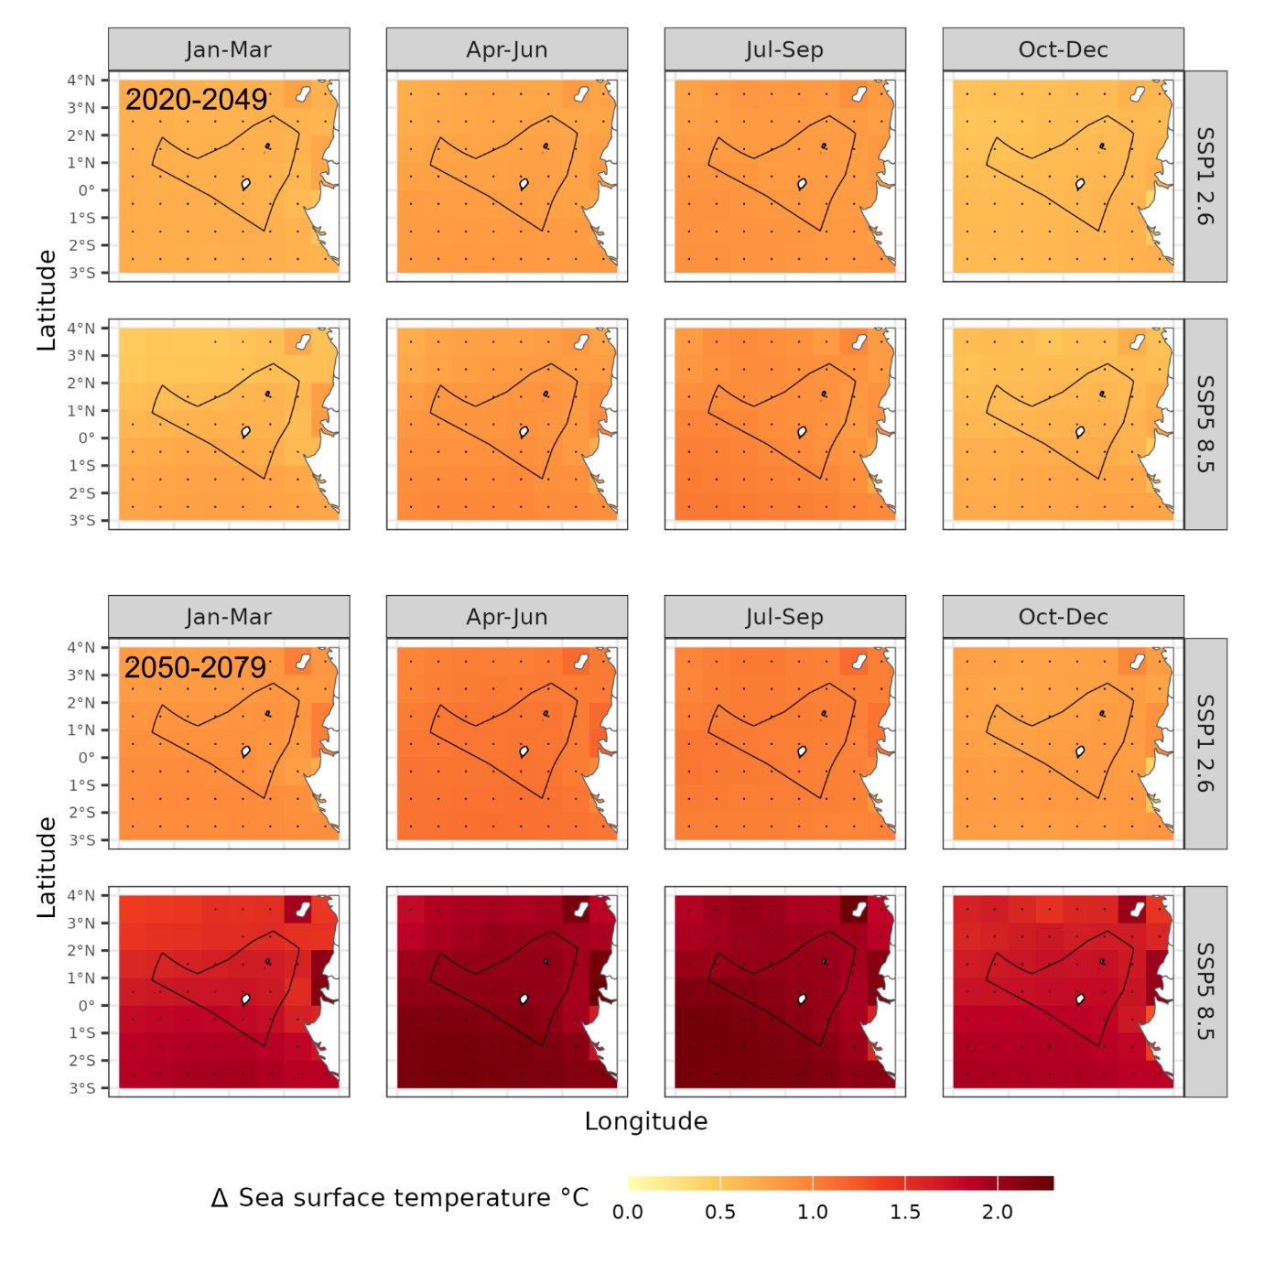
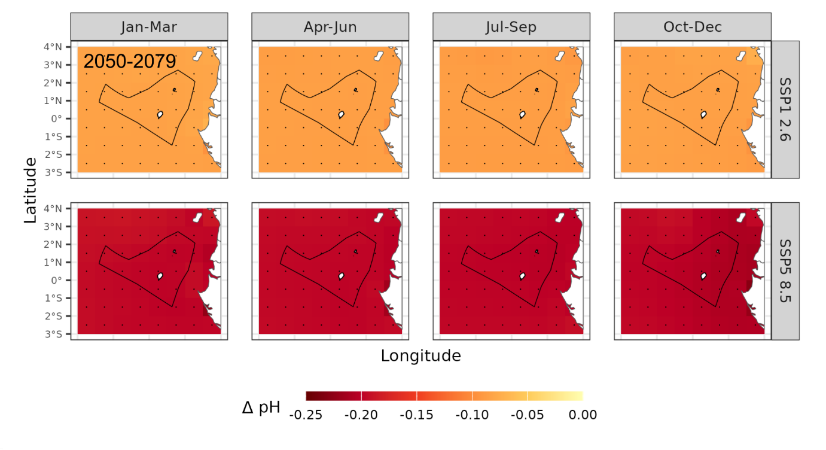
Fisheries – climate exposure
Future climate trends:
Projected temperature increases
Projected ocean acidification
Projected ocean deoxygenation

Slide 11
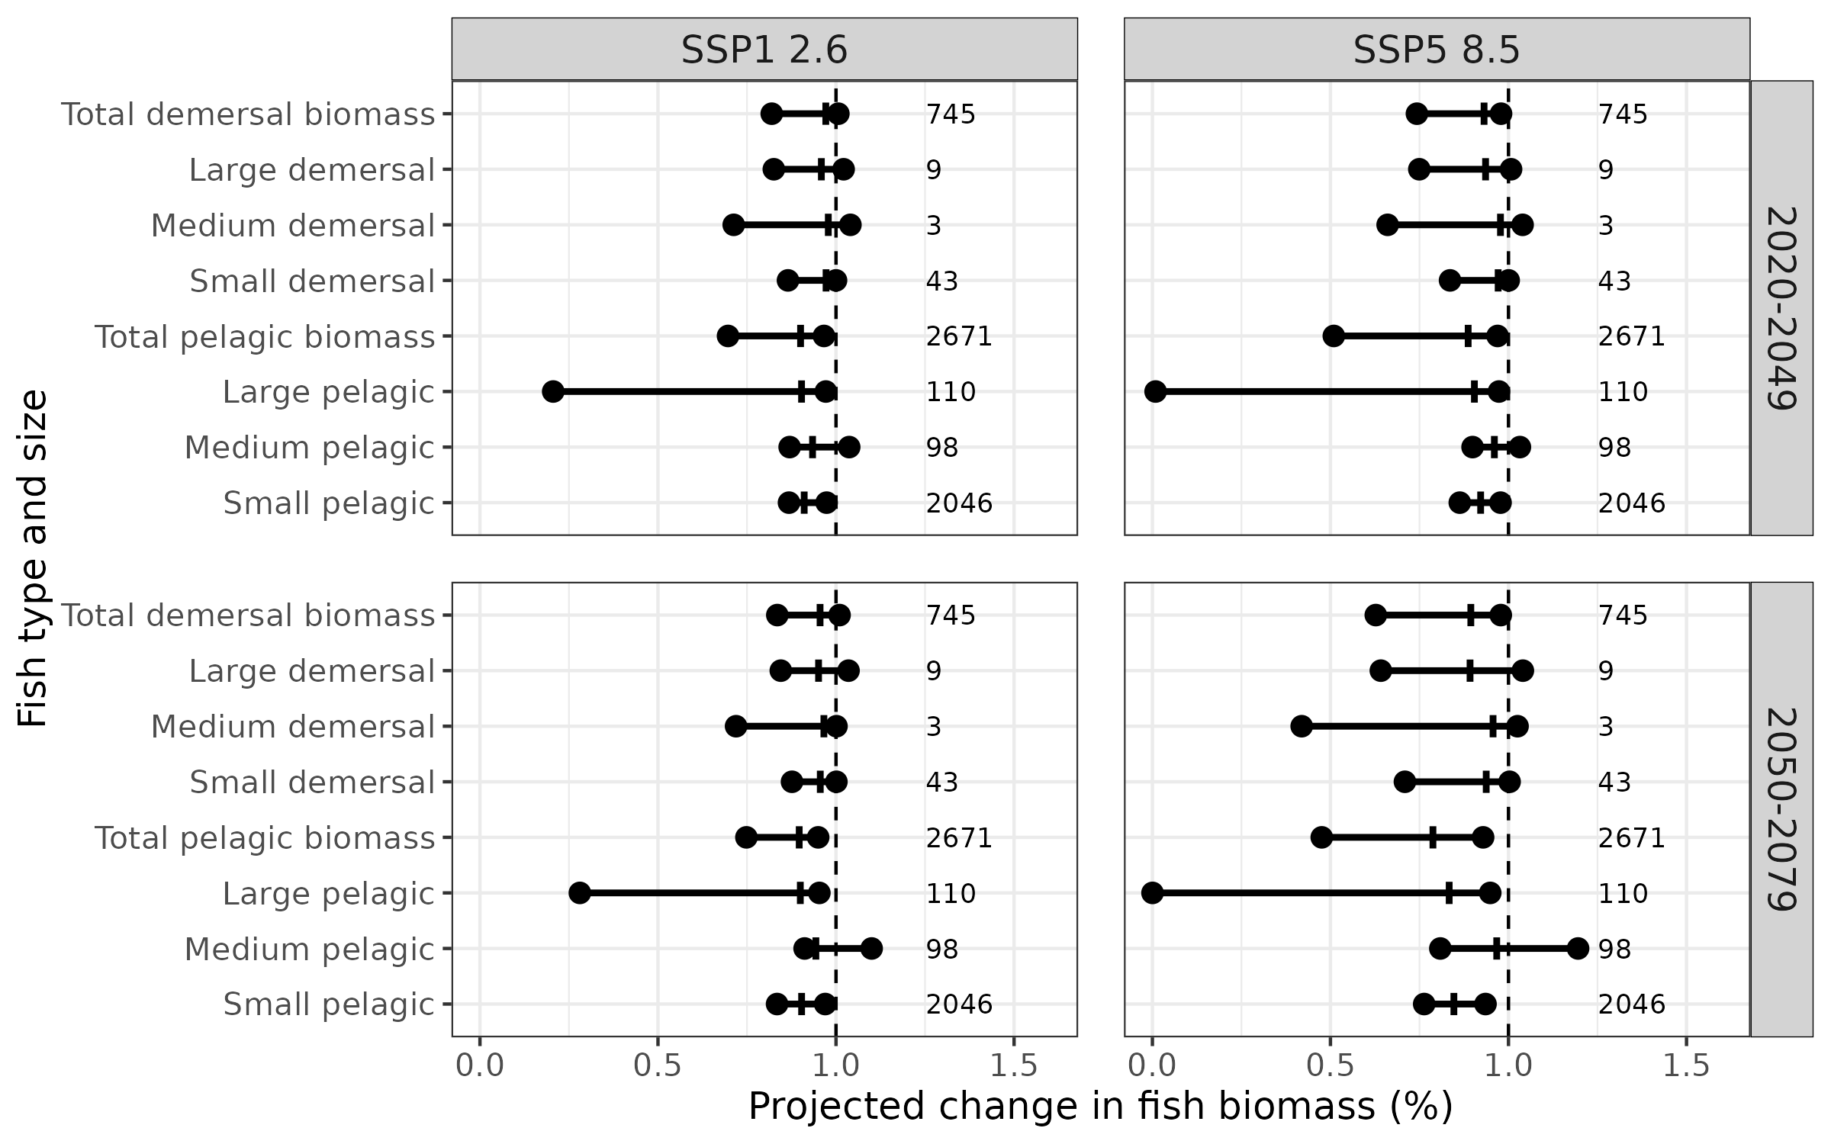
Fisheries – climate impact (mechanistic modelling)
ISIMIP
Fish biomass impact models:
APECOSM
BOATS
EcoOcean
DBPM
FEISTY
ZooMSS
Climate models
IPSL-CMIP6-LR
GFDL-ESM4

Slide 12
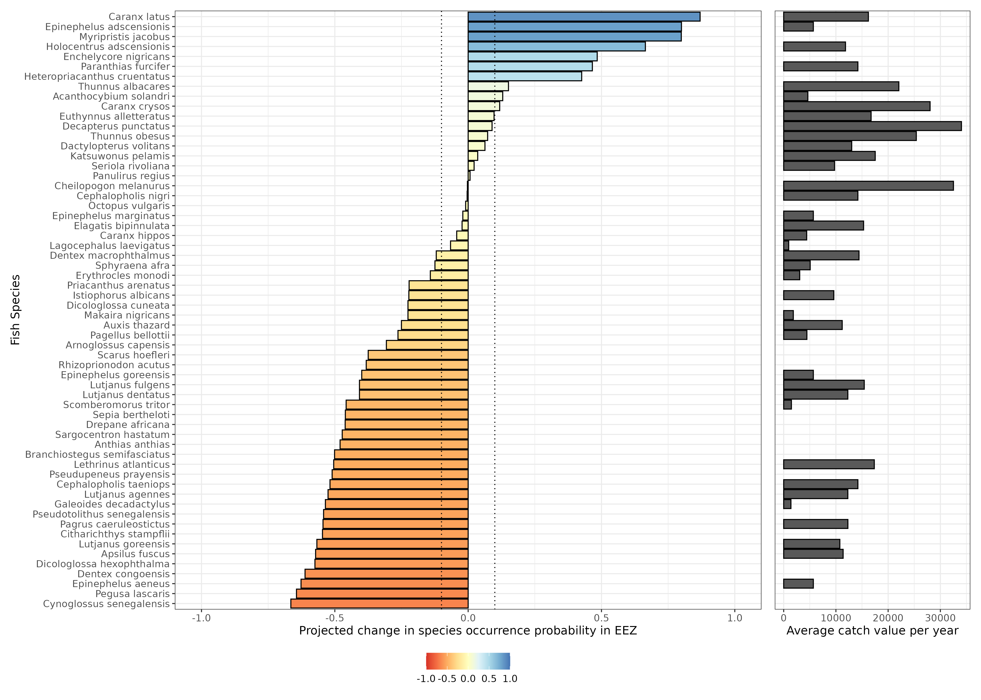
Fisheries – climate impact (empirical modelling)
Fish occurrence probability is projected to vary considerably with climate change
With a 0.1 change cut-off, occurrence probability projected to:
Increase for 10 species
No change for 14 species
Decrease for 36 species

Slide 13
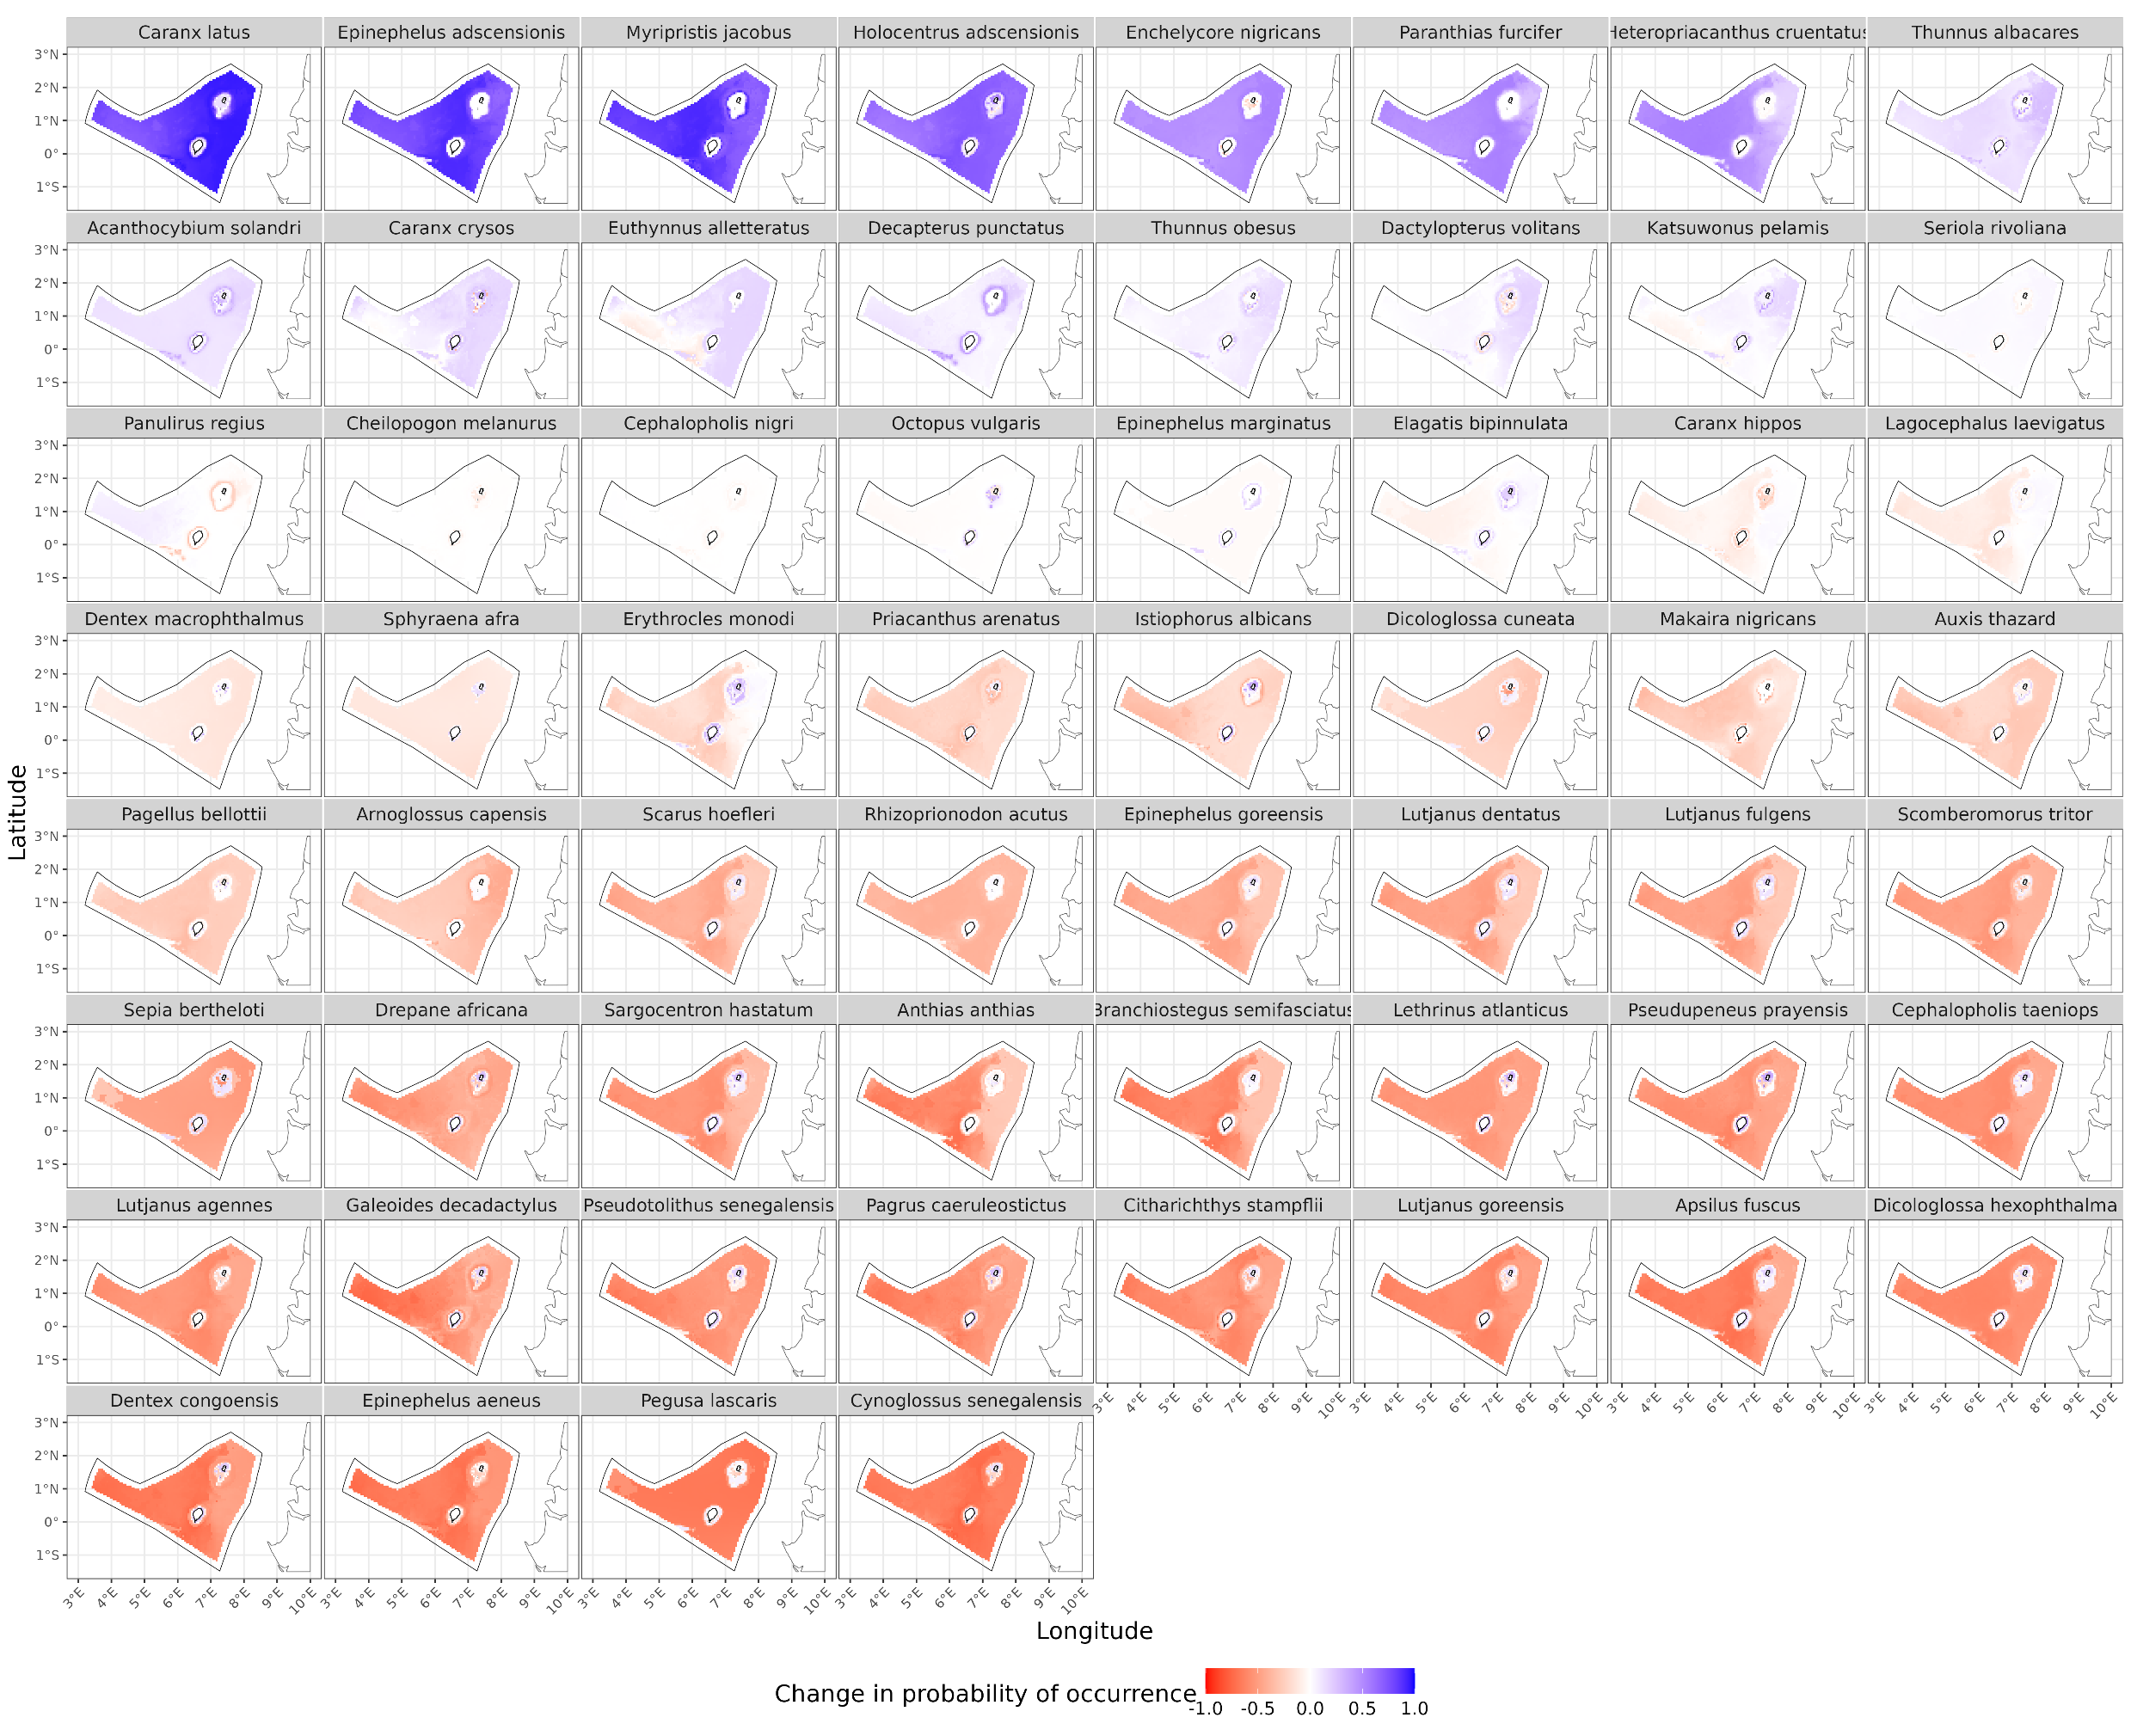
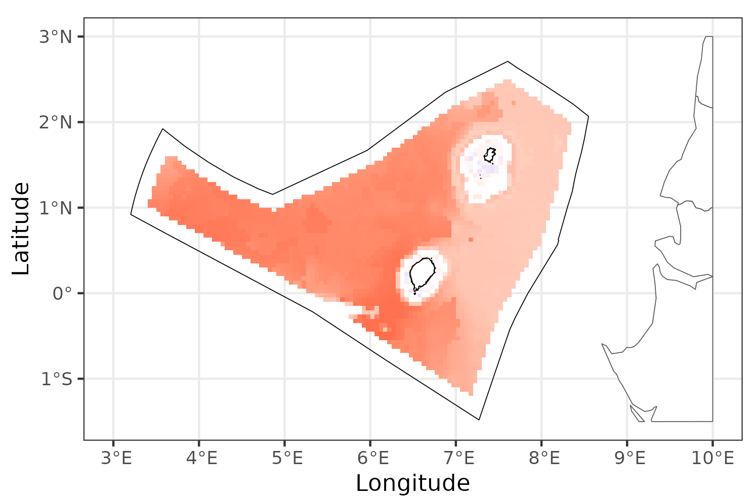
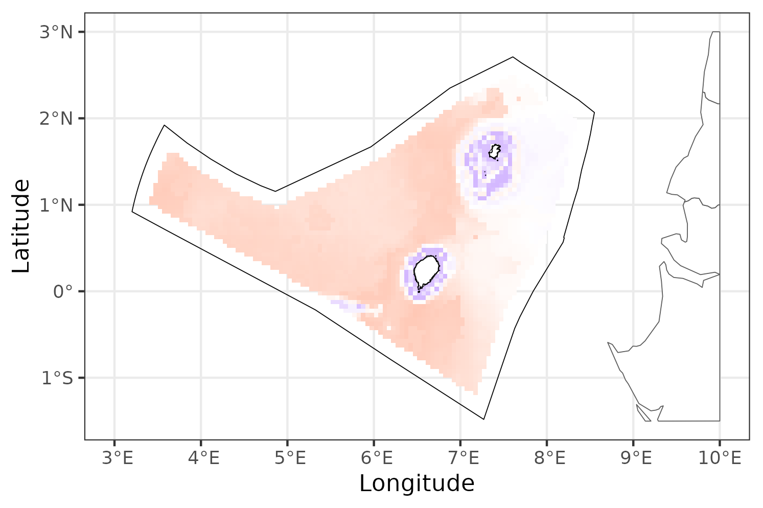
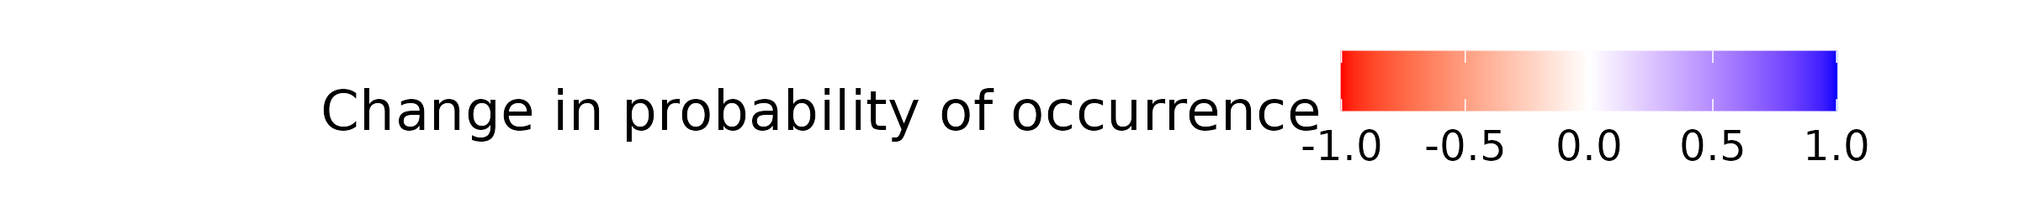
Fisheries – climate impact (empirical modelling)
Climate impact is greater in the west than east, consistent with mechanistic models
Coastal waters are buffered from climate impact
Anthias anthias
Erythrocles monodi

Slide 14
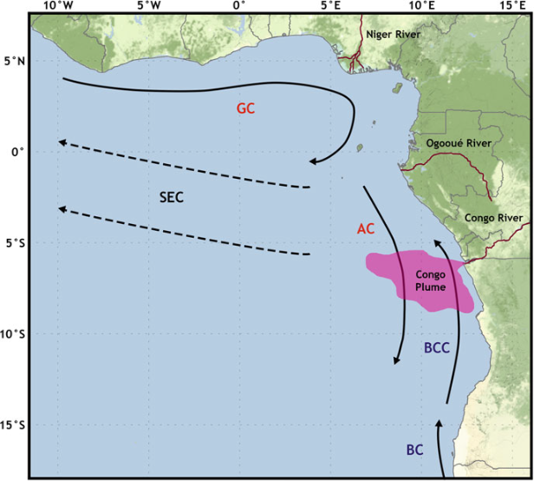
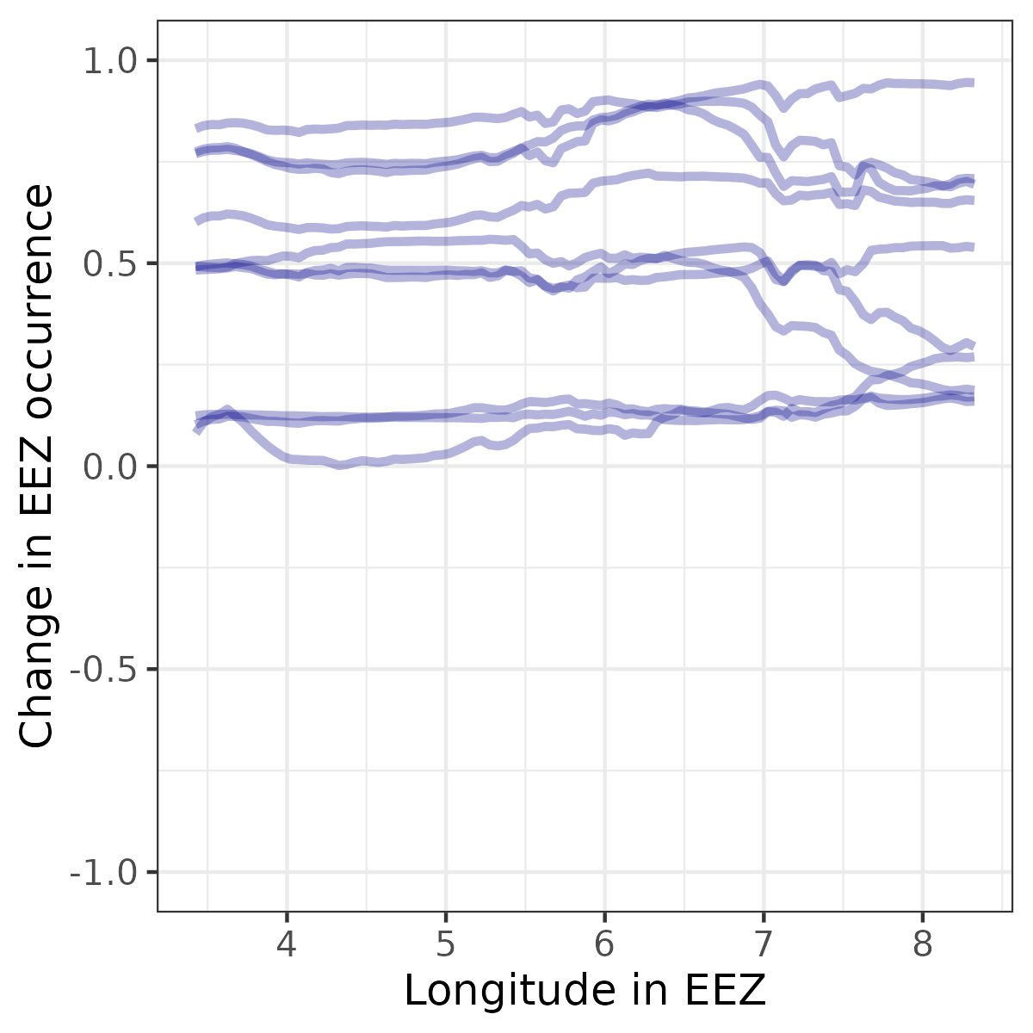
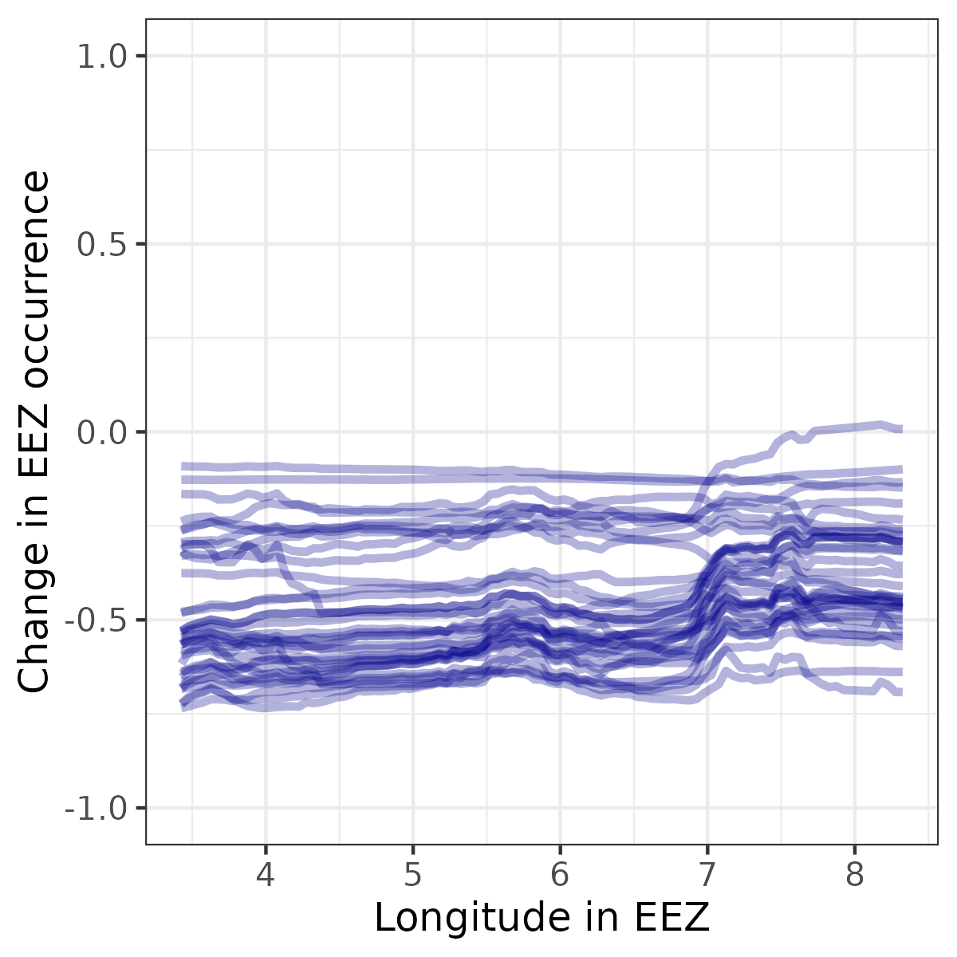
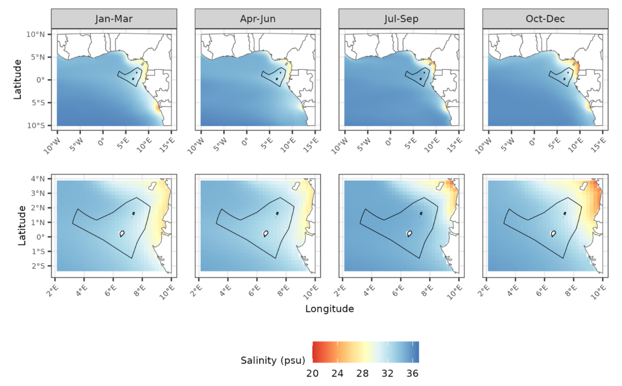
Fisheries – climate impact (empirical modelling)
Positively affected by climate change
Negatively affected by climate change

Slide 15
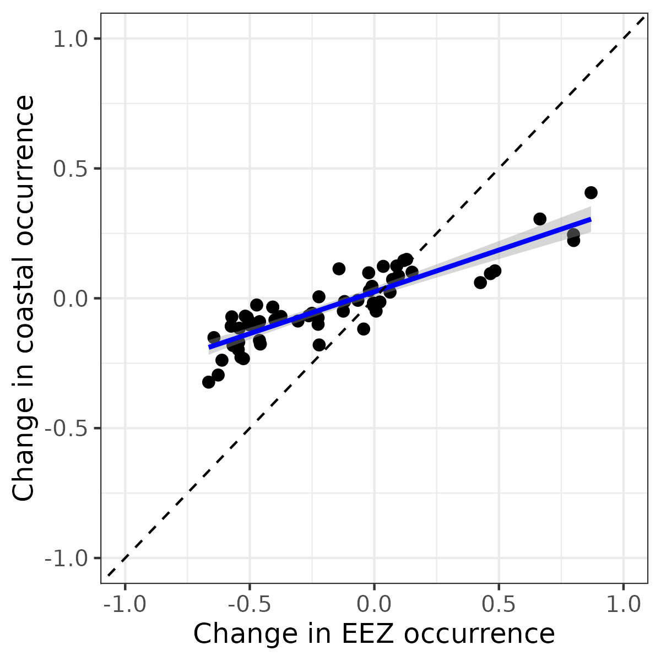
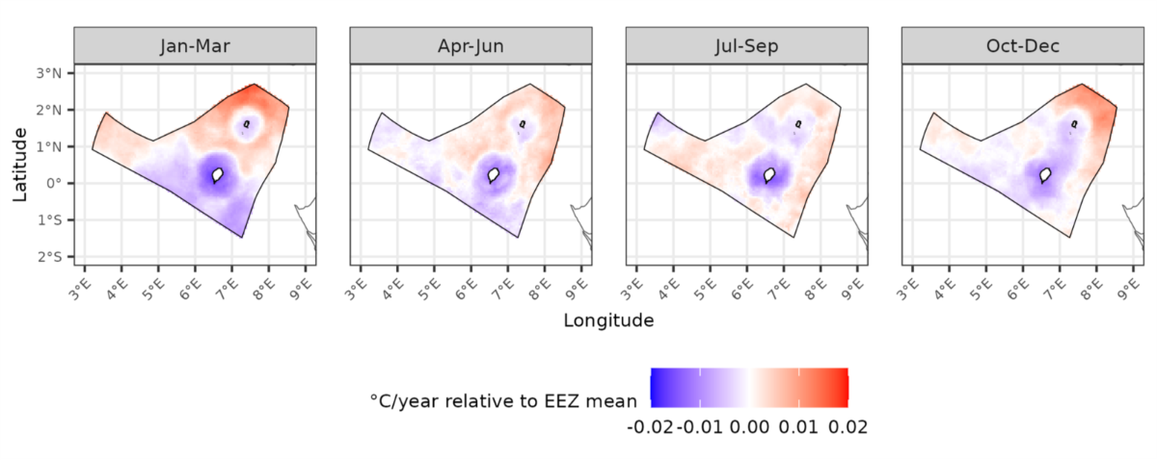
Fisheries – climate impact (empirical modelling)
Coastal buffering occurs across all species
Result may be due to greater climatic stability near coast
m = 0.32
R² = 0.78

Slide 16
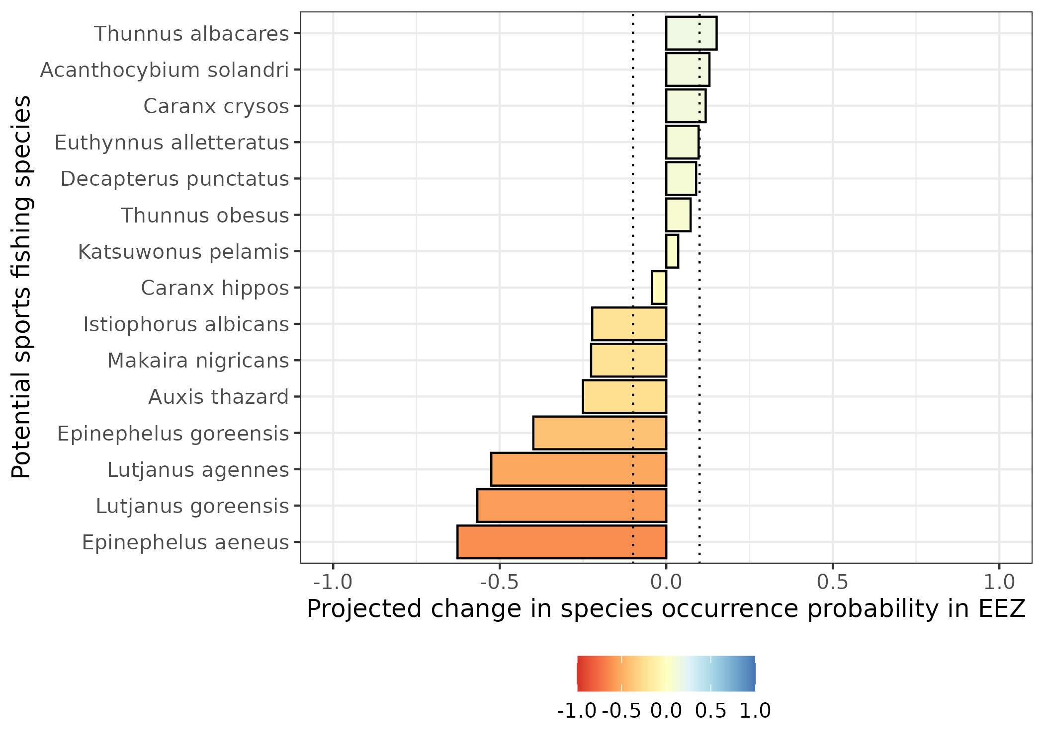
Fisheries – climate impact (sports fishing)
15 fish species identified as candidates for sports fishing
With a 0.1 change cut-off, presence probability projected to:
Increase for 3 species
No change for 5 species
Decrease for 7 species
Tuna
Grouper
Snapper

Slide 17
Conclusions
Future climate change is expected to affect both tourism and blue economy:
Sea level rise
Increased tourist discomfort
Reduction in EEZ fish biomass
Alterations to probability of pelagic and demersal occurrence in EEZ and species
We recommend an adaptation strategy (outlined in a later session) to mitigate the impacts of climate change.

Slide 18
Merci Thank you

