Slide 1


Technical workshop for GCF project: Climate change and climate change impacts on São Tomé and Príncipe with a focus on fishery and tourism sectors in a Blue Economy context Sao Tome and Principe, November/December 2025
Species distribution modelling using maxent
By: Samuel Greenrod, Marco Fusi, Riccardo Soldan, Lionel Kinadjian

Slide 2
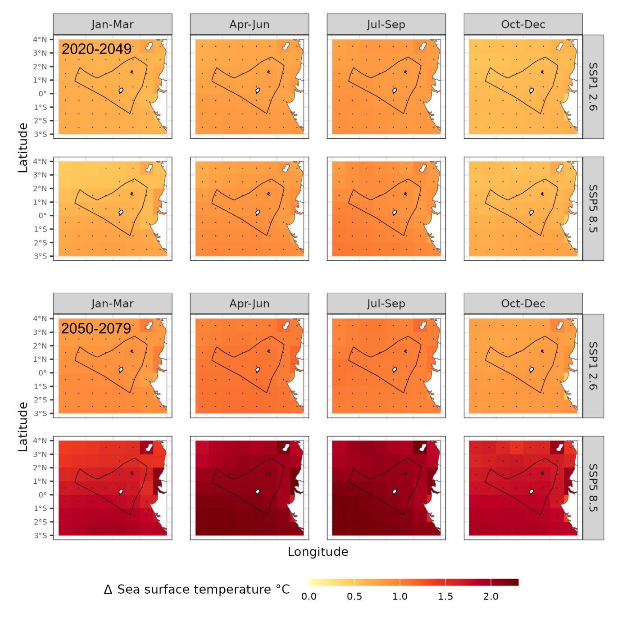
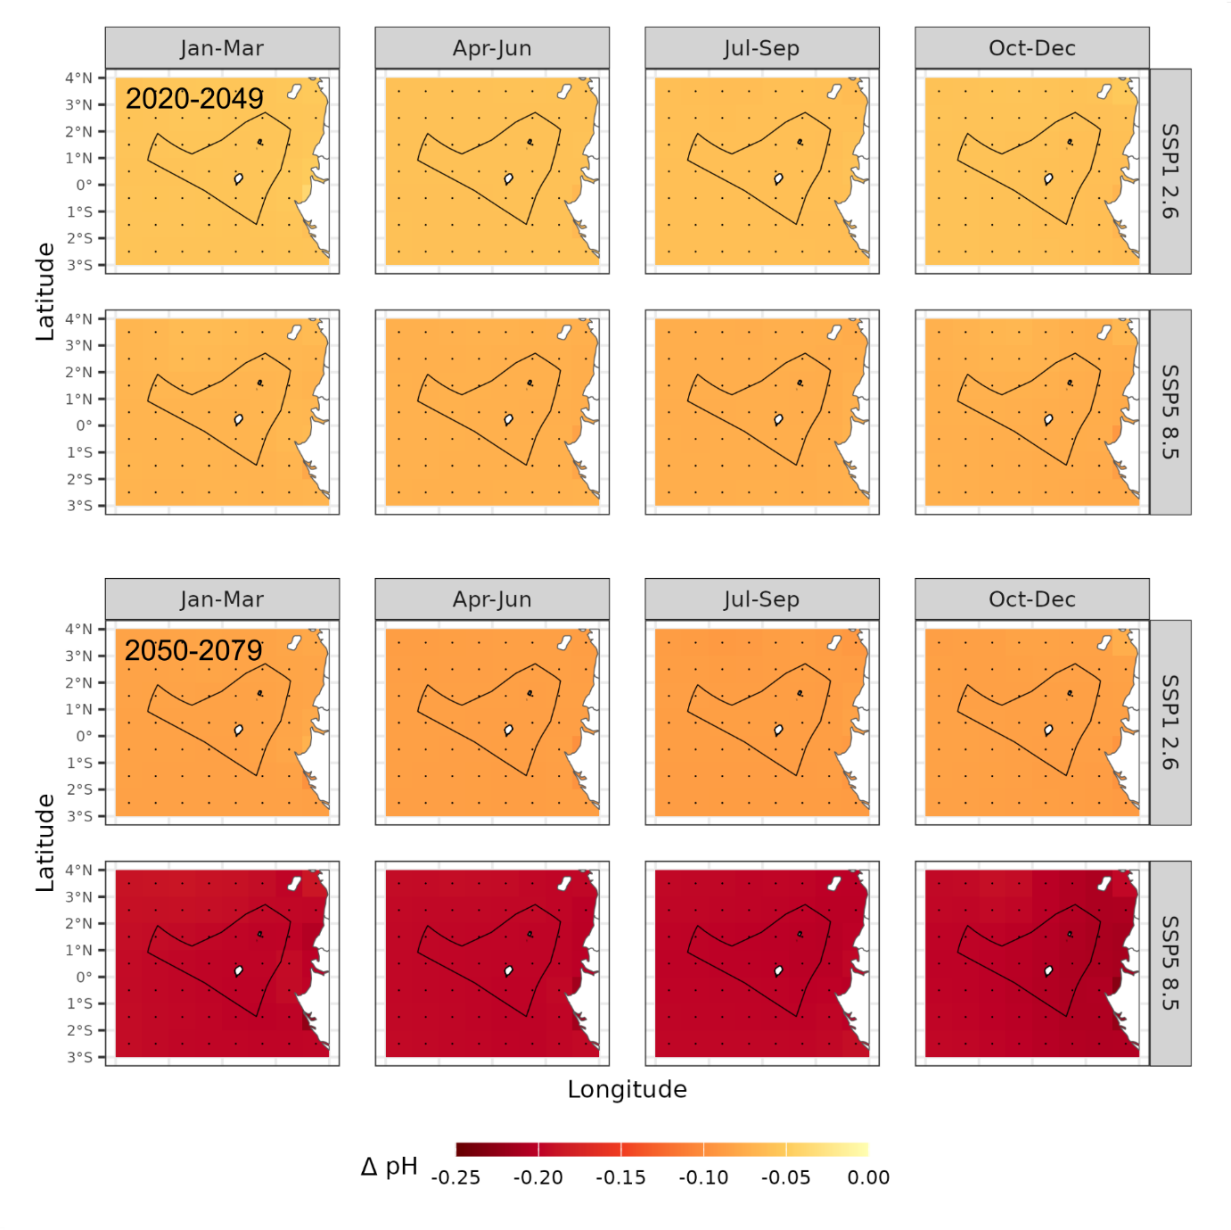

Fisheries in Sao Tome and Principe: the challenge
Climate models project significant future oceanographic change
Climate change is expected to affect fisheries by altering:
Fish reproduction
Fish densities
Fish migration patterns
Values are relative to historical run

Slide 3

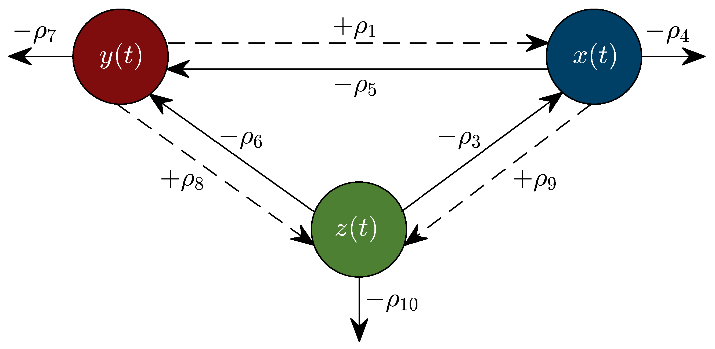
Species distribution modelling approaches
Species distribution modelling can be used to assess climate impact on fish distributions
Most models are “empirical” – find statistical associations between species occurrence and environmental parameters
MaxEnt
R-INLA
SdmTMB
A small number are “mechanistic” – use equations that model how fish systems function and interact with climate

Slide 4
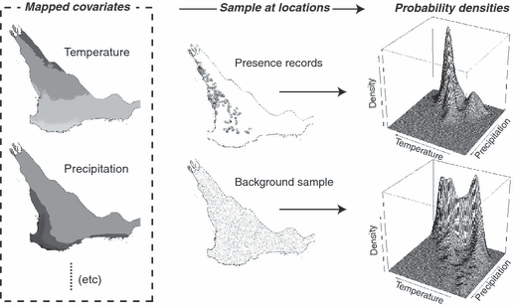
Empirical modelling – MaxEnt for species distributions
For the STP report, we used an empirical modelling approach called “MaxEnt” or Maximum Entropy
Species presence records
Climatic values across a region
Compares probability distribution of associated climatic values against background data.
Once model is trained, you can apply new climate projection data.
Occurrence probabilities calculated for:
Time periods: historical run, 2020-2049, 2050-2079
Climate scenarios: SSP1 2.6 & SSP5 8.5
Climate model: CMIP6 ensemble

Slide 5
Important considerations
Advantages of MaxEnt:
Handles presence-only data: MaxEnt is well-suited for situations where only presence data is available, which is common in ecological research.
Handles complex relationships: It can model complex interactions between environmental variables and species distributions.
Open-source software: MaxEnt is freely available and open-source.
Widely used: It's one of the most widely used SDM methods in ecology.
Potential Limitations:
Bias in background data:
The choice of background data can influence the model results.
Assumptions about environmental relationships:
MaxEnt assumes that environmental variables are the primary drivers of species distributions, which may not always be true.
Overfitting:
Overfitting can occur if the model is too complex for the available data, leading to poor predictive performance in new areas.

Slide 6
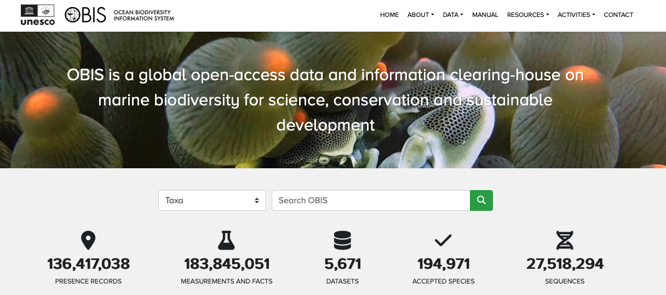
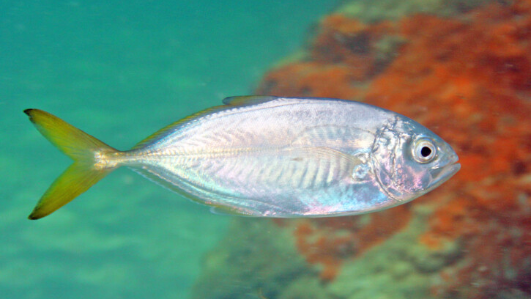
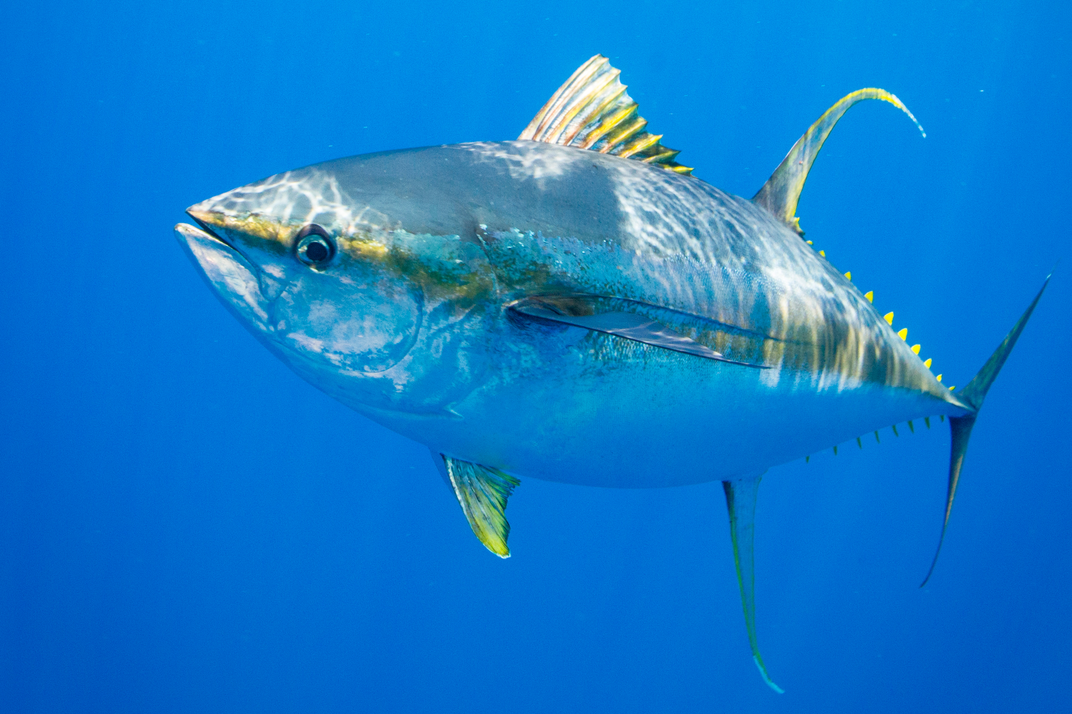
Data collection – Species presence data
MaxEnt only requires presence data, not presence/absence data
Data was acquired from the Ocean Biodiversity Information System (OBIS)
Required information:
Species name
Historical Lon/Lat positions

Slide 7
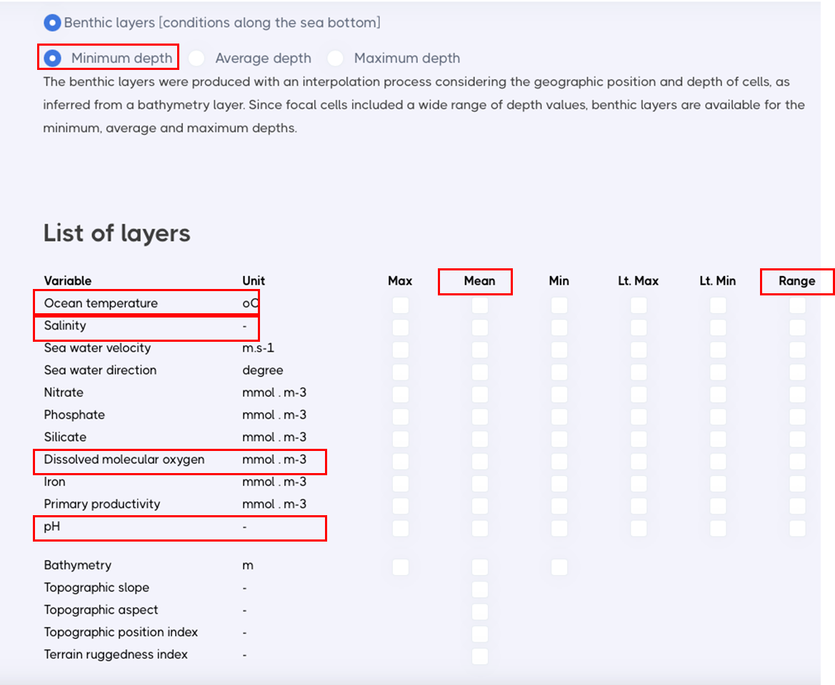
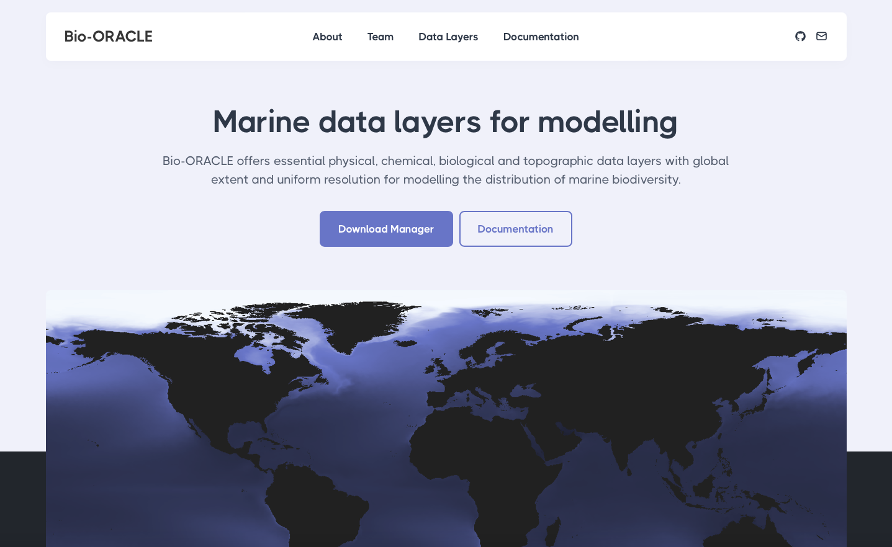
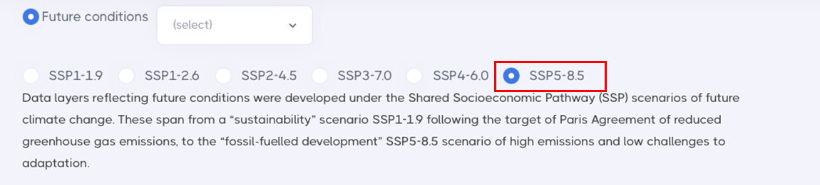
Data collection – marine climatic data
Historical and future climate data was acquired from Bio-Oracle:
Ocean temperature
Salinity
Dissolved molecular oxygen
pH
Mean and range* values selected

Slide 8
Example: Caranx crysos

Slide 9
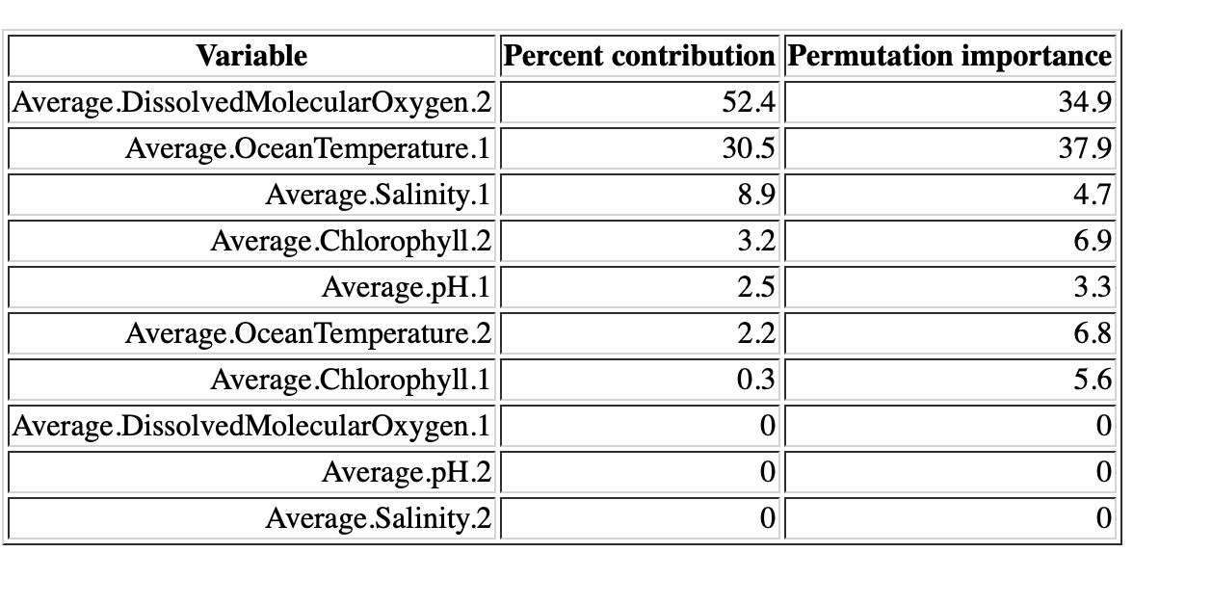
Empirical modelling – MaxEnt for species distributions
.2 = Range
.1 = Mean
For Caranx crysos:
Most important indicators:
Dissolved molecular oxygen range
Average ocean temperature

Slide 10
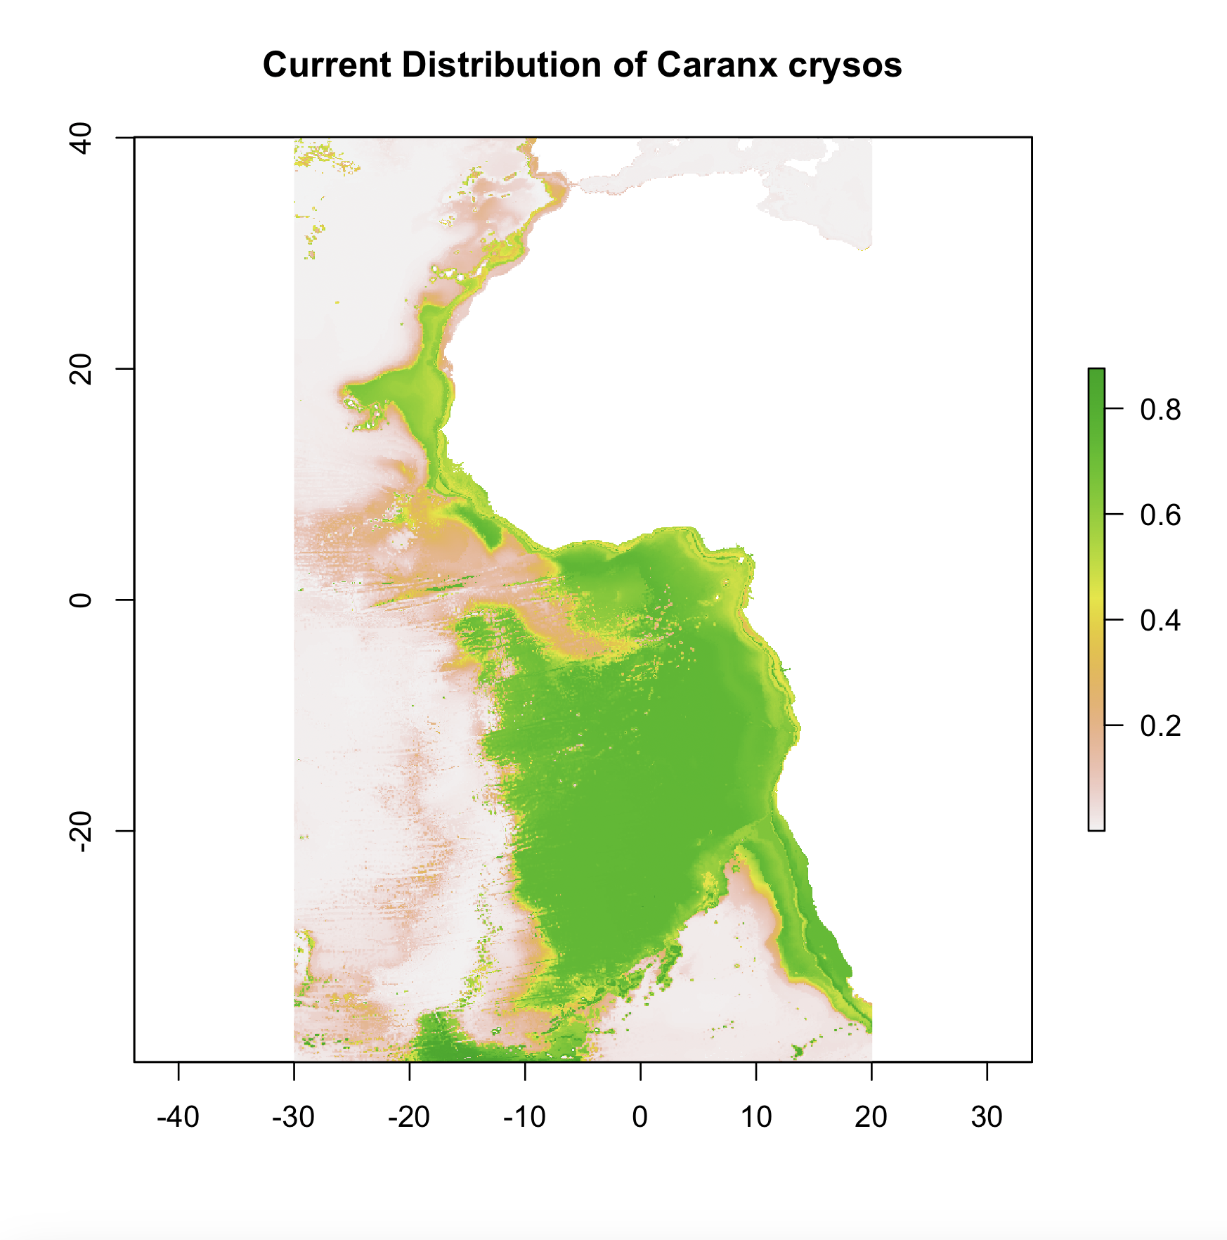
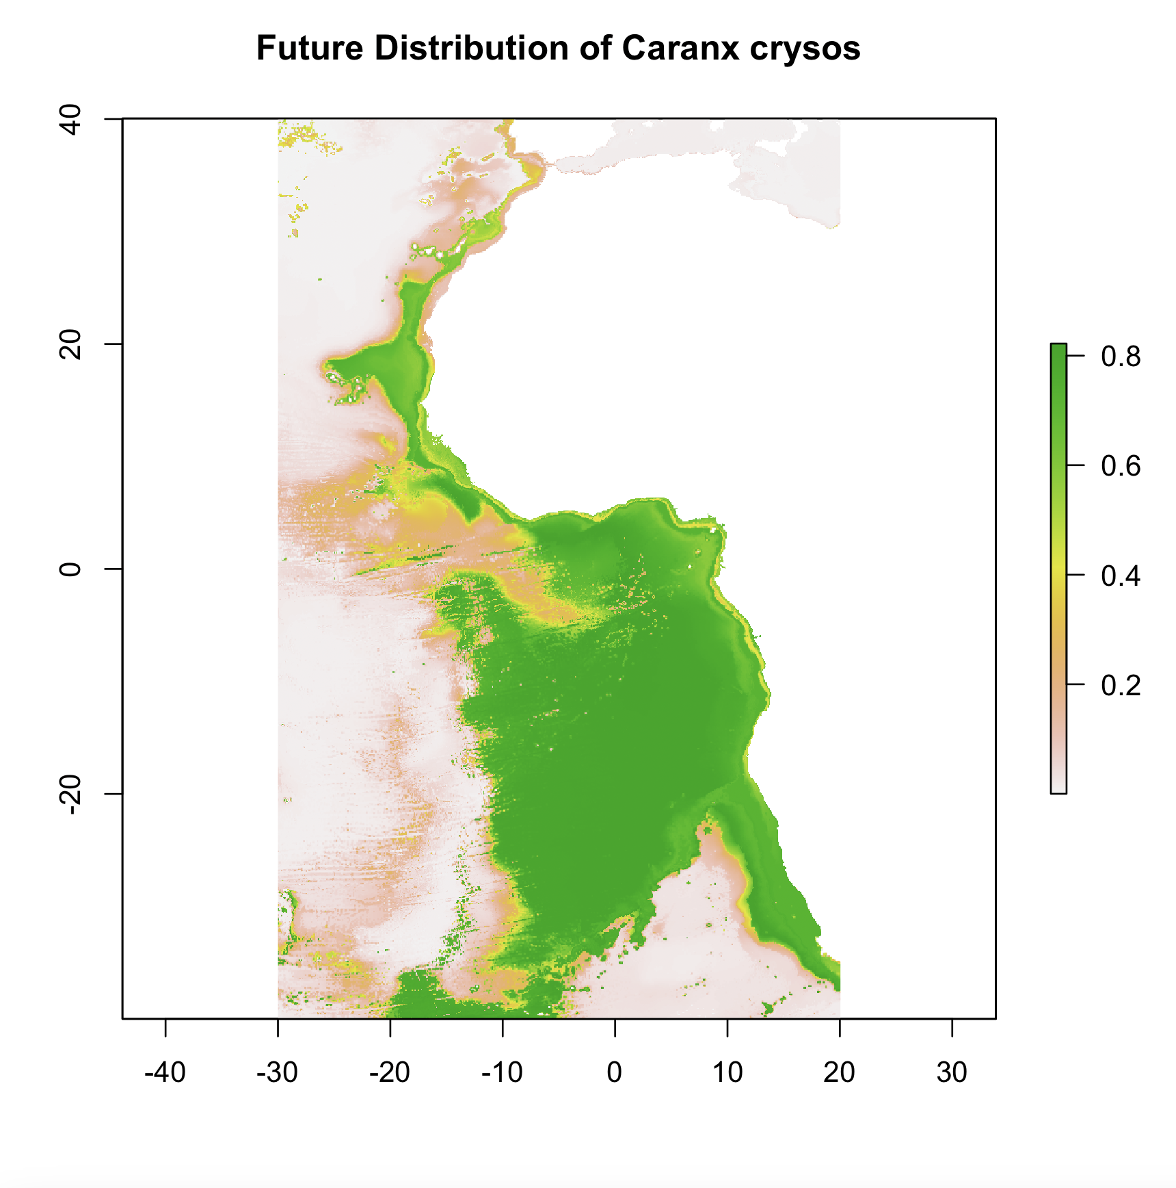
Empirical modelling – MaxEnt for species distributions
Probability of species occurrence

Slide 11
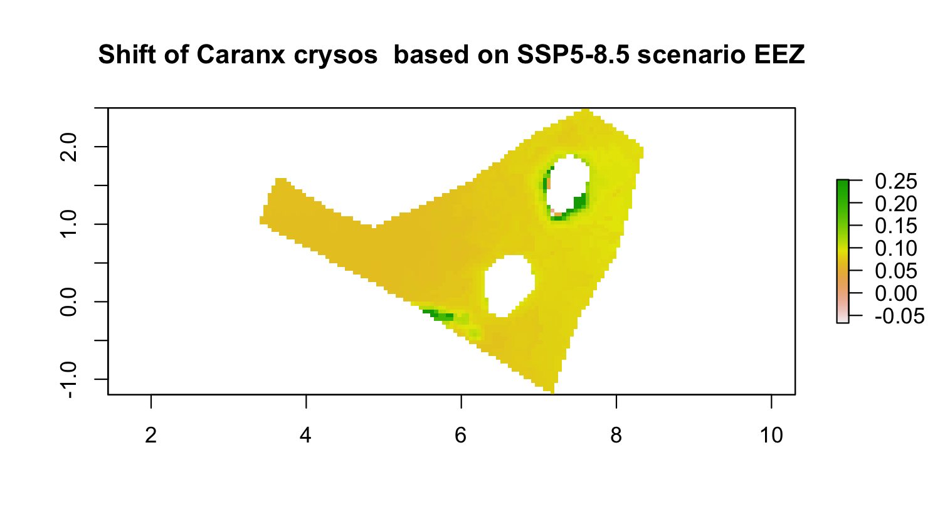
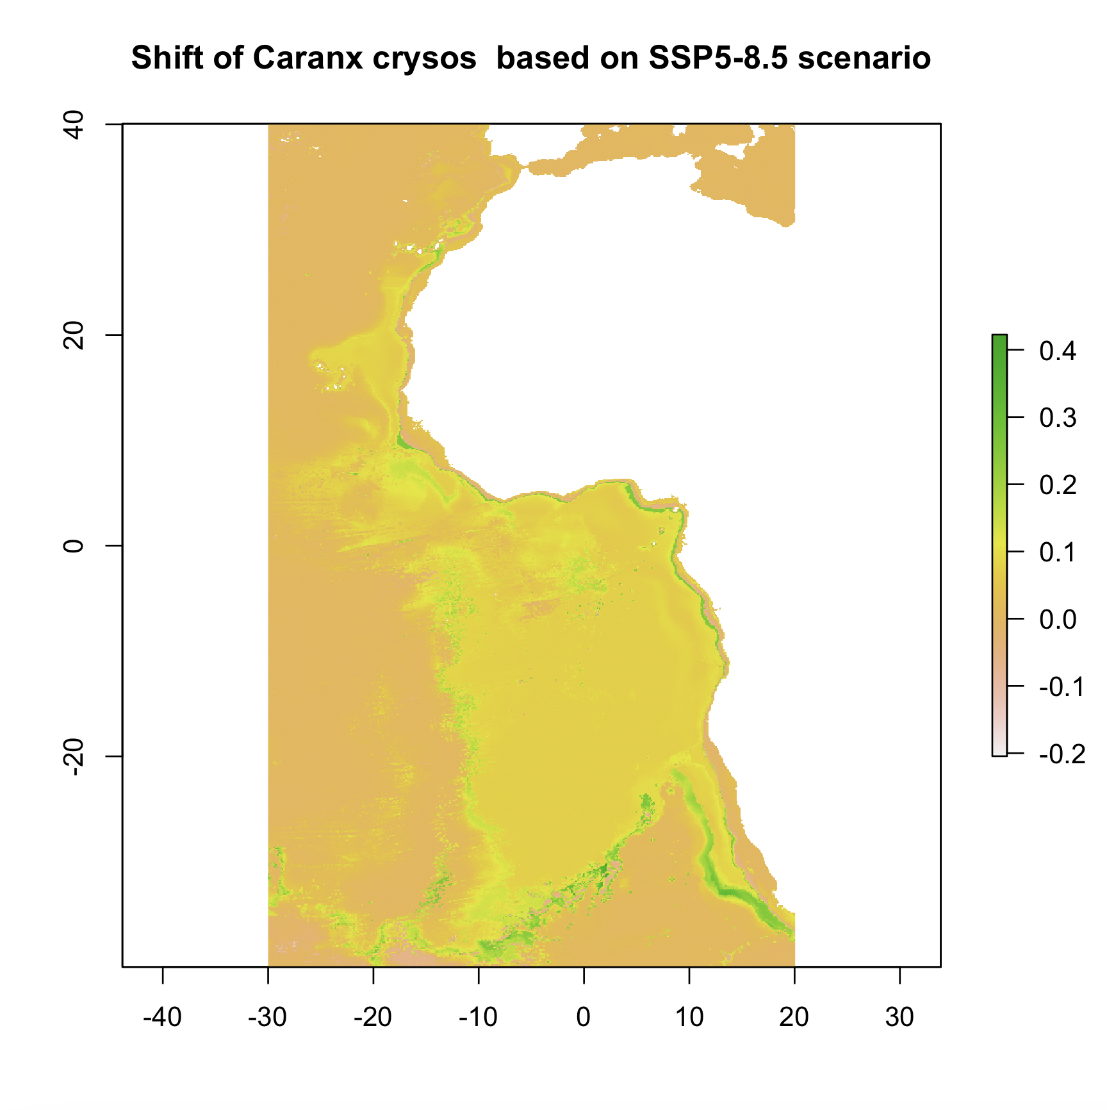
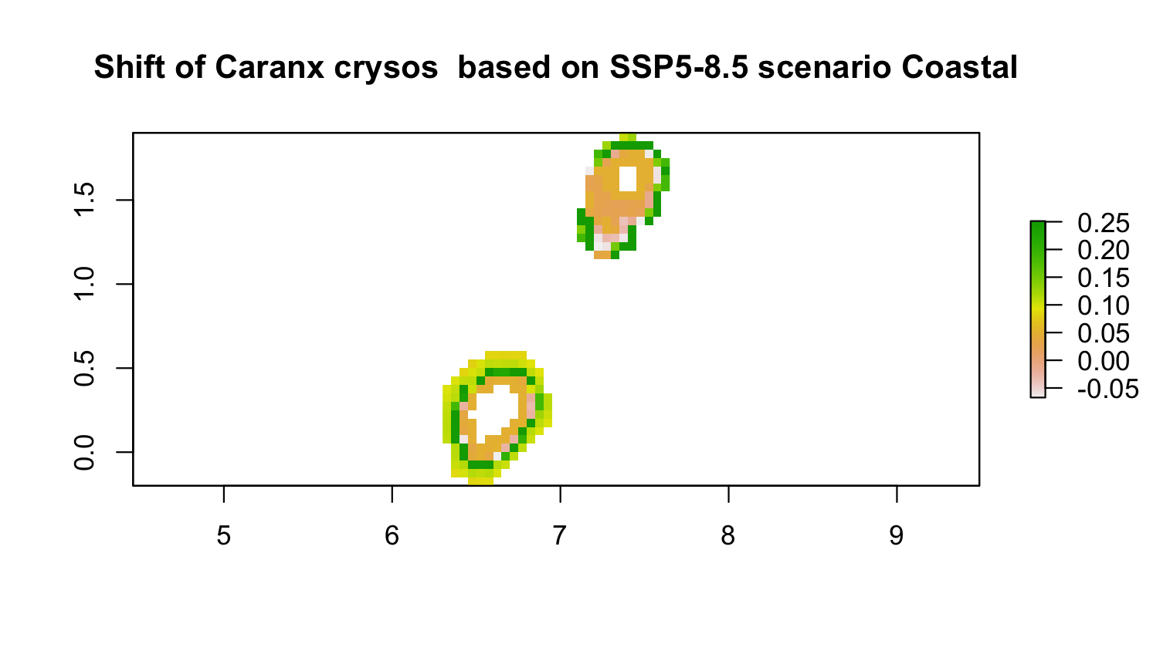
Empirical modelling – MaxEnt for species distributions
Shift in probability of species occurrence
Shift in probability of species occurrence

