Slide 1


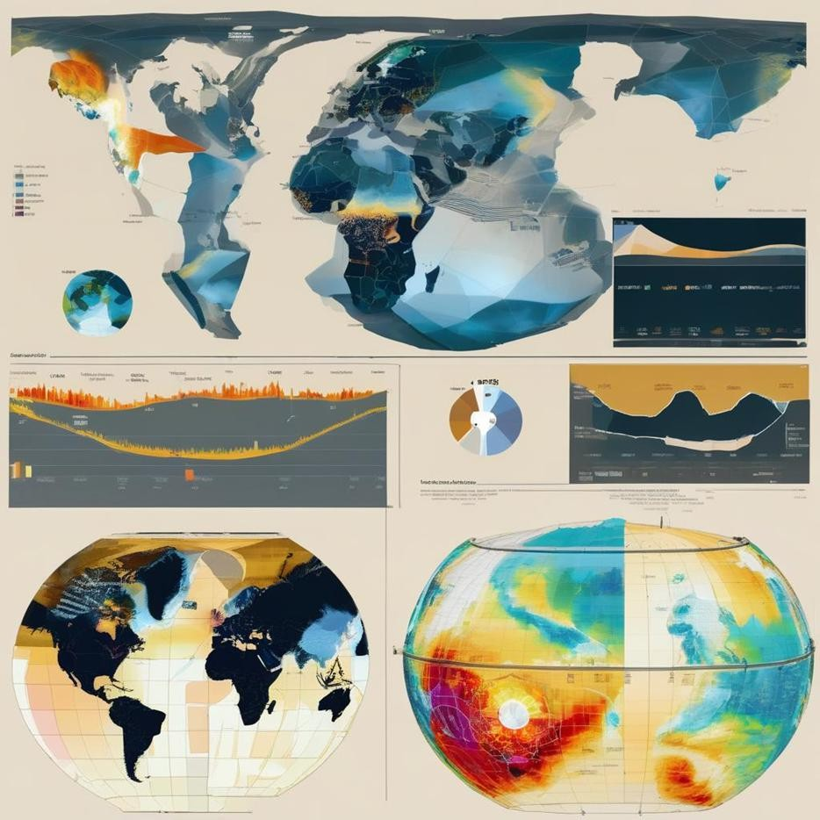


CAVA Analytics training for Mauritius Meteorological Service
22nd October 2026
Samuel Greenrod
Climate Risk Specialist – samuel.greenrod@fao.org
Andrea Setti
Climate Risk Specialist – andrea.setti@fao.org

Slide 2
Agenda
Accessing climate data
CAVA Analytics installation
Understanding climate data
CAVA Analytics tutorial
CAVA Analytics demonstration
Hands-on exercise

Slide 3
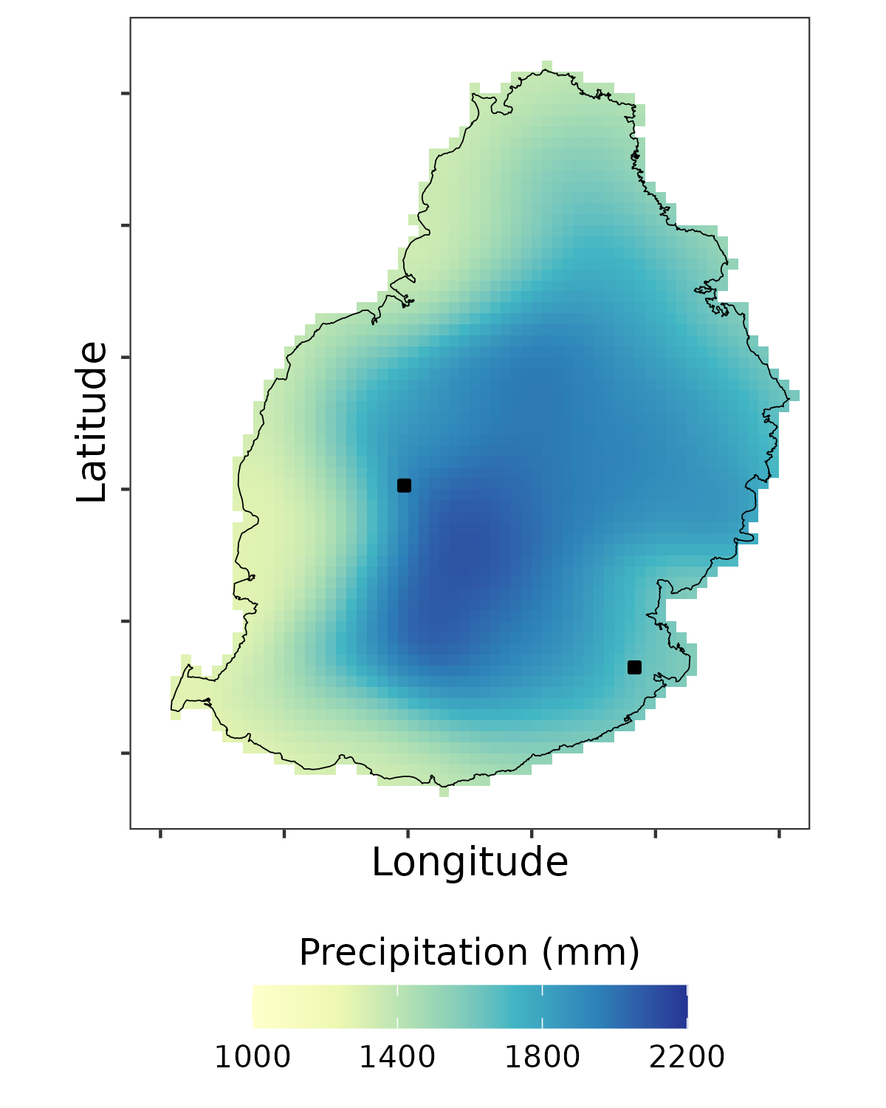
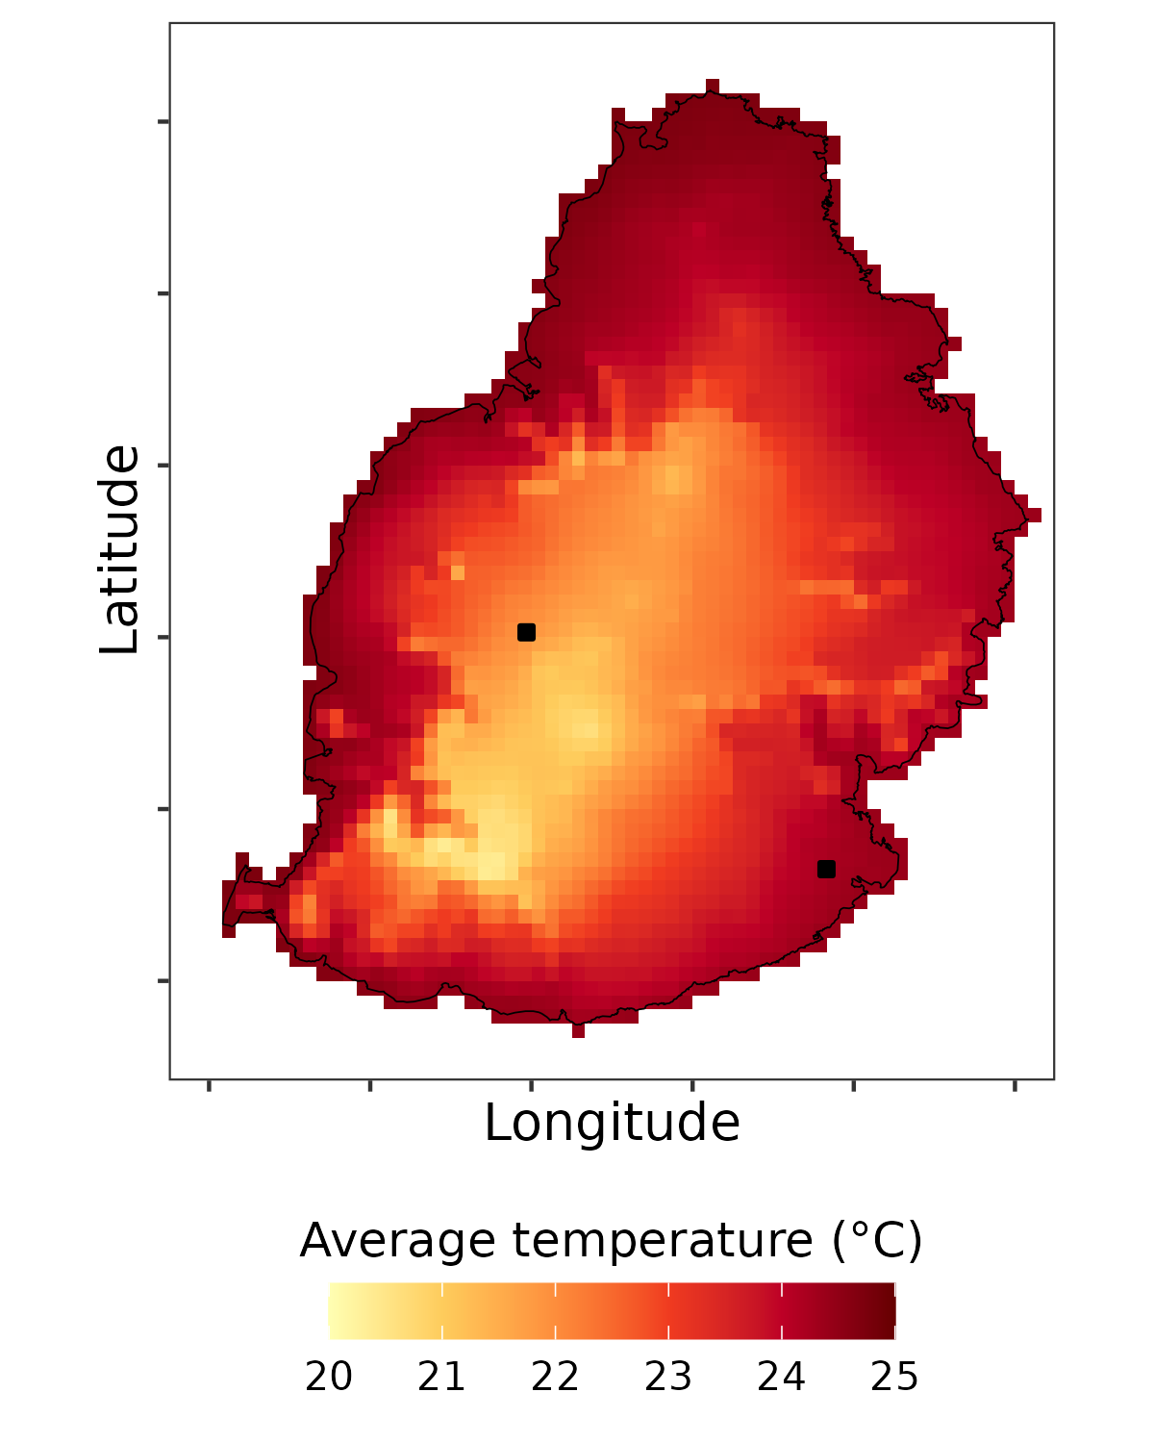
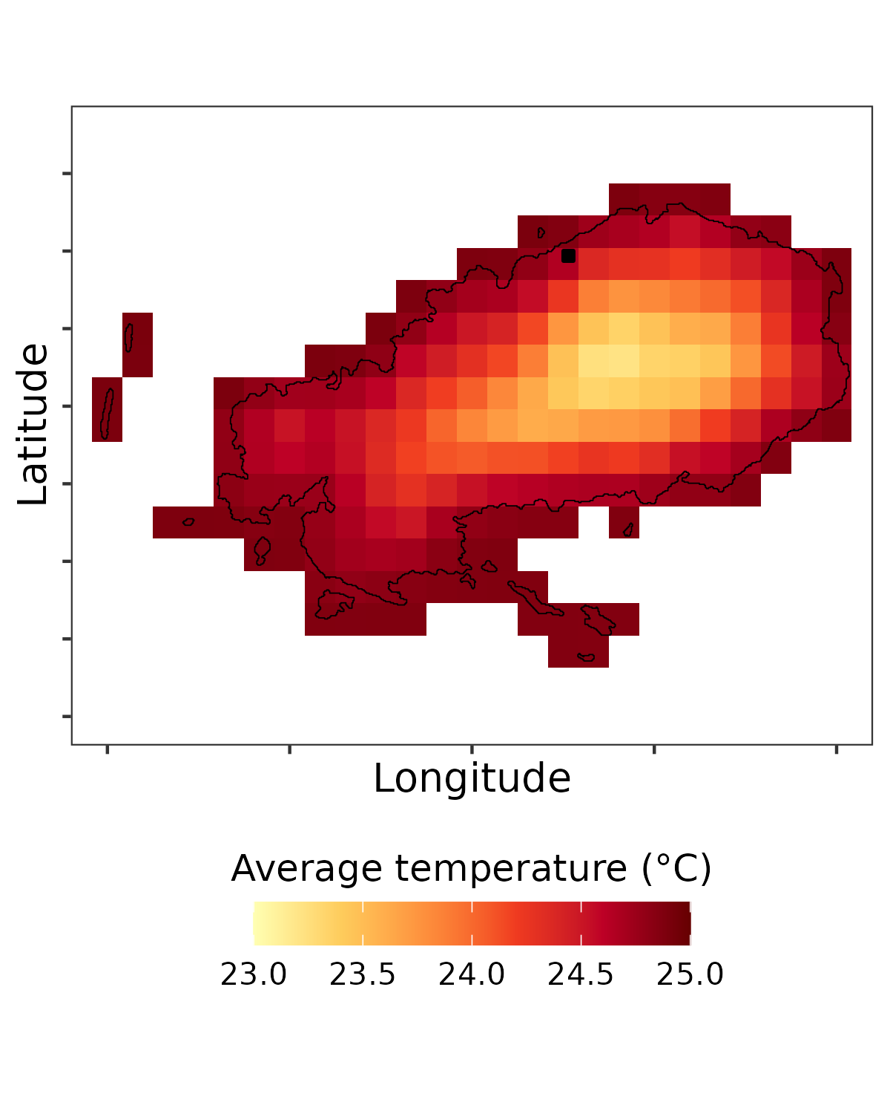
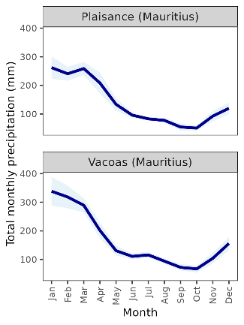
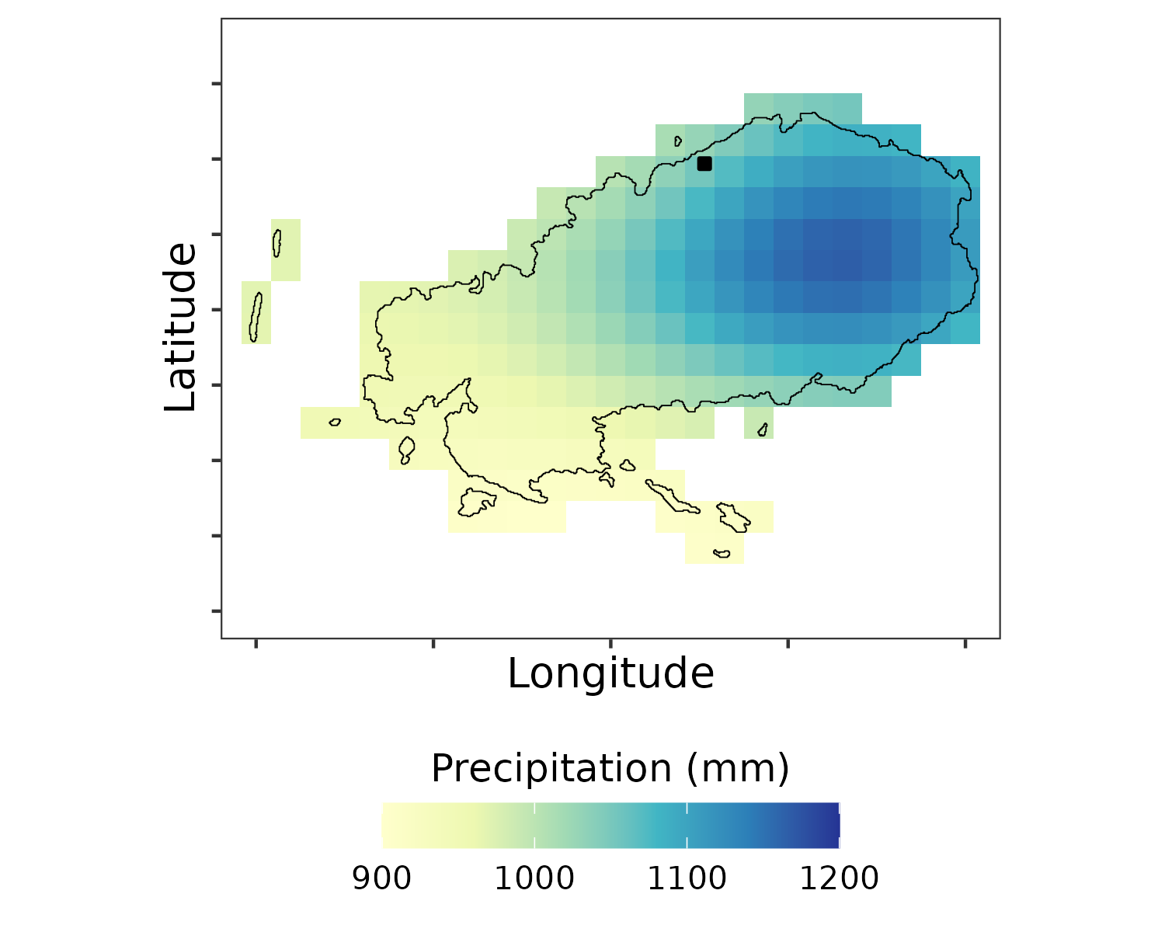
Use of MMS data in climate risk analysis
MMS station data was used in two ways:
Direct analysis of station data
Bias-correction of CHELSA v2.1 1km² daily historical dataset (1981-2020)
Benchmarking of bias-corrected dataset

Slide 4
SECTION 1:
Accessing climate data

Slide 5

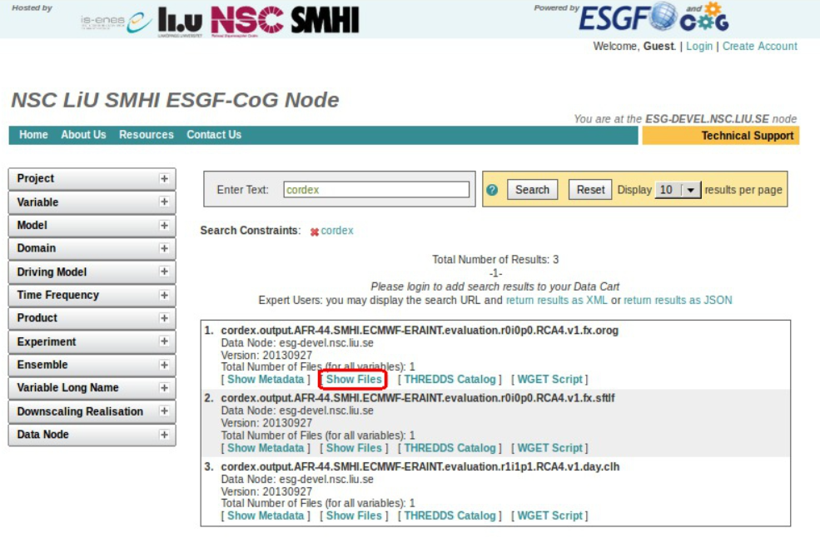
Where climate information is found today
01
WEB PORTALS
02
DISTRIBUTED ARCHIVES
Copernicus Climate Data Store
ESGF data nodes
Institutional repositories
Files organised by experiment
The data exist
Access patterns, accounts and request methods vary by source.

Slide 6
A climate-data request becomes a workflow
DISCOVER
REQUEST
HARMONIZE
Find the relevant catalogue or service
Configure access, register and API calls
Align units, calendars and spatial grids
01
02
03
04
05
SUBSET
SPECIFY
Choose dataset, model, scenario, variable and period
Limit the data to the project area and dates
RESULT
A defensible workflow, but one that users must assemble and repeat

Slide 7
What problem does CAVA solve?
THE BOTTLENECK
CAVA
WHAT CHANGES
Accessing and interpreting climate information is challenging:
Choice of climate information
Access
Processing
Interpretation
Climate data become easier to use without hiding the scientific choices
A shared access and processing layer
ACCESS
Retrieve only the place, period and variables needed
READY
Analysis-ready historical and future data
HARMONIZE
Apply consistent handling of formats and conventions
CONSISTENT
Comparable indicators, maps and outputs
REUSE
Expose the same workflow through web tools, code and APIs
CAVA democratises access and interpretation of climate information while retaining scientific approach

Slide 8
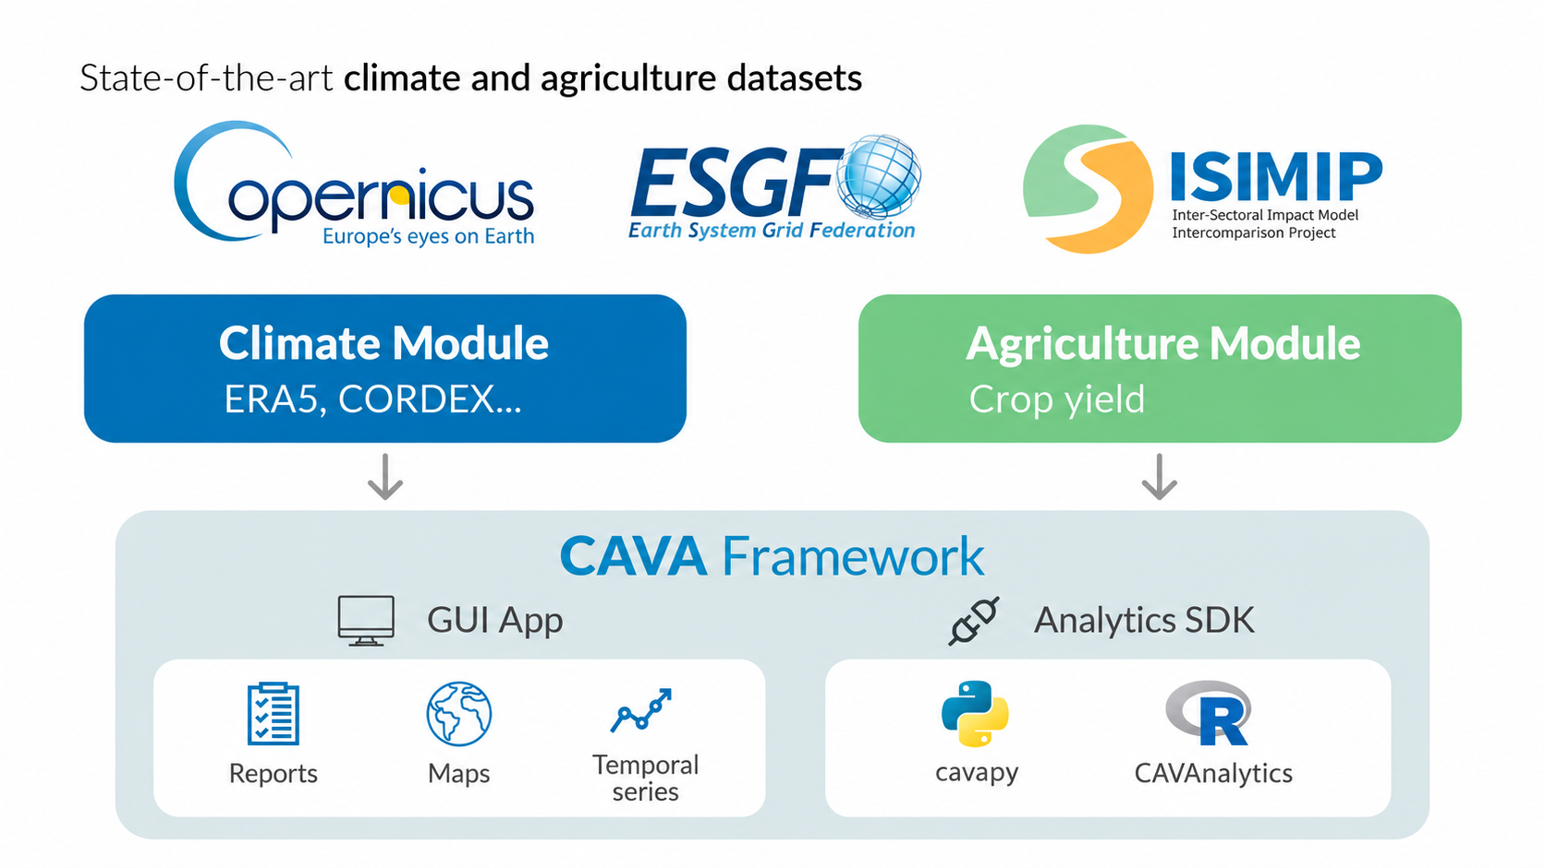
One CAVA framework, several entry points
CAVA Analytics
R package intended for intermediate technical users
Allows flexible climate data loading, processing, and visualisation

Slide 9
One CAVA framework, several entry points
01
SOURCE DATA
ERA5 and CORDEX-CORE climate datasets (NetCDF, ~20 TB)
02
REMOTE SERVICES AND COMPUTE
THREDDS and OPeNDAP deliver only the requested subset
03
HARMONIZATION
Spatial selection, calendars, units and analysis-ready structures
04
ANALYTICAL OUTPUTS
Indicators, maps, time series and data for downstream workflows

Slide 10
SECTION 2:
CAVA Analytics Installation

Slide 11
Installation pre-requisites
Mac/Linux
Windows
Miniforge (Python and Conda)
Visual Studio Code
R and Rstudio
Rtools
Java JDK
Installation scripts: https://github.com/Risk-Team/trainings/tree/main/CAVAtraining/ROM
Pre-downloaded data: https://we.tl/t-SguJFbJOtDFwfi6G (no longer valid)

Slide 12
Installation pre-requisites
Note for Windows users
Download the latest version of each package in the following order:
R (https://cran.r-project.org/bin/windows/base/)
RStudio (https://posit.co/downloads)
Rtools (https://cran.r-project.org/bin/windows/Rtools/)
Java JDK (https://www.oracle.com/java/technologies/downloads/#jdk27-windows)
You need to open all downloads and click through installation instructions
When installing CAVA Analytics you may receive error about download being blocked by Smart App Control. You must deactivate live Windows Security activity to proceed.

Slide 13
SECTION 3:
Understanding climate data

Slide 14
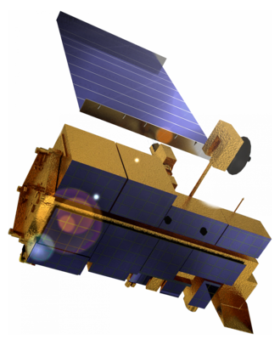
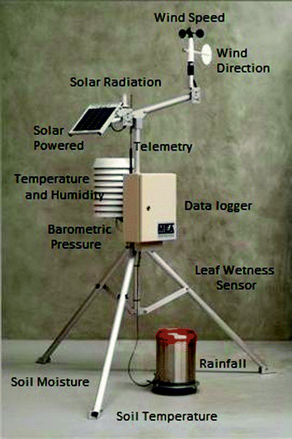
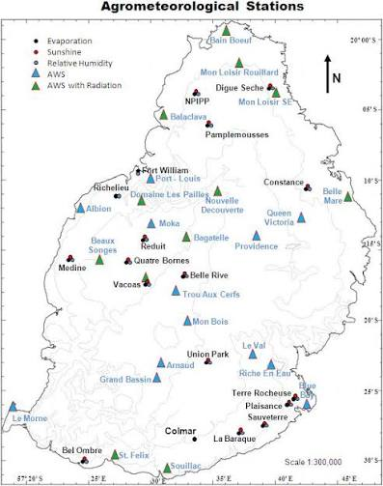
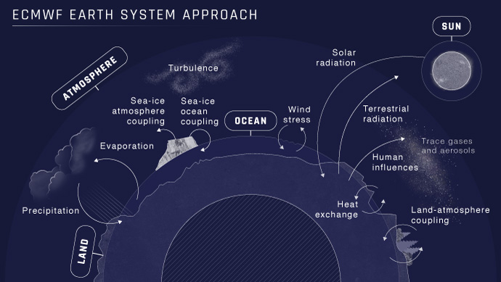
Measuring historical climate - observations
MODIS Terra
Temperature
Water vapour
Aerosols
Surface albedo
Weather stations
Weather forecast models
Ahmad et al., 2017 Experimental Agrometeorology: A Practical Manual

Slide 15
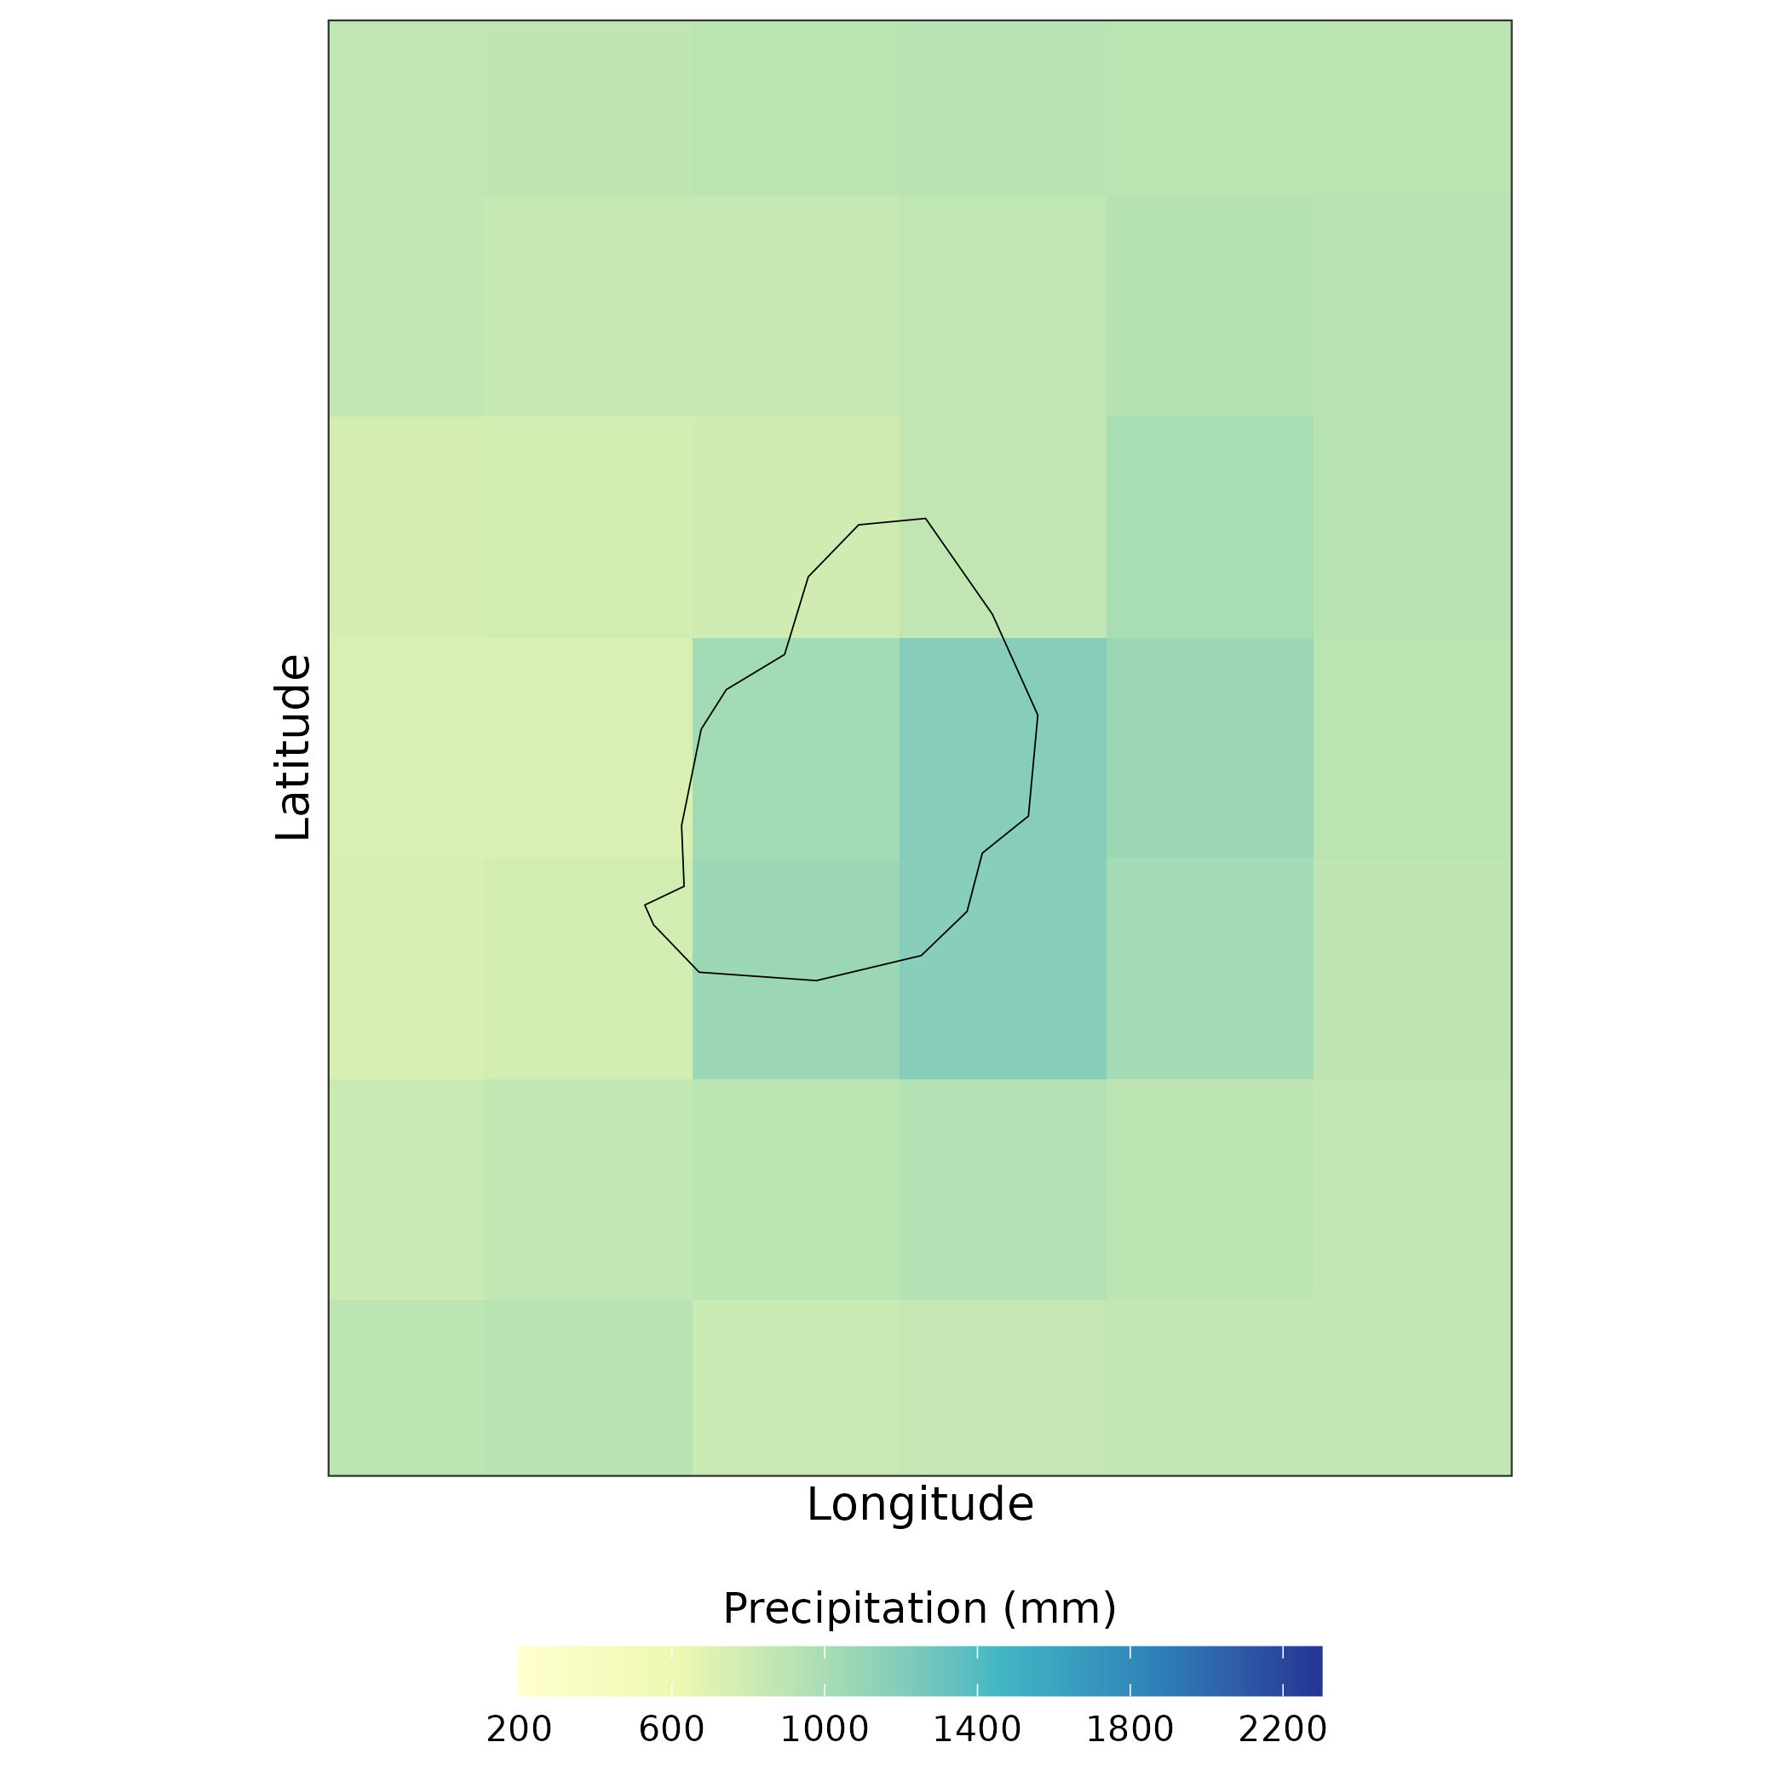
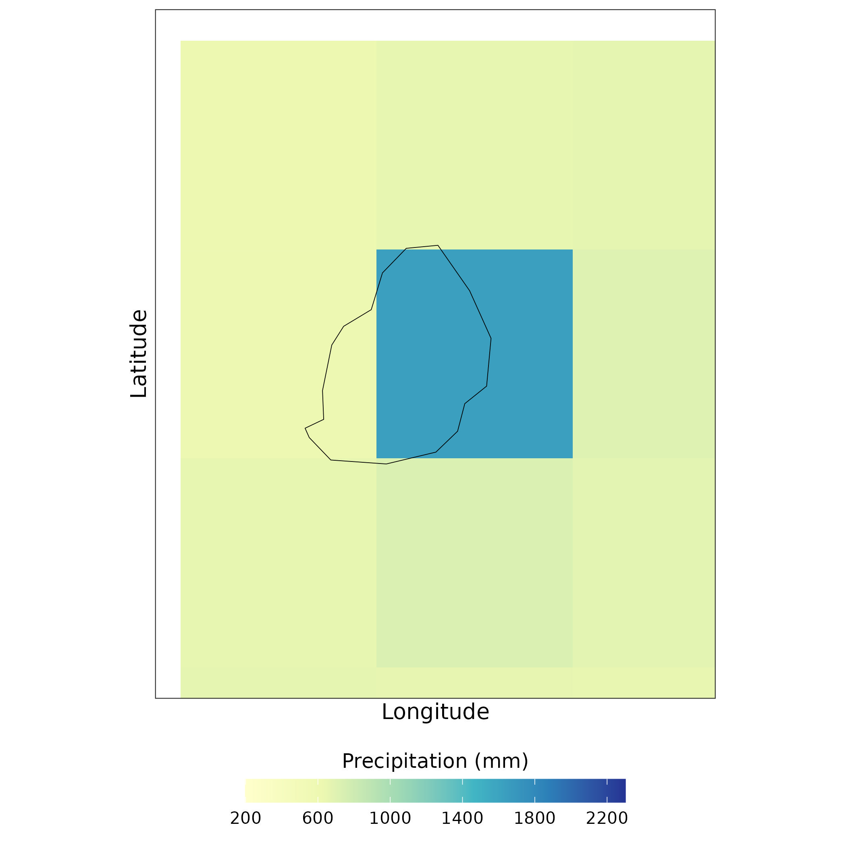
Measuring historical climate – gridded datasets
ERA5 - ECMWF Reanalysis v5
1940-present
~31km spatial resolution
Hourly temporal resolution
Weather forecasting model – 12h intervals
Observational data (satellite, station etc.) – correction
Outputs:
  Temperature (tas, tasmin, tasmax)
  Precipitation
  Other (wind speed, humidity, solar radiation etc.)
ERA5
W5E5
W5E5 (bias-corrected ERA5)
Uses more recent, better observational data for model correction
Has low spatial resolution (~60km)
Shorter time period (1979-2019)

Slide 16
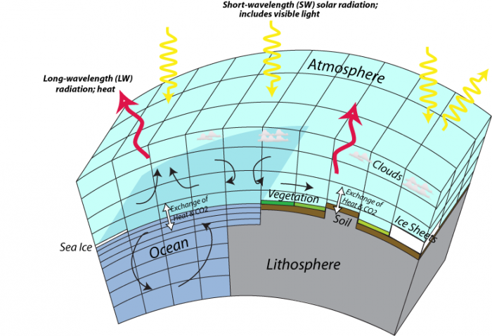
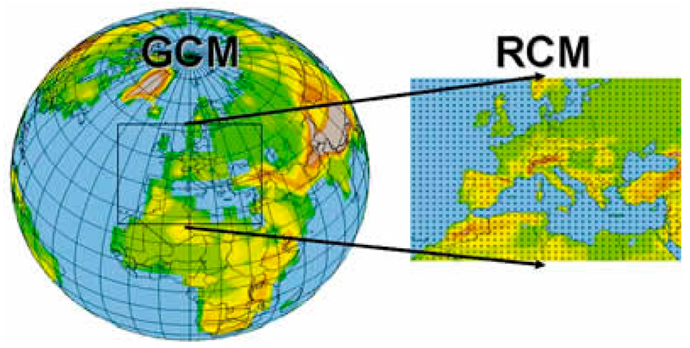
Measuring future climate – GCMs vs RCMs
Aspect | Global Climate Models (GCMs) | Regional Climate Models (RCMs)
Scale | Global (entire earth) | Regional (specific regions)
Grid size | ±100 to 500km or more | ±1 to 50 km
Implications | Captures global climate trends, but not the local details | Provides detailed simulations of local climatic processes
Use | Long-term climate projections and global climate studies | Regional climate and impact-based studies

Slide 17
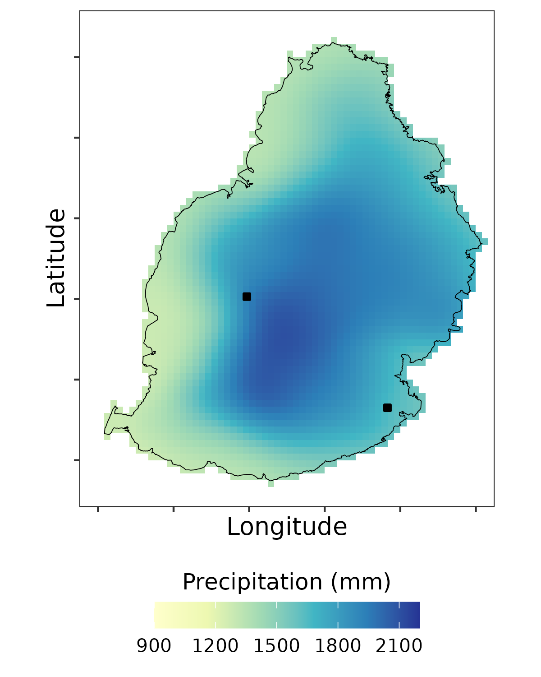
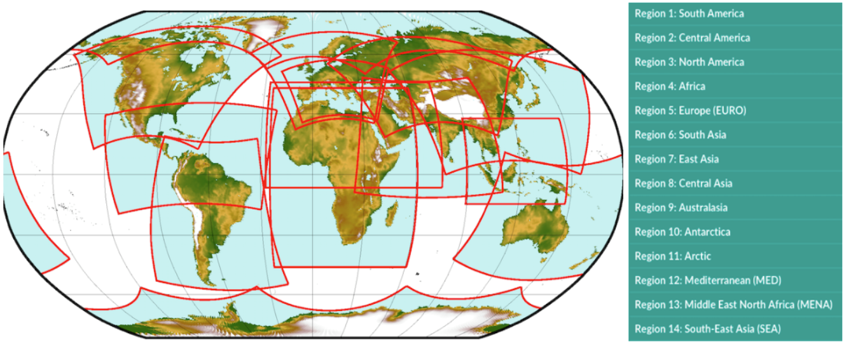
Future climate modelling – downscaling
Dynamical downscaling
High resolution RCMs run with GCM boundary conditions
Climatic conditions determined through atmospheric modelling
Computationally expensive
Statistical downscaling
Determines statistical relationship between GCM/RCM conditions and local climate
Climatic conditions determined by applying statistical relationship
Relatively low computational cost
CORDEX-CORE RCM domains

Slide 18
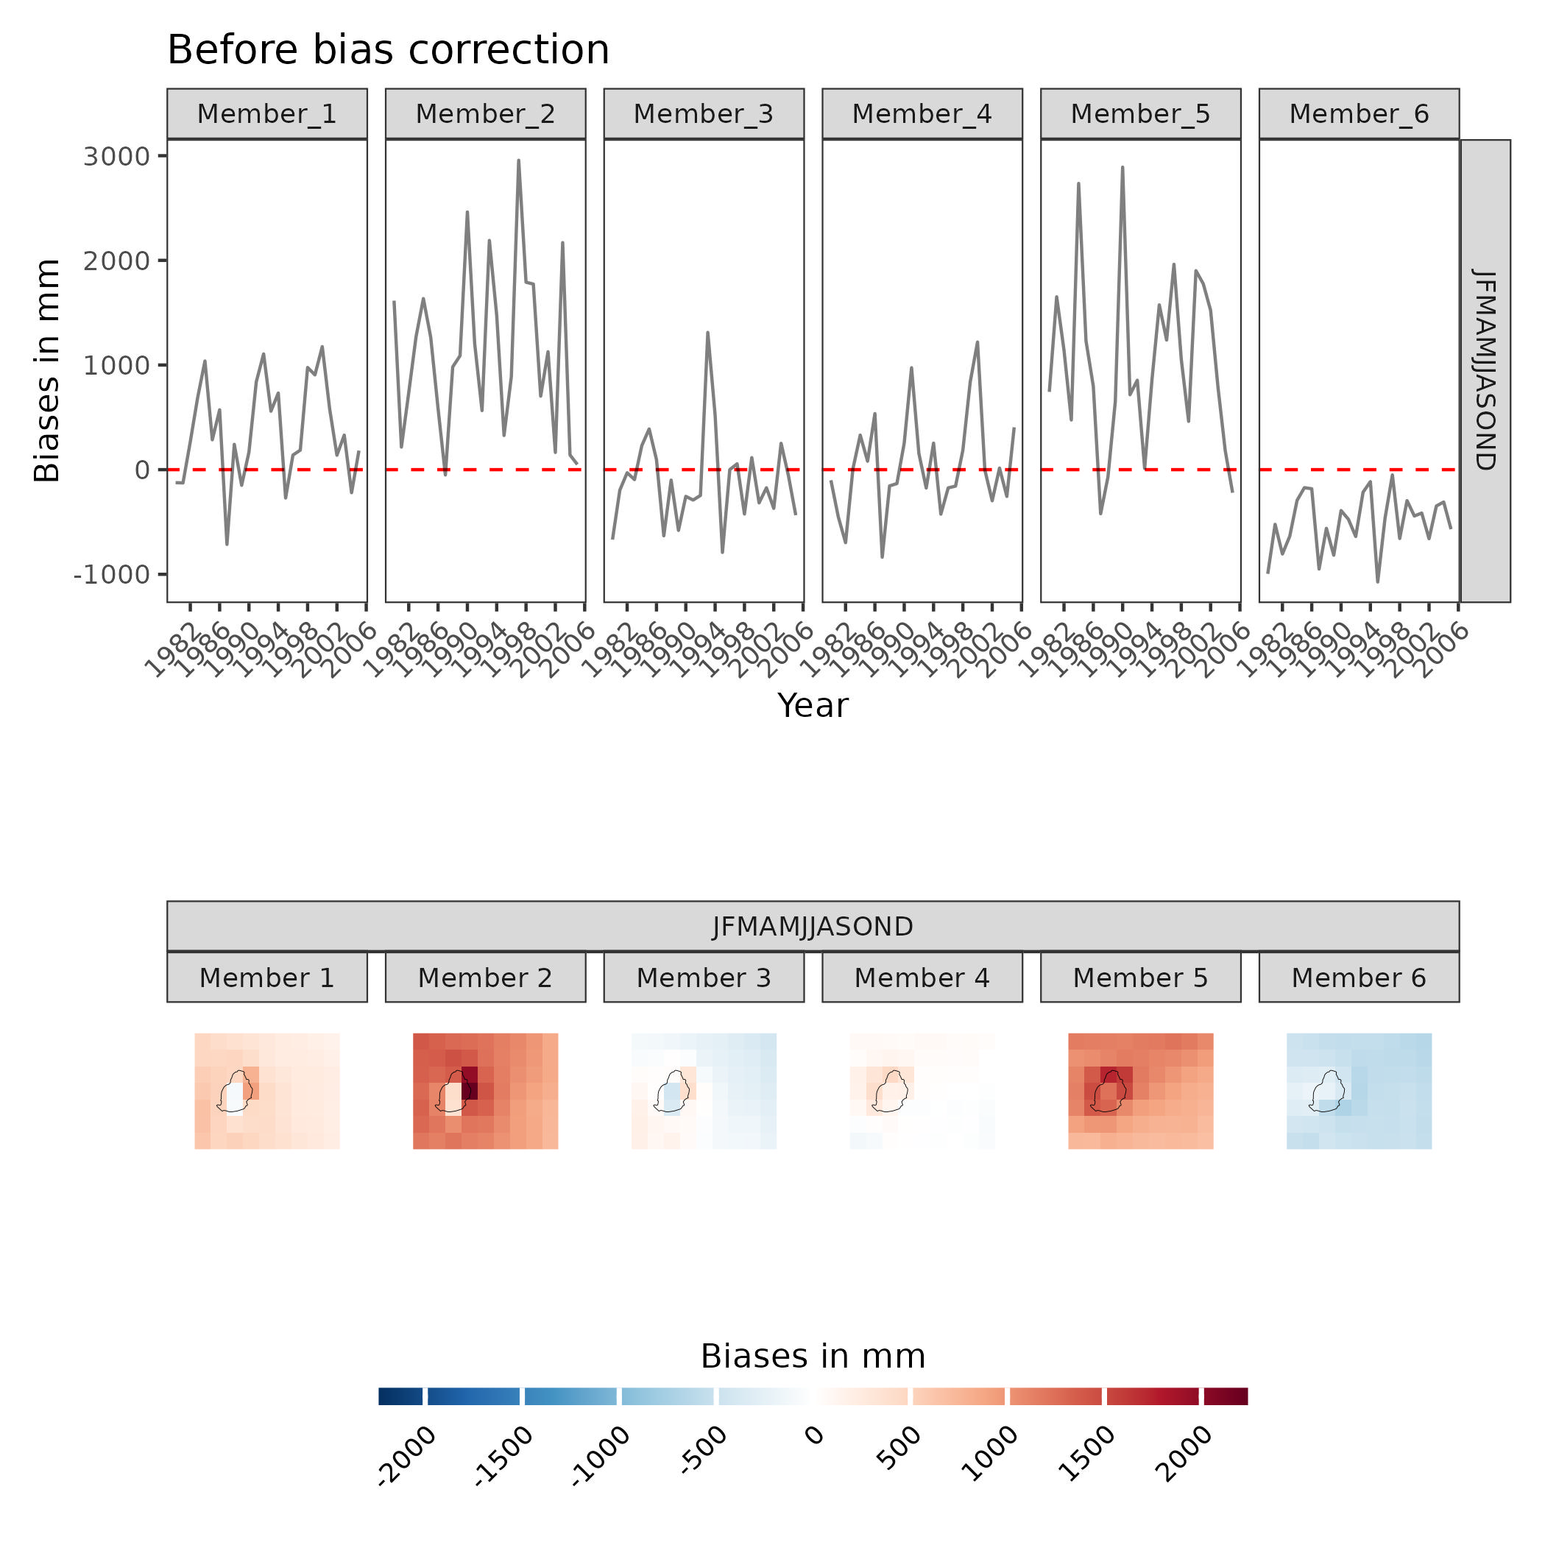
Future climate modelling – bias correction
CORDEX-CORE models
Climate model accuracy: historical simulation vs historical observations
Often historical simulations systematically over or underestimate temperature and precipitation
Simulation biases feed into future projections too!
The solution: bias correction

Slide 19
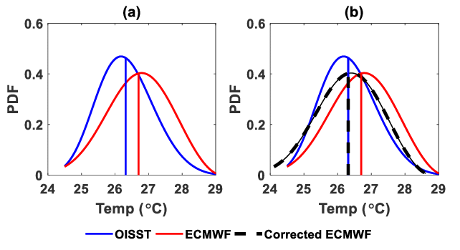
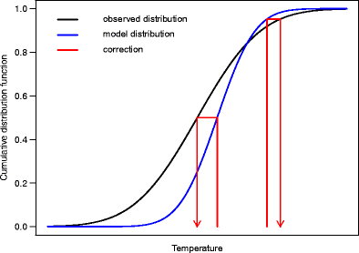
Future climate modelling – bias correction
Scaling (simple)
Calculate the difference or ratio between model and observed:
Model = 32°C, Obs = 30°C
32°C – 30°C = 2°C
Calculate for all pixels, average, then subtract from all future projection values
Corrects the mean but not variance
Empirical quantile mapping (advanced)
Create a cumulative distribution function of historical simulation & observed
Calculate the difference between simulation + observed at each quantile
Apply the difference to the historical and future simulations at the same quantile.
Obs90th = 30°C
Hist90th = 28°C
Difference = +2°C
Fut90th = 33°C
Corrected Hist90th = 30°C
Corrected Fut90th = 35°C
Maraun, 2016
Nurdiati et al., 2021
Notes:
Problem with EQM – it doesn’t preserve climate change signal
As the historical bias correction is applied to the future distribution, if the future distribution has a different shape and different bias then the bias correction will eat into the climate change signal.

Slide 20
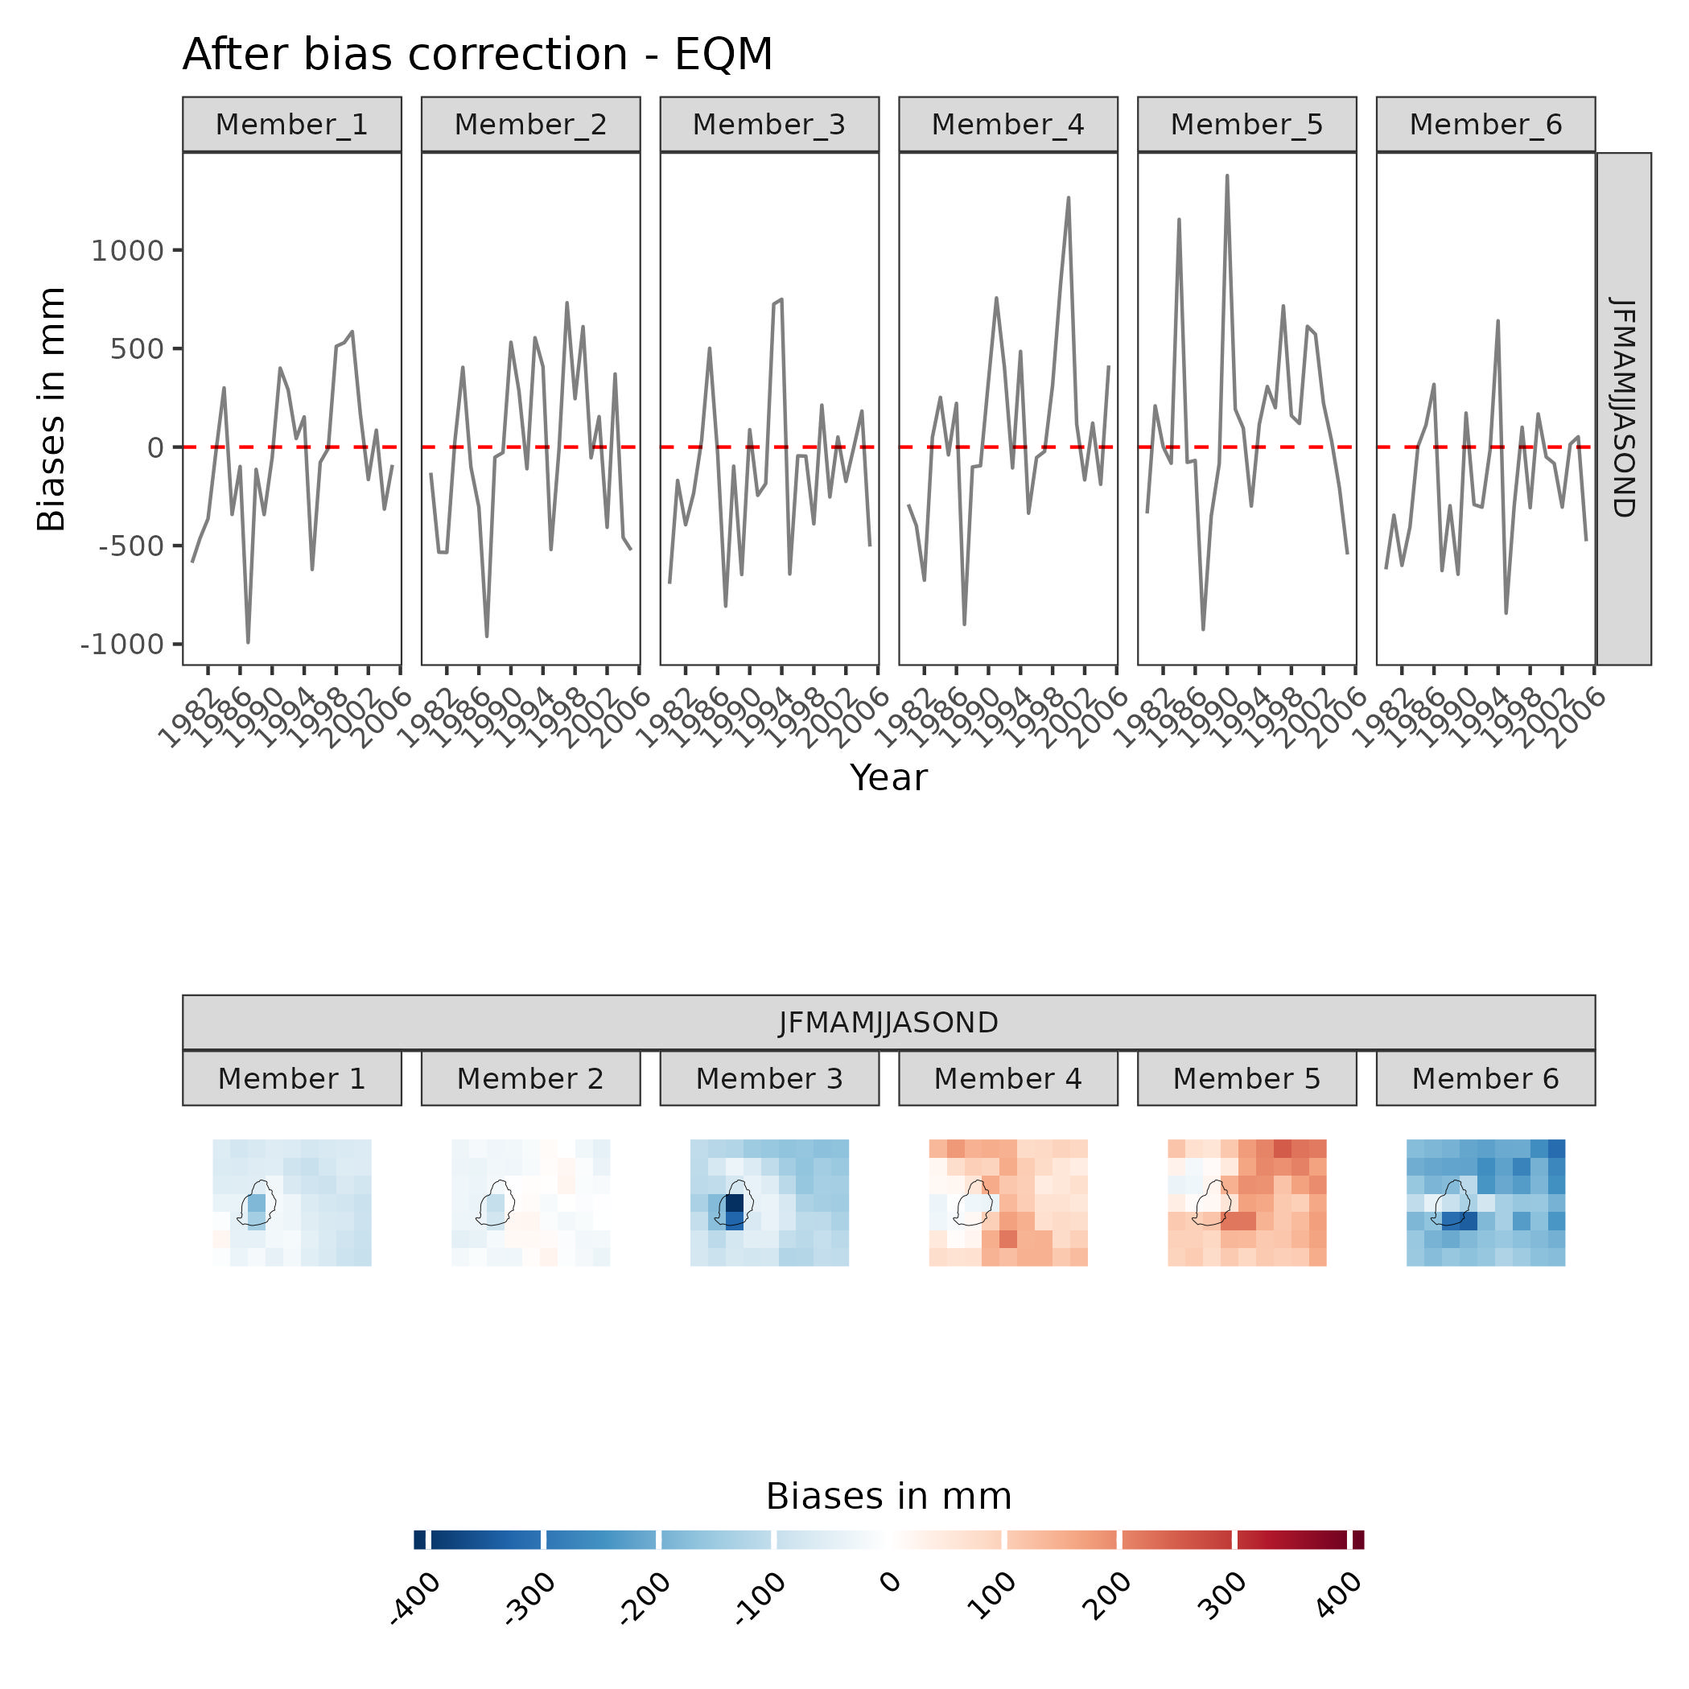
Future climate modelling – bias correction
CORDEX-CORE models
Notes:
Lunch break after here

Slide 21
Measuring future climate – GCMs vs RCMs
Aspect | Global Climate Models (GCMs) | Regional Climate Models (RCMs)
Scale | Global (entire earth) | Regional (specific regions)
Grid size | ±100 to 500km or more | ±1 to 50 km
Implications | Captures global climate trends, but not the local details | Provides detailed simulations of local climatic processes
Use | Long-term climate projections and global climate studies | Regional climate and impact-based studies

Slide 22
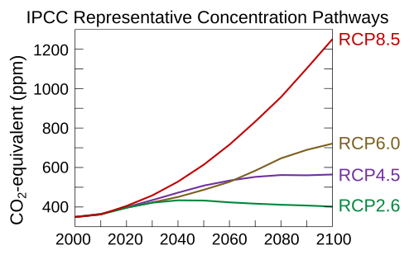
Future climate modelling – climate forcings
Climate models run in an equilibrium state
Climate forcings push the models out of equilibrium:
  Changes in solar radiation
  Changes in greenhouse gas concentrations
  Volcanic eruptions
Applying different climate forcings allows you to simulate different future climate scenarios
Climate change projections are determined by extracting variable outputs from the climate simulations
Note: Climate feedbacks
Climate changes are affected by feedbacks as well as forcings
E.g ice and snow melt can reduce albedo effect – accelerated surface warming

Slide 23
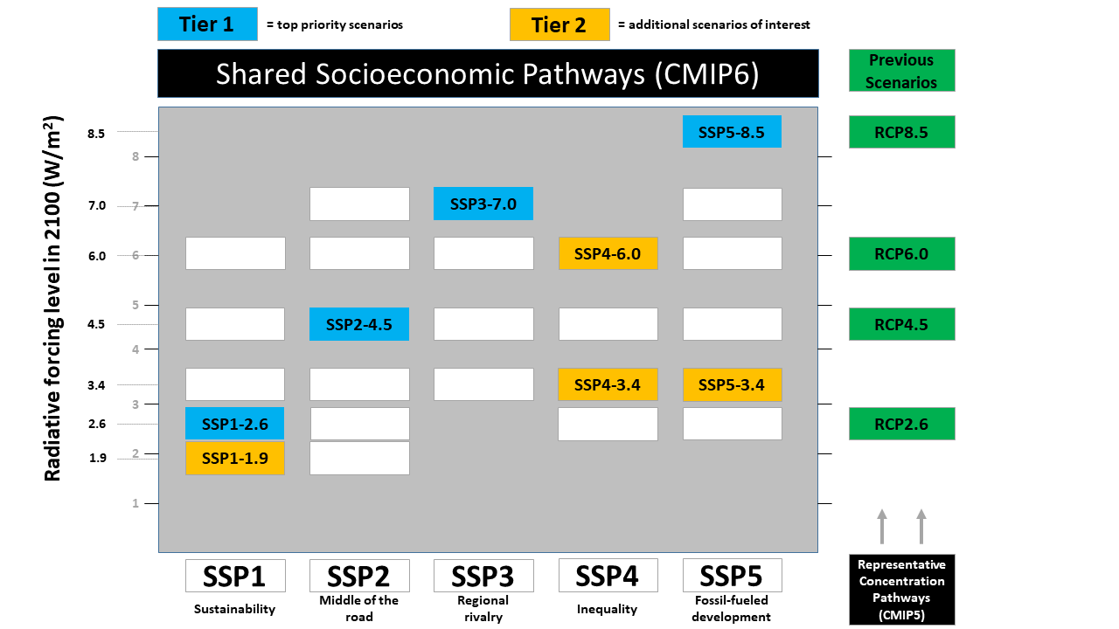
Future climate modelling – climate forcings
CMIP5 (Coupled Model Intercomparison Project)
(2008, outputs released by 2013)
Representative Concentration Pathways (RCPs)
RCP 2.6 <- watts/m² added by 2100 relative to pre-industrial baseline (~1750)
RCP 4.5
RCP 6.0
RCP 8.5
CMIP6
(2016, outputs released by 2022)
Shared Socioeconomic Pathways (SSPs)
SSP1 2.6
SSP2 4.5
SSP3 7.0
SSP5 8.6

Slide 24
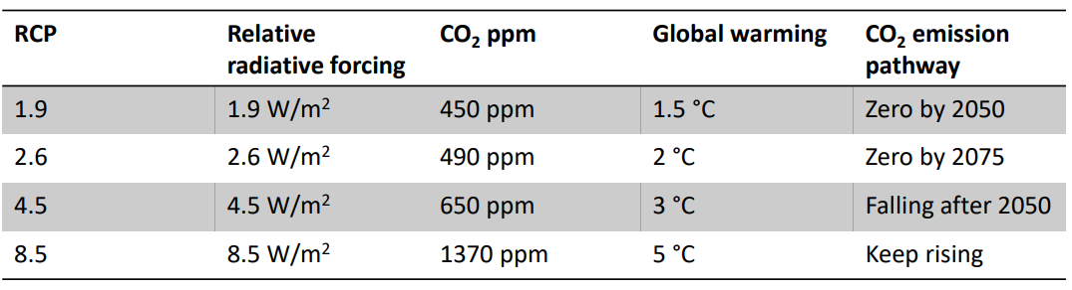
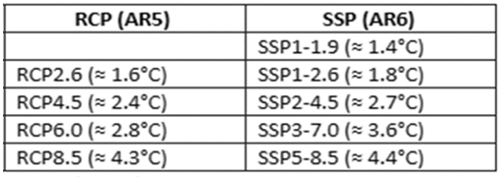
Scientific approach: global warming potential
Models consider different radiative forces (due to changes in CO2, methane and aerosols) ranging from 1.9 to 8.5 W/m².
Paris Agreement. You can check the CO₂ concentration in the atmosphere here: link
Global warming levels (at the end of the century relative to 1800-1850) for different RCPs/SSPs
CAVA
The projected changes under RCP 4.5, an intermediate scenario stabilizing the global temperature increase between 2 to 3 °C, are considered to fall within the range provided by future simulations using RCPs 2.6 and 8.5.
CAVA

Slide 25
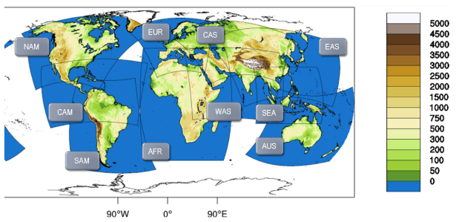
CORDEX-CORE
CORDEX-CORE DOMAINS
Coordinated Regional Climate Downscaling Experiment - Coordinated Output for Regional Evaluations
  Two regional climate models (RCMs) – REMO & RegC4
  Three general circulation models (GCMs)
    HadGEM2-ES (high equilibrium climate sensitivity)
    MPI-ESM-MR (medium)
    NorESM1-M (low)
Gridded regional climate projections for most inhabited land areas at a resolution of ±25 km for the period 1970-2100.
Bias-corrected using historical data (ERA5) for period 1976-2005.
Two future climate scenarios: RCPs 2.6 (low) and 8.5 (high emissions).
Observed
ERA5
(1976-2005)
Bias-correction
Simulated
CORDEX CORE
(1976-2005)
Simulated
CORDEX CORE
(2010-2100)

Slide 26
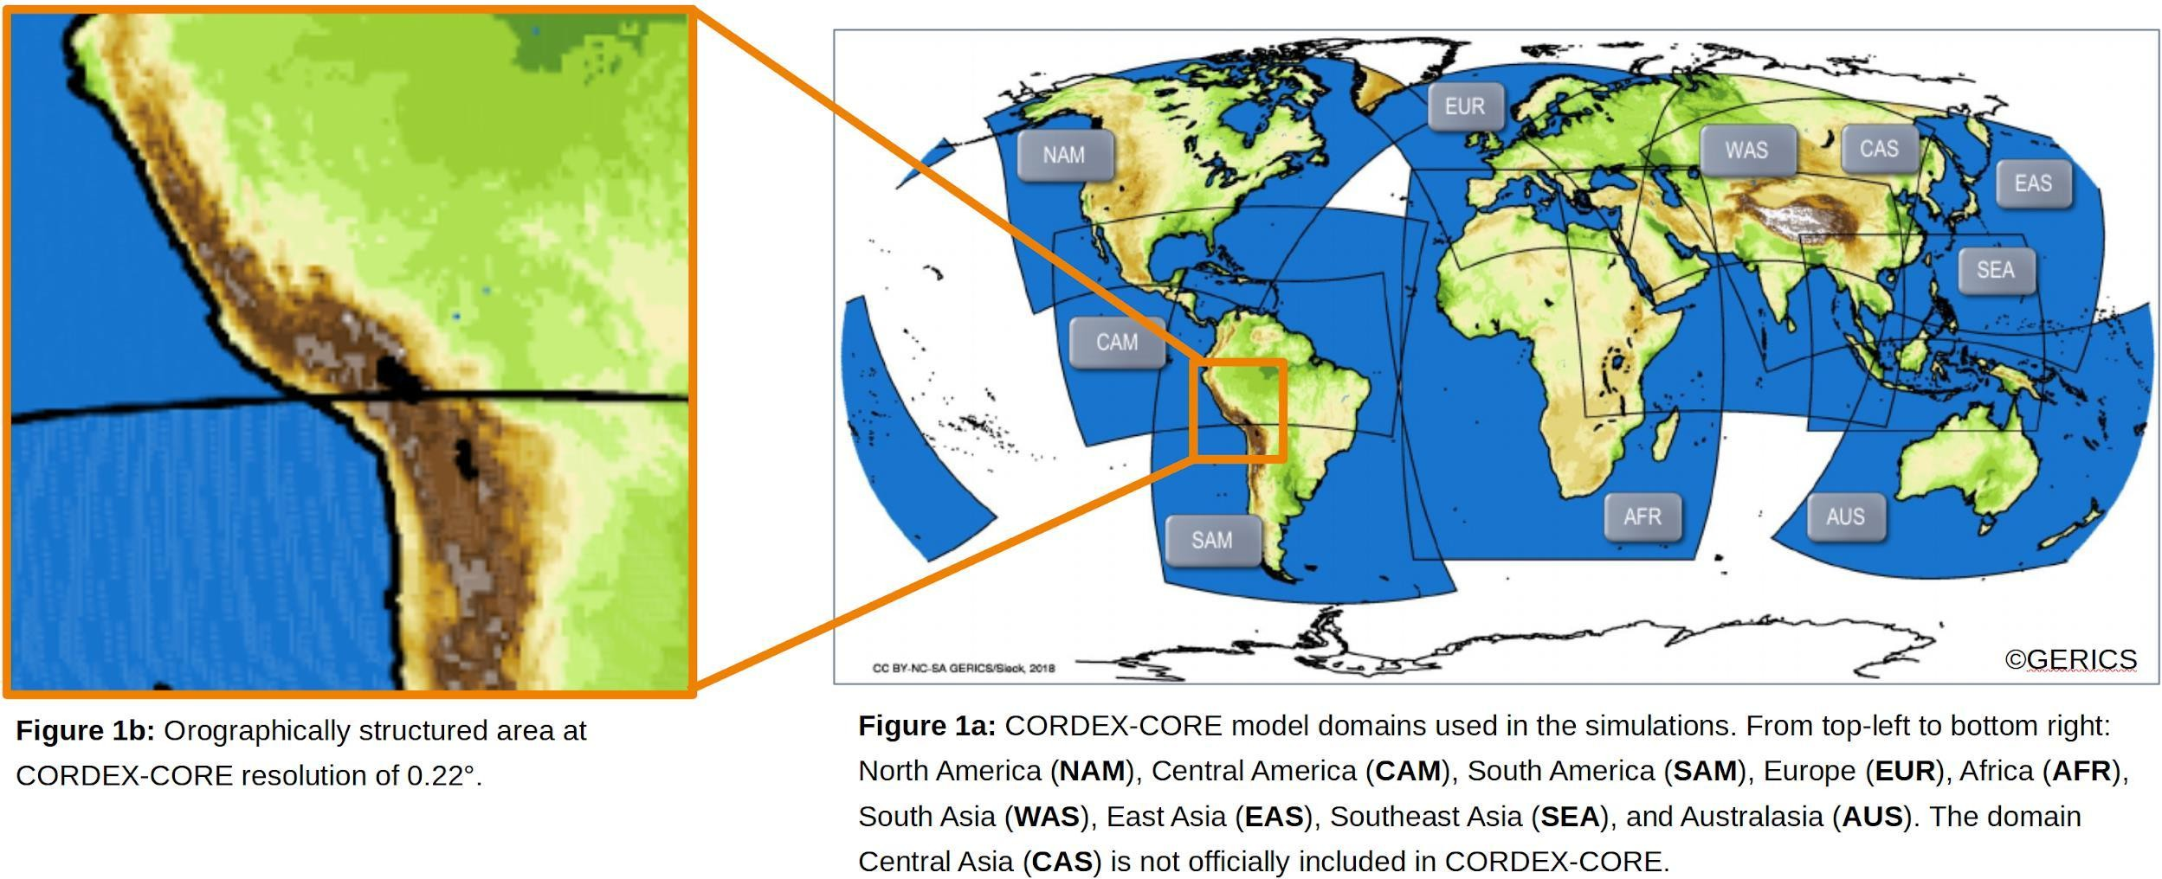
CORDEX-CORE

Slide 27
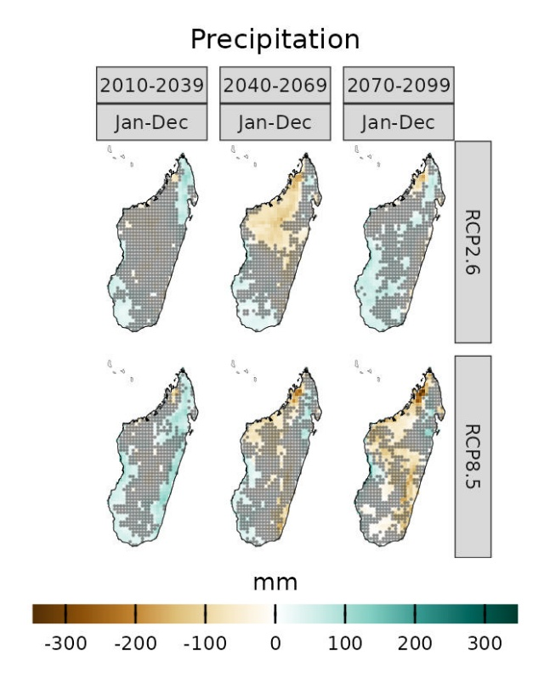

Interpreting a climate signal
Spread
How wide is the range across models and scenarios?
Magnitude
How large is the change relative to the baseline?
Pattern
Where and when does the change occur?
Relevance
Does the indicator reflect the decision and exposed system?
Agreement
Do most models show the same direction of change?
Limitations
Which assumptions could change the interpretation?
Climate information informs judgement alongside sector expertise, local knowledge and risk preferences

Slide 28
SECTION 4:
CAVA Analytics tutorial
Tutorial resources:
https://un-fao.github.io/CAVAanalytics/articles/Introduction.html

Slide 29
SECTION 5:
CAVA Analytics demonstration

Slide 30
SECTION 6:
Hands-on exercise

