Slide 1
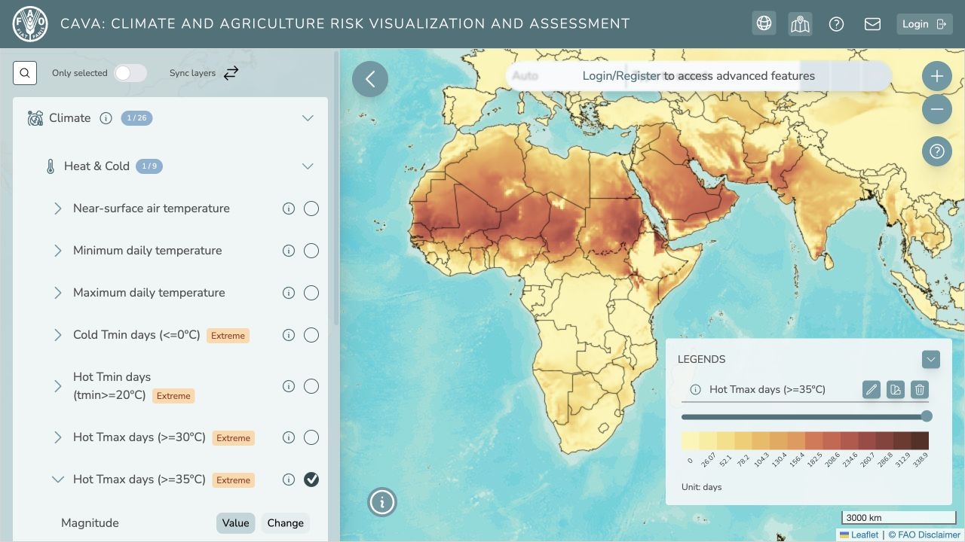
CAVA TRAINING SERIES
Climate data workflows
with CAVAanalytics
and cavapy
MODULE 3
30 September 2026
09:00–12:00 · Hybrid
Installation and reproducible climate analysis
Notes:
Timing: 2 minutes. Introduce Module 3. The first 30 minutes cover installation and troubleshooting. Riccardo then leads the CAVAanalytics notebook and Sam leads cavapy.

Slide 2
Today’s route
09:00–11:00 core session, followed by optional hands-on support
01
09:00
Environment setup (30 min): Miniforge, packages and notebook kernels
02
09:30
CAVAanalytics notebook (60 min): practical climate analysis in R
03
10:30
cavapy notebook with Sam (30 min): climate data access in Python
04
11:00
Optional hands-on session (60 min): participant practice and questions
CAVA MODULE 3
02
Notes:
The core session runs from 09:00 to 11:00. Allow 30 minutes for environment setup, 60 minutes for CAVAanalytics and 30 minutes for cavapy. The 11:00 to 12:00 hour is optional hands-on practice, troubleshooting and participant questions.

Slide 3
Preparation before Modules 3 and 4
Complete as much as possible before the session
01
Training materials
https://github.com/Risk-Team/trainings/tree/main/CAVAtraining/HQ
02
Software
Install Miniforge and a notebook editor before the session
03
Environment
Create cava-training and install CAVAanalytics and cavapy
04
Errors
Keep the complete error message so we can review it together
CAVA MODULE 3
03
Notes:
The training materials are available at https://github.com/Risk-Team/trainings/tree/main/CAVAtraining/HQ. Participants should attempt the installation before Modules 3 and 4. The session reserves 30 minutes for installation and troubleshooting.

Slide 4
Miniforge and notebook editor
Install these tools before creating the training environment
01
02
Miniforge
VS Code or Cursor
Download: https://conda-forge.org/download/
Windows: use Miniforge Prompt
macOS or Linux: use a terminal
VS Code: https://code.visualstudio.com/download
Install the Python and Jupyter extensions
No separate Python or R installation is required. JupyterLab is also available in a browser.
CAVA MODULE 3
04
Notes:
Miniforge includes Mamba. Participants who already use Miniforge, Miniconda or Anaconda and have access to Mamba can skip the first installation. VS Code is recommended, while Cursor is also compatible. Install the Python and Jupyter extensions.

Slide 5
The cava-training environment
Run these commands in Miniforge Prompt or a terminal
01
02
Create
Activate
mamba create -n cava-training -c conda-forge python=3.12 r-base=4.5.3 r-rjava r-terra r-sf r-irkernel jupyterlab ipykernel pip
Enter y if asked to confirm.
mamba activate cava-training
The environment installs the required versions of Python and R.
CAVA MODULE 3
05
Notes:
Run the environment creation command exactly as shown. Enter y if Mamba requests confirmation, then activate cava-training. Participants do not need to install Python or R separately.

Slide 6
CAVAanalytics installation
Keep the cava-training environment active
01
02
Start R
Install and test
mamba activate cava-training
R
install.packages("pak", repos = "https://cloud.r-project.org")
pak::pak("un-fao/CAVAanalytics")
library(CAVAanalytics); library(rJava)
packageVersion("CAVAanalytics")
Exit with q() and select No if R asks to save the workspace.
CAVA MODULE 3
06
Notes:
At the R prompt, install pak from CRAN, install CAVAanalytics from GitHub, then load CAVAanalytics and rJava and print the package version. If no errors appear, run q() and select No when asked to save the workspace.

Slide 7
cavapy installation
Run these commands in the terminal
01
Activate
mamba activate cava-training
02
Install
python -m pip install cavapy
03
Test
python -c "import cavapy; print(cavapy.__version__)"
04
Expected result
The final command displays the installed cavapy version
CAVA MODULE 3
07
Notes:
Return to the terminal, activate cava-training, install cavapy with pip and run the one-line import test. The final command should print the installed version.

Slide 8
R kernel for VS Code or Cursor
Register the kernel after activating cava-training
01
02
Register
Select
mamba activate cava-training
Rscript -e "IRkernel::installspec(user = TRUE, name = 'ir-cava', displayname = 'R (CAVA)')"
Open the R notebook in VS Code or Cursor and select R (CAVA) as the notebook kernel.
JupyterLab remains available as a browser-based alternative.
CAVA MODULE 3
08
Notes:
The R kernel registration is required for R notebooks in VS Code or Cursor. After registration, select R (CAVA) from the notebook kernel menu. JupyterLab is an alternative interface.

Slide 9
Installation check
Confirm the setup before starting the notebooks
01
Miniforge
The mamba command works in Miniforge Prompt or the terminal
02
R
CAVAanalytics and rJava load without errors
03
Python
The cavapy test prints the installed version
04
Support
Keep the complete error message if any step fails
CAVA MODULE 3
09
Notes:
Use this checklist before moving to the notebooks. Ask participants to retain the complete error message for any failed step so it can be reviewed during the first 30 minutes.

Slide 10
pyAEZ installation
Required for the Module 4 crop modelling workflow
01
02
Status
For now
Installation instructions will be added when the Module 4 setup is confirmed.
Complete the Miniforge, editor, CAVAanalytics, cavapy and R-kernel steps.
Do not install an unconfirmed pyAEZ configuration.
CAVA MODULE 3
10
Notes:
The participant message contains a placeholder for pyAEZ. Do not provide unconfirmed installation commands. Update this slide when the Module 4 team confirms the required pyAEZ version and installation method.

Slide 11
NEXT
Open the CAVAanalytics notebook
01
Load and inspect a country-scale multi-model dataset
02
Analyse observations, biases and future projections
03
Calculate climate indicators, model agreement and raster outputs
Select R (CAVA) as the notebook kernel.
Notes:
Open the supplied CAVAanalytics notebook and select R (CAVA). The remote data-loading cell is the slowest step and requires internet access.

