Slide 1

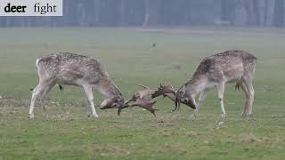
Theory and Experiments of Multiscale Vision Transformers-
Mammal-Net Dataset…
23.01.2024 | Computer Vision | Visual Intelligence and Machine Learning Group | Ravi H M
“ In the symphony of pixels and frames, Multiscale Vision Transformers choreograph a visual ballet, their algorithms pirouetting through the dance of images, transforming fleeting moments into an enchanting tapestry of understanding across the cinematic canvas of artificial sight.”

Slide 2

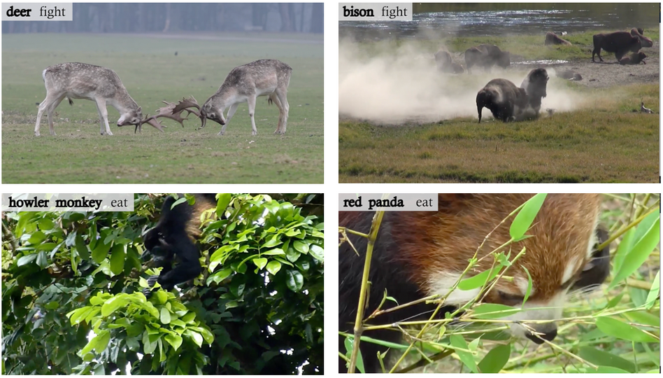
Agenda
Related work
Why Self-Attention
Attention Is All You Need (NIPS 2017)
Vision Transformer (ViT) (ICLR 2021)
ViViT: A Video Vision Transformer (arXiv 2021.03.29)
2. Multiscale Vision Transformers(MViT)
Transformer Architecture
Multi Head Pooling Attention(MHPA)
ViT vs MViT
Multiscale Transformer Networks
3. Experiments: Video Recognition (Mammal-Net Dataset)
Dataset: Mammal-Net
Parameters Pretrained on Kinetics 400
Parameters Pretrained on Kinetics 400 and Something-Something v2

Slide 3
Related Works

Slide 4
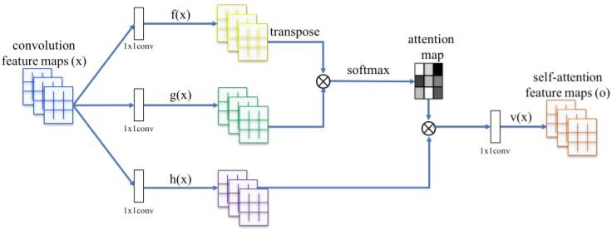
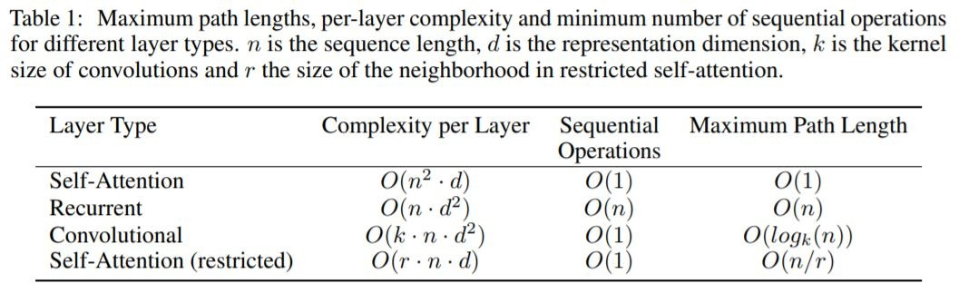
Why Self-Attention
One is the total computational complexity per layer.
Another is the amount of computation that can be parallelized, as measured by the minimum number of sequential operations required.
The third is the path length between long-range dependencies in the network.
Learning long-range dependencies is a key challenge in many sequence transduction tasks. As side benefit, self-attention could yield more interpretable models. We inspect attention distributions from our models.
Attention(Q,K,V) : Self-Attention Generative Adversarial Networks
self-attention models for image recognition, object detection, semantic and instance segmentation, video analysis and classification, visual question answering, visual commonsense reasoning, image captioning, vision language navigation, clustering, few-shot learning, and 3D data analysis.
Attention Is All You Need

Slide 5
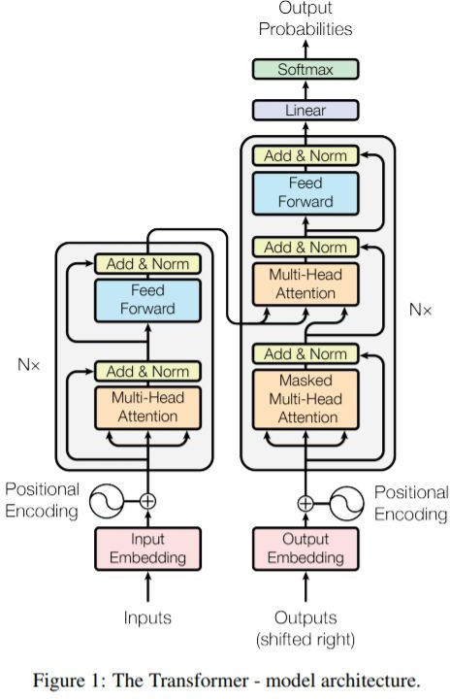
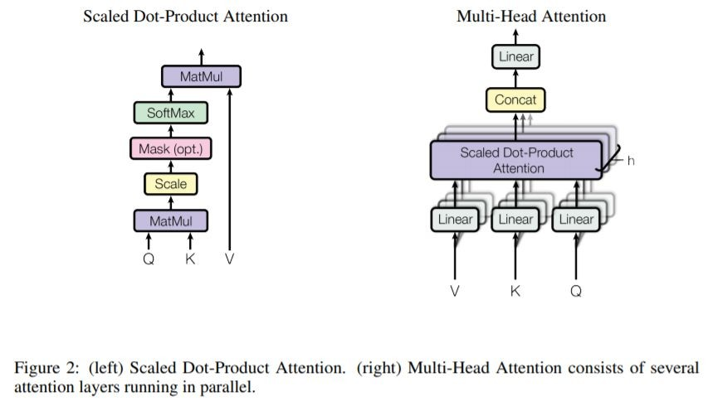



Attention Is All You Need (NIPS 2017)
Transformer, the first sequence transduction model based entirely on attention, replacing the recurrent layers.
This lead to having more stable gradients

Slide 6
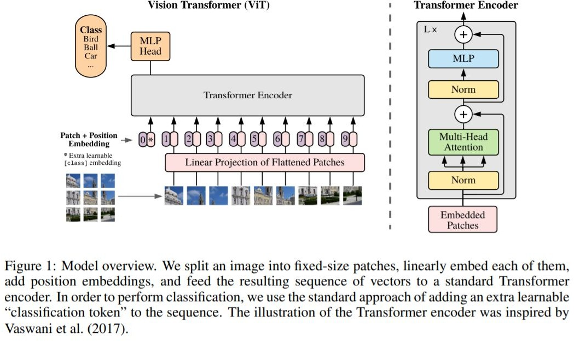
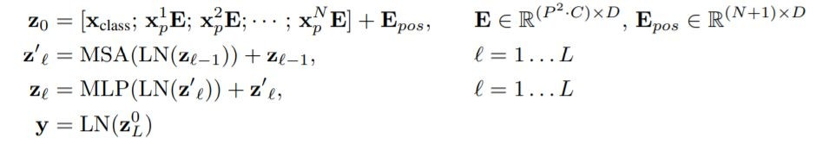
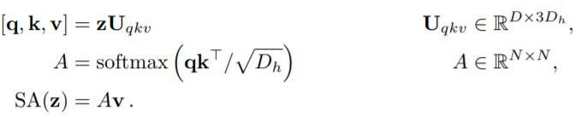
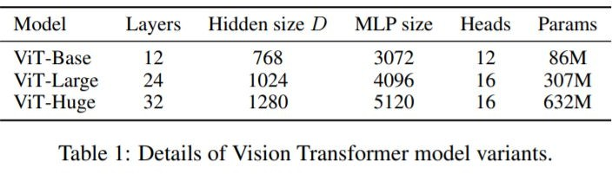
Vision Transformer (ViT) (ICLR 2021)
An Image is Worth 16x16 Words: Transformers for Image Recognition at Scale
CNNs is not necessary and a pure transformer applied directly to sequences of image patches Vision Transformer has much less image-specific inductive bias than CNNs
The sequence of linear embeddings of these patches as an input to a Transformer. The Transformer encoder consists of alternating layers of multi headed self attention (MSA) and MLP blocks. Layernorm (LN) is applied before every block, and residual connections after every block
The Vision Transformer performs well when pre-trained on a large
JFT-300M dataset.
※ JFT-300M Dataset (300M web images / ~ 19K categories)

Slide 7
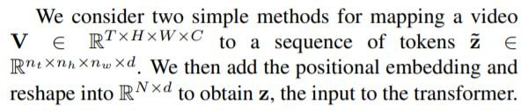
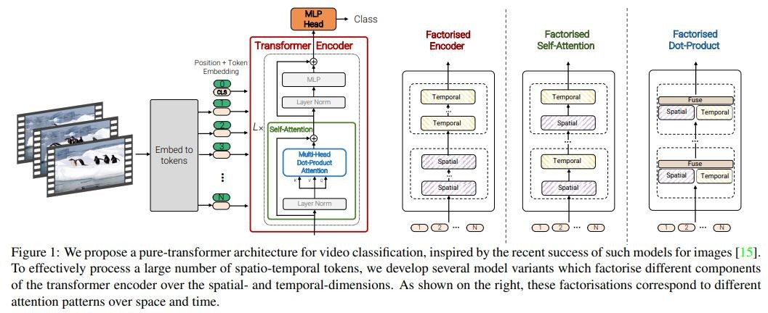
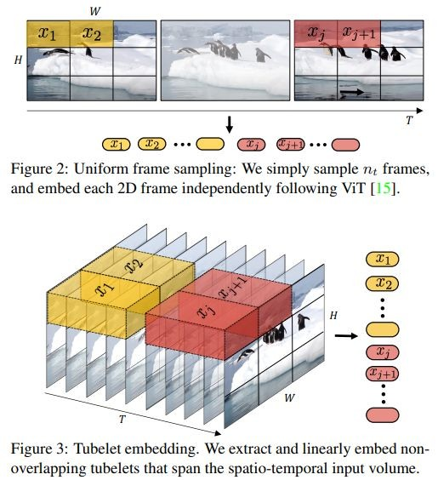

ViViT: A Video Vision Transformer (arXiv 2021.03.29)
Pure-transformer based models for video classification, we propose several, efficient variants of the model which factorise the spatial- and temporal-dimensions of the input. how we can effectively regularise the model during training and leverage pretrained image models to be able to train on comparatively small datasets.
Model 1: Spatio-temporal attention : all spatio-temporal tokens
Model 2: Factorised encoder : two separate transformer encoders
Model 3: Factorised self-attention : the order of spatial-then-temporal self attention. Model 4: Factorised dot-product attention :

Slide 8
Multiscale Vision Transformers(MViT)

Slide 9
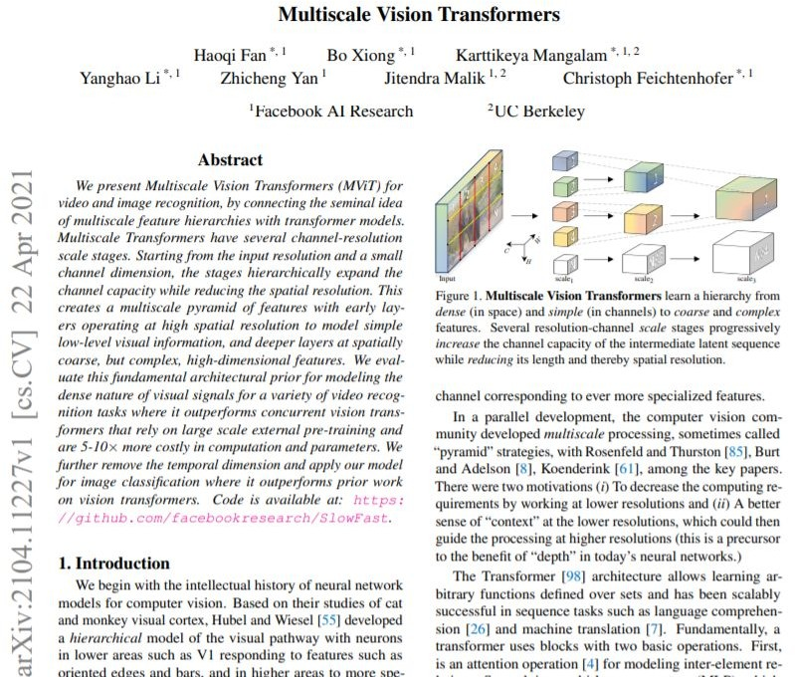
Multiscale Vision Transformers(MViT) (arXiv 2021.04.22)
There were two motivations
(i) To decrease the computing requirements by working at lower resolutions and
(ii) A better sense of “context” at the lower resolutions, which could then guide the processing at higher resolutions (this is a precursor to the benefit of “depth” in today’s neural networks.)
In this paper, the intention is to connect the seminal idea of multiscale feature hierarchies with the transformer model.
A multiscale pyramid of features with early layers operating at high spatial resolution to model simple low-level visual information visual pathway with a hierarchical model.

Slide 10
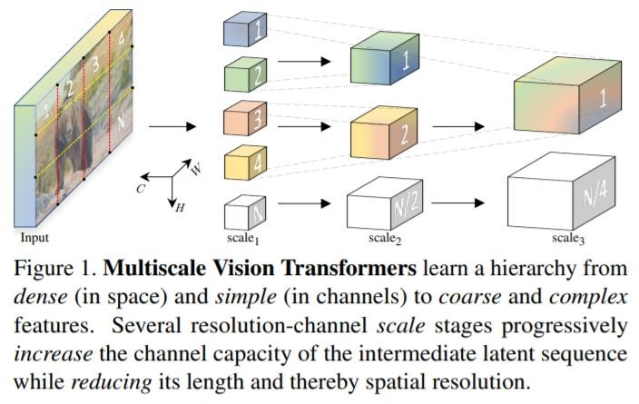
Transformer Architecture
MViT builds on the core concept of stages. Each stage consists of multiple transformer blocks with specific space-time resolution and channel dimension. The main idea of Multiscale Transformers is to progressively expand the channel capacity, while pooling the resolution from input to output of the network
Multiscale Transformers have several
channel-resolution ‘scale’ stages. Starting from the image resolution and a small channel dimension, the stages hierarchically expand the channel capacity while reducing the spatial resolution
This creates a multiscale pyramid of feature activations inside the transformer network, effectively connecting the principles of transformers with multi scale feature hierarchies.
The early layers of our architecture can operate at high spatial resolution to model simple low-level visual information, due to the lightweight channel capacity. In turn, the deeper layers can effectively focus on spatially coarse but complex high-level features to model visual semantics. The fundamental advantage of our multiscale transformer arises from the extremely dense nature of visual signals, a phenomenon that is even more pronounced for space-time visual signals captured in video.

Slide 11
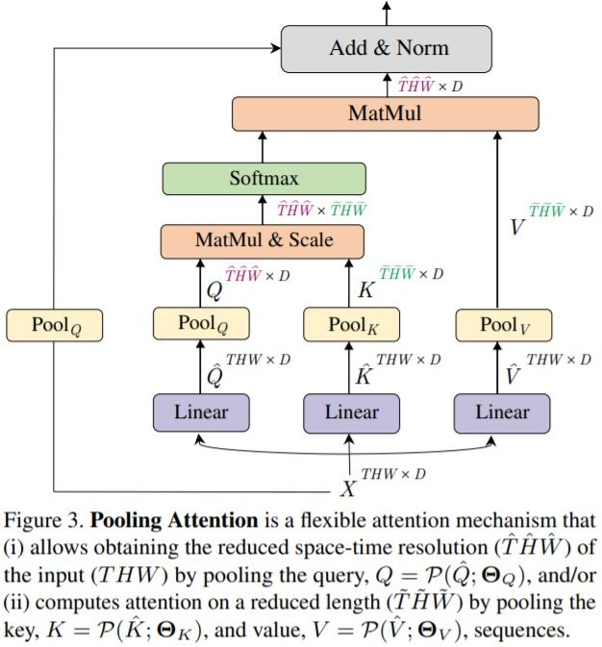
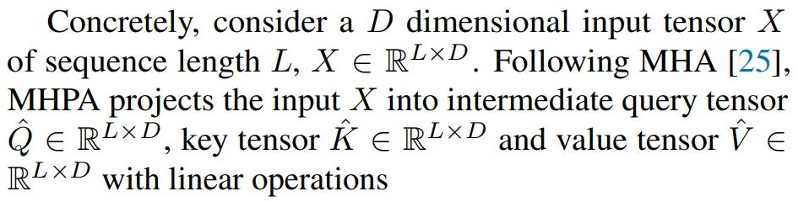
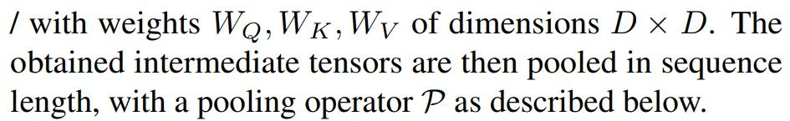
Multi Head Pooling Attention(MHPA)
Multiscale Transformers to operate at progressively changing spatio-temporal resolution.(a self attention operator that enables flexible resolution modeling in a transformer block allowing)
Multi Head Attention MHA) operators, where the channel dimension and the spatiotemporal resolution remains fixed, MHPA pools the sequence of latent tensors to reduce the sequence length (resolution) of the attended input.

Slide 12

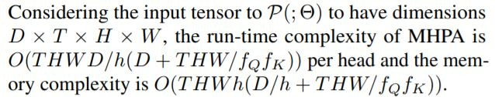

Multi Head Pooling Attention(MHPA)
Pooling Operator. The operator P(·; Θ) performs a pooling kernel computation on the input tensor along each of the dimensions. Unpacking Θ as Θ := (k, s, p) (kernel, stride, padding) input tensor of dimensions L
= T × H × W to L˜ given by,
Pooling Attention. The pooling operator P(·; Θ) is applied to all the intermediate tensors Qˆ, Kˆ and Vˆ independently with chosen pooling kernels k, stride s and padding p. Denoting θ yielding the pre-attention vectors Q = P(Qˆ; ΘQ), K = P(Kˆ ; ΘK) and V = P(Vˆ ; ΘV ) with reduced sequence lengths. Attention is now computed on these shortened vectors, with the operation,
Multiple heads. computation can be parallelized by considering h heads where each head is performing the pooling attention on a non overlapping subset of D/h channels of the D dimensional input tensor X.
Computational Analysis. the sequence length, pooling the key, query and value tensors has dramatic benefits on the fundamental compute and memory requirements of the Multiscale Transformer model.

Slide 13
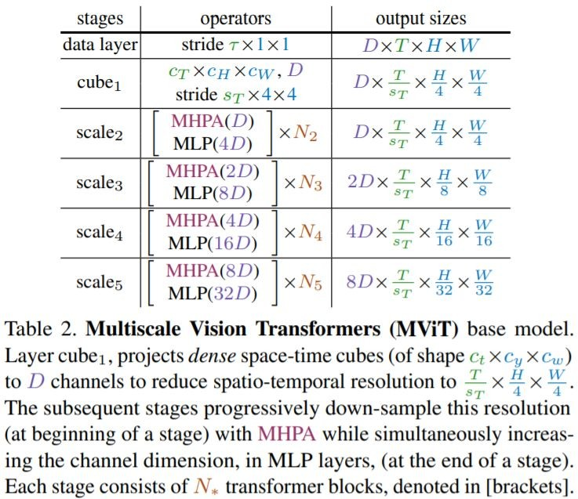
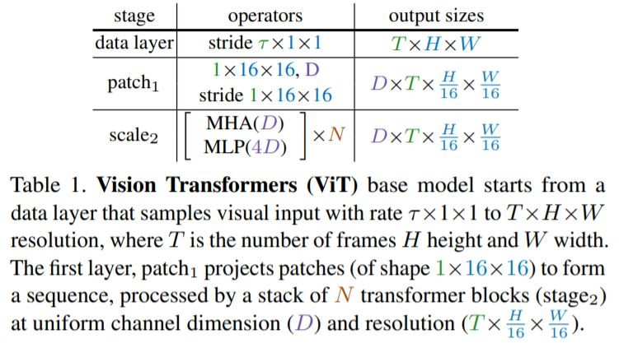

ViT vs MViT
ViT maintains a constant channel capacity and spatial resolution throughout all the blocks.This is equivalent to a convolution with equal kernel size and stride of 1×16×16 and is shown as patch1 stage in the model definition in Table 1. sequence of length L with dimension D to encode the positional information and break permutation invariance.
MViT architecture has fine spacetime (and coarse channel) resolution in early layers that is
up-/downsampled to a coarse spacetime (and fine channel) resolution in late layers.

Slide 14
Multiscale Transformer Networks
Scale stages : the channel dimension of the processed sequence is upsampled while the length of the sequence is down-sampled. This effectively reduces the spatio-temporal resolution of the underlying visual data while allowing the network to assimilate the processed information in more complex features.
Channel expansion : we expand the channel dimension by increasing the output of the final MLP layer in the previous stage by a factor that is relative to the resolution change introduced at the stage. down-sample the space-time resolution by 4×, we increase the channel dimension by 2×.
Query pooling : The pooling attention operation affords flexibility not only in the length of key and value vectors but also in the length of the query, and thereby output, sequence. our intention is to decrease resolution at the beginning of a stage and then preserve this resolution throughout the stage
Key-Value pooling : We decouple the usage of K, V and Q pooling, with Q pooling being used in the first layer of each stage and K, V pooling being employed in all other layers. Since the sequence length of key and value tensors need to be identical to allow attention weight calculation, the pooling stride used on K and value V tensors needs to be identical. In our default setting, we constrain all pooling parameters (k; p; s) to be identical i.e. ΘK ≡ ΘV within a stage, but vary s adaptively
w.r.t. to the scale across stages.
5.Skip connections : MHPA handles this mismatch by adding the query pooling operator P(·; ΘQ) to the residual path. instead of directly adding the input X of MHPA to the output, we add the pooled input X to the output, thereby matching the resolution to attended query Q. For handling the channel dimension mismatch between stage changes, we employ an extra linear layer that operates on the layer-normalized output of our MHPA operation. Note that this differs from the other (resolution-preserving) skip connections that operate on the un-normalized signal.

Slide 15
Experiments: Video Recognition (Mammal-Net Dataset)

Slide 16
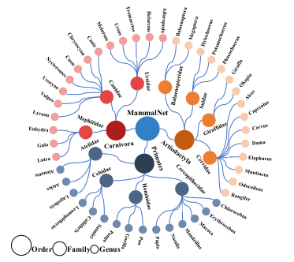
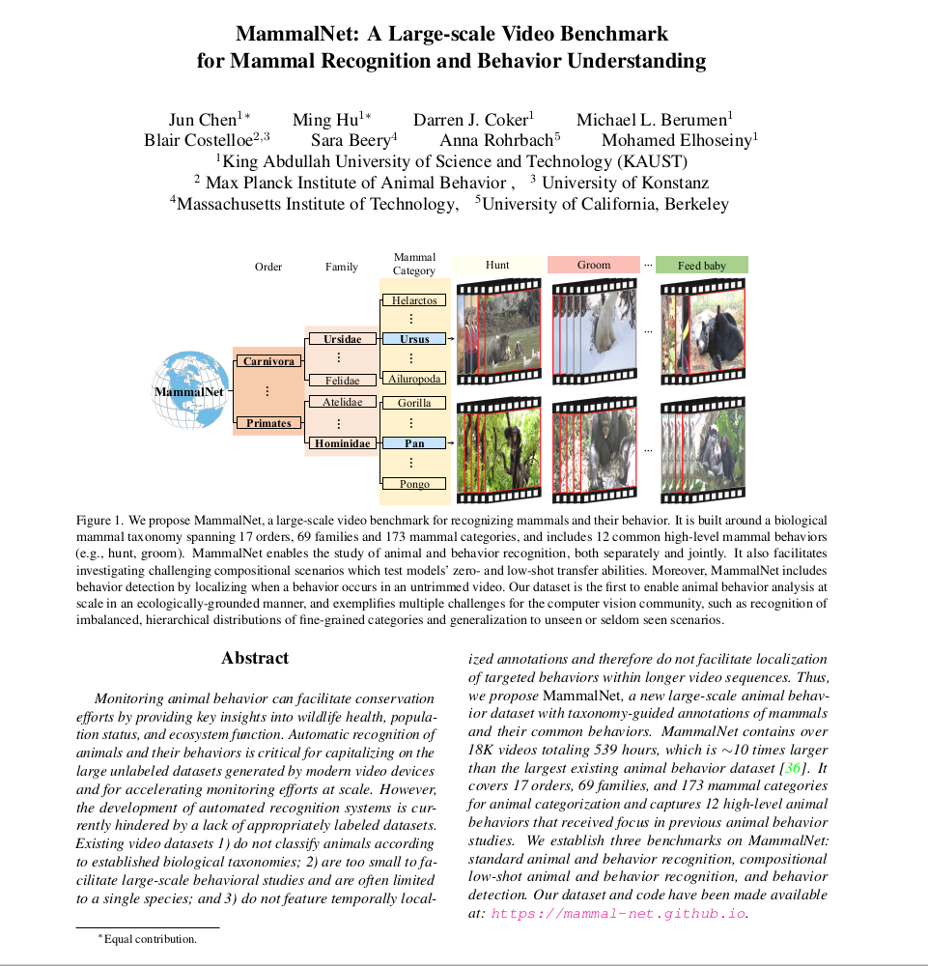
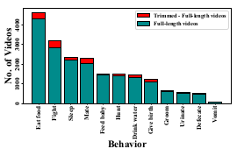
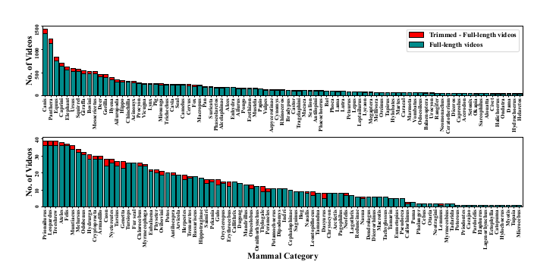
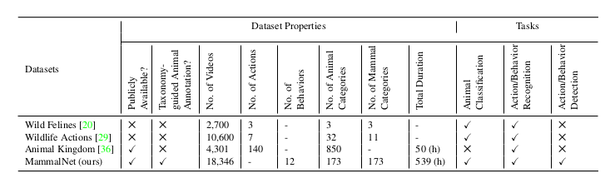
Dataset: MammalNet (arXiv 2306.00576)

Slide 17
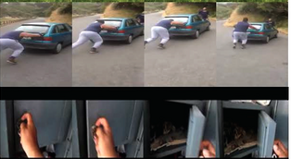
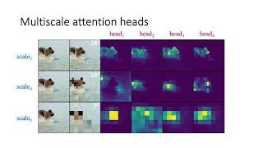
Experiments Results
Hardware:
We trained our models on Param-Himalaya 4 compute nodes with 8 NVIDIA V100 GPUs of 16GB RAM each for a 4 days long each task.
Kinetics 400: Extensive dataset capturing diverse global human activities, enabling broad video understanding.
Results:
MammalNet | Animal Classification |  |  |  | Behavior Classification
Pretrain | Many | Medium | Few | All | Many | Medium | Few | All
– | 48.5 | 35.5 | 12.9 | 19.7 | 42.3 | 29.2 | 11.6 | 27.7
K400 | 66.7 | 56.0 | 23.4 | 32.5 | 50.9 | 42.4 | 20.0 | 37.8
K400 + Something-Something V2 | 59.2 | 51.3 | 21.7 | 31.8 | 39.6 | 36.1 | 18.3 | 35.2
Something-Something V2: Comprehensive video dataset portraying various human actions, facilitating fine-grained analysis.
Initially, we evaluated the MVIT model using parameters trained solely on the Mammal-Net dataset.
we assessed the MVIT model by loading parameters pre-trained on the Kinetics 400 dataset and subsequently fine-tuning it on the Mammal-Net dataset.
In an experimental phase, I attempted to utilize pre-trained model parameters trained on Kinetics 400 by first training on the Something-Something V2 dataset before completing the training on Mammal-Net.

Slide 18
Codes
# MViT options (/slowfast/config/defaults.py)
_C.MVIT = CfgNode()
_C.MVIT.PATCH_KERNEL = [3, 7, 7] \ _C.MVIT.PATCH_STRIDE = [2, 4, 4] \ _C.MVIT.PATCH_PADDING = [2, 4, 4]
_C.MVIT.EMBED_DIM = 96 \ _C.MVIT.MLP_RATIO = 4.0 \ _C.MVIT.DEPTH = 16 \ _C.MVIT.NORM = "layernorm"
# MViT options (/slowfast/models/video_model_builder.py) @MODEL_REGISTRY.register()
class MViT(nn.Module):
if cfg.MVIT.NORM == "layernorm":
norm_layer = partial(nn.LayerNorm, eps=1e-6) self.patch_dims = [
self.input_dims[i] // self.patch_stride[i] for i in range(len(self.input_dims))
]
num_patches = math.prod(self.patch_dims)
dim_mul, head_mul = torch.ones(depth + 1), torch.ones(depth + 1) for i in range(len(cfg.MVIT.DIM_MUL)):
dim_mul[cfg.MVIT.DIM_MUL[i][0]] = cfg.MVIT.DIM_MUL[i][1] for i in range(len(cfg.MVIT.HEAD_MUL)):
head_mul[cfg.MVIT.HEAD_MUL[i][0]] = cfg.MVIT.HEAD_MUL[i][1]
https://github1s.com/facebookresearch/SlowFast/blob/master/slowfast/config/defaults.py

Slide 19
Codes
for i in range(len(cfg.MVIT.POOL_Q_STRIDE)):
for i in range(len(cfg.MVIT.POOL_KV_STRIDE)):
for i in range(depth):
num_heads = round_width(num_heads, head_mul[i])
embed_dim = round_width(embed_dim, dim_mul[i], divisor=num_heads) dim_out = round_width( embed_dim, dim_mul[i + 1],
divisor=round_width(num_heads, head_mul[i + 1]),
)
self.blocks.append( MultiScaleBlock(
dim=embed_dim, dim_out=dim_out, num_heads=num_heads, mlp_ratio=mlp_ratio, qkv_bias=qkv_bias, drop_rate=self.drop_rate, drop_path=dpr[i], norm_layer=norm_layer, kernel_q=pool_q[i] if len(pool_q) > i else [],
kernel_kv=pool_kv[i] if len(pool_kv) > i else [], stride_q=stride_q[i] if len(stride_q) > i else [], stride_kv=stride_kv[i] if len(stride_kv) > i else [],
mode=mode, has_cls_embed=self.cls_embed_on, pool_first=pool_first,
)
)
https://github1s.com/facebookresearch/SlowFast/blob/master/slowfast/models/video_model_builder.py

Slide 20
Thanks

