Slide 1
RiskWeb

Slide 2
RiskWeb - Business idea
To offer financial risk, pricing and XVA services through an easy access online platform built around Open Risk Engine (ORE)
ORE is an advanced open source risk platform developed by market professionals and academics.
Access provided through a subscription service
Hosted on a Cloud platform which provides access to the power of cloud computing.
Selling Points
Affordable and easy access to best in class financial risk solutions
No need to shell out for in-house development costs, licence fees, hardware, support functions etc.
The integration of free open source risk libraries ensures a vast, innovative and constantly evolving risk solution

Slide 3
Potential threats
Copy cats
Clients implementing the technologies themselves
Team skillsets (missing sales skills/contacts)

Slide 4
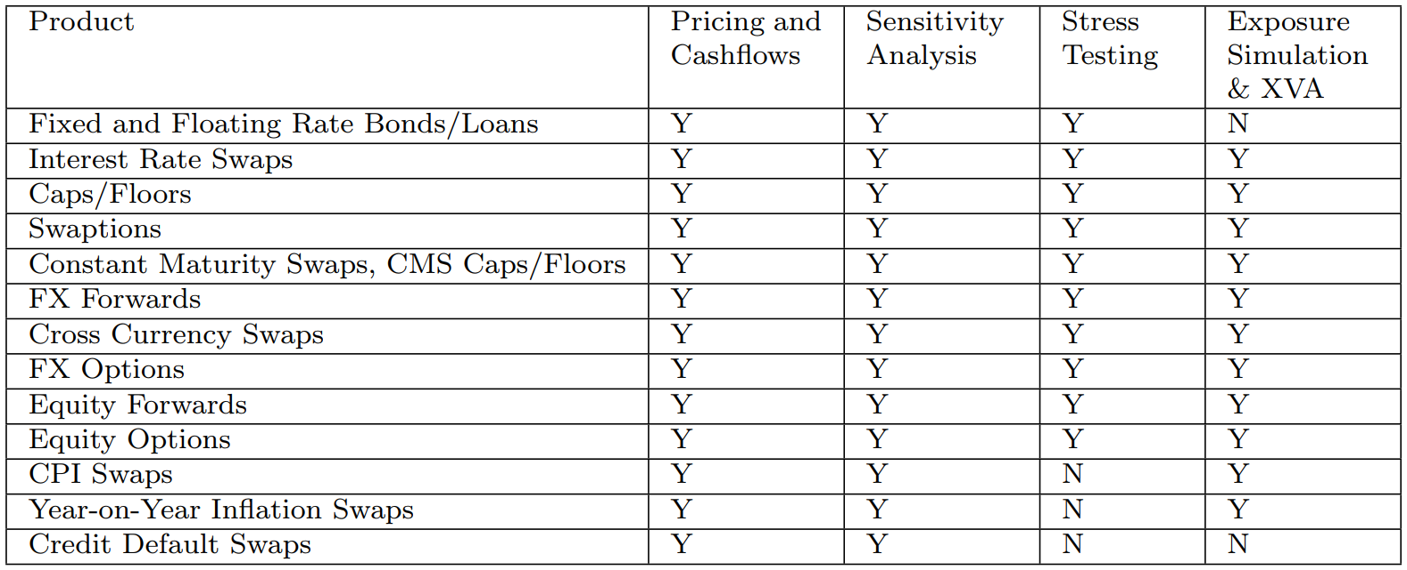
Open Source Risk Engine [opensourcerisk.org]
The Open Source Risk Engine’s objective is to provide a free/open source platform for risk analytics and XVA. It is based on QuantLib and released under the Modified BSD Licence.
Product coverage

Slide 5
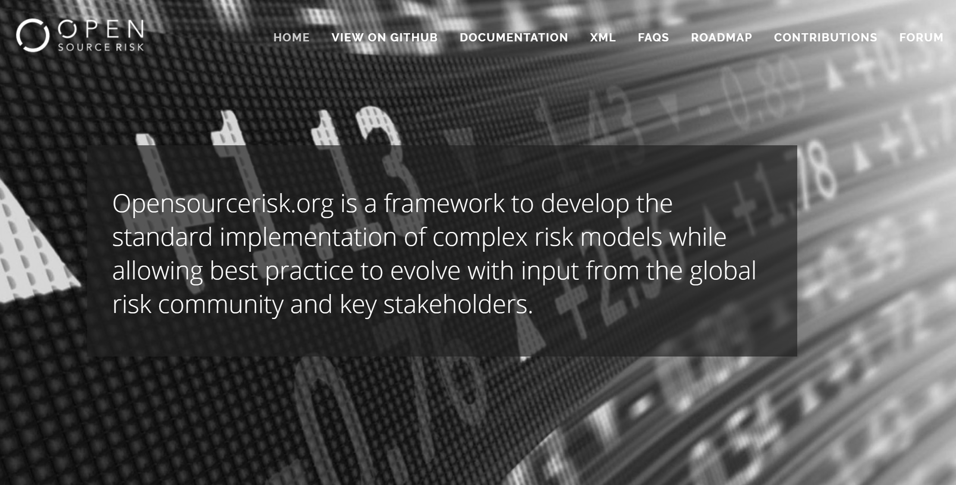
Open Source Risk Engine (Demo) [opensourcerisk.org]
ORE road map

Slide 6

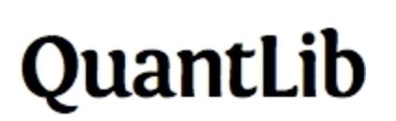

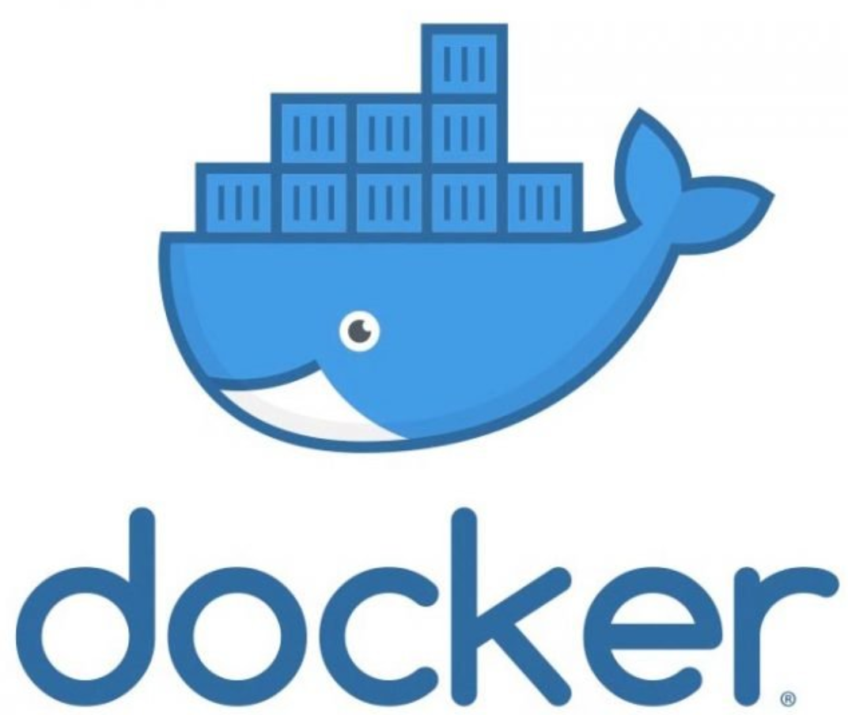


RiskWeb (Demo) [Heroku link]
RoadMap
Prototype by Q2 2019
Market Survey
Platform and open source technologies
ASP.NET Core
Platform deployed and calculations initiated using Docker and Kubernetes

Slide 7
Potential Clients
Smaller banks and financial institutions in the Nordics (e.g. Sparebanker)
SME’s using derivative transactions
DNB
Risk Advisory (XVA solution)
Support functions in need of third party references for e.g. validation /IPV /Audit /Accounting purposes
Consulting firms offering Risk Advisory Services (EY, PWC, Deloitte)

