Slide 1
CarWatcher - Kubernetes deployment

Slide 2
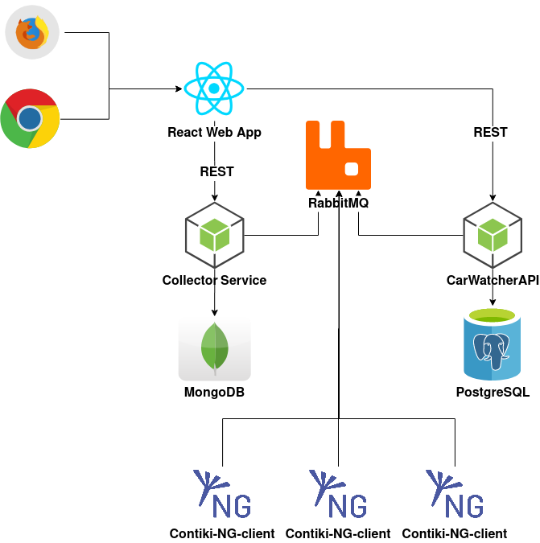
CarWatcher app microservice architecture
Contiki-NG clients read value from car sensors and publish data to RabbitMQ
Collector Service collects published sensor data, store it in MongoDB and exposes REST API service for access to this data
CarWatcher API contains business logic for CarWatcher app and exposes REST API service
Collector Service and CarWatcher API synchronize about Contiki-NG client status through RabbitMQ
React Web App

Slide 3
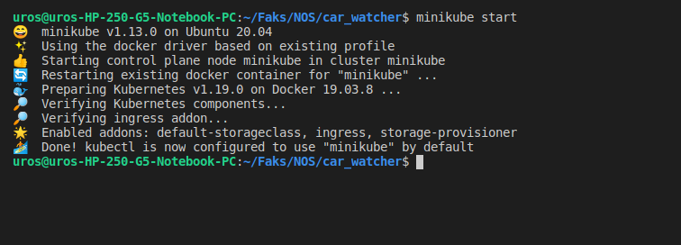
Starting minikube cluster

Slide 4
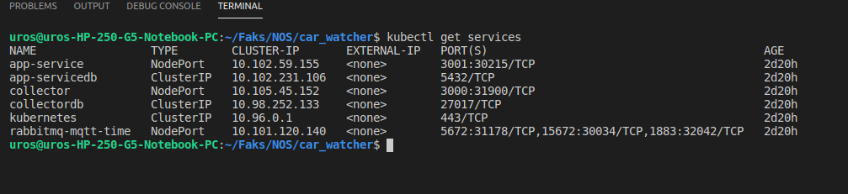
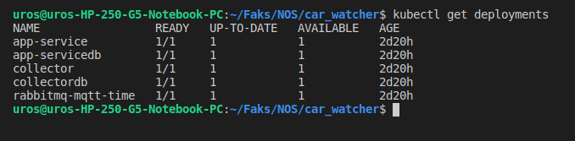
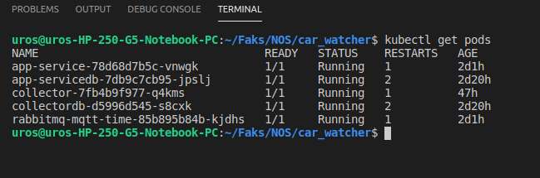
Available services deployments and pods

Slide 5
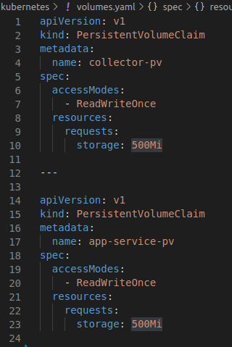
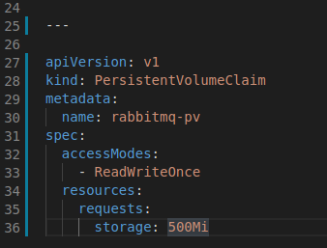
Volumes - for persisting data

Slide 6
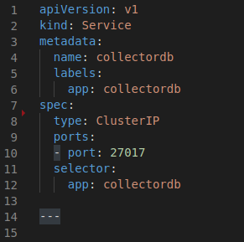
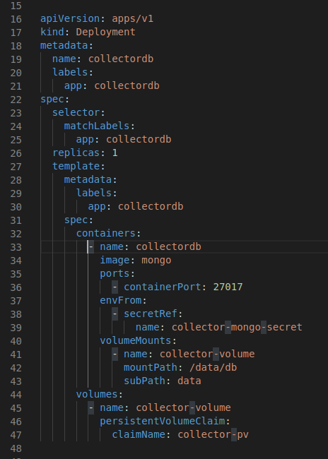
MongoDB Service and Deployment

Slide 7
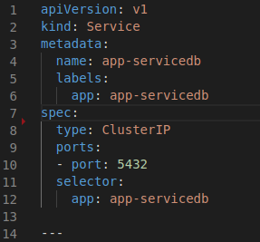
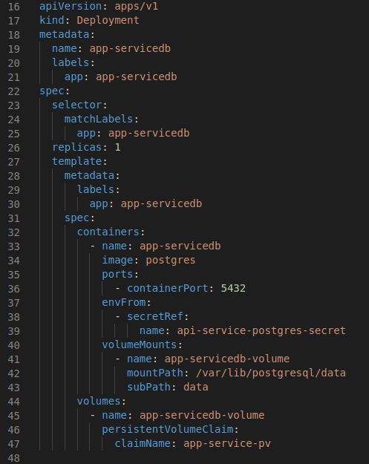
PostgreSQL Service and Deployment

Slide 8
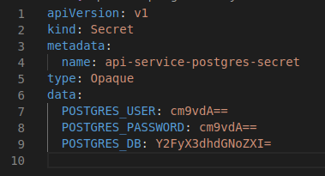
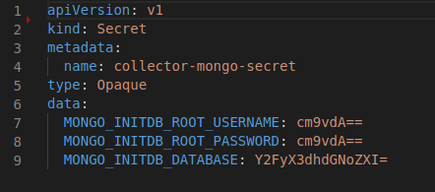
Secrets

Slide 9
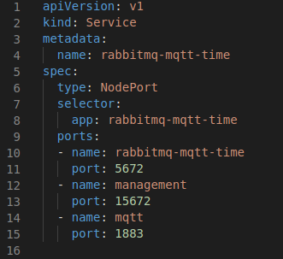
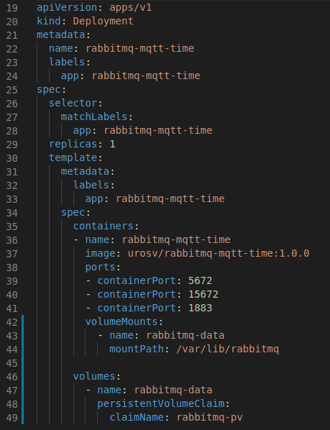
RabbitMQ Service and Deployment

Slide 10
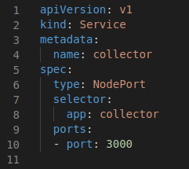
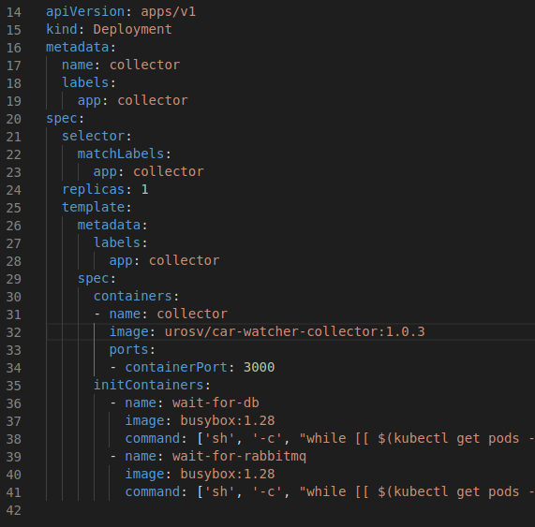
Collector Service and Deployment

Slide 11
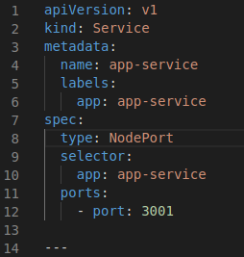
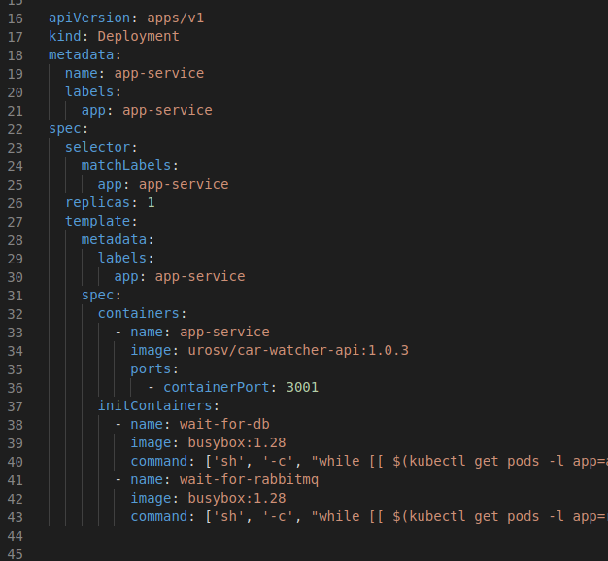
CarWatcher API Service and Deployment

Slide 12
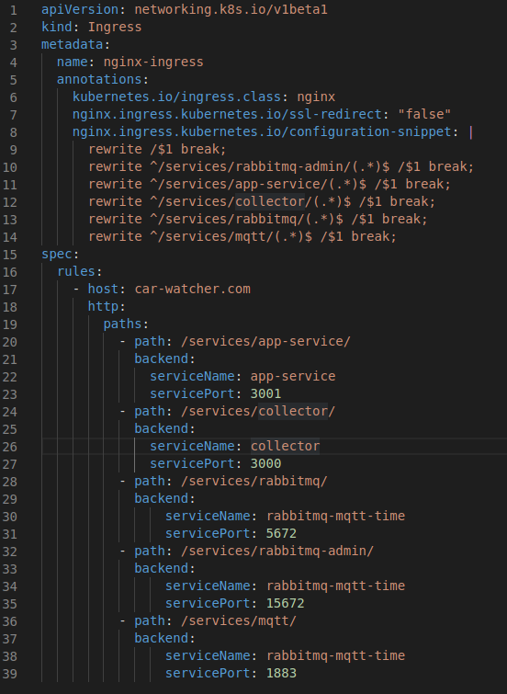
Ingress

Slide 13
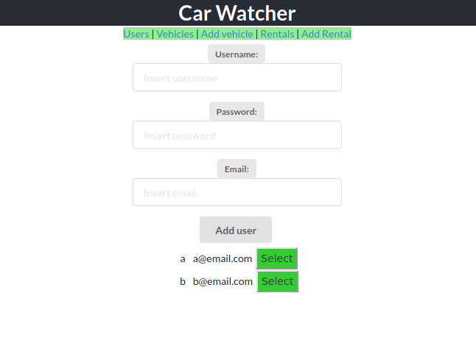
Test Web App

Slide 14
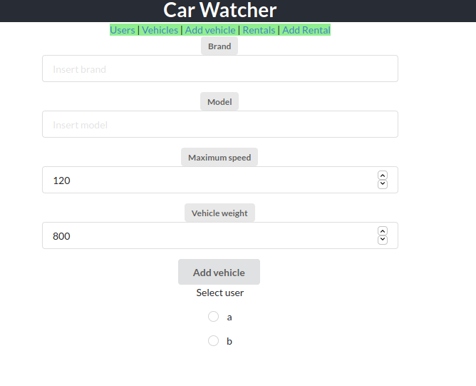
Test Web App

Slide 15
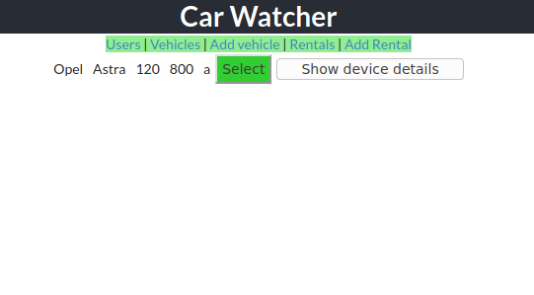
Test Web App

Slide 16
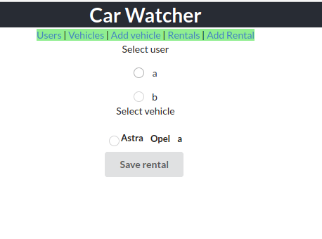
Test Web App

Slide 17
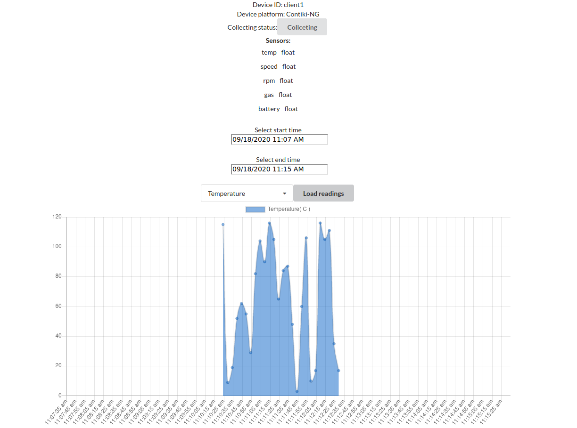
Test Web App

