Slide 1
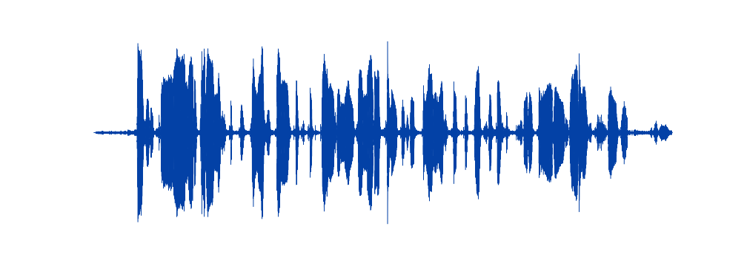
Speaker recognition – Getting gender and accent of the speaker.
By: Risto Rahulan and Frederik Raud
Introduction
DATA
Common Voice by Mozilla
Datasets included audio files, age, gender, accent, text
- Estonian dataset
- 12 hours of audio
- 225 different voices
- English dataset
- 1087 hours of audio
- 39 577 different voices
- Includes accents
FEATURES:
Zero crossing rate
Spectral roll-off
Spectral centroid
Spectral bandwidth
Chromagram
Mel-frequency cepstral coefficients
Root-mean-square
References:

