Slide 1
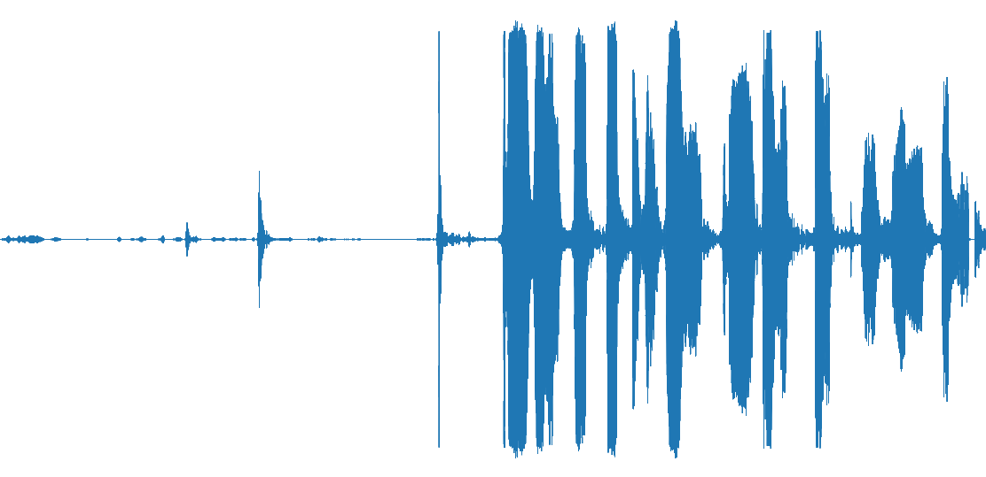
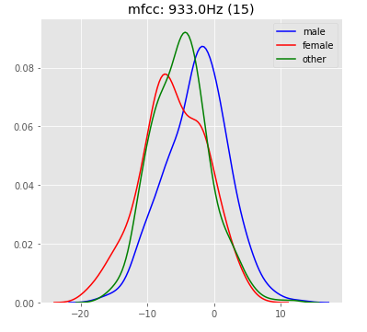
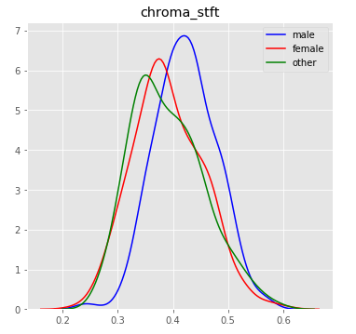
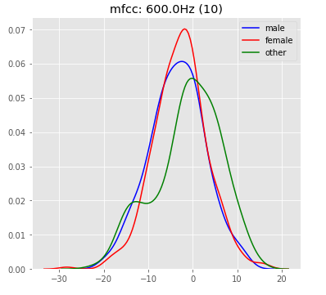
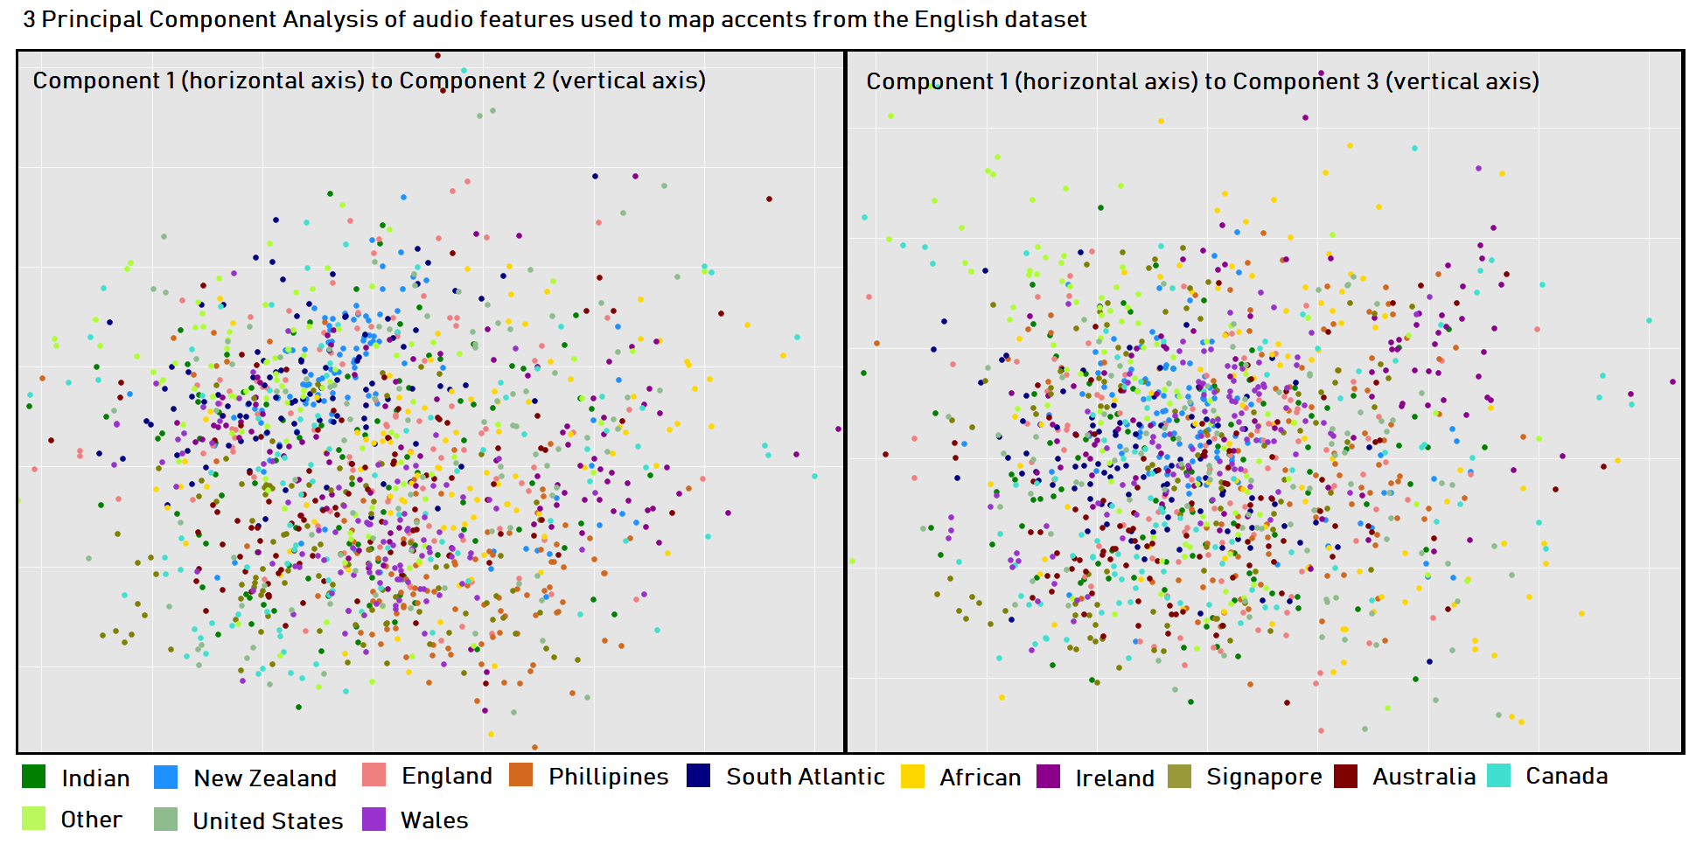

Speaker Recognition
Gender and Accent Classification Based on the Speaker’s Voice
By Risto Rahulan & Frederik Raud
Introduction:
The goal of this project was to explore Mozilla’s Common Voice datasets and to use them to both study the relationships between gender, accent and voice, and model their classification.
Data:
Findings and Models:
Common Voice by Mozilla
Datasets include mp3 audio files and tsv-files relating the audio files to words, the speaker, including their accent, age, and gender.
Data Validation
The correspondence of the spoken words to the mp3-files is validated by online contributors through their website, by up- or down-voting a given pair of words and audio. Only clips with at least two up-votes and no more than one down-vote make it into the Common Voice datasets. The up-vote and down-vote counts are also included in the tsv-file.
Description of The Original Datasets
English dataset (30GB)
1087 hours of audio, 780 hours of it validated
39 577 different voices
More than 80000 audio files
Includes accents
Additional Datasets
German (9GB)
French (5GB)
Italian (1GB)
Russian (850MB)
Chinese (China) (359MB)
Estonian (358MB)
Turkish (288MB)
Sakha (173MB)
Swedish (89MB)
Features found more relevant by the Random Forest algorithm for Gender Classification (Accuracy 82.53%) based on balanced data of the gender classes “male”, “female” and “other” (1239 rows)
In order of relevance and from left to right: frequency plot for frequency occurrence around 933Hz, mean spectral Chroma feature (pitch), and frequency occurrence around 660Hz.
According to this data, English men speak with a higher pitch than women and others.
Gender Classification:
We trained our models on the English dataset. By just keeping gender classes “male” and “female” we could get a balanced dataset with 11583 rows. This gave us accuracy of 91.80% using the Random Forest (RF) algorithm and 81.24% accuracy using a Support Vector Classifier with a linear kernel. By omitting the “other” gender, the RF model had
12% increased accuracy. Also note that the feature with the
Greatest importance is no longer MFCC15 but MFCC19.
We experiment with the models trained on the English
dataset and used it to classify genders in other languages.
Estonian – RF accuracy: 87.92% , SVC(Linear) accuracy: 86.22%
Swedish – RF accuracy: 89.72% , SVC(Linear) accuracy: 84.64%
Russian – RF accuracy: 90.78% , SVC(Linear) accuracy: 87.24%
Chinese – RF accuracy: 91.03% , SVC(Linear) accuracy: 86.98%
Italian – RF accuracy: 80.51% , SVC(Linear) accuracy: 85.43%
You can see that the RF models were just as accurate in classifying genders in Chinese, but they were the worst at classifying genders in Italian. It is also notable that the SVC was better at classifying genders in other languages than English.
Feature Extraction:
Before feature extraction, the English dataset files needed to be converted from an mp3 format into a wav format. Only 100K clips from the total 800K, made it through this stage due to resource limitations. were converted and studied. Dropping rows where the gender or accent is nan, reduced the data by a further third.
The features extracted were:
Mean zero-crossing rate (How often the wave’s amplitude crosses over 0.)
Mean spectral roll-off
Mean spectral centroid (Frequency’s centre of mass)
Mean spectral bandwidth
Mean chromagram (A pitch scale with 0 being the lowest and 1 being the highest)
Mean spectral root-mean-square
Mean value of 20 Mel-frequency cepstral coefficients over time.
Accent Classification:
We also trained models to classify accents. The highest accuracy achieved was with random forest classifier that had a 52% accuracy. When reducing the features to 3 principal components, the results did not improve, although SVC did perform better.
Below you can see a visualization of the “distance” between different accents. Note the wide dispersion of the accents “England” and “Canada”, most likely a result of those being the main accent in the old British Empire. Note the wide dispersion of the accent “Africa”, which most likely the results of the terms vagueness.
Mel-Frequency Cepstral Coefficient plot of human speech. On the vertical axis: Frequency bins. On the horizontal axis: Time. Ranging from blue to red, the raw audio-wave contains less to more frequencies in a given bin. The value of a bin is reduced by neighbouring bin values. The MFCC helps reduce the dimensionality of a Fourier transform through binning. It bins logarithmically, as to mimic the human auditory system that can differentiate lower frequencies better than higher ones. Note how there is more activity in the lower bins, where the frequencies are lower.
The frequencies correlating to the bin number: (1: 0.0Hz) (2: 67.0Hz) (3: 133.0Hz) (4: 200.0Hz) (5: 267.0Hz) (6: 333.0Hz) (7: 400.0Hz) (8: 467.0Hz) (9: 533.0Hz) (10: 600.0Hz) (11: 667.0Hz) (12: 733.0Hz) (13: 800.0Hz) (14: 867.0Hz) (15: 933.0Hz) (16: 1000.0Hz)
(17: 1071.0Hz) (18: 1147.0Hz) (19: 1229.0Hz) (20: 1317.0Hz)
References:
[1] The Mozilla Voice Dataset: https://voice.mozilla.org/en/datasets
[2] Some audio features https://towardsdatascience.com/extract-features-of-music-75a3f9bc265d
[3] Audio feature extraction LibROSA: https://librosa.github.io/librosa/
[4] Modelling with SKLearn: Scikit-learn: Machine Learning in Python, Pedregosa et al., JMLR 12, pp. 2825-2830, 2011.
[5] Help with LibROSA: https://towardsdatascience.com/extract-features-of-music-75a3f9bc265d

